Slide 1
Zπ
Zπ MATHS HUB
Pearson Edexcel IGCSE (9–1) · Higher Tier
dy
dx
Differentiation
The Gradient Function · Tangents · Stationary Points · Maximum & Minimum · Optimisation
Zahra Sheikh Ali
IGCSE Mathematics Teacher · M.Sc. Differential Geometry & Geometric Control
☎ 66613748 ✉ zahraa.sheikhali@outlook.com

Slide 2
Zπ
LESSON OVERVIEW
Finding the Gradient of a Curve
Differentiation gives the GRADIENT FUNCTION of a curve. From it you can find the gradient at any point, the equation of a tangent, and where a curve has its maximum or minimum.
The power rule
Multiple terms
Gradient at a point
1
2
3
Tangents & normals
Maximum & minimum
Past-paper questions
4
5
6
Key words: derivative · gradient function · dy/dx · tangent · stationary point · maximum · minimum

Slide 3
Zπ
THE KEY IDEA
Differentiation = the Gradient Function
A straight line has ONE gradient. A curve’s gradient keeps changing. Differentiating gives a formula for that gradient.
If y = x^{n} then
= nx^{n−1}
dy
dx
The rule in words
1. MULTIPLY by the power.
2. SUBTRACT 1 from the power.
dy/dx is read ‘dee y by dee x’.
It is the gradient at any value of x.

Slide 4
Zπ
THE POWER RULE
Multiply by the Power, Then Reduce It
Bring the power down to the front, then take one off the power.
y = x⁵
dy
= 5x⁴
5 × x, power 5→4
dx
y = 3x²
dy
= 6x
3 × 2 = 6, power 2→1
dx
y = 9x
dy
= 9
9x¹ → 9x⁰ = 9
dx
y = 7
dy
= 0
a constant has gradient 0
dx
A number multiplying x stays; a number on its own differentiates to 0.

Slide 5
Zπ
MULTIPLE TERMS
Differentiate Term by Term
1
y = x³ + 4x² − 7x + 5
Method
Apply the power rule to EACH term.
Keep the + and − signs between terms.
The constant term always disappears.
Simplify the final answer.
2
Differentiate each term separately:
3
x³ → 3x²; 4x² → 8x; −7x → −7; 5 → 0
4
dy/dx = 3x² + 8x − 7
dy/dx = 3x² + 8x − 7
Rewrite roots and fractions as powers first, e.g. √x = x^(1/2).

Slide 6
Zπ
ROOTS & RECIPROCALS
Rewrite as a Power First
The power rule works for ANY power — fractions and negatives too. Rewrite roots and ‘1 over x’ as powers, then differentiate normally.
Written as
Rewrite as a power
√x
x^(1/2)
³√x
x^(1/3)
1 / x
x^(−1)
1 / x²
x^(−2)
1 / √x
x^(−1/2)
a / xⁿ
a·x^(−n)
A root becomes a fraction power; ‘1 over xⁿ’ becomes a negative power. Then multiply by the power and subtract 1.

Slide 7
Zπ
WORKED · ROOTS
Differentiating Square & Cube Roots
1
y = √x = x^{1/2}: dy/dx = ½x^{−1/2} = 1 / (2√x)
Method
Rewrite the root as a fractional power.
Multiply by the power, subtract 1 (as usual).
A number in front (like 6) just stays and multiplies.
You may rewrite the answer back as a root.
2
y = ³√x = x^{1/3}: dy/dx = ⅓x^{−2/3} = 1 / (3³√(x²))
3
y = 1/√x = x^{−1/2}: dy/dx = −½x^{−3/2}
4
y = 6√x = 6x^{1/2}: dy/dx = 6 × ½ x^{−1/2} = 3 / √x
√x → x^(1/2), so dy/dx = ½x^(−1/2) = 1/(2√x)
Subtracting 1 from ½ gives −½; from ⅓ gives −⅔.

Slide 8
Zπ
WORKED · x IN THE DENOMINATOR
Differentiating 1 Over x
1
y = 1/x = x⁻¹: dy/dx = −1x⁻² = −1 / x²
Watch the signs
Move x to the top with a NEGATIVE power.
Multiplying by a negative power makes dy/dx negative.
Subtracting 1 from −2 gives −3 (more negative).
Rewrite the answer with x back on the bottom.
2
y = 4/x² = 4x⁻²: dy/dx = 4 × (−2) x⁻³ = −8 / x³
3
y = 3/x = 3x⁻¹: dy/dx = −3x⁻² = −3 / x²
4
So a term like 5/x³ = 5x⁻³ → −15x⁻⁴ = −15/x⁴.
1/x → x^(−1), so dy/dx = −x^(−2) = −1/x²
Never differentiate the top and bottom separately — rewrite as a single power first.

Slide 9
Zπ
GRADIENT AT A POINT
Substitute the x-value into dy/dx
1
Find the gradient of y = x² − 4x at the point where x = 3.
Method
First differentiate to get dy/dx.
Then put the x-value in to get a NUMBER.
That number is the gradient there.
It is also the gradient of the tangent.
2
Differentiate: dy/dx = 2x − 4
3
Substitute x = 3: 2(3) − 4 = 2
4
Gradient at that point = 2
Gradient at x = 3 is 2
dy/dx is a formula; the gradient at a point is a single number.

Slide 10
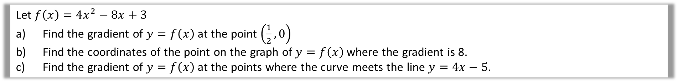
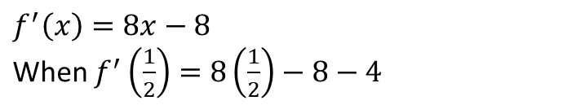

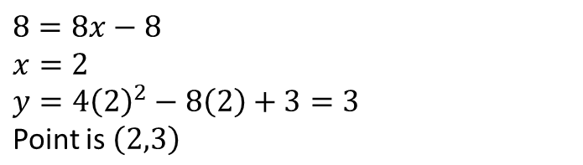
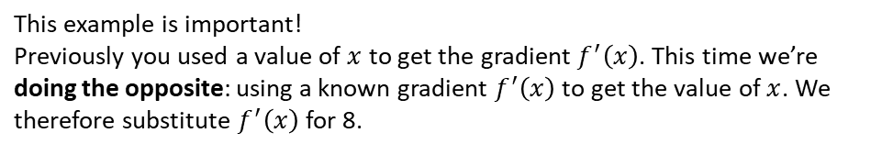

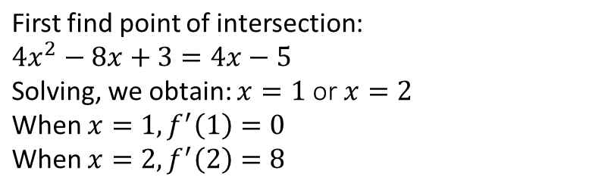
Zπ
WORKED EXAMPLE
Harder Question
Calculate Gradient of a curve at a point
a
?
b
?
c
?

Slide 11
Zπ
TANGENTS & NORMALS
Lines That Touch the Curve
The gradient of the TANGENT equals dy/dx at that point. Then use y − y₁ = m(x − x₁).
TANGENT
NORMAL
Touches the curve, same direction.
gradient m = dy/dx at the point
Find m, then use the point in y = mx + c.
Perpendicular to the tangent.
gradient = −1 ÷ (tangent gradient)
The negative reciprocal of dy/dx.
Tangent gradient = dy/dx. Normal gradient = −1 ÷ (dy/dx).

Slide 12
Zπ
STATIONARY POINTS
Where the Gradient Is Zero
At a maximum or minimum the curve is momentarily flat. So set dy/dx = 0 and solve.
MINIMUM point
MAXIMUM point
gradient 0 at the bottom
gradient 0 at the top
To find turning points: solve dy/dx = 0, then find the y-value.

Slide 13
Zπ
WORKED EXAMPLE
Finding a Turning Point & Its Nature
1
y = x² − 4x. dy/dx = 2x − 4
Nature of the point
Differentiate AGAIN to get d²y/dx².
If it is POSITIVE → minimum.
If it is NEGATIVE → maximum.
Or check the gradient just either side.
2
Set = 0: 2x − 4 = 0 → x = 2
3
y = 2² − 4(2) = −4, so turning point (2, −4)
4
Second derivative d²y/dx² = 2 > 0 → MINIMUM
Minimum turning point at (2, −4)
Every turning point has dy/dx = 0; the second derivative tells you which type.

Slide 14

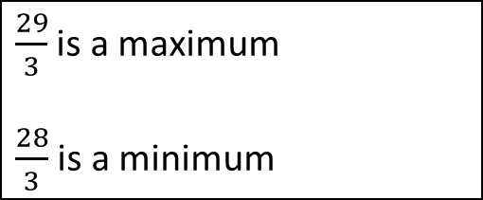

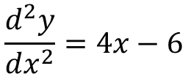
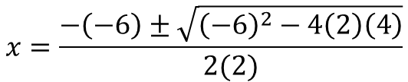





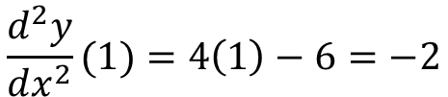
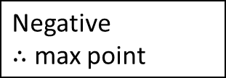
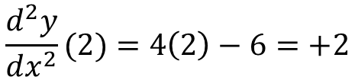
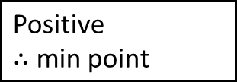
Zπ
WORKED EXAMPLE
Find a Turning Point
graph
gradient
rate of change of gradient
x-coordinates
y-coordinates
Max or min?

Slide 15
Zπ
OPTIMISATION
Maximum & Minimum in Real Problems
‘Maximum volume’, ‘minimum surface area’ — these mean differentiate and set to zero.
Write the quantity (V, A, R…) as a formula in ONE variable.
1
Differentiate it with respect to that variable.
2
Set the derivative = 0 and solve to find the variable.
3
Substitute back to get the maximum or minimum value.
4
‘Show that’ questions usually want you to build the formula first, then differentiate.

Slide 16
Zπ
PART 2
Past-Paper Questions
Differentiate, then use dy/dx = 0 for turning points or substitute for a gradient.
1
Find dy/dx first
2
Gradient → substitute the x-value
3
Turning point → solve dy/dx = 0
4
Nature → second derivative

Slide 17
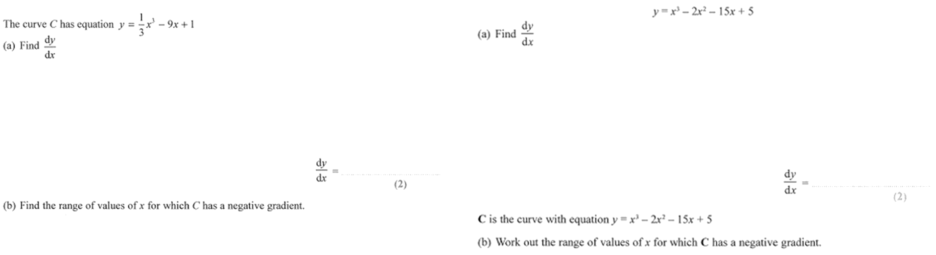
Zπ
PAST-PAPER QUESTION
Question 1

Slide 18
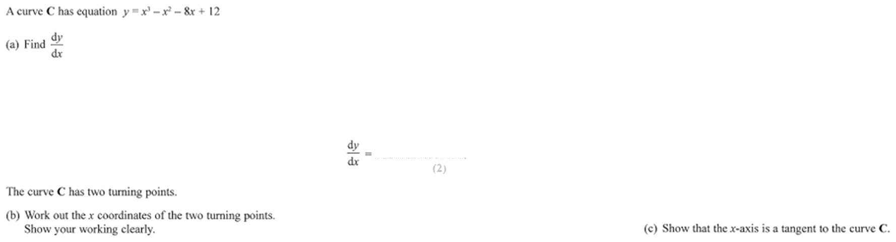
Zπ
PAST-PAPER QUESTION
Question 2

Slide 19
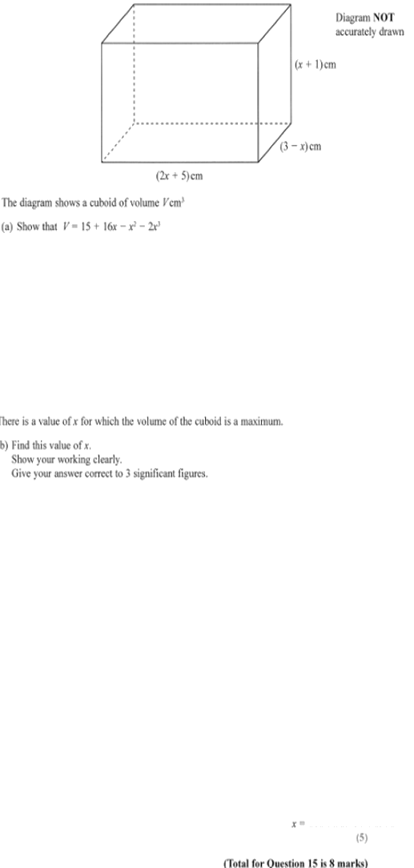
Zπ
PAST-PAPER QUESTION
Question 3

Slide 20
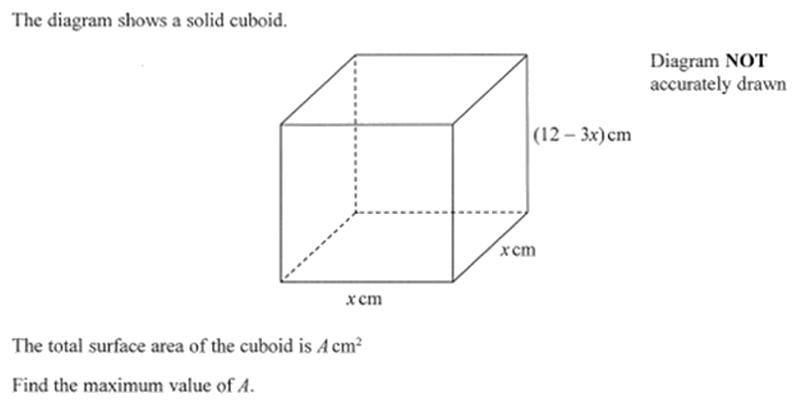
Zπ
PAST-PAPER QUESTION
Question 4

Slide 21
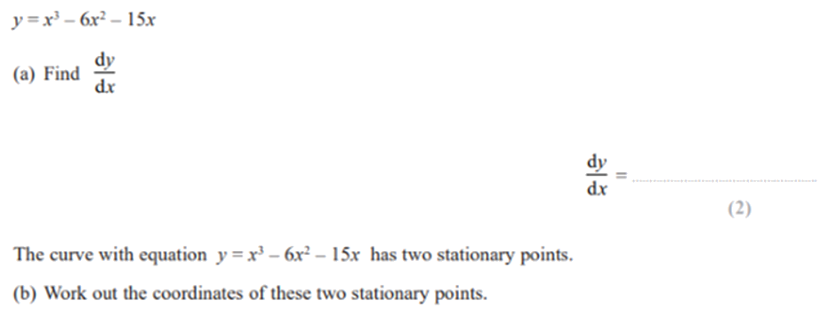
Zπ
PAST-PAPER QUESTION
Question 5

Slide 22
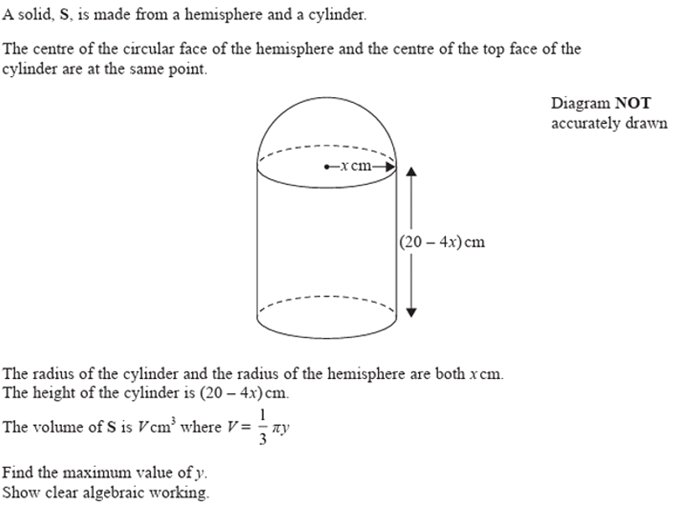
Zπ
PAST-PAPER QUESTION
Question 6

Slide 23
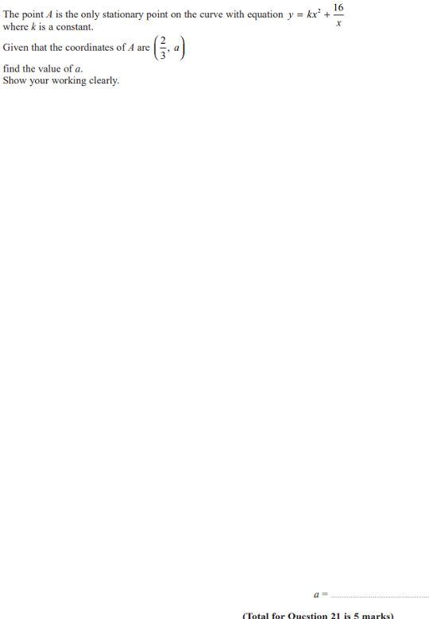
Zπ
PAST-PAPER QUESTION
Question 7

Slide 24
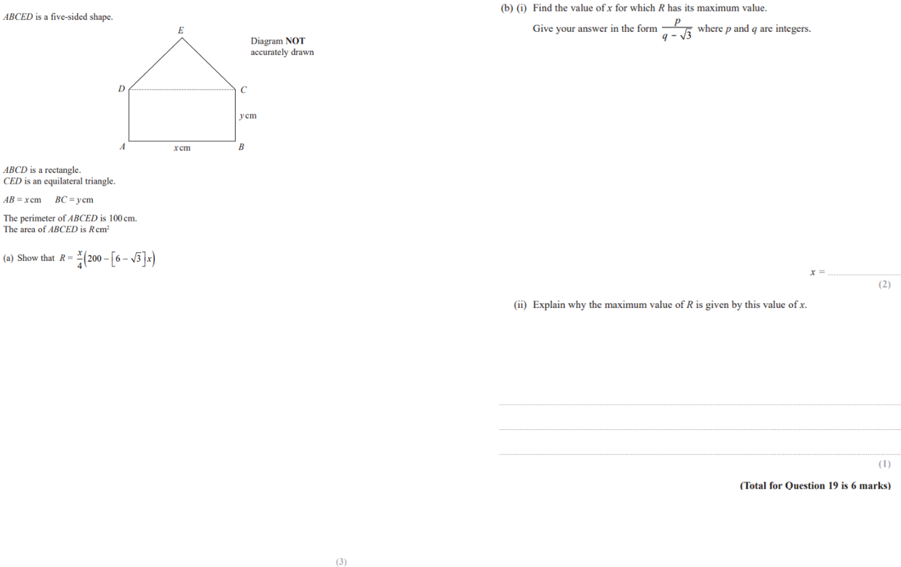
Zπ
PAST-PAPER QUESTION
Question 8

Slide 25
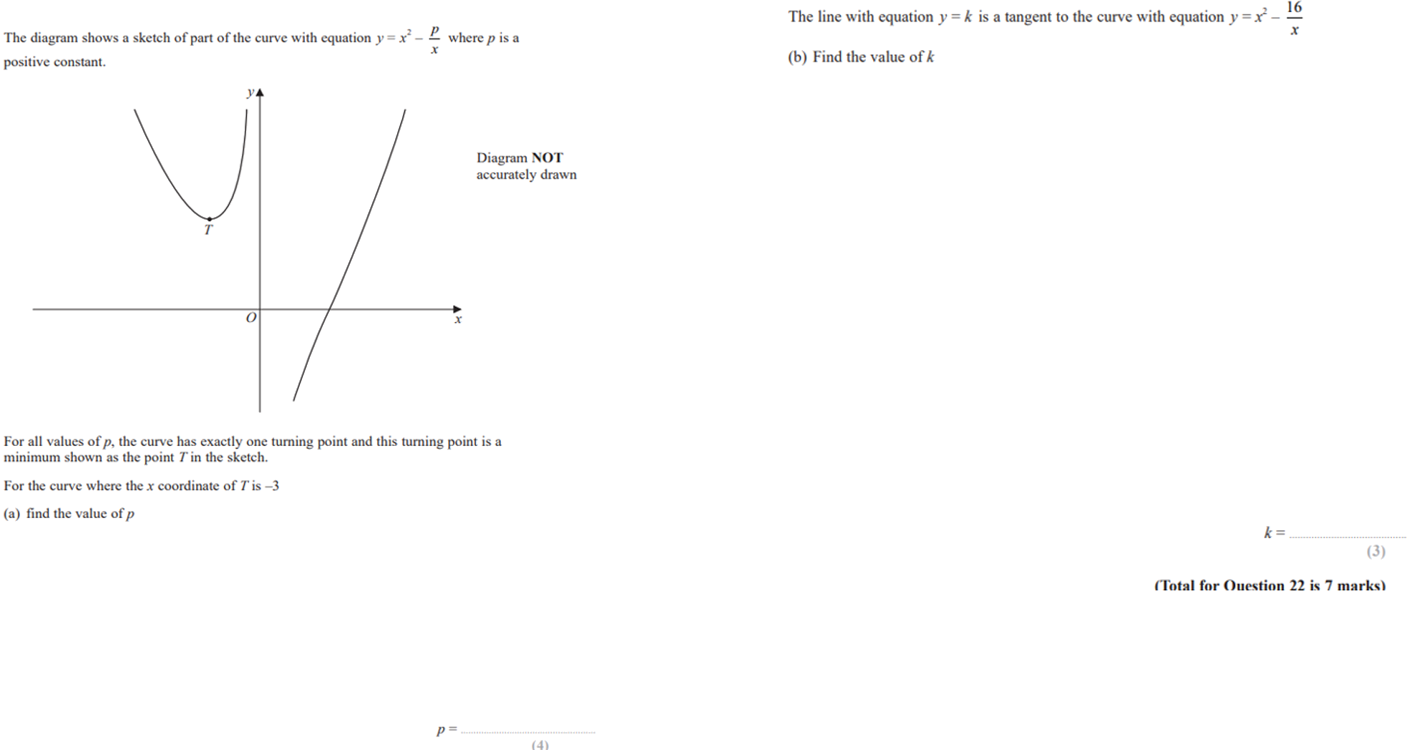
Zπ
PAST-PAPER QUESTION
Question 9

Slide 26
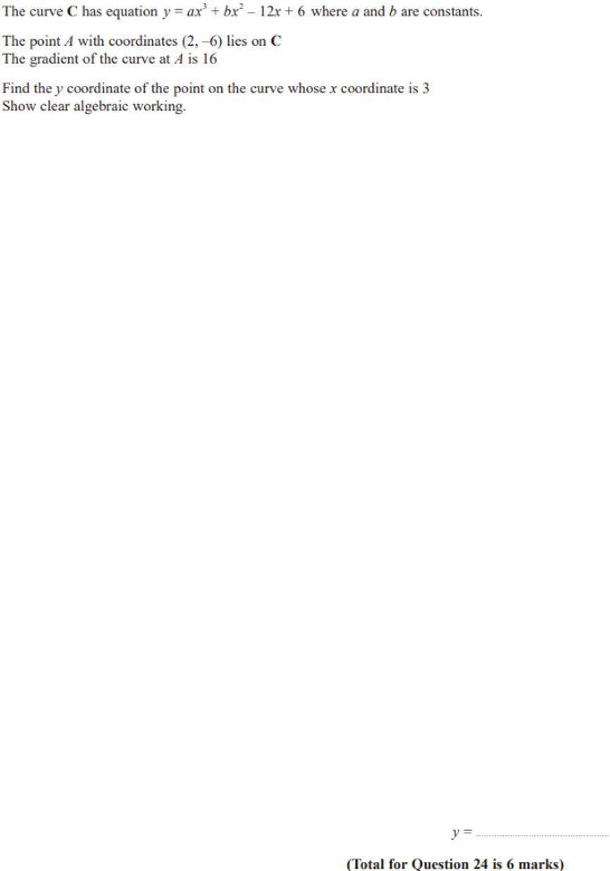
Zπ
PAST-PAPER QUESTION
Question 10

Slide 27
Zπ
RECAP
Key Takeaways
Differentiation gives the gradient function dy/dx.
Power rule: y = xⁿ → dy/dx = nxⁿ⁻¹ — works for fractions and negatives too.
Rewrite roots as fractional powers (√x = x^½) and 1/xⁿ as negative powers before differentiating.
Gradient at a point: differentiate, then substitute the x-value.
Tangent gradient = dy/dx; normal gradient = −1 ÷ (dy/dx).
Turning points: solve dy/dx = 0; the second derivative shows max (−) or min (+).
Golden rule: gradient → substitute; turning point → set dy/dx = 0.

