Slide 1
Zπ
Zπ MATHS HUB
Pearson Edexcel IGCSE (9–1) · Higher Tier
s → v → a
Kinematics
Displacement, Velocity & Acceleration · Differentiating with Respect to Time
Zahra Sheikh Ali
IGCSE Mathematics Teacher · M.Sc. Differential Geometry & Geometric Control
☎ 66613748 ✉ zahraa.sheikhali@outlook.com

Slide 2
Zπ
LESSON OVERVIEW
Motion in a Straight Line
Kinematics describes how an object moves. If you know displacement as a formula in time, differentiating gives velocity, and differentiating again gives acceleration.
Displacement, velocity, acceleration
Differentiate s → v → a
At rest: v = 0
1
2
3
Max / min displacement
Max velocity: a = 0
Past-paper questions
4
5
6
Key words: displacement · velocity · acceleration · at rest · ds/dt · dv/dt · stationary

Slide 3
Zπ
THE KEY IDEA
Differentiate to Go Down the Chain
Each step DIFFERENTIATES with respect to time t. Velocity is the rate of change of displacement; acceleration is the rate of change of velocity.
DISPLACEMENT
VELOCITY
ACCELERATION
differentiate
differentiate
s (metres)
v = ds/dt (m/s)
a = dv/dt (m/s²)
v = ds/dt and a = dv/dt = d²s/dt². Differentiate once for velocity, twice for acceleration.

Slide 4
Zπ
KEY FACTS
The Conditions Examiners Ask For
Translate the words into an equation — that is the whole skill.
‘at rest’ or ‘momentarily stationary’
velocity = 0
solve v = 0
‘maximum / minimum displacement’
velocity = 0
solve v = 0
‘maximum / minimum velocity’
acceleration = 0
solve a = 0
‘returns to O’ / ‘at the origin’
displacement = 0
solve s = 0
‘initial’ value
at time t = 0
substitute t = 0
‘Rate of change of velocity’ means acceleration — differentiate v.

Slide 5
Zπ
WORKED EXAMPLE
From Displacement to Velocity & Acceleration
1
s = t³ − 6t² + 9t (displacement in metres)
Method
Differentiate s to get v.
Differentiate v to get a.
‘At rest’ → put v = 0 and solve.
‘Max/min velocity’ → put a = 0 and solve.
2
Velocity: v = ds/dt = 3t² − 12t + 9
3
At rest (v = 0): 3t² − 12t + 9 = 0 → (t−1)(t−3)=0 → t = 1 or 3 s
4
Acceleration: a = dv/dt = 6t − 12. Min velocity when a = 0 → t = 2 s
At rest at t = 1 s and t = 3 s; velocity is least at t = 2 s
Always differentiate with respect to time t — not x.

Slide 6
Zπ
GOOD TO KNOW
Units, Signs & the Reverse
Read the sign and the units carefully.
Signs tell direction
Units
Positive velocity → moving forward.
Displacement s: metres (m).
Negative velocity → moving backward.
Velocity v: metres per second (m/s).
Positive acceleration → speeding up (if v > 0).
Acceleration a: m/s².
Speed is the size of velocity (ignore the sign).
Time t: seconds (s).
Going the other way (a → v → s) uses integration — the reverse of differentiation.

Slide 7
Zπ
PART 2
Past-Paper Questions
Differentiate the displacement, then translate the words into v = 0 or a = 0.
1
v = ds/dt, a = dv/dt
2
‘At rest’ → v = 0
3
‘Max/min velocity’ → a = 0
4
‘Initial’ → t = 0

Slide 8
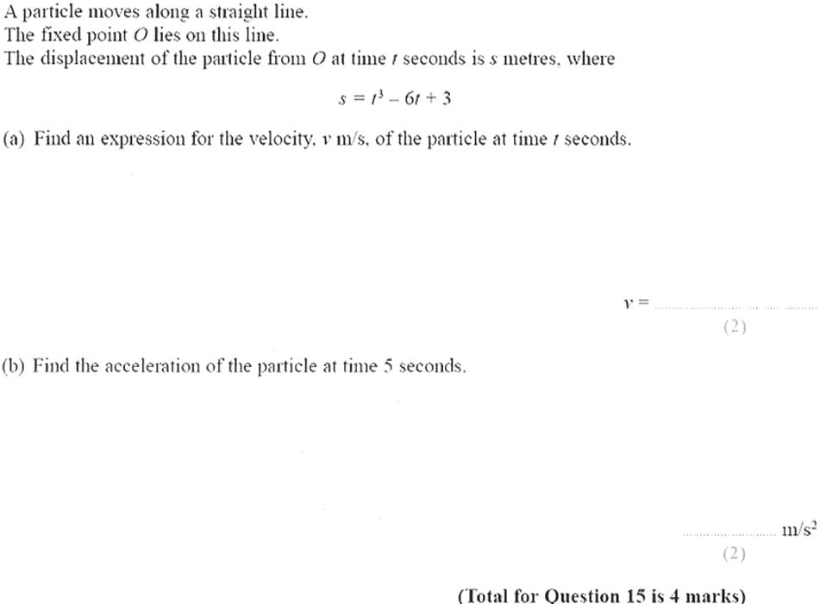
Zπ
PAST-PAPER QUESTION
Question 1

Slide 9
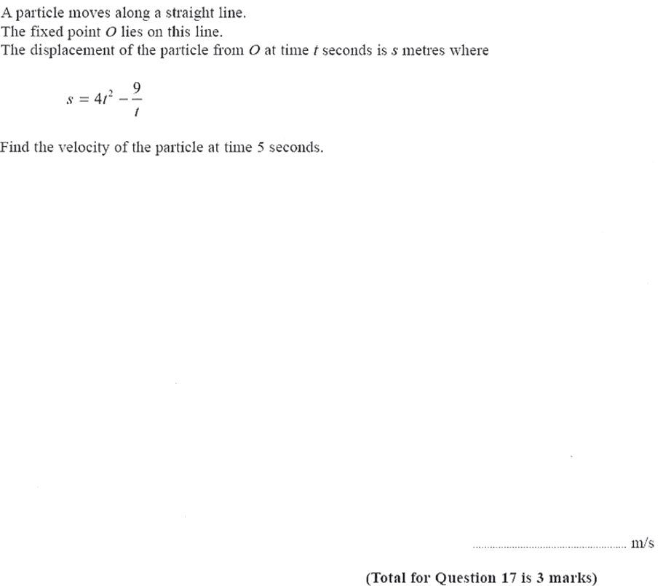
Zπ
PAST-PAPER QUESTION
Question 2

Slide 10
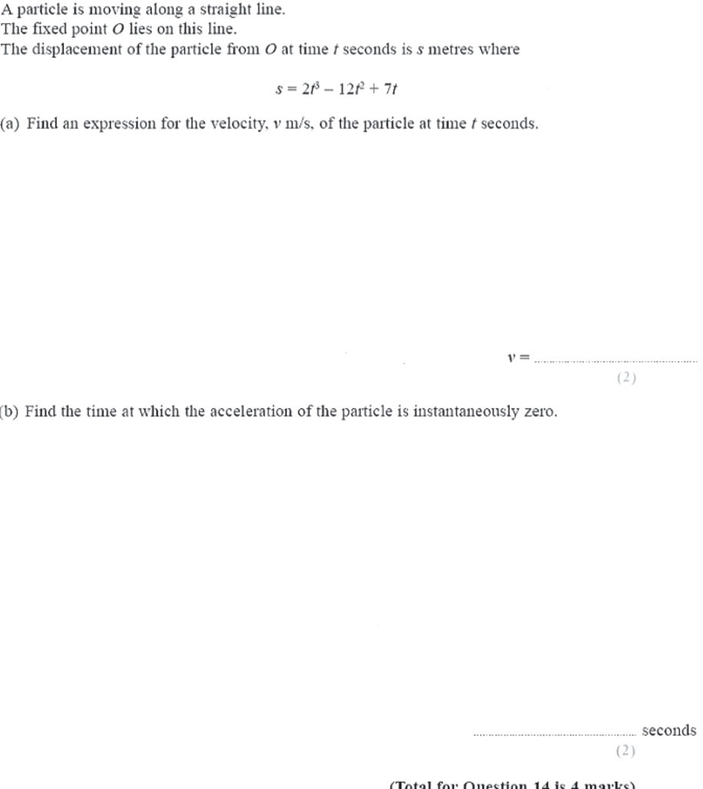
Zπ
PAST-PAPER QUESTION
Question 3

Slide 11
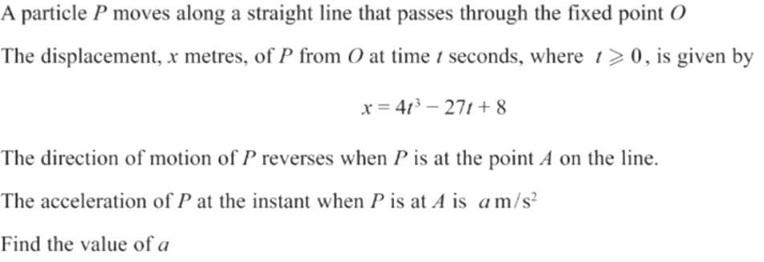
Zπ
PAST-PAPER QUESTION
Question 4

Slide 12
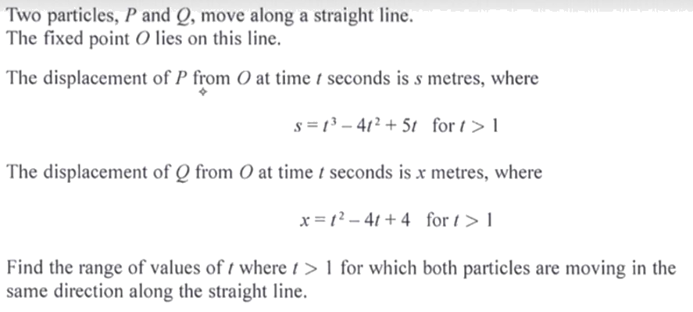
Zπ
PAST-PAPER QUESTION
Question 5

Slide 13
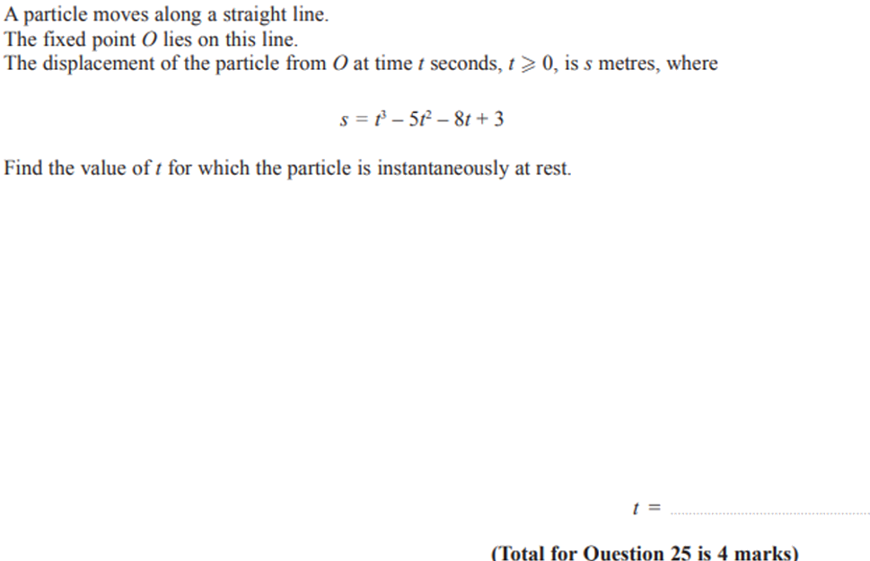
Zπ
PAST-PAPER QUESTION
Question 6

Slide 14
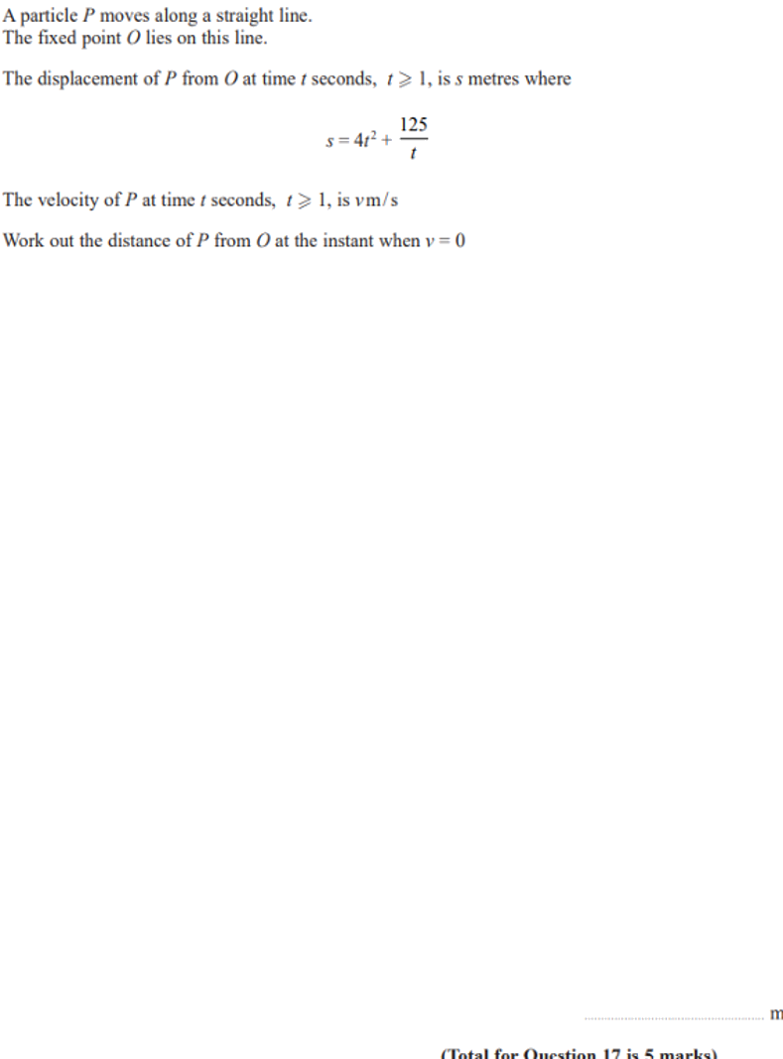
Zπ
PAST-PAPER QUESTION
Question 7

Slide 15
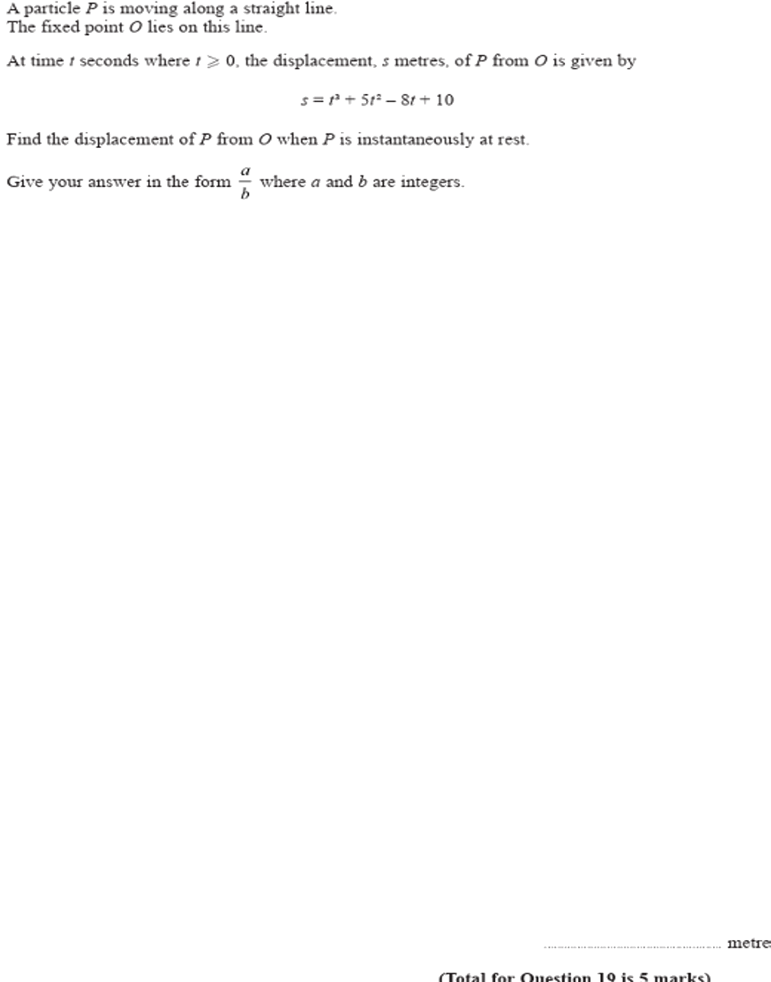
Zπ
PAST-PAPER QUESTION
Question 8

Slide 16
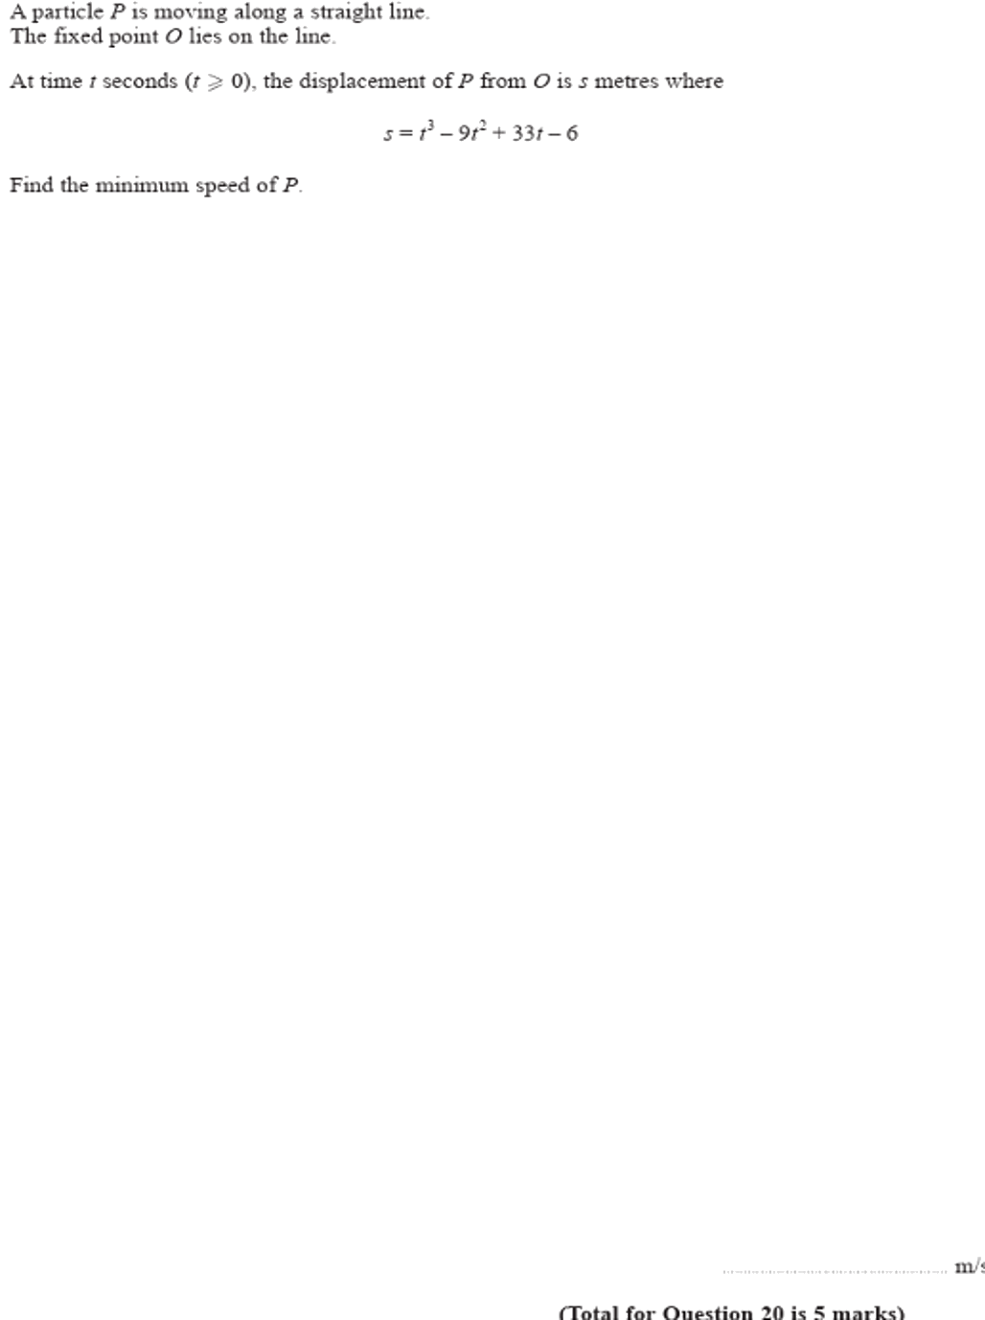
Zπ
PAST-PAPER QUESTION
Question 9

Slide 17
Zπ
RECAP
Key Takeaways
Displacement → differentiate → Velocity → differentiate → Acceleration.
v = ds/dt; a = dv/dt = d²s/dt².
‘At rest’ and ‘maximum/minimum displacement’ both mean v = 0.
‘Maximum/minimum velocity’ means a = 0.
‘Initial’ means t = 0; the sign of v or a gives the direction.
Golden rule: differentiate with respect to time, then turn the words into v = 0 or a = 0.

