Slide 1
Zπ
Zπ MATHS HUB
Pearson Edexcel IGCSE (9–1) · Higher Tier
f(x)
Functions
Notation & Machines · Domain & Range · Composite Functions · Inverse Functions
Zahra Sheikh Ali
IGCSE Mathematics Teacher · M.Sc. Differential Geometry & Geometric Control
☎ 66613748 ✉ zahraa.sheikhali@outlook.com

Slide 2
Zπ
LESSON OVERVIEW
A Rule That Turns Inputs into Outputs
A function is a rule: put a number IN, get one number OUT. We write it as f(x). This lesson covers notation, domain & range, composite functions and inverses.
Function notation f(x)
Algebraic inputs
Domain & range
1
2
3
Composite fg(x)
Inverse f⁻¹(x)
Past-paper questions
4
5
6
Key words: function · input · output · domain · range · composite · inverse · f(x)

Slide 3
Zπ
THE KEY IDEA
Function Notation: f(x)
f(x) is the OUTPUT when the input is x. To evaluate f(a), substitute a for every x.
x
× 2, then − 1
2x − 1
A function machine for f(x) = 2x − 1
Find f(3)
Find f(0) and f(−2)
f(3) = 2(3) − 1 = 5
f(0) = −1, f(−2) = 2(−2) − 1 = −5
Substitute the value in place of x — that is all f(a) means.

Slide 4
Zπ
ALGEBRAIC INPUTS
Substituting an Expression
1
For f(x) = x², the input can be an expression too.
Key idea
Replace EVERY x with the whole input.
Use brackets — (2x)² = 4x², not 2x².
Then expand and simplify.
This is the basis of composite functions.
2
f(x + 1) = (x + 1)² = x² + 2x + 1
3
f(2x) = (2x)² = 4x²
4
f(−3) = (−3)² = 9
Replace every x with the input, in brackets
A common slip: forgetting the brackets when the input is negative or an expression.

Slide 5
Zπ
DOMAIN & RANGE
Inputs In, Outputs Out
Two words examiners love. The domain is what you are allowed to put IN; the range is what can come OUT.
DOMAIN
RANGE
the set of allowed INPUTS (x-values).
Think: what can I feed into the machine?
the set of possible OUTPUTS (f(x)-values).
Think: what can come out of the machine?
Domain = inputs (x). Range = outputs (y or f(x)).

Slide 6

Zπ
DOMAIN RESTRICTIONS
Values That Are Not Allowed
Two things are forbidden in maths: dividing by zero, and square-rooting a negative. These restrict the domain.
No dividing by 0
No root of a negative
f(x) =
1
x − 2
f(x) =
The denominator cannot be 0,
so x − 2 ≠ 0 → x ≠ 2
The inside must be ≥ 0,
so x − 3 ≥ 0 → x ≥ 3
‘Which value cannot be in the domain?’ → the one that makes the bottom 0.

Slide 7
Zπ
RANGE OF A QUADRATIC
Use the Turning Point
1
Find the range of f(x) = x² − 4x + 1.
Method
A quadratic has a minimum (∪) or maximum (∩).
Complete the square, or find the turning point.
∪-shape: range is f(x) ≥ the minimum.
∩-shape: range is f(x) ≤ the maximum.
2
Complete the square: (x − 2)² − 3
3
Smallest value is −3 (when x = 2) — a MINIMUM.
4
Range: f(x) ≥ −3
Minimum value −3, so the range is f(x) ≥ −3
The turning point gives the smallest (or largest) output — that is the edge of the range.

Slide 8
Zπ
COMPOSITE FUNCTIONS
One Machine, Then Another
fg(x) means do g FIRST, then f. Work from the inside out — right to left.
x
g first
then f
fg(x)
fg(x) = f( g(x) ). The function nearest x acts first.
Order matters: fg(x) is usually NOT the same as gf(x).

Slide 9
Zπ
COMPOSITE · WORKED
fg(x), gf(x) and ff(x)
1
f(x) = 2x − 1, g(x) = x² + 3
ff and gg
ff(x) means apply f TWICE: f(f(x)).
gg(x) means apply g twice: g(g(x)).
Same rule — put the whole output back in as the input.
ff(x) is not (f(x))² — it is f OF f(x).
2
fg(x) = f( g(x) ) = 2(x² + 3) − 1 = 2x² + 5
3
gf(x) = g(2x − 1) = (2x − 1)² + 3 (different order!)
4
ff(x) = f( f(x) ) = 2(2x − 1) − 1 = 4x − 3
5
gg(x) = g( g(x) ) = (x² + 3)² + 3
ff(x) = f(f(x)) = 4x − 3 (apply f twice)
ff(x) and gg(x) are just composites of a function with itself.

Slide 10
Zπ
INVERSE FUNCTIONS
f⁻¹(x) Undoes f(x)
The inverse reverses the function. Three steps: change notation, rearrange, change notation back.
Write y = f(x) (change f(x) to y).
1
REARRANGE to make x the subject.
2
Swap x and y (change notation back).
3
That expression is f⁻¹(x).
4
The domain of f becomes the range of f⁻¹, and the range of f becomes the domain of f⁻¹.

Slide 11
Zπ
INVERSE · WORKED
Finding f⁻¹(x)
f(x) = 2x − 1. Write y = f(x), rearrange for x, then swap.
Working
Check it
y = 2x − 1
y + 1 = 2x
x =
f⁻¹ undoes f: f⁻¹(f(x)) = x.
f(3) = 5, and f⁻¹(5) = (5+1)/2 = 3. ✓
y + 1
2
Only one-to-one functions have an inverse.
then swap x and y:
Give the answer as f⁻¹(x) = …
f⁻¹(x) =
x + 1
2
‘Express the inverse in the form f⁻¹(x) = …’ is a very common exam instruction.

Slide 12

Zπ
HARDER INVERSES (1)
Fraction & Square-Root Functions
Same three steps — just more algebra to rearrange.
x on top AND bottom
Square-root function
f(x) =
2x + 1
f(x) =
(x ≥ 4)
x − 3
Square both sides:
y² = x − 4
x = y² + 4
y (x − 3) = 2x + 1
xy − 3y = 2x + 1
xy − 2x = 3y + 1
x (y − 2) = 3y + 1
f⁻¹(x) = x² + 4 (x ≥ 0)
f⁻¹(x) =
3x + 1
x − 2
Reverse a square root by SQUARING; reverse a fraction by multiplying up and collecting the x-terms.

Slide 13


Zπ
HARDER INVERSES (2)
Quadratic — Complete the Square
You cannot rearrange x² + 6x − 7 for x directly. Complete the square first, then undo it with a root.
Working
Why complete the square?
f(x) = x² + 6x − 7 (x ≥ −3)
= (x + 3)² − 16
y + 16 = (x + 3)²
x + 3 =
No way to rearrange x² + 6x − 7 for x.
It gives ONE (x + 3)² to undo.
Undo with a square root, then − 3.
x ≥ −3 → take the POSITIVE root.
f⁻¹(x) =
− 3
A quadratic only has an inverse on a restricted domain (x ≥ −3) so it is one-to-one.

Slide 14
Zπ
PART 2
Past-Paper Questions
Evaluate, find the range, build composites, and rearrange for inverses.
1
f(a) → substitute a for x
2
Domain → avoid ÷0 and √(negative)
3
fg(x) → do g first
4
Inverse → rearrange, then swap

Slide 15
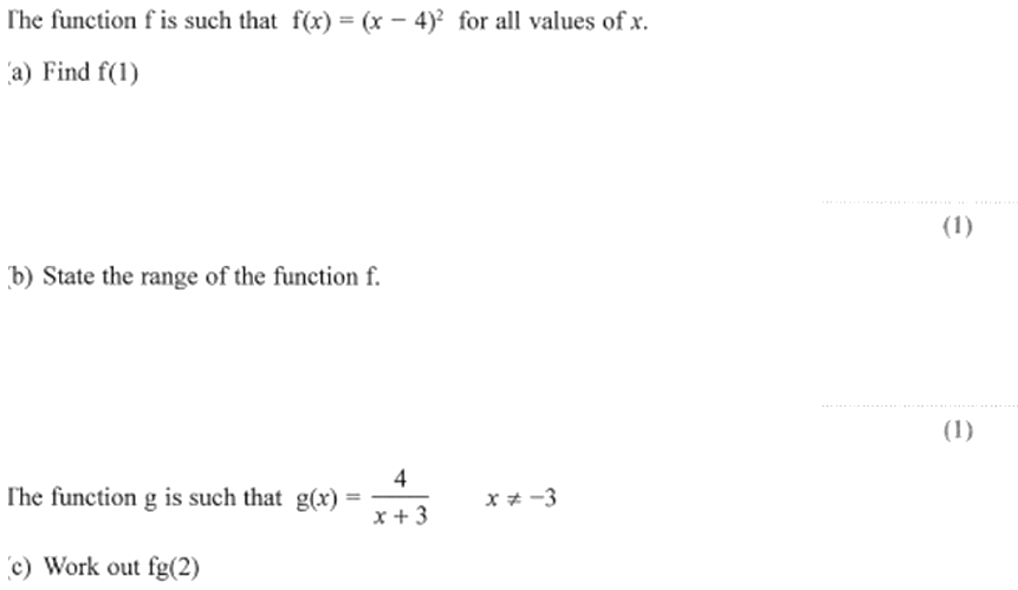
Zπ
PAST-PAPER QUESTION
Question 1

Slide 16
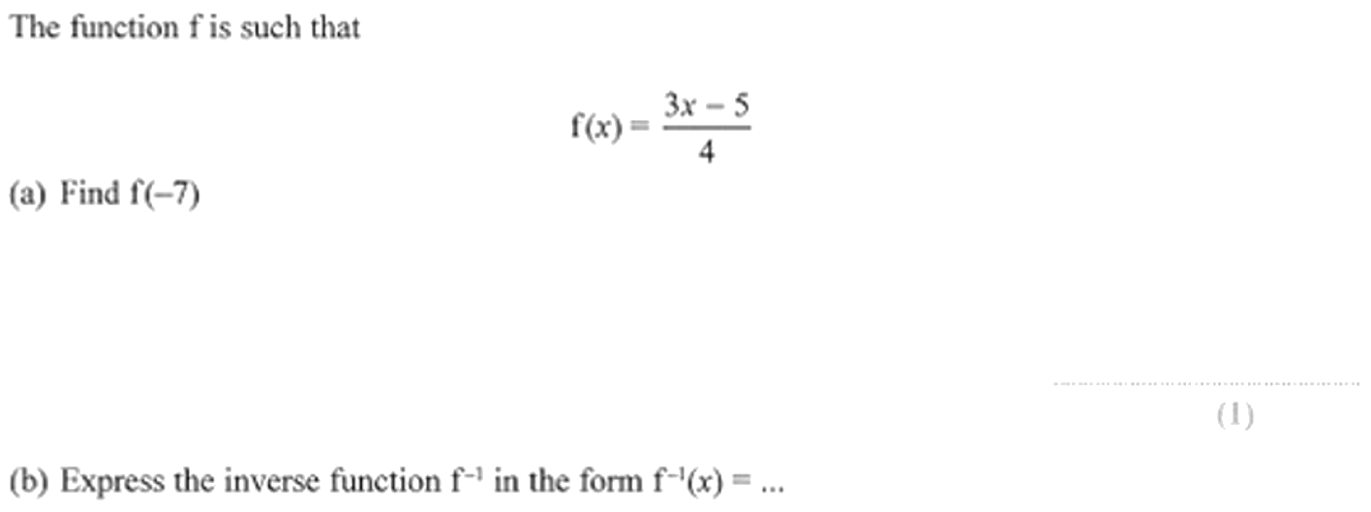
Zπ
PAST-PAPER QUESTION
Question 2

Slide 17
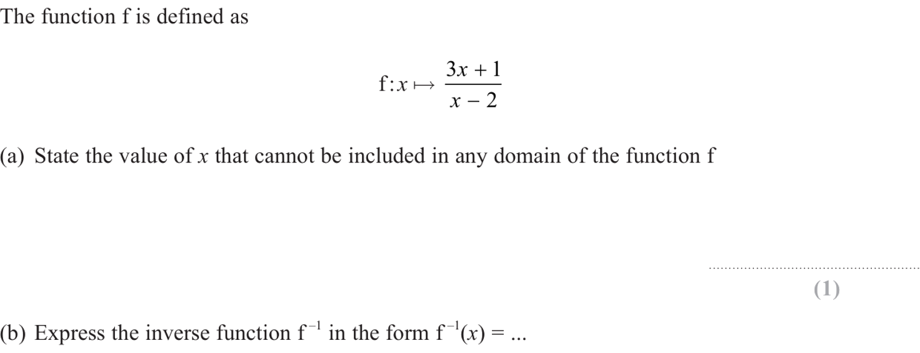
Zπ
PAST-PAPER QUESTION
Question 3

Slide 18
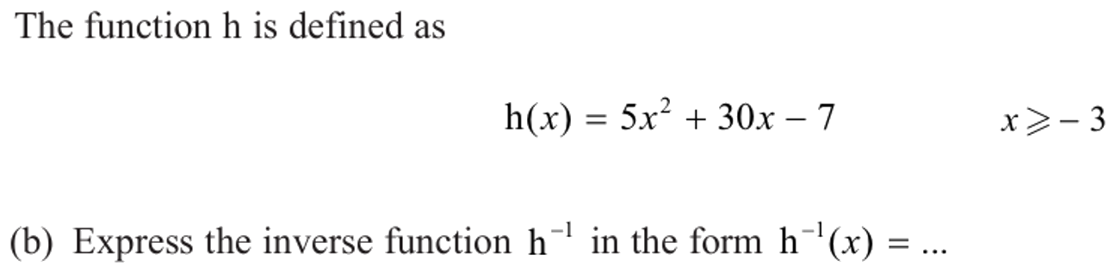
Zπ
PAST-PAPER QUESTION
Question 4

Slide 19
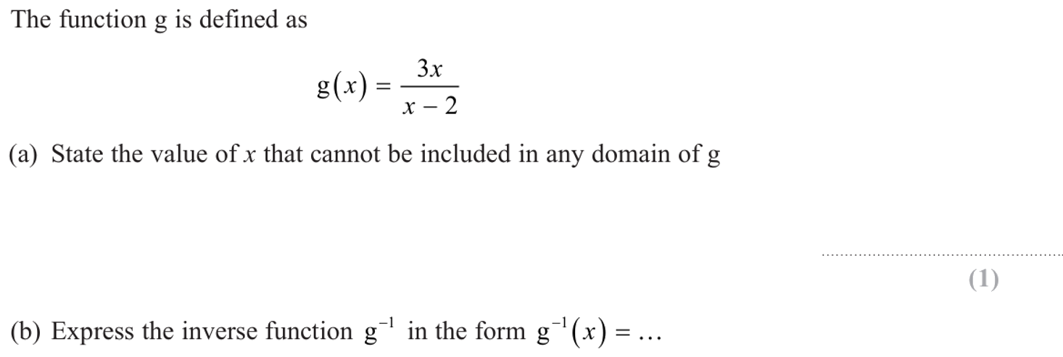
Zπ
PAST-PAPER QUESTION
Question 5

Slide 20
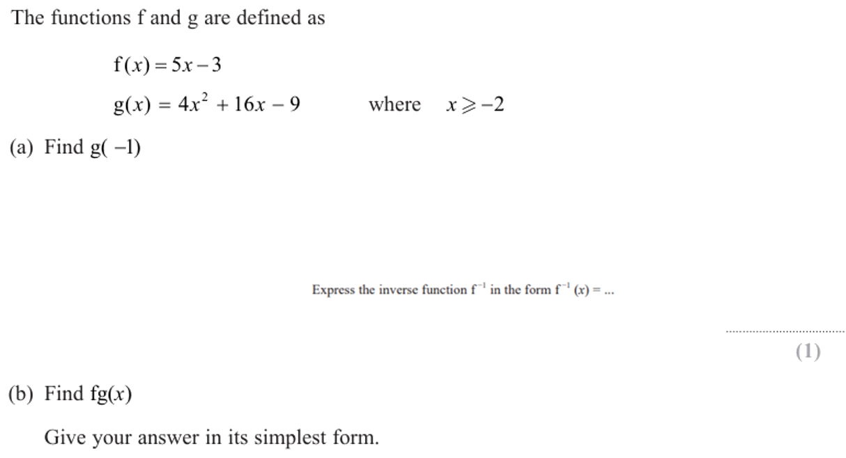
Zπ
PAST-PAPER QUESTION
Question 6

Slide 21
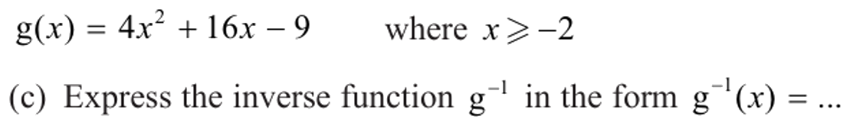
Zπ
PAST-PAPER QUESTION
Question 7

Slide 22
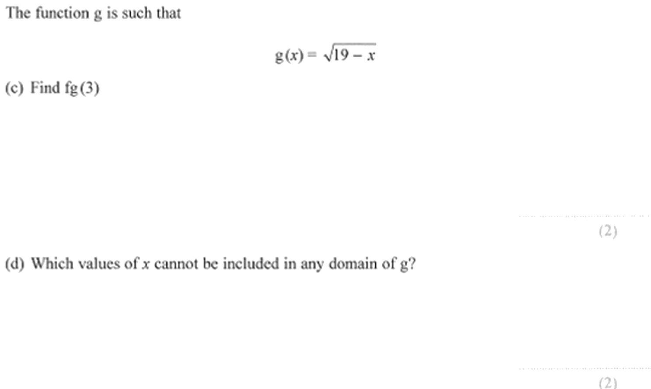
Zπ
PAST-PAPER QUESTION
Question 8

Slide 23
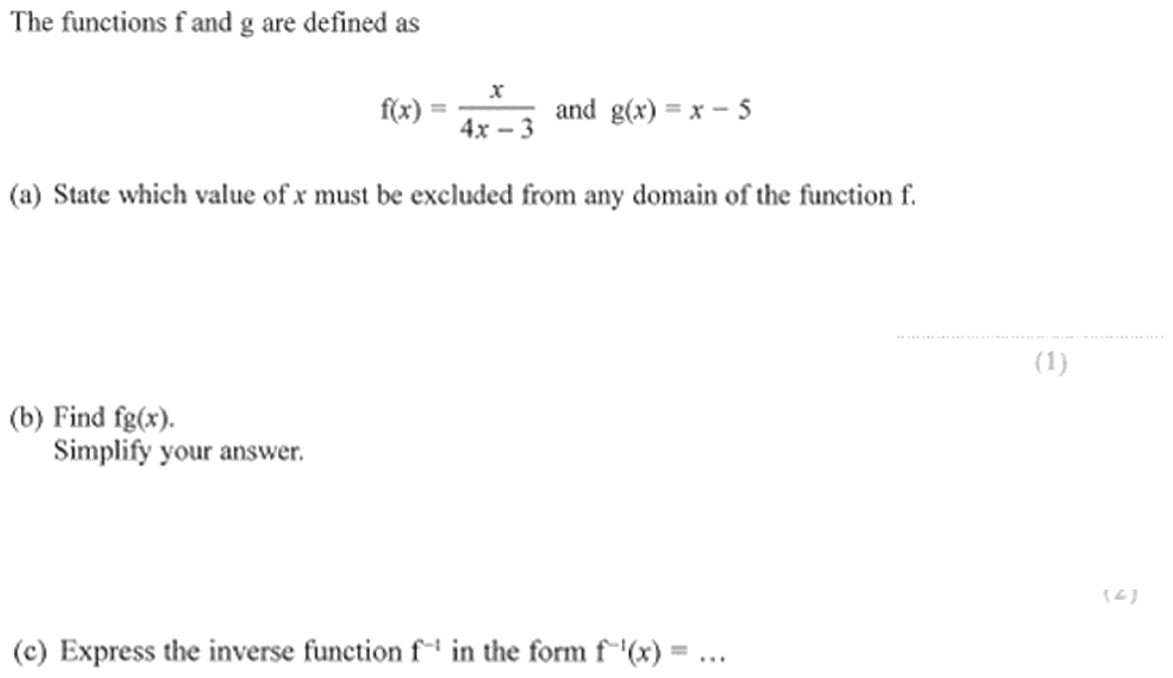
Zπ
PAST-PAPER QUESTION
Question 9

Slide 24
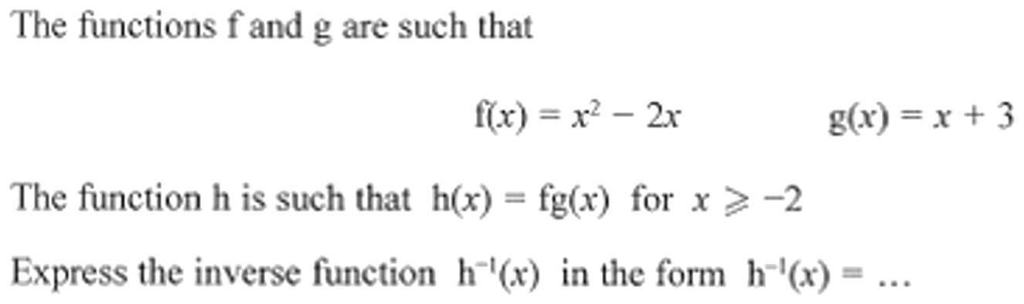
Zπ
PAST-PAPER QUESTION
Question 10

Slide 25
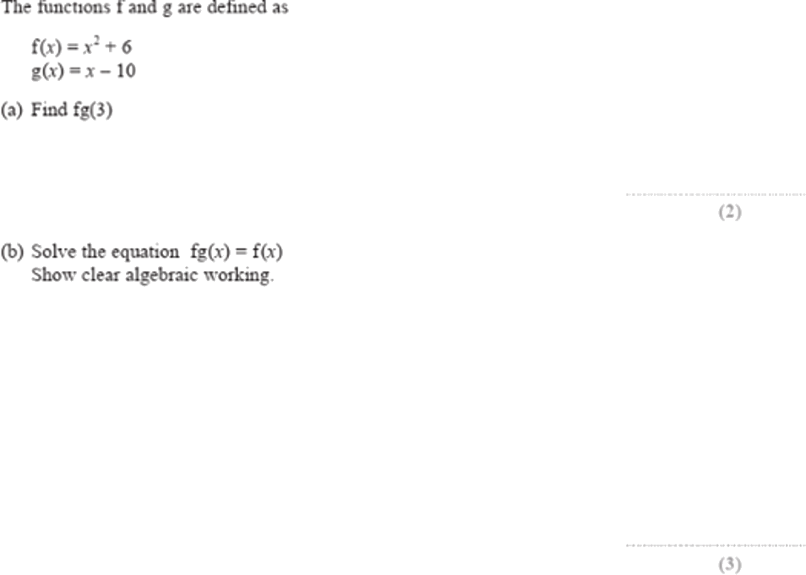
Zπ
PAST-PAPER QUESTION
Question 11

Slide 26
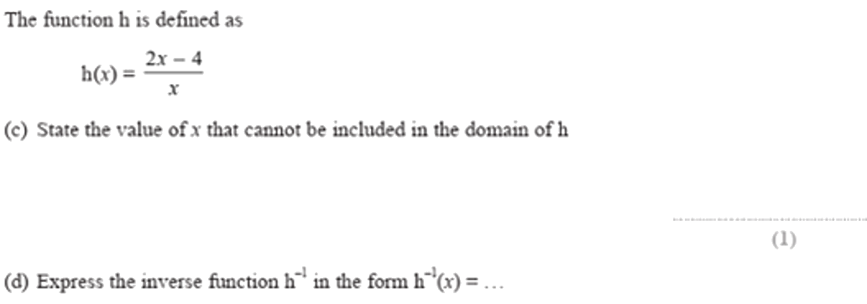
Zπ
PAST-PAPER QUESTION
Question 12

Slide 27
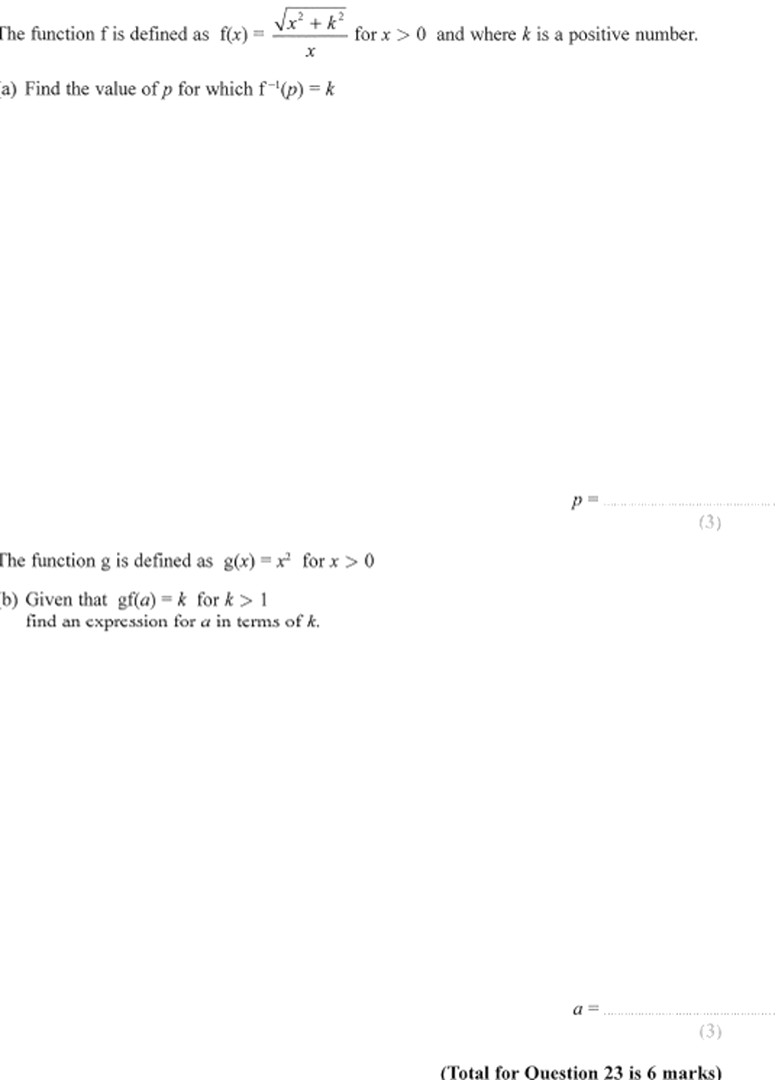
Zπ
PAST-PAPER QUESTION
Question 13

Slide 28
Zπ
RECAP
Key Takeaways
f(x) is the output for input x; to find f(a), substitute a for every x.
Domain = allowed inputs; range = possible outputs.
Domain restrictions: never divide by 0, never square-root a negative.
Composite fg(x) = f(g(x)) — do the inner function g FIRST.
Inverse f⁻¹(x): write y = f(x), rearrange for x, then swap x and y.
Golden rule: fg means g first; the inverse just reverses the steps.

