Slide 1
Zπ
Zπ MATHS HUB
Pearson Edexcel IGCSE (9–1) · Higher Tier
Transformations of Graphs
y = f(x) + a · y = f(x + a) · y = a f(x) · y = f(ax) · Reflections · Trig Graphs
Zahra Sheikh Ali
IGCSE Mathematics Teacher · M.Sc. Differential Geometry & Geometric Control
☎ 66613748 ✉ zahraa.sheikhali@outlook.com

Slide 2
Zπ
LESSON OVERVIEW
Shifting, Stretching & Reflecting Curves
A transformation moves or reshapes the whole graph of y = f(x). The secret is whether the change is INSIDE the bracket (affects x) or OUTSIDE it (affects y).
Inside vs outside
Vertical: f(x)+a, a f(x)
Horizontal: f(x+a), f(ax)
1
2
3
Reflections
Effect on a point
Past-paper questions
4
5
6
Key words: translation · stretch · reflection · shift · f(x) · inside/outside the bracket

Slide 3
Zπ
THE KEY IDEA
Inside the Bracket vs Outside
This is all you need to remember. Outside the bracket → vertical, and it does what you expect. Inside → horizontal, and it does the OPPOSITE.
OUTSIDE → vertical (y)
INSIDE → horizontal (x)
Affects the y-values.
Does what you EXPECT:
f(x) + 3 → up 3
2 f(x) → stretch taller
Affects the x-values.
Does the OPPOSITE:
f(x + 3) → LEFT 3
f(2x) → squash narrower
Outside = vertical & as expected. Inside = horizontal & opposite.

Slide 4
Zπ
VERTICAL TRANSFORMATIONS
Outside the Bracket
These change the y-values — and behave exactly as written.
y = f(x) + a
Translation UP by a
(0, a) vector — down if a is negative
y = f(x) − a
Translation DOWN by a
every point moves down a
y = a f(x)
Vertical STRETCH, factor a
y-values × a (x-axis stays fixed)
y = −f(x)
Reflection in the x-axis
every y-value changes sign
Outside the bracket, everything happens the obvious way — up means up.

Slide 5
Zπ
HORIZONTAL TRANSFORMATIONS
Inside the Bracket — the Opposite Way
These change the x-values — and do the OPPOSITE of what the sign suggests.
y = f(x + a)
Translation LEFT by a
(−a, 0) — ‘+ inside’ moves left!
y = f(x − a)
Translation RIGHT by a
(a, 0) — ‘− inside’ moves right
y = f(ax)
Horizontal STRETCH, factor 1/a
x-values ÷ a (y-axis fixed)
y = f(−x)
Reflection in the y-axis
every x-value changes sign
The classic trap: f(x + 2) shifts LEFT, not right. Inside the bracket is always opposite.

Slide 6
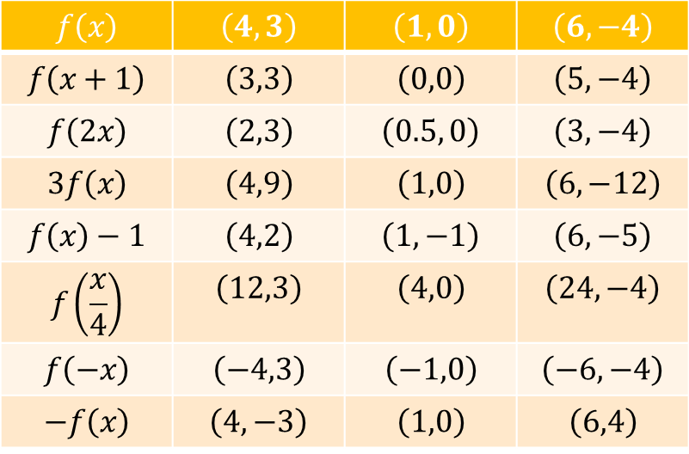
Zπ
EFFECT ON A POINT
Tracking One Point Through a Transformation
How to move a point
?
?
?
?
?
?
Horizontal change → adjust the x-coordinate (opposite sign).
Vertical change → adjust the y-coordinate (as written).
Reflection in x-axis → change sign of y.
Reflection in y-axis → change sign of x.
?
?
?
?
?
?
?
?
?
?
?
?
?
?
?
Inside → change x (opposite); outside → change y (as written)
A minimum or maximum point moves the same way as any other point.

Slide 7
Zπ
GRAPHS IN ACTION
Seeing Every Rule as a Graph
For each transformation below we sketch the graph and track exactly where every point moves.
y = f(x) + a vertical shift up
y = f(x + a) horizontal shift left
y = f(x) − a vertical shift down
y = f(x − a) horizontal shift right
y = a f(x) vertical stretch, factor a
y = f(ax) horizontal stretch, factor 1/a
y = −f(x) reflect in x-axis
y = f(−x) reflect in y-axis
Base curve used throughout: y = f(x) = x², with points (−2, 4), (−1, 1), (0, 0), (1, 1), (2, 4).

Slide 8
Zπ
VERTICAL TRANSLATION · DOWN
y = f(x) − 3
Outside the bracket → subtract 3 from every y-value. The graph slides straight down 3 units.
8
Original point | New point
(-2, 4) | (-2, 1)
(-1, 1) | (-1, -2)
(0, 0) | (0, -3)
(1, 1) | (1, -2)
(2, 4) | (2, 1)
6
4
2
-4
-2
2
4
-2
-4
y = f(x)
-6
y = f(x) − 3
Rule: (x, y) → (x, y − 3). Every point moves down 3 units — the shape stays identical.

Slide 9
Zπ
REFLECTION · X-AXIS
y = −f(x)
Outside the bracket → flip the sign of every y-value. The graph reflects in the x-axis.
6
Original point | New point
(-2, 4) | (-2, -4)
(-1, 1) | (-1, -1)
(0, 0) | (0, 0)
(1, 1) | (1, -1)
(2, 4) | (2, -4)
4
2
-4
-2
2
4
-2
-4
y = f(x)
-6
y = −f(x)
Rule: (x, y) → (x, −y). The x-axis acts as the mirror line.

Slide 10
Zπ
HORIZONTAL TRANSLATION · LEFT
y = f(x + 2)
Inside the bracket → do the OPPOSITE of the sign. ‘+2’ inside shifts the whole graph LEFT by 2 units.
10
Original point | New point
(-2, 4) | (-4, 4)
(-1, 1) | (-3, 1)
(0, 0) | (-2, 0)
(1, 1) | (-1, 1)
(2, 4) | (0, 4)
8
6
4
2
-6
-4
-2
2
4
y = f(x)
-2
y = f(x + 2)
Rule: (x, y) → (x − 2, y). Every point moves left 2 units — the classic trap.

Slide 11
Zπ
REFLECTION · Y-AXIS
y = f(−x)
Inside the bracket → flip the sign of every x-value. The graph reflects in the y-axis.
10
Original point | New point
(-2, 4) | (2, 4)
(-1, 1) | (1, 1)
(0, 0) | (0, 0)
(1, 1) | (-1, 1)
(2, 4) | (-2, 4)
8
6
4
2
-4
-2
2
4
y = f(x)
-2
y = f(−x)
Rule: (x, y) → (−x, y). The y-axis acts as the mirror line.

Slide 12
Zπ
COMBINING TRANSFORMATIONS
y = 2 f(x − 1) − 3
Work outside-in: stretch vertically ×2, then shift right 1 (inside, opposite sign), then shift down 3.
10
Original point | New point
(-2, 4) | (-1, 5)
(-1, 1) | (0, -1)
(0, 0) | (1, -3)
(1, 1) | (2, -1)
(2, 4) | (3, 5)
8
6
4
2
-4
-2
2
4
6
-2
-4
y = f(x)
-6
y = 2f(x−1)−3
Rule: (x, y) → (x + 1, 2y − 3). Apply the stretch before the translations.

Slide 13
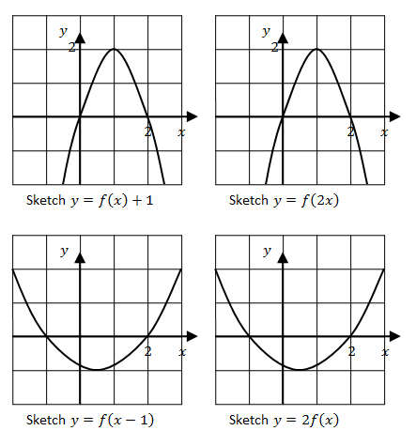
Zπ
QUICK PRACTICE
Sketch It Yourself
Starting from the curve y = f(x), sketch each transformed graph on its own grid. The worked answers are already plotted so you can check your work.
Tip: check inside vs outside the bracket first — inside is horizontal & opposite, outside is vertical & as written.

Slide 14
Zπ
GRAPHS · RECAP
From Graphs Back to the Golden Rule
Whatever the transformation, track it one point at a time — the table method always works.
f(x) + a → (x, y+a) shift up a
f(x+a) → (x−a, y) shift left a
f(x) − a → (x, y−a) shift down a
f(x−a) → (x+a, y) shift right a
a f(x) → (x, ay) stretch ×a
f(ax) → (x/a, y) squash ÷a
−f(x) → (x, −y) reflect in x
f(−x) → (−x, y) reflect in y
Next: the same rules applied to y = sin x and y = cos x.

Slide 15
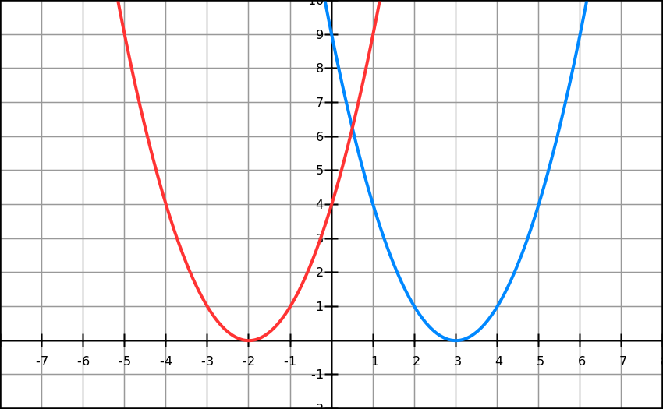
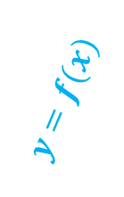

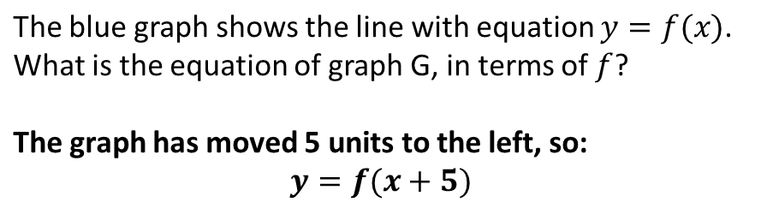
Zπ
WORKED EXAMPLE
Reading a Translation from a Graph
Compare the key points on the red graph with the blue original to spot the shift. Then write the new equation in terms of f(x).
Rule: moving left 5 units means f(x) becomes f(x + 5) — inside the bracket, always opposite.
?

Slide 16
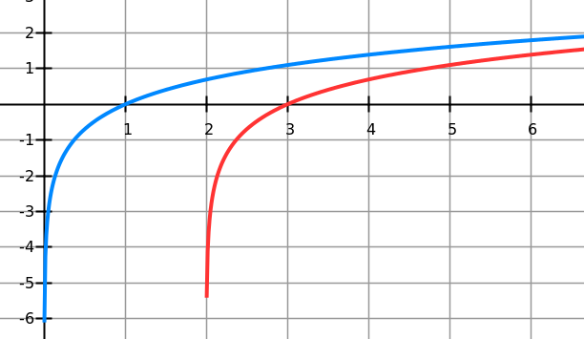
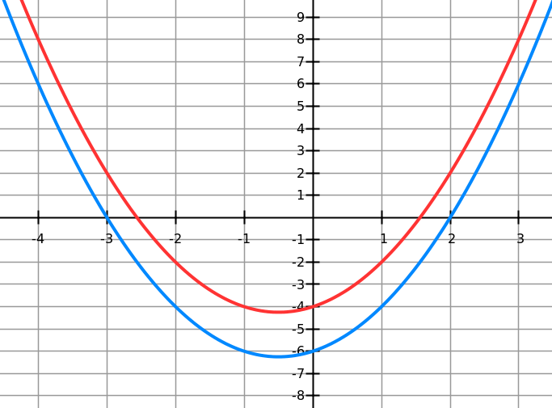


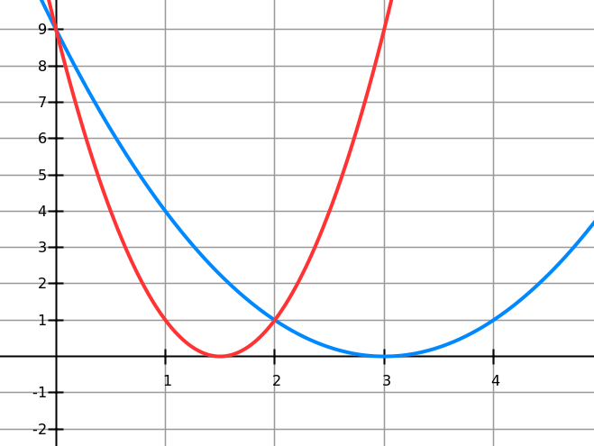
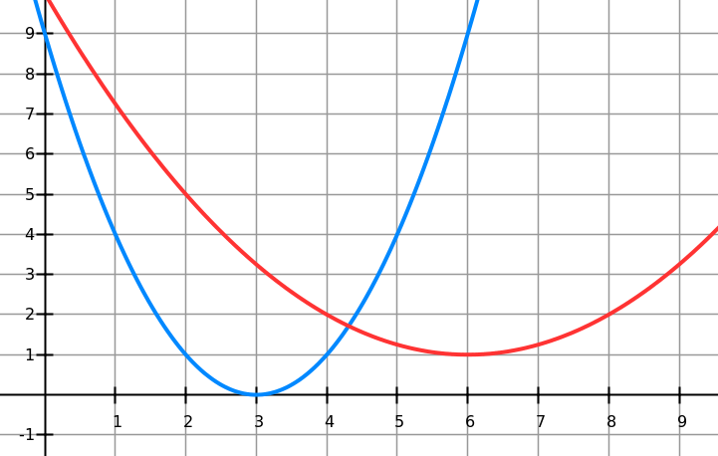

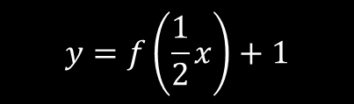
PRACTICE · YOUR TURN
Zπ
Spot the Transformation
?
?
?
?

Slide 17


Zπ
TRIG GRAPHS
Transforming sin and cos
The same rules apply to y = sin x and y = cos x. They just start in different places.
Know the basic shapes
y = a sin(bx) + c
sin x starts at (0, 0).
cos x starts at (0, 1).
Both repeat every 360°.
b = how many waves in 360°.
Both range between −1 and 1.
(x − d) inside → shift right d.
y = a cos(x − b) + c combines a stretch, a horizontal shift and a vertical shift — all at once.

Slide 18
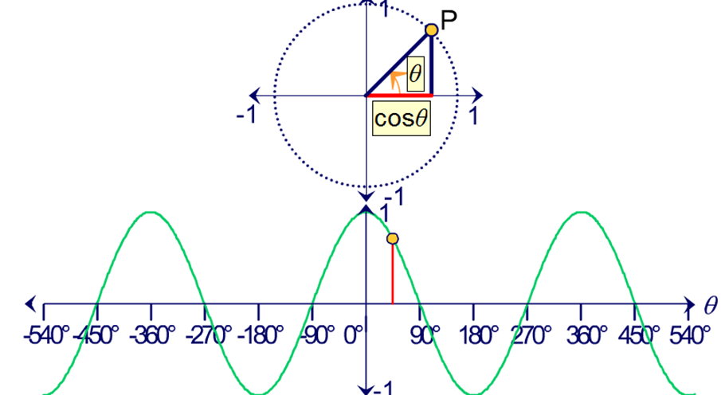
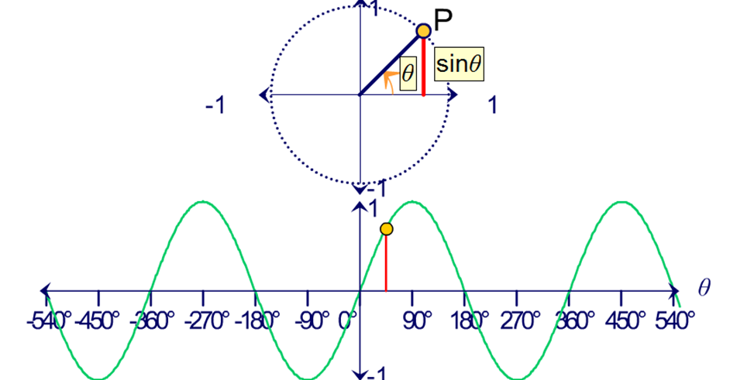
Zπ
TRIG GRAPHS · BASIC SHAPES
Transforming sin and cos
The same rules apply to y = sin x and y = cos x. They just start in different places.
x | 0° | 90° | 180° | 270° | 360°
y = sin x | 0 | 1 | 0 | −1 | 0
x | 0° | 90° | 180° | 270° | 360°
y = cos x | 1 | 0 | −1 | 0 | 1
y = a cos(x − b) + c combines a stretch, a horizontal shift and a vertical shift — all at once.

Slide 19
Zπ
TRIG GRAPHS · WORKED EXAMPLE 1
Tip: The function here is the sin. So consider whether the change happens inside or outside the sin.
Sketching y = 2 sin(x) and y = sin(x + 90°)
Below is a sketch of y = sin(x). Hence sketch the following.
y
y
2
2
y = 2sin(x)
y = sin(x + 90)
y = sin(x)
y = sin(x)
1
1
x
x
-360 -270 -180 -90 90 180 270 360
-360 -270 -180 -90 90 180 270 360
-1
-1
Answer:
y = sin(x + 90)
Answer:
y = 2sin(x)
Outside sin/cos → amplitude & vertical shift, as written. Inside → period & horizontal shift, opposite sign.
-2
-2

Slide 20
Zπ
TRIG GRAPHS · WORKED EXAMPLE 2
Sketching y = sin(2x) and y = 1.5 sin(x/2)
Below is a sketch of y = sin(x). Hence sketch the following.
y
y
2
2
y = 1.5sin(x/2)
y = sin(2x)
y = sin(x)
y = sin(x)
1
1
x
x
-360 -270 -180 -90 90 180 270 360
-360 -270 -180 -90 90 180 270 360
-1
-1
Inside the bracket, coefficients squeeze or stretch the period — always the reciprocal effect.
Answer:
y = sin(2x)
Answer:
y = 1.5sin(x/2)
-2
-2

Slide 21
Zπ
PART 2
Past-Paper Questions
Decide inside/outside, then shift, stretch or reflect the key points.
1
Inside the bracket? → horizontal, opposite
2
Outside? → vertical, as written
3
Move the marked point
4
Reflections change a sign

Slide 22
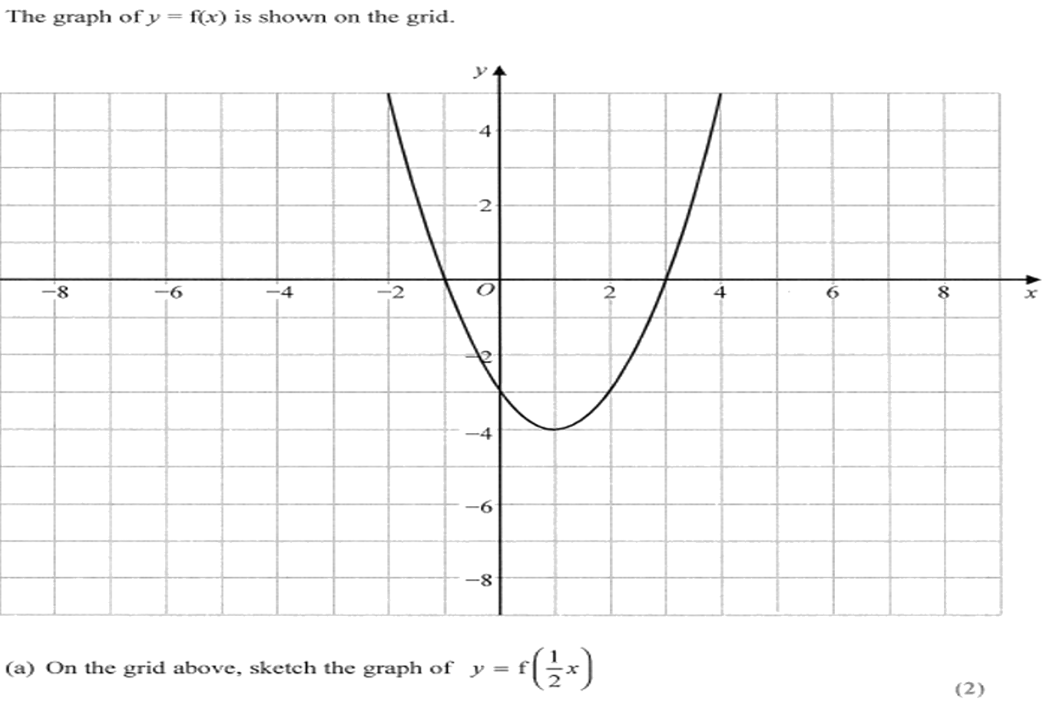
Zπ
PAST-PAPER QUESTION
Question 1

Slide 23
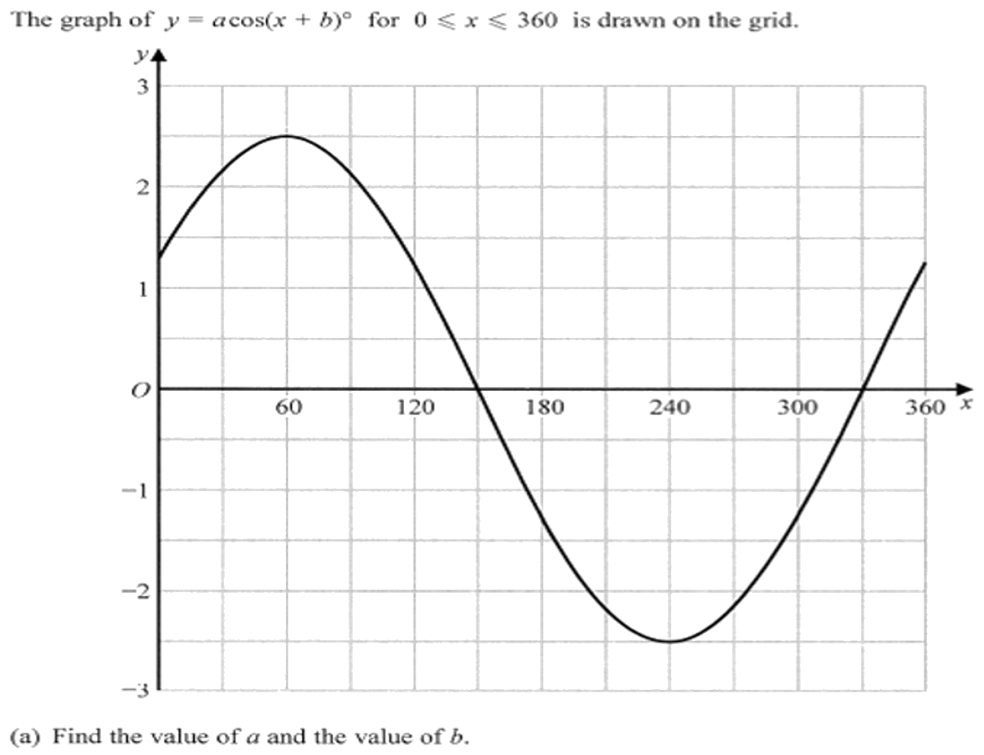
Zπ
PAST-PAPER QUESTION
Question 2

Slide 24
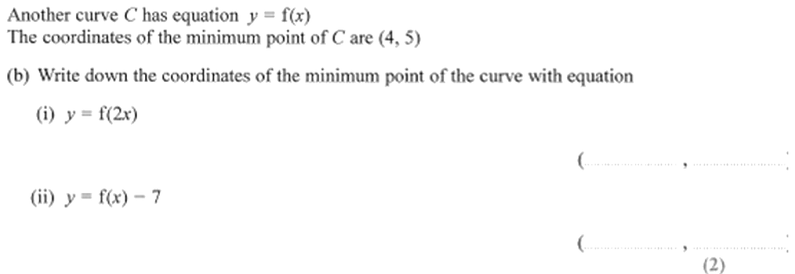
Zπ
PAST-PAPER QUESTION
Question 3

Slide 25
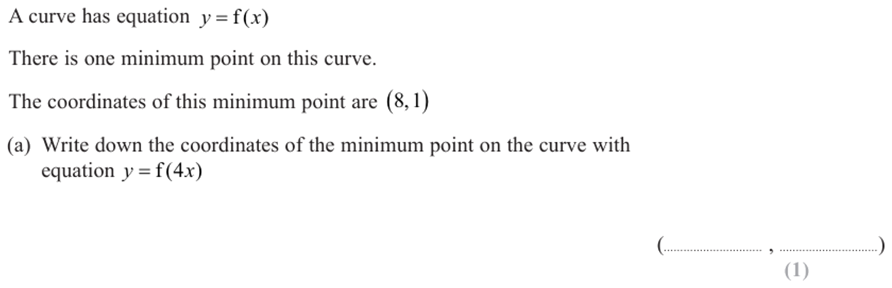
Zπ
PAST-PAPER QUESTION
Question 4

Slide 26
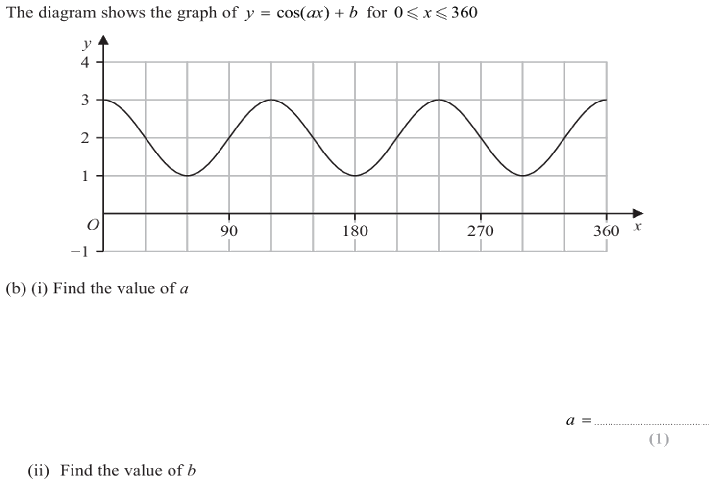
Zπ
PAST-PAPER QUESTION
Question 5

Slide 27
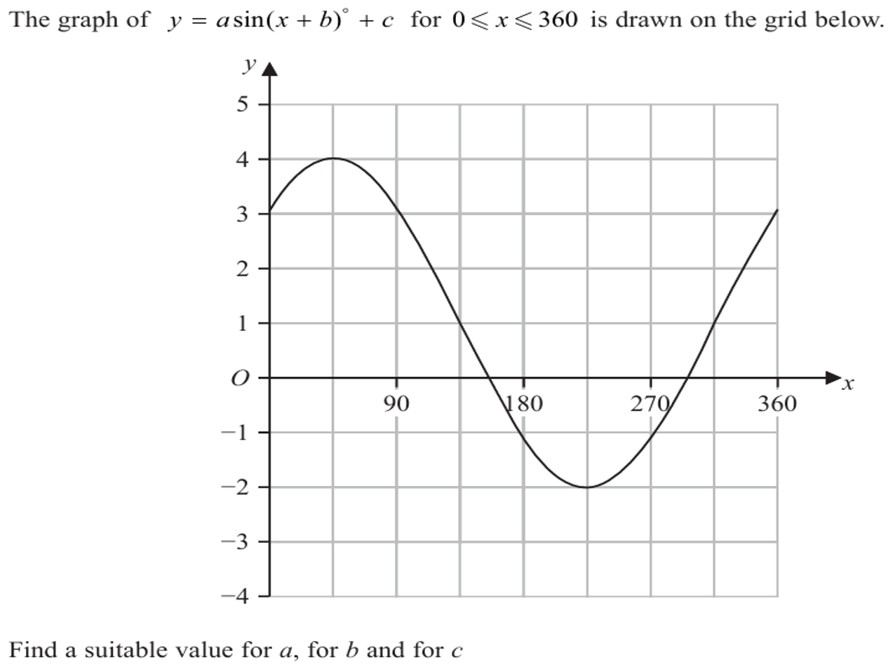
Zπ
PAST-PAPER QUESTION
Question 6

Slide 28
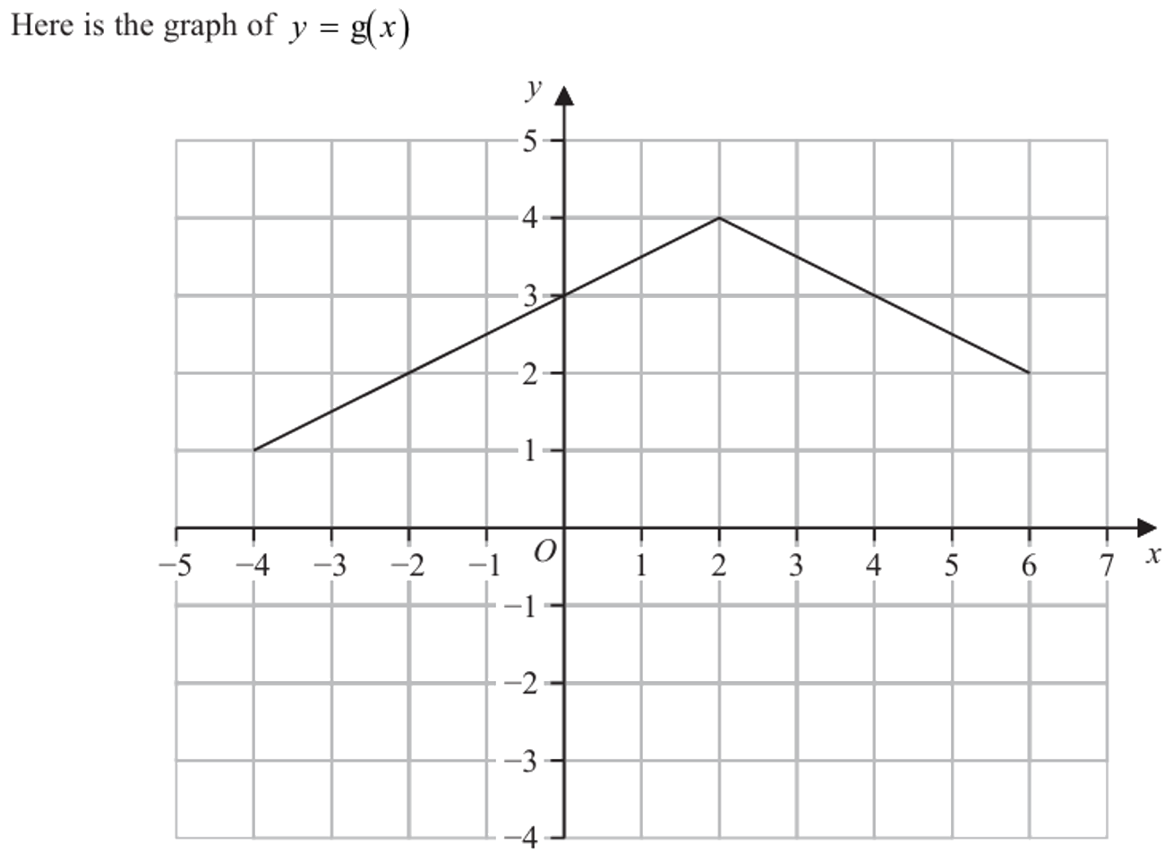
Zπ
PAST-PAPER QUESTION
Question 7

Slide 29
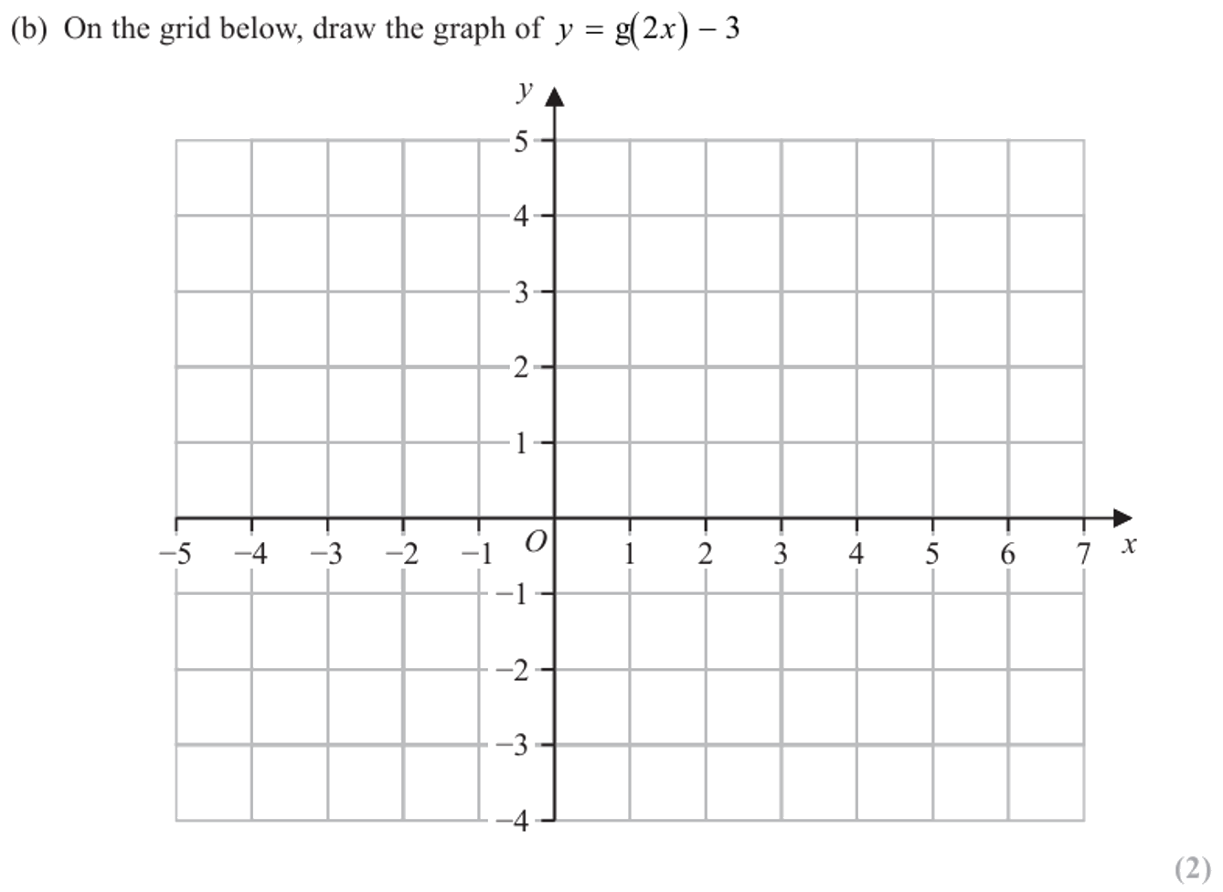
Zπ
PAST-PAPER QUESTION
Question 8

Slide 30
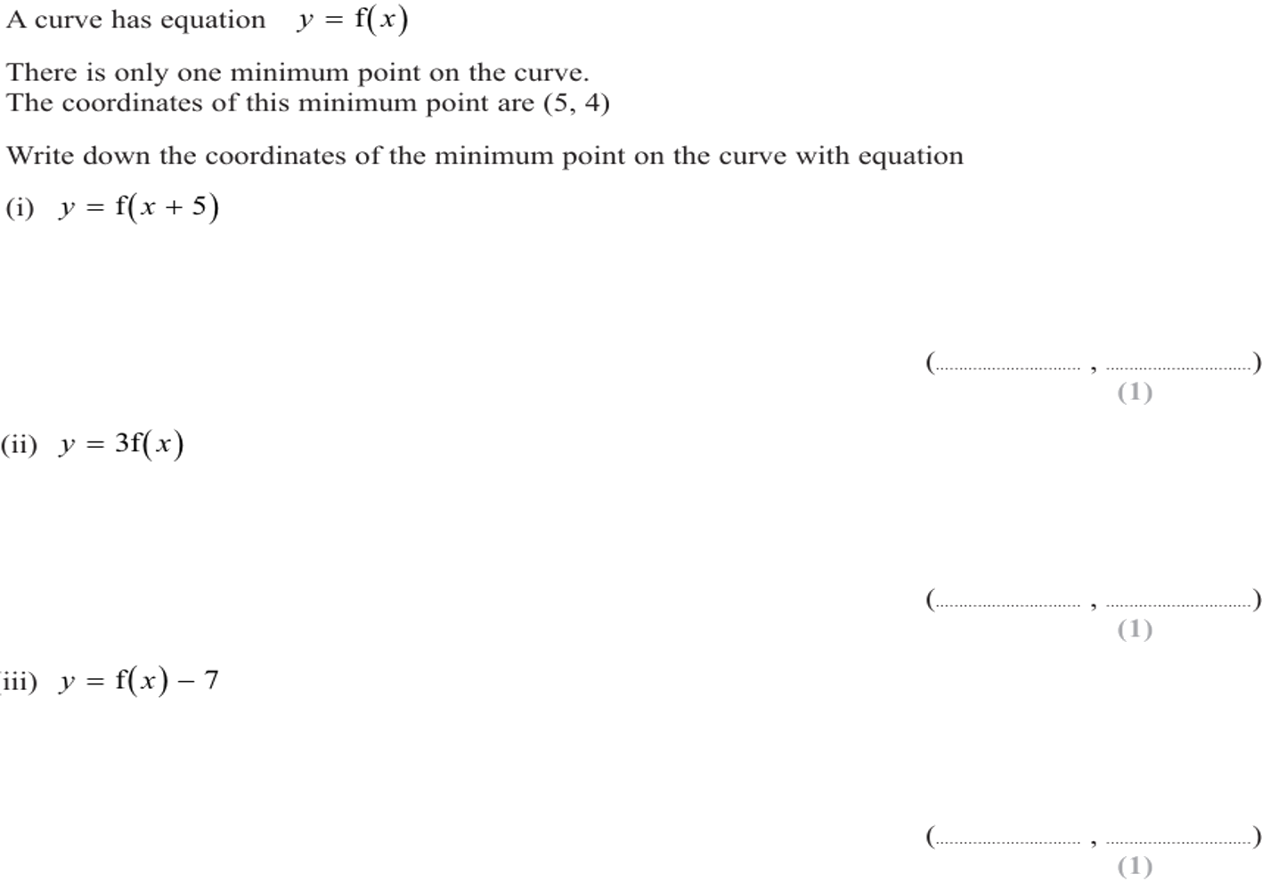
Zπ
PAST-PAPER QUESTION
Question 9

Slide 31
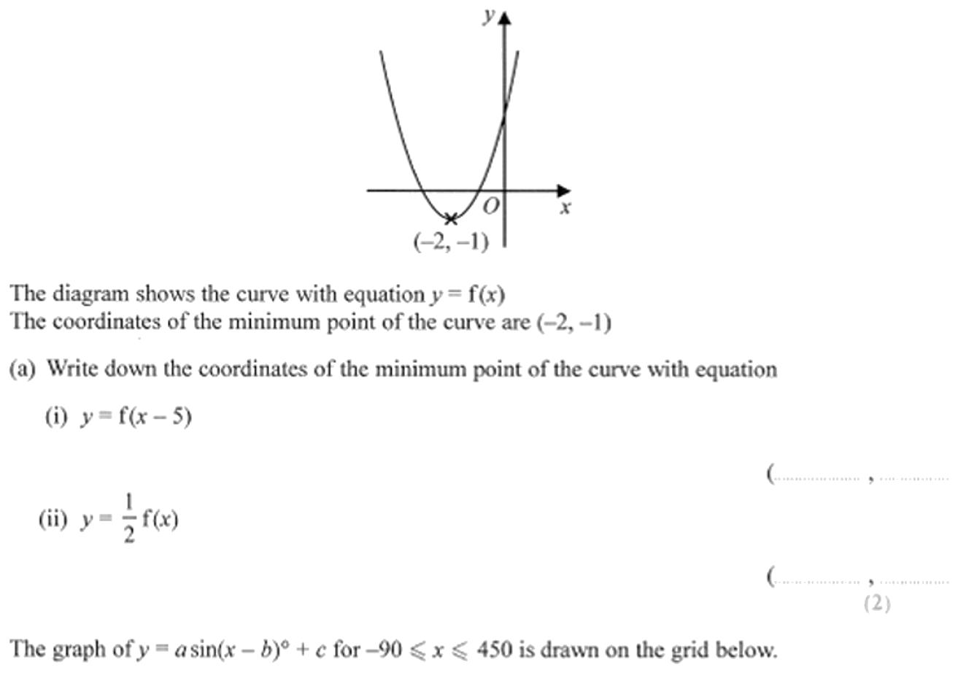
Zπ
PAST-PAPER QUESTION
Question 10

Slide 32
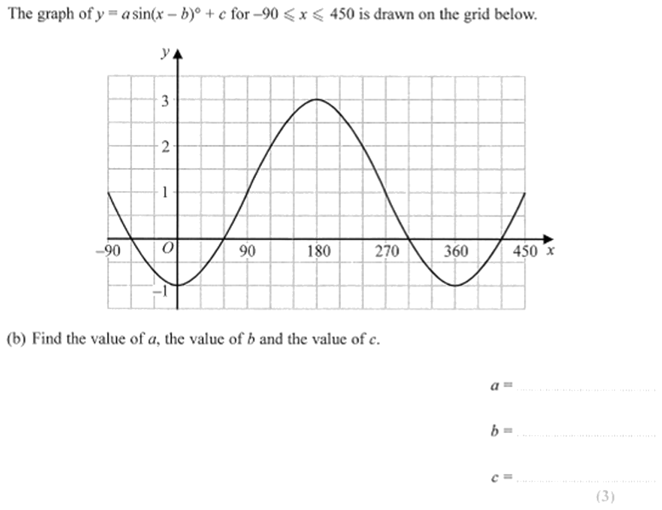
Zπ
PAST-PAPER QUESTION
Question 11

Slide 33
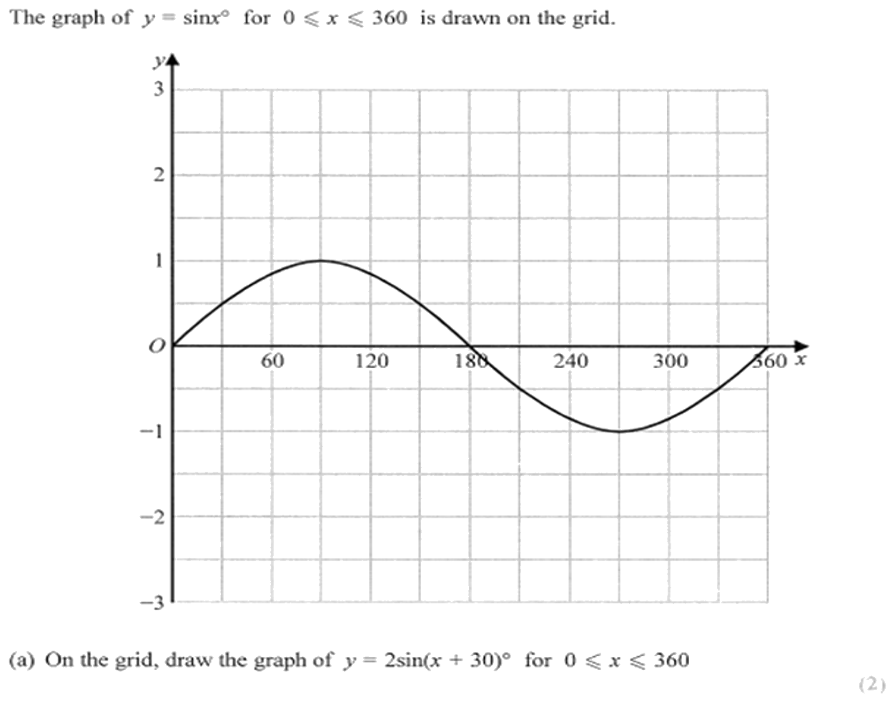
Zπ
PAST-PAPER QUESTION
Question 12

Slide 34
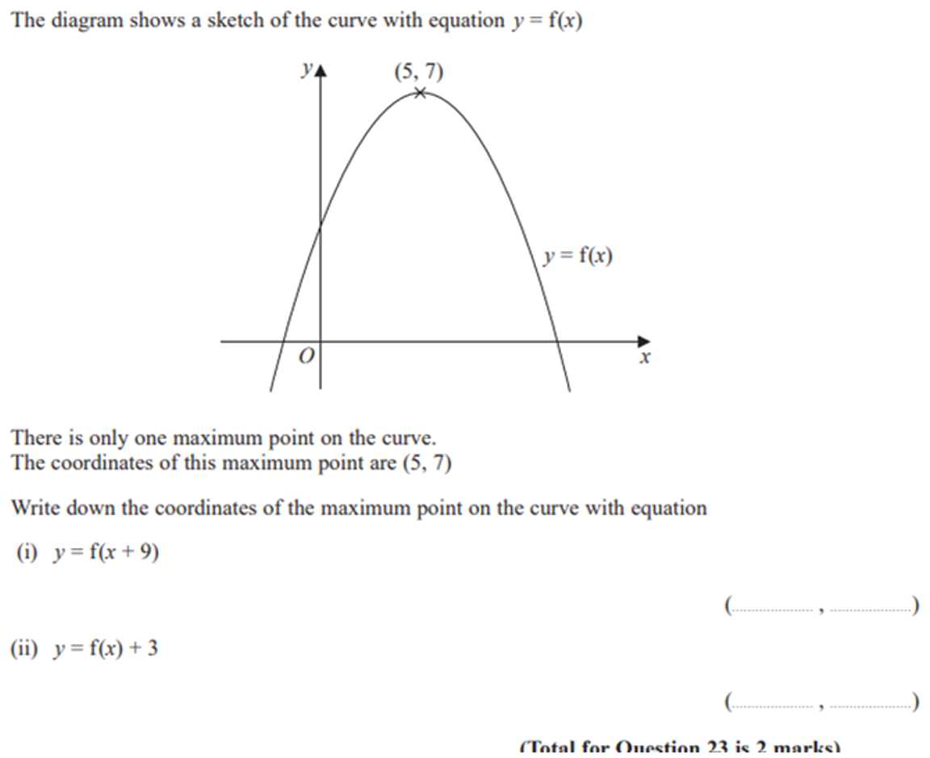
Zπ
PAST-PAPER QUESTION
Question 13

Slide 35
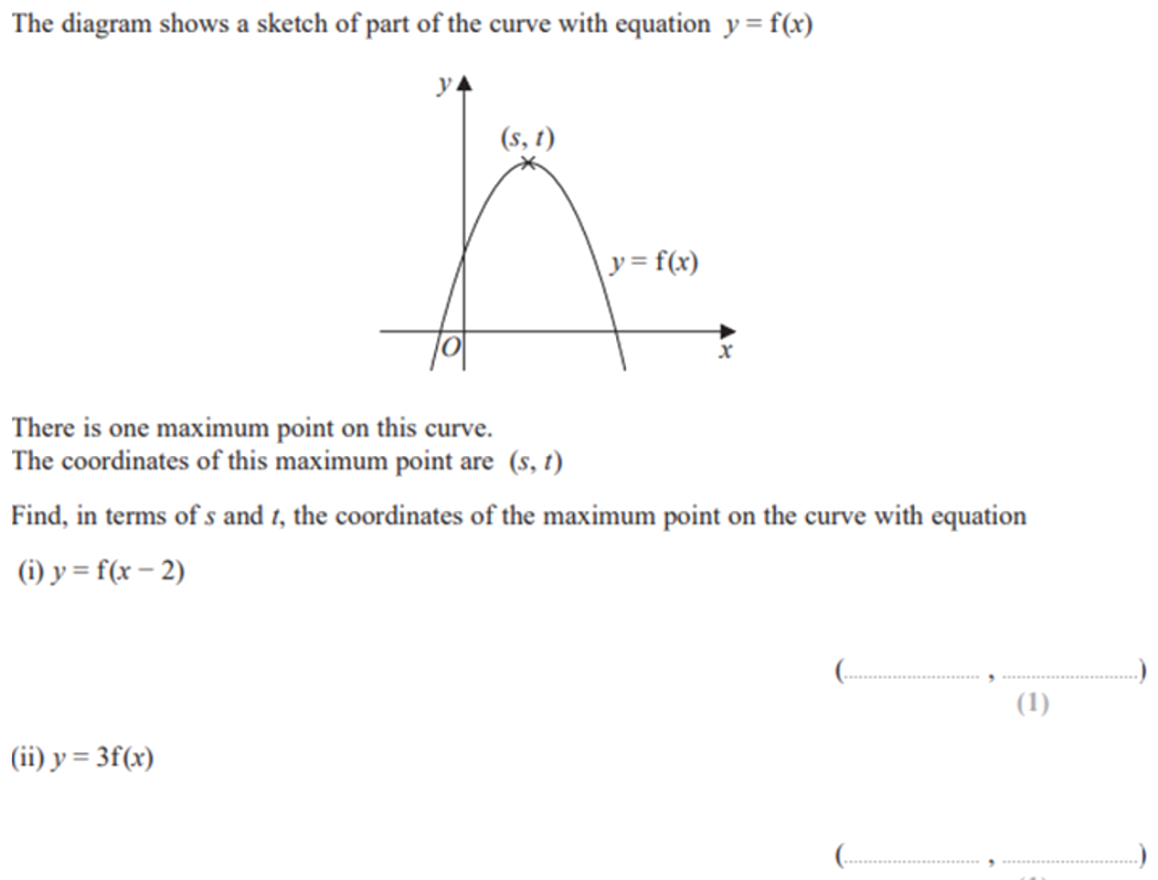
Zπ
PAST-PAPER QUESTION
Question 14

Slide 36
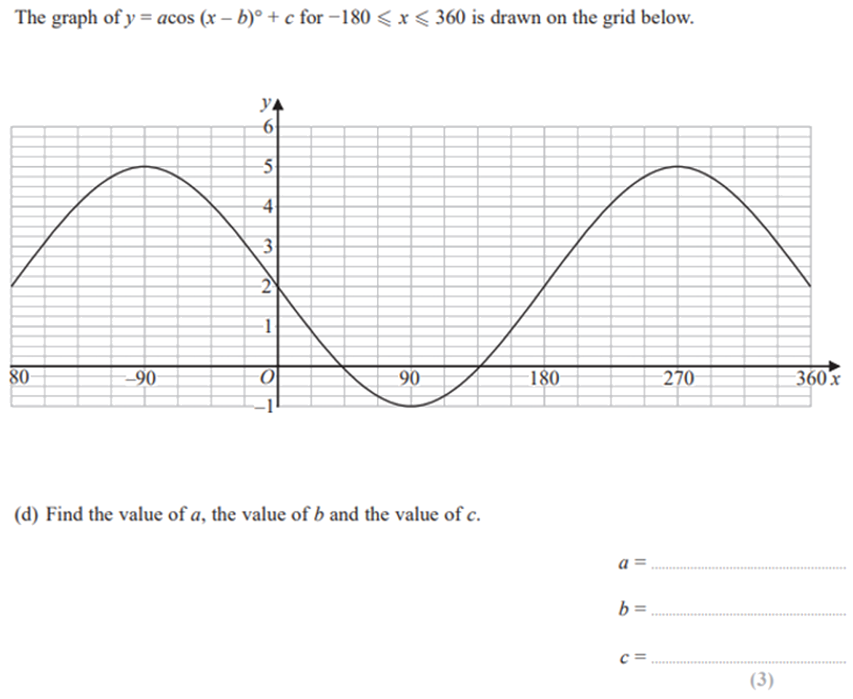
Zπ
PAST-PAPER QUESTION
Question 15

Slide 37
Zπ
RECAP
Key Takeaways
Outside the bracket → vertical change, and it does what you expect.
Inside the bracket → horizontal change, and it does the OPPOSITE.
f(x)+a: up a; f(x+a): LEFT a; a f(x): stretch ×a; f(ax): squash by 1/a.
−f(x) reflects in the x-axis; f(−x) reflects in the y-axis.
Move each key point (like the turning point) by the same rule.
Golden rule: inside the bracket is horizontal and opposite; outside is vertical and as-written.

