Slide 1
Zπ
Zπ MATHS HUB
Pearson Edexcel IGCSE (9–1) · Higher Tier
Vectors
Column Vectors · Magnitude · Adding & Subtracting · Scalar Multiples · Vector Geometry
Zahra Sheikh Ali
IGCSE Mathematics Teacher · M.Sc. Differential Geometry & Geometric Control
☎ 66613748 ✉ zahraa.sheikhali@outlook.com

Slide 2
Zπ
LESSON OVERVIEW
Quantities with Size AND Direction
A vector has both a MAGNITUDE (size) and a DIRECTION. We write it as a column, or with an arrow. This lesson builds up to full vector-geometry proofs.
Column vectors & notation
Magnitude
Adding & subtracting
1
2
3
Scalar multiples
Parallel vectors & paths
Past-paper questions
4
5
6
Key words: vector · column vector · magnitude · scalar · parallel · resultant · position · ratio

Slide 3
Zπ
BEFORE WE START
Speed vs Velocity
Vectors exist because some quantities need a direction as well as a size. Compare these two ideas.
Speed
Velocity
How fast something moves.
Has magnitude only — just a number.
“I moved 5 steps.”
This tells us HOW MUCH, but not which way.
How fast AND in which direction.
Has magnitude + direction — a vector.
“I moved 5 steps to the right.”
5 steps = magnitude. Right = direction.
magnitude only
magnitude + direction
A vector is a quantity with both magnitude and direction — velocity is a vector, speed is not.
Coordinates (x, y)
Vectors (right, up)
Represent a MOVEMENT.
“Move 3 right and 5 up.”
Free — can start anywhere.
Written stacked, no comma: (3 over 5).
Represent a POSITION.
“The point is at (3, 5).”
Fixed — tied to the origin.
Written with a comma: (3, 5).
Coordinates fix a position; vectors describe a movement between positions.

Slide 4
Zπ
THE KEY IDEA
Writing a Vector
A vector takes you FROM one point TO another. The top number is across (right +), the bottom is up (up +).
y
6
Three ways to write it
4
• with the endpoints: AB (with an arrow on top)
• with a bold/underlined letter: a
• as a COLUMN vector:
A
2
–6
–4
–2
0
2
4
6
x
–2
B
4
–4
4 right, 2 down
−4
–6
BA is the reverse of AB — same length, opposite direction (negate both numbers).

Slide 5
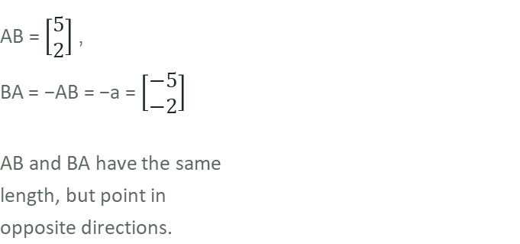
Zπ
THE OPPOSITE VECTOR
BA is the Reverse of AB
AB = (5, 2). If the arrow points the other way, every number flips sign: BA = −AB = (−5, −2).
B
AB
BA
A
To reverse a vector, negate every number inside it: BA = −AB.

Slide 6
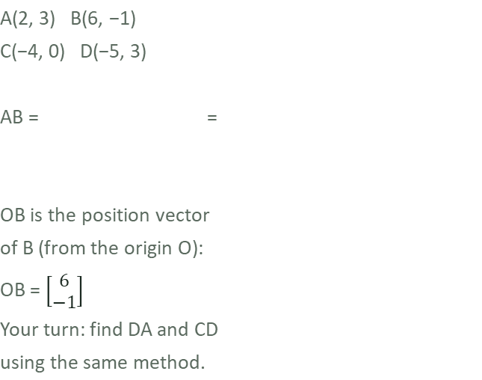
Zπ
COORDINATES
Reading a Vector from a Grid
Plot the points, then read the vector straight off the grid: across then up.
D
A
6 − 2
4
−1 − 3
−4
C
B
A vector = (end − start) for each coordinate: (x2−x1, y2−y1).

Slide 7
Zπ
PRACTICE
Draw These Column Vectors
On squared paper, draw each vector starting from any point you like.
a) | b) | c)
d) | e) | f)
Top number = across (right if positive). Bottom number = up (up if positive).

Slide 8
Zπ
MAGNITUDE
The Length of a Vector
1
Magnitude = the length. Use Pythagoras on the two numbers.
Method
2
|a| = √(x² + y²)
a
5
3
= √(9 + 25) = √34 ≈ 5.83
3
4
|a| = √(3² + 5²) = √34 ≈ 5.83
|a| = √(x² + y²) — Pythagoras
Magnitude is always positive — it is a length.

Slide 9
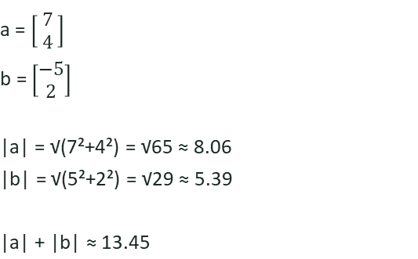
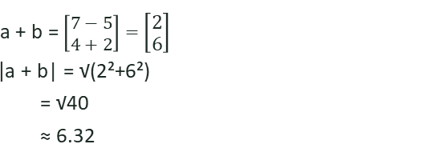
Zπ
WORKED EXAMPLE
Finding |a|, |b| and |a + b|
Notice that |a| + |b| is NOT the same as |a + b| — magnitudes don't simply add.
Given
Add the vectors
Compare the magnitudes
13.45 ≠ 6.32
|a| + |b| ≠ |a + b|
You must add the vectors
FIRST, then find the
magnitude of the result.
Add components first, then take the magnitude — never add the magnitudes directly.

Slide 10
Zπ
SCALAR MULTIPLICATION
Stretching a Vector
Multiplying a vector by a number (a scalar) multiplies BOTH components. It changes the length, not the direction.
What the scalar does
Multiply each part
2a is twice as long, same direction.
3
6
−a is the same length, OPPOSITE direction.
2
=
2
4
Multiply a scalar by a vector and you get a PARALLEL vector
a
Every number inside is multiplied by 2.
2a
−a
Same line, different length — that's a scalar multiple.

Slide 11
Zπ
TASK
Find 2a, −3b and 4c
For the vectors below, find its new column form.
a =
b =
c =
2a =2 =
-3b =-3 =
4c =4 =
Multiply every number inside the vector by the scalar — including the sign.
A negative scalar reverses the direction as well as changing the length.

Slide 12
Zπ
PARALLEL VECTORS
Spotting Parallel Vectors
AB = a. Every arrow below is a scalar multiple of a — so every arrow is parallel to AB.
AB = a
CD = 2a (CD = 2 AB)
EF = ½a (EF = ½ AB)
HG = −2a (HG = −2 AB)
If one vector is a number times another, the two are parallel — whatever that number is.

Slide 13
Zπ
PARALLEL VECTORS
Proving Two Vectors Are Parallel
ka is parallel to a for any number k. ABCD is a parallelogram: AB and DC are equal and parallel.
B
b
C
Why AB is parallel to DC
In parallelogram ABCD:
AB = a and DC = a → parallel, equal length.
AD = b and BC = b → parallel, equal length.
The diagonals combine both:
BD = b − a AC = a + b
General rule: if PQ = k × RS for any
number k, then PQ is parallel to RS.
a
a
A
b
D
If one vector is a scalar multiple of another (PQ = k × RS), the two lines are parallel — and if they share a point, all three points are collinear.

Slide 14
Zπ
ADDING & SUBTRACTING
Work Top and Bottom Separately
Add (or subtract) the top numbers, then the bottom numbers. Geometrically, add vectors nose-to-tail.
In columns
Nose-to-tail (triangle law)
5
2
7
+
=
b
3
−1
2
a
a + b
Add the tops (5+2=7), add the bottoms (3−1=2).
a + b goes straight from start to finish.
a − b = a + (−b). Subtracting reverses the second vector.

Slide 15
Zπ
WORKED EXAMPLE
a + c, 3b and 2c − b
5
–2
–1
a =
b =
and
c =
3
6
4
Work through each combination separately.
1) a + c
2) 3b
3) 2c − b
5
–1
–2
–1
–2
a + c =
+
3b = 3 ×
=
2c – b = 2 ×
–
3
4
6
4
6
3 × –2
–6
–2 – –2
0
=
=
=
5 + –1
3 × 6
18
8 – 6
2
=
3 + 4
4
=
7
Work inside the brackets first (the scalar multiple), then add or subtract component by component.

Slide 16
Zπ
WORKED EXAMPLE
Using a Ratio: RS = a, PQ = 2a
RS = a, PQ = 2a, SQ = b. Diagrams not accurately drawn. Find RP in terms of a and b.
Q
2a
P
Go anti-clockwise from R to P:
RP = RS + SQ + QP
= a + b + (−2a)
= b − a
Since PQ = 2 × RS, PQ is parallel
to RS and twice as long —
equivalently, RS = ½ PQ.
b
R
a
S
Build the vector you want (RP) from a route of known vectors — here, R → S → Q → P.

Slide 17
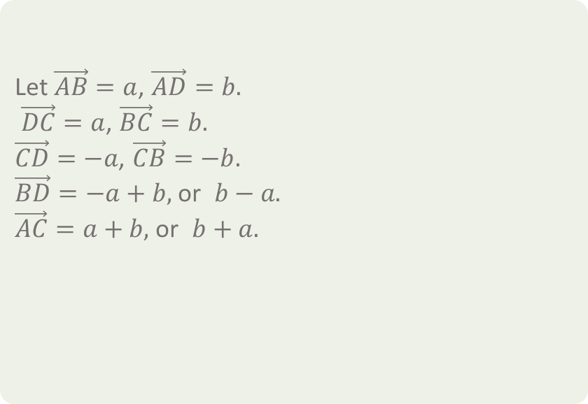
Zπ
PRACTICE
Name the Vectors
OABC is a parallelogram with OA = a and OC = c. Write each vector in terms of a and c.
B
b
C
a
-a
a
A
D
b
B
C
a
A
D
Opposite sides of a parallelogram are equal and parallel — reuse vectors you already know.
b

Slide 18



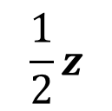
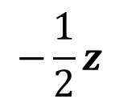

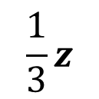
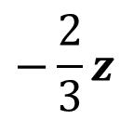

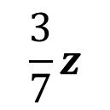
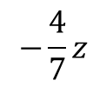

Zπ
QUICK FIRE
Splitting a Vector by Ratio
The vector z = AB. P lies on AB. Find AP and BP for each ratio AP:PB.
P
B
A
z
?
?
?
?
?
?

Slide 19







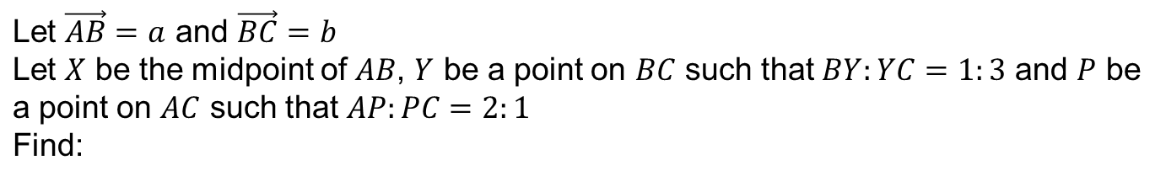
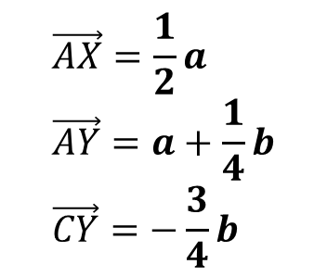
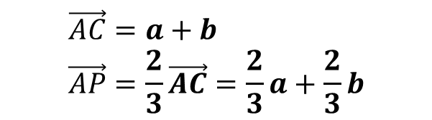
Zπ
PUTTING IT TOGETHER
Combining Portions of Vectors
?
?
?
?
?
Break the journey into stages you know, using the given ratios as fractions of each side.

Slide 20
Zπ
EXAM TECHNIQUE
How to Answer a Vector-Geometry Question
These questions look hard but follow the same routine.
Write down the vectors you are GIVEN (e.g. OA = a, OB = b).
1
Find the vector you want by travelling along known vectors.
2
Use ratios to find fractions of a line (AP:PB = 2:3 → ⅗).
3
To prove PARALLEL or a straight line: show one vector = k × another.
4
If two vectors are multiples of each other AND share a point, the three points are in a straight line.

Slide 21
Zπ
QUESTION 1
ABCD is a Parallelogram
ABCD is a parallelogram with AB = DC = p and DA = CB = q. Find: (i) DA (ii) CD (iii) DB (iv) AC (v) CA
A
p
(i) DA = q
(opposite sides parallel, equal length)
(ii) CD = −p
(opposite sides parallel, opposite dir.)
(iii) DB = q + p (via A)
= p + q (via C)
(iv) AC = p − q (via B)
(v) CA = −AC = −(p−q) = q − p
B
q
D
C
Opposite sides of a parallelogram are equal and parallel — reuse p and q to build every vector you need.

Slide 22
Zπ
QUESTION 2
AB = a, BC = b, FC = 4a, DE = 3a
Find: (i) AC (ii) FA (iii) FD (iv) DC (v) AE
a
B
A
(i) AC = a + b
(ii) FA = 4a − b − a = 3a − b
(iii) FD = b + 3a
(iv) DC = −3a − b + 4a = a − b
(v) AE = AF + b = −FA + b
= −(3a−b) + b = 2b − 3a
b
4a
F
C
b
E
D
3a
Build each unknown vector from a route of edges you already know — direction matters, so watch every sign.

Slide 23
Zπ
QUESTION 3
OABCDEF is a Regular Hexagon
→
→
→
→
→
O is the centre. Given the usual vectors a and b, and remembering opposite sides of a regular hexagon are parallel, find: (i) FC (ii) DA (iii) EB (iv) EA (v) FD
a
(i) FC = 2a
(ii) DA = −2b
(iii) EB = EF+FO+OA+AB
= −b + a − b + a
= 2a − 2b = 2(a−b)
(iv) EA = EB − a = a − 2b
(v) FD = b + a
A
B
b
F
O
C
E
D
Remember: opposite sides of a regular hexagon are parallel — use that to shortcut long routes.

Slide 24
Zπ
QUESTION 4
AB = 4p, DC = p, CB = q, M is the Midpoint of AB
Find: (i) AD (ii) CA (iii) DB (iv) CM (v) MD
4p
M
B
(i) AD = 4p − q − p = 3p − q
(ii) CA = q − 4p
(iii) DB = p + q
(iv) CM = q − 2p
(v) MD = −2p + AD
= −2p + 3p − q = p − q
A
q
D
p
C
M splits AB exactly in half, so AM = MB = 2p — use that to shortcut CM and MD.

Slide 25
Zπ
QUESTION 5
Triangle ABC, P on AC with CP:PA = 3 : 1
BA = m, CB = n. P lies on AC such that CP:PA = 3 : 1. Find BP in terms of m and n.
A
CA = n + m
CP = ¾ CA = ¾ (n + m)
BP = −n + ¾ (n + m)
= ¾ m − ¼ n or ¼(3m − n)
P
m
n
B
C
Write CP as a fraction of CA first, then travel B → C → P to reach BP.

Slide 26
Zπ
QUESTION 6
Triangle ABC, P on AC with CP:PA = 2 : 1
BA = m, CB = n. P lies on AC such that CP:PA = 2 : 1. Find BP in terms of m and n.
A
CA = n + m
CP = ⅔ CA = ⅔ (n + m)
BP = −n + ⅔ (n + m)
= ⅔ m − ⅓ n
P
m
n
B
C
Write CP as a fraction of CA first, then travel B → C → P to reach BP.

Slide 27
Zπ
SOLUTIONS · QUESTION 7
Triangle XYZ: XS = 2SZSZ, YT = 2SZTZ
S is on XZ with XS = 2SZ. T is on ZY with YT = 2SZ. Prove ST is parallel to XY.
XZ = a + b
XS = ⅔ (a + b) (since XS = 2SZSZ)
Going clockwise from S to T:
ST = −⅔(a+b) + a + ⅔b
= −⅔a − ⅔b + a + ⅔b
= ⅓a
∴ ST ∥ XY, and ⅓a means it's that fraction of XY's length.
X
a
S
Going clockwise from S to T
Z
T
b
Y
Travel S → X → Y → T (clockwise) and simplify — if only 'a' terms survive, ST is parallel to XY.

Slide 28
Zπ
PART 2
Past-Paper Questions
Write the known vectors, build a path, use ratios, then prove parallel or collinear.
1
Label OA = a, OB = b…
2
AB = b − a
3
Use the given ratio as a fraction
4
k × vector → parallel / straight line

Slide 29
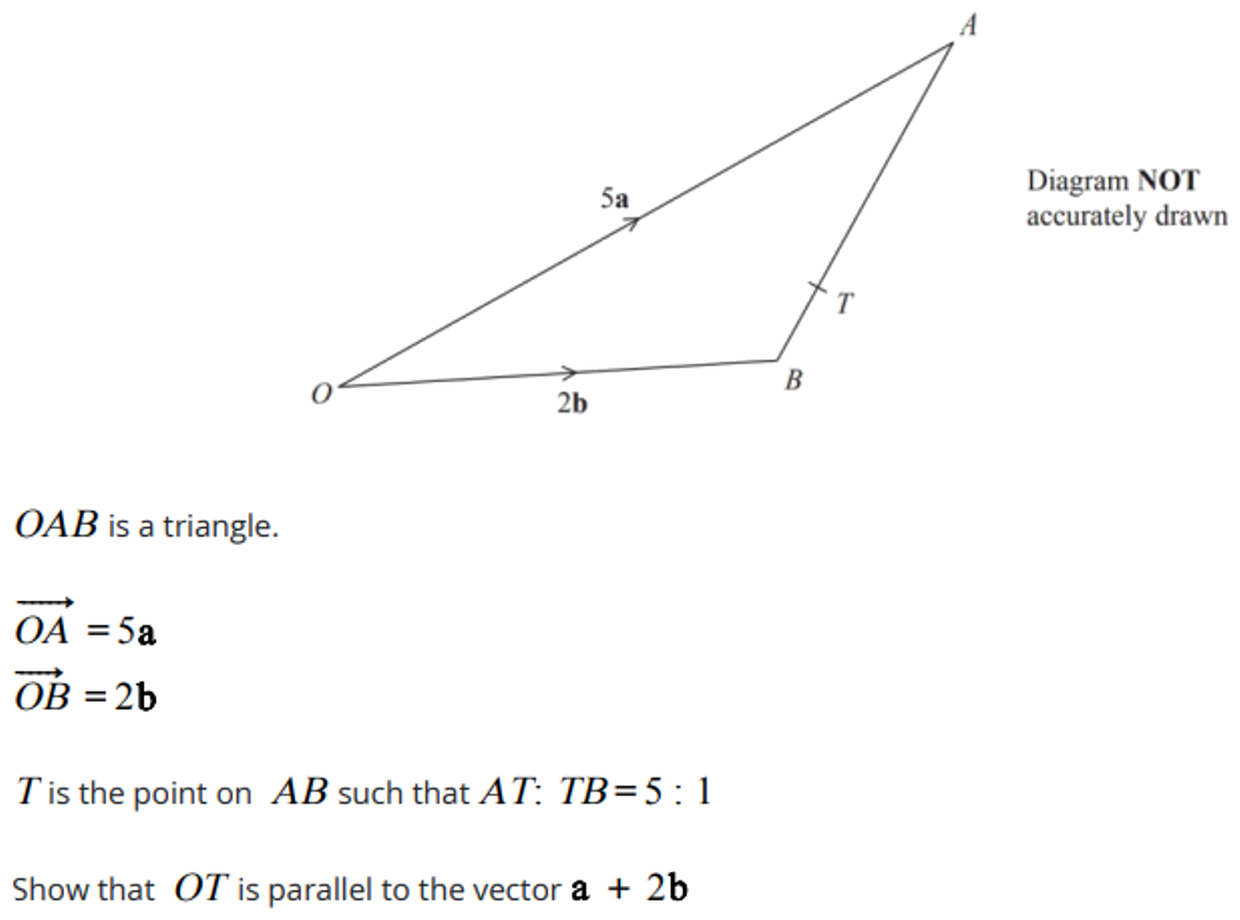
Zπ
PAST-PAPER QUESTION
Question 1

Slide 30
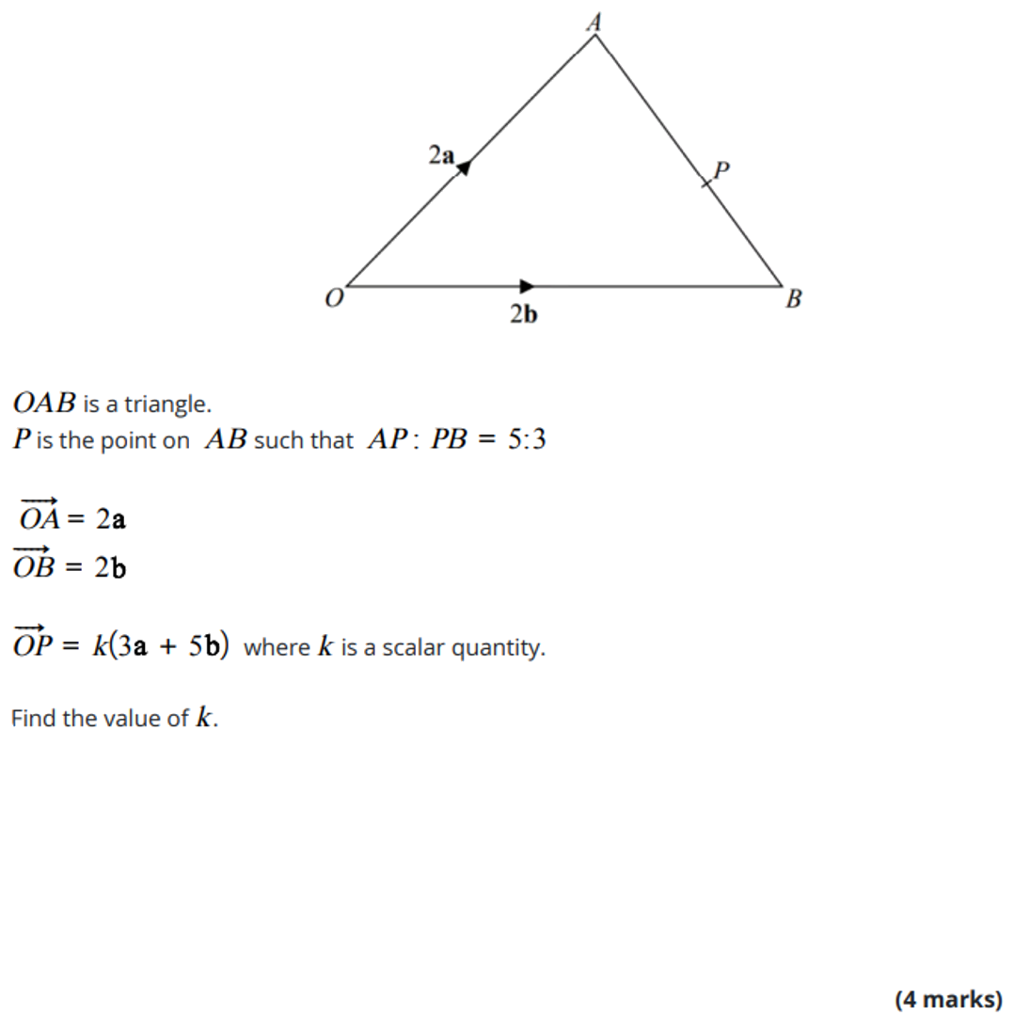
Zπ
PAST-PAPER QUESTION
Question 2

Slide 31
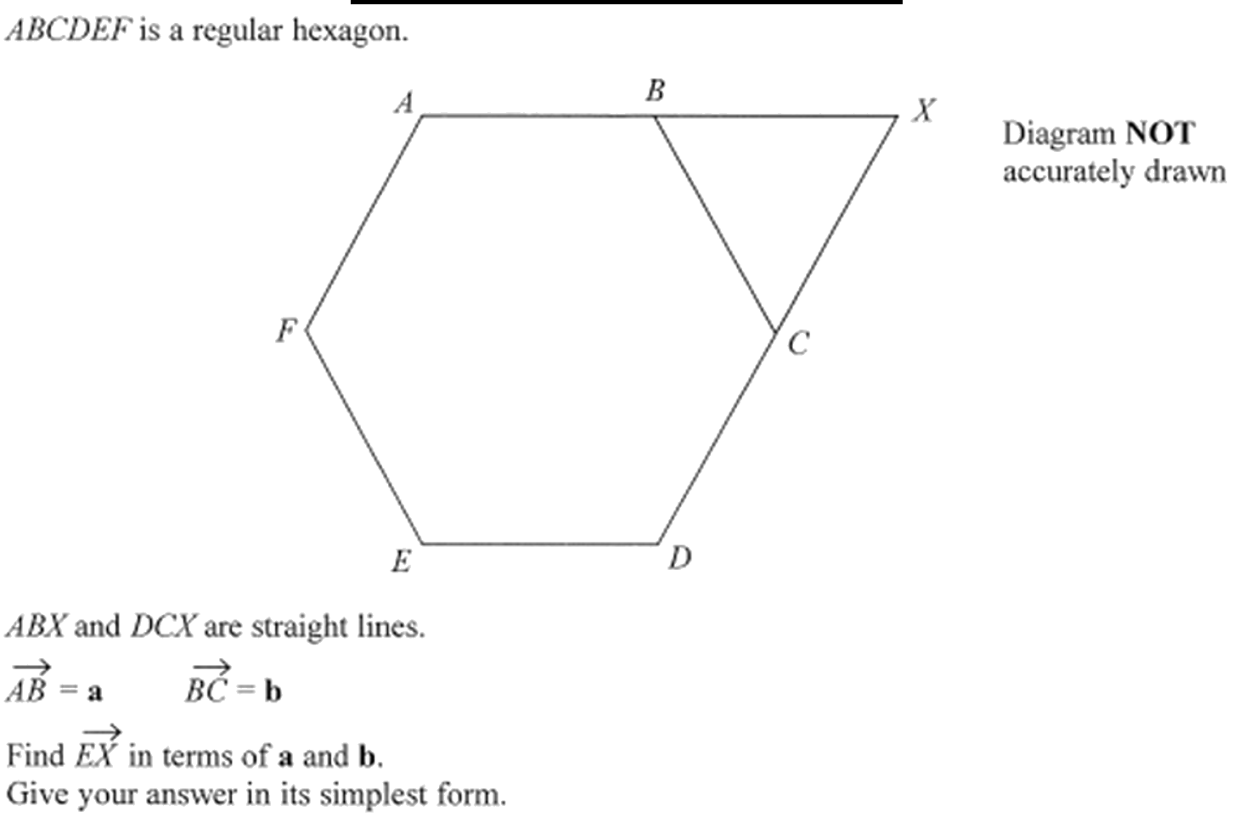
Zπ
PAST-PAPER QUESTION
Question 3

Slide 32
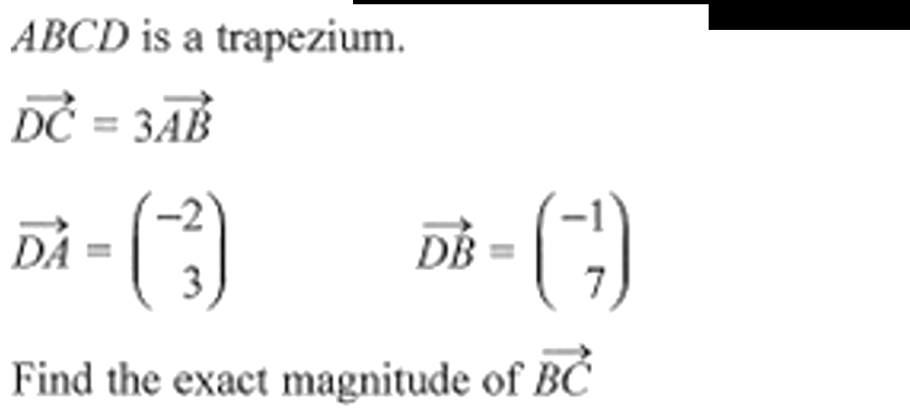
Zπ
PAST-PAPER QUESTION
Question 4

Slide 33
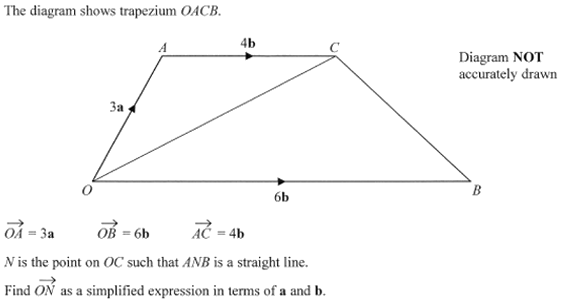
Zπ
PAST-PAPER QUESTION
Question 5

Slide 34
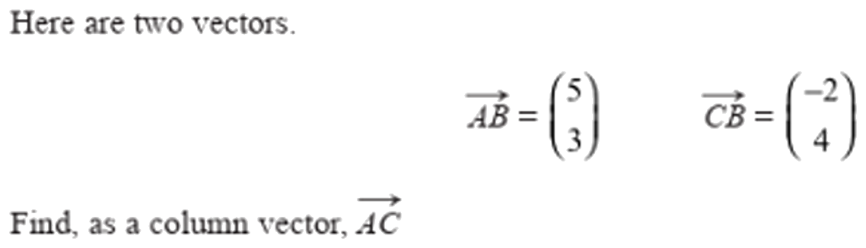
Zπ
PAST-PAPER QUESTION
Question 6

Slide 35
Zπ
RECAP
Key Takeaways
A vector has magnitude and direction; a column vector is (across, up).
Magnitude = √(x² + y²) by Pythagoras.
Add/subtract vectors component by component, or nose-to-tail.
k a is parallel to a — this proves lines parallel or points collinear.
Vector geometry: AB = b − a; build the point you need from known vectors and ratios.
Golden rule: travel along vectors you know; a scalar multiple means parallel.

