Slide 1
Zπ
Zπ MATHS HUB
Pearson Edexcel IGCSE (9–1) · Higher Tier
nth
Sequences: The nth Term
Term-to-Term & Position-to-Term · Linear (Arithmetic) Sequences · Finding & Using the nth Term
Zahra Sheikh Ali
IGCSE Mathematics Teacher · M.Sc. Differential Geometry & Geometric Control
☎ 66613748 ✉ zahraa.sheikhali@outlook.com

Slide 2
Zπ
LESSON OVERVIEW
A Rule for Every Term
A sequence is a list of numbers following a rule. The nth-term rule lets you jump straight to ANY term — the 5th, the 100th — without listing them all.
Term & position (n)
Term-to-term vs position
The common difference
1
2
3
Finding the nth term
Using the nth term
Past-paper questions
4
5
6
Key words: sequence · term · position · nth term · common difference · arithmetic · linear

Slide 3
Zπ
THE KEY IDEA
Term-to-Term vs Position-to-Term
Each number is a TERM; its place in the line is its POSITION n. There are two ways to describe a sequence.
Term-to-term
Position-to-term (nth term)
Tells you how to get the NEXT term from the one before.
2, 5, 8, 11, … → ‘add 3 each time’
Slow for far-off terms (you must build up).
A formula in n that gives ANY term directly.
nth term = 3n − 1
Put n = 100 to get the 100th term instantly.
The nth-term (position-to-term) rule is the powerful one — it works for any position n.

Slide 4
Zπ
ARITHMETIC SEQUENCES
A Constant Common Difference
An arithmetic (linear) sequence goes up or down by the SAME amount each time. That amount is the common difference, d.
6
+4
10
+4
14
+4
18
+4
22
Here the common difference is d = 4 (it increases). A decreasing sequence has a NEGATIVE d.
Find d by subtracting any term from the next one: 10 − 6 = 4, 14 − 10 = 4.

Slide 5
Zπ
FINDING THE nth TERM
nth term = dn + (first term − d)
1
Sequence 6, 10, 14, 18, …
Quick method
The number in front of n is the common difference d.
Then adjust by a constant to match the first term.
Formula: nth term = dn + (a − d).
Check with n = 1 and n = 2.
2
Common difference d = 4, so start with 4n.
3
Check 4n at n = 1: 4 — but we need 6, so add 2.
4
nth term = 4n + 2
nth term = 4n + 2 (check: n=1 → 6 ✓, n=2 → 10 ✓)
For a decreasing sequence d is negative, e.g. 85, 79, 73 → −6n + 91.

Slide 6
Zπ
USING THE nth TERM
Find Any Term, or Test a Number
1
Sequence has nth term = 4n + 2.
Two common tasks
Find a term → substitute the position n.
Test a value → set the rule equal to it and solve.
A whole-number n means the value IS in the sequence.
A fraction or negative n means it is NOT.
2
100th term: 4(100) + 2 = 402
3
Is 87 in the sequence? Solve 4n + 2 = 87
4
4n = 85 → n = 21.25 — not a whole number, so NO
Substitute n to find a term; solve for n to test a value
n must be a positive whole number — you cannot have the 21.25th term.

Slide 7
Zπ
PART 2
Past-Paper Questions
Find the common difference, then the nth-term rule dn + (a − d).
1
Find the common difference d
2
nth term = dn + (a − d)
3
Check with n = 1
4
Use it to find or test a term

Slide 8
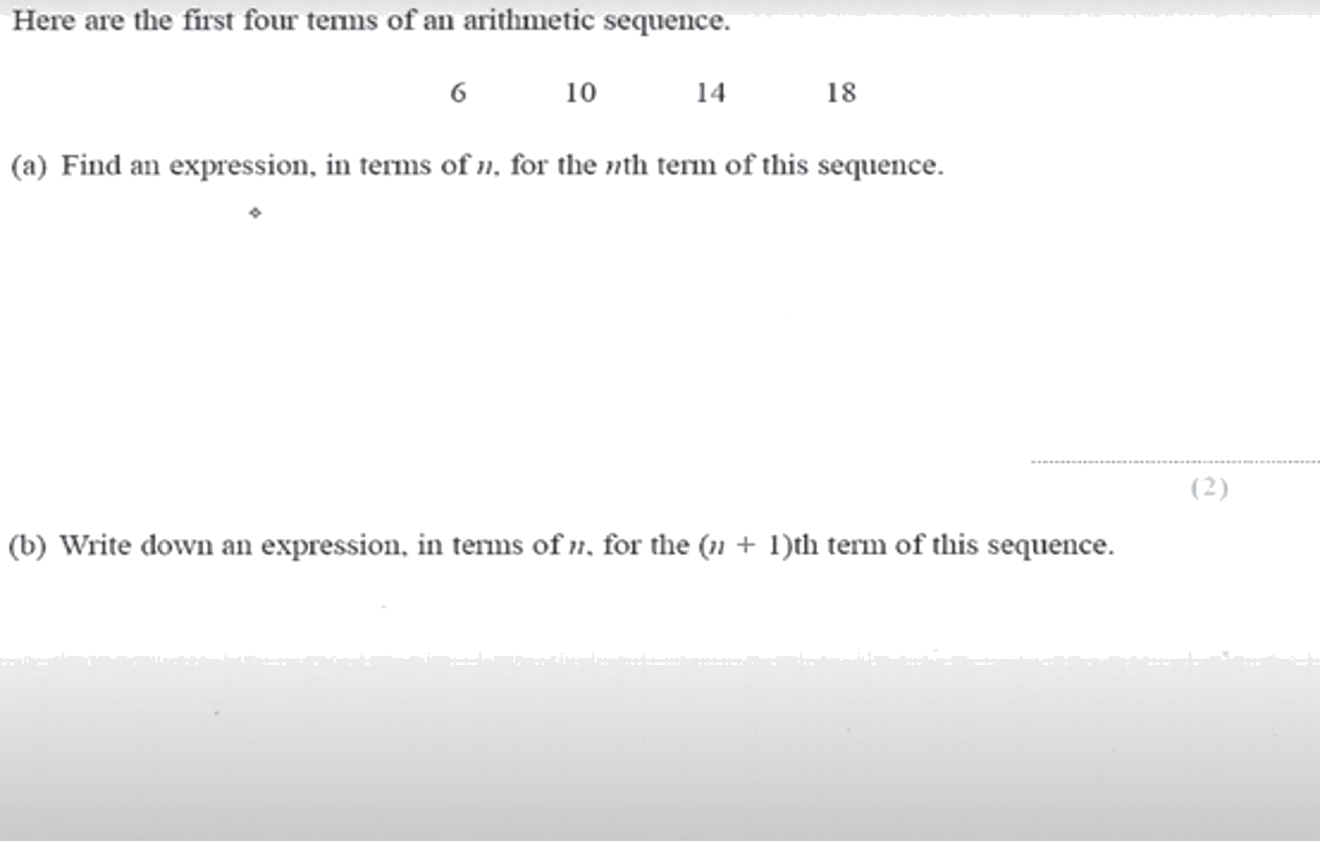
Zπ
PAST-PAPER QUESTION
Question 1

Slide 9
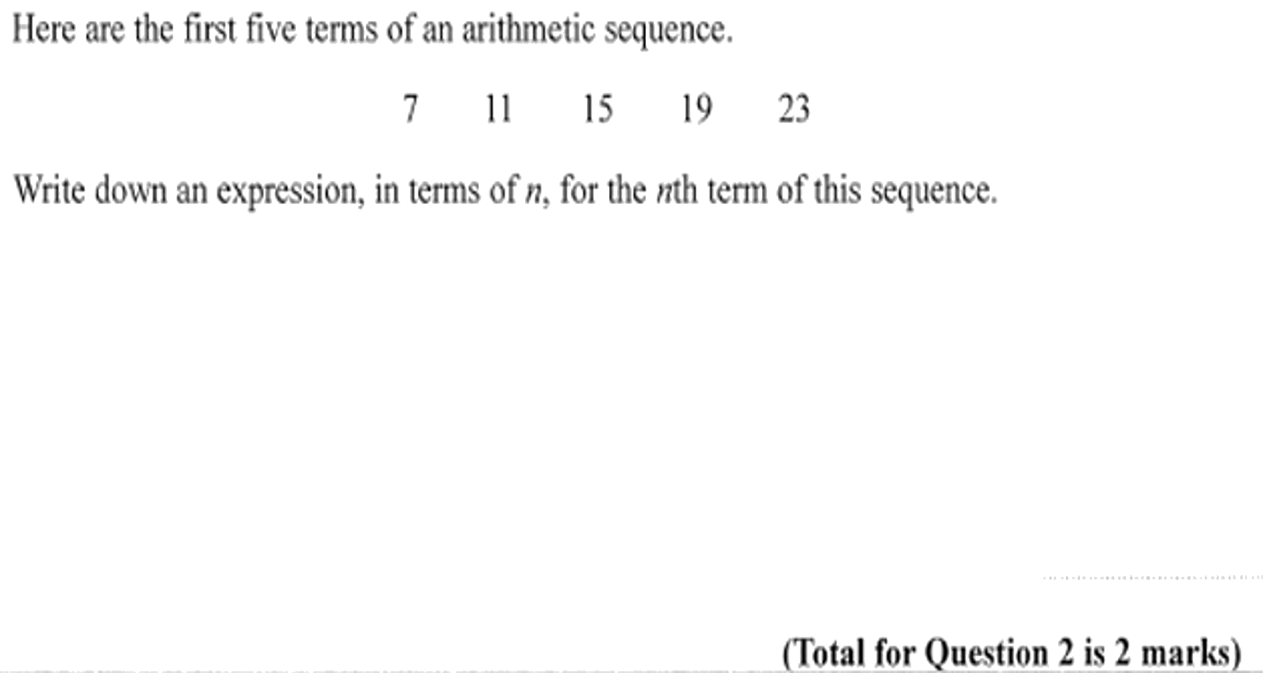
Zπ
PAST-PAPER QUESTION
Question 2

Slide 10
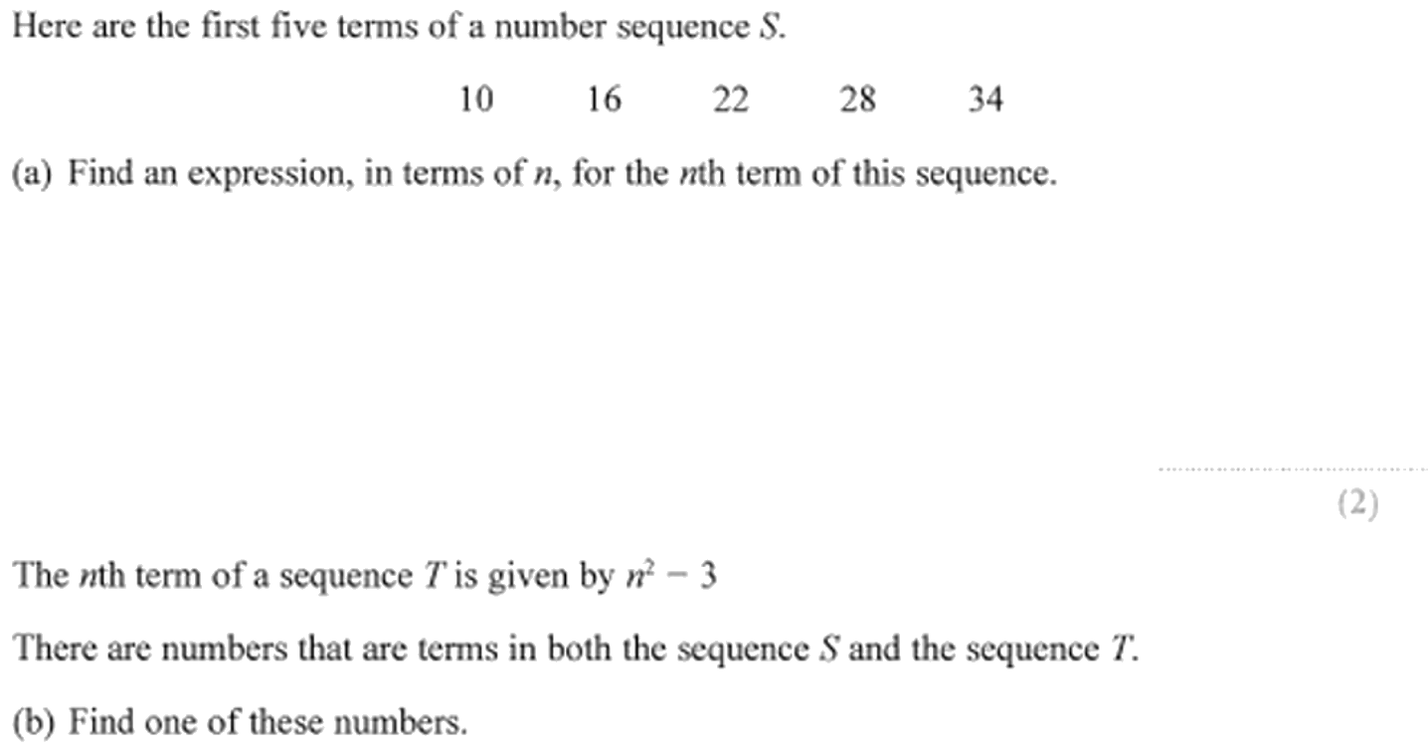
Zπ
PAST-PAPER QUESTION
Question 3

Slide 11
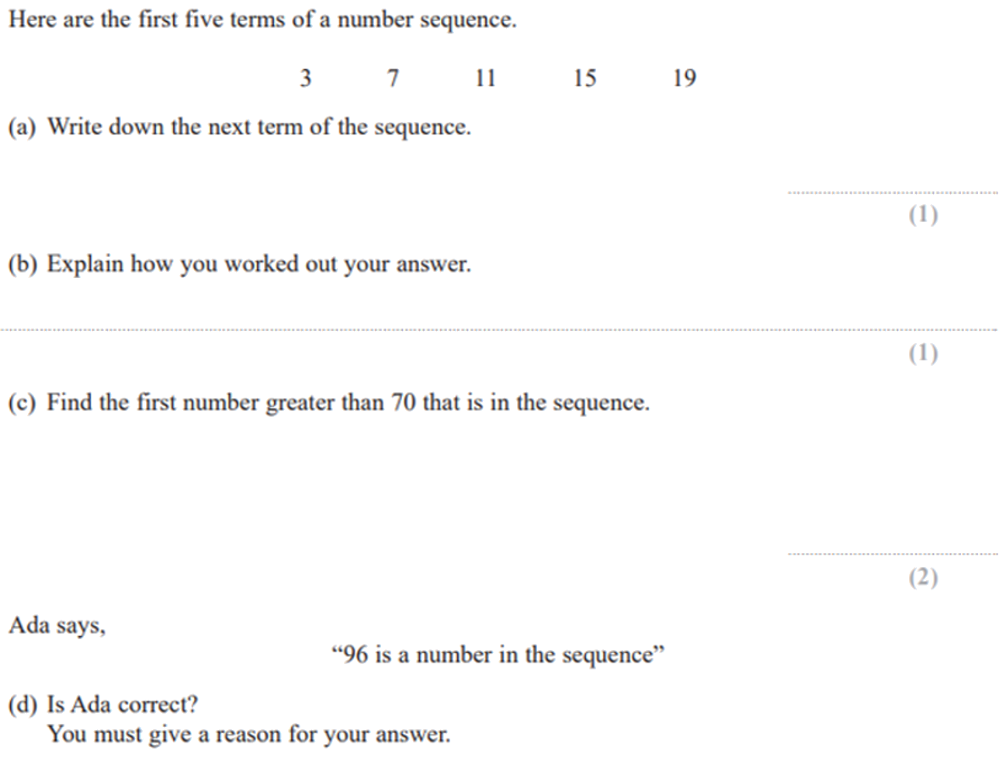
Zπ
PAST-PAPER QUESTION
Question 4

Slide 12
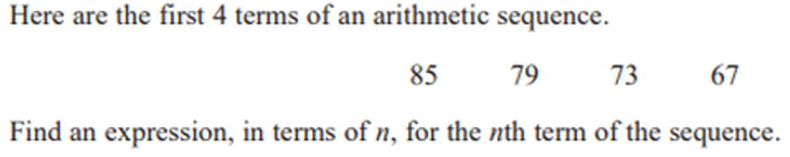
Zπ
PAST-PAPER QUESTION
Question 5

Slide 13
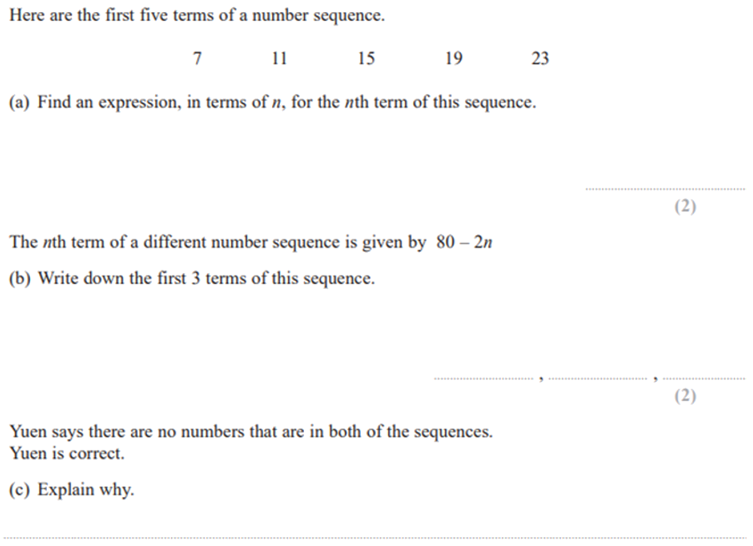
Zπ
PAST-PAPER QUESTION
Question 6

Slide 14
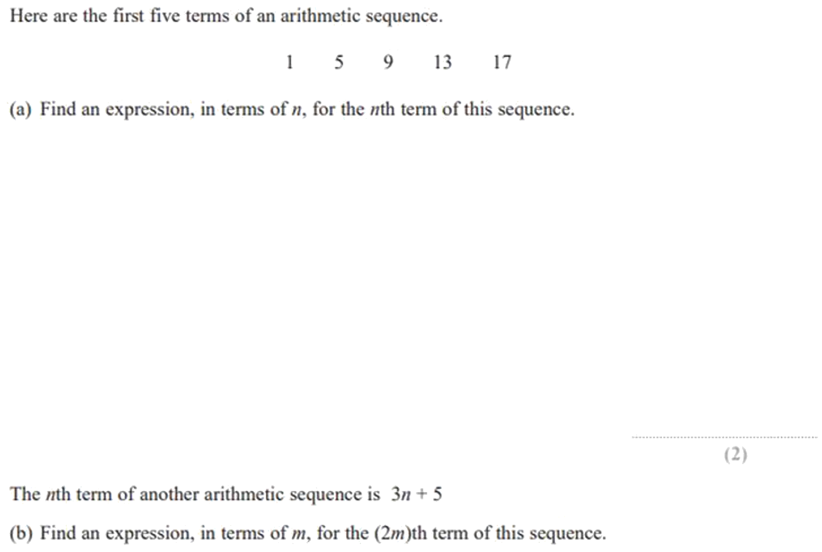
Zπ
PAST-PAPER QUESTION
Question 7

Slide 15
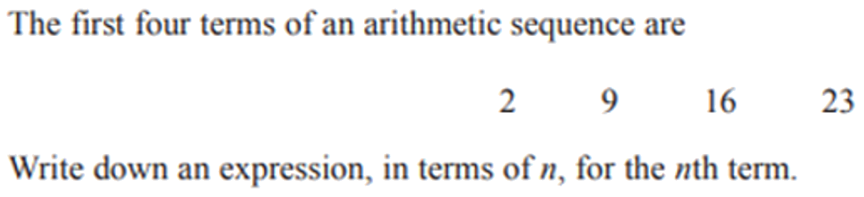
Zπ
PAST-PAPER QUESTION
Question 8

Slide 16
Zπ
RECAP
Key Takeaways
A sequence follows a rule; each number is a term at position n.
Term-to-term describes the step; the nth-term rule gives any term directly.
Arithmetic sequences have a constant common difference d.
nth term = dn + (first term − d) — the coefficient of n is d.
Substitute n to find a term; solve the rule = value to test if a number is in the sequence.
Golden rule: the number in front of n is the common difference; adjust to match the first term.

