Slide 1
Zπ
Zπ MATHS HUB
Pearson Edexcel IGCSE (9–1) · Higher Tier
Σ
Arithmetic Series: Sum
The Sum Formula · nth Term · Number of Terms · Finding a and d · Summation Notation
Zahra Sheikh Ali
IGCSE Mathematics Teacher · M.Sc. Differential Geometry & Geometric Control
☎ 66613748 ✉ zahraa.sheikhali@outlook.com

Slide 2
Zπ
LESSON OVERVIEW
Adding Up an Arithmetic Sequence
A SERIES is what you get when you ADD the terms of a sequence. For an arithmetic sequence there is a neat formula, so you never add hundreds of terms by hand.
The two key formulas
nth term = a + (n−1)d
Sum of n terms
1
2
3
Number of terms
Finding a and d
Past-paper questions
4
5
6
Key words: series · sum · first term a · common difference d · Sn · nth term · summation Σ

Slide 3
Zπ
THE KEY FORMULAS
Learn These Two
a = first term, d = common difference, n = number of terms, l = last term.
nth term
Sum of the first n terms
a_{n} = a + (n − 1) d
S
=
n
[ 2a + (n − 1) d ]
n
2
The value of the term in position n.
n
or S_{n} =
( a + l )
e.g. a = 7, d = 3: a₁₀ = 7 + 9×3 = 34
2
(use a + l when you know the LAST term l)
nth term: a + (n−1)d. Sum: n/2 [2a + (n−1)d] = n/2 (first + last).

Slide 4
Zπ
WORKED EXAMPLE
Sum of the First 100 Terms
1
Series 7, 10, 13, 16, 19, … so a = 7, d = 3, n = 100.
Method
Write down a, d and n.
Substitute into Sn = n/2[2a + (n−1)d].
Work out the bracket first, then multiply.
Double-check n is the number of terms.
2
S₁₀₀ = (100/2) [ 2(7) + (100 − 1)(3) ]
3
= 50 [ 14 + 297 ] = 50 × 311
4
= 15 550
S₁₀₀ = 15 550
If you know the last term, n/2 (first + last) is quicker.

Slide 5
Zπ
NUMBER OF TERMS
How Many Terms Are There?
Before summing, you often need n. Use the last term with aₙ = a + (n − 1)d and solve for n.
Example
Then find the sum
How many terms in 5, 8, 11, …, 92?
a = 5, d = 3, last term = 92
92 = 5 + (n − 1)(3)
87 = 3(n − 1) → n − 1 = 29
n = 30 terms
Now use n = 30:
S₃₀ = (30/2)(5 + 92)
= 15 × 97 = 1455
(using n/2 (first + last), since we know both ends)
Find n from the last term, THEN put it into the sum formula.

Slide 6
Zπ
FINDING a AND d
Two Facts → Two Equations
1
Given: the 25th term is 44.5 and S₃₀ = 765.
Method
Turn each fact into an equation in a and d.
Use aₙ = a + (n−1)d for a term.
Use Sn = n/2[2a + (n−1)d] for a sum.
Solve the two equations together.
2
a₂₅: a + 24d = 44.5
3
S₃₀: (30/2)[2a + 29d] = 765 → 2a + 29d = 51
4
Solve the pair simultaneously to find a and d.
A term gives one equation; a sum gives another — solve simultaneously
This is the most common harder exam question — always form two equations.

Slide 7
Zπ
SUMMATION NOTATION
The Σ Symbol
Σ (sigma) means ‘add up’. The numbers below and above tell you where to start and stop.
10
Σ
How to read it
(3n + 1)
‘Add up 3n + 1 for n = 1 up to n = 10.’
• Bottom (n = 1): where to start.
• Top (10): where to stop.
• The expression: the term rule.
It is an arithmetic series (a = 4, d = 3, n = 10) — use the sum formula.
n = 1
Work out the first term and common difference, then apply Sn = n/2 [2a + (n − 1)d].

Slide 8
Zπ
PART 2
Past-Paper Questions
Turn each fact into an equation, then use the sum and nth-term formulas.
1
aₙ = a + (n − 1)d
2
Sn = n/2 [2a + (n − 1)d]
3
Two facts → two equations
4
Solve for a, d or n

Slide 9
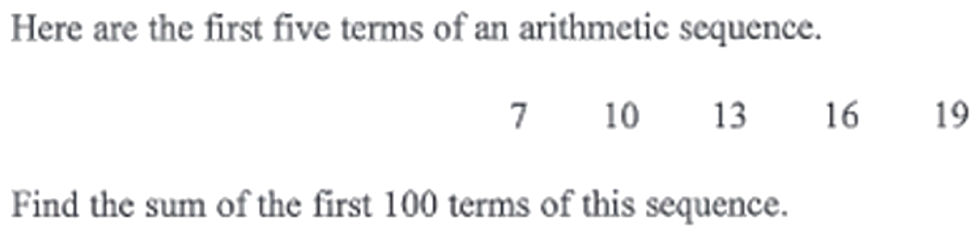
Zπ
PAST-PAPER QUESTION
Question 1

Slide 10
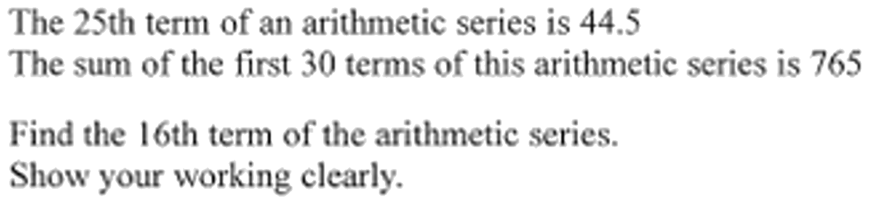
Zπ
PAST-PAPER QUESTION
Question 2

Slide 11
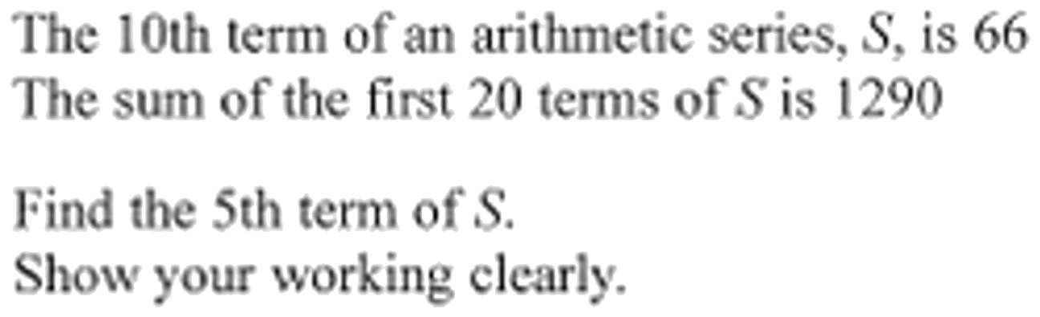
Zπ
PAST-PAPER QUESTION
Question 3

Slide 12
Zπ
PAST-PAPER QUESTION
Question 4

Slide 13
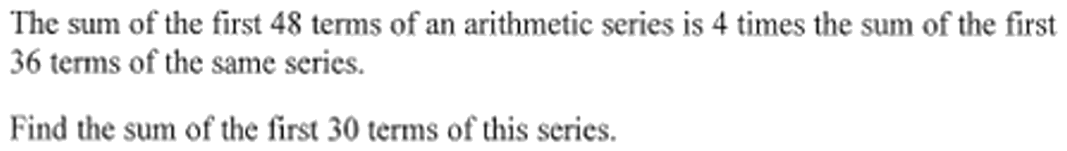
Zπ
PAST-PAPER QUESTION
Question 5

Slide 14
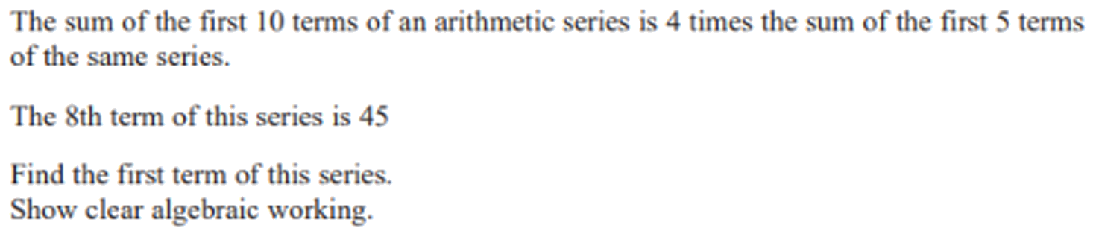
Zπ
PAST-PAPER QUESTION
Question 6

Slide 15
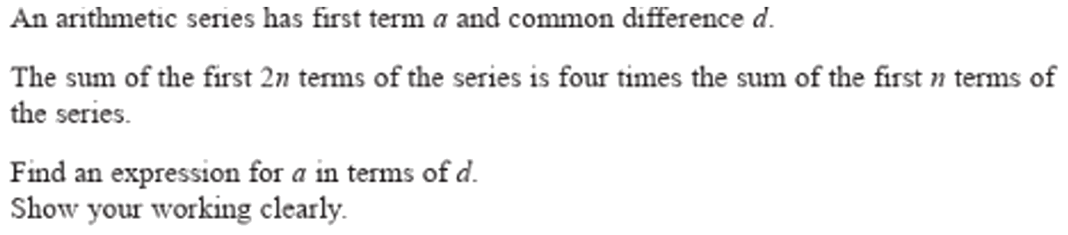
Zπ
PAST-PAPER QUESTION
Question 7

Slide 16
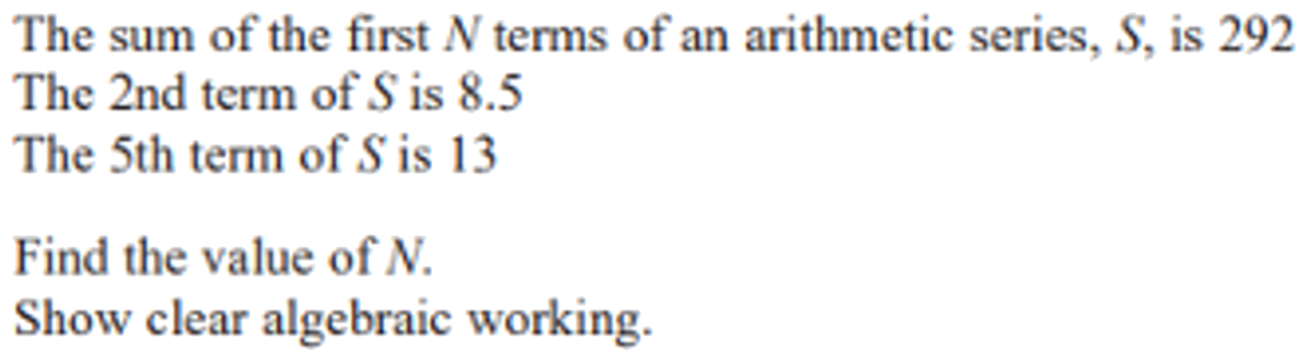
Zπ
PAST-PAPER QUESTION
Question 8

Slide 17
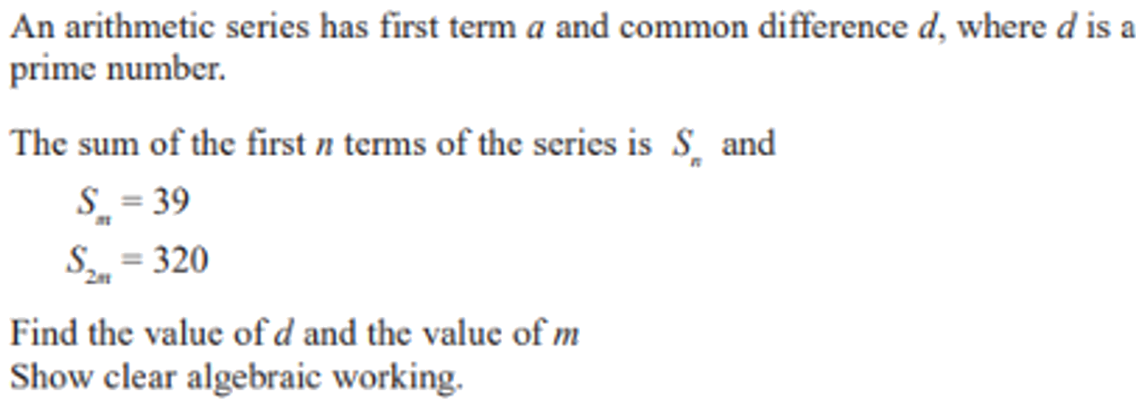
Zπ
PAST-PAPER QUESTION
Question 9

Slide 18
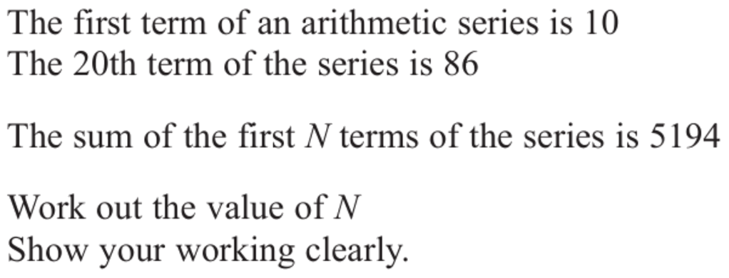
Zπ
PAST-PAPER QUESTION
Question 10

Slide 19
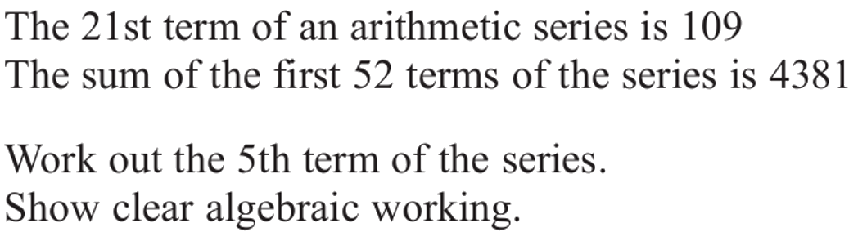
Zπ
PAST-PAPER QUESTION
Question 11

Slide 20
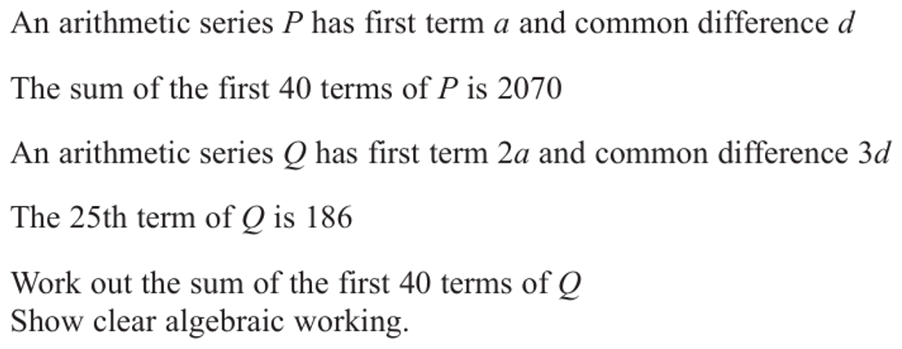
Zπ
PAST-PAPER QUESTION
Question 12

Slide 21
Zπ
RECAP
Key Takeaways
A series is the SUM of the terms of a sequence.
nth term: aₙ = a + (n − 1)d.
Sum of n terms: Sn = n/2 [2a + (n − 1)d] = n/2 (first + last).
Find the number of terms from the last term before summing.
Given a term and a sum, form two equations in a and d and solve simultaneously.
Golden rule: every fact becomes an equation in a and d — then solve.

