Slide 1
Zπ
Zπ MATHS HUB
ξ
Pearson Edexcel IGCSE (9–1) · Higher Tier
A
B
Sets & Venn Diagrams
Set Notation · Elements · Intersection · Union · Complement · Solving Problems
Zahra Sheikh Ali
IGCSE Mathematics Teacher · M.Sc. Differential Geometry & Geometric Control
☎ 66613748 ✉ zahraa.sheikhali@outlook.com

Slide 2
Zπ
LESSON OVERVIEW
Sorting Things into Groups
A SET is a collection of objects, and a VENN DIAGRAM shows how sets overlap. Learn the notation, then you can read and complete any Venn diagram.
Sets & notation
The key symbols
Intersection (∩)
1
2
3
Union (∪)
Complement (A′)
Past-paper questions
4
5
6
Key words: set · element · universal set ξ · intersection · union · complement · subset · empty set

Slide 3
Zπ
THE KEY IDEA
Sets and Their Elements
A set is a collection of objects, written in curly brackets { }. Each object in the set is called an ELEMENT.
Writing a set
The universal set ξ
A = {1, 2, 3, 4, 5}
The elements are 1, 2, 3, 4 and 5.
n(A) = 5 (five elements).
ξ is EVERYTHING being considered.
e.g. ξ = {whole numbers 1 to 10}.
Every set sits inside ξ — the rectangle on a Venn diagram.
3 ∈ A means ‘3 is an element of A’; 6 ∉ A means ‘6 is NOT in A’.

Slide 4
Zπ
SET NOTATION
The Symbols You Must Know
These come up in every exam — learn what each one means.
Symbol
Meaning
Example
ξ
the universal set (everything)
all values considered
∈
is an element of
3 ∈ {1, 2, 3}
∉
is NOT an element of
5 ∉ {1, 2, 3}
n(A)
number of elements in A
n({2,4,6}) = 3
A ∪ B
union — in A OR B (or both)
everything in the circles
A ∩ B
intersection — in A AND B
only the overlap
A′
complement — NOT in A
everything outside A
∅ or { }
the empty set
no elements

Slide 5
Zπ
VENN DIAGRAMS
Reading the Regions
The rectangle is the universal set ξ. Each circle is a set. Numbers go in the region they belong to.
ξ
The four regions
In A only (left part of A).
A
B
In B only (right part of B).
In BOTH — the overlap (A ∩ B).
In NEITHER — outside both circles.
Anything not in A or B still belongs to ξ — it goes in the rectangle, outside the circles.

Slide 6
Zπ
INTERSECTION
A ∩ B — in Both (AND)
The intersection is the OVERLAP — elements in A AND B. Only what is shared by both sets.
ξ
Example
A = {1, 2, 3, 4, 5}
B = {1, 3, 5, 7, 9}
A ∩ B = {1, 3, 5}
Only the numbers in BOTH lists.
A
B
∩ = intersection = AND = the overlap only.

Slide 7
Zπ
UNION
A ∪ B — in Either (OR)
The union is EVERYTHING in A or B (or both). Put every element in, but do not list repeats twice.
ξ
Example
A = {1, 2, 3, 4, 5}
B = {1, 3, 5, 7, 9}
A ∪ B = {1, 2, 3, 4, 5, 7, 9}
All elements, each written once.
A
B
∪ = union = OR = both circles altogether.

Slide 8
Zπ
COMPLEMENT
A′ — Everything NOT in A
The complement A′ is all elements of ξ that are NOT in A. Everything outside the circle.
ξ
Example
ξ = {1, 2, 3, 4, 5, 6}
A = {2, 4, 6}
A′ = {1, 3, 5}
Everything in ξ that is not in A.
A
B
A′ = complement = NOT in A. (A ∩ B)′ means ‘not in the overlap’.

Slide 9
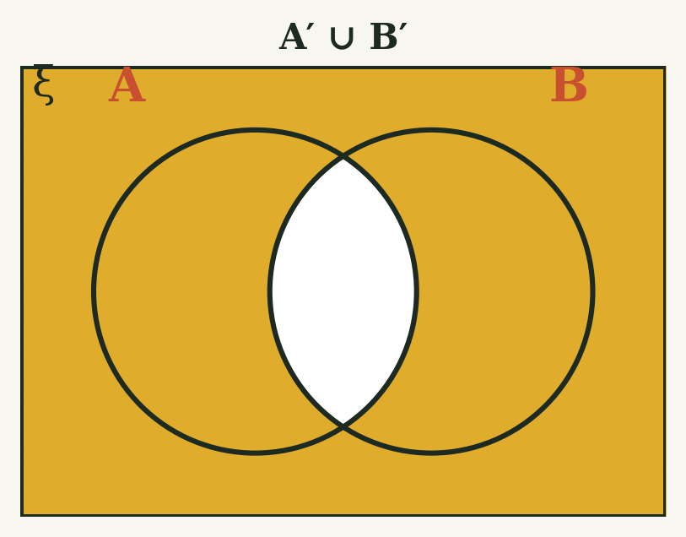
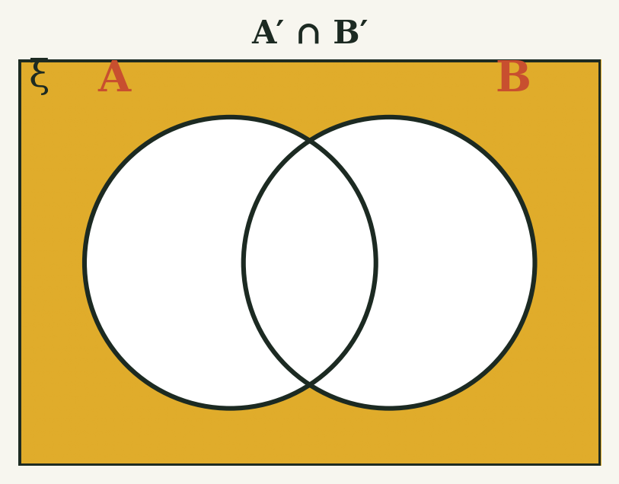
Zπ
COMPLEMENT · COMPOUND REGIONS
Shading A′ ∪ B′ and A′ ∩ B′
Combine NOT with AND/OR: shade region by region, then check for overlap between the two conditions.
A′ ∪ B′ = everything except the overlap
A′ ∩ B′ = outside both circles
A′ ∩ B′ is always OUTSIDE both circles — it can never include any part of A or B.

Slide 10
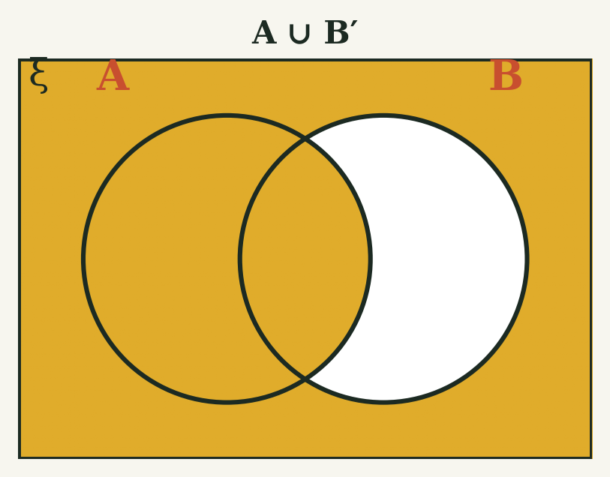
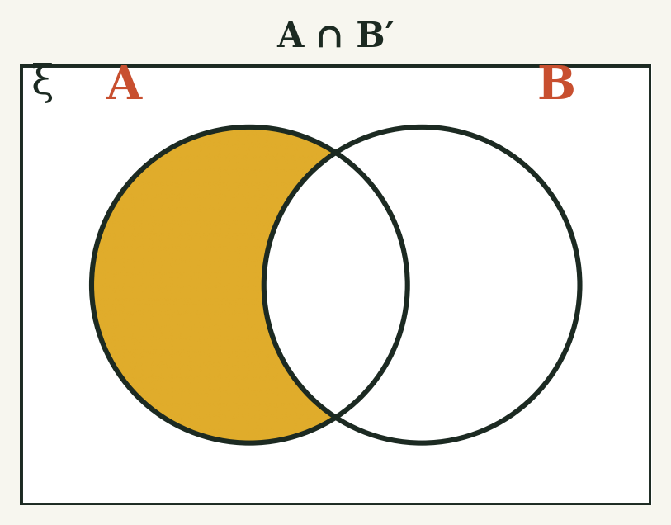
Zπ
COMPLEMENT · COMPOUND REGIONS
Shading A ∪ B′ and A ∩ B′
Only one set is complemented here: work out NOT B first, then combine it with A using OR or AND.
A ∪ B′ = everything except ‘B only’
A ∩ B′ = ‘A only’ region
A ∩ B′ is the ‘A only’ crescent — inside A, but outside B.

Slide 11
Zπ
SOLVING PROBLEMS
Completing a Venn Diagram
Always fill in the OVERLAP first. Then work outwards so each region is counted once.
Put the number in A ∩ B (the overlap) FIRST.
1
Subtract it to find ‘A only’ and ‘B only’.
2
Fill in anything outside both circles (in ξ, not in A or B).
3
Check every region adds up to the total, n(ξ).
4
For a probability, divide the number in the region you want by the total n(ξ).

Slide 12
Zπ
SOLVING PROBLEMS · WORKED EXAMPLE
The Science Club
Apply the method: fill the overlap first, then work outwards to find each region.
ξ
1
1) Both brown hair and glasses?
Brown hair
Glasses
2) Neither brown hair nor glasses?
4
3
1
2
3) Brown hair (total)?
3 + 1 = 4
4) Glasses (total)?
1 + 2 = 3
4
5) Total members in the club?
3+1+2+4 = 10
Overlap first (1), then subtract to find each ‘only’ region, then whatever is left goes outside.

Slide 13
Zπ
PART 2
Past-Paper Questions
Read the notation, fill the overlap first, then list or count each region.
1
∩ = AND (overlap); ∪ = OR (all)
2
A′ = everything not in A
3
Fill the overlap first
4
Regions add up to n(ξ)

Slide 14
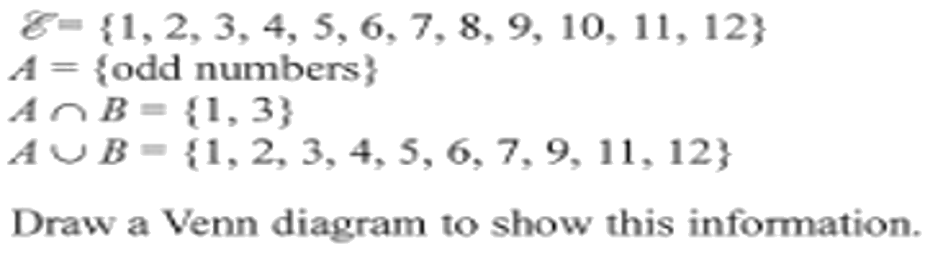
Zπ
PAST-PAPER QUESTION
Question 1

Slide 15
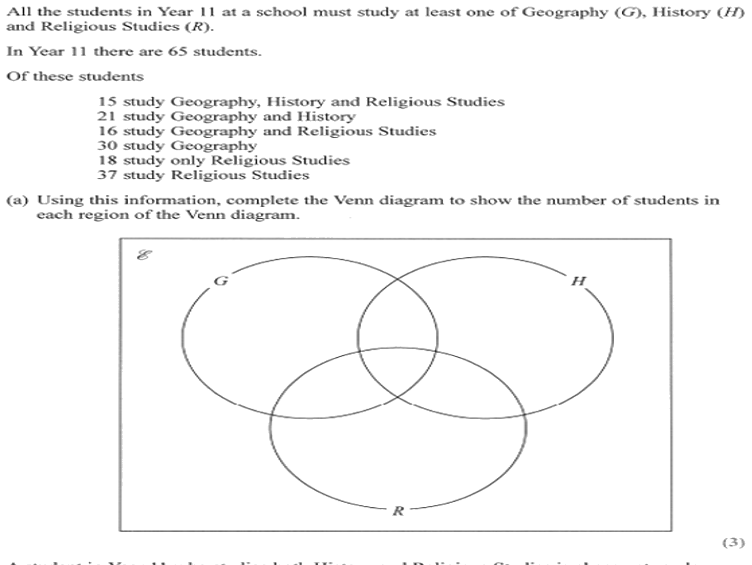
Zπ
PAST-PAPER QUESTION
Question 2

Slide 16
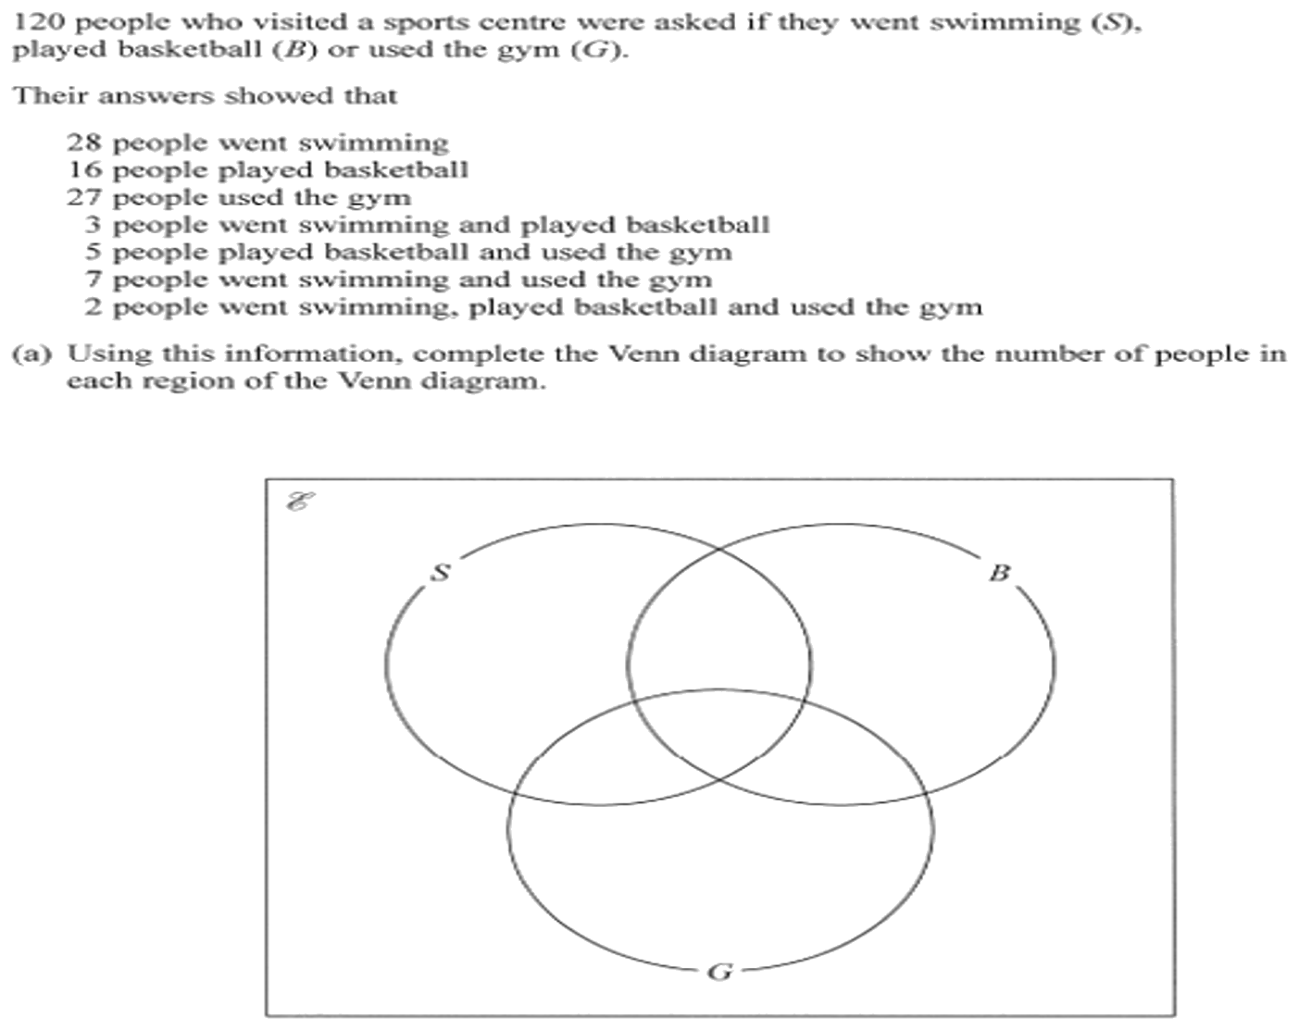
Zπ
PAST-PAPER QUESTION
Question 3

Slide 17
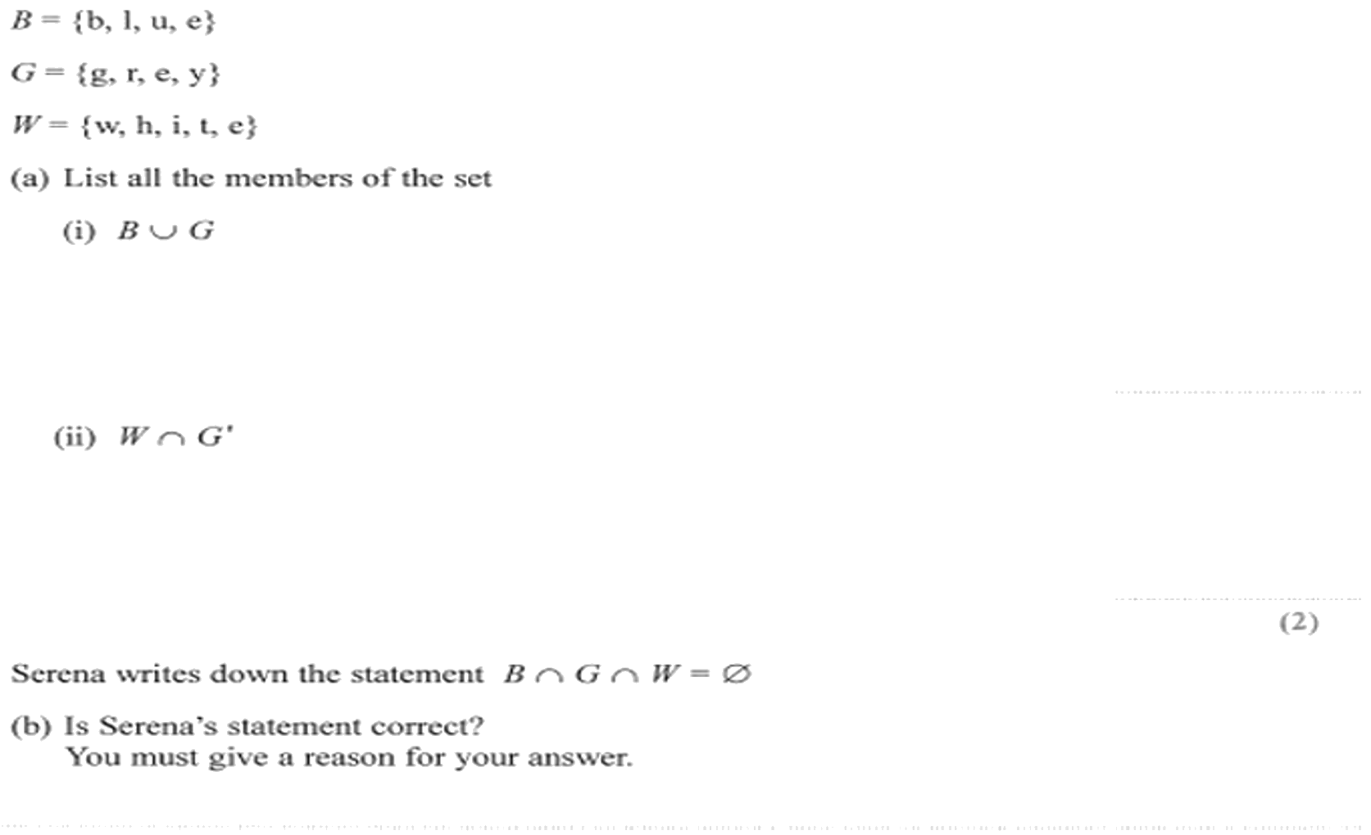
Zπ
PAST-PAPER QUESTION
Question 4

Slide 18
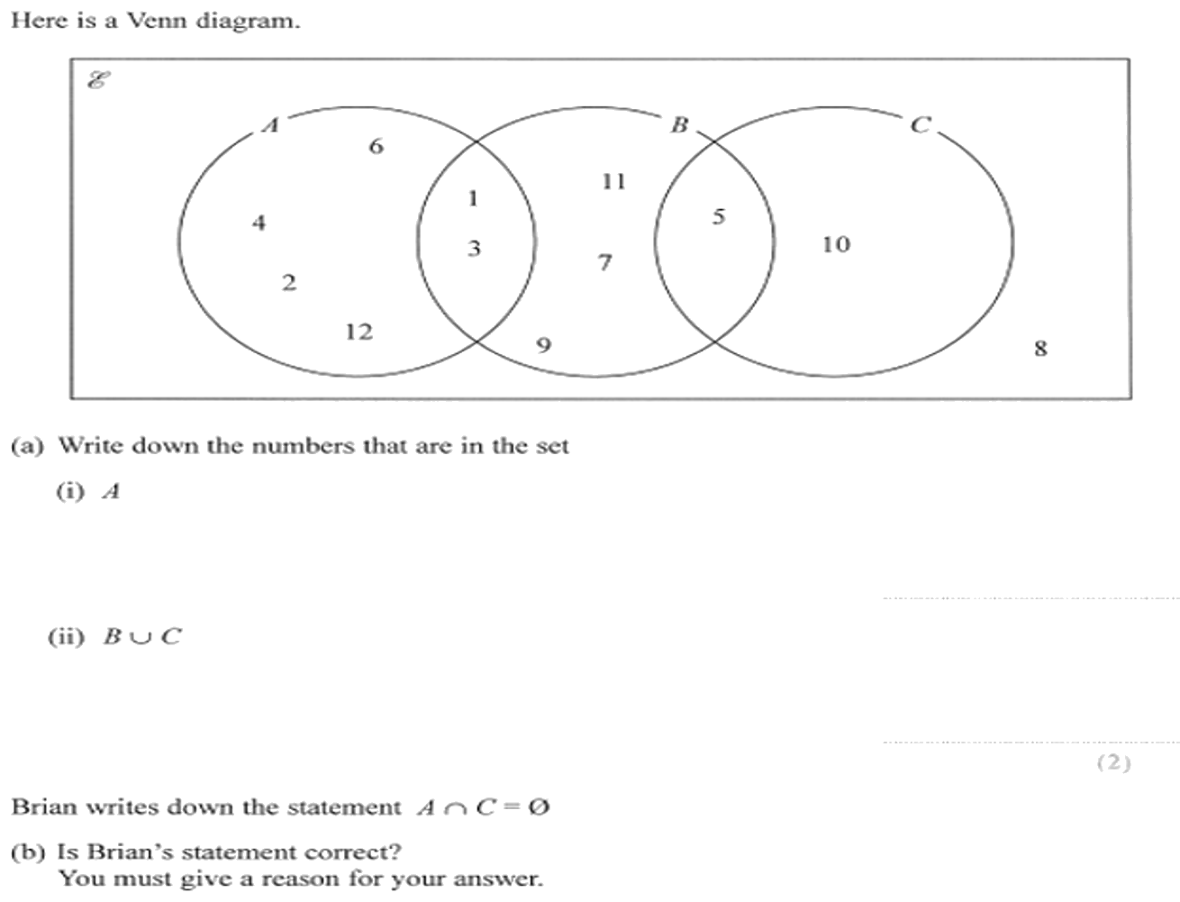
Zπ
PAST-PAPER QUESTION
Question 5

Slide 19
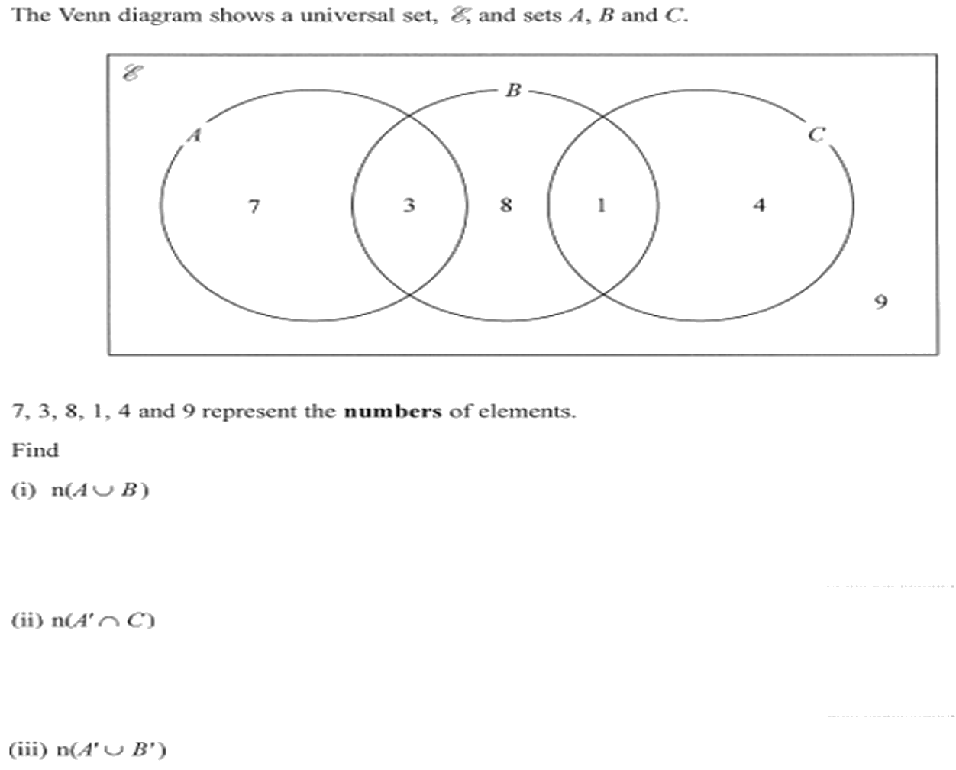
Zπ
PAST-PAPER QUESTION
Question 6

Slide 20
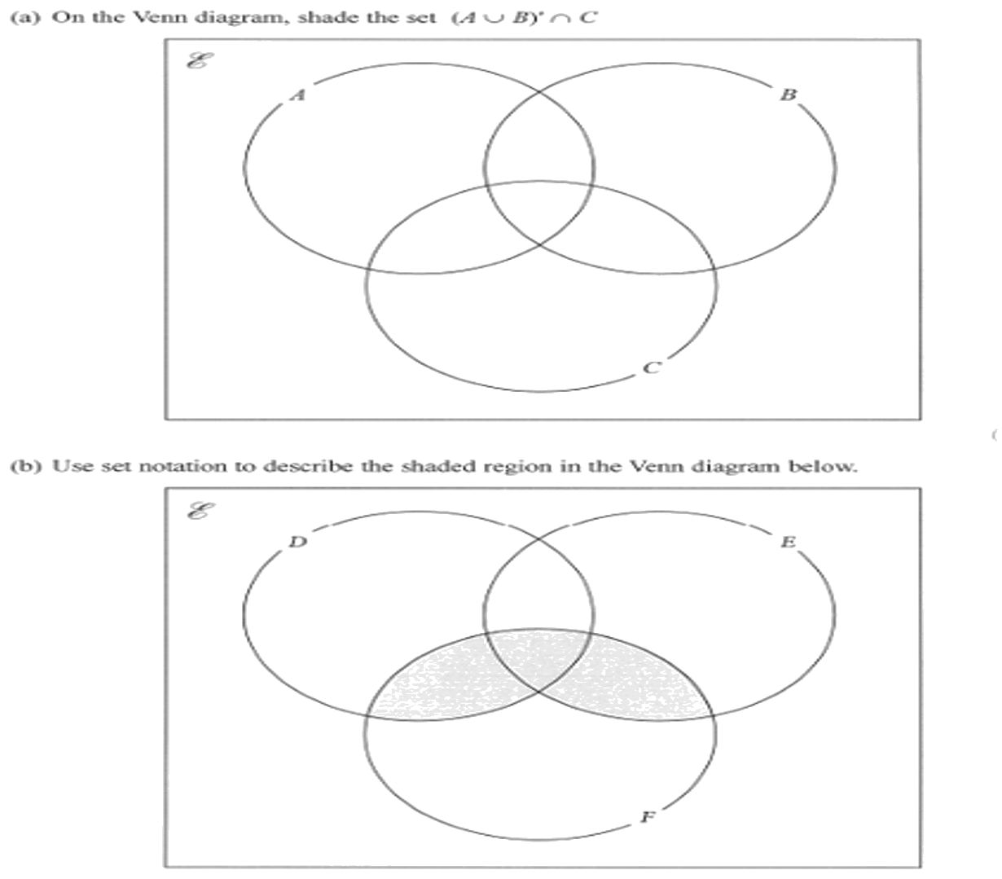
Zπ
PAST-PAPER QUESTION
Question 7

Slide 21
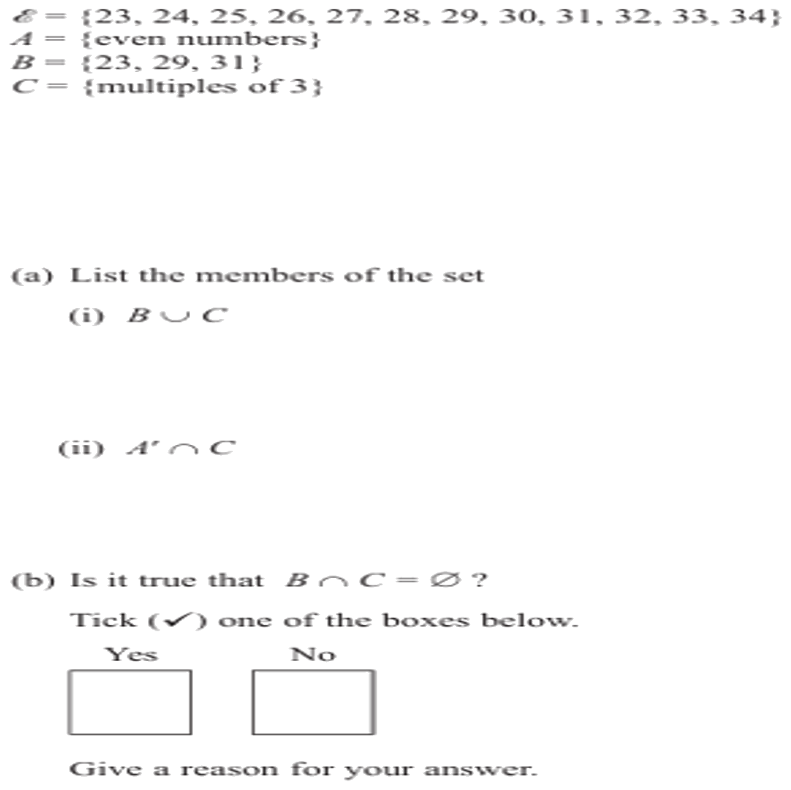
Zπ
PAST-PAPER QUESTION
Question 8

Slide 22
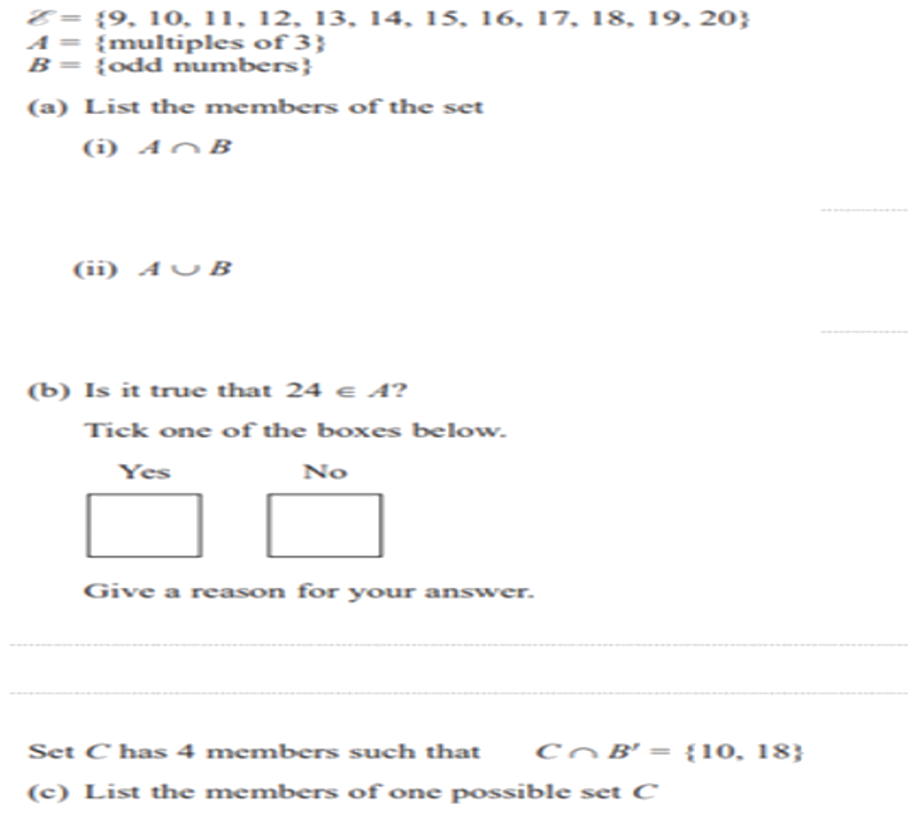
Zπ
PAST-PAPER QUESTION
Question 9

Slide 23
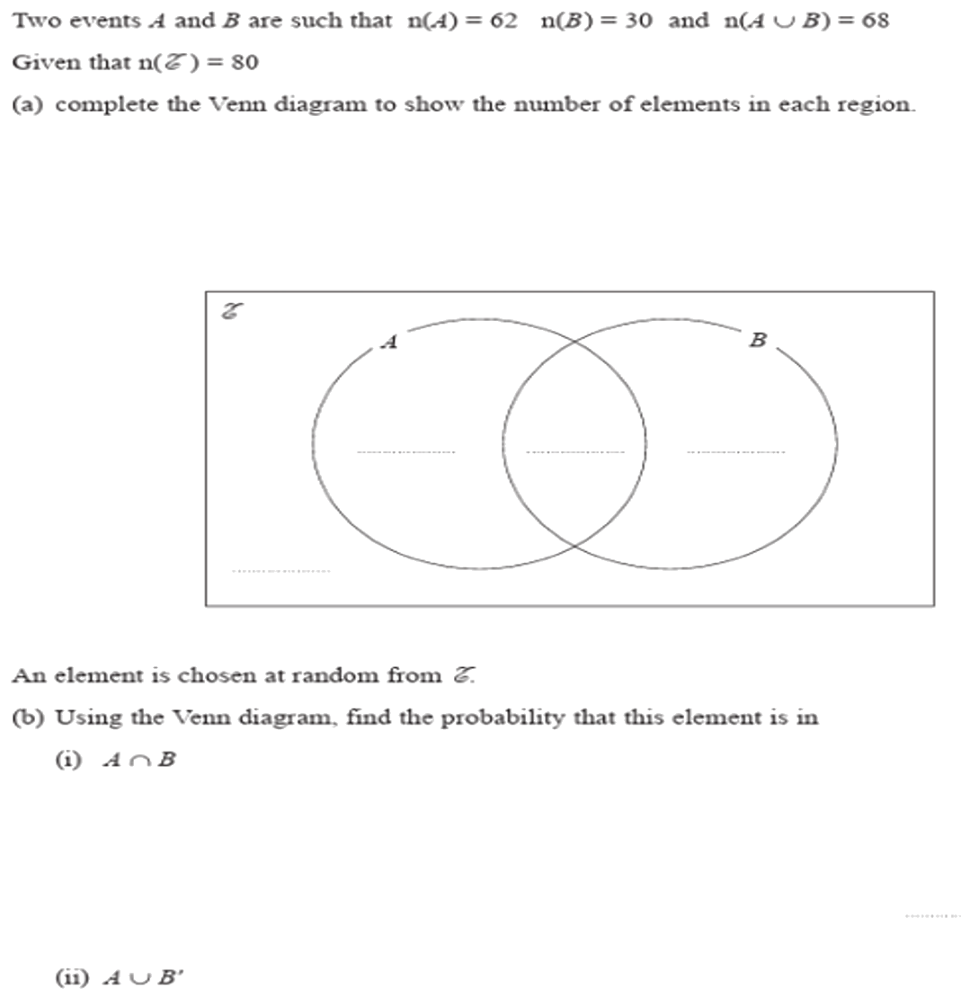
Zπ
PAST-PAPER QUESTION
Question 10

Slide 24
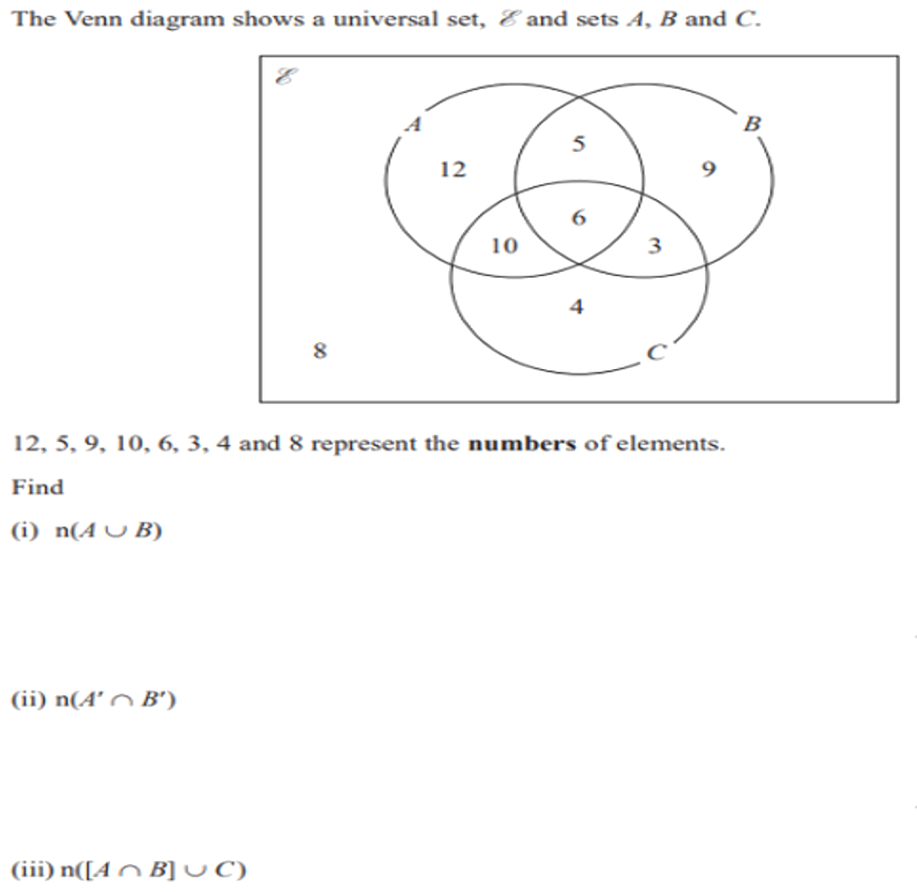
Zπ
PAST-PAPER QUESTION
Question 11

Slide 25
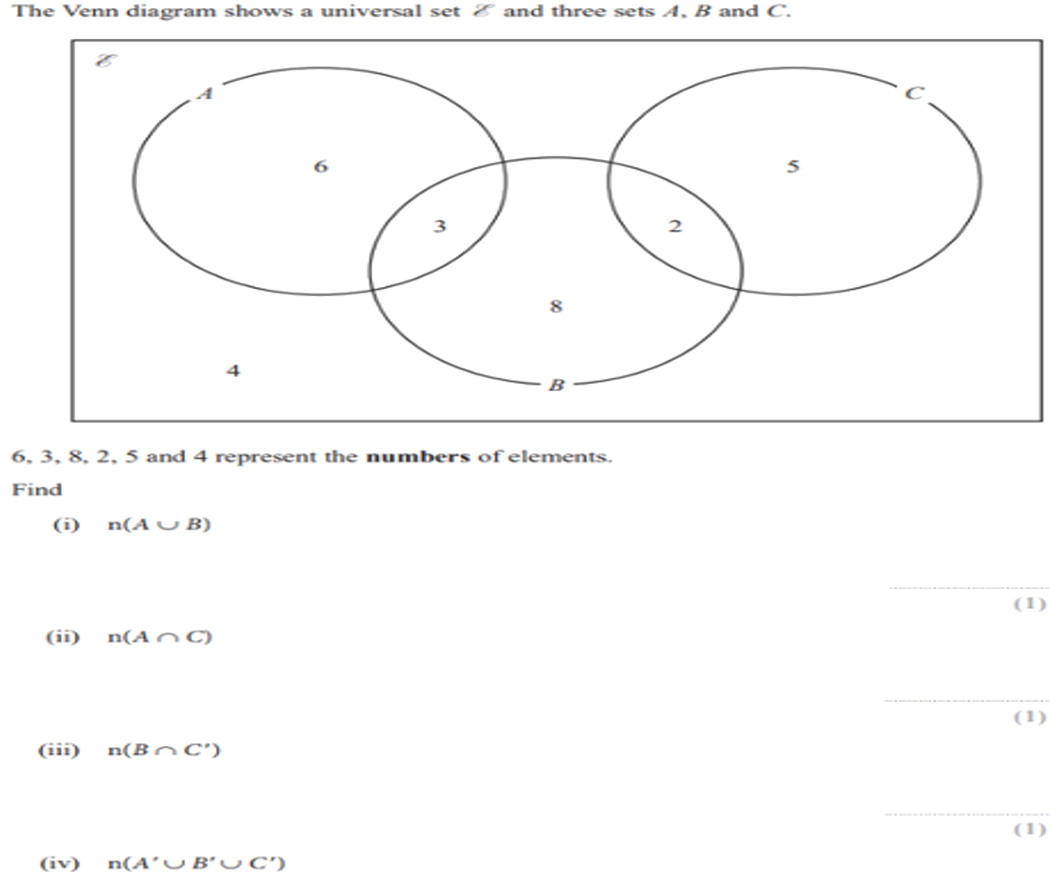
Zπ
PAST-PAPER QUESTION
Question 12

Slide 26
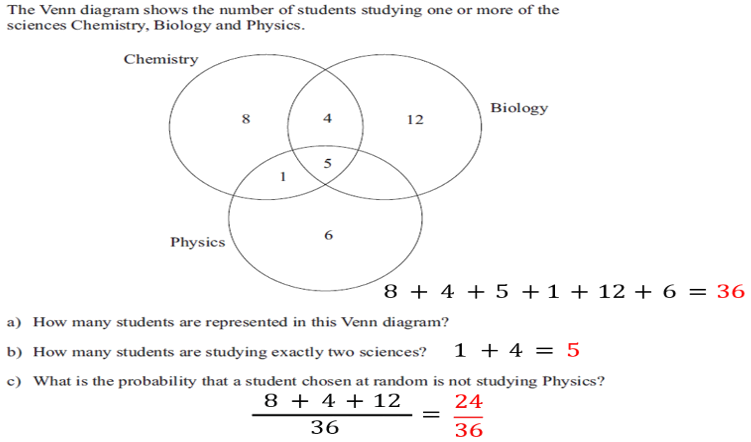
Zπ
PAST-PAPER QUESTION
Question 13

Slide 27
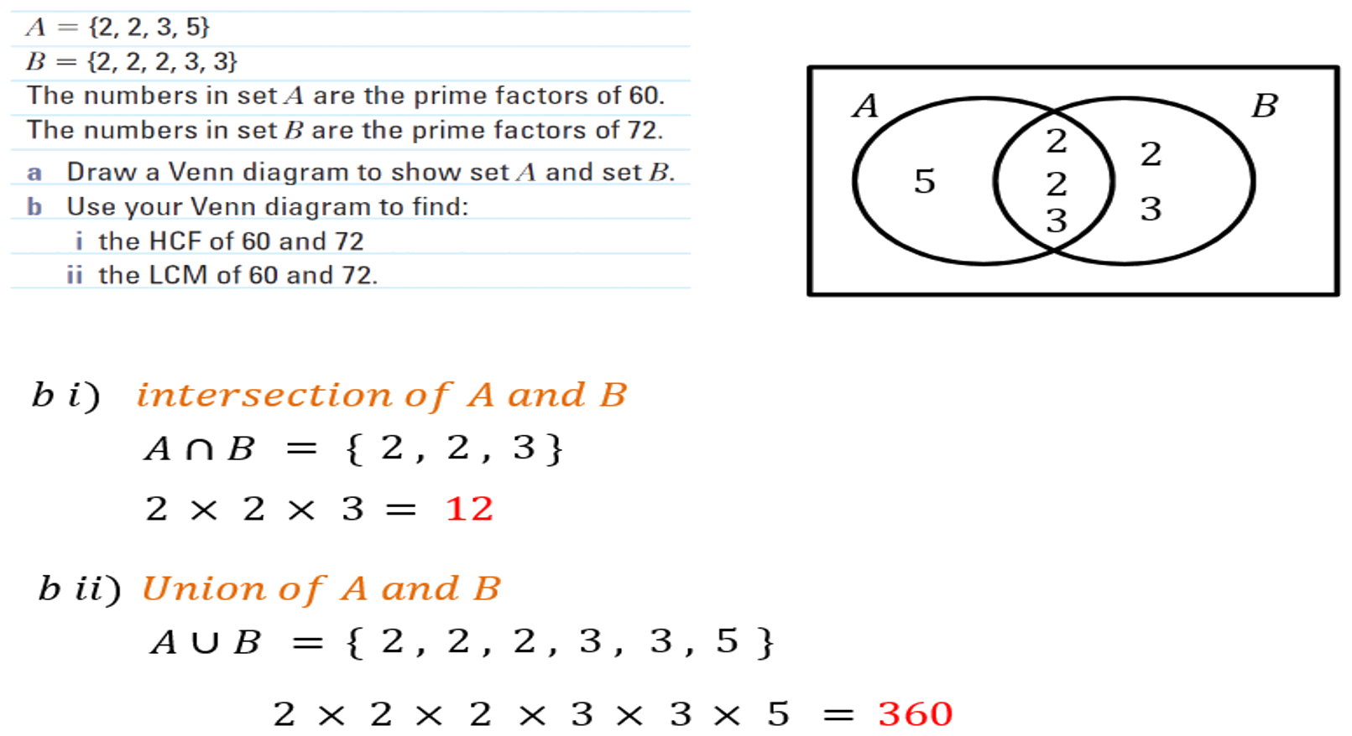
Zπ
PAST-PAPER QUESTION
Question 14

Slide 28
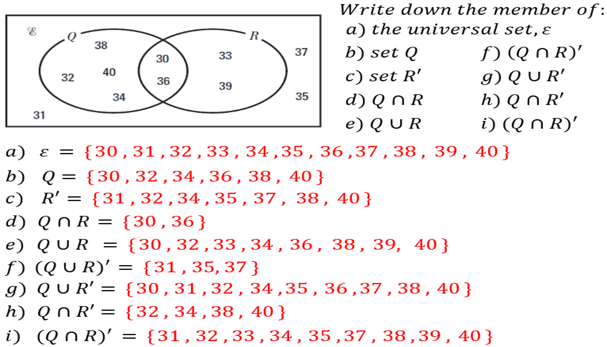
Zπ
PAST-PAPER QUESTION
Question 15

Slide 29
Zπ
RECAP
Key Takeaways
A set is a collection of elements, written in { }; ξ is the universal set (everything).
∈ means ‘is an element of’; n(A) is the number of elements in A.
Intersection A ∩ B = the overlap (in BOTH = AND).
Union A ∪ B = everything in either circle (OR), each element once.
Complement A′ = everything in ξ that is NOT in A.
Golden rule: ∩ is AND (overlap), ∪ is OR (all), A′ is NOT. Fill the overlap first.

