Slide 1
Zπ
Zπ MATHS HUB
Pearson Edexcel IGCSE (9–1) · Higher Tier
x̄
Averages & Range
Mode · Median · Mean · Range · Quartiles & the Interquartile Range
Zahra Sheikh Ali
IGCSE Mathematics Teacher · M.Sc. Differential Geometry & Geometric Control
☎ 66613748 ✉ zahraa.sheikhali@outlook.com

Slide 2
Zπ
LESSON OVERVIEW
Three Averages and a Spread
An average is a single number that represents a whole set of data. There are three — mode, median and mean — plus the range and quartiles to measure the SPREAD.
Mode
Median
Mean
1
2
3
Range
Quartiles & IQR
Past-paper questions
4
5
6
Key words: mode · median · mean · range · lower quartile · upper quartile · interquartile range

Slide 3
Zπ
THE KEY IDEA
The Three Averages
Data: 3, 5, 5, 6, 11. Watch how each average is found.
MODE
MEDIAN
MEAN
most common
middle value
add ÷ count
5
5
6
the value that appears most
order first, then take the middle
(3+5+5+6+11) ÷ 5 = 30 ÷ 5
RANGE (spread) = highest − lowest = 11 − 3 = 8. (Range is not an average.)

Slide 4
Zπ
MODE & MEDIAN
The Two ‘No-Calculation’ Averages
The mode you just spot; the median you find by ordering. For the median, ORDER the data first — always.
MODE
MEDIAN
The most frequent value.
7, 3, 7, 9, 7, 2 → mode = 7
There can be no mode, or more than one.
Order the data, take the MIDDLE.
2, 3, 7, 7, 9 → median = 7
Even amount? Average the two middle numbers.
Median position = (n + 1) ÷ 2. For 8 values that is the 4.5th — average the 4th and 5th.

Slide 5
Zπ
MEAN
Add Everything, Divide by How Many
1
Work out the mean of 6, 4, 3, 2, 5.
Method
Add up all the values (the total).
Divide by how many values there are.
The mean can be a decimal — that is fine.
Reverse it: total = mean × number of values.
2
Add them: 6 + 4 + 3 + 2 + 5 = 20
3
Count them: there are 5 values.
4
Mean = 20 ÷ 5 = 4
Mean = total ÷ number of values = 20 ÷ 5 = 4
If you know the mean, you can find the total: total = mean × how many.

Slide 6
Zπ
RANGE
A Measure of Spread
The range tells you how SPREAD OUT the data is — not an average. A small range means the data is consistent.
RANGE = highest value − lowest value
Data 4, 9, 2, 11, 6: range = 11 − 2 = 9
A smaller range = more consistent / more reliable data.

Slide 7
Zπ
QUARTILES & IQR
Splitting the Data into Quarters
Quartiles split ORDERED data into four equal parts. The IQR measures the spread of the middle half.
The three quartiles
12, 6, 4, 9, 8, 4, 9, 8, 5, 9, 8, 10
Lower quartile (LQ): ¼ of the way in.
Median (Q2): halfway.
Upper quartile (UQ): ¾ of the way in.
Order the data first, always.
Order the data
Q₁
Q₂
Q₃
4, 4, 5, 6, 8, 8, 8, 9, 9, 9, 10, 12
Interquartile range
LQ (Q₁)= 5½
Median (Q₂) = 8
UQ (Q₃)= 9
IQR = UQ − LQ
The spread of the middle 50% of the data.
It ignores extreme values, so it is more reliable than the range.
Inter- Quartile Range = 9 - 5½ = 3½
IQR = upper quartile − lower quartile — the range of the middle half.

Slide 8
Zπ
PART 2
Past-Paper Questions
Order the data, then find the average or spread the question asks for.
1
Mode = most common
2
Median = middle (order first)
3
Mean = total ÷ count
4
Range & IQR = spread

Slide 9
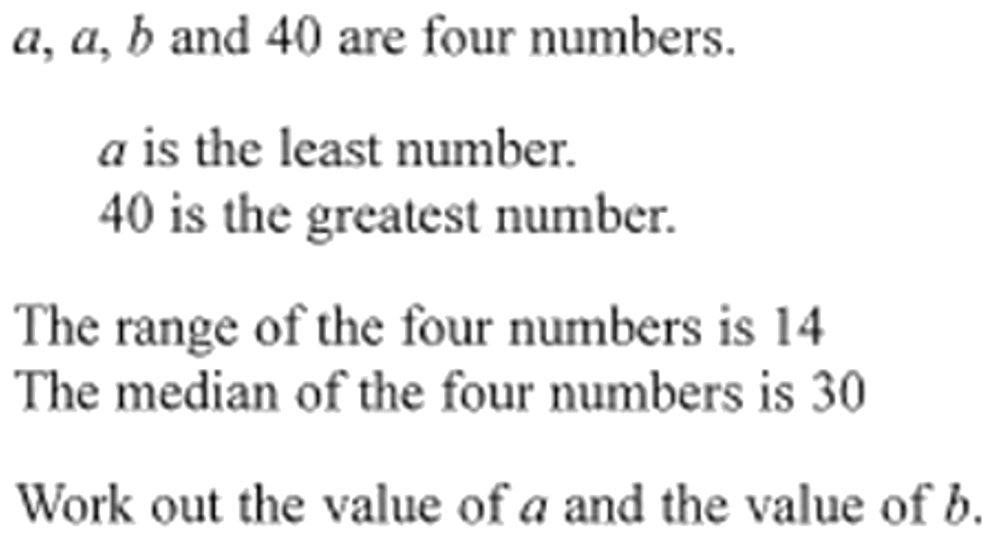
Zπ
PAST-PAPER QUESTION
Question 1

Slide 10
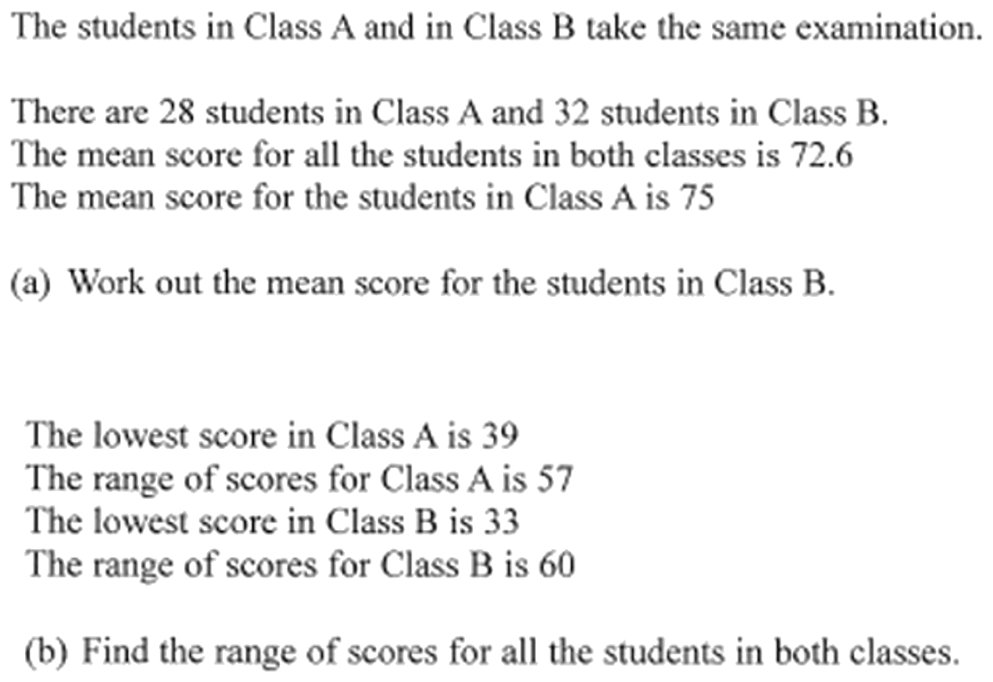
Zπ
PAST-PAPER QUESTION
Question 2

Slide 11
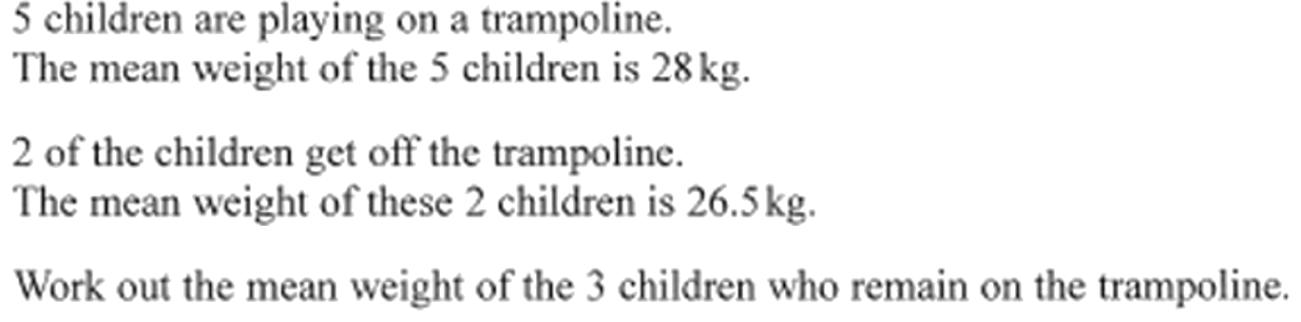
Zπ
PAST-PAPER QUESTION
Question 3

Slide 12
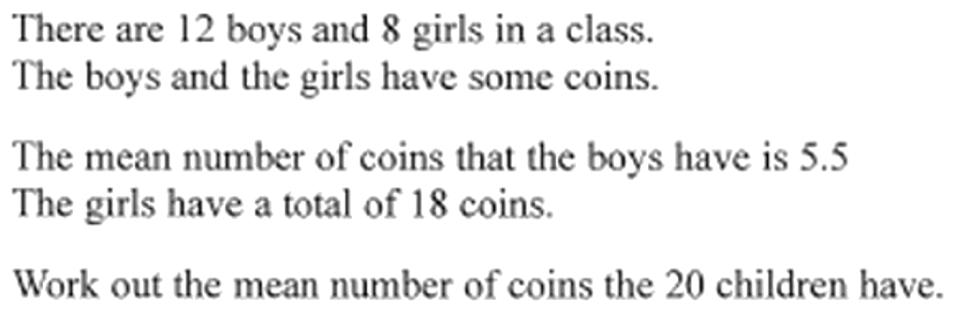
Zπ
PAST-PAPER QUESTION
Question 4

Slide 13
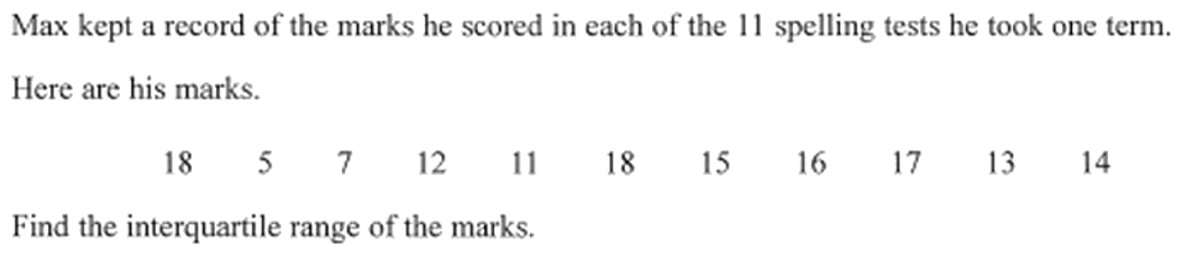
Zπ
PAST-PAPER QUESTION
Question 5

Slide 14
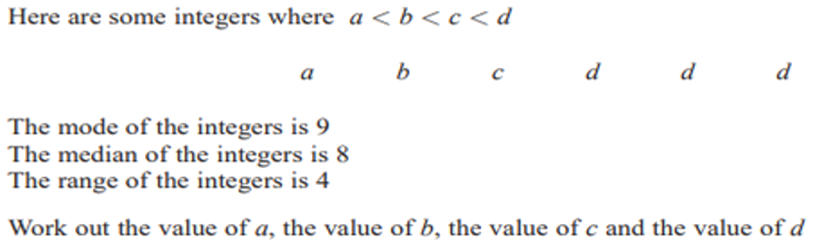
Zπ
PAST-PAPER QUESTION
Question 6

Slide 15
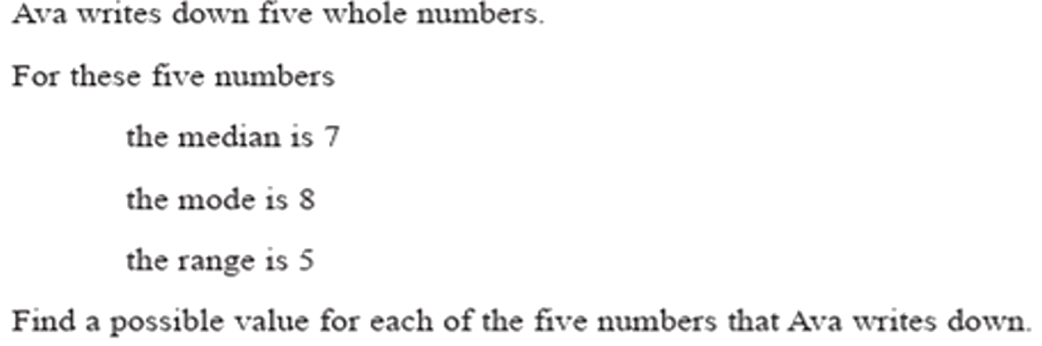
Zπ
PAST-PAPER QUESTION
Question 7

Slide 16
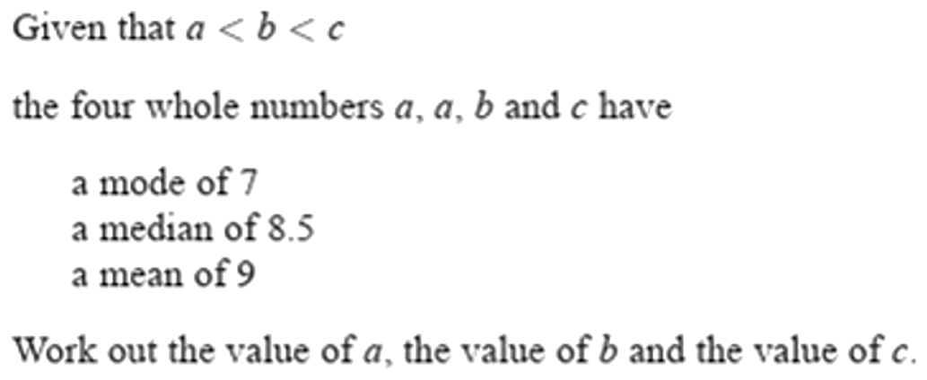
Zπ
PAST-PAPER QUESTION
Question 8

Slide 17
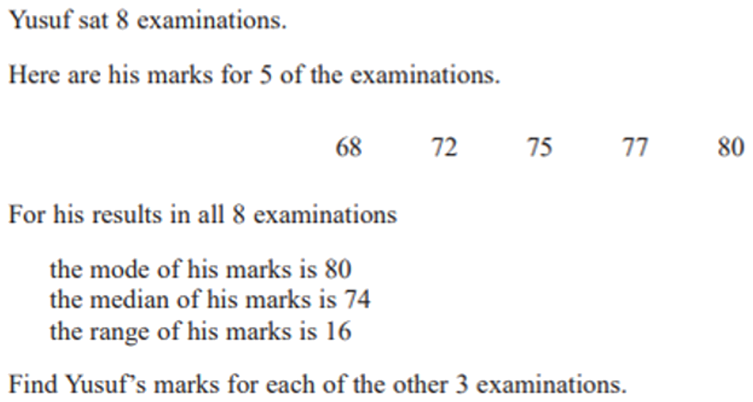
Zπ
PAST-PAPER QUESTION
Question 9

Slide 18
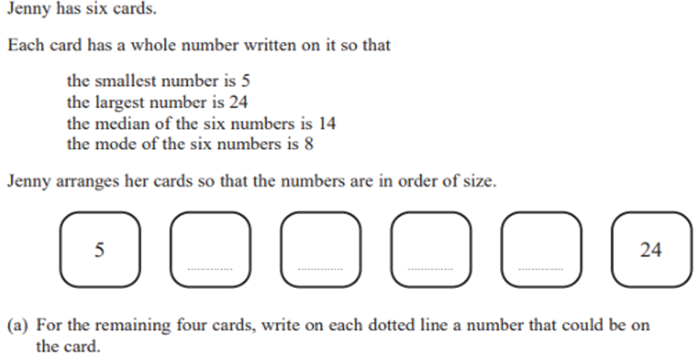
Zπ
PAST-PAPER QUESTION
Question 10

Slide 19
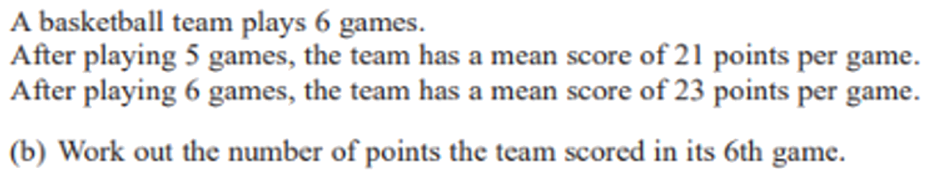
Zπ
PAST-PAPER QUESTION
Question 11

Slide 20
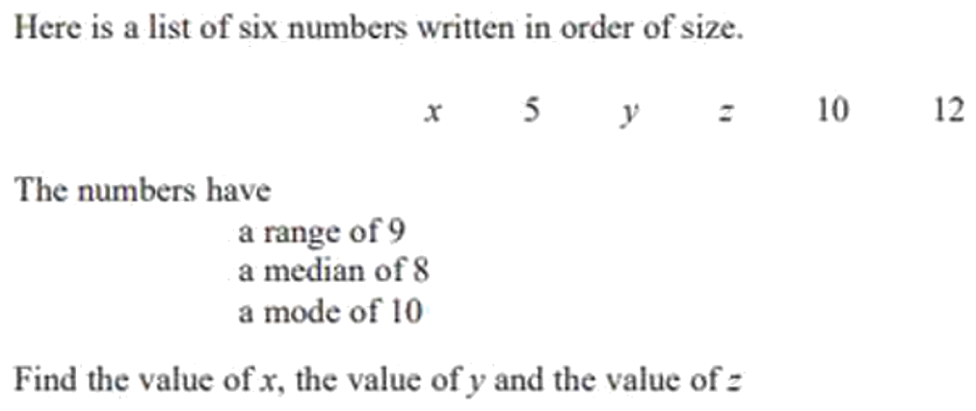
Zπ
PAST-PAPER QUESTION
Question 12

Slide 21
Zπ
RECAP
Key Takeaways
Mode = most common value; median = middle value (order the data first).
Mean = total ÷ number of values; total = mean × number of values.
Range = highest − lowest — a measure of SPREAD, not an average.
Quartiles split ordered data into quarters (LQ, median, UQ).
IQR = UQ − LQ — the spread of the middle half, unaffected by extremes.
Golden rule: always ORDER the data first for the median, quartiles and range.

