Slide 1
Zπ
Zπ MATHS HUB
Pearson Edexcel IGCSE (9–1) · Higher Tier
Averages from a Table
Ungrouped & Grouped Frequency Tables · Modal Class · Median Class · Estimated Mean
Zahra Sheikh Ali
IGCSE Mathematics Teacher · M.Sc. Differential Geometry & Geometric Control
☎ 66613748 ✉ zahraa.sheikhali@outlook.com

Slide 2
Zπ
LESSON OVERVIEW
Finding Averages from Frequency Tables
A frequency table records how OFTEN each value (or class) occurs. The averages are the same idea as before — you just use the frequencies, with an extra fx column for the mean.
Reading a frequency table
Mode & median from a table
Mean: Σfx ÷ Σf
1
2
3
Grouped: modal class
Grouped: estimated mean
Past-paper questions
4
5
6
Key words: frequency · Σfx ÷ Σf · modal class · median class · midpoint · estimated mean

Slide 3
Zπ
UNGROUPED TABLE
Mode, Median & Mean
Number of pets owned by 20 people. Add an fx column to find the mean.
Pets (x)
Freq (f)
f × x
The three averages
0
5
0
MODE = 1 (highest frequency, 8)
MEDIAN = 1 (10th & 11th values)
MEAN = Σfx ÷ Σf = 25 ÷ 20
= 1.25
1
8
8
2
4
8
Totals: Σf = 20 Σfx = 25
3
3
9
Mean from a table = Σfx ÷ Σf (total of f×x, divided by total frequency).

Slide 4
Zπ
THE MEAN FROM A TABLE
Σfx ÷ Σf
Multiply each value by its frequency (fx), add those up, then divide by the total frequency.
mean =
Σ f x
Σ f
= total of (f × x) ÷ total frequency
Do NOT just add the values and divide — you must weight each by its frequency.

Slide 5
Zπ
GROUPED TABLE
Modal Class & Median Class
With grouped data we cannot know exact values — so we give a CLASS.
Height h (cm)
Freq (f)
Reading the classes
0 < h ≤ 10
3
MODAL CLASS = 10 < h ≤ 20
the class with the highest frequency (7).
MEDIAN CLASS = 20 < h ≤ 30
the 10.5th value falls here (running totals 3, 10, 16, 20).
10 < h ≤ 20
7
20 < h ≤ 30
6
30 < h ≤ 40
4
You give the CLASS, not a single value — e.g. ‘the modal class is 10 < h ≤ 20’.

Slide 6
Zπ
GROUPED TABLE
Estimated Mean — Use Midpoints
We do not know exact values, so use the MIDPOINT of each class as x.
Height
f
mid x
f × x
Estimated mean
0–10
3
5
15
10–20
7
15
105
mean ≈
410
20–30
6
25
150
20
Totals: Σf = 20 Σfx = 410
30–40
4
35
140
= 20.5 cm
It is an ESTIMATE — midpoints are assumed.
Estimated mean = Σfx ÷ Σf with x = the midpoint of each class = 410 ÷ 20 = 20.5.

Slide 7
Zπ
PART 2
Past-Paper Questions
Add an fx column, total it, then divide by Σf — use midpoints if grouped.
1
Mode / modal class = highest f
2
Mean = Σfx ÷ Σf
3
Grouped → use midpoints
4
Median: use running totals

Slide 8
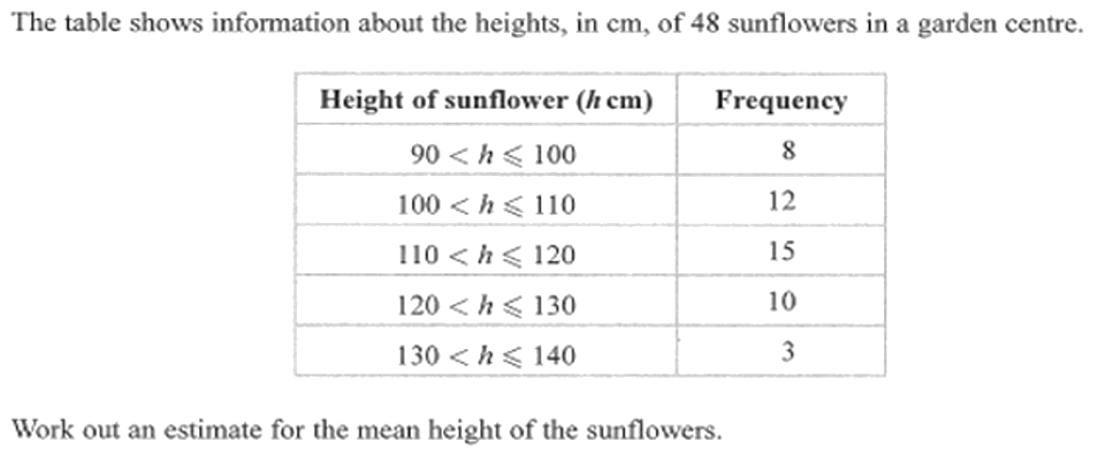
Zπ
PAST-PAPER QUESTION
Question 1

Slide 9
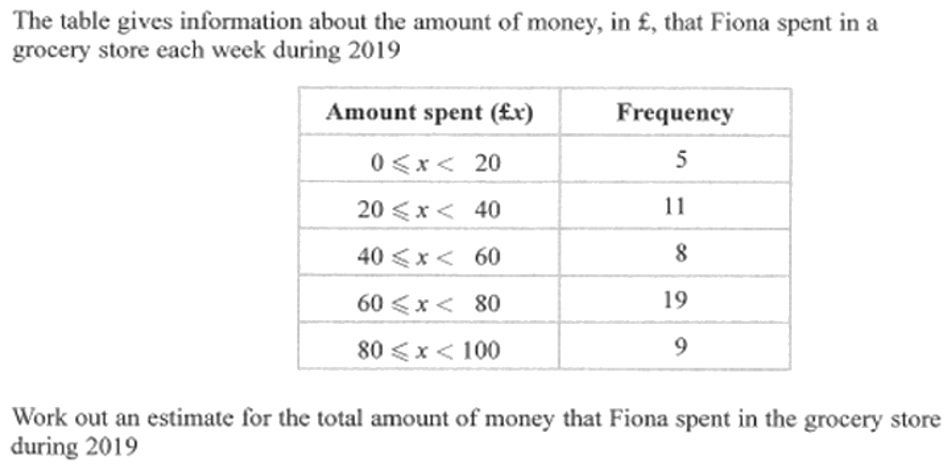
Zπ
PAST-PAPER QUESTION
Question 2

Slide 10

Zπ
PAST-PAPER QUESTION
Question 3

Slide 11
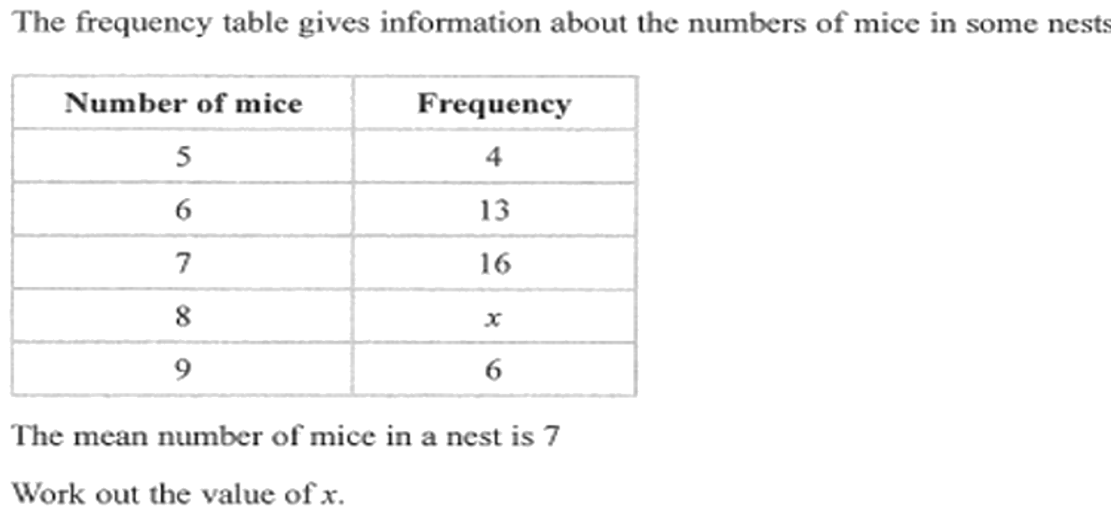
Zπ
PAST-PAPER QUESTION
Question 4

Slide 12
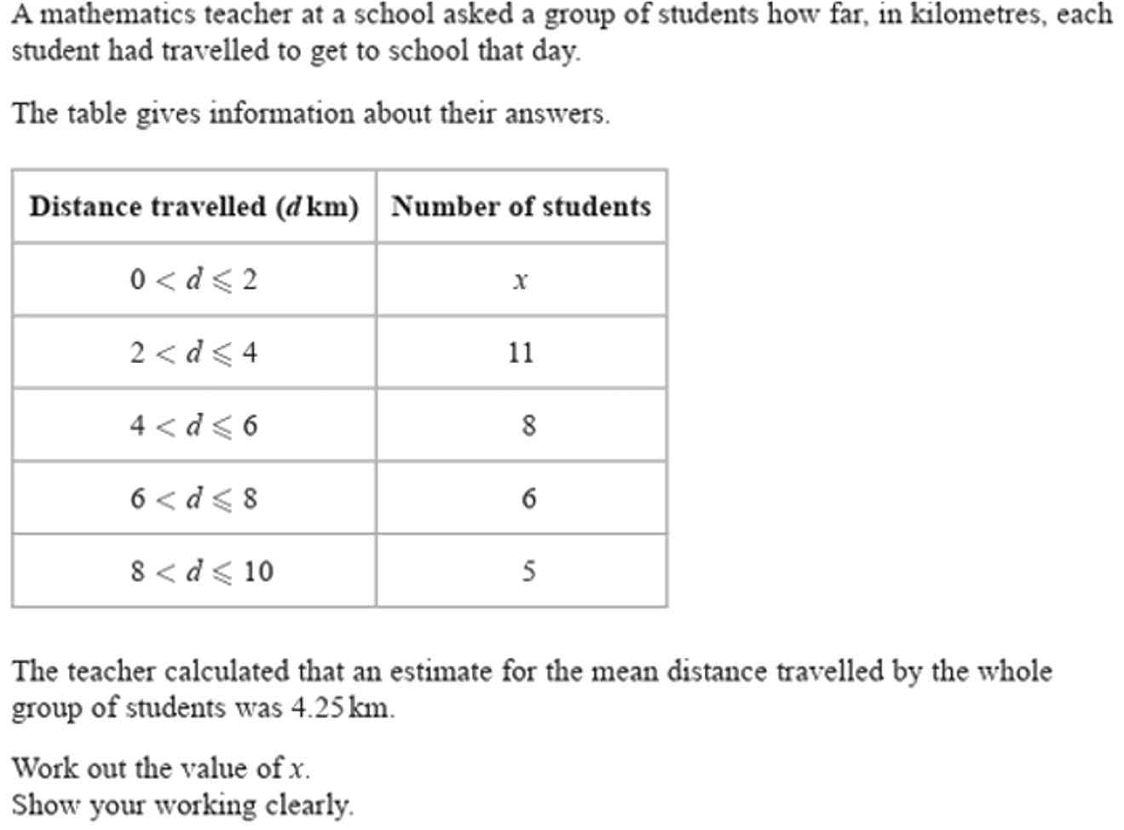
Zπ
PAST-PAPER QUESTION
Question 5

Slide 13
Zπ
RECAP
Key Takeaways
In a frequency table, add an fx column (value × frequency).
Mean = Σfx ÷ Σf — the total of fx divided by the total frequency.
Mode = the value (or class) with the highest frequency.
Grouped data: give the MODAL CLASS and MEDIAN CLASS, not single values.
Estimated mean of grouped data uses the MIDPOINT of each class as x.
Golden rule: mean from a table is always Σfx ÷ Σf — weight every value by its frequency.

