Slide 1
Zπ
Zπ MATHS HUB
Pearson Edexcel IGCSE (9–1) · Higher Tier
Histograms
Bar Charts vs Histograms · Frequency Density · Area = Frequency · Drawing & Reading
Zahra Sheikh Ali
IGCSE Mathematics Teacher · M.Sc. Differential Geometry & Geometric Control
☎ 66613748 ✉ zahraa.sheikhali@outlook.com

Slide 2
Zπ
LESSON OVERVIEW
When Class Widths Are Not Equal
A histogram shows grouped continuous data. Unlike a bar chart, the bars can be different widths — so it is the AREA, not the height, that shows the frequency. The height is the FREQUENCY DENSITY.
Bar chart vs histogram
Frequency density
Area = frequency
1
2
3
Finding GW & FD (table)
Drawing & reading
Past-paper questions
4
5
6
Key words: histogram · frequency density · class / group width · area = frequency · continuous data

Slide 3
Zπ
THE KEY IDEA
Bar Chart vs Histogram
They look similar, but a histogram is for grouped data with (often) unequal widths. The big change: the vertical axis.
BAR CHART
HISTOGRAM
Bars have GAPS between them.
Bars TOUCH (no gaps).
All bars the SAME width.
Widths can be DIFFERENT.
Vertical axis = FREQUENCY.
Vertical axis = FREQUENCY DENSITY.
Height shows the frequency.
AREA of a bar shows the frequency.
Histogram: no gaps, unequal widths allowed, y-axis is frequency density, AREA = frequency.

Slide 4

Zπ
FREQUENCY DENSITY
F
The Two Formulas — and Area = Frequency
×
Because widths differ, we plot frequency DENSITY (frequency per unit width).
FD
GW
To DRAW: find the height
To READ: find the frequency
frequency density (FD) =
Frequency (F)
frequency =
FD × Group width
Group width (GW)
AREA of each bar = frequency
Frequency density is ‘how crowded’ the class is — frequency shared over its width.

Slide 5
Zπ
WORKED EXAMPLE
Find the Group Width & Frequency Density
For each class: group width = upper − lower, FD = frequency ÷ width.
Time t (s)
Freq
Group width
Freq density
Check one
10 < t ≤ 30
5
30 – 10 = 20
0.25
40 < t ≤ 50:
width = 50 − 40 = 10
FD = 27 ÷ 10
= 2.7
30 < t ≤ 35
4
35 – 30 = 5
0.8
35 < t ≤ 40
8
5
1.6
40 < t ≤ 50
27
10
2.7
50 < t ≤ 70
24
20
1.2
FD = frequency ÷ class width. Divide every frequency by its own width.

Slide 6
Zπ
DRAWING A HISTOGRAM
Plot Frequency Density; Bars Touch
Using the frequency densities from the table — the bars have different widths but no gaps.
A wide, short bar can hold the same frequency as a narrow, tall one — equal areas.
Frequency density
Time taken (t seconds) | F | GW | FD
10 < t ≤ 30 | 5 | 20 | 0.25
30 < t ≤ 35 | 4 | 5 | 0.8
35 < t ≤ 40 | 8 | 5 | 1.6
40 < t ≤ 50 | 27 | 10 | 2.7
50 < t ≤ 70 | 24 | 20 | 1.2
3
2.5
2
1.5
Steps
Work out the FD for every class.
1
Frequency density goes up the y-axis.
0.5
Each bar spans its class width on the x-axis.
Bars TOUCH — no gaps.
0
10
20
30
40
50
60
70
Time t

Slide 7
Zπ
READING A HISTOGRAM
Find the Frequency of a Group
Frequency density
First read the GW and the FD off the histogram
Time taken (t seconds) | F | GW | FD
10 < t ≤ 30 |  | 20 | 0.25
30 < t ≤ 35 |  | 5 | 0.8
35 < t ≤ 40 |  | 5 | 1.6
40 < t ≤ 50 |  | 10 | 2.7
50 < t ≤ 70 |  | 20 | 1.2
Example – From the histogram, find the frequency of each group
3
20 × 0.25 = 5
5 × 0.8 = 4
2.5
8
27
2
24
To find the frequency, all you need to do is remember that the frequency is the AREA of each bar.
GW and FD are the length and width of the bar!
1.5
1
0.5
0
10
20
30
40
50
60
70
Time t
frequency = frequency density × class width = the bar’s area
Going the other way, you can complete a table from a histogram, then the histogram from a table.

Slide 8
Zπ
READING A HISTOGRAM
Find the Frequency of a Group
Exam question
Time (m) | Frequency | GW | FD
0 < t ≤ 10 | 20 | 10
10 < t ≤ 15 |  | 5
15 < t ≤ 30 |  | 15
30 < t ≤ 50 | 62 | 20
50 < t ≤ 60 | 23 | 10
a) Use the information on the histogram to complete the table
b) Use the table to complete the histogram
2
15
3
60
4
3.1
5
2.3
4
Find the bar where you ALSO have the info in the table…
Calculate the FD of that bar, and use it to label the FD axis on the graph
3
Read off the FD of the other bars on the graph, and use that to calculate F for these bars
Calculate FD for the rest of the table, and use these values to draw the rest of the histogram
2
1

Slide 9
Zπ
PART 2
Past-Paper Questions
Frequency density = frequency ÷ width; frequency = the bar’s area.
1
FD = frequency ÷ class width
2
frequency = FD × width (area)
3
Bars touch; widths can differ
4
Part of a class → area of that part

Slide 10
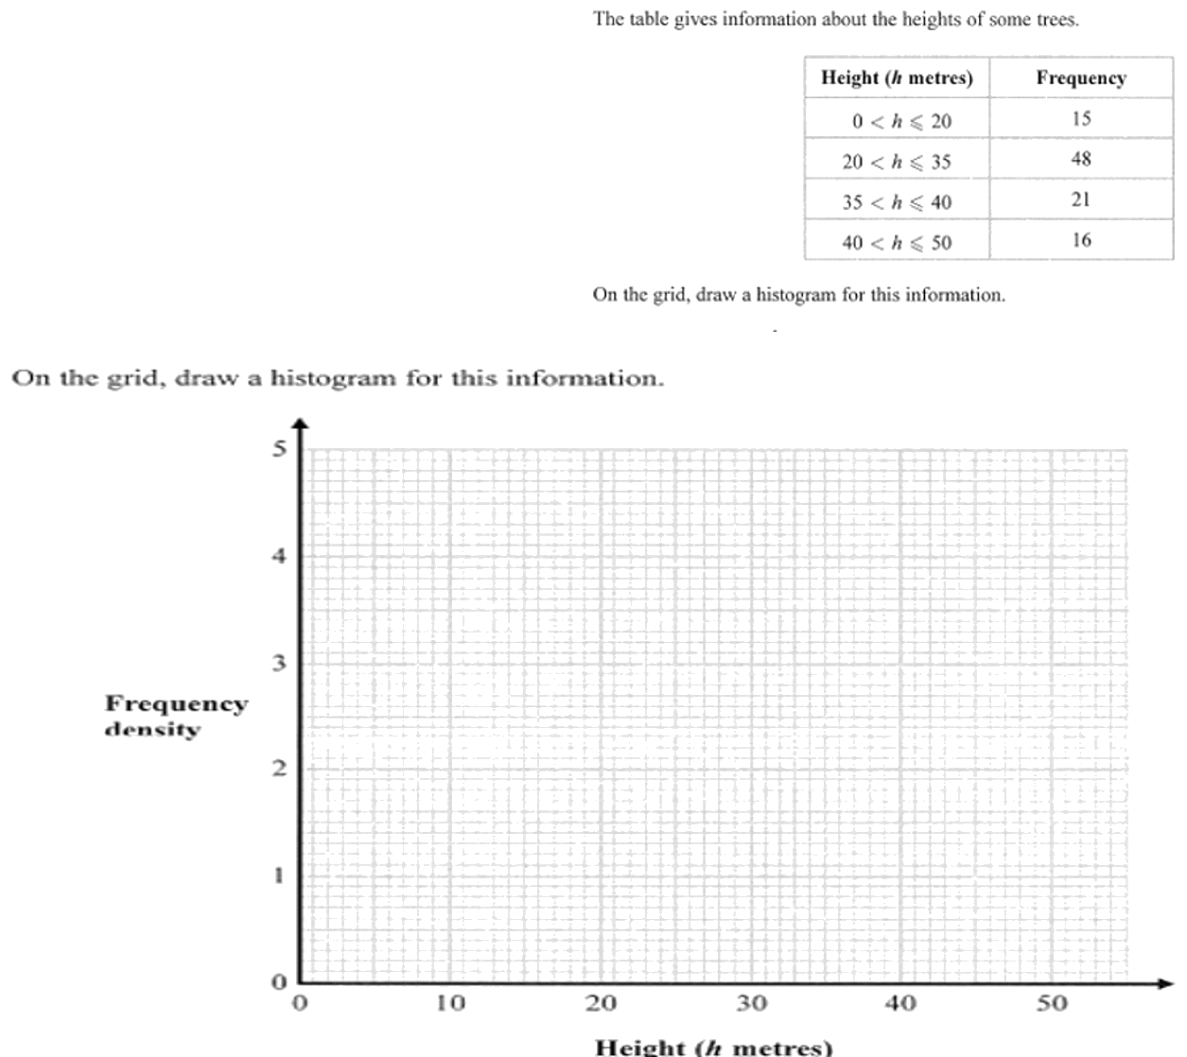
Zπ
PAST-PAPER QUESTION
Question 1

Slide 11
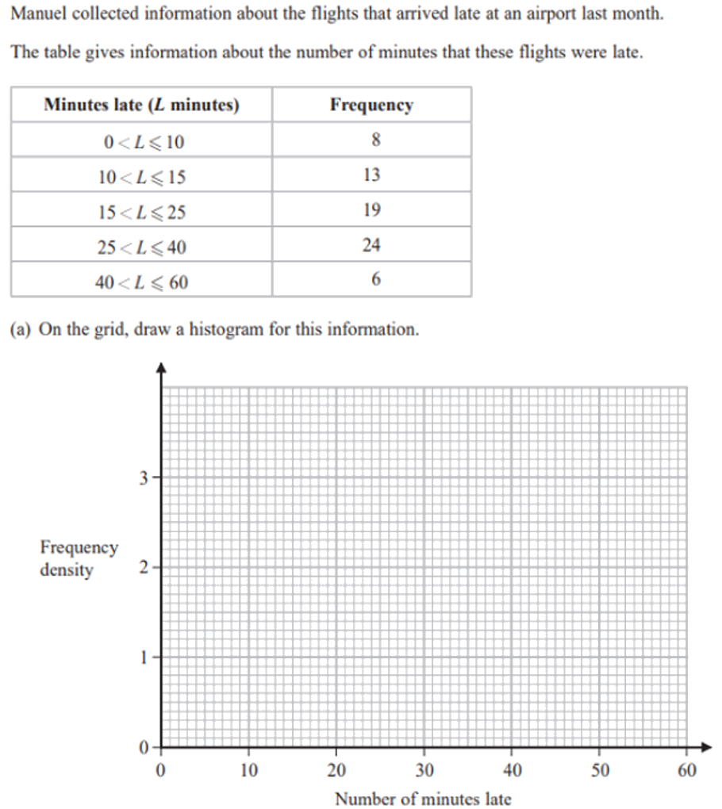
Zπ
PAST-PAPER QUESTION
Question 2

Slide 12
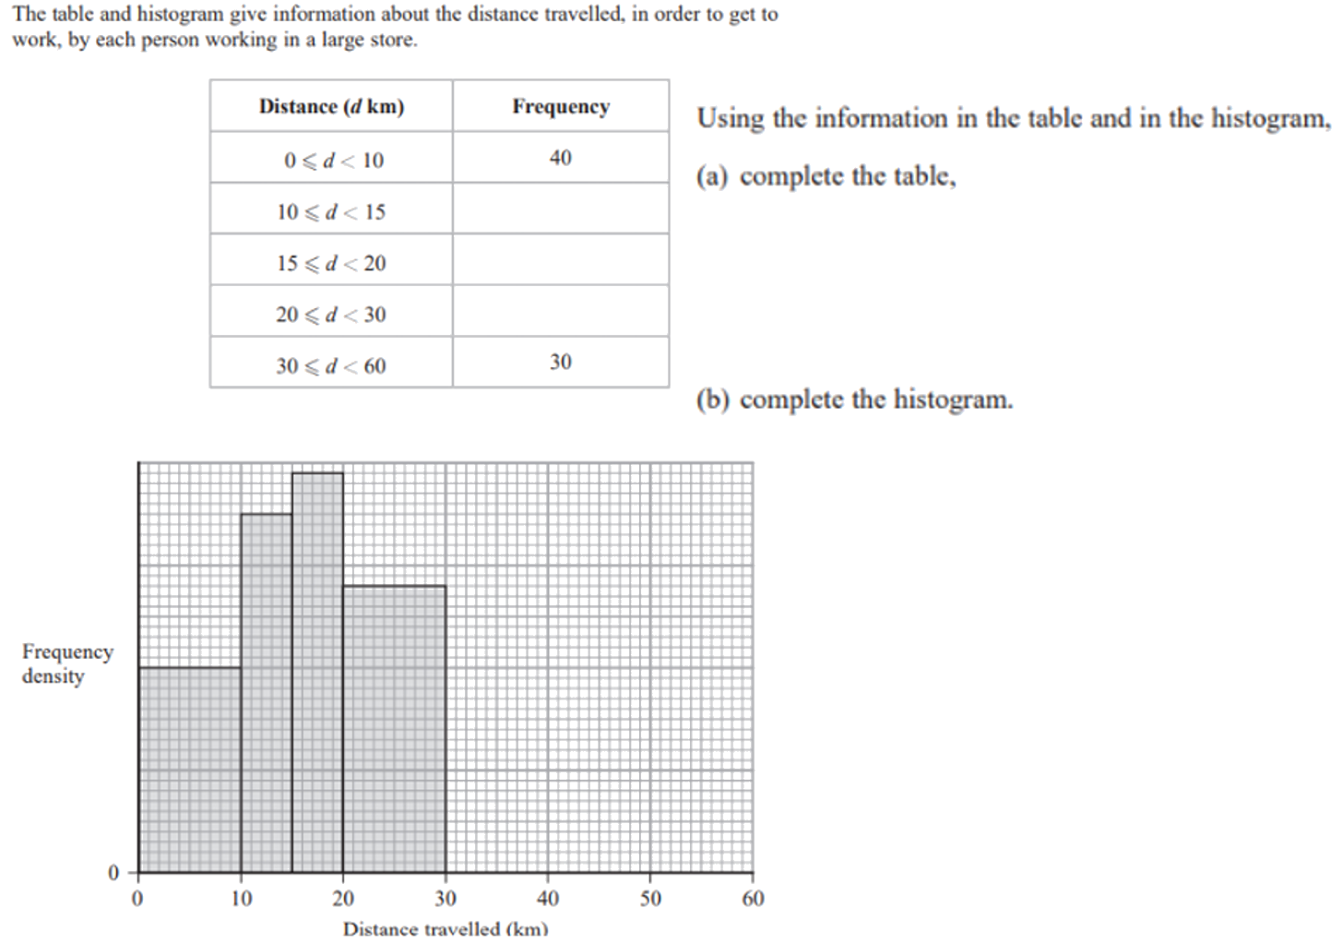
Zπ
PAST-PAPER QUESTION
Question 3

Slide 13
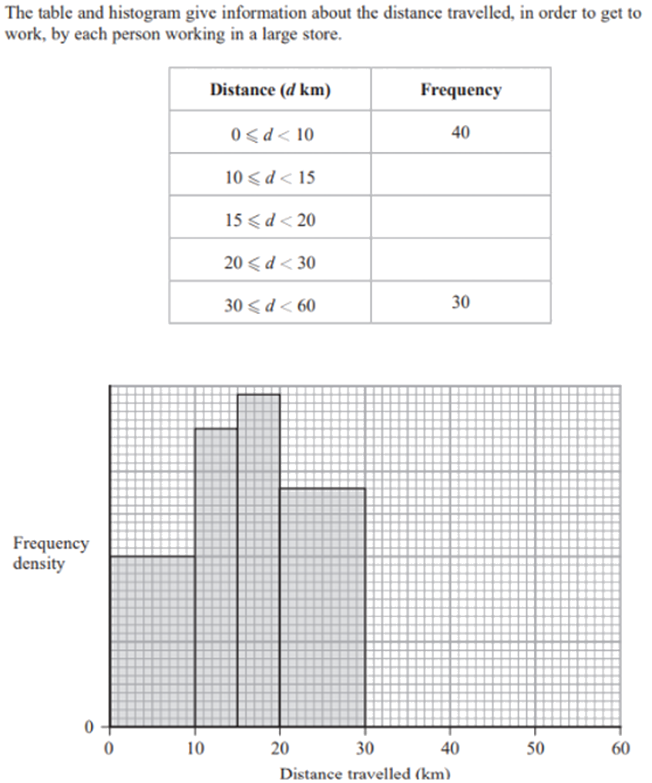
Zπ
PAST-PAPER QUESTION
Question 4

Slide 14
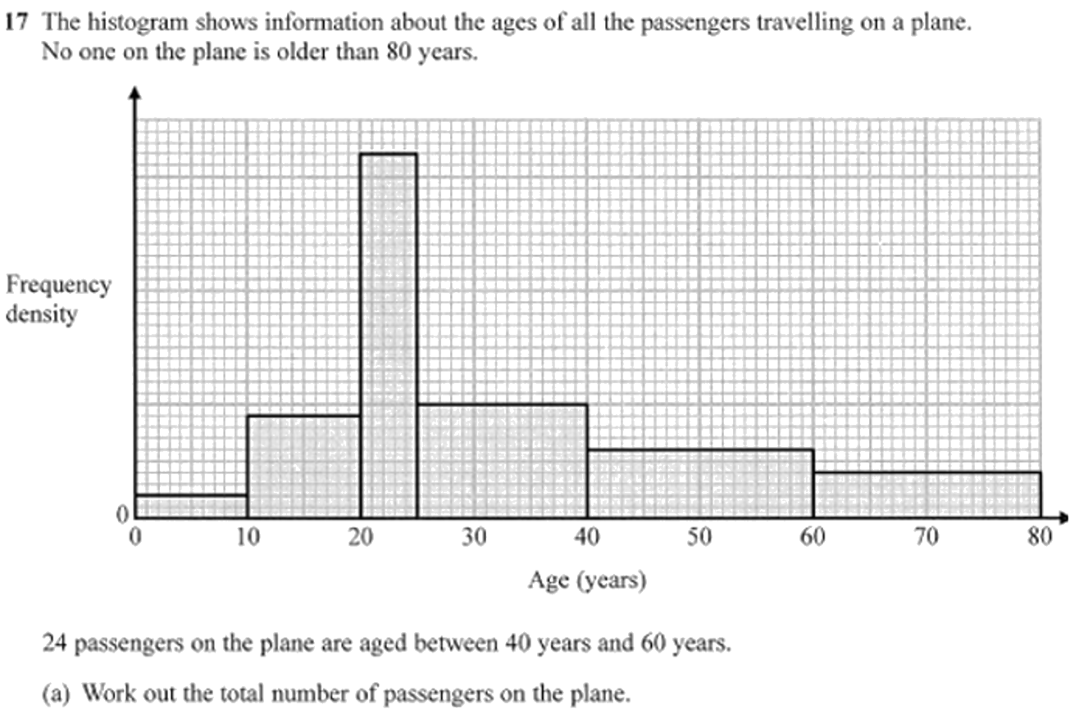
Zπ
PAST-PAPER QUESTION
Question 5

Slide 15
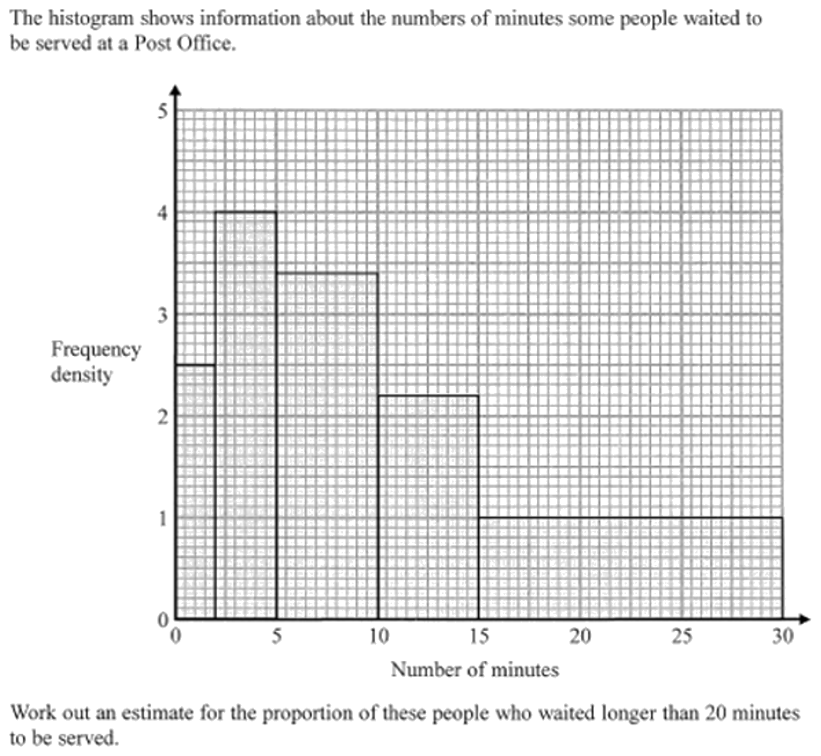
Zπ
PAST-PAPER QUESTION
Question 6

Slide 16
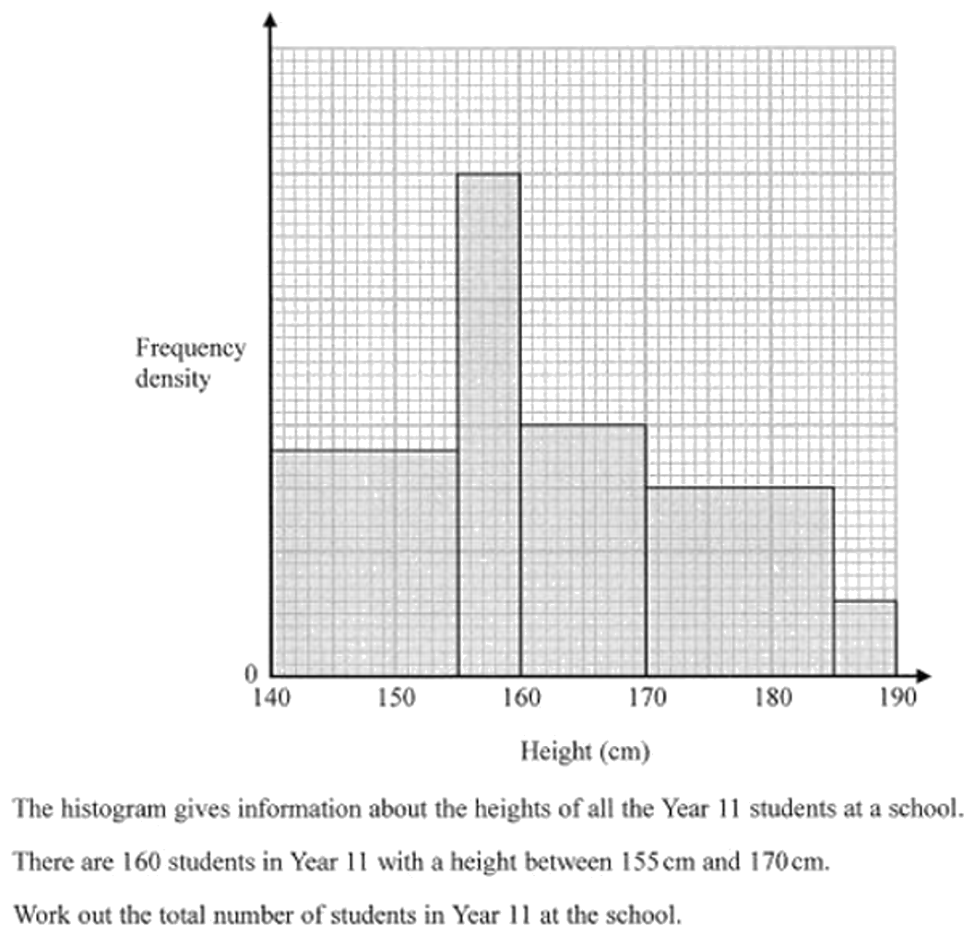
Zπ
PAST-PAPER QUESTION
Question 7

Slide 17
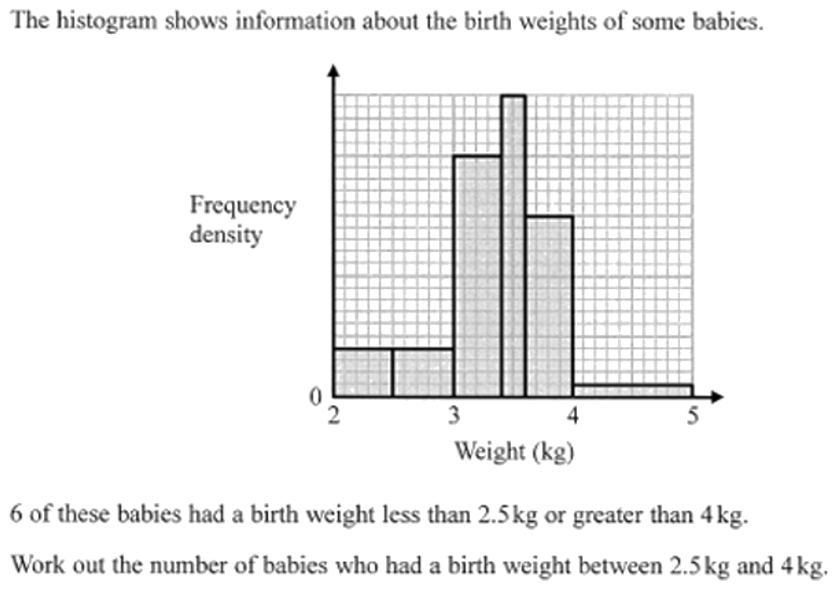
Zπ
PAST-PAPER QUESTION
Question 8

Slide 18
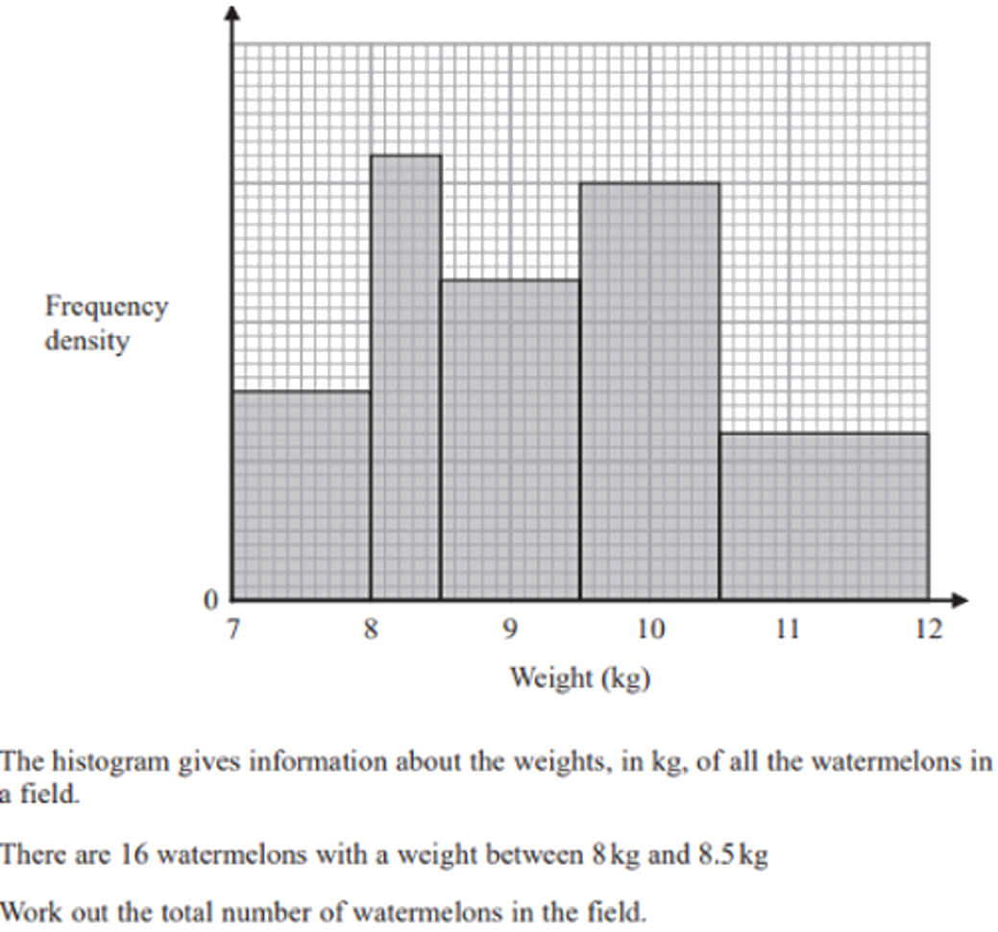
Zπ
PAST-PAPER QUESTION
Question 9

Slide 19
Zπ
RECAP
Key Takeaways
A histogram shows grouped data; bars touch and can have different widths.
The vertical axis is FREQUENCY DENSITY, not frequency.
Frequency density = frequency ÷ class width.
Frequency = frequency density × class width — the AREA of the bar.
For part of a class, use the area of just that part (same frequency density).
Golden rule: AREA = frequency. Height is frequency density = frequency ÷ width.

