Slide 1
Zπ
Zπ MATHS HUB
Pearson Edexcel IGCSE (9–1) · Higher Tier
P
Probability
The Basic Formula · NOT Happening · Mutually Exclusive · Expected Frequency · Combined Events
Zahra Sheikh Ali
IGCSE Mathematics Teacher · M.Sc. Differential Geometry & Geometric Control
☎ 66613748 ✉ zahraa.sheikhali@outlook.com

Slide 2
Zπ
LESSON OVERVIEW
Measuring How Likely Something Is
Probability is a number from 0 (impossible) to 1 (certain). This lesson builds the key formulas — each with an example — then combined events with and without replacement.
The basic formula
NOT happening: 1 − P(A)
Mutually exclusive: add
1
2
3
Expected frequency
Combined events: multiply
Past-paper questions
4
5
6
Key words: probability · outcome · event · complement · mutually exclusive · expected · independent · replacement

Slide 3
Zπ
THE BASIC FORMULA
P(event) = successful ÷ total
For equally likely outcomes:
P(event) =
number of successful outcomes
Example
total number of outcomes
A bag has 3 green and 5 red (8 total).
P(green) =
0
½
1
3
impossible
even
certain
8
Probability is a fraction: how many ways it CAN happen, over how many outcomes in total.

Slide 4
Zπ
NOT HAPPENING
P(not A) = 1 − P(A)
All the probabilities add up to 1, so ‘not A’ is whatever is left.
P(not A) = 1 − P(A)
Example (decimals)
Example (fractions)
P(win) = 0.65
P(not win) = 1 − 0.65 = 0.35
The two decimals add up to 1.
P(red) = 2/5, so P(not red) = 3/5
The top numbers (2 + 3) add up to the bottom (5).
P(not A) = 1 − P(A). Fractions: tops add to the bottom; decimals add to 1.

Slide 5
Zπ
MUTUALLY EXCLUSIVE
P(A or B) = P(A) + P(B)
Mutually exclusive = cannot happen at the same time. Then ADD the probabilities for ‘A OR B’.
P(A or B) = P(A) + P(B)
Example
Using ‘all add to 1’
P(red) = 0.2, P(blue) = 0.3
P(red or blue) = 0.2 + 0.3
= 0.5
If P(red)=0.2, P(blue)=0.3, P(green)=0.25,
P(yellow) = 1 − (0.2+0.3+0.25)
= 0.25
‘OR’ → ADD. All mutually exclusive probabilities add up to 1.

Slide 6
Zπ
EXPECTED FREQUENCY
Given a Probability, Find the Number of Times
1
‘How many times would you expect it?’ → multiply by the number of trials.
Method
This is the EXPECTED (predicted) number, not exact.
expected = probability × number of trials.
Works with a fraction, decimal or percentage.
Reverse it: probability = number of times ÷ trials.
2
expected number = probability × number of trials
3
P(win) = 0.65, John plays 20 games: 0.65 × 20 = 13 wins
4
P(six) = 1/6, dice rolled 300 times: 1/6 × 300 = 50 sixes
Expected number of times = probability × number of trials
e.g. P = 0.65 over 20 games gives 0.65 × 20 = 13 expected wins.

Slide 7
Zπ
COMBINED EVENTS
P(A and B) = P(A) × P(B)
For ‘A AND B’ (both happening), MULTIPLY the probabilities. Watch whether the second probability changes.
P(A and B) = P(A) × P(B)
Example
A coin and a dice. P(head) = 1/2, P(six) = 1/6.
P(head AND six) = 1/2 × 1/6 = 1/12 (‘and’ → multiply).
‘AND’ → MULTIPLY. ‘OR’ → ADD.

Slide 8
Zπ
EXAMPLE 1 · FIND THE MISSING PROBABILITY
Two Sections Have the SAME Probability
A biased 4-sided spinner. Sections 2 and 4 have the SAME probability, x. Find x.
Number
1
2
3
4
Probability
0.2
x
0.3
x
Sections 2 and 4 are equal — both x.
Working — all probabilities add up to 1
0.2 + x + 0.3 + x = 1 → 2x + 0.5 = 1 → 2x = 0.5 → x = 0.25
Two equal sections → 2x. All the probabilities add to 1, so 2x + 0.5 = 1, giving x = 0.25.

Slide 9
Zπ
EXAMPLE 2 · FIND THE MISSING PROBABILITY
One Section is DOUBLE the Other
A similar spinner, but now section 4 is TWICE section 2 — so they are x and 2x. Find x.
Number
1
2
3
4
Probability
0.1
x
0.3
2x
Section 4 is double section 2 → x and 2x.
Working — all probabilities add up to 1
0.1 + x + 0.3 + 2x = 1 → 3x + 0.4 = 1 → 3x = 0.6 → x = 0.2 (so 2x = 0.4)
‘Double’ → use 2x. Then x + 2x = 3x; 3x + 0.4 = 1, so x = 0.2 and 2x = 0.4.

Slide 10
Zπ
PART 2
Past-Paper Questions
Add for OR, multiply for AND, × trials for expected, and check for replacement.
1
P = successful ÷ total
2
OR → add; AND → multiply
3
Expected = P × trials
4
Without replacement → totals drop

Slide 11
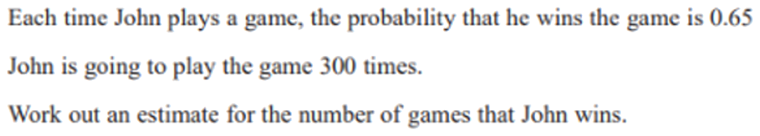
Zπ
PAST-PAPER QUESTION
Question 1

Slide 12
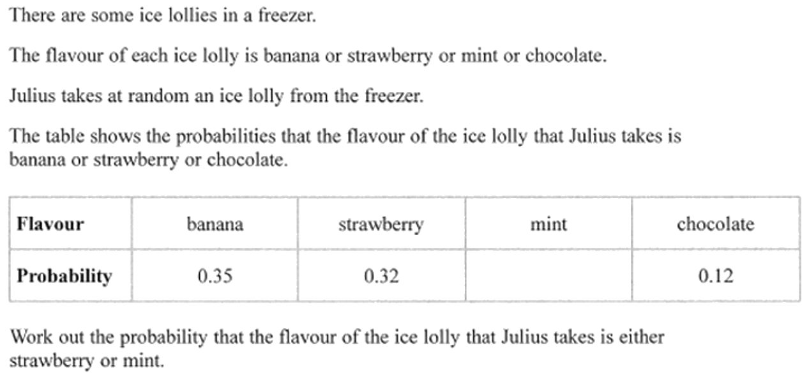
Zπ
PAST-PAPER QUESTION
Question 2

Slide 13
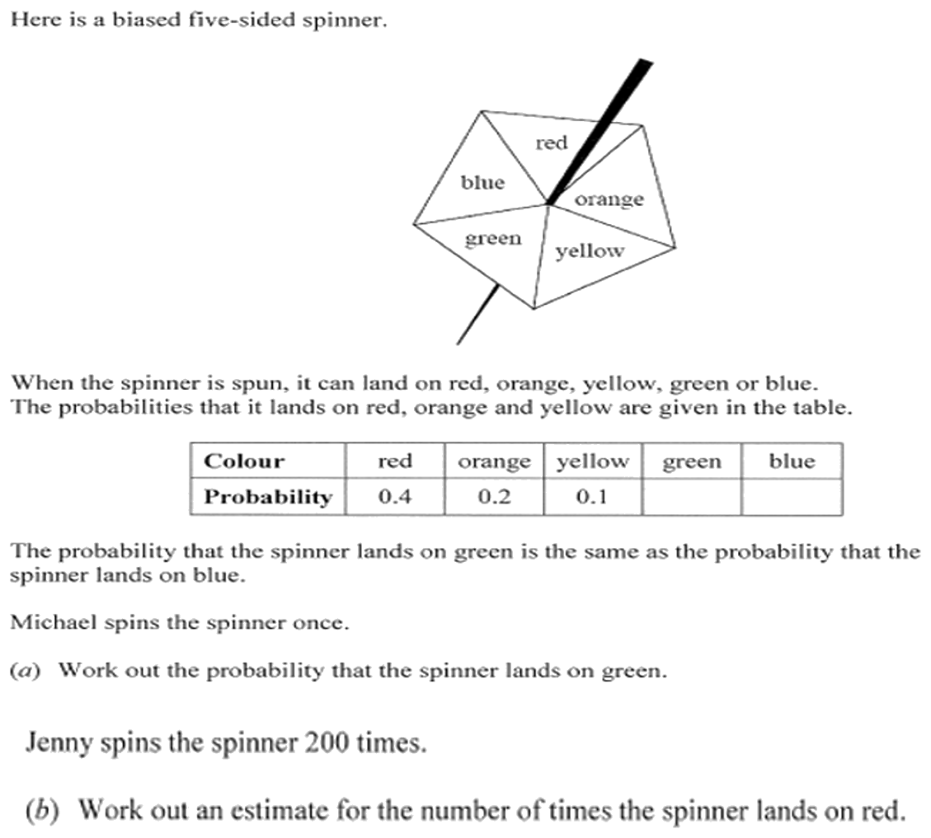
Zπ
PAST-PAPER QUESTION
Question 3

Slide 14
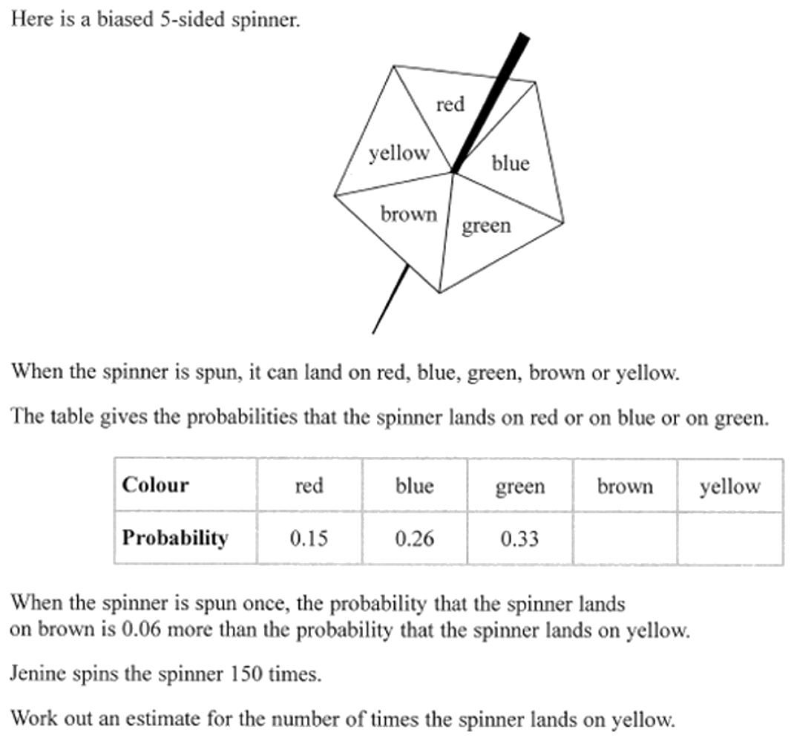
Zπ
PAST-PAPER QUESTION
Question 4

Slide 15
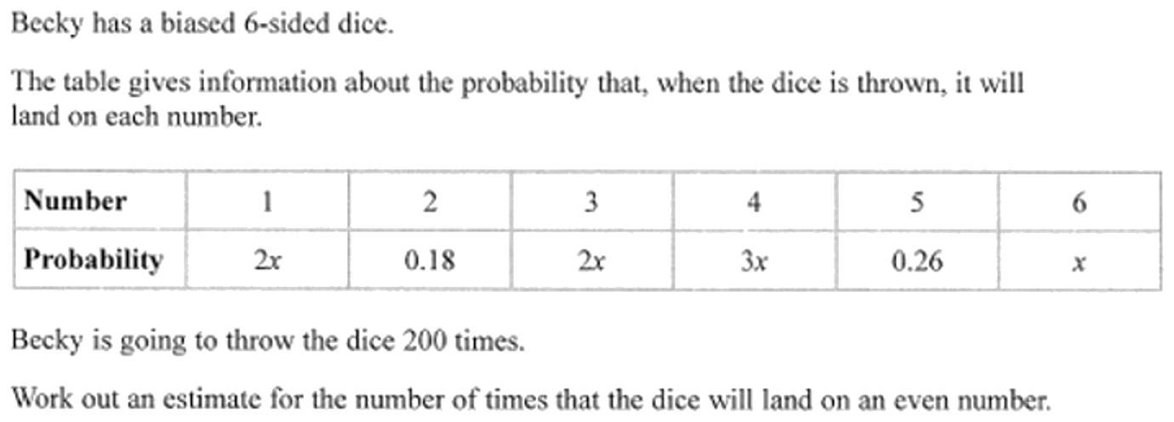
Zπ
PAST-PAPER QUESTION
Question 5

Slide 16
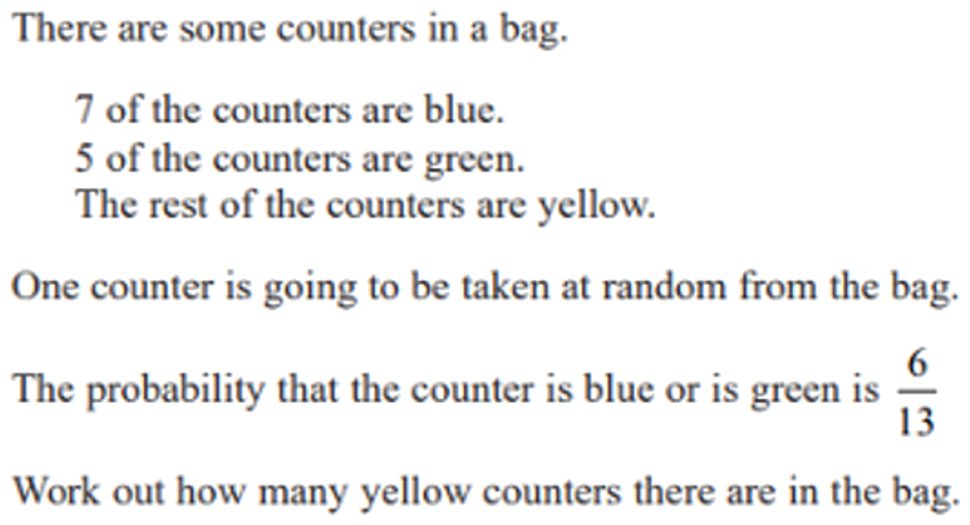
Zπ
PAST-PAPER QUESTION
Question 6

Slide 17
Zπ
RECAP
Key Takeaways
Probability = number of successful outcomes ÷ total outcomes (a value from 0 to 1).
P(not A) = 1 − P(A); all probabilities add up to 1.
Mutually exclusive (‘OR’): P(A or B) = P(A) + P(B).
Combined (‘AND’): P(A and B) = P(A) × P(B); expected number = P × trials.
If probabilities are unknown (x, or x and 2x), use that they all add up to 1 to find x.
Golden rule: OR adds, AND multiplies; and every probability in a table adds up to 1.

