Slide 1
Zπ
Zπ MATHS HUB
Pearson Edexcel IGCSE (9–1) · Higher Tier
Tree Diagrams
Sequential Events · With & Without Replacement · Multiply Along, Add Down
Zahra Sheikh Ali
IGCSE Mathematics Teacher · M.Sc. Differential Geometry & Geometric Control
☎ 66613748 ✉ zahraa.sheikhali@outlook.com

Slide 2
Zπ
LESSON OVERVIEW
One Event After Another
A tree diagram maps out two (or more) events happening in sequence. Each branch carries a probability; you multiply along branches and add the results.
What a tree diagram shows
Multiply along, add down
With replacement
1
2
3
Without replacement
Combining branches
Past-paper questions
4
5
6
Key words: tree diagram · branch · outcome · with / without replacement · multiply along · add down

Slide 3
Zπ
THE KEY IDEA
How a Tree Diagram Works
First event branches, then each branch splits for the second event. Write the probability on every branch.
Second Choice
First Choice
Two golden rules
red
red
1. MULTIPLY along the branches
(‘and’ — first AND second).
2. ADD the branch results going DOWN
(‘or’ — this way OR that way).
Each PAIR of branches adds up to 1.
blue
red
blue
blue
Multiply ALONG (×) for ‘and’; add DOWN (+) for ‘or’.

Slide 4
Zπ
WITH REPLACEMENT
The Probabilities Stay the SAME
Bag: 3 red, 7 blue (10). Take one, PUT IT BACK, take another. Both sets of branches are identical.
R
Second Choice
First Choice
red
red
blue
WITH replacement → the bag resets → the second-choice probabilities are the SAME as the first.
red
blue
The probabilities for each event are shown along the arm of each branch and they sum to 1.
blue
Ends of first and second level branches show the different outcomes.
Probabilities are multiplied along each arm.

Slide 5
Zπ
WITHOUT REPLACEMENT
The Second Probabilities CHANGE
R
Rebecca has nine coloured beads in a bag. Four of the beads are black and the rest are green. She removes a bead at random from the bag and notes the colour before replacing it. She then chooses a second bead. (a) Draw a tree diagram showing all possible outcomes. (b) Calculate the probability that Rebecca chooses: (i) 2 green beads (ii) A black followed by a green bead.
Second Choice
WITHOUT replacement → both the count and the total drop by 1 → second probabilities change.
First Choice
black
black
green
black
green
green

Slide 6





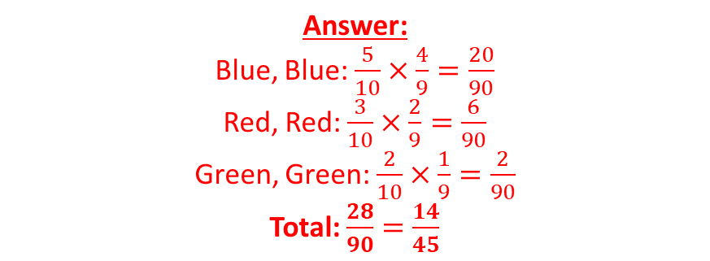





Zπ
COMBINING BRANCHES
‘Same Color’ — Add the Branches
A bag contains 5 blue counters, 3 red counters and 2 green counters. If I take out one counter, without replacement, then another, what is the probability that they will be the same color?
Method
Multiply ALONG each branch you want.
‘Same color’ can happen two ways — find both.
ADD those branch probabilities (‘or’).
Check: all end-probabilities add to 1.
Put on the probabilities
B
B
R
The probabilities of the second pick change depending upon what the first pick was.
G
We have 3 options so need 3 “branches”
B
R
R
G
B
Don’t simplify until the end!
G
R
G
P(Same color) = P(R,R) + P(B,B) + P(G,G)
‘At least one’ is often quickest as 1 − P(none).

Slide 7
Zπ
PART 2
Past-Paper Questions
Draw the tree, multiply along the branches, then add the ones you need.
1
Probability on every branch
2
Multiply ALONG (and)
3
Add DOWN (or)
4
Not replaced → second probs change

Slide 8
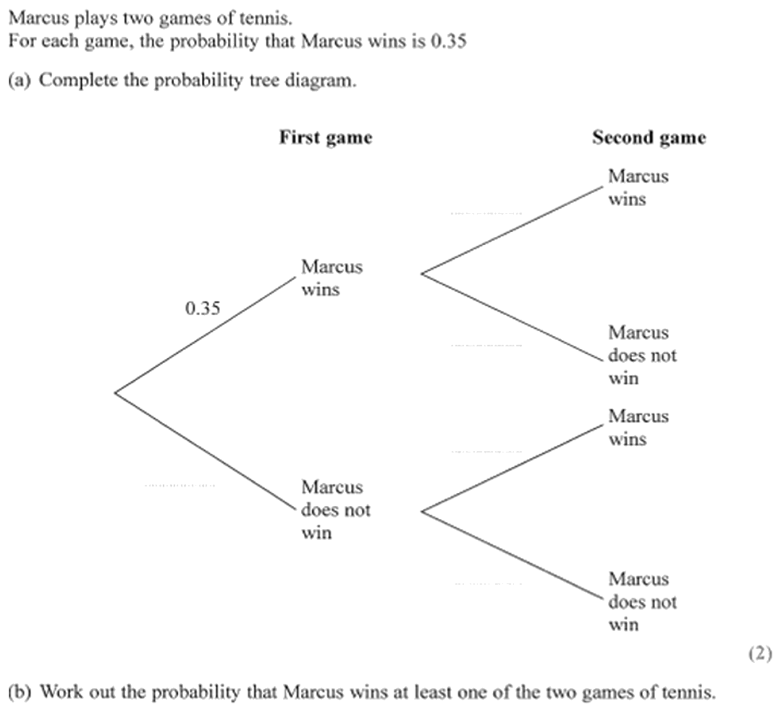
Zπ
PAST-PAPER QUESTION
Question 1

Slide 9
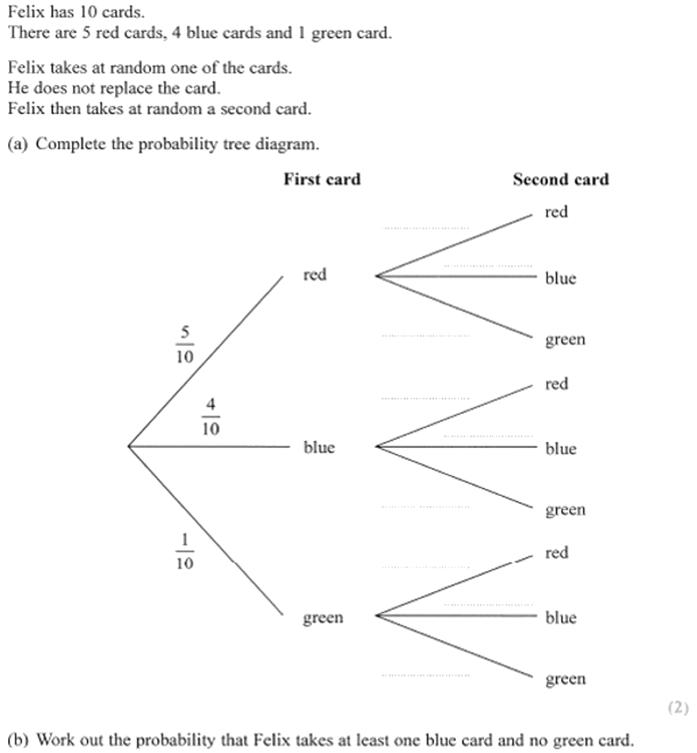
Zπ
PAST-PAPER QUESTION
Question 2

Slide 10
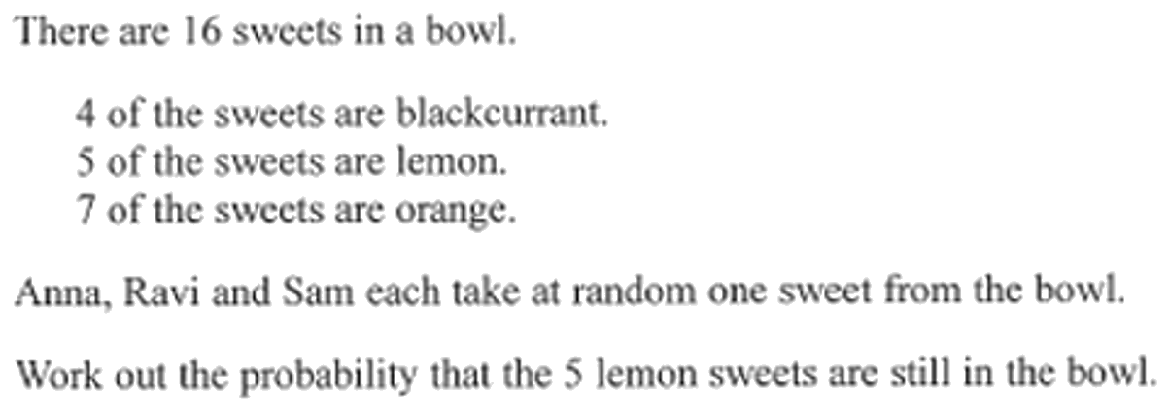
Zπ
PAST-PAPER QUESTION
Question 3

Slide 11
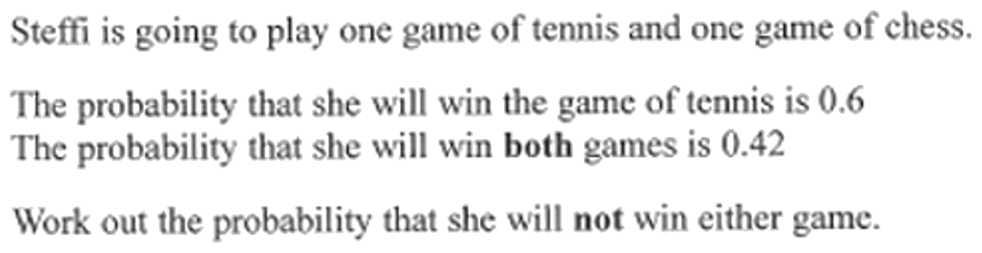
Zπ
PAST-PAPER QUESTION
Question 4

Slide 12
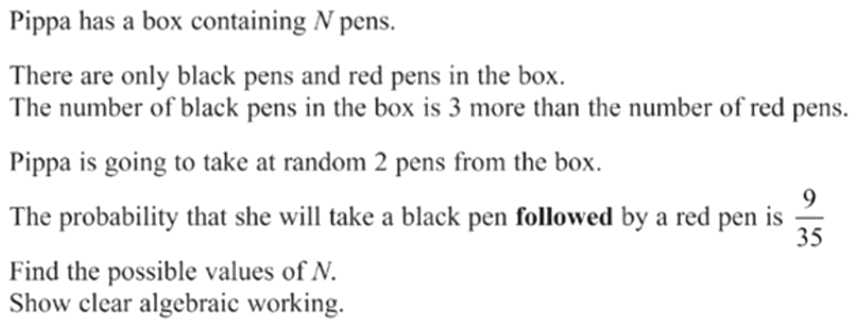
Zπ
PAST-PAPER QUESTION
Question 5

Slide 13
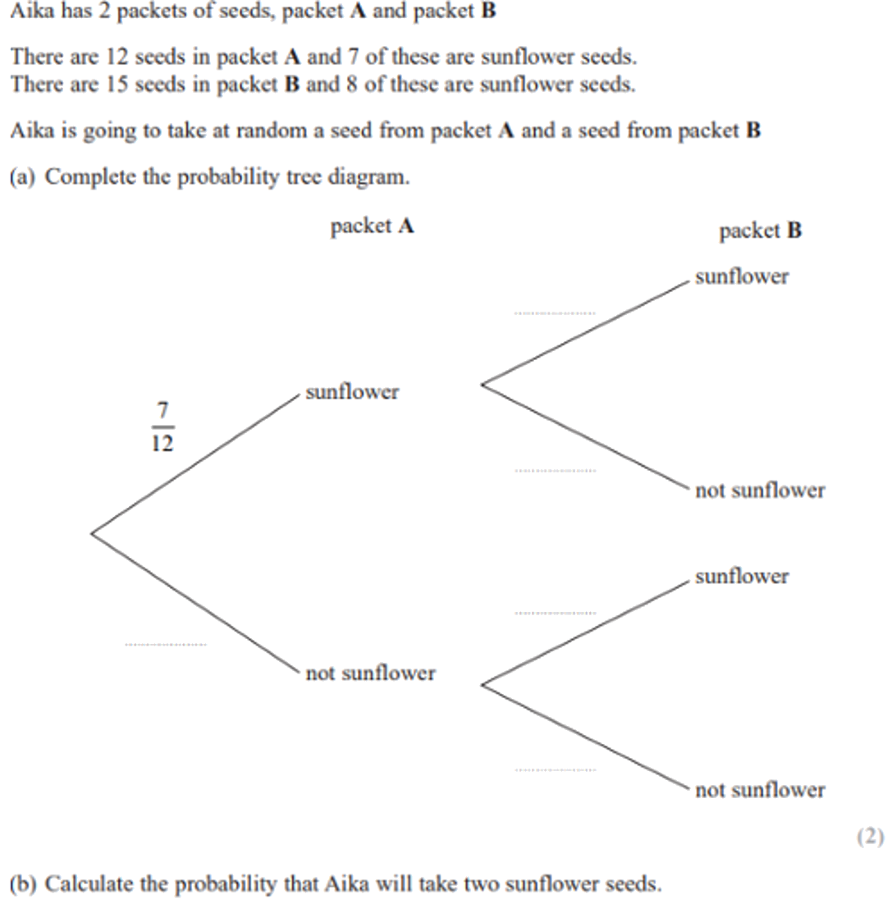
Zπ
PAST-PAPER QUESTION
Question 6

Slide 14
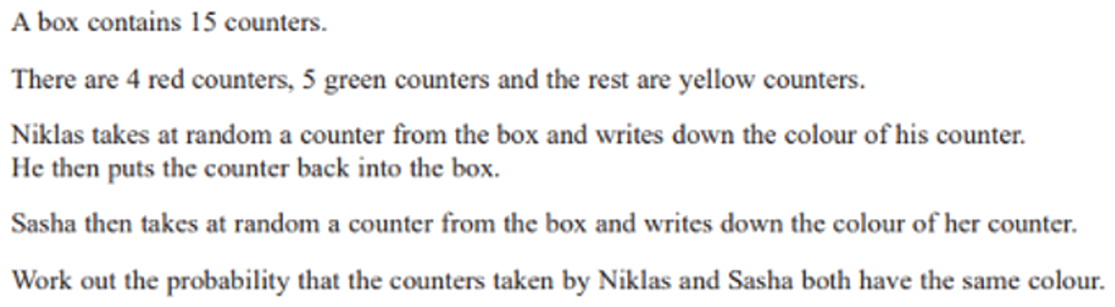
Zπ
PAST-PAPER QUESTION
Question 7

Slide 15
Zπ
RECAP
Key Takeaways
A tree diagram shows events happening one after another, with a probability on each branch.
Multiply ALONG the branches (‘and’); add the results going DOWN (‘or’).
Each pair of branches adds up to 1.
WITH replacement: the second-choice probabilities are the same as the first.
WITHOUT replacement: the count and the total both drop, so the second probabilities change.
Golden rule: multiply along for ‘and’, add down for ‘or’ — and check for replacement.

