Slide 1
Zπ
Zπ MATHS HUB
a
b
Pearson Edexcel IGCSE (9–1) · Higher Tier
+
x + 1
x − 1
Algebraic Fractions
Add & Subtract (number → linear → quadratic) · Multiply & Divide · Solving Equations
Zahra Sheikh Ali
IGCSE Mathematics Teacher · M.Sc. Differential Geometry & Geometric Control
☎ 66613748 ✉ zahraa.sheikhali@outlook.com

Slide 2
Zπ
WARM-UP
It Starts with Number Fractions
To add or subtract: find a common denominator, rewrite each fraction over it, then combine the numerators.
Add
Subtract
2
+
1
=
8
+
3
5
−
3
=
20
−
9
3
4
12
12
6
8
24
24
=
11
=
11
12
24
Every algebraic-fraction question uses this same idea — only the denominators get more interesting.

Slide 3
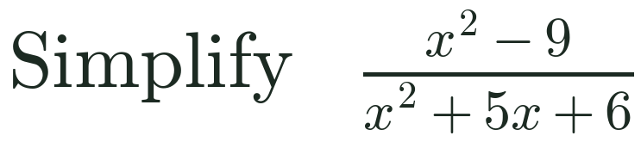
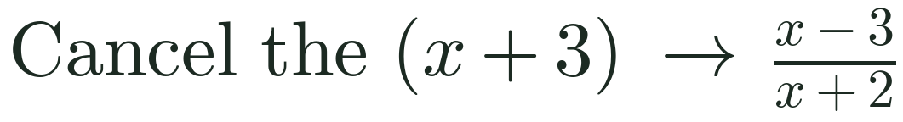

Zπ
SIMPLIFYING
Simplifying Algebraic Fractions
1
Key idea
Factorise the numerator and denominator fully, then cancel any factor that appears on BOTH top and bottom. Never cancel single terms across a + or − sign.
2
Factorise the top: x² − 9 = (x − 3)(x + 3)
3
Factorise the bottom: x² + 5x + 6 = (x + 2)(x + 3)
4
=
x − 3
x + 2

Slide 4
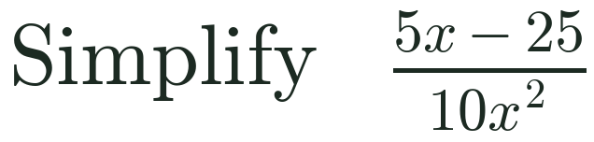
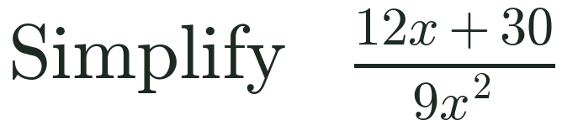
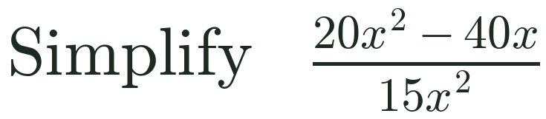
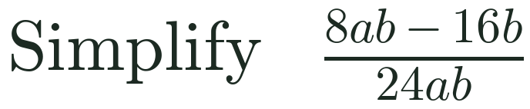
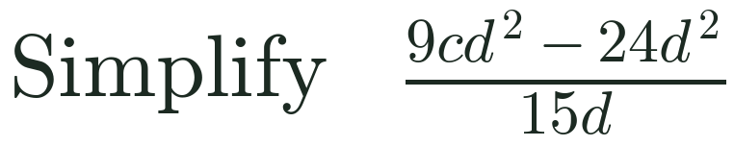
Zπ
PAST-PAPER PRACTICE
Simplify — Past-Paper Practice (1)
Factorise the numerator and denominator, then cancel common factors.
1
[2]
2
[2]
3
[2]
4
[2]
5
[2]
Answers: 1) (x−5)/(2x²) 2) 2(2x+5)/(3x²) 3) 4(x−2)/(3x) 4) (a−2)/(3a) 5) d(3c−8)/5

Slide 5
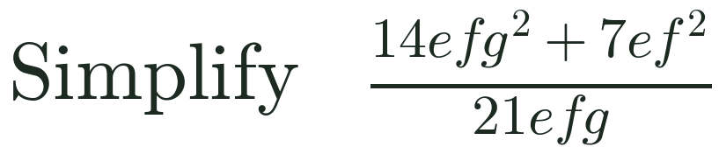
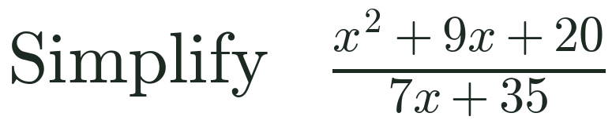
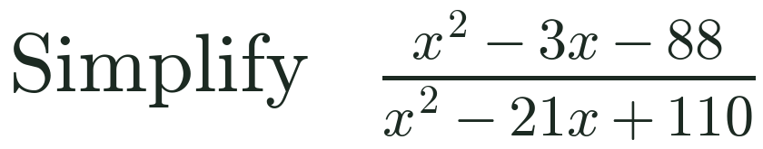
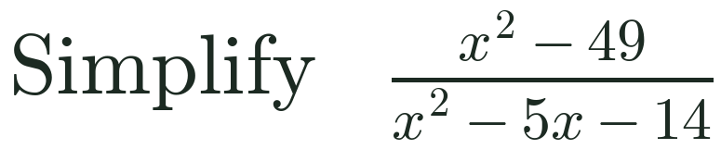
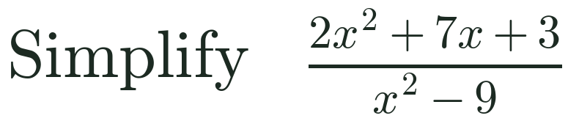
Zπ
PAST-PAPER PRACTICE
Simplify — Past-Paper Practice (2)
Factorise the numerator and denominator, then cancel common factors.
1
[2]
2
[3]
3
[3]
4
[3]
5
[3]
Answers: 1) (f+2g²)/(3g) 2) (x+4)/7 3) (x+8)/(x−10) 4) (x+7)/(x+2) 5) (2x+1)/(x−3)

Slide 6
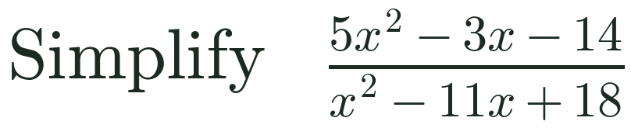
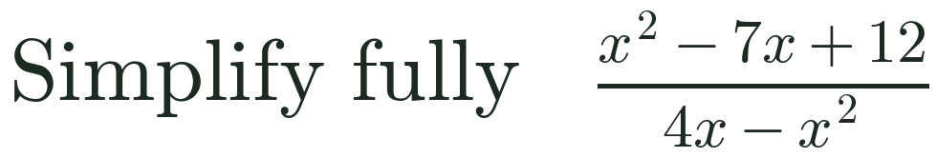
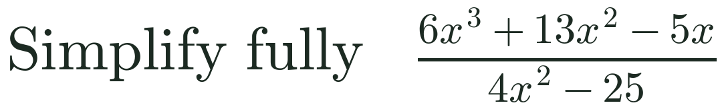
Zπ
PAST-PAPER PRACTICE
Simplify Fully — Past-Paper Practice (3)
Factorise the numerator and denominator, then cancel common factors.
1
[3]
2
[3]
3
[4]
Answers: 1) (5x+7)/(x−9) 2) (3−x)/x 3) x(3x−1)/(2x−5)

Slide 7
Zπ
PART 1
Adding & Subtracting
Build up the denominator: a number, then linear, then quadratic.
1
Find the common denominator
2
Rewrite each fraction over it
3
Combine the numerators
4
Simplify — factorise & cancel

Slide 8
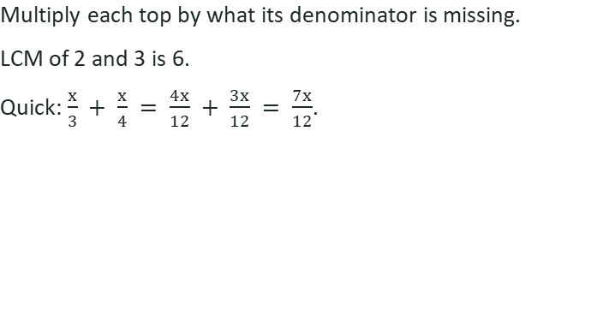

Zπ
DENOMINATOR = A NUMBER
Number Denominators
1
Key idea
2
Common denominator = 6
3
4
Top: 3x + 3 + 2x − 4 = 5x − 1
=
5x − 1
6
With number denominators the common denominator is just the LCM of the numbers.

Slide 9

Zπ
DENOMINATOR = A NUMBER
Subtracting with Number Denominators
1
Watch the signs
The minus sign multiplies the whole second numerator.
− 5(x − 3) = − 5x + 15.
A sign slip here is the most common error.
2
Common denominator = 20
3
4
Top: 8x + 4 − 5x + 15 = 3x + 19
=
3x + 19
20
Subtracting flips the sign of every term in the second numerator.

Slide 10
Zπ
DENOMINATOR = LINEAR
When the Denominator Contains x
The common denominator is the product of the linear denominators. Multiply each fraction top and bottom by the factor it is missing, then combine.
General pattern
a
+
b
=
a(x + q) + b(x + p)
x + p
x + q
(x + p)(x + q)
Multiply the two different denominators together to get the common denominator.

Slide 11

Zπ
DENOMINATOR = LINEAR
Adding with Linear Denominators
1
Key idea
Multiply the two denominators to get the common one.
(x + 1)(x − 1) = x² − 1.
Expand the top; you may leave the bottom factorised.
2
Common denominator = (x + 1)(x − 1)
3
Top: 3(x − 1) + 2(x + 1)
4
= 3x − 3 + 2x + 2 = 5x − 1
=
5x − 1
x² − 1

Slide 12

Zπ
DENOMINATOR = LINEAR
Subtracting with Linear Denominators
1
Watch the signs
− 3(x + 2) = − 3x − 6, not − 3x + 6.
Use brackets every time you subtract.
Leave the denominator factorised.
2
Common denominator = (x + 2)(x − 1)
3
Top: 5(x − 1) − 3(x + 2)
4
= 5x − 5 − 3x − 6 = 2x − 11
=
2x − 11
(x + 2)(x − 1)

Slide 13
Zπ
DENOMINATOR = QUADRATIC
Factorise the Denominator First
Always factorise a quadratic denominator first. Often one denominator already contains the other's factor, so the common denominator is smaller than you expect.
Spot the shared factor
3
=
3
x² − 1
(x + 1)(x − 1)
Because x² − 1 = (x + 1)(x − 1), a fraction over (x + 1) only needs one extra factor.

Slide 14

Zπ
DENOMINATOR = QUADRATIC
Quadratic Denominators (1)
1
Key idea
The first denominator already IS the common denominator.
Only the second fraction needs multiplying by (x − 1).
3 + 2(x − 1) = 3 + 2x − 2 = 2x + 1.
2
Factorise: x²−1 = (x+1)(x−1)
3
Common denominator = (x + 1)(x − 1)
4
Top: 3 + 2(x − 1) = 2x + 1
=
2x + 1
x² − 1

Slide 15

Zπ
DENOMINATOR = QUADRATIC
Quadratic Denominators (2)
1
Watch the signs
Subtracting (x + 3): x − x − 3 = − 3.
The x-terms cancel — a tidy constant numerator.
Leave the denominator factorised.
2
Factorise: x²+5x+6 = (x+2)(x+3)
3
Common denominator = (x + 2)(x + 3)
4
Top: x − (x + 3) = − 3
=
− 3
(x + 2)(x + 3)

Slide 16
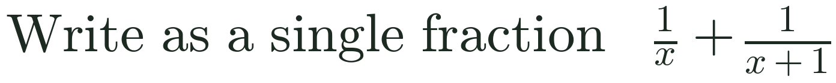
Zπ
PAST-PAPER PRACTICE
Add & Subtract — Exam Questions
Write each as a single fraction in its simplest form. Show every line.
1
[3]
2
[3]
3
[2]
4
[3]
5
[3]
Answers: 1) (5x+7)/[(x+3)(x−1)] 2) (x+10)/[(x−2)(x+1)] 3) (2x+1)/[x(x+1)] 4) (x²+2x+6)/[(x+2)(x−1)] 5) (8−x)/[(x+3)(x−3)]

Slide 17
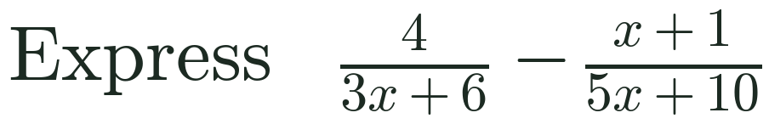
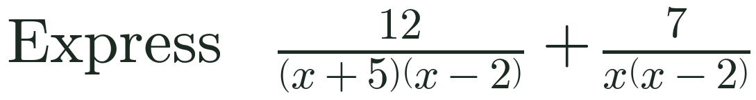
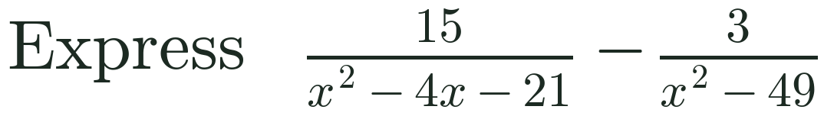
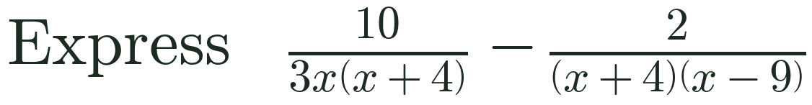
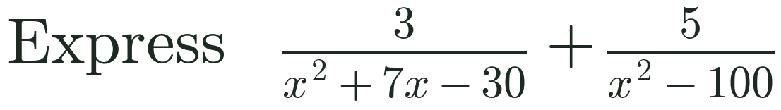
Zπ
PAST-PAPER PRACTICE
Add & Subtract — More Past-Paper Questions
Write each as a single fraction in its simplest form. Factorise the denominators first.
1
[3]
2
[3]
3
[4]
4
[4]
5
[4]
Answers: 1) (17−3x)/[15(x+2)] 2) (19x+35)/[x(x−2)(x+5)] 3) 12(x+8)/[(x−7)(x+3)(x+7)] 4) (4x−90)/[3x(x−9)(x+4)] 5) (8x−45)/[(x−10)(x−3)(x+10)]

Slide 18
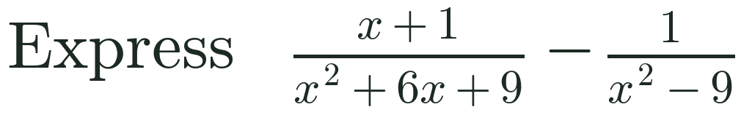
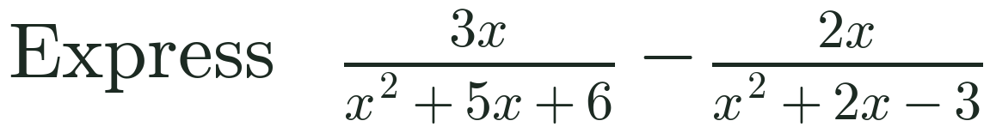
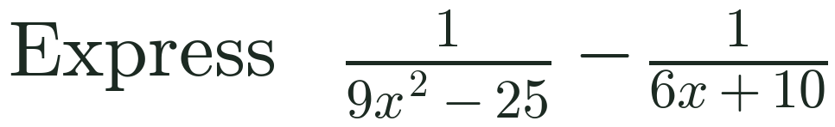
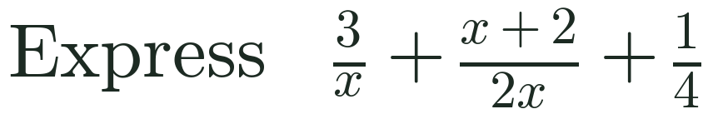
Zπ
PAST-PAPER PRACTICE
Add & Subtract — Harder Past-Paper Questions
Factorise every denominator first, then find the common denominator.
1
[4]
2
[4]
3
[4]
4
[3]
Answers: 1) (x²−3x−6)/[(x−3)(x+3)²] 2) x(x−7)/[(x−1)(x+2)(x+3)] 3) (7−3x)/[2(3x−5)(3x+5)] 4) (3x+16)/(4x)

Slide 19
Zπ
PART 2
Multiplying & Dividing
Factorise everything, then cancel. To divide, flip and multiply.
1
Factorise each numerator and denominator
2
Multiply: tops × tops, bottoms × bottoms
3
Divide: keep, flip the 2nd, multiply
4
Cancel common factors

Slide 20

Zπ
MULTIPLYING
Multiplying Algebraic Fractions
1
Key idea
No common denominator needed for ×.
Factorise first so you can cancel.
Multiply numerators together and denominators together.
2
Factorise: x²−4 = (x−2)(x+2)
3
4
=
x
x − 2

Slide 21

Zπ
DIVIDING
Dividing Algebraic Fractions
1
Keep – Flip – Multiply
Dividing = multiplying by the reciprocal.
Only the second fraction flips.
Then factorise and cancel as usual.
2
3
Factorise: x²−1 = (x+1)(x−1)
4
=
x − 1
2

Slide 22

Zπ
MULTIPLY & DIVIDE
Factorise, then Cancel
1
Key idea
Factorise every quadratic before cancelling.
Cancel factors that appear on top and bottom.
Never cancel single terms across a + or − sign.
2
3
4
=
x + 3
x

Slide 23
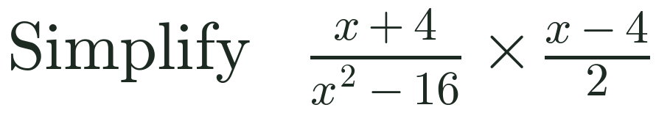
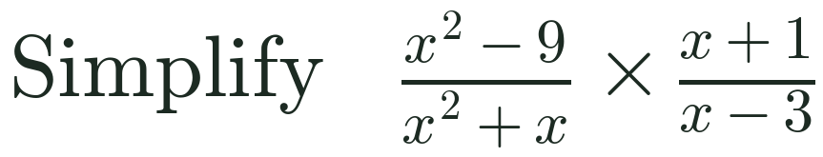
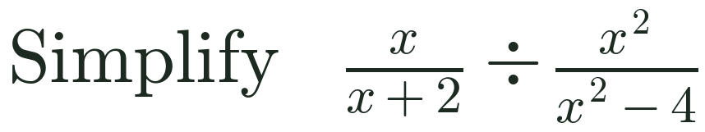
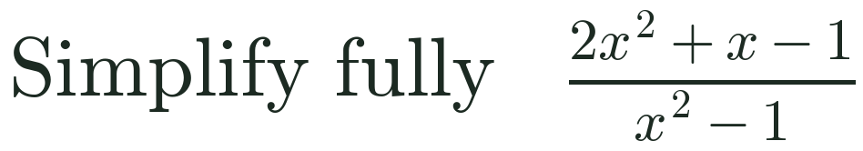
Zπ
PAST-PAPER PRACTICE
Multiply, Divide & Simplify — Exam Questions
Simplify each expression fully. Factorise first, then cancel.
1
[3]
2
[3]
3
[3]
4
[3]
Answers: 1) 1/2 2) (x+3)/x 3) (x−2)/x 4) (2x−1)/(x−1)

Slide 24
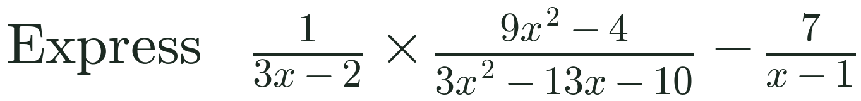
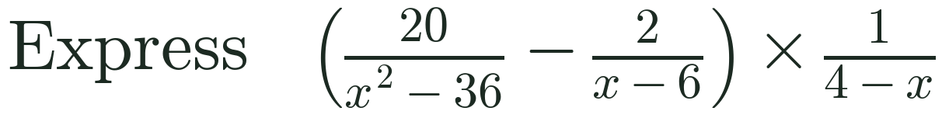
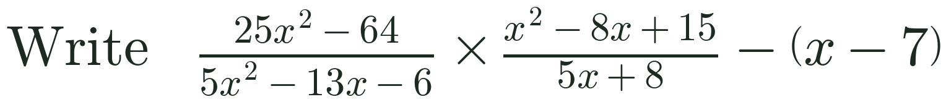
Zπ
PAST-PAPER PRACTICE
Multiply, Divide & Combine — Past-Paper Questions
Factorise first, cancel, then combine. Show clear algebraic working.
1
[4]
2
[4]
3
[5]
Answers: 1) (34−6x)/[(x−5)(x−1)] 2) 2/[(x−6)(x+6)] 3) 54/(5x+2)

Slide 25
Zπ
PART 3
Solving Equations
Clear the fractions first — then solve what is left.
1
Equal to a number
2
Equal to a linear expression
3
A sum of fractions = a number
4
Equations that become quadratic

Slide 26
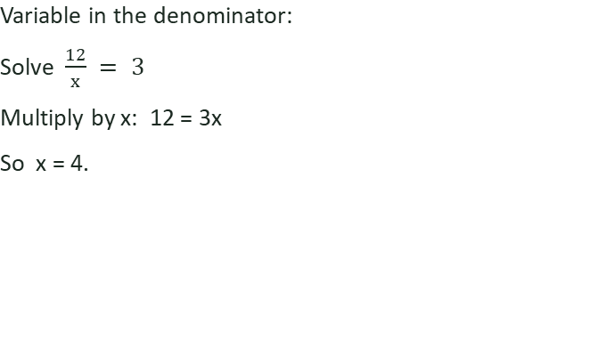
Zπ
SOLVING · = A NUMBER
When a Fraction Equals a Number
1
Another type
2
Multiply both sides by 4:
3
x + 3 = 8
4
Subtract 3: x = 5
x = 5
Multiply both sides by the denominator to remove the fraction.

Slide 27
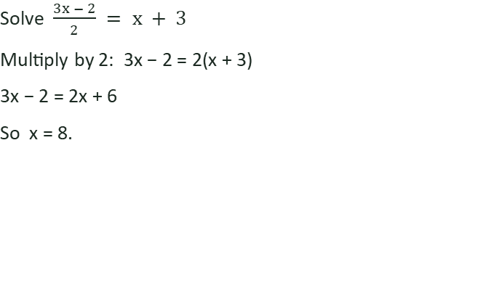
Zπ
SOLVING · = A LINEAR EXPRESSION
When a Fraction Equals an Expression
1
Another type
2
Multiply both sides by 3:
3
2x + 1 = 3(x − 1)
4
2x + 1 = 3x − 3 → x = 4
x = 4
Multiply out the bracket, gather the x-terms, then solve.

Slide 28
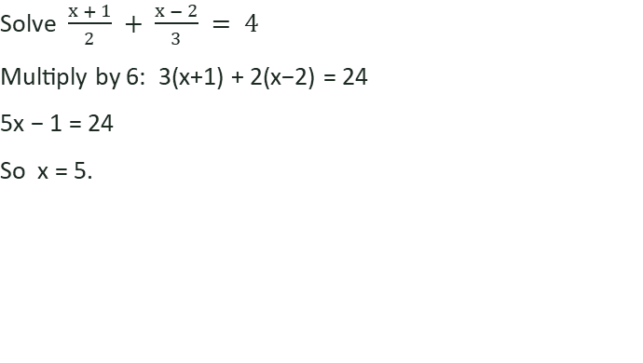
Zπ
SOLVING · A SUM = A NUMBER
Add the Fractions, then Solve
1
Another type
2
Multiply every term by 6:
3
3x + 2x = 30
4
5x = 30 → x = 6
x = 6
Multiplying every term by the common denominator clears all fractions at once.

Slide 29
Zπ
SOLVING · BECOMES QUADRATIC
When Solving Gives a Quadratic
1
Key idea
A variable in the denominator often leads to a quadratic.
Bring everything to one side: = 0.
Factorise and read off both solutions.
2
Multiply every term by x:
3
x² + 6 = 5x
4
x² − 5x + 6 = 0 → (x−2)(x−3) = 0
x = 2 or x = 3
Always check for two solutions when the equation becomes quadratic.

Slide 30
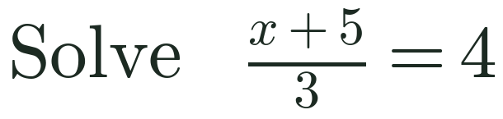
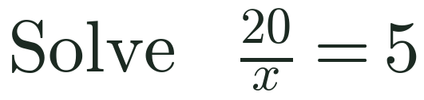
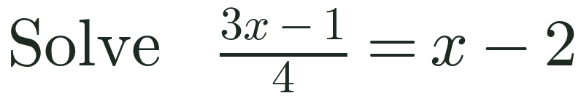
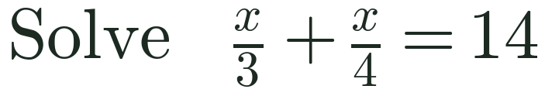
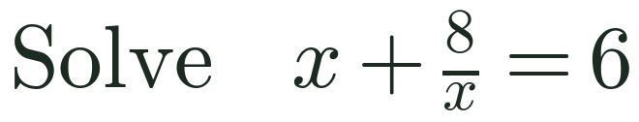
Zπ
PAST-PAPER PRACTICE
Solving — Exam Questions
Solve each equation. Show your method clearly.
1
[2]
2
[2]
3
[3]
4
[3]
5
[3]
Answers: 1) x = 7 2) x = 4 3) x = 7 4) x = 24 5) x = 2 or x = 4

Slide 31
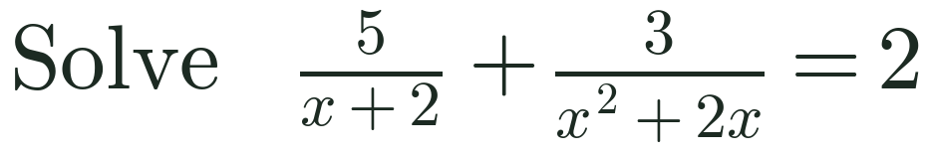
Zπ
PAST-PAPER PRACTICE
Solving & Rearranging — Past-Paper Questions
Show clear algebraic working for each.
1
[4]
2
[4]
Answers: 1) x = −1 or x = 3/2 2) a = (3 − 4y)/(2y − 3)

Slide 32
Zπ
RECAP
Key Takeaways
Add / subtract: common denominator first — number, then linear, then quadratic.
Factorise quadratic denominators; often one already contains the other's factor.
Multiply: multiply tops and bottoms, factorise and cancel — no common denominator needed.
Divide: keep the first, flip the second, multiply.
Solve: multiply every term by the denominator to clear fractions, then solve (watch for quadratics).
Golden rule: never cancel single terms across a + or − sign — only cancel whole factors.

