Slide 1






Adaptive Sparsity Level during Training for Efficient Time Series Forecasting
with Transformers
Zahra Atashgahi*, Mykola Pechenizkiy, Raymond Veldhuis, and Decebal Constantin Mocanu
11 September 2024
ECML-PKDD 2024 | Vilinus, Lithuania
9-13 September 2024

Slide 2
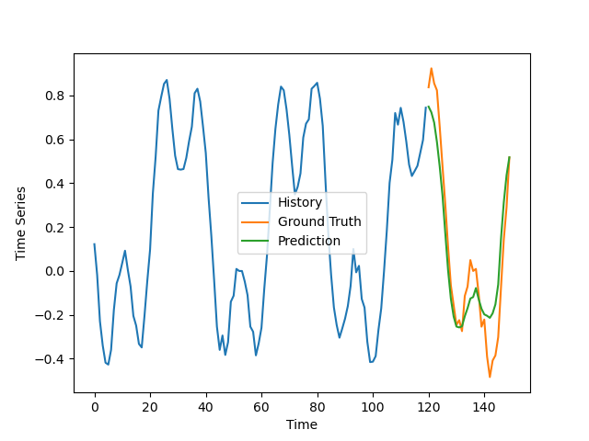
Time Series Forecasting with Transformers
Time series forecasting in real-world applications
Weather forecasting
Energy management
Financial analysis
Transformers
Increase the capacity for time series forecasting
Good performance in various tasks
Challenge → Transformers are known to be computationally expensive!
Wen, Q., Zhou, T., Zhang, C., Chen, W., Ma, Z., Yan, J., & Sun, L. (2023, August). Transformers in time series: a survey. In Proceedings of the Thirty-Second International Joint Conference on Artificial Intelligence.

Slide 3
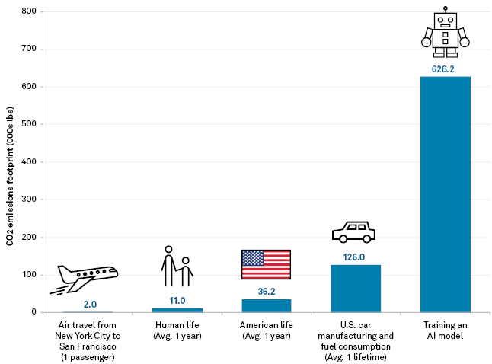
Carbon Footprint of Training AI Models
Training Transformer (big) w/ neural architecture search
Strubell, E., Ganesh, A., & McCallum, A. (2019). Energy and policy considerations for deep learning in NLP. S&P Global.

Slide 4


How can we reduce the computational and memory overheads of training and deploying transformers for time series forecasting without compromising the performance?
4

Slide 5
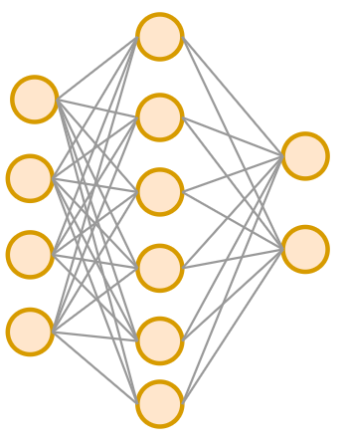
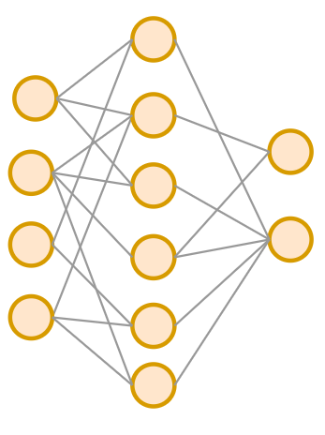
Background: Sparse Neural Networks
Unimportant connections can be dropped, without compromising accuracy
FLOPs (computation)
Parameter Count (memory)
Dense Neural Network
Sparse Neural Network
Hoefler, T., Alistarh, D., Ben-Nun, T., Dryden, N., & Peste, A. (2021). Sparsity in deep learning: Pruning and growth for efficient inference and training in neural networks. The Journal of Machine Learning Research.

Slide 6

How to obtain Sparse Neural Networks?
Dense Neural Network
Sparse Neural Network

Slide 7
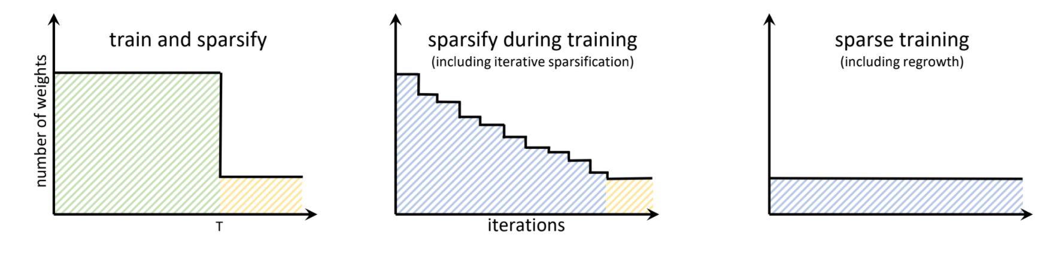
How to obtain Sparse Neural Networks?
Sparse-to-sparse
Dense-to-sparse
Hoefler, T., Alistarh, D., Ben-Nun, T., Dryden, N., & Peste, A. (2021). Sparsity in deep learning: Pruning and growth for efficient inference and training in neural networks. The Journal of Machine Learning Research.

Slide 8
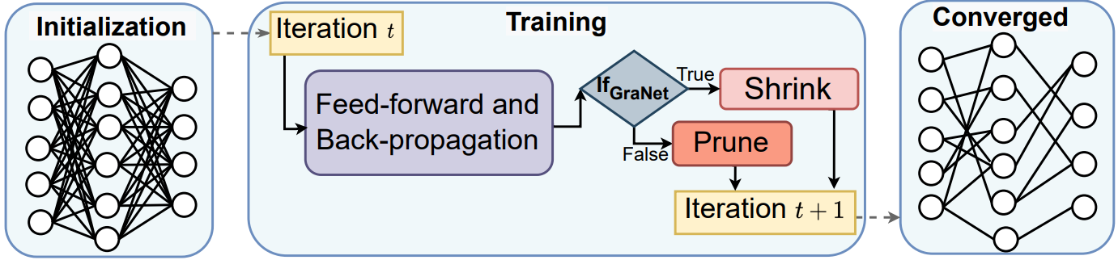
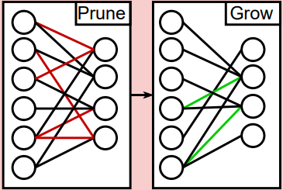

Background: During-Training Pruning
Liu, S., Chen, T., Chen, X., Atashgahi, Z., Yin, L., Kou, H., ... & Mocanu, D. C. (2021). Sparse training via boosting pruning plasticity with neuroregeneration. Advances in Neural Information Processing Systems, 34, 9908-9922.

Slide 9
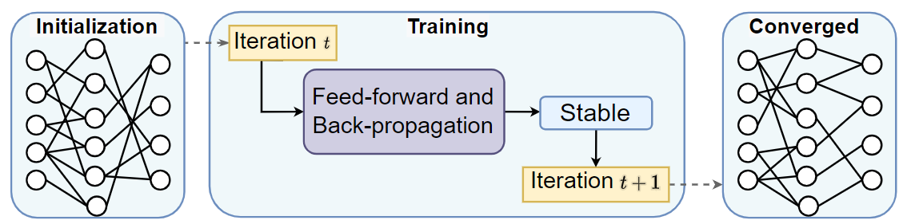
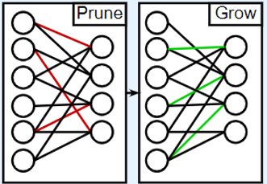
Background: Dynamic Sparse Training (DST)
Challenges of existing approach
Random search: Low training speed
Mocanu, D. C., Mocanu, E., Pinto, T., Curci, S., Nguyen, P. H., Gibescu, M., ... & Vale, Z. A. (2021). Sparse training theory for scalable and efficient agents. AAMAS '21.

Slide 10
Analyzing Sparsity Effect in Transformers for Time Series Forecasting

Slide 11
Experimental Settings
Time series forecasting transformers
NSTransformer
Autoformer
FEDformer
Informer
Vanilla transformer
Loss
MSE (prediction, ground truth)
Pruning algorithm
GraNet
During-training pruning

Slide 12
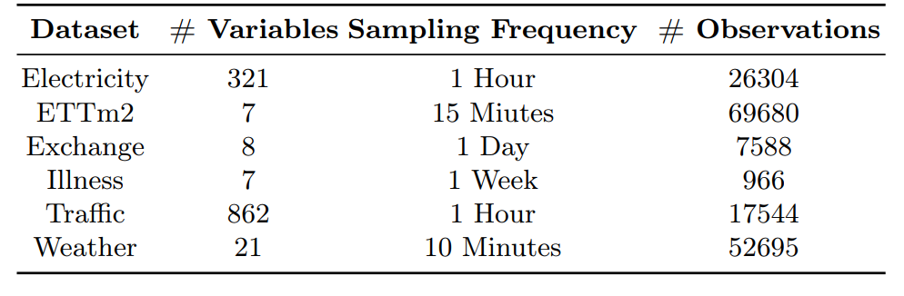
Datasets

Slide 13
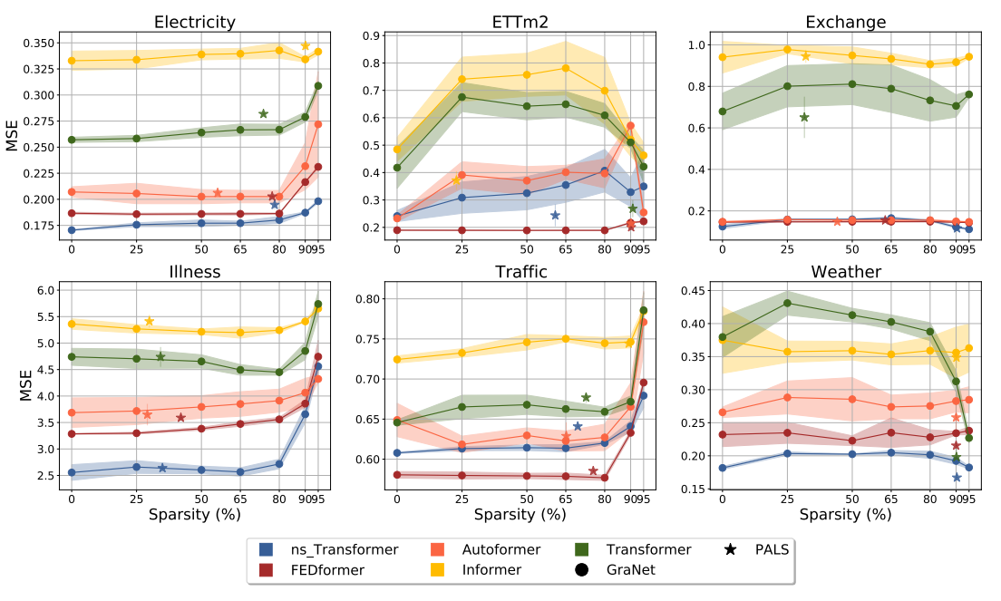
Challenge: Optimal Sparsity Level
Solution → Automatically tuning the sparsity level
Wen, Q., Zhou, T., Zhang, C., Chen, W., Ma, Z., Yan, J., & Sun, L. (2023, August). Transformers in time series: a survey. In Proceedings of the Thirty-Second International Joint Conference on Artificial Intelligence.

Slide 14
Time Series Forecasting with Transformers
Challenge → Transformers are known to be computationally expensive
Solution → Pruning transformers
Challenge → Applying sparsity for time series forecasting task is not trivial and an optimal sparsity level can be very different in each setting (models, datasets, prediction window)
Solution → Automatically tuning the sparsity level
Wen, Q., Zhou, T., Zhang, C., Chen, W., Ma, Z., Yan, J., & Sun, L. (2022). Transformers in time series: A survey. arXiv preprint arXiv:2202.07125.

Slide 15
Methodology

Slide 16
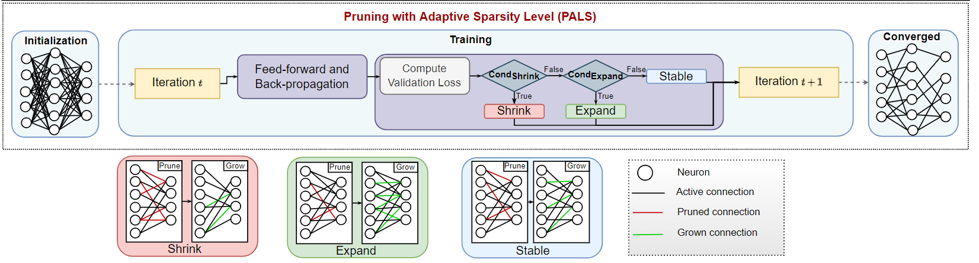


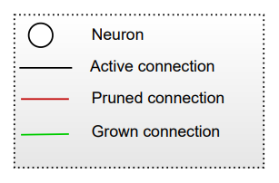
Adaptive sparsity level during training for efficient time series forecasting with transformers
DST
GMP
(Pruning with Adaptive Sparsity Level) PALS
Weight update mechanism(s)
Tuning sparsity level during training
Atashgahi, Z., Veldhuis, R., & Pechenizkiy, M, Mocanu, D. C.. (2023). Pruning Transformers During Training with Adaptive Sparsity for Efficient Time Series Forecasting.

Slide 17
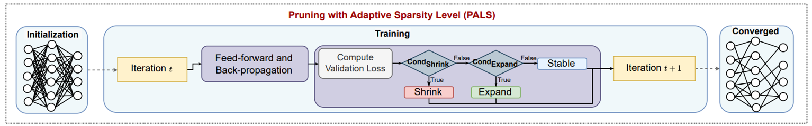
Adaptive sparsity level during training for efficient time series forecasting with transformers
Atashgahi, Z., Veldhuis, R., & Pechenizkiy, M, Mocanu, D. C.. (2023). Pruning Transformers During Training with Adaptive Sparsity for Efficient Time Series Forecasting.

Slide 18
Results

Slide 19
Results
PALS reduces 65% memory and 63% computational costs on average.

Slide 20
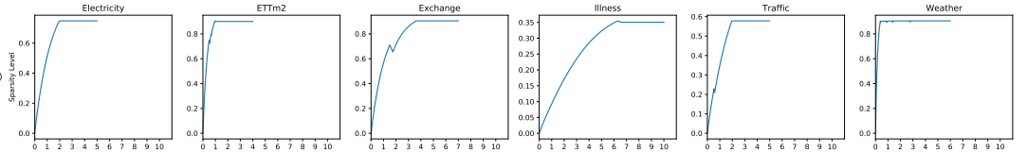
Sparsity Level During Training
PALS finds a sparse topology fast

Slide 21
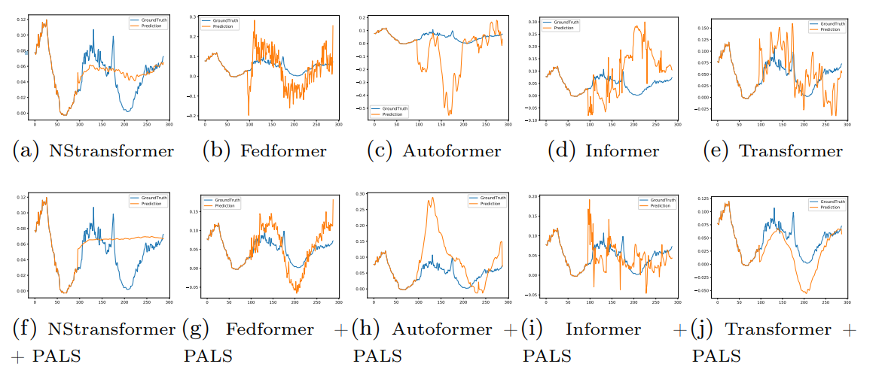
Results on the Weather Dataset

Slide 22
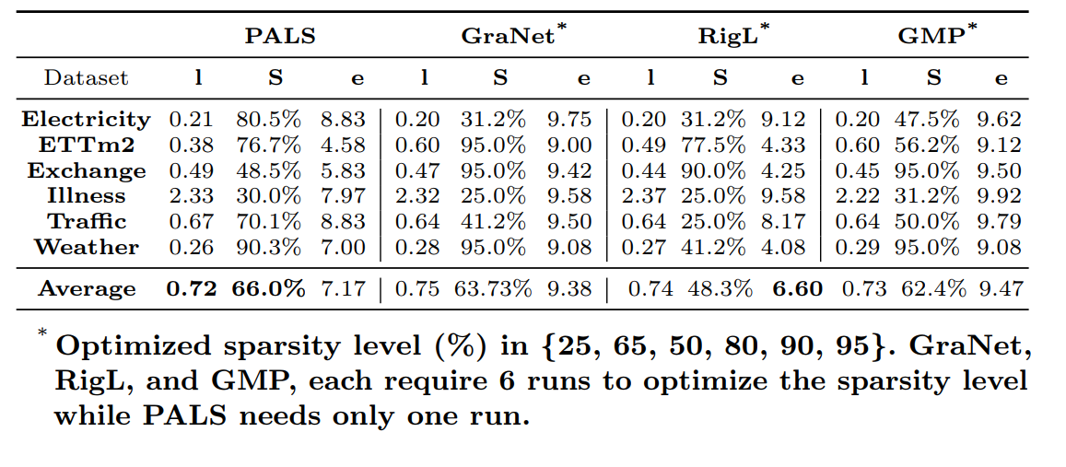
Comparison with other Approaches to Gain Sparsity
PALS can find a sparser and more accurate model (on average) compared to the competitors without optimizing the sparsity level
Atashgahi, Z., Veldhuis, R., & Pechenizkiy, M, Mocanu, D. C.. (2023). Pruning Transformers During Training with Adaptive Sparsity for Efficient Time Series Forecasting.

Slide 23
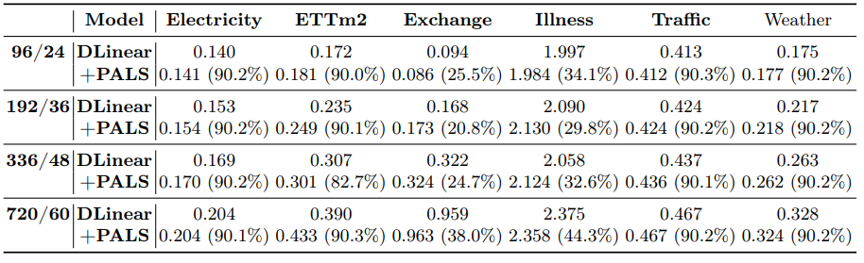
Results on DLinear model
PALS can be applied to various models
Atashgahi, Z., Veldhuis, R., & Pechenizkiy, M, Mocanu, D. C.. (2023). Pruning Transformers During Training with Adaptive Sparsity for Efficient Time Series Forecasting.

Slide 24
Conclusions
Efficient time series forecasting with Transformers
Pruning with adaptive sparsity level (PALS)
Automatic tuning of sparsity level
Introducing Expand mechanism
Future direction
Truly sparse implementation on GPU
Start with highly sparse networks

Slide 25



Acknowledgement
Prof. dr. Decebal Mocanu
University of Luxembourg
Prof. dr. Raymond Veldhuis
University of Twente
Prof. dr. Mykola Pechenizkiy
Eindhoven University of Technology

Slide 26




Thank you!
Questions?
Contact: z.atashgahi@utwente.nl

