Slide 1

From Dark Matter to Galaxies with Convolutional Networks
Based on paper by Zhang et. al. (1902.05965)
Laya Ghodsi, Setare Foroozan, , Zahra Baghkhani, Arefe Abghari ,Mohammad Hadi Sotoudeh
Machine Learning Course project
Under the supervision of Dr. Sadegh Raeisi
5/24/19

Slide 2
Overview
1
Introduction
2
data
3
regression
4
Convolutional network
5
result

Slide 3
Introduction: From Darkness to light
Dark matter halos form the skeleton inside which galaxies form, evolve, and merge. Hence, the behaviors, such as growth, internal properties, and spatial distribution of galaxies, are likely to be closely connected to the behaviors of dark matter halos.

Slide 4
Introduction: From Darkness to light
Computer simulations are being widely used in cosmological studies, they can help determine if a set of rules or specific parameters can lead to the observed Universe
They are computationally significantly less expensive than when we include other complex physics such as hydrodynamics and astrophysical processes.

Slide 5
DATA
1
Dark matter-only simulation
2
gravito-hydrodynamics simulation

Slide 6
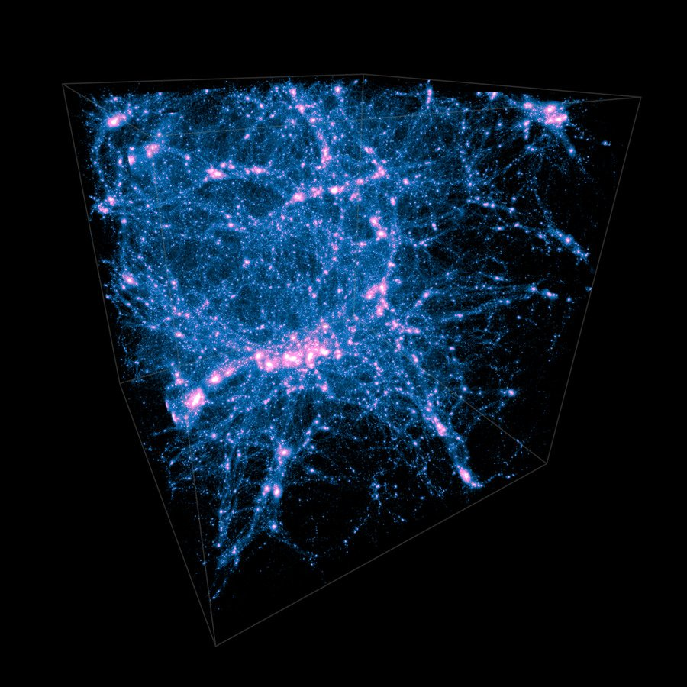
Illustris simulation
Dark matter distribution

Slide 7
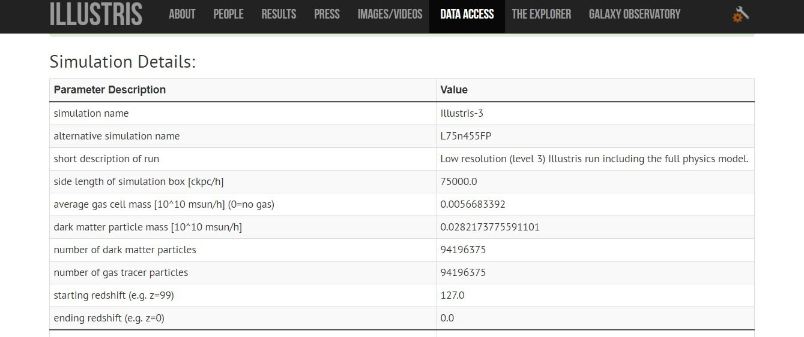
Illustris simulation

Slide 8
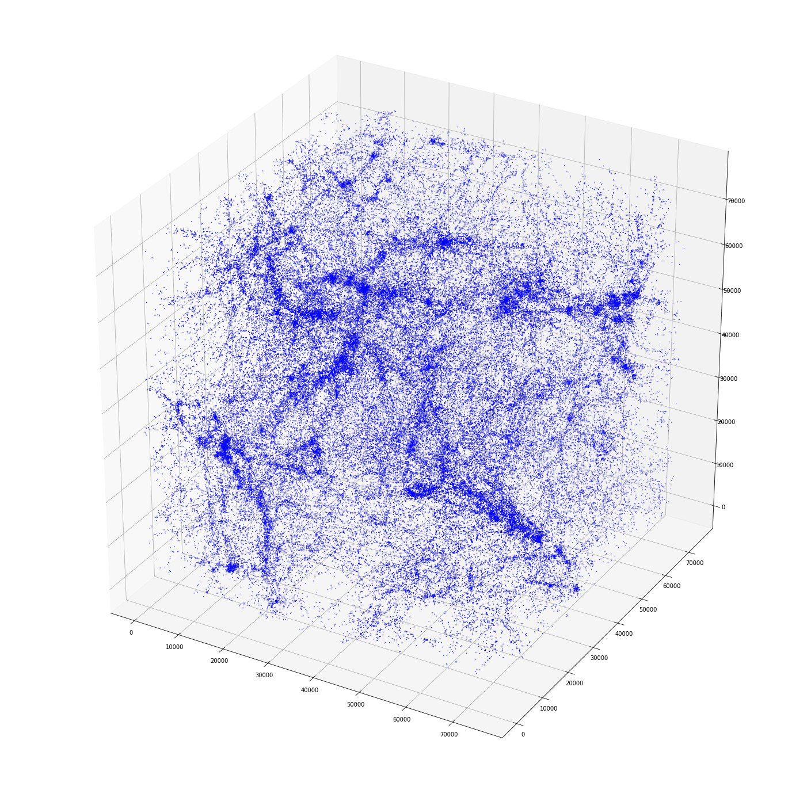
Illustris simulation

Slide 9
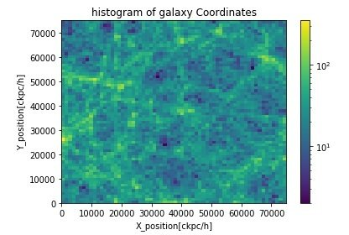
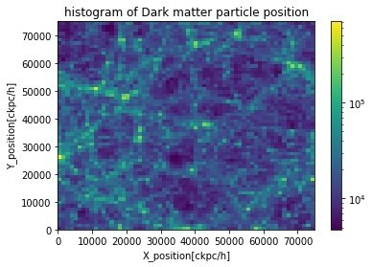
Illustris simulation

Slide 10
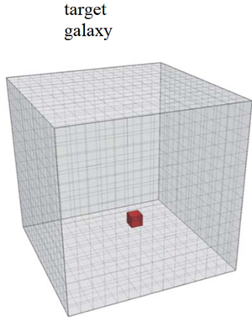
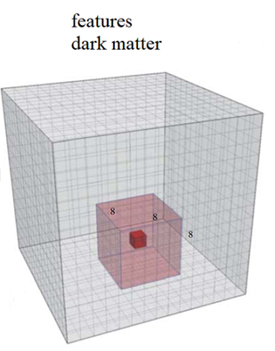
Grid the Box and making sampels

Slide 11
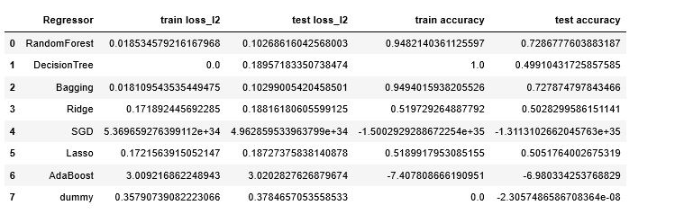
Try some Regressor

Slide 12
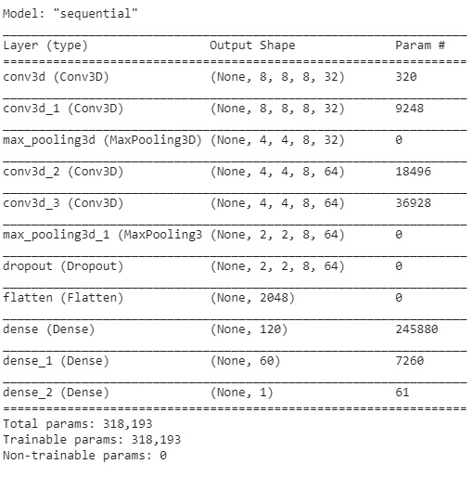
Convolutional neural network 1

Slide 13
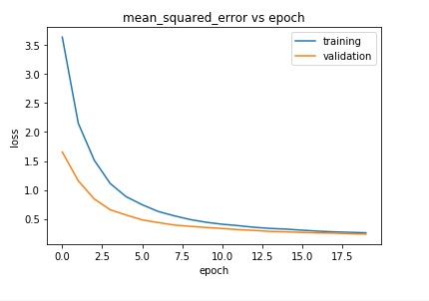
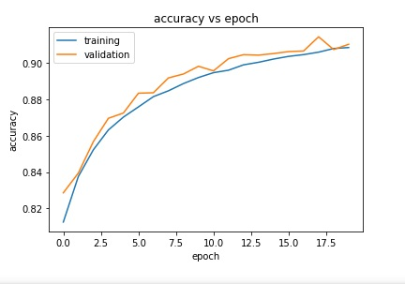
Convolutional neural network 1

Slide 14
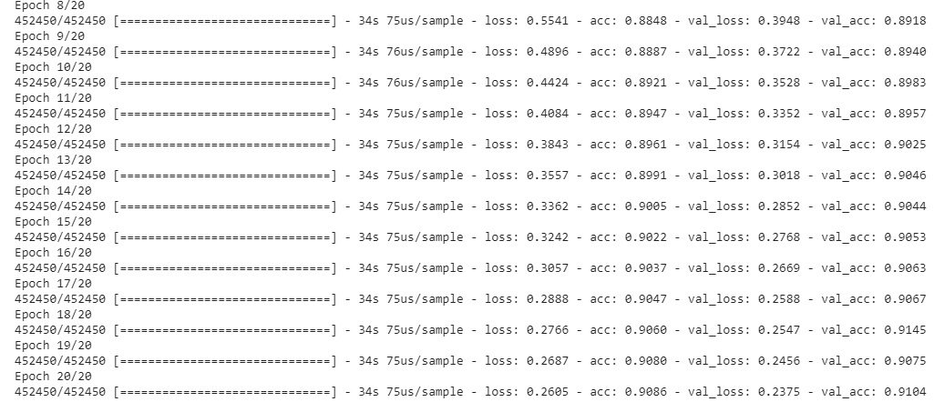
Convolutional neural network 1

Slide 15
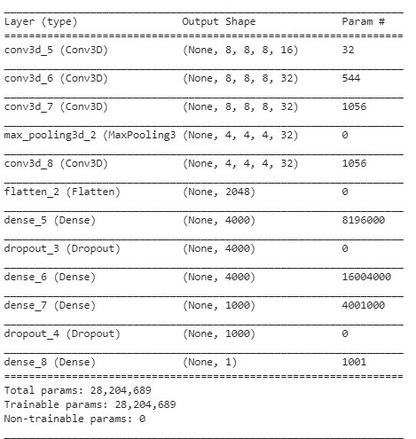
Convolutional neural network 2

Slide 16
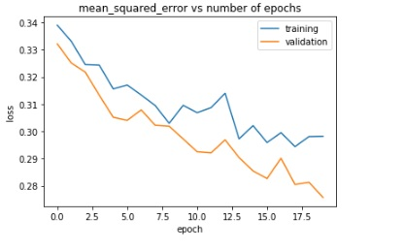
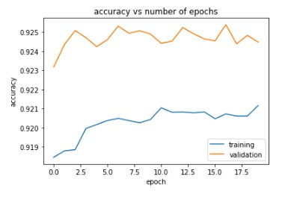
Convolutional neural network 2

Slide 17
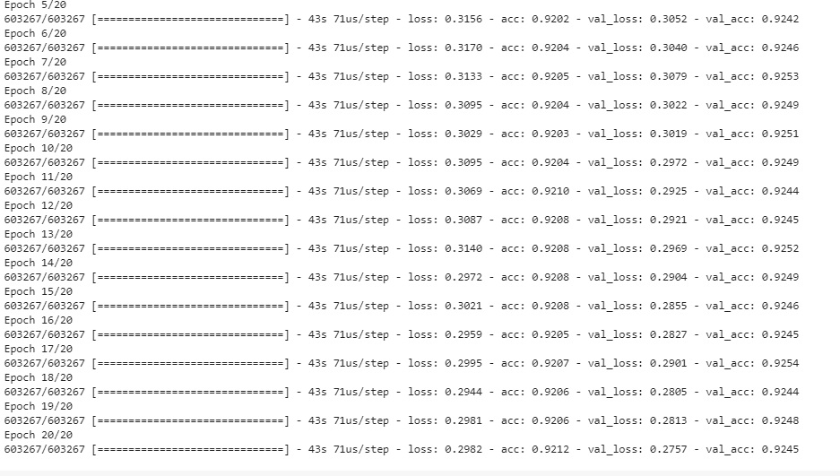
Convolutional neural network 2

Slide 18
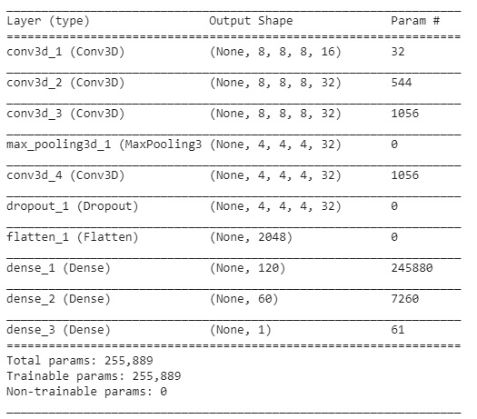
Convolutional neural network 3

Slide 19
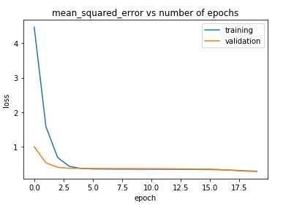
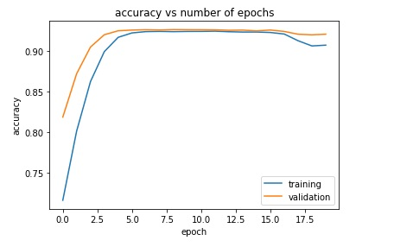
Convolutional neural network 3

Slide 20
RESULT
WITH RANDOM FOREST AND BAGGING , WE HAVE 72% ACCURACY ON TRAIN SET AND
94% ON TEST SET
WE FOUND A CONVOLUTIONAL NEURAL NETWORK MODEL THAT GIVES 90% ACCURACY
ON TEST SET AND 92% ACCURACY ON TRAIN SET

