Slide 1
Machin Learning
Food-101 Image Classification Project
Zahra Dastfal, Umesh Chander Reddy, Vinod Kumar Reddy
Instructor: Dr. I-Hua Tsai

Slide 2
Agenda
Introduction
Problem Statement
Dataset
Methodology
Baseline Model
EfficientNetB0
Fine-Tuning
Results & Analysis
Comparison
Future Work

Slide 3
Introduction
Food classification is challenging due to visual variability.
Applications: health apps, calorie tracking, automation.
Deep learning improves classification accuracy.

Slide 4
Problem Statement
Food-101 includes 101 food classes with high variability.
Images differ in lighting, angle, background.
Goal: Build models to classify all 101 categories accurately.

Slide 5
Food-101 Dataset
101 food categories
101,000 total images
75,750 training images
25,250 test images

Slide 6
Methodology
Data preprocessing (resize, normalize)
Baseline CNN training
EfficientNetB0 (transfer learning)
EfficientNetB0 fine-tuning
Model evaluation and comparison

Slide 7
Baseline CNN Model
Simple CNN architecture:
• Convolution + MaxPooling
• Dense classification layer
Used as baseline benchmark.

Slide 8
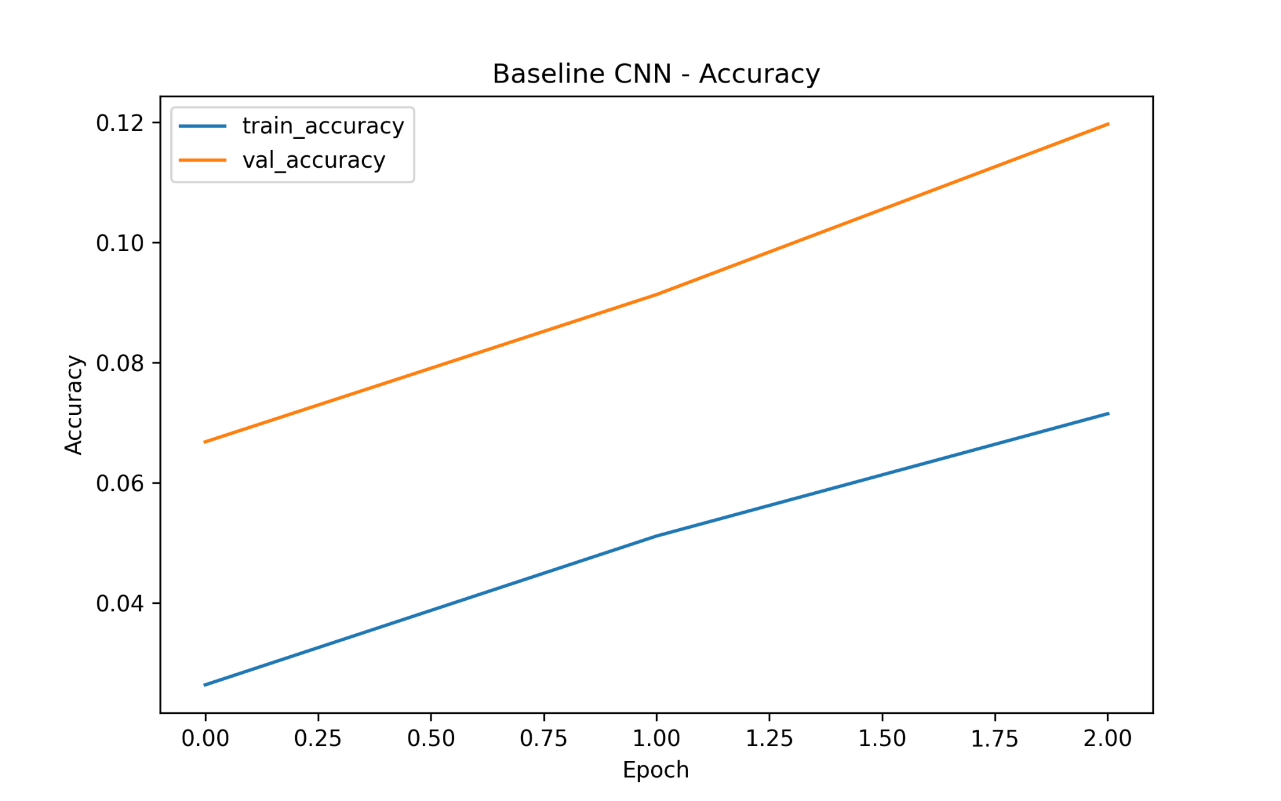
Baseline CNN – Accuracy Curve

Slide 9
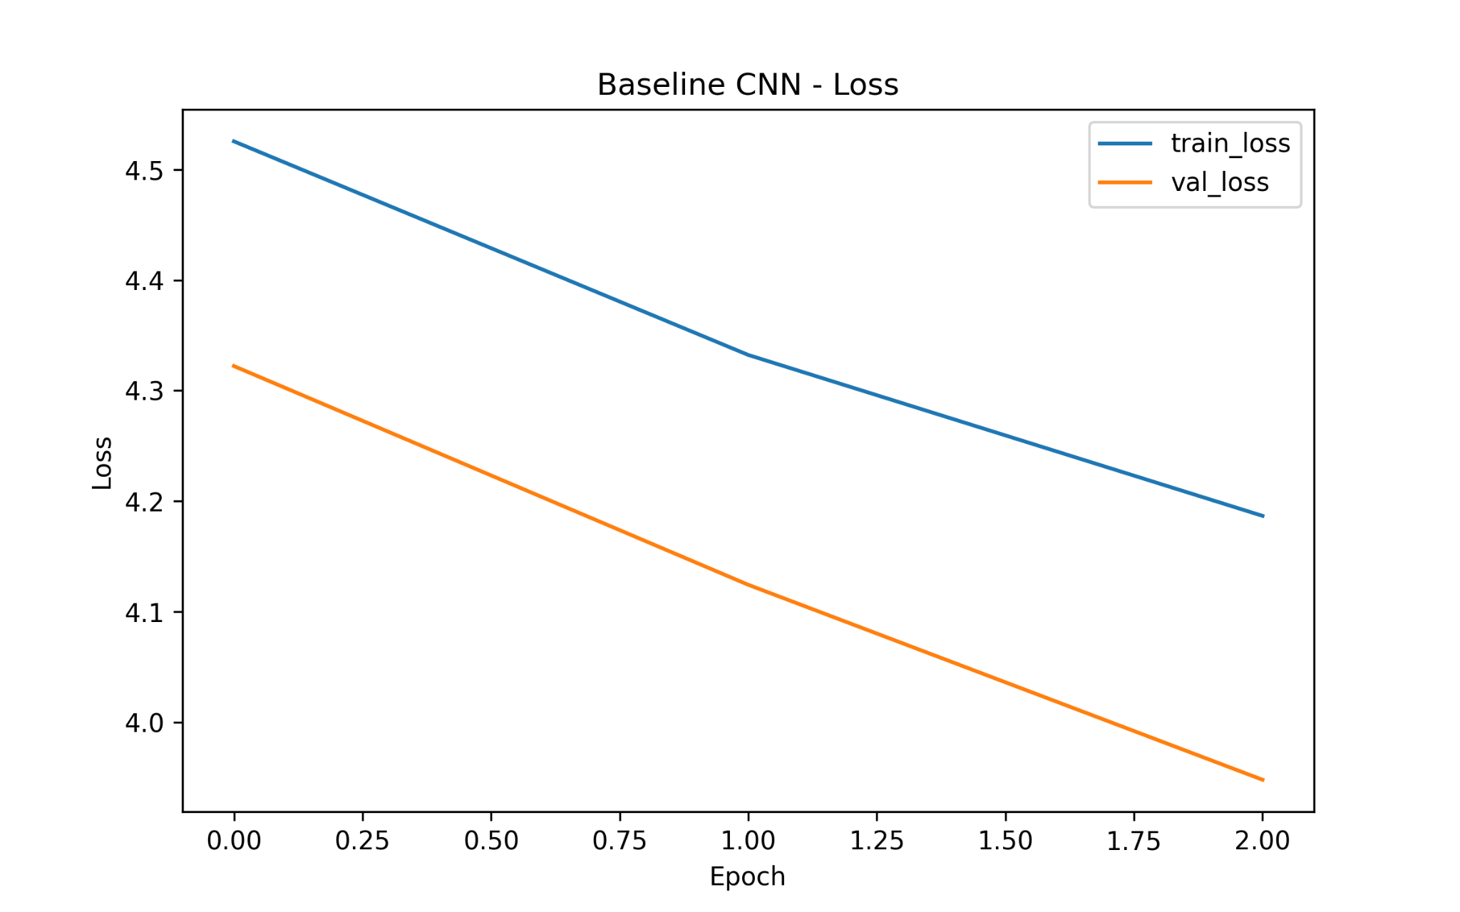
Baseline CNN – Loss Curve

Slide 10
Baseline CNN – Analysis
Model is underfitting.
Accuracy remains low and unstable.
Model lacks capacity for complex food categories.

Slide 11
EfficientNetB0 (Initial Training)
Uses pretrained ImageNet weights.
Base layers frozen (feature extraction).
Much stronger performance compared to baseline.

Slide 12
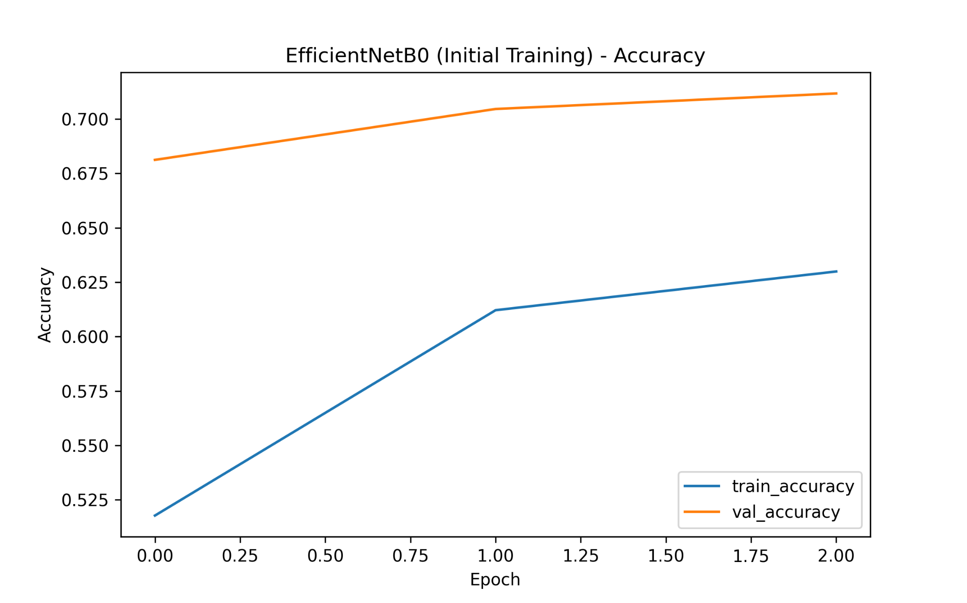
EfficientNetB0 Initial – Accuracy

Slide 13
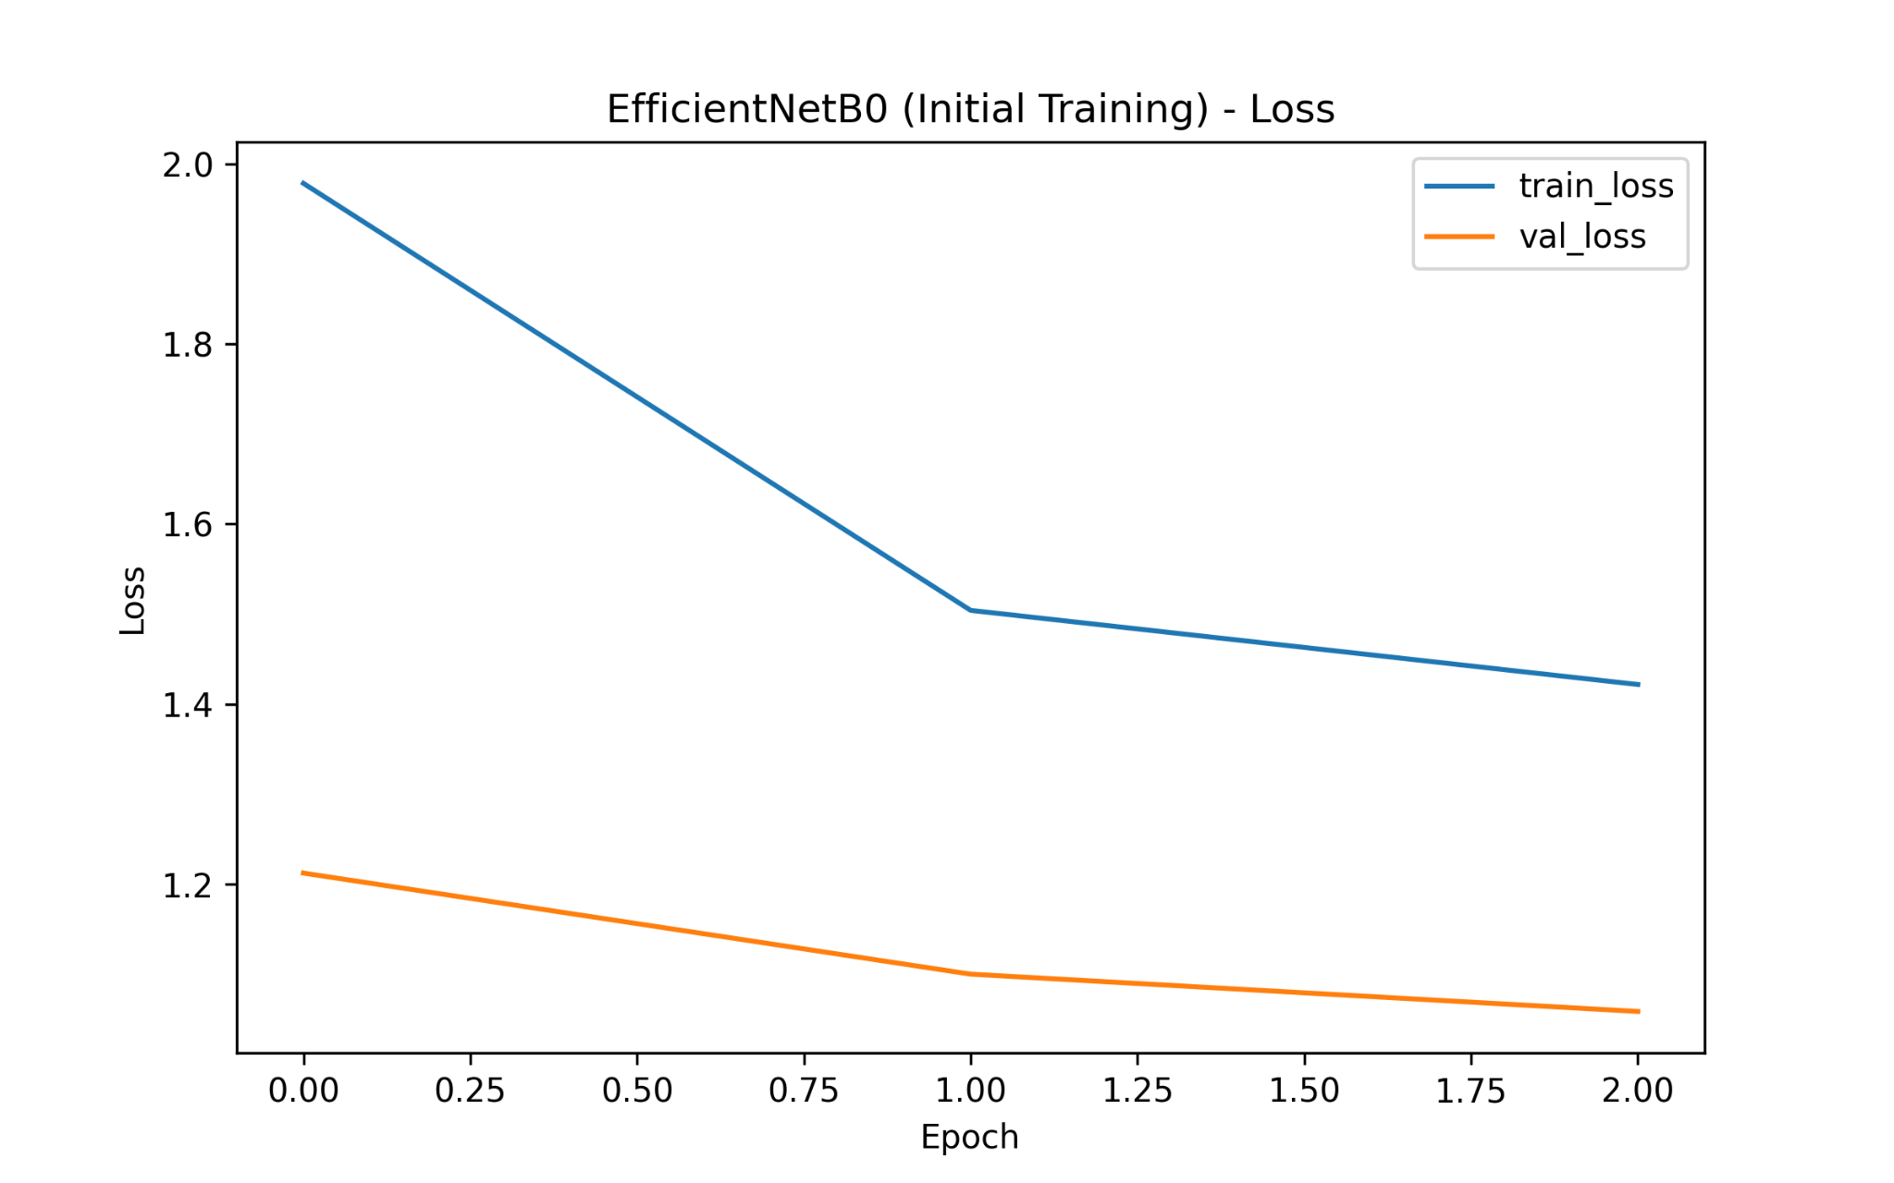
EfficientNetB0 Initial – Loss

Slide 14
Initial Training – Analysis
Fast convergence and high accuracy.
Validation loss decreases steadily.
Model generalizes well even without fine-tuning.

Slide 15
EfficientNetB0 (Fine-Tuning)
Top layers unfrozen for more learning.
Small learning rate prevents overfitting.
Accuracy improves further.

Slide 16
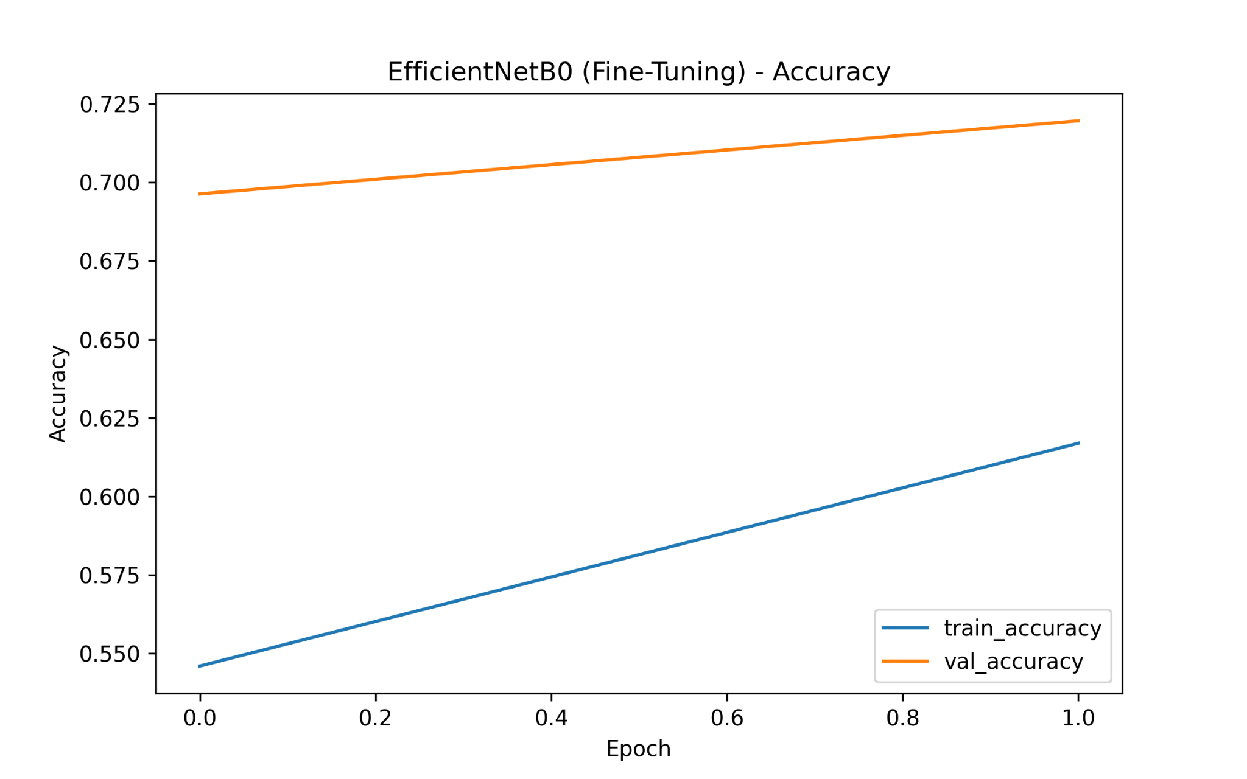
Fine-Tuning – Accuracy Curve

Slide 17
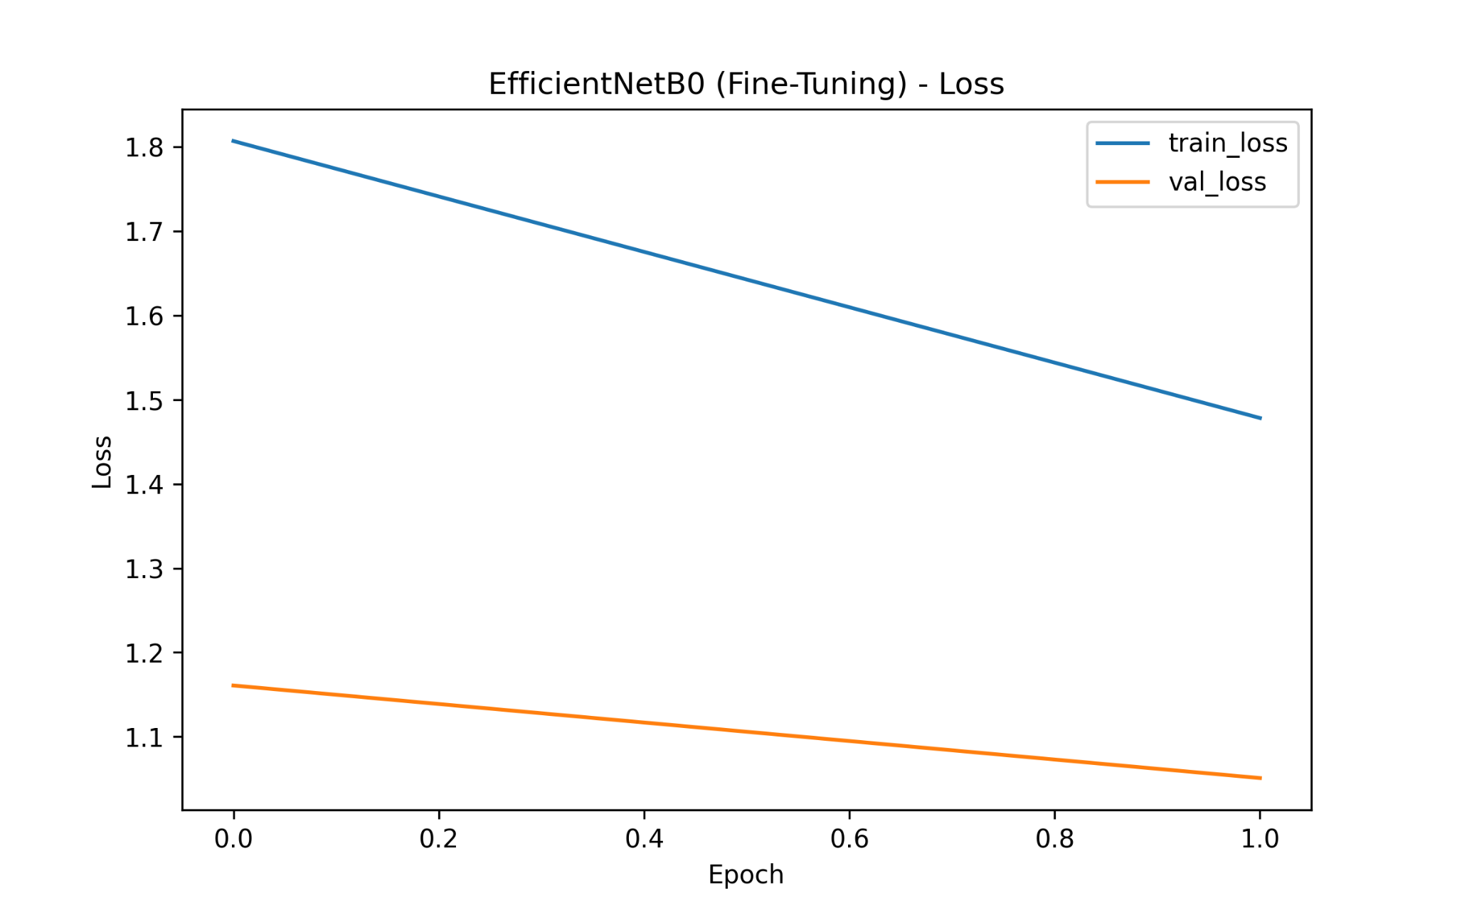
Fine-Tuning – Loss Curve

Slide 18
Fine-Tuning – Analysis
Accuracy increases beyond initial model.
Model adapts to Food-101 dataset.
Best performing version of the model.

Slide 19
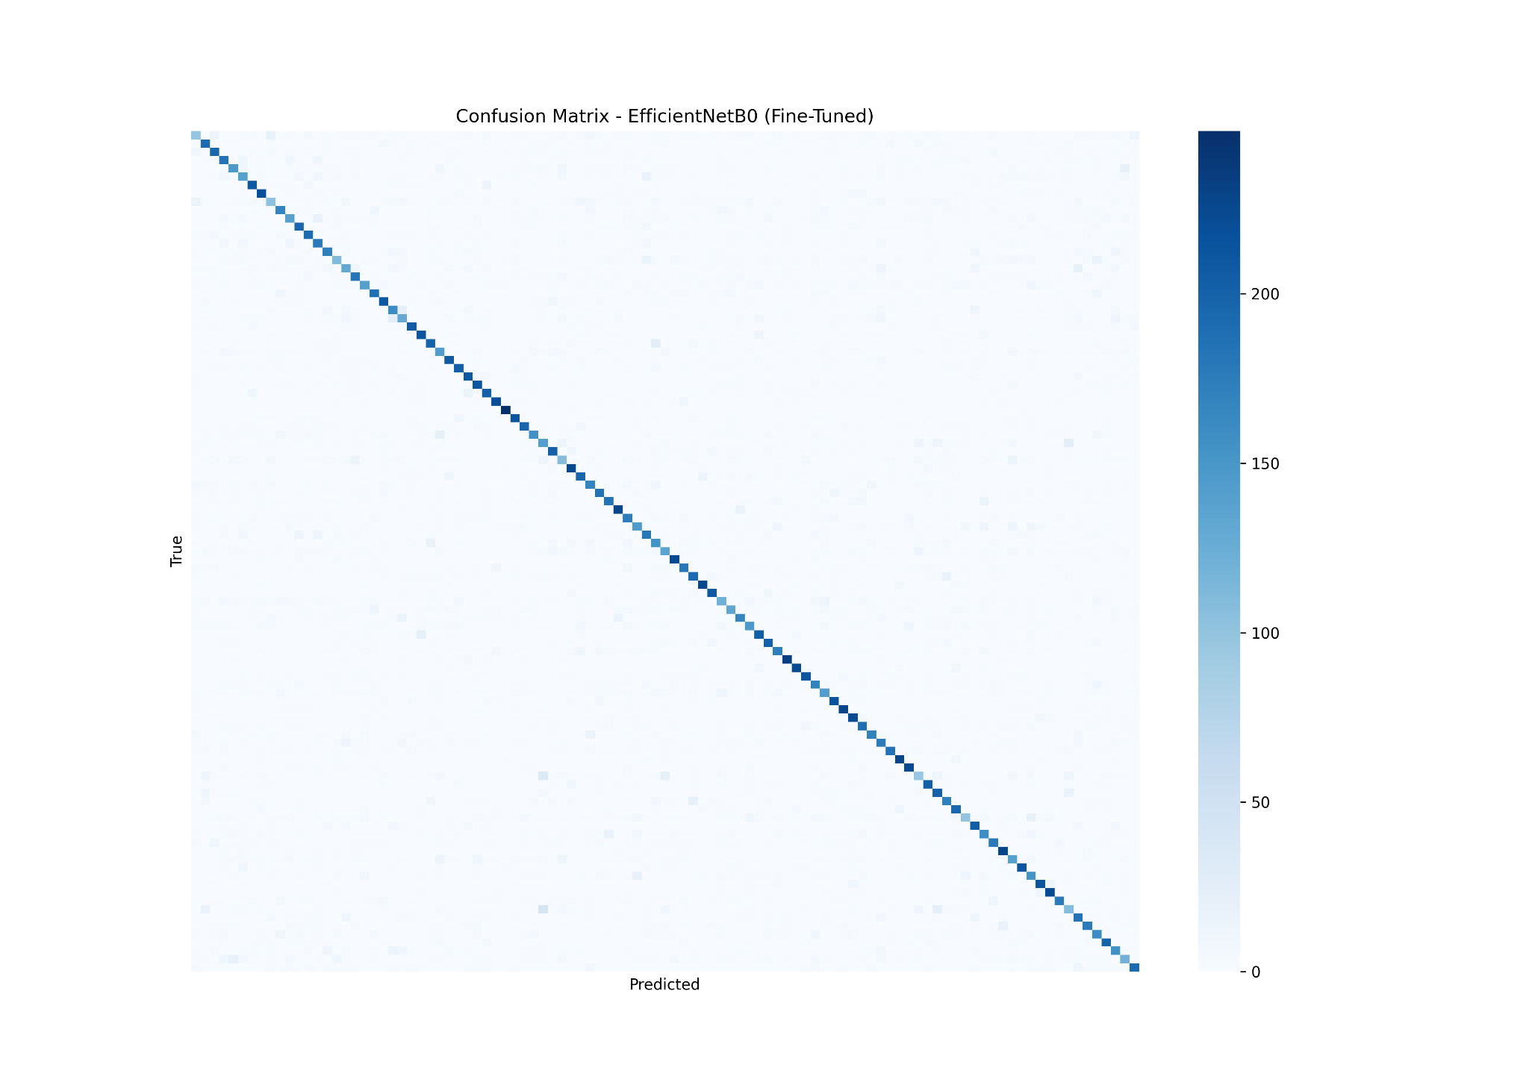
Confusion Matrix (Final Model)

Slide 20
Model Comparison
Baseline CNN: very low accuracy, underfitting.
EfficientNet Initial: strong accuracy (~70%).
Fine-Tuned EfficientNet: best accuracy (~71%).

Slide 21
Conclusion
Transfer learning significantly outperforms baseline CNN.
Fine-tuning yields additional improvements.
EfficientNetB0 is effective for large-scale food datasets.

Slide 22
Future Work
Train more epochs.
Use EfficientNetB3/B4.
Apply data augmentation.
Hyperparameter optimization.
Deploy model as web/mobile app.

