Slide 1
Project Title
🎓 Sensor Data Streaming Using Kafka and HDFS
Zahra Dastfal Graduate Student – Data Science & AI University of Central Missouri
📘 Course Project DSA 5620 – Big Data Analytics

Slide 2
Project Overview
- Simulate real-time sensor data
- Stream it using Apache Kafka
- Save data using Python consumer
- Store result in HDFS (Ubuntu VM)

Slide 3
Tools Used
- Apache Kafka (for streaming)
- Python (producer & consumer)
- HDFS (for storage)
- Oracle VirtualBox with Ubuntu
- Shared folder between Windows & VM

Slide 4
What Kafka is Used For
- Kafka is used for real-time event streaming and messaging
- Commonly used in log aggregation, monitoring, real-time analytics
- Enables decoupling of data producers and consumers
- Alternatives: RabbitMQ, Apache Pulsar, AWS Kinesis

Slide 5
Kafka Architecture
- Producer: Sends data to Kafka topic
- Topic: Named "sensor-data"
- Broker: Kafka server
- Consumer: Listens to topic and saves to JSON
- Zookeeper: Coordinates brokers and manages configurations

Slide 6
System Setup
- Kafka & Zookeeper on Windows
- HDFS on Ubuntu (Oracle VM)
- Shared folder to transfer JSON

Slide 7
Kafka Producer Script
- Python script simulates:
- sensor_id
- temperature
- humidity
- Sends every 2 seconds to topic `sensor-data`

Slide 8
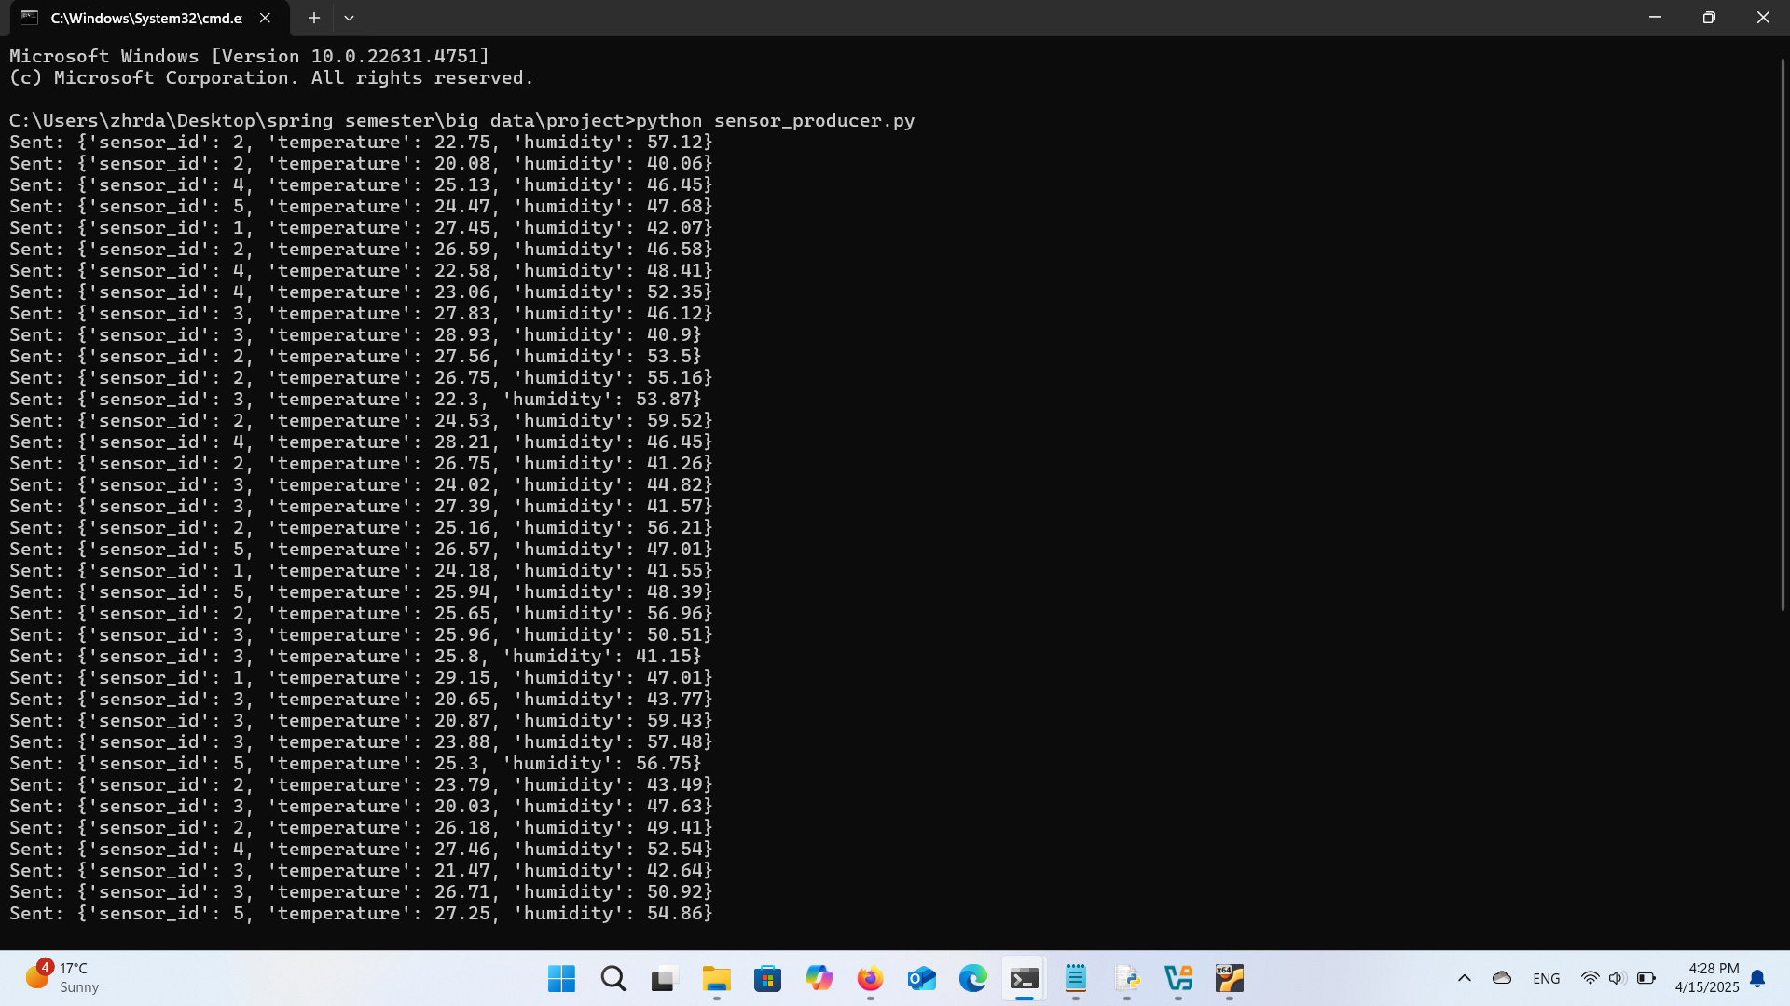

Slide 9
Kafka Consumer Script
- Python consumer listens to topic
- Saves each message to `.json` file

Slide 10
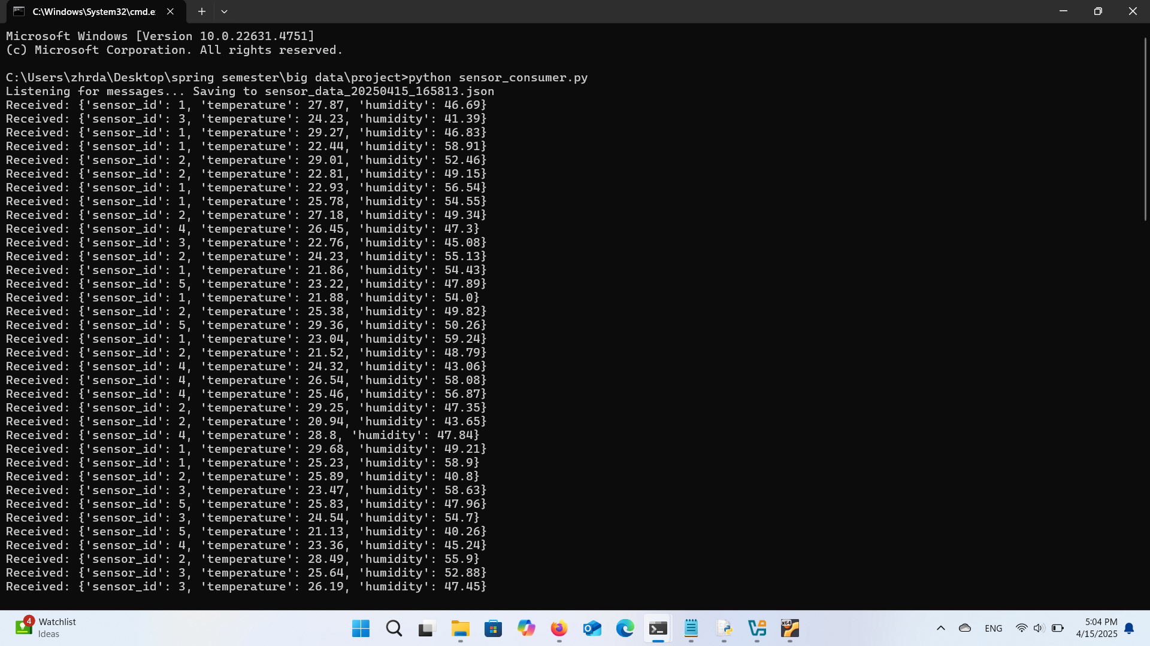

Slide 11
Output JSON File
- File saved in `/media/sf_project/`
- Contains structured JSON sensor records

Slide 12
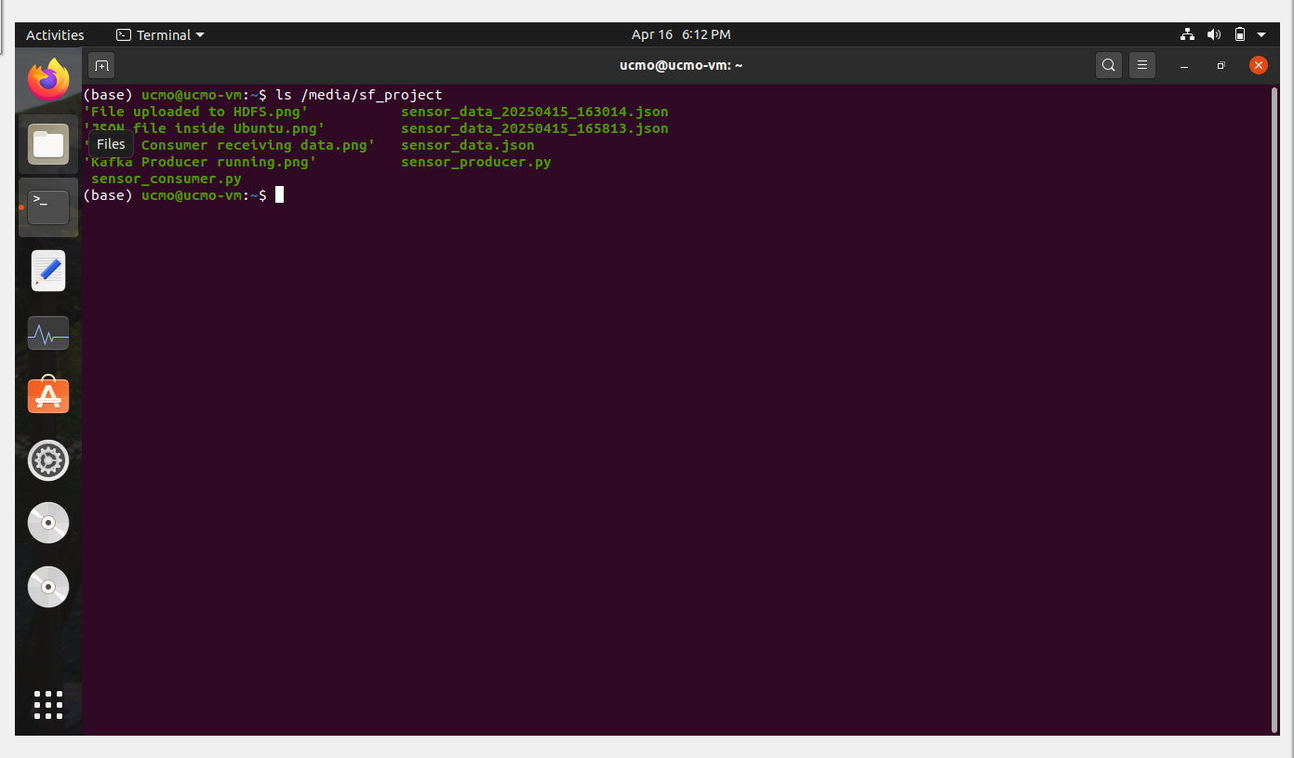

Slide 13
HDFS Upload
- Command: `hdfs dfs -put ...`
- Path: `/user/zahra/sensor_datatype/sensor_data.json`

Slide 14
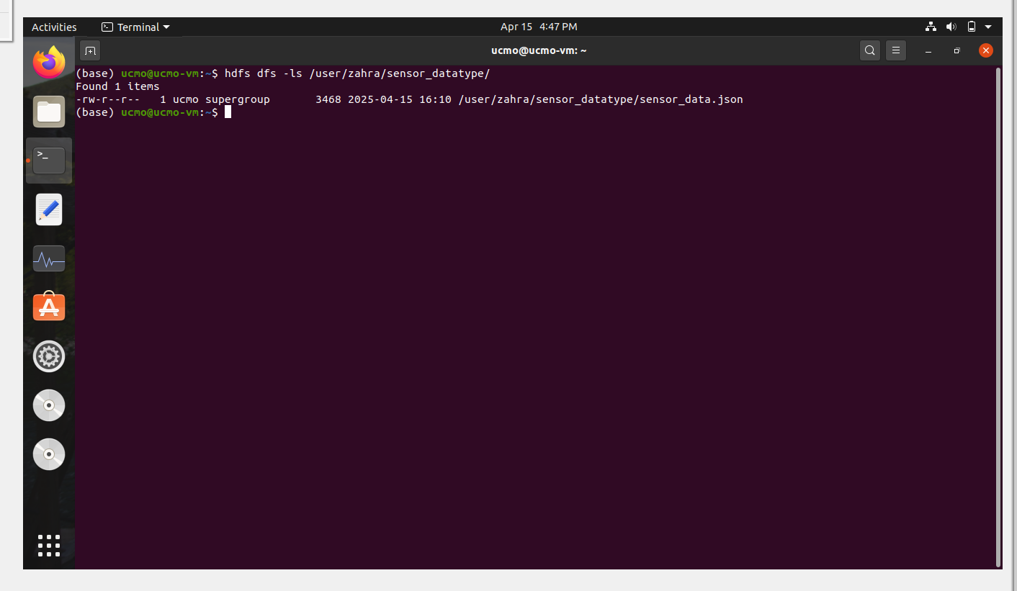

Slide 15
Getting Started with Kafka
- Install Kafka: extract `.tgz` from Apache site
- Start Zookeeper:
- `bin/zookeeper-server-start.sh config/zookeeper.properties`
- Start Kafka:
- `bin/kafka-server-start.sh config/server.properties`
- Create topic:
- `bin/kafka-topics.sh --create --topic sensor-data --bootstrap-server localhost:9092`
- Python client: install `kafka-python`

Slide 16
Demo Summary
- Producer → Kafka → Consumer → JSON → HDFS
- Real-time streaming into Hadoop ecosystem

Slide 17

What I Learned
- Kafka setup and topic management
- Using Python to connect to Kafka
- Working with shared folders in VirtualBox
- Uploading files to HDFS

Slide 18
Thank You
- Thanks for watching!
- Questions welcome :)

