Slide 1
LA 558 Web Mapping and Spatial Data Visualization Spring 2023 Final Project Documentation
Zahra Khalilzadeh
Impacts of Weather Variables on Corn Yield in Iowa

Slide 2
Data Source:
The data used in this project included the weather variables and corn yield for years of 1980-2018 corn_data_soilgrid250_modified_states_9.csv from this link: https://github.com/saeedkhaki92/CNN-RNN-Yield-Prediction

Slide 3
Dashboard 1: Show Iowa Counties' Corn Yield Percentage Change between 1980 and 2018 1-1-Data Preprocessing
For the first part of the project I wanted to show the yearly corn yield in Iowa counties from 1980 to 2018 and have a wide format of data. In this format, the data will have the yield values for each county on each row and the corresponding year on the columns. Then, by creating a parameter in Tableau, users can select a year and view the corn yield for different counties of Iowa for the selected year.

Slide 4
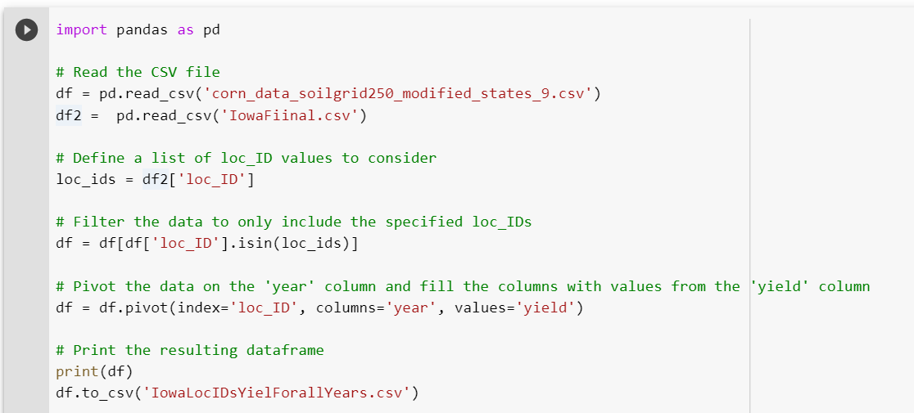
Dashboard 1: Show Iowa Counties' Corn Yield Percentage Change between 1980 and 2018 1-1-Data Preprocessing
So, I wrote a python code in CornDataForeachyearIowa.ipynb to make the data ready.
1-The data included the corn yield data along with soil and weather variables for all counties of all US states, and I just got the data for Iowa counties, and pivote the data to have the wide format:

Slide 5
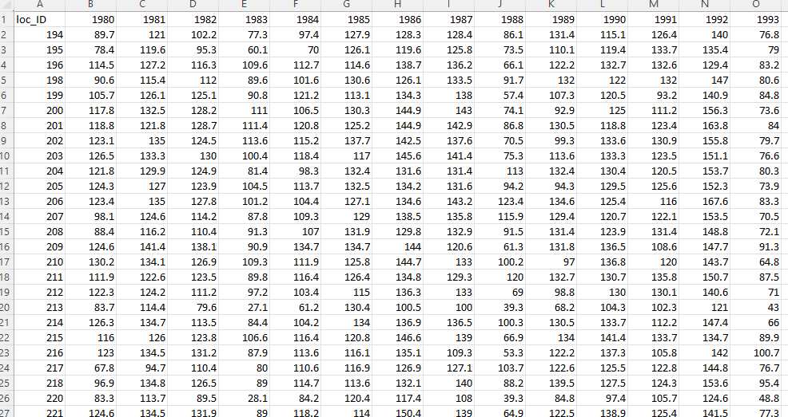
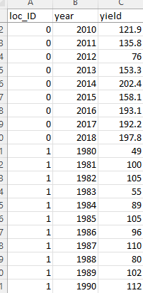
Dashboard 1: Show Iowa Counties' Corn Yield Percentage Change between 1980 and 2018 1-1-Data Preprocessing
Python code to filter the data for Iowa counties and pivote the data to have a wide format:
Long format to wide format

Slide 6
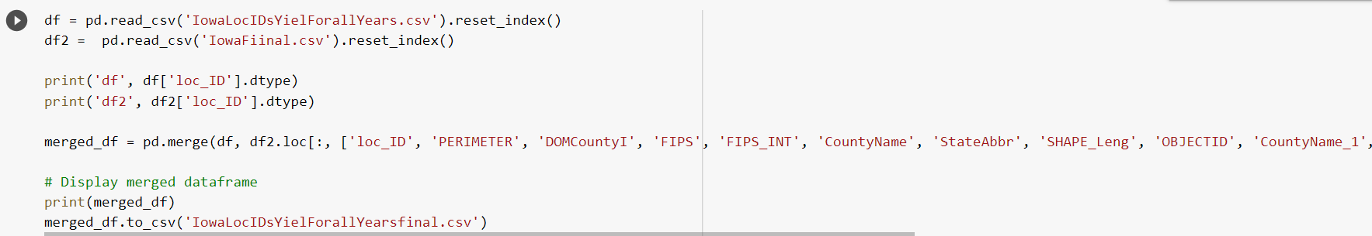
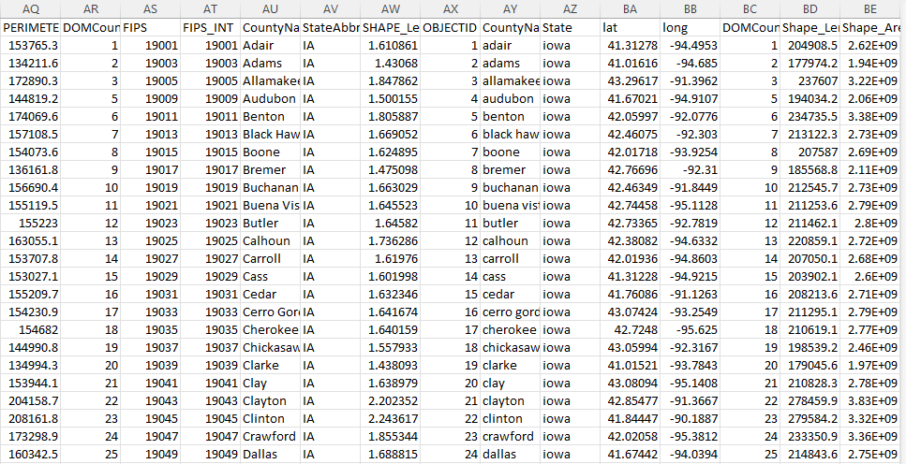
Dashboard 1: Iowa Counties' Corn Yield Percentage Change between 1980 and 2018 1-1-Data Preprocessing
Python code merge the wide data with loc_ID to the Iowa counties shapefiel details. So that for each county we have these column information as well: ['PERIMETER', 'DOMCountyI', 'FIPS', 'FIPS_INT', 'CountyName', 'StateAbbr', 'SHAPE_Leng', 'OBJECTID', 'CountyName_1', 'State', 'lat', 'long', 'DOMCountyI_1', 'Shape_Length', 'Shape_Area' ]

Slide 7
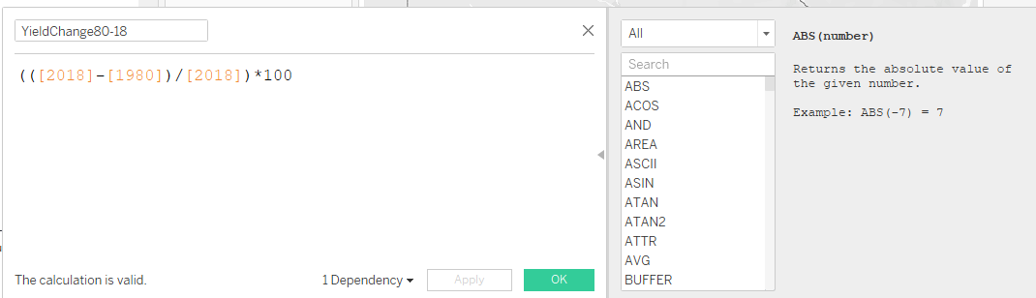
Dashboard 1: Iowa Counties' Corn Yield Percentage Change between 1980 and 2018 1-2-Create first Tableau dashboard
After uploading the csv final csv file: IowaLocIDsYielForallYearsfinal.csv to Tableau, we can show the percentage of yearly corn change from 1980 to 2018. So, I created a calculated field and use it as a colur marks in the map. I also used the county names and yields of 1980 and 2018 to show as labels on each county when the user select it.
Calculated field

Slide 8
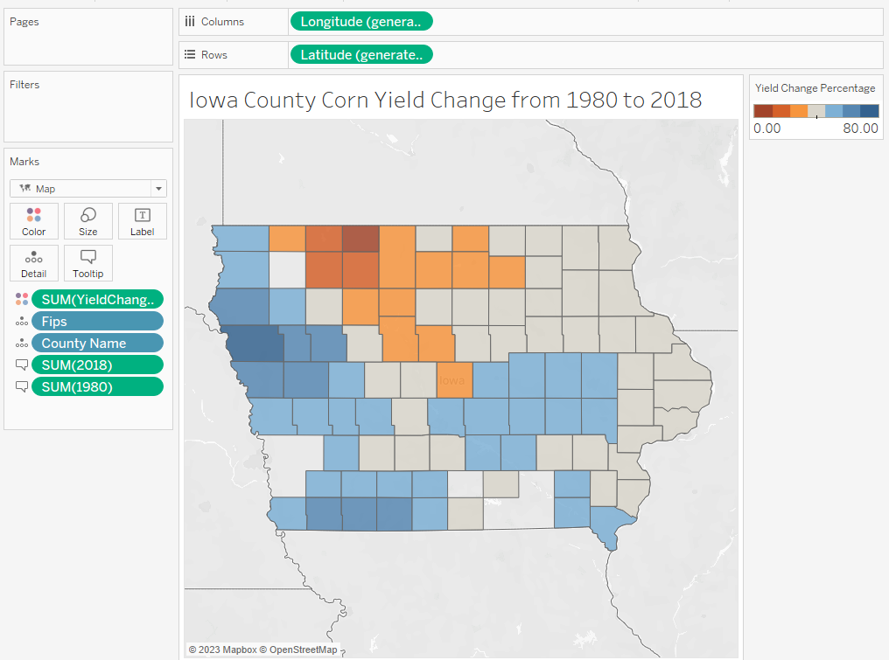
Dashboard 1: Iowa Counties' Corn Yield Percentage Change between 1980 and 2018 1-2-Create first Tableau dashboard
After uploading the csv final csv file: IowaLocIDsYielForallYearsfinal.csv to Tableau, we can show the percentage of yearly corn change from 1980 to 2018. So, I created a calculated field and use it as a colur marks in the map. I also used the county names and yields of 1980 and 2018 to show as labels on each county when the user select it.
Results of the first dashboard:

Slide 9
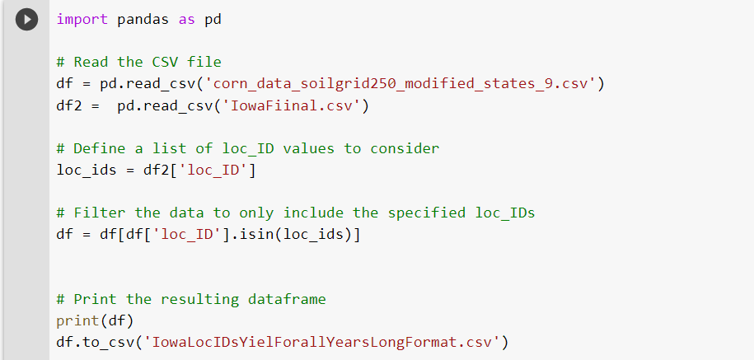
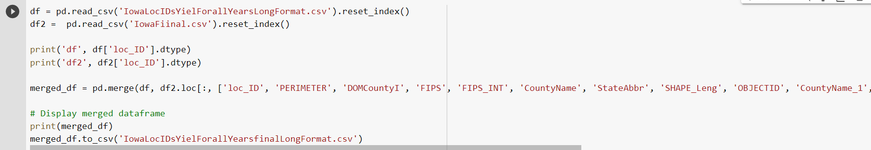
Dashboard 2: Show the Yearly Corn Yield in Iowa Counties from 1980 to 2018 2-1-Data Preprocessing
Here I wanted to keep the long format of data and just wanted to filter the data to have only Iowa Counties’ data. So, I wrote a python code to filter the data for Iowa counties.
Then merge merge the wide data with loc_ID to the Iowa counties shapefiel details. So that for each county we have these column information as well: ['PERIMETER', 'DOMCountyI', 'FIPS', 'FIPS_INT', 'CountyName', 'StateAbbr', 'SHAPE_Leng', 'OBJECTID', 'CountyName_1', 'State', 'lat', 'long', 'DOMCountyI_1', 'Shape_Length', 'Shape_Area' ]

Slide 10
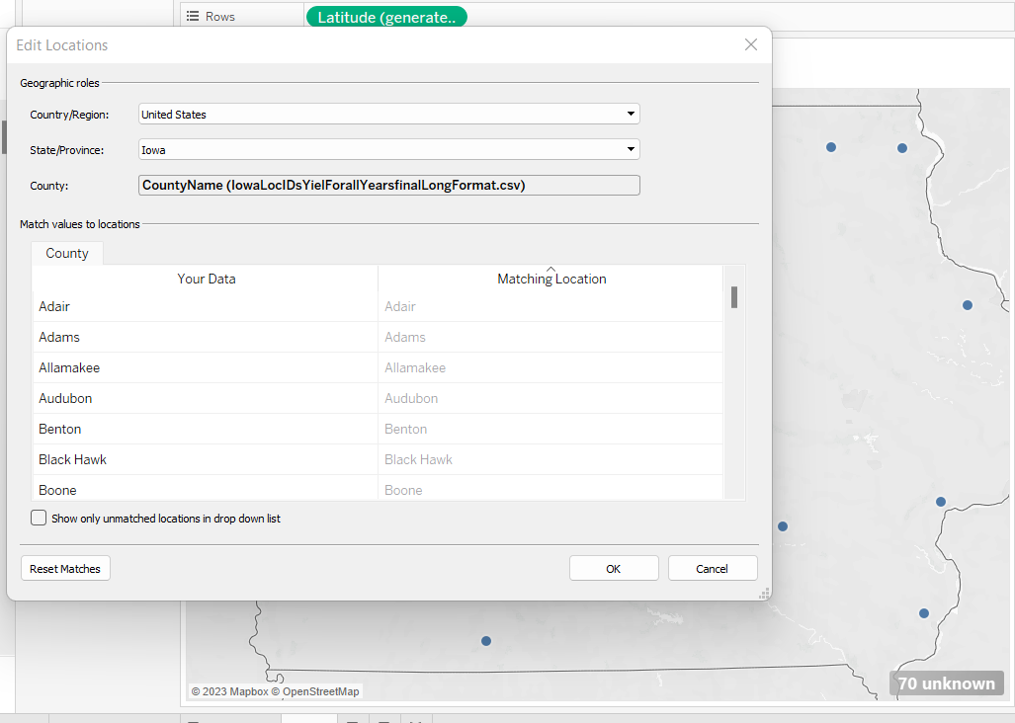
Dashboard 2: Show the Yearly Corn Yield in Iowa Counties from 1980 to 2018 2-2-Create Second Tableau dashboard
After uploading the second csv final in the long format: IowaLocIDsYielForallYearsfinalLongFormat.csv, I faced the unknown problem. I was able to solve this problem by choosing state of Iowa in the following table:

Slide 11
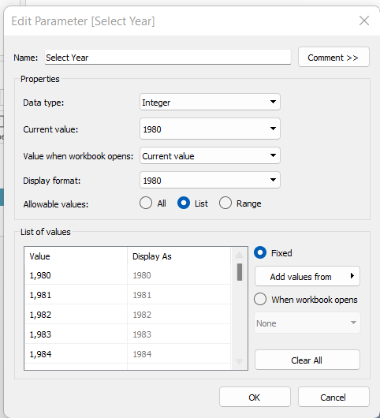
Dashboard 2: Show the Yearly Corn Yield in Iowa Counties from 1980 to 2018 2-2-Create Second Tableau dashboard
After uploading the csv final csv file: IowaLocIDsYielForallYearsfinalLongFormat.csv to Tableau, we created a parameter and named it as select year, and select years as a list from Year column.

Slide 12
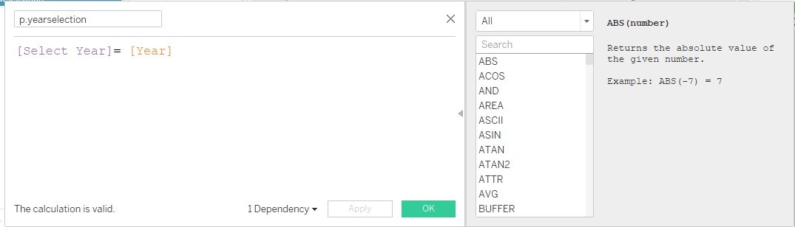
Dashboard 2: Show the Yearly Corn Yield in Iowa Counties from 1980 to 2018 2-2-Create Second Tableau dashboard
Then we created a calculated field and used it as a filter so that it will show the yield of counties based on the selected year by the user.

Slide 13
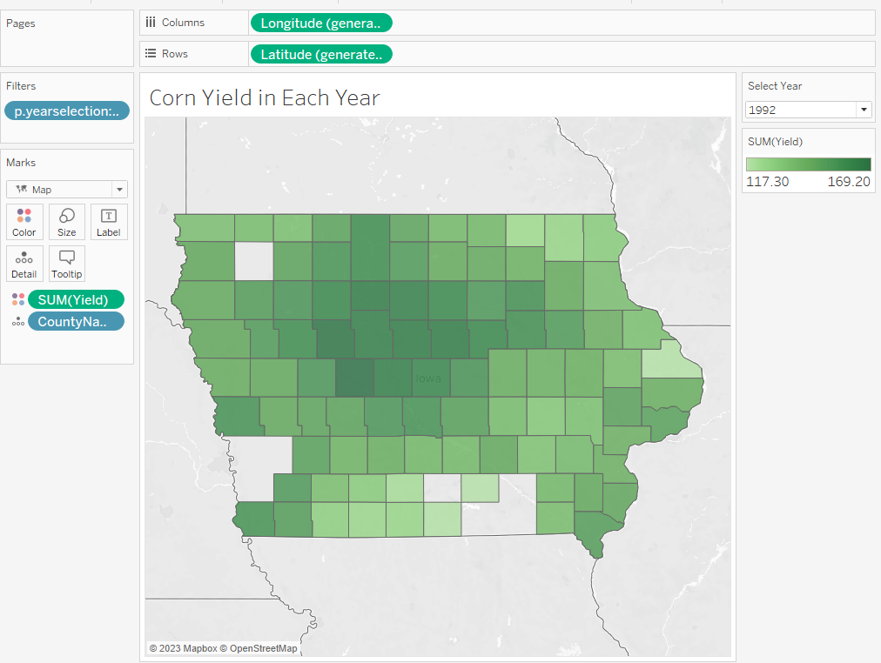
Dashboard 2: Show the Yearly Corn Yield in Iowa Counties from 1980 to 2018 2-2-Create Second Tableau dashboard
Results of the second dashboard:

Slide 14
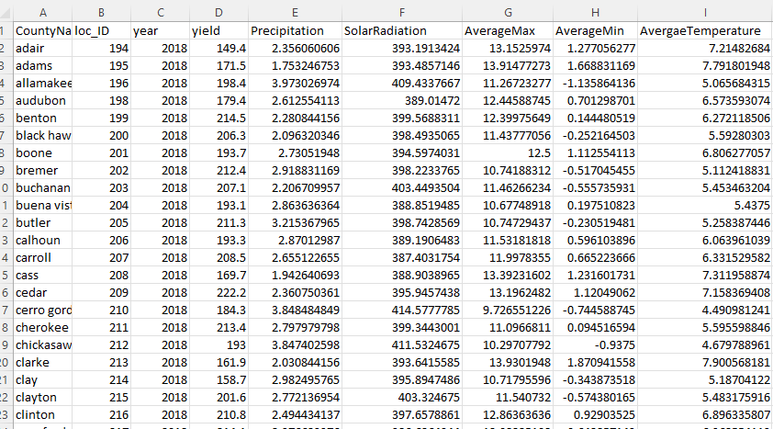
Dashboard 3: Impacts of Weather Variables on Corn Yield in Iowa 3-1-Data Preprocessing
First, we put all the weather variables that we wanted to analyze including, precipitation, solar radiation, and average temperature from weeks of growing season which are week 10 to week 44 and took the average over the whole weeks for each county in excel.

Slide 15
Dashboard 3: Impacts of Weather Variables on Corn Yield in Iowa 3-1-Data Preprocessing
To assess whether there is also an interaction effect between these three independent variables on a corn yield, we implemented a three-way ANOVA in R. For this matter, we used the following formula in excel to create 3 levels for weather variables that we wanted to analyze including, precipitation, solar radiation, and average temperature .
For precipitation: =IF(E2<2.35,"P1",IF(E2<3.05,"P2",IF(E2<3.98,"P3")))
For solar radiation: =IF(F2<394.6,"S1",IF(F2<405.88,"S2",IF(F2<423.46,"S3")))
For average temperature : =IF(I2<5.49,"T1",IF(I2<6.96,"T2",IF(I2<8.81,"T3")))

Slide 16
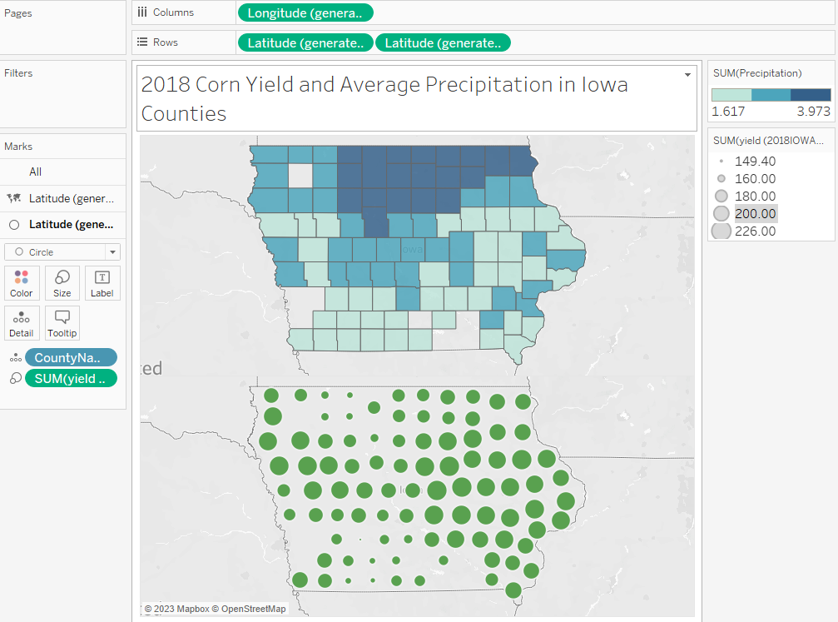
Dashboard 3: Impacts of Weather Variables on Corn Yield in Iowa 3-2-Create 3rd dashboard including 3 maps
We did the same process to generate 3 maps that show 2018 corn yield of Iowa counties along with average precipitation, average solar radiation, and average temperature through the growing season.
To do it first we generated two maps first with the value of the weather variable with colors, and second with the values of yield in shapes and selected circle as the shape of the second map.

Slide 17

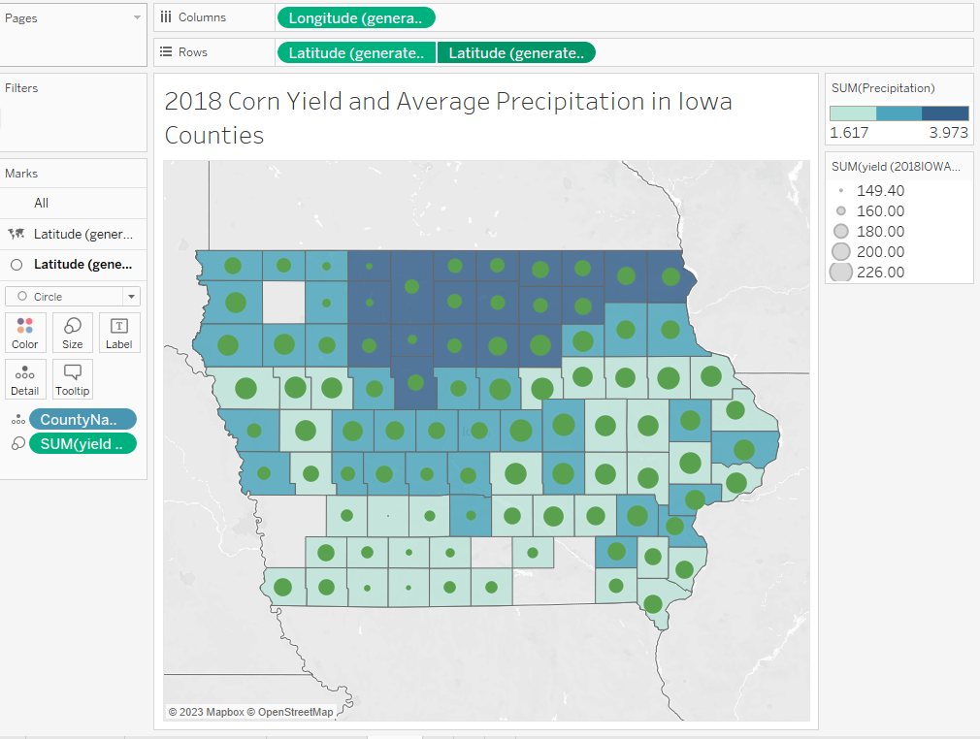
Dashboard 3: Impacts of Weather Variables on Corn Yield in Iowa 3-2-Create 3rd dashboard including 3 maps
The to merge them right click on the second Latitued and select Dual axis:
Then we can see the merged map:

Slide 18
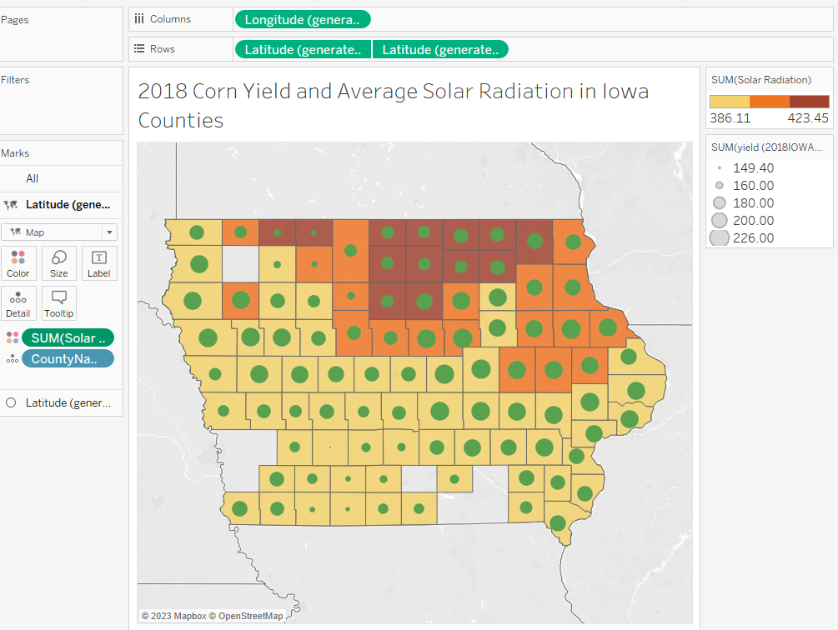
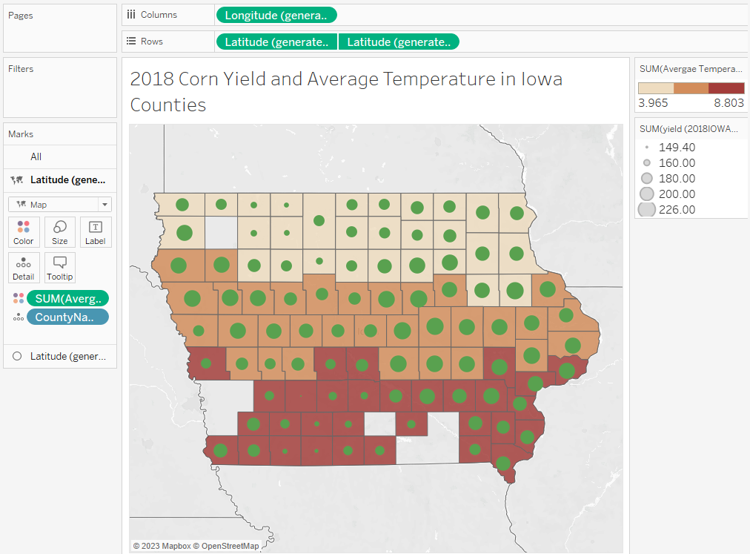
Dashboard 3: Impacts of Weather Variables on Corn Yield in Iowa 3-2-Create 3rd dashboard including 3 maps
We did the same process for average solar radiation and average temperature and got the following maps:

Slide 19
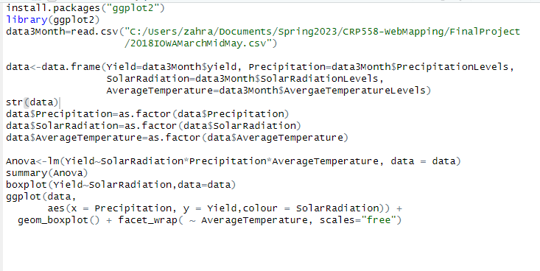
Dashboard 3: Impacts of Weather Variables on Corn Yield in Iowa 3-4-A three-way ANOVA in R
We used R to do the three-way ANOVA. The following is my code in R and the box plot from my code.

Slide 20
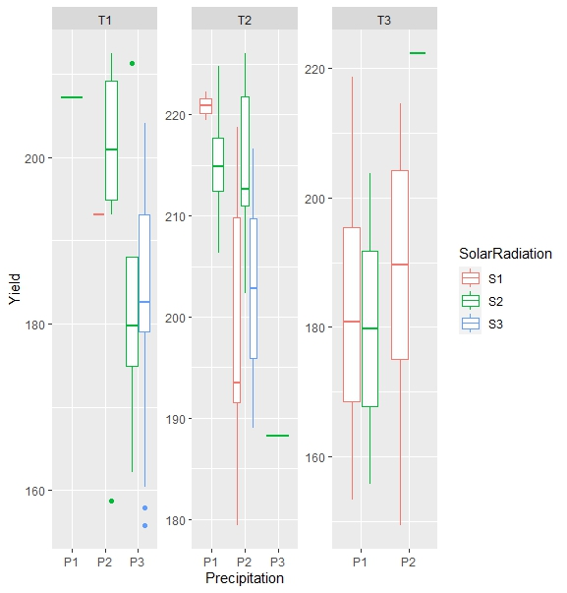
Dashboard 3: Impacts of Weather Variables on Corn Yield in Iowa 3-4-A three-way ANOVA in R
We used R to do the three-way ANOVA. The following is my code in R and the box plot from my code.

Slide 21
Dashboard 3: Impacts of Weather Variables on Corn Yield in Iowa 3-4-A three-way ANOVA in R
Results from ANOVA: To assess whether there is also an interaction effect between these three independent variables on a corn yield, we implemented a three-way ANOVA in R. The results indicate that the solar radiation and precipitation are statistically significant at level 2 ( between 394.15 and 405.87 and between 2.34 and 3.04 respectively) and average temperature is statistically significant at level 3 (between 6.95 and 8.8). The results also show that solar radiation and precipitation interaction is statistically significant at level 2 ( between 394.15 and 405.87 and between 2.34 and 3.04 for solar radiation and precipitation respectively). Finally, the results indicate that that precipitation and average temperature interaction is statistically significant at level 3 ( between 3.04 and 3.97 and between 6.95 and 8.8 for precipitation and average temperature respectively).

Slide 22
Link to my Tableau public
https://public.tableau.com/views/FinalProject-LA558-ZahraKhalilzadeh/Resultsofthethree-wayANOVA?:language=en-US&publish=yes&:display_count=n&:origin=viz_share_link

