Slide 1
Code Security Analyzer
My name: Zahraa Ibrahim
GitHub username: zahrra55
edX username: shugo7385
My city: Baghdad
My country: Iraq
the date I have recorded this video: 2025/ 3/ 22

Slide 2
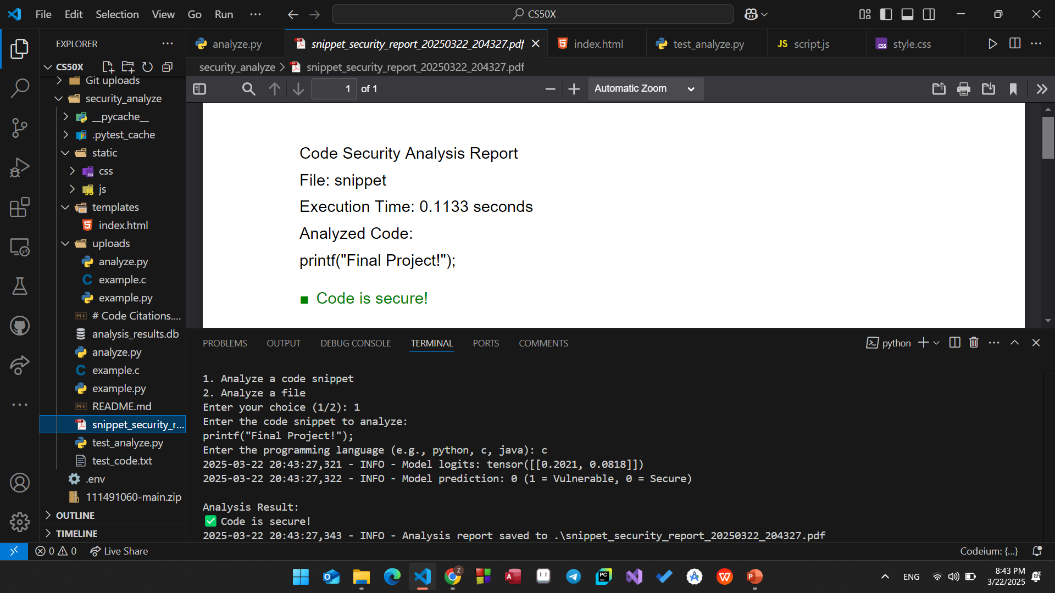
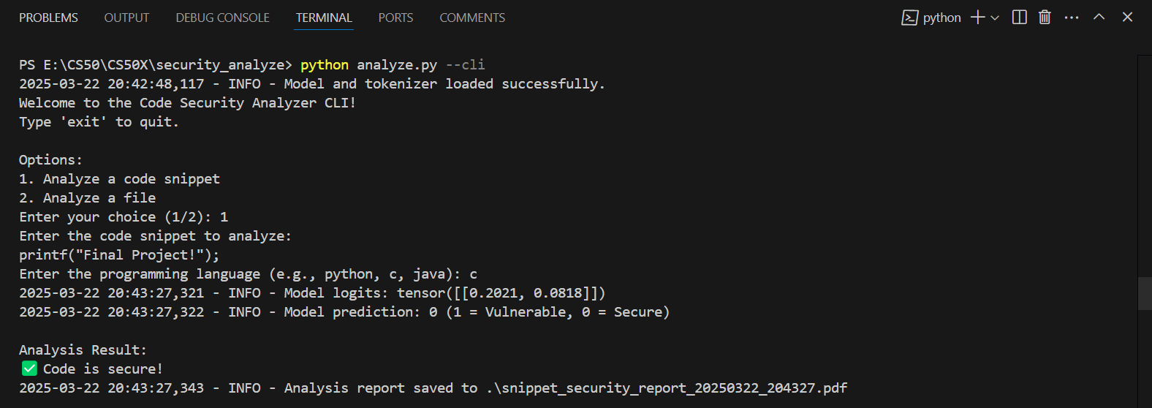

Slide 3
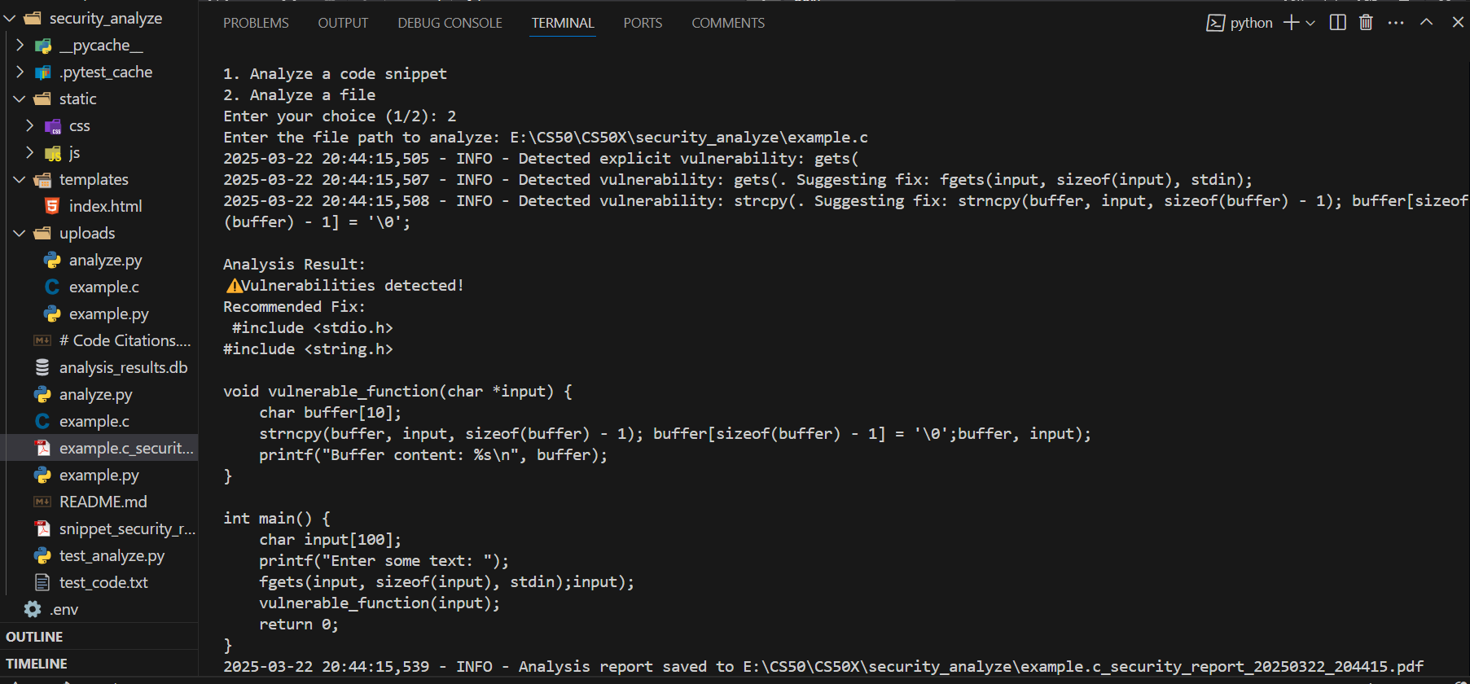
Analyze a file with CLI:

Slide 4
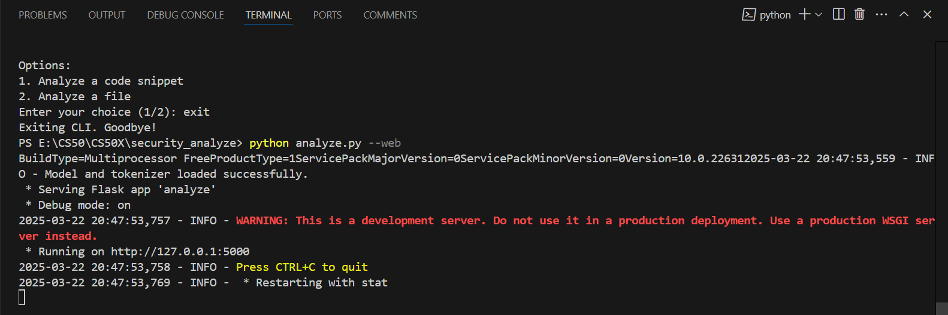
Switching to the web app mode:

Slide 5
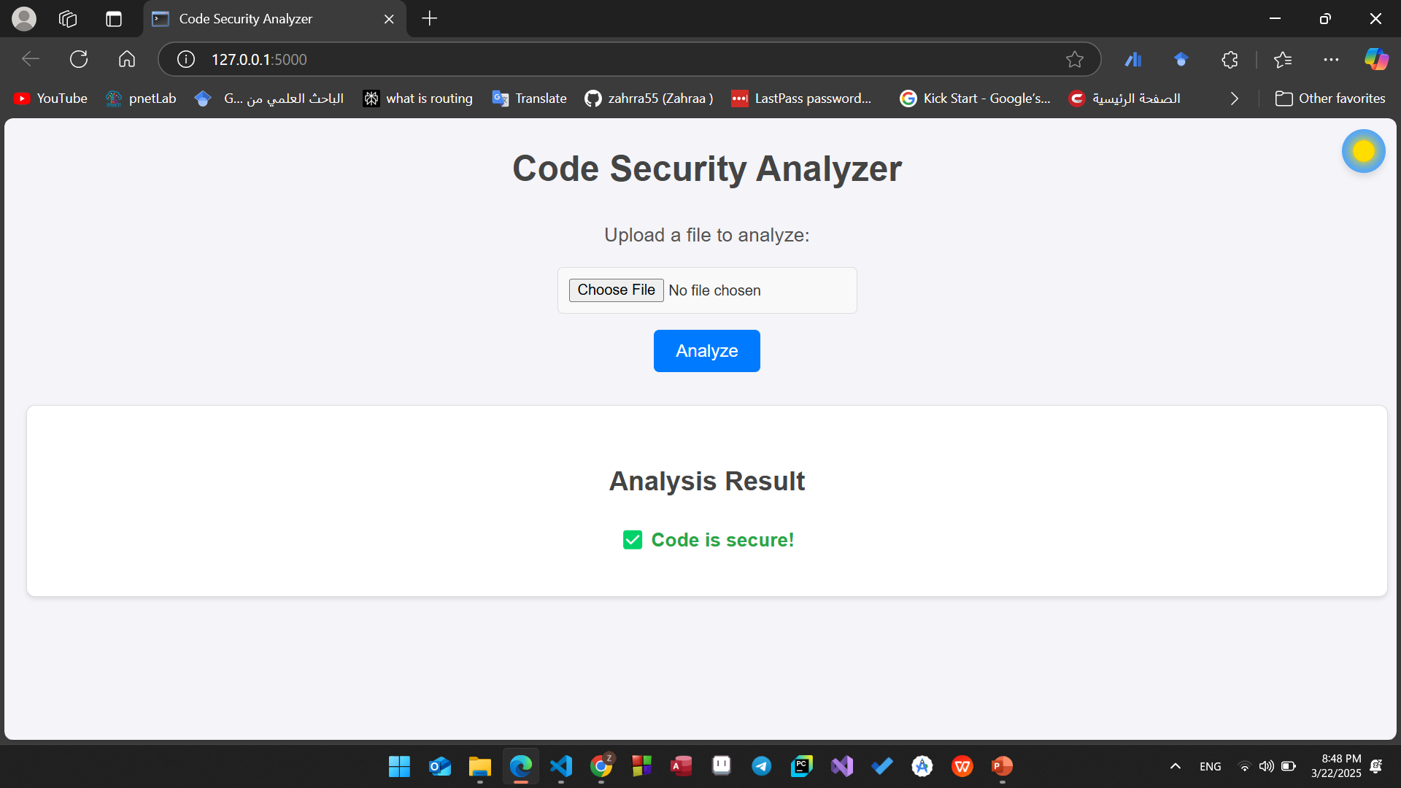
Light mode:

Slide 6
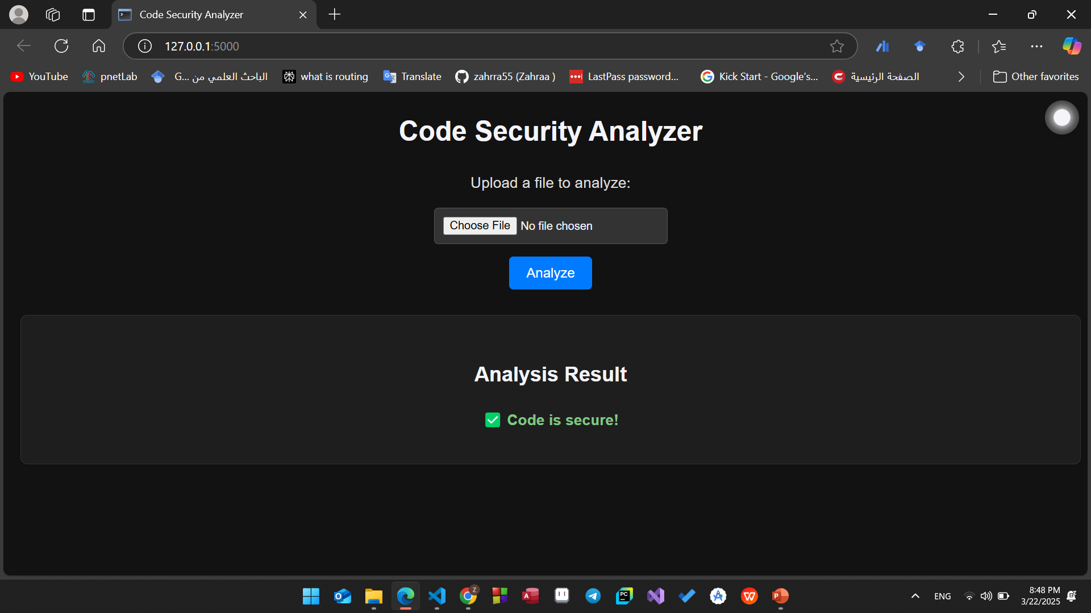
Dark mode:

Slide 7
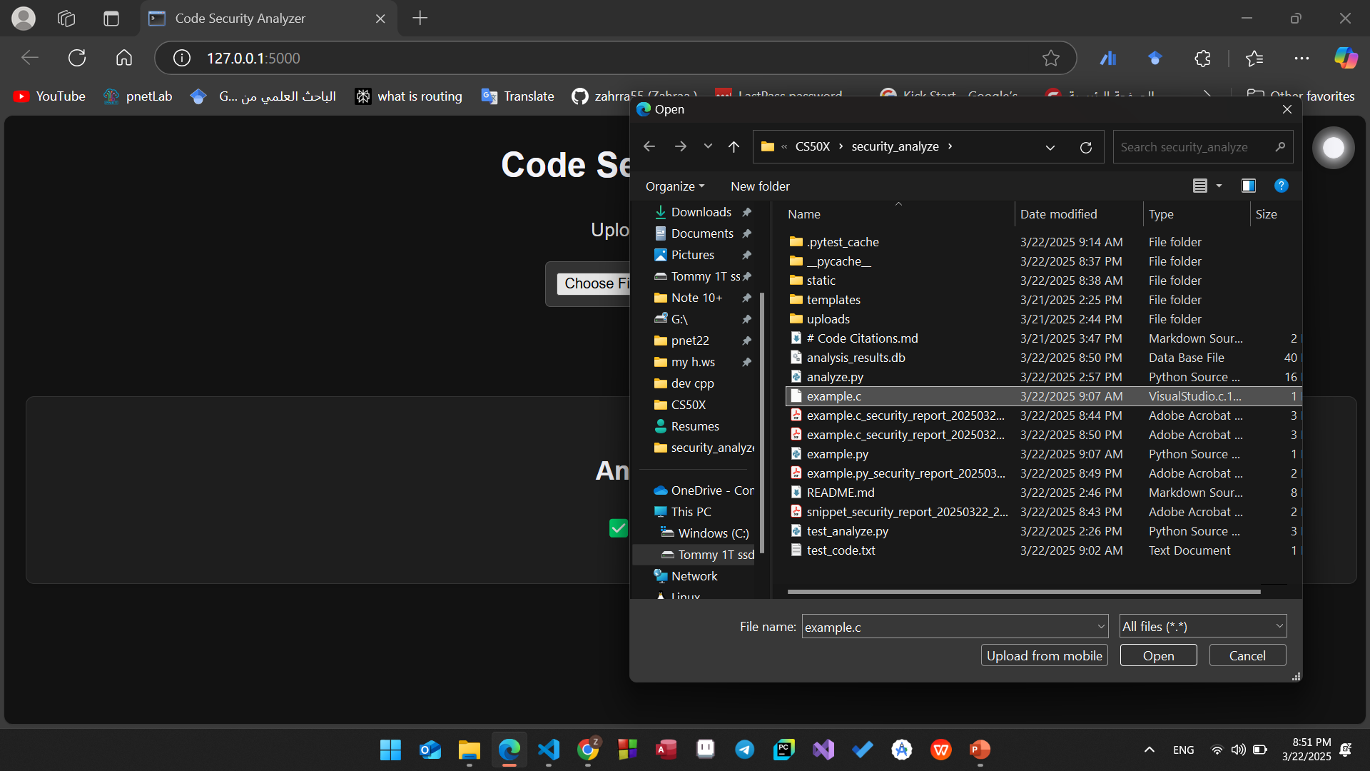

Slide 8
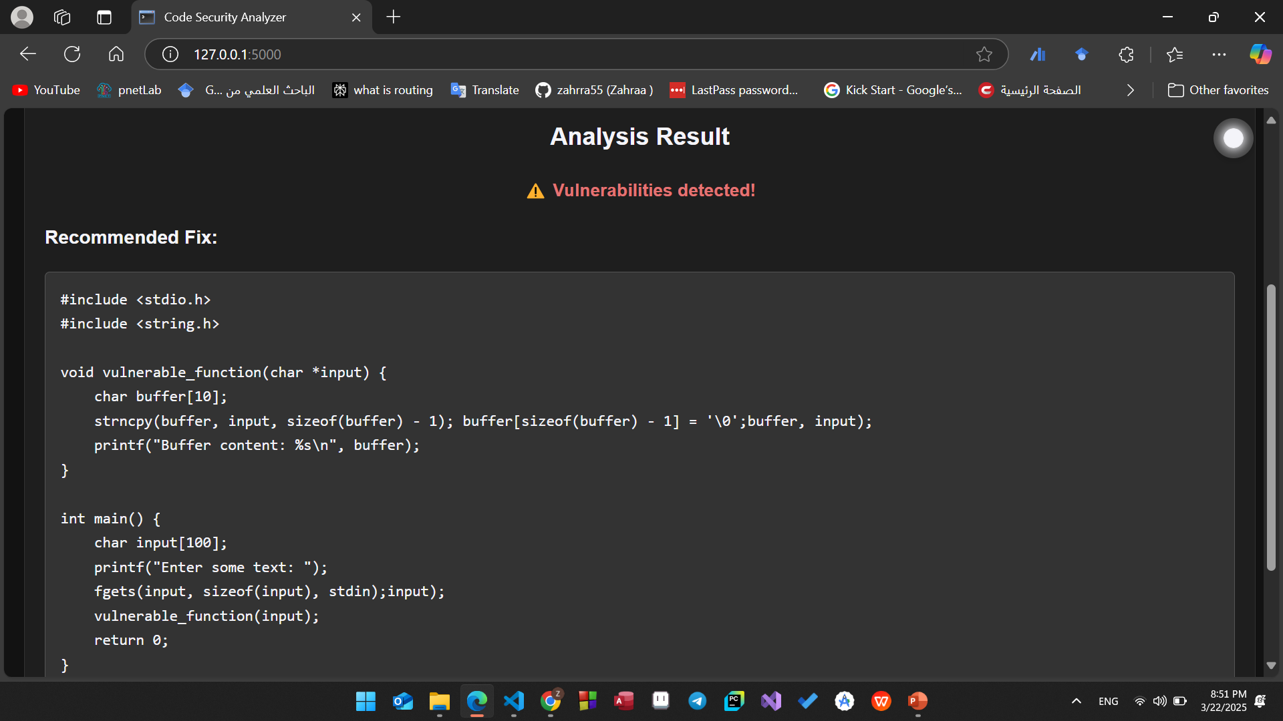

Slide 9
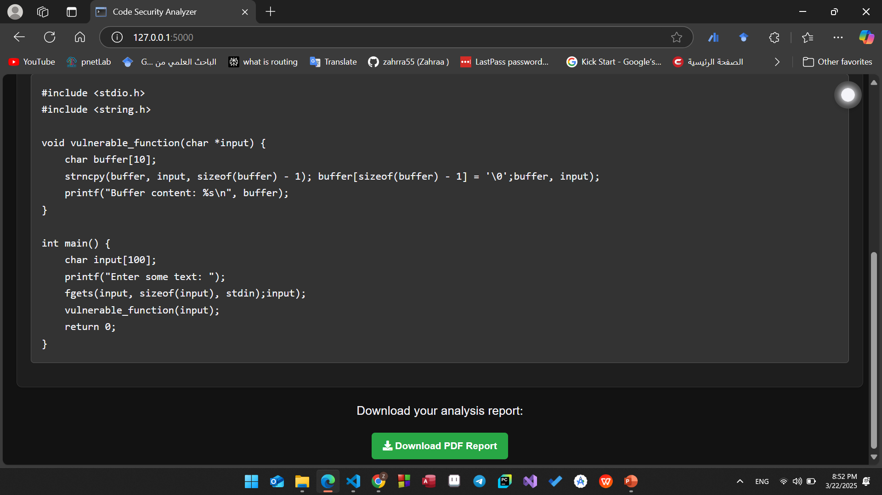

Slide 10
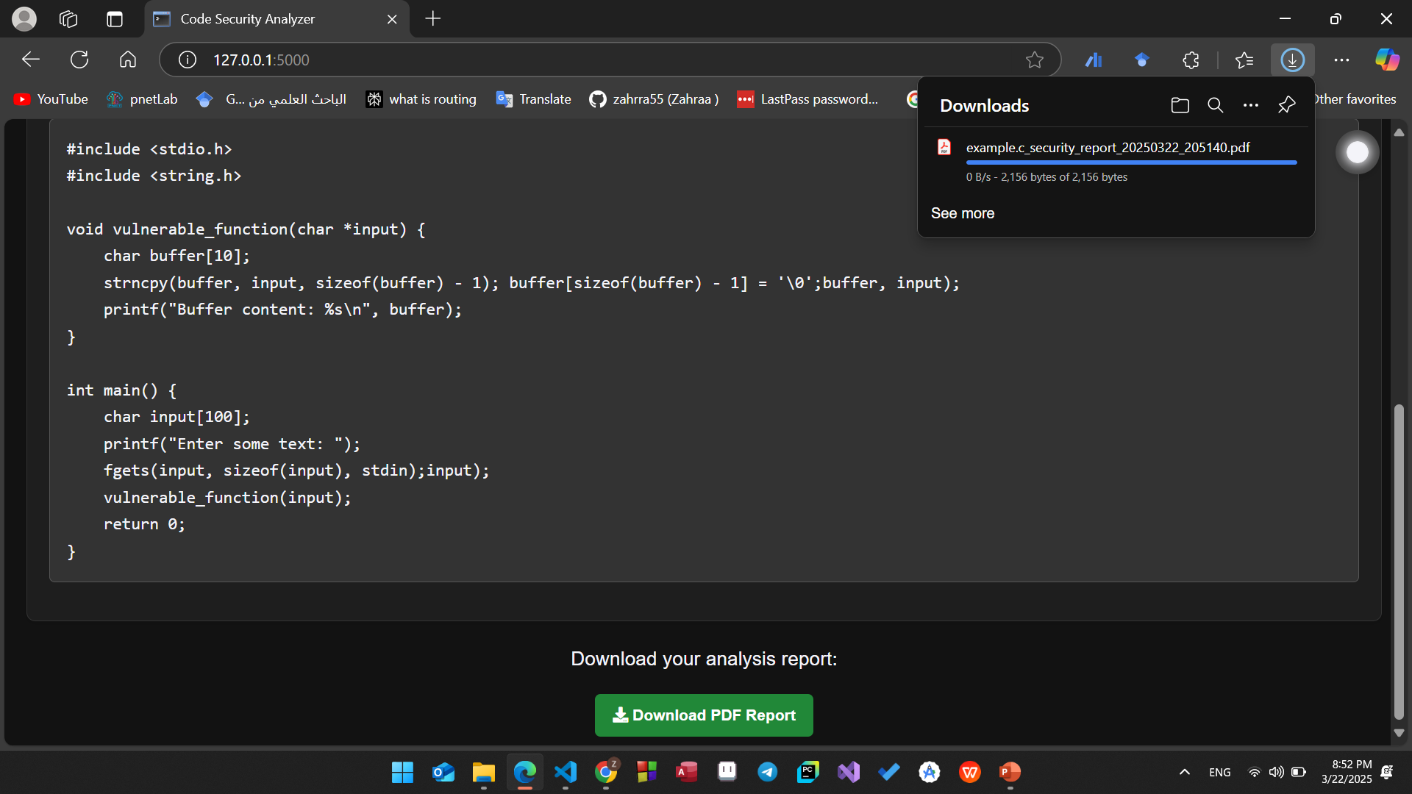

Slide 11
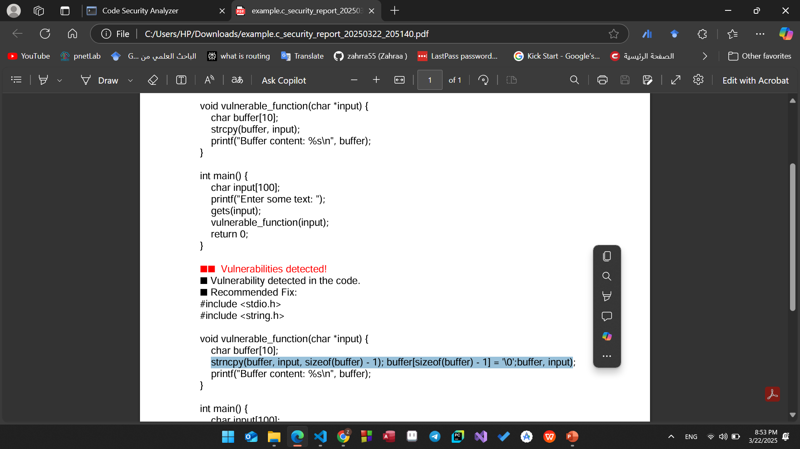

Slide 12
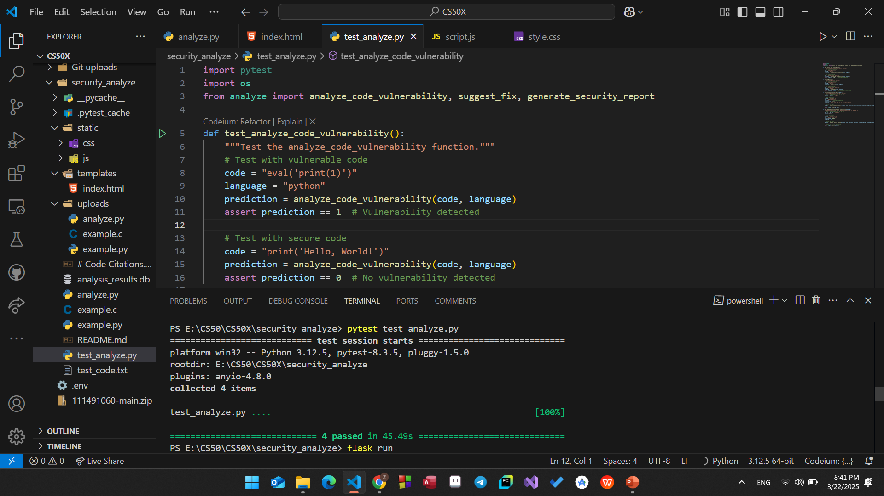

Slide 13
Thank you.

