Slide 1
PERFORMANCE / ENERGY STUDY
CPU x GPU Governor Study
RAW RUNS
2,400
240 aggregate cells
WORKLOADS
DGX Spark
30
Latency, device time, power, and GPU EDP across the measured operating space
GOVERNOR MODES
2 CPU / 4 GPU
SOURCE governor_effects.csv
01

Slide 2
DECISION FRAME
One central question
When does spending more power on frequency control produce a material, repeatable gain?
CPU governor
GPU governor
Workload
Host-side launch path
Device time + power
Bottleneck determines value
OUTPUT -> a transparent policy, not a universal max-performance setting
DGX SPARK / CPU x GPU GOVERNORS
02

Slide 3
2,400-RUN STUDY
Experimental design
STUDY DESIGN
AGGREGATE CELLS
WORKLOADS
2,400 runs
240
30
full experiment
governor_effects.csv
observed labels
CPU
GPU
WORKLOAD
cpu_performance
gpu_default
babelstream-cuda
backprop-cuda
gpu_ondemand
bfs-cuda
cpu_powersave
gpu_performance
bh-cuda
cfd-cuda
gpu_powersave
fft-cuda
+ 24 more
DGX SPARK / CPU x GPU GOVERNORS
03

Slide 4
KEEP THE BOUNDARIES EXPLICIT
Metric definition
GPU EDP
LAUNCH TIME
gpu_time² x GPU power
LATENCY ONLY
Device-side energy-delay proxy; lower is better
Never folded into GPU EDP
Why this matters
Avoids mixing host launch effects with device work
Makes CPU and GPU governor attribution interpretable
Preserves the measured units from source artifacts
DGX SPARK / CPU x GPU GOVERNORS
04

Slide 5
EVIDENCE HEALTH
Data quality and censoring
AGGREGATE CELLS
CENSORED
GPU TIME VALID
EDP VALID
240
60
234
220
ARTIFACT-REPORTED FLAGS
Censoring and instrumentation
DGX SPARK / CPU x GPU GOVERNORS
05

Slide 6
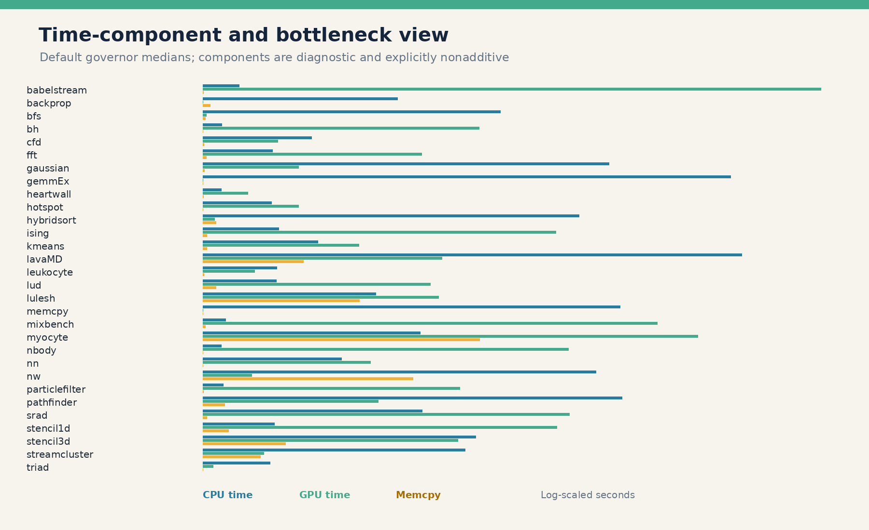
THE GOVERNOR ONLY HELPS THE CONSTRAINED STAGE
Workload bottlenecks
READOUT
CPU, GPU, memcpy, and launch timers may overlap and are nonadditive. The component plot is a bottleneck diagnostic, not a decomposition of launch latency.
CPU package power is absent on DGX Spark, so CPU EDP and whole-system EDP cannot be computed. CPU time and launch time are latency metrics only.
05_time_components_bottlenecks.png
DGX SPARK / CPU x GPU GOVERNORS
06

Slide 7
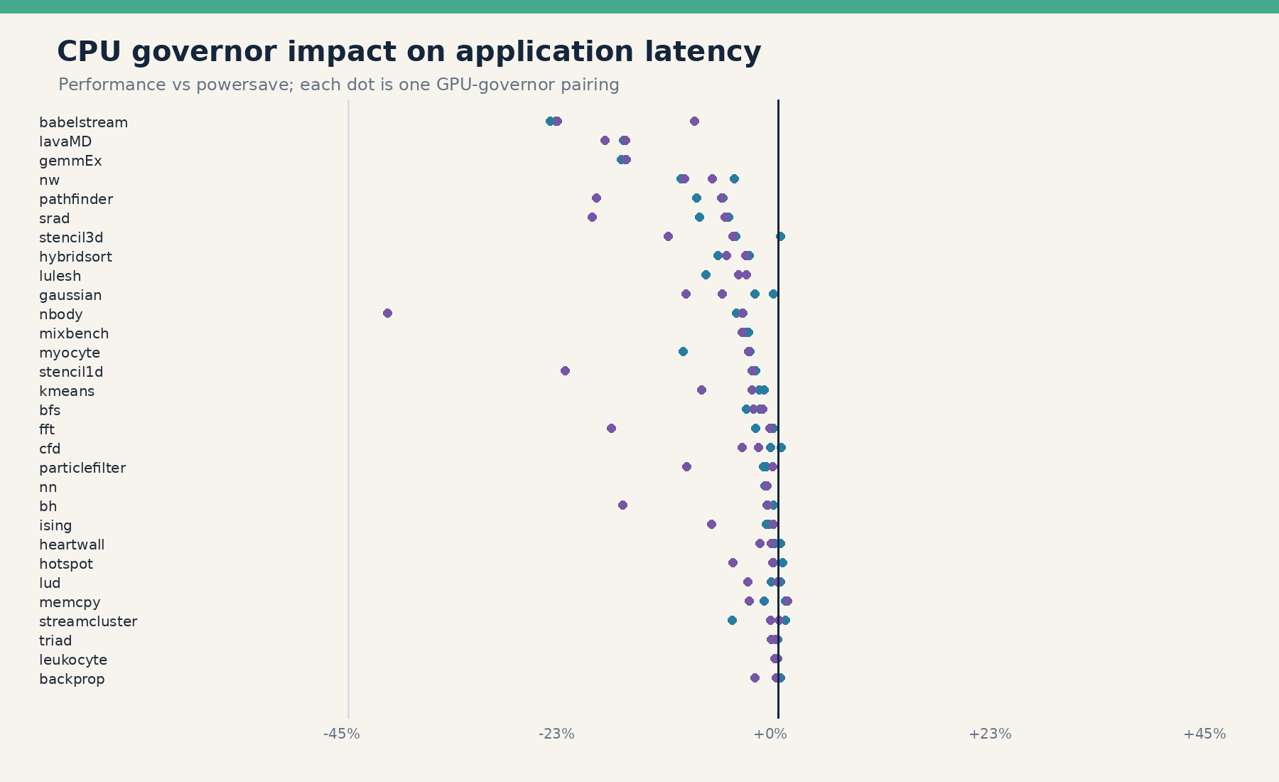
HOST-SIDE EFFECT
CPU governor impact on launch latency
CPU PERFORMANCE
-2.8%
median application-latency change vs CPU powersave
CPU performance lowers latency in 106 of 117 comparable cells.
Largest application-level gains include babelstream, lavaMD, nw, pathfinder, and srad.
This is a host/application effect; GPU execution remains nearly unchanged.
02_cpu_impact_latency.png
DGX SPARK / CPU x GPU GOVERNORS
07

Slide 8
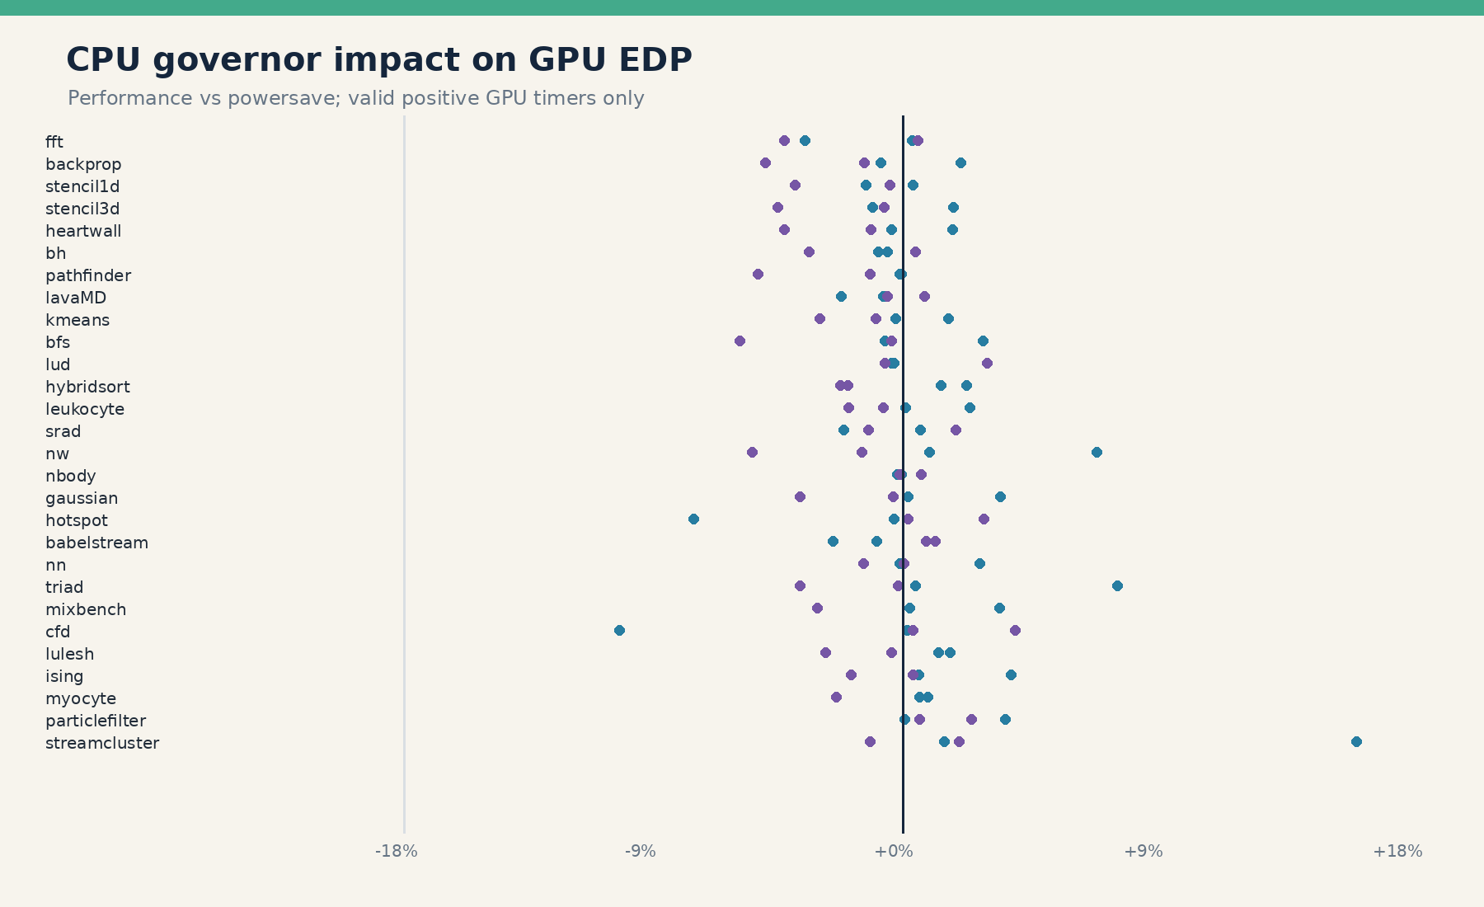
CROSS-DOMAIN COUPLING
CPU impact on GPU time and EDP
GPU TIME
GPU EDP
INTERPRETATION
-0.0%
-0.2%
Treat host and device metrics independently
CPU performance vs CPU powersave; paired-cell median
CPU performance vs CPU powersave; paired-cell median
03_cpu_impact_gpu_edp.png
DGX SPARK / CPU x GPU GOVERNORS
08

Slide 9
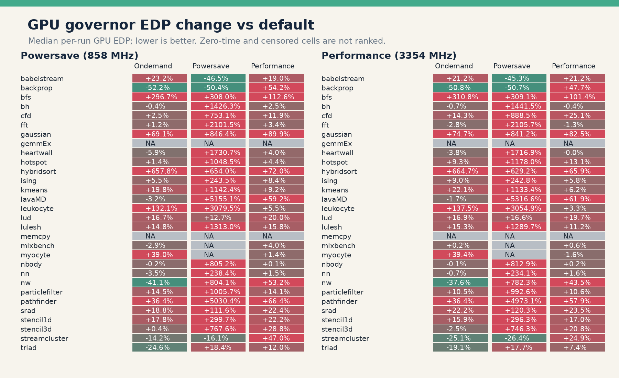
TIME SAVED VERSUS POWER SPENT
GPU governor tradeoff
ONDEMAND GPU EDP
+4.0% / +9.9%
CPU powersave / CPU performance; median vs default
POWERSAVE GPU EDP
+786% / +798%
~73% less power, but ~5x GPU time
Decision rule
Prefer lower EDP unless latency SLOs justify the power premium.
04_gpu_governor_edp_heatmaps.png
DGX SPARK / CPU x GPU GOVERNORS
09

Slide 10
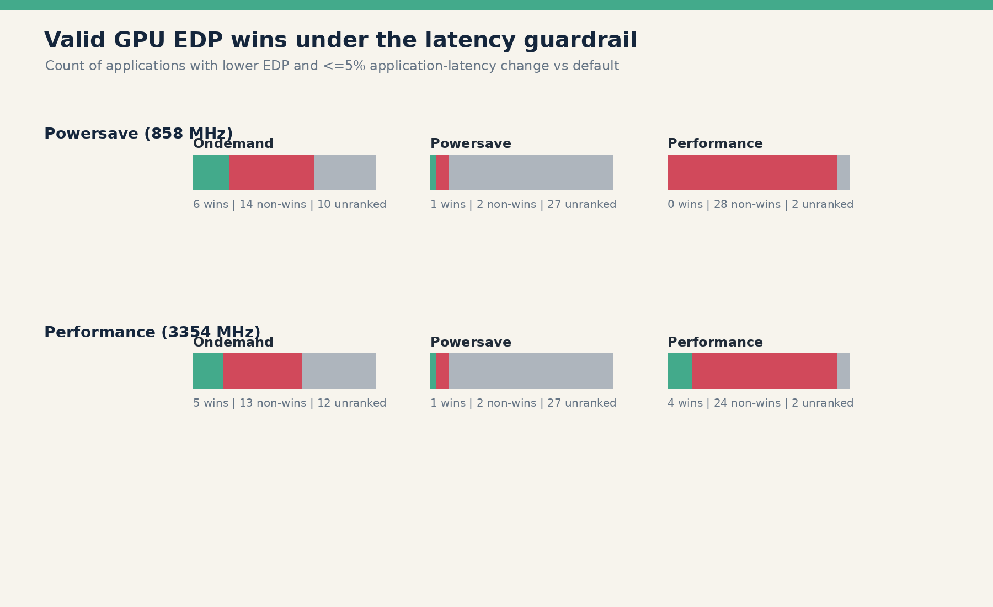
WHERE POLICY EARNS ITS COMPLEXITY
Workload-specific wins
BACKPROP / ONDEMAND
LAVAMD / ONDEMAND
BH + NBODY
-51.5%
-2.5%
<1%
GPU EDP; <=2.2% latency; 10/10 repeats
GPU EDP; no latency cost; 10/10 repeats
direction agrees, but practical significance is weak
06_valid_wins.png
DGX SPARK / CPU x GPU GOVERNORS
10

Slide 11
EVIDENCE FIRST; EXCEPTIONS EXPLICIT
Robust recommendations
01
Use gpu_ondemand for backprop and lavaMD after a short guarded trial.
02
Treat bh and nbody as marginal candidates; their gains are below 1% and repeat consistency is weak.
03
Retain gpu_default for other measured workloads and for unknown applications.
04
Avoid gpu_powersave globally; only backprop shows a robust valid win. Never use it for censored gemmEx, mixbench, or myocyte cells.
DGX SPARK / CPU x GPU GOVERNORS
11

Slide 12
PORTABLE COUNTERS, INSPECTABLE DECISIONS
Transparent runtime policy
01
02
03
04
Observe
Classify
Select
Verify
launch latency / device time / utilization
host-bound / device-bound / insensitive
lowest-cost governor meeting the SLO
re-sample; fall back on drift
PORTABLE SIGNAL CLASSES
SM active %
normalized SM clock
normalized memory clock
GPU power / temperature
launch latency sentinel
DGX SPARK / CPU x GPU GOVERNORS
12

Slide 13
WHAT MUST GENERALIZE BEFORE DEPLOYMENT
Limitations and x86 HPC next steps
LIMITATIONS
X86 HPC VALIDATION
CPU modes were measured on different dates; frequency is confounded with run-date and system drift.
Repeat the full factorial design on target CPU and accelerator
CPU package power is unavailable, so CPU EDP and whole-system EDP are not reported.
Normalize counter classes, not platform-specific event names
Component timers may overlap and are diagnostic, not an additive launch-time decomposition.
Test NUMA, MPI rank placement, and multi-GPU contention
Sub-percent EDP differences need reproduction before deployment.
Validate policy under production power and thermal limits
Decision gate: reproduce direction, magnitude, and stability before rollout
DGX SPARK / CPU x GPU GOVERNORS
13

