Slide 1
Centre of Competence
in
Visual Computing
Internship Phase III presentation
Title: Real-time Sign Language Recognition and Speech Synthesis System
Under the Guidance of
Dr. Anala M R
Team Member:
1RV22MC119(Zaiba Farheen)

Slide 2
Introduction:
Real-time Sign Language Recognition and Speech
Synthesis System
Sign language serves as a vital means of communication for individuals with hearing impairments.
The existing communication within the deaf community could be enhanced by bridging the gap between sign language users and those not proficient in signing.
The project's primary objective is the development of a real-time system proficient in recognizing sign language gestures.
The ultimate aim is the conversion of these identified gestures into understandable and coherent speech.
This conversion facilitates seamless and effective communication between users proficient in sign language and those who primarily rely on spoken language.

Slide 3
Objectives
Develop a robust system for real-time recognition of sign language gestures captured through a camera or other input devices.
Ensure that the entire system operates in real-time, allowing for immediate and seamless communication between the user and the system.
Integrate a speech synthesis module to convert recognized sign language gestures into spoken words, ensuring natural and coherent speech output.
Train a machine learning model (potentially using CNN or other suitable algorithms) to recognize a diverse set of sign language gestures with high accuracy.
Conduct thorough testing and evaluation of the system's accuracy, responsiveness, and overall performance using a diverse dataset of sign language gestures.

Slide 4
Problem Statement
The communication divide between individuals who use sign language and those who rely on spoken language presents a significant challenge. Sign language, a crucial mode of communication for the hearing-impaired community, often creates barriers when interacting with individuals unfamiliar with signing. To address this issue, the project aims to develop a real-time system capable of recognizing sign language gestures and seamlessly converting them into coherent speech. The absence of such a system impedes effective communication between sign language users and the broader community. Bridging this gap is essential for fostering inclusivity and enhancing the overall communicative experience for individuals with hearing impairments. The current lack of efficient real-time conversion systems highlights the pressing need for a solution that facilitates immediate and natural communication across diverse language modalities.

Slide 5
Dataset
Dataset Description:
The custom dataset comprises a diverse set of hand gestures capturing expressions for the entire alphabet (A-Z) and numerals (0). Each gesture is meticulously annotated, providing a robust foundation for training a sign language recognition model. The dataset's focus on clarity and consistency aids in achieving accurate and reliable results.
Reason for selecting the dataset:
Existing datasets in RGB format did not align with our requirements, prompting the creation of a customized dataset tailored to our project needs.
By capturing images from a webcam feed, the dataset introduces real-world variability, ensuring the model's adaptability to diverse environmental factors.
The decision to employ a black-and-white background demonstrates a strategic choice to enhance computational efficiency and training accuracy.

Slide 6
Data Preprocessing
Grayscale Conversion: Converting images and live webcam frames to grayscale.
Resize Images: Standardizing image dimensions and resize processed images to a fixed size.
Image Normalization: Scaling pixel values to the range [0, 1](Normalizing pixel values to enhance convergence during model training.)
Data Reshaping: Reshape data to match the neural network's expected input format.
Region of Interest (ROI) Definition: Defining a specific region within the live webcam frame for focused processing.
Gaussian Blurring: Applying Gaussian blurring to the cropped image to reduce noise.
Adaptive Thresholding: Utilizing adaptive thresholding to segment the hand gesture from the background.
Otsu's Thresholding: Implementing Otsu's thresholding for additional refinement in image binarization.

Slide 7
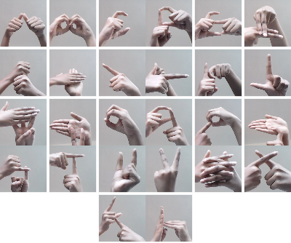
Dataset
Dataset Visualization:

Slide 8
Model Architecture
CNN(Convolutional Neural Network):
Convolutional Layers: Utilizing multiple layers with numerous filters aids in effective feature extraction. Filters, initially random, improve through training, enhancing overall feature extraction.
Feature Extraction: Convolutional layers excel at capturing and learning essential features, a critical aspect for sign language gestures.
Training Enhancement: The model refines feature extraction capabilities during training, adapting filters for improved performance.
Image Classification Focus: CNNs, inherently designed for image tasks, align well with the visual nature of sign language recognition.
Hierarchical Representation: CNN architecture enables learning hierarchical representations, capturing complex patterns in input data crucial for recognizing diverse sign language gestures.

Slide 9
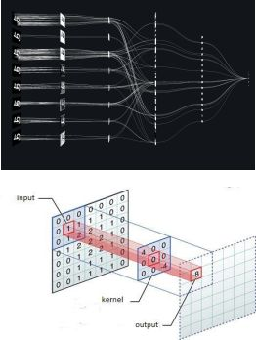
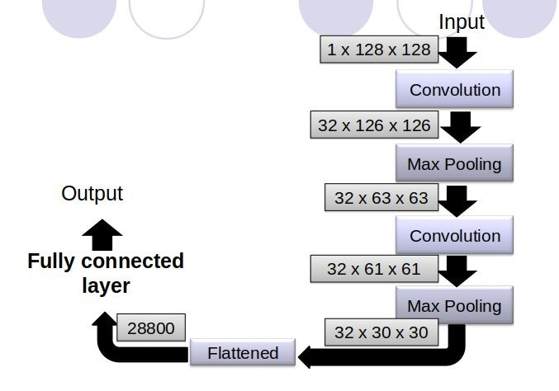
Model Architecture

Slide 10
Hyper parameter Tuning
In the context of developing the Real-time Sign Language Recognition and Speech Synthesis application the following hyperparameters have been tuned to optimize the model's performance:
Epochs (Training Iterations): Trained over 20 epochs, the model gets enough exposure to the dataset without risking overfitting, improving its ability to handle new data.
Batch Size: The batch size is flexible, adapting to the number of training examples in each iteration. This adaptability optimizes the balance between model generalization and training efficiency.
Convolutional Layer Filters: Two layers, each with 32 filters, deepen the model and enhance its ability to learn hierarchical features, crucial for understanding sign language gestures.
Dense Layer Units: Two dense layers with 128 and 96 units strike a balance between capacity and preventing overfitting, helping the model extract intricate patterns from the dataset.

Slide 11
Hyper parameter Tuning
Dropout Rate: Dropout layers, set at a 0.4 rate, introduce regularization after dense layers. This helps prevent overfitting by randomly deactivating input units during training, promoting model robustness.
Learning Rate: Using the Adam optimizer with its default learning rate ensures effective weight updates during training.

Slide 12
Partial Implementation
Demo.

Slide 13
References
Muhammad Al-Qurishi, Thariq Khalid and Riad Souissi, ‘Deep Learning for Sign Language Recognition: Current Techniques, Benchmarks, and Open Issues’, IEEE Access , 9, (31), page: 126917 - 126951, 07 September 2021.
Ying He, Alifu Kuerban, QingLing Yu, QiNa Xie, ‘Design and Implementation of a Sign Language Translation System for Deaf People’, 2021 3rd International Conference on Natural Language Processing (ICNLP) Beijing, China, 26-28 March 2021 , page: 453.
Anna Deza, Danial Hasan, ‘Sign Language Recognition’, University of Toronto, Ontario, Canada, REP.MIE324, December 2nd 2018.
Yung-Chuan Oneal Lin, ‘Sign Language Recognition System and Method’ , U.S. 12/752, 154, April ,01, 2010.
Rafael C. Gonzalez, Richard E. Woods, ‘Digital Image Processing’ , 4th Edition, Pearson, 2018.

Slide 14

Thank You

