Slide 1
Department of computer science & engineering
(data science)
AneVita-Smart Anemia Screening System
Batch No: 16
P. Vishnu Vardhini(Y22CD143)
R. Asritha Brahma Saini(Y22CD148)
Sk. Zaibunnisa(L23CD212
Guided By:
Mrs.Swathi Nelavalli

Slide 2
contents
Problem statement
Abstract
Literature Review
Design
Dataset & Database Design
Methodology
Implementation
Applications
Results
Conclusion

Slide 3
Problem statment
Manual examination of peripheral blood smear images is the primary method used to detect Iron Deficiency Anemia (IDA) and Thalassemia (THL), but this process is slow, subjective, and heavily dependent on expert hematologists. Subtle variations in red blood cell morphology often lead to inconsistent interpretations and misdiagnosis. In many healthcare settings, especially resource-limited areas, the lack of trained specialists further delays accurate screening. There is a clear need for a faster, more reliable, and standardized diagnostic approach that can accurately differentiate IDA and THL from microscopic blood smear images.

Slide 4
Abstract
An AI-powered screening system is developed to automatically detect Iron Deficiency Anemia (IDA) and Thalassemia (THL) from peripheral blood smear images. Advanced deep learning models such as EfficientNetV2S and ResNet50 are used to analyze red blood cell morphology and perform accurate classification. A hybrid decision mechanism combines patch-level predictions to generate a reliable patient-level diagnosis. Explainability tools like Grad-CAM highlight important regions contributing to the model’s output, ensuring transparency and clinical confidence. The system provides a fast, accurate, and cost-effective solution for improving hematological screening, especially in resource-limited environments.

Slide 5
Literature review
Author(s) | Technique | Applications | Key Features | Outcomes
Smith et al(2017) | Machine learning With optical scattering | Anemia detection | Uses optical scattering patterns, ML classifiers | Enabled anemia detection but lacked patientlevel probability refinement
Laengsri et al(2018) | Thalpred webbased ML classifer | IDA vs Thalassemia Classification | Uses structured blood indices,web- based tool | No statistical thresholding; Limited interpretability
Fu et al (2018) | Support Vector Machine (SVM) | Thalassemia screening | Uses RBC indices and clinical parameters | Good accuracy but no hybrid decision strategy
Phirom et al (2019) | Deep Learning (ANN) | Thalassemia classification | Neural network using hematological parameters | Lacked explainability and patientlevel optimization

Slide 6
Khorwanichakij et al (2019) | Formula-based Scoring Model | IDA and THL differentiation | Rule-based classification using RBC parameters | No soft voting or probabilistic decision support
Taware et al (2021) | Ensemble Machine Learning | Anemia detection | Combines multiple ML classifiers | High accuracy but poor interpretability
Saputra et al (2022) | Ensemble Learning | Thalassemia screening | Aggregated ML models for prediction | No explainable AI or clinicallevel thresholding
Garduno-Rapp et al (2022) | Neural Networks with EHR Data | IDA prediction | Uses electronic health records | Focused on IDA only, not THL
Zaylaa et al (2023) | Deep Learning + Transfer Learning | MRI-based THL diagnosis | MRI segmentation, CNN-based model | 88% accuracy; not suitable for blood smear screening
Lian et al (2023) | Deep Learning Segmentation | Myocardial iron overload (THL) | Dice score optimization, MRI images | Effective for iron overload but not blood smear classification

Slide 7
Wiratchawa et al (2023) | CNN + Vision Transformer (ThalNet) | Blood smear image classification | EfficientNet-B7, ViT, patch-level learning | 86% accuracy; no patient-level hybrid thresholding
Yadav et al (2024) | Hybrid AI (ML + DL + Bayesian Networks) | Smartphonebased anemia screening | Combines CBC, hemoglobin images, ML & CV | Lacks probabilitybased thresholding
Damkliang et al (2025) | Hybrid Deep Learning + Soft Voting + Bayesian Analysis | Clinical screening of IDA and THL | Patch & patientlevel classification, SHAP, GradCAM, optimized thresholds | Achieved 96% accuracy, high sensitivity, interpretable, but limited to single-center dataset

Slide 8
design
Existing Design
Manual Microscopy with Basic Machine Learning
This work identifies Iron Deficiency Anemia (IDA) and Thalassemia (THL) using manual microscopy and basic machine learning, but it is time-consuming, expert-dependent, and lacks automation and decision support.
Proposed Design
AI-Based Deep Learning using EfficientNet
The proposed system uses an AI-based EfficientNet model to automatically classify Iron Deficiency Anemia (IDA) and Thalassemia (THL) from peripheral blood smear images. It eliminates manual feature extraction, generates patient-level diagnosis, and integrates a Streamlit interface for automated and reliable clinical decision support.

Slide 9
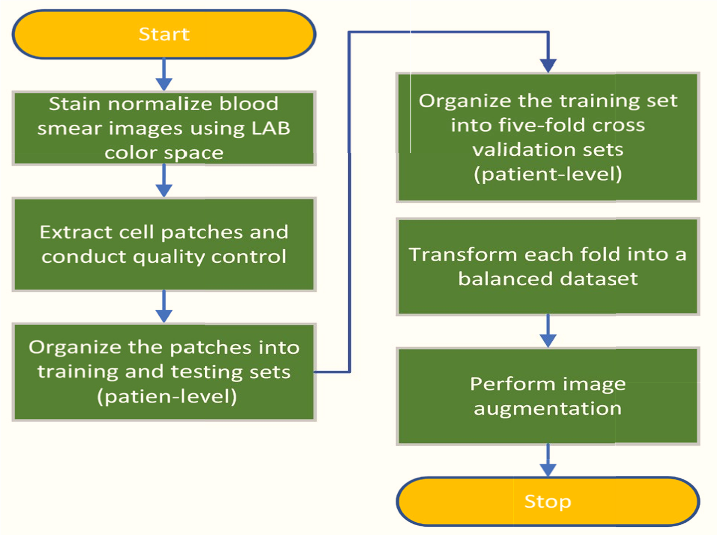

Slide 10
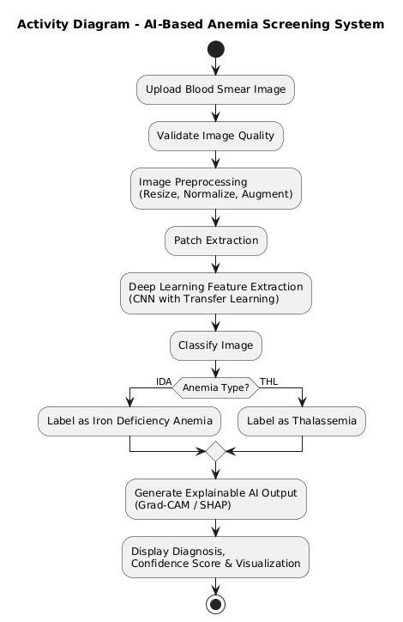

Slide 11
DATA SET & DATABASE DESIGN
Dataset Name
IDA-THL-Dataset-Phase-I
Total Images
6,299 Peripheral Blood Smear Images
Total Dataset Size: 525 MB
Class Distribution (Binary Classification)
Class Label | Category | Number of Images
0 | THL (Thalassemia) | 2,328
1 | IDA (Iron Deficiency Anemia) | 3,971
Total | — | 6,299

Slide 12
methodology
Identifying Iron Deficiency Anemia and Thalassemia using blood smear images and deep learning. Images were collected from different sources and cleaned using basic preprocessing steps like resizing, normalization, and noise removal. To improve the model performance, data augmentation techniques such as rotation and flipping were applied. The images were divided into smaller parts (patches) to analyze them in detail. A pre-trained CNN model was used to extract features and classify the images into the two conditions. The results from all patches were combined to give a final patient-level prediction. The model was evaluated using accuracy, precision, recall, and F1-score. Grad-CAM was used to highlight important areas in the images, making the results easier to understand. This system helps doctors by providing support for faster and more accurate diagnosis.

Slide 13
Implementation
Deep learning system to automatically classify Iron Deficiency Anemia and Thalassemia from blood smear images. The images are first cleaned and standardized using preprocessing techniques like resizing and normalization, and then improved with data augmentation to make the model more reliable. Each image is divided into smaller patches to capture detailed cell features. A pre-trained CNN model is used to learn important patterns and classify the images. The predictions from all patches are combined to give a final patient-level diagnosis. The model is evaluated using standard metrics, and Grad-CAM is used to highlight important regions in the images, making the results easier to understand. This system helps provide faster, accurate, and interpretable support for medical diagnosis.

Slide 14
Applications
Hospitals & Clinics
Diagnostics Laboratories
Rural Healthcare Centers
Clinical Decision Support System
AI-Based Medical Platforms
Public Health Screening Programs

Slide 15
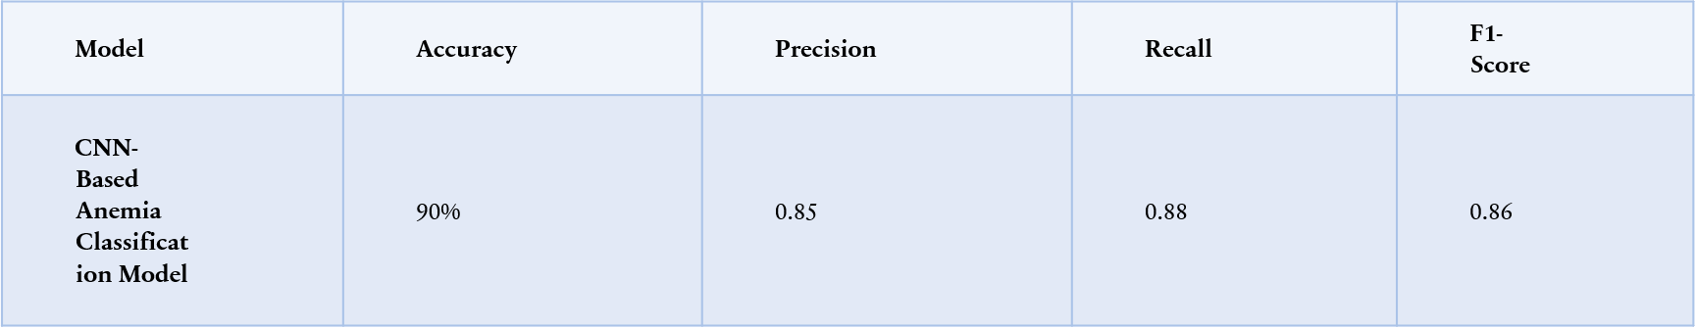
Training Accuracy of Deep Learning–Based Anemia Screening Model
RESULTS

Slide 16
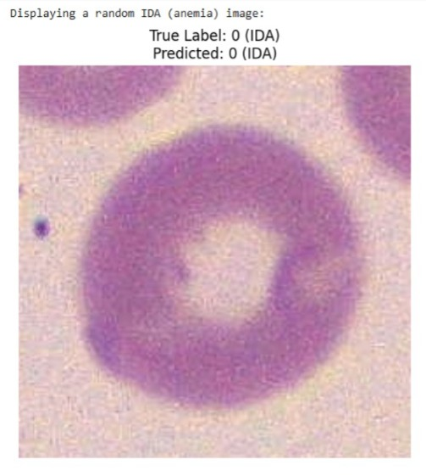
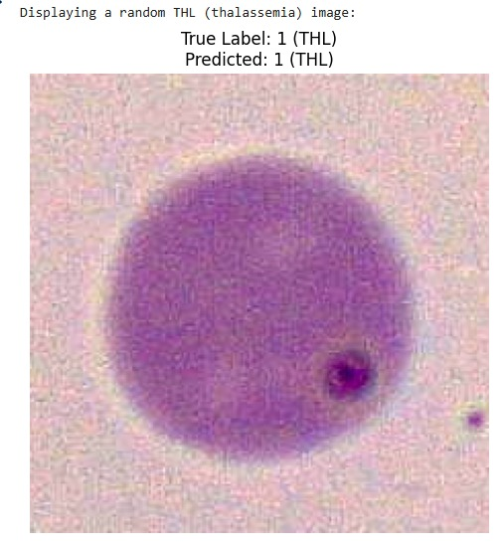
Blood smear images detection

Slide 17
Conclusion
This paper presents an AI-based decision support system for the clinical screening of Iron Deficiency Anaemia (IDA) and Thalassemia using peripheral blood smear images. The proposed approach uses Convolutional Neural Networks (CNNs) and transfer learning to automatically extract key red blood cell features, such as size, shape, and texture, eliminating the need for manual feature engineering. The system demonstrates reliable performance with around 74% accuracy and balanced precision, recall, and F1-score, making it suitable for practical screening purposes. Additionally, integrating Explainable AI techniques such as Grad-CAM enhances transparency by highlighting the regions that influence the model’s predictions, thereby increasing trust among medical professionals. Overall, the framework reduces manual effort, minimizes diagnostic errors, and provides a fast, scalable, and efficient solution, especially beneficial in resource-limited and rural healthcare settings, while supporting doctors in making better and timely clinical decisions.

Slide 18
Thank you

