Slide 1
Team Spectacular
Algorithmic Trading Model Development for BTC/USDT
Team Members
Zaid Ahmed Khan
Akash Kaushik
Shishir Haldia
Bhanupriya Gupta

Slide 2
Introduction
Model Design
Index
Technical Analysis
Backtesting
Risk Management

Slide 3
Introduction
Objective
To create profitable BTC/USDT algorithmic trading models that outperformed benchmark returns, managed risk, and capitalised on market volatility.
Solution
We have employed a trading algorithm based on an MLP as a classifier with three classifications, Buy, Hold and Sell.

Slide 4
Model Design
Using LSTM Model to predict future prizes of stocks
Using MLP Classifier & Monte Carlo Simulation to predict by combining all information of past and present prizes
Final Prediction whether we should Buy/Sell or Hold stock
Doing Technical Analysis with indicators like Boland Indicator etc.

Slide 5
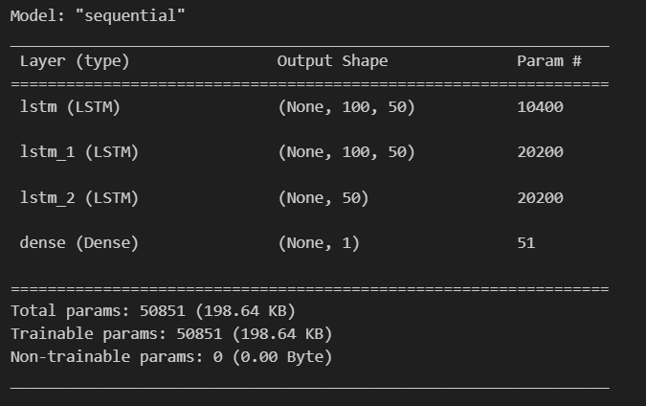
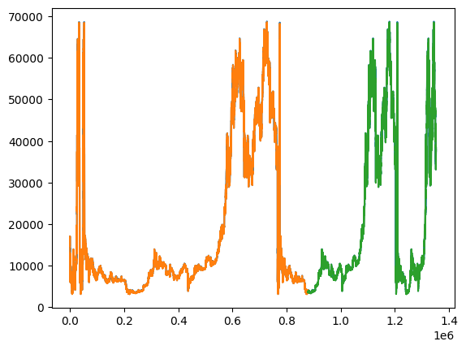
LSTM Model
Architecture
Predictions Graph

Slide 6
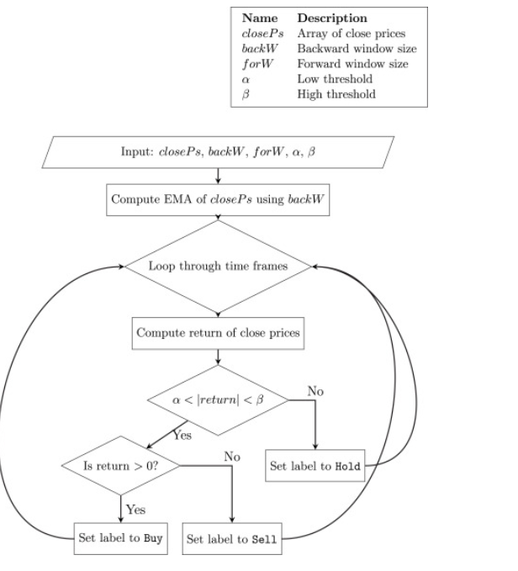
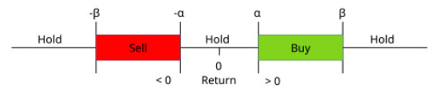
MLP Classifier
Labelling Algorithm

Slide 7
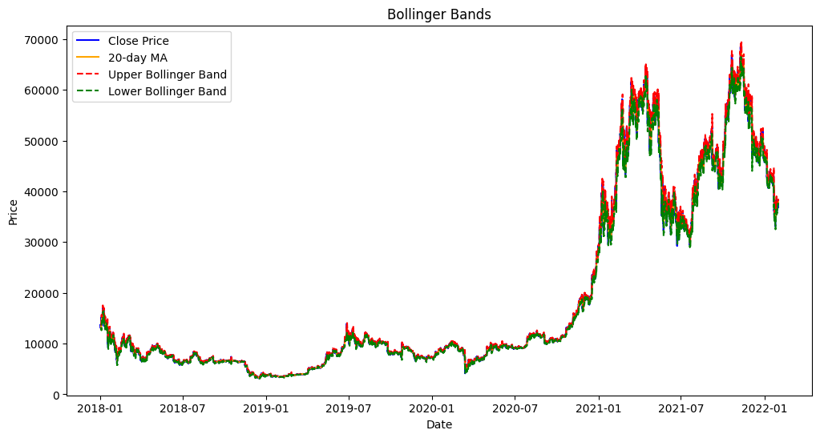
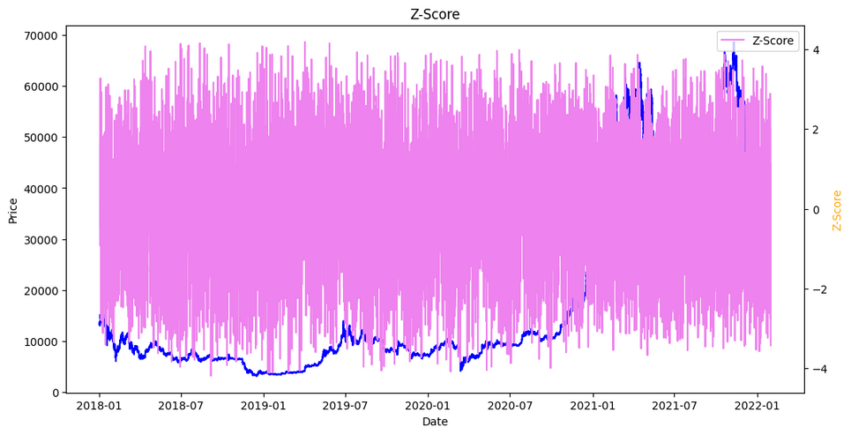
Technical Analysis
Bollinger bands
Z-Score

Slide 8
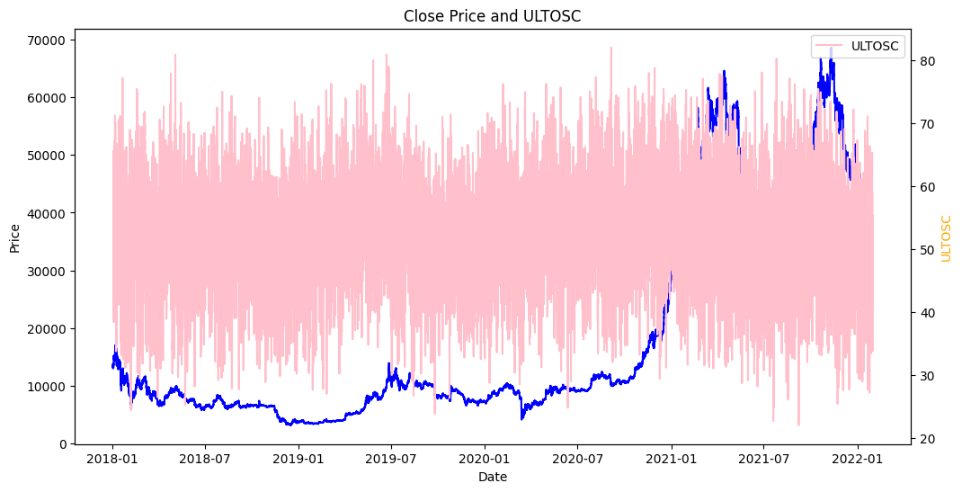
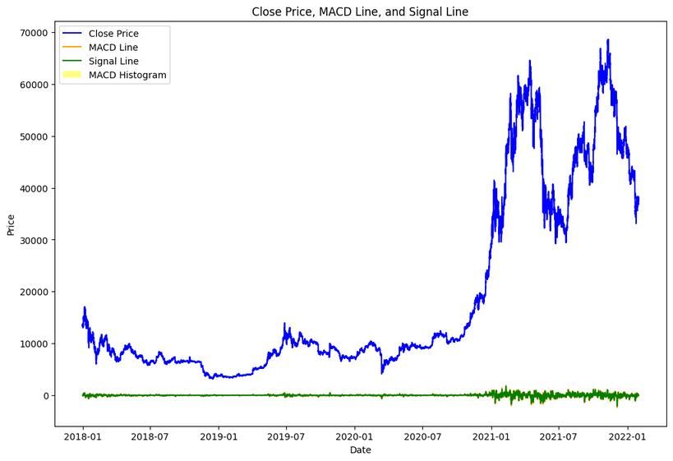
Technical Analysis
ULTOSC
MACD

Slide 9
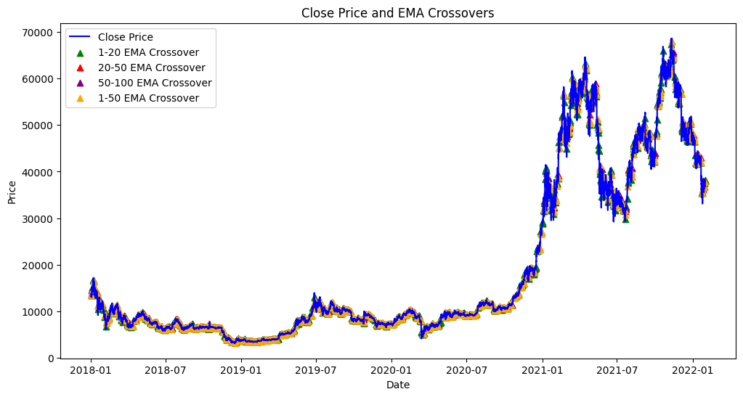
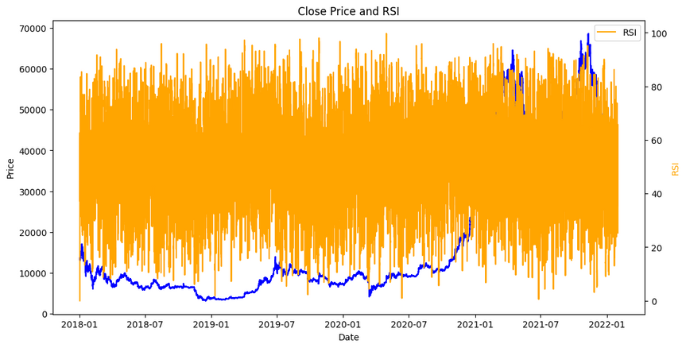
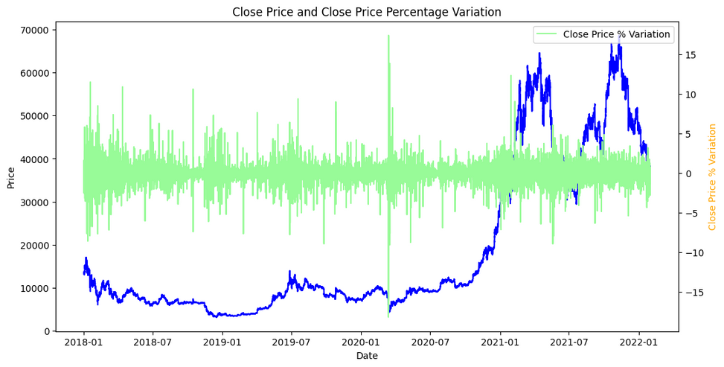
EMA crossovers
RSI
Close price percentage variation

Slide 10
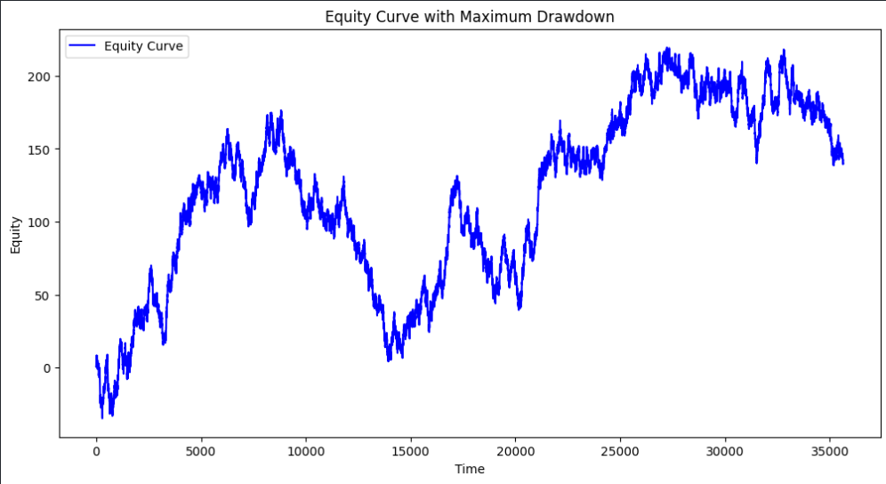
Equity Curve
Back to Agenda Page
The plotted equity curve with Maximum Drawdown provides a visual representation of the strategy's performance over time.

Slide 11
Backtesting Results
Back to Agenda Page
Mean Net Profit (Rs.) | 132485.48
Sharpe Ratio | 1.93
Win Rate (Profitability %) | 84.0161
Maximum Drawdown | 0.0894
Sortino Ratio | 2.96
Risk-Reward Ratio | 1.9484
Net Profit Exceeding Benchmark | 255632.8075

Slide 12
Risk Management
Proposed strategy using MLP model for algorithmic trading, classifying instances into buy, sell, or hold actions
Strategies include fixed percentage, technical indicators, and the common trailing stop loss method
Use of regression models like Linear Regression, Decision Trees for predicting stop-loss levels
Combining MLP model with dynamic stop-loss to balance profit pursuit and limit potential losses in algorithmic trading

Slide 13

Thank You

