Slide 1
INTRODUCTION
The Ultra High Performance Composite is a type of cementitious composite that's composed of a high percentage of internal fiber reinforcement and a low water-to-carbon ratio. It's ideal for high-speed transportation and is commonly used in industrial applications. UHPC is not just a material, it's a technology that opens up new horizons of innovation and creativity for architects, engineers, and builders. It Provides an aesthetic and functional benefits that enhance the quality of life.

Slide 2
OBJECTIVES
01
analyze the data includes looking for outliers, determining its correlation between features and expected values.
02
Filter out the features which doesn’t have relation with output or doesn’t depend on expected value.
03
To make as accurate as possible prediction on test data based upon the model which yield best accuracy.

Slide 3
MODEL
APPROACH

Slide 4
Text Preprocessing
Methods
Function
Purpose
Recursive feature elimination (RFE) selects features by recursively considering smaller and smaller sets of features until the desired number of features are selected.
Recursive feature elimination
RFE( )

Slide 5
Exploratory Data
Analysis

Slide 6
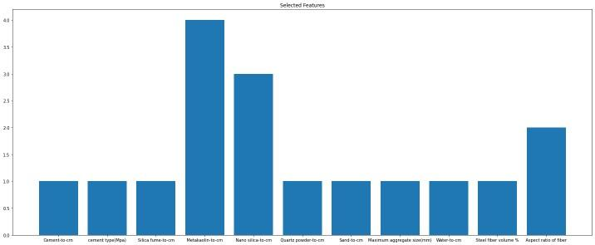
RFE.fit.ranking_ Vs Features

Slide 7
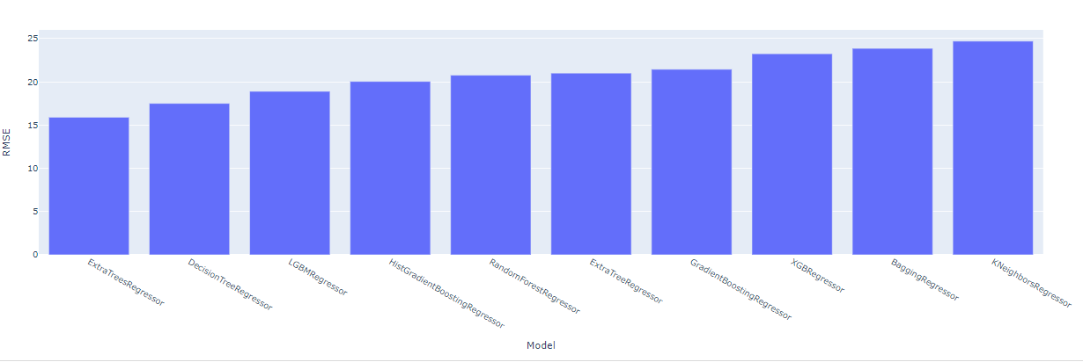
RMSE value Vs Model graph

Slide 8
OBSERVATIONS-
Superplasticizer, fly ash, slag, and limestone are not major contributors to compressive strength from the correlation graph.
We can observe from Root mean squared error graph Vs model Extra trees regressor has least error and then Decision tree regressor.
We can see from correlation graph that steel fibre and sand have the greatest positive and negative correlations, respectively, with the compressive strength value.

Slide 9
MODELS

Slide 10
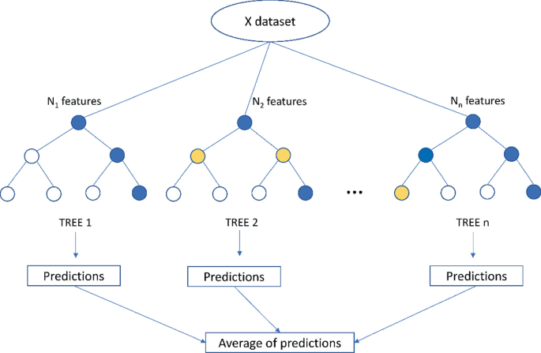
Extra Trees Regressor-
The extra trees method generates many number of decision trees, but each tree's sampling is random, resulting in a dataset with distinct examples. The most crucial and distinctive feature of extra trees is the random selection of a splitting value for a feature, which entails figuring out a locally optimal value by separating the data using Gini or entropy. As a result, the plants are diverse and unrelated.

Slide 11
RESULTS-
Model | R-squared | RMSE | Accuracy
Extra trees regressor | 0.72 | 15.91 | 0.99
Decision tree regressor | 0.66 | 17.51

Slide 12
THANKYOU!!

