Slide 1
TASK-2
Mathematics behind GANs.
NAME – ZAID AHMED KHAN
ROLL NO-21CH10079

Slide 2
What is GAN?

Slide 3
GAN Is basically a combination of two neural network namely generator model (denoted by G) and discriminator model (denoted by D) .
The generator model is helpful in generating new instance of data i.e some fake data points .
The discriminator is used to tell if a given data point is original one or it has been produced by our generator .
These two model work in a competitive behaviour and eventually both of them get better in their job .

Slide 4
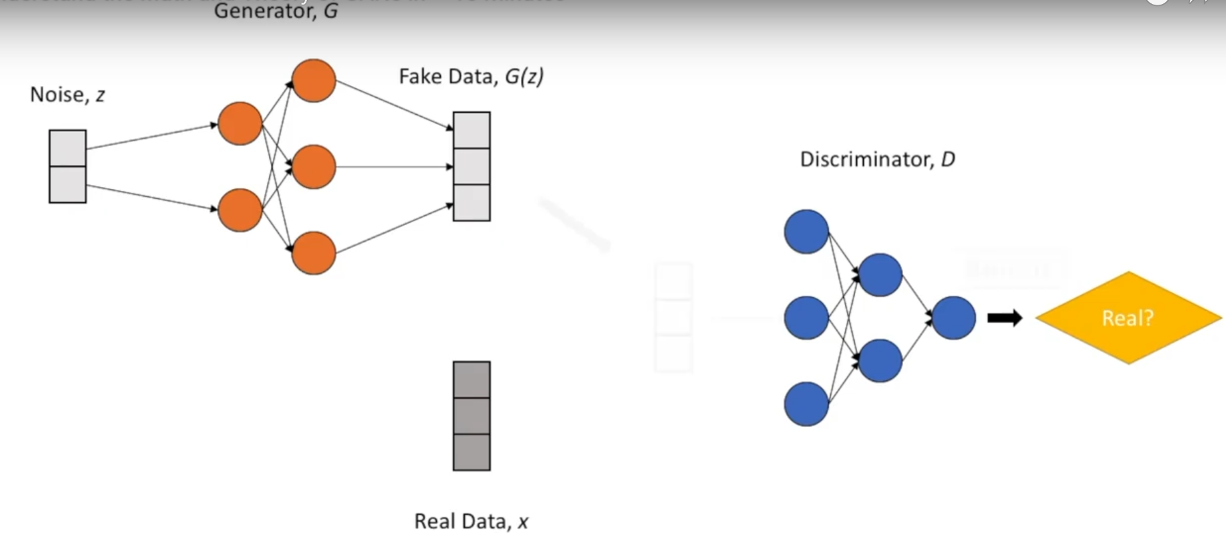
We first pass our input noise in the generator (G) it converts them into some fake data points . Then we pass these fake data points and real data points into the discriminator which given a single number as output representing the probability that the input is from real distribution or not. These fake points are represented as G(z) .
If we use a fake data as input to discriminator then the output is labelled as D(G(z)) which represent the probability of fake samples are real and when we pass real data points then the output is labelled as D(x).

Slide 5
Where min G max D means that G wants to minimize this function D want to maximize this function .
First part represent the discriminator prediction on real data and other part the discriminator prediction on fake data .
There is 1- D(G(z)) which help the generator in minimizing the quantity

Slide 6
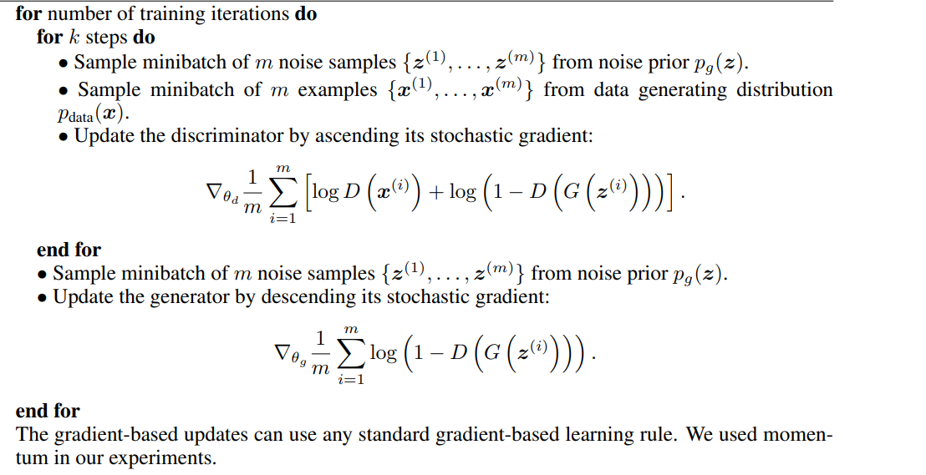
Where Θg and Θd are weight of the neural networks .
When D is constant C(G) = max D V (G, D) , here C(G) is called virtual training criterion

Slide 7
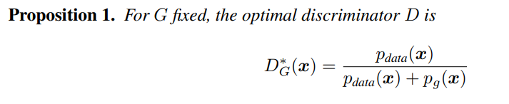
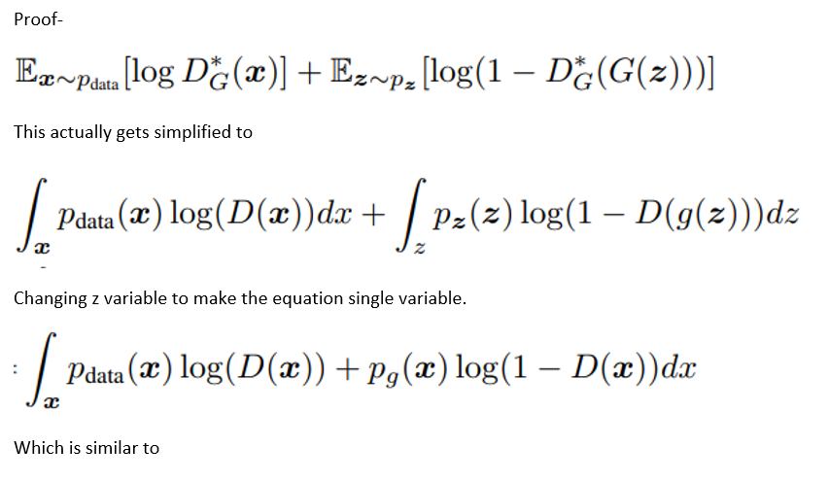

Slide 8

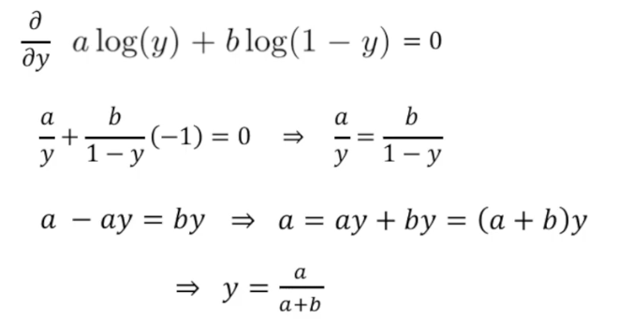
To get minimum of equation like these we differentiate the equation .

Slide 9
To get minimum of equation like these we differentiate the equation .

Slide 10
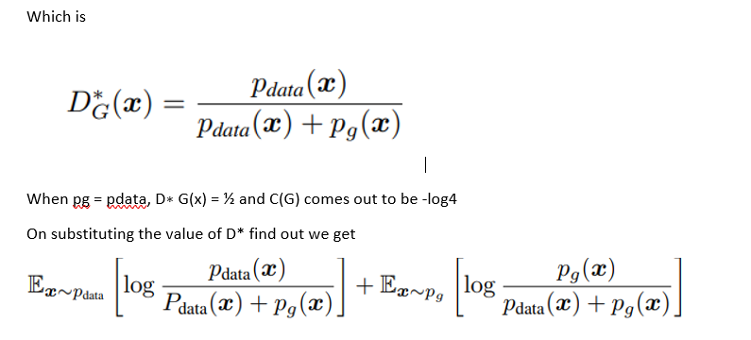
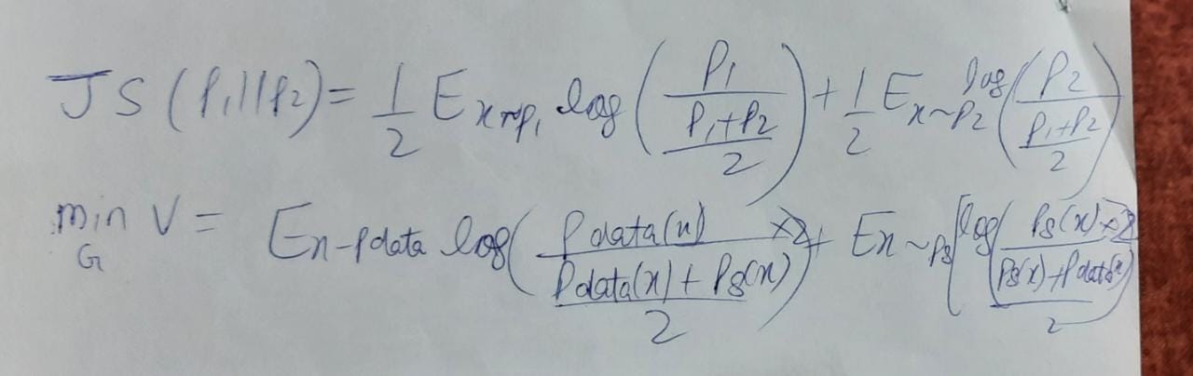

When Pdata=Pg then JSD term will be zero and C(G) comes out to be -log(4) .

Slide 11
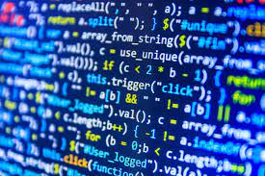
THANK YOU

