Slide 1

PREDICTING RHEOLOGICAL PROPERTIES USING AI & ML
Vedic Dutta &
Zaid Ahmed Khan

Slide 2

CONTENT
01
EXISTING RESEARCH
02
OUR APPROACH

Slide 3
EXISTING RESEARCH

Slide 4
OTHER EXISTING PAPERS
Elastic Properties :
The prediction of elastic properties represents a significant application area, particularly in materials engineering :
Storage and loss moduli prediction using advanced neural networks, particularly for viscoelastic materials and magnetorheological systems ( Link )
Young's modulus, shear modulus, and bulk modulus for various material systems including metals, rocks, and composite materials ( Link-1 , Link-2 )
Viscosity Properties :
Viscosity remains the most extensively studied rheological property using AI/ML approaches. :
Dynamic and apparent viscosity for drilling fluids, enabling real-time monitoring and automated mud system control ( Link )
Viscosity of specialized fluids such as ionic liquids, deep eutectic solvents, binary liquid mixtures, and lubricants ( Link )
Shear-rate dependent viscosity for complex and non-Newtonian fluids ( Link )

Slide 5
OUR
APPROACH

Slide 6
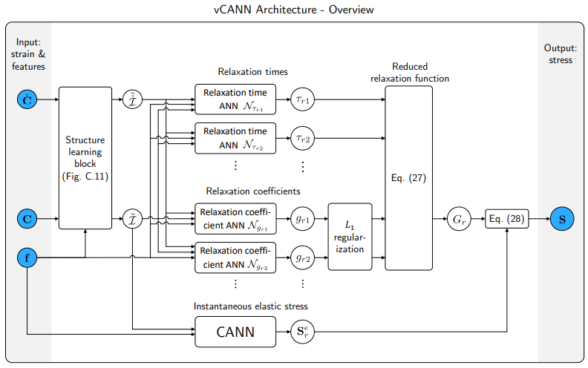
MOTIVATION
The generalized Maxwell model (GMM) used in vCANNs captures complex viscoelastic behavior ( Lin
However, it often uses a large number of branches, leading to high computational cost and overfitting.
Our goal: replace GMM with a compact, interpretable, and efficient model that preserves performance within a specified tolerance.
We achieve this by learning a sparse viscoelastic network composed of Maxwell and Kelvin–Voigt (KV) elements.

Slide 7
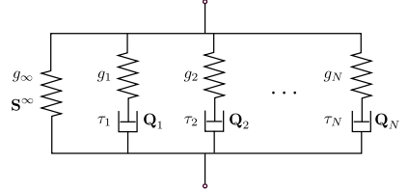
IDEA
Represent the viscoelastic model as a learnable physical network on a fixed mxm grid.
Each grid edge can host one of 4 types:
Spring (S), Dashpot (P), Maxwell (SP), or Null (∅)
A neural network learns:
Where to place branches
What type each branch should be
What parameters (G′,G′′G', G''G′,G′′) they should have
The final model approximates the GMM with far fewer components.

Slide 8
MODEL WORKFLOW
Input: Strain invariants and features (same as vCANN)
Teacher model: Use vCANN to produce full generalized Maxwell parameters
Compression network:
Predicts a grid of components and their types/parameters
Outputs a structured viscoelastic network
Loss:
Match GMM response (accuracy)
Penalize unnecessary branches (sparsity)
Encourage locality of branches (structural consistency)

Slide 9
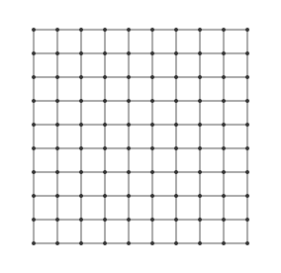
GRID-BASED PARAMETRIZATION
Define a fixed mxm template grid (e.g., m=100)
Each edge between grid nodes can be:
Spring (S): stores elastic energy
Dashpot (P): dissipates energy
Maxwell (SP): both
Null (∅): inactive / trimmed after training
Parameters G′G'G′, G′′G''G′′ are predicted for each non-null edge
The structure forms a directed, interpretable network

Slide 10

LOSS FUNCTION
Fit loss: matches the compact model’s output with the GMM
Sparsity loss: discourages extra branches
Compactness loss: discourages scattered elements far from the grid origin

Slide 11
POST PROCESSING
After processing, remove:
All ∅ edges
Disconnected components
Keep only the minimal, connected subgraph that reproduces behavior
Output: a symbolic, interpretable model with greatly reduced complexity

Slide 12
KEY BENEFITS
Model reduction: compact replacement of large GMMs
Interpretability: physical structure can be visualized and analyzed
Efficiency: fewer branches lead to faster simulations in finite element solvers
Generalization: structure is dynamically adapted to each material’s characteristics
Avoiding Overfitting : Use of combination of Kelvin-Vogit and Maxewell model can lead to smaller Network to predict the substance properties

Slide 13

THANK YOU
FOR YOUR ATTENTION

