Slide 1

PREDICTING RHEOLOGICAL PROPERTIES USING AI & ML
Vedic Dutta &
Zaid Ahmed Khan

Slide 2

CONTENT
01
WORK DONE
02
PAPER OVERVIEW
03
DATASET USED
04
EXPERIMENTS DONE

Slide 3
WORK
DONE

Slide 4
WORK DONE
DONE LITERATURE REVIEW OF PAPER
CURATED STRESS, STRAIN DATA FROM INTERNET FOR VARIOUS MATERIALS AT VARIOUS TEMPERATURE
UPDATED THE VCAN GITHUB REPOSITORY TO MAKE IT WORKING AND GENERATED OUTPUT FOR VARIOUS CONFIGURATION AND COMPARED WITH PROPERTIES OF MATERIAL AVAILABLE AT THE INTERNET
GENERATED RESULTS WITH DIFFERENT ARRANGEMENTS OF SPRINGPOT ELEMENT AND COMPARED WITH PROPERTIES OF MATERIAL AVAILABLE AT THE INTERNET

Slide 5
PAPER OVERVIEW

Slide 6
UNDERSTANDING MATERIAL BEHAVIOR
•Soft materials like gels, tissues, and polymers exhibit viscoelastic behavior.
•Traditional models use springs and dashpots, but fail to capture power-law responses.
•Fractional calculus introduces new models using non-integer derivatives.
•Many soft materials show stress/strain decay as σ(t) ∝ t^(-β)
•Traditional exponential decay (e.g., e^(-t)) is insufficient.
•Requires models that account for slow, memory-dependent behavior.

Slide 7

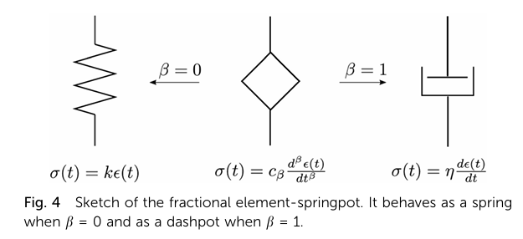
THE SPRINGPOT: BRIDGING SPRING AND DASHPOT
• Springpot is a fractional-order element.
• Governing equation of springpot system :
• Here Cb generally referes to firmness of a material and Beta is the power exponent
• Models combine springpots with traditional elements.
• Efficient modeling with fewer parameters.

Slide 8
DATASET
USED

Slide 9
STRESS–STRAIN DATA FOR ALUMINUM
Material & Source: Aluminum alloy 6061-T651, 9 lots from multiple manufacturers
Temperatures: 6 levels → 20, 100, 150, 200, 250, 300 °C
Key Features:
High-quality dataset enabling study of variability in aluminum mechanical behavior
Useful for uncertainty quantification, probabilistic modeling, fire resistance design (Eurocode 9)
Public Access: Available via Mendeley Data → DOI: 10.17632/rd6jm9tyb6.1

Slide 10
EXPERIMENTS DONE

Slide 11
MODELLING POWER: IMPLEMENTATION DETAILS
Source: Experimental stress–strain field for aluminium
Goal: Fit constitutive models that map strain history → stress response
Preprocessing:
Uniform time-step Δt (=3s) calculated from strain increments.
Models Used & Fairness Comparison Criteria:
Maxwell and Springpot elements (k branches each)
Same number of branches k in both models.
Same optimizer (scipy.optimize.curve_fit) and bounds on parameters.
Same dataset, fitted on entire series (no data leakage issues).
RMSE (root-mean-square error) computed over the full dataset.

Slide 12
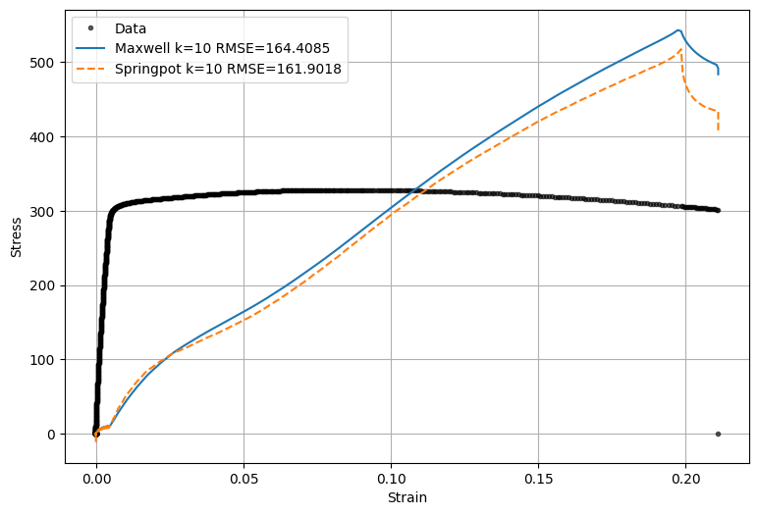
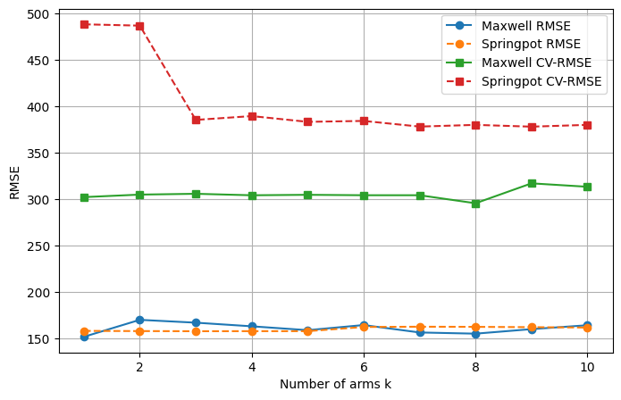
MODELLING POWER: RESULTS

Slide 13
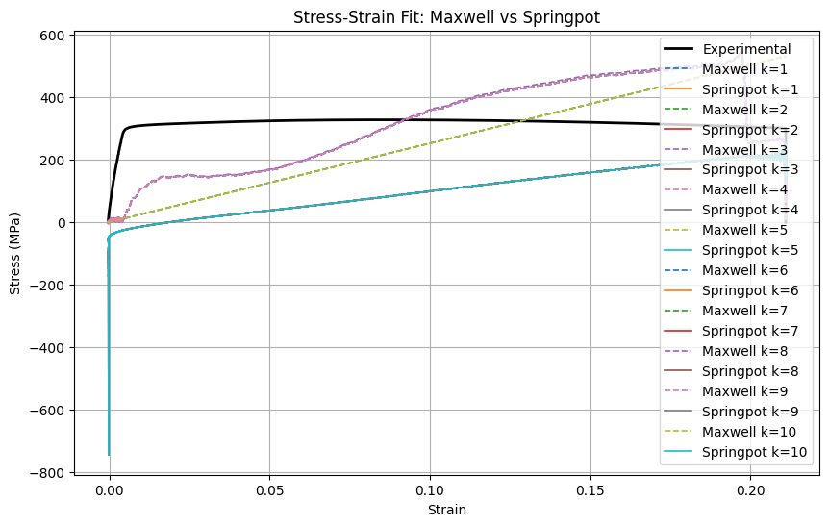
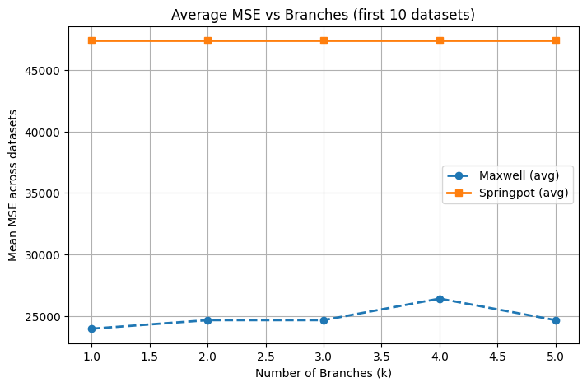
MODELLING POWER: PARALLEL+SERIES (2 STACKS)

Slide 14
MODELLING POWER: OBSERVATIONS
RMSE comparison:
Springpot consistently achieved lower RMSE than Maxwell for the same k.
Both models’ RMSE remained non-increasing as k increased, but neither reached near-zero error within tested k range.
Qualitative fit:
Maxwell model’s predicted stress curves often lagged or over-smoothed certain features.
Springpot handled intermediate viscoelastic slopes better, likely due to fractional-order flexibility.
Implication:
For this dataset, springpot elements are more efficient at capturing the material’s stress–strain relationship per branch, for this particular material, although pronounced difference was not observed.
Neither model with limited k perfectly interpolates the experimental curve — additional branches or hybrid formulations might be necessary for exact match, justifying grid-like architecture. Introducing two stacked layers instead of a single layer reduced the average generalisation error for both models. However, this did not decisively make springpot superior — Maxwell remains competitive.

Slide 15
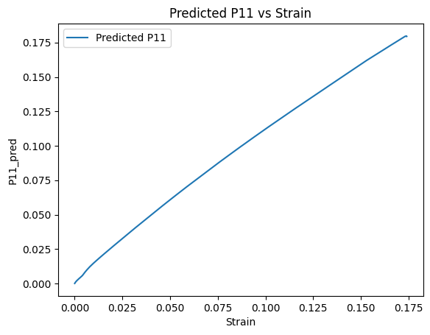
VCAN OUTPUT FOR ALUMINIUM AT T=100C
Young Modulus for this dataset : 55 GPa using true dataset
Young Modulus for this using Predicted P11 of VCAN : 0.00186 GPa

Slide 16
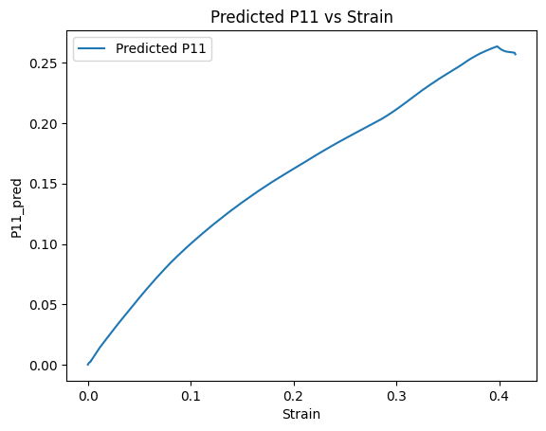
VCAN OUTPUT FOR ALUMINIUM AT T=300C
Young Modulus for this dataset : 31.75 GPa using true dataset
Young Modulus for this using Predicted P11 of VCAN : 0.00149 GPa

Slide 17

THANK YOU
FOR YOUR ATTENTION

