Slide 1
Team-262 D'Blaze
Open IIT Product Design 2021-22

Slide 2
Problem statement
To identify the type of fire and provide information on combatting it.

Slide 3
Motivation
Currently there is no veracious way to find out the type of fire.
Making it precarious for first responders and firefighters to extinguish the fire, often making the state worse.
To help these brave men and women, we came up with a unique, one of a kind solution.
No other product in the market addresses the same issue as ours.
Loss of invaluable lives of citizens as in the case of Meerut Fair Fire in 2006.

Slide 4
D'BLAZE

Slide 5
Aim Of Product
To identify the type of fire and provide information on combatting it.
To help minimize damage caused by fires
Efficient use of resources and making it safe for the first responders to douse the fire.

Slide 6
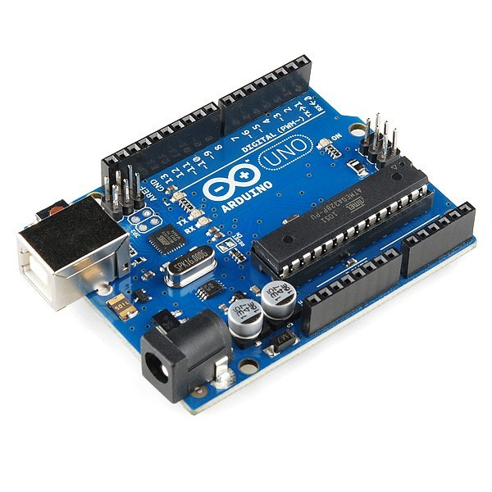
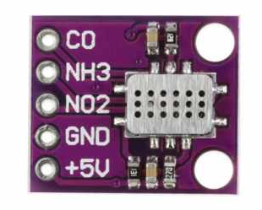
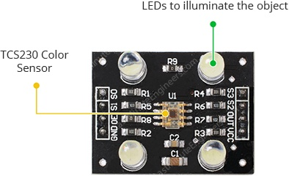
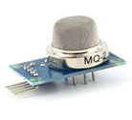
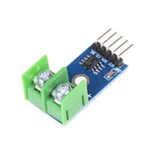
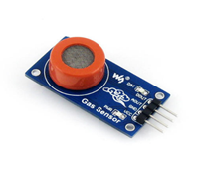
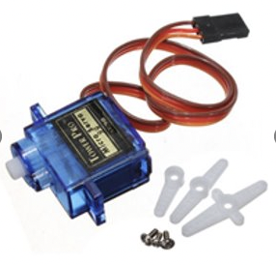
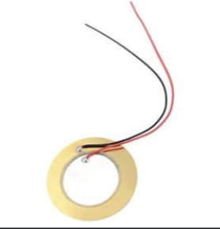
Components used
1) Arduino Uno
2) MiCS 6814 Sensor
3) TCS230 Color Sensor Module
4) MQ 2
5) MQ 3
6) MAX6675
7) Micro Servo Motor SG90
8) Piezo Buzzer

Slide 7
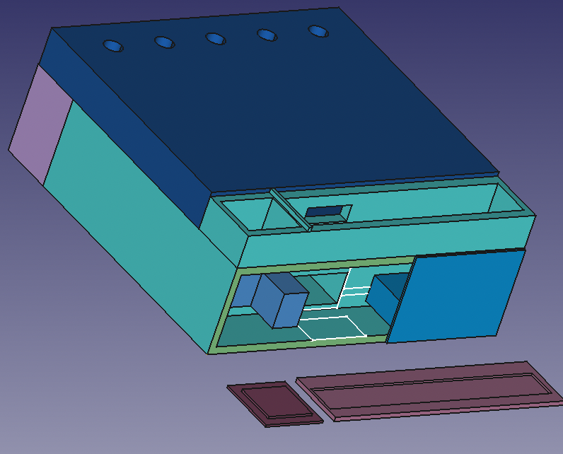
Working Mechanism
LEDs
Sensor module
Holds arduino
The product consists of servomotors, temperature sensors, gas sensors and color sensors to allow for the intake, cooling and assessment of fumes to detect the type of fire.
For water replacement
Cooling module
To connect arduino to a battery
Temperature sensor
Micro servo

Slide 8
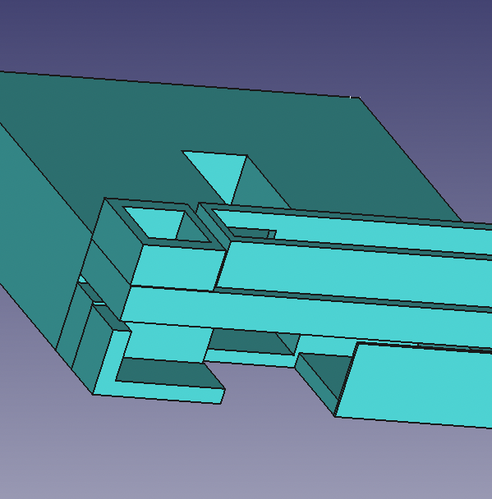
Holds water for cooling
Cooling Module
Cooled gas flows out
The cooling module lets the hot fumes enter and cools it down.
The CO2 in the sample is also absorbed using a CaO coating.
Hole for wiring
Hot gas flows in
The gas is allowed to pass into the sensor module once it reaches a temperature of 50°C.

Slide 9
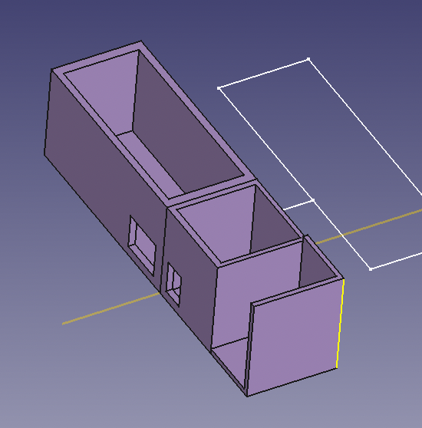
Sensor Module
The sensors
The sensor module has a litmus test area and three sensors.
The information gathered from the litmus test and the sensors i.e. MQ2, MQ3 ,MiCS 6648 is used to assess the fumes of the fire.
Litmus paper
Micro servo
Cooled gas flows in

Slide 10
Detecting fire using data collected
-If the litmus turns blue and there is no nh3 in the fumes we can confirm that the fumes consists of metallic oxides.
Most metallic fires start due to the combustion of sodium, potassium, lithium, magnesium, calcium, titanium, uranium or plutonium. All these metals have basic oxides.
The presence or absence of nh3 is checked using the mics 6814 sensor.

Slide 11
-If the litmus solution turns deep red and there is no NO2 in the fumes we can conclude the presence of HCl in the fumes which is a byproduct of burning insulation (PVC).
Now since we absorb the fumes as soon as it reaches the product, we are able to absorb the fumes that were evolved when the fire started burning. PVC burning right at the start of the fire is a indication of a electrical fire.

Slide 12
-If the gas sensors MQ2 or MQ3 are stimulated it tells us the fire started due to liquid flammables.
-Now, to check for type A fires we use the carbon monoxide pin of the mics 6814 detector. If carbon monoxide is released in the fire and the fire is not electrical we can conclude that the fire is a type A fire.
-After the detection is done the appropriate led is turned on and the buzzer is activated to inform the user about the fire.

Slide 13
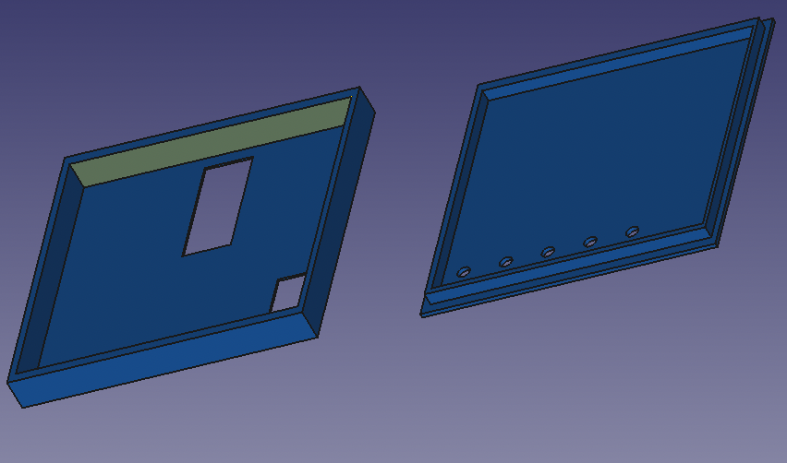
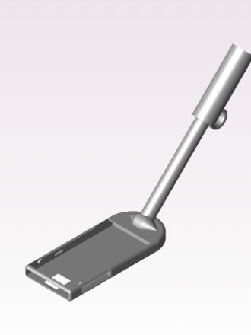
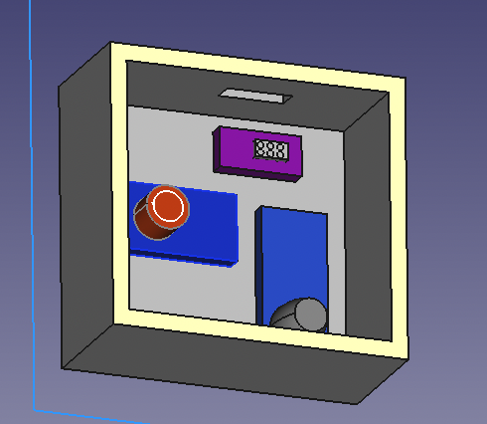
Other parts of the product
Casing for the arduino breadboard and buzzer
Stick to increase range
sensors

Slide 14
OUR SOLUTION
Place the device near fire
Wait for the device to assess the fumes
Different coloured LEDs will glow according to type of fire

Slide 15
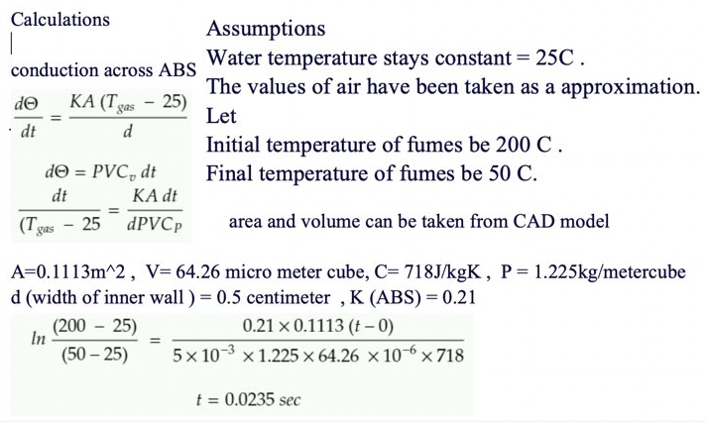

Calculations

Slide 16
Putting out the fire
Type of fire | Mode of combating the fire
Class A fires | ABC fire extinguisher, Water, Foam
Fires cause by flammable liquids | ABC fire extinguisher, BC fire extinguisher ,CO2, Foam (Stopping the source of liquid must be a priority)
Electrical fires | ABC fire extinguisher, BC fire extinguisher ,CO2 (using water can be lethal)
Metal fires | Dry powder (using water will only fuel the flames)

Slide 17
Future prospects
We would be enabling the device to communicate with the fire department, updating them on the case.
We would make the replenishable components easy to change, i.e., litmus.
We would improve the overall accuracy of the product and also detect class K fires.
We would also like to increase the effective range of the product.

Slide 18
Price of Components
Component Name | Component Price | Quantity
Arduino Uno | 400 | 2
Mics 6814 | 2800 | 1
MQ2 | 98 | 1
MQ3 | 98 | 1
TCS230 | 280 | 1
Max 6675 | 285 | 2
Led | 1 | 4
Servo | 100 | 2
Piezo Buzzer | 40 | 1
ABS | 1000 per Kg | 800g
Fibre-glass | 55 per Kg | 200g
Total = 5700

Slide 19
1.https://www.tutorialspoint.com/arduino/index.htm
2.https://www.pololu.com/file/0J310/MQ3.pdf
3.https://www.pololu.com/file/0J309/MQ2.pdf
4.https://components101.com
5.https://www.sgxsensortech.com/content/uploads/2015/02/1143_Datasheet-MiCS-6814-rev-8.pdf
6.https://indianexpress.com/article/india/india-others/2006-meerut-fire-accident-victim-if-my-mother-is-not-dead-why-cant-they-find-her/
References

Slide 20
THANK YOU

