Slide 1
IBM University Engagement Project Submission
“Exploring the Power of Agentic AI with IBM Granite and LangFlow”

Slide 2

Project Tile – Travel / Tourism / Agentic AI
Domain of Project – AI-Powered Travel Planner Agent
Student Name | Recent Passport Photo | Email ID | Mobile number [WhatsApp]
ZAID KHAN |  | zaidkhan.hcst.cs24@sgei.org | 9149221041

Slide 3
Problem Statement -
Problem Statement : AI-Powered Travel Planner Agent
The Challenge
Planning trips efficiently is complex due to scattered information across multiple platforms regarding destinations, transport, weather, and local accommodations. Without personalized, real-time guidance, travelers often struggle to create optimal itineraries or manage trip budgets.
The Objective
Build an AI-powered Travel Planner Agent that delivers personalized travel insights, dynamic itineraries, and real-time guidance. The solution should feature:
Personalized Itineraries: Recommend destinations, activities, and schedules based on user preferences, budget, and group size.
Travel Data RAG Retrieval: Fetch and summarize local guides, attraction details, and transit info from reliable sources.
Trip Tracking & Feedback: Allow users to update plans dynamically and receive instant recommendations.
Multi-Agent System:
City Selection Agent (selects destinations and coordinates preferences)
Local Expert Agent (retrieves local attraction data and guidelines)
Travel Concierge Agent (manages schedules, transport, and real-time adjustments)
Visualization Dashboard: Display daily/weekly travel legs, budgets, and schedules.

Slide 4
Proposed Solution -
Proposed Solution: AI-Powered Nutrition Agent
The proposed solution is a multi-agent AI-powered Travel Planner Agent built using LangFlow, IBM watsonx.ai, and Granite Models to provide personalized, real-time trip planning guidance.
Core Mechanisms: At its core, the solution uses a Retrieval-Augmented Generation (RAG) pipeline to fetch accurate travel data from trusted datasets. This data is embedded and stored in a vector database, enabling the system to retrieve and summarize attraction and transit details using Granite models.
Architecture Flow:
City Selection Agent evaluates user criteria and chooses destination paths.
Local Expert Agent gathers location-specific insights and guidelines via RAG.
Travel Concierge Agent synthesizes inputs into a coherent, budget-friendly day-by-day itinerary.
Technology Integration: Langflow orchestrates agent workflows, while watsonx.ai ensures scalable model deployment and AI governance. Granite models power reasoning, summarization, and personalization.

Slide 5
Technology Used
Langflow platform: For designing and orchestrating multi-agent workflows visually.
IBM Granite Model (granite-4-h-small / ibm-granite-3-2-8b): For natural language understanding, reasoning, and itinerary personalization.
IBM Cloud: Provides a reliable, secure, and scalable infrastructure to build, deploy, and scale the Travel Planner Agent efficiently.
RAG (Retrieval-Augmented Generation): To fetch real travel data first, then generate intelligent answers, making recommendations trustworthy and effective.
IBM watsonx.ai: For model deployment, embeddings, and AI governance.
Vector Database (FAISS/Chroma): For RAG-based travel data retrieval.

Slide 6
Langflow component Used -
Chat Input: Interface where users enter travel preferences, destination choices, and budget constraints (text/voice).
IBM watsonx AI Agent: Processes user input using Granite models to generate personalized travel insights and itineraries.
IBM Granite Model (granite-4-h-small): Fast, efficient model powering real-time reasoning and trip planning.
Chat Output: Displays AI-generated responses such as day-by-day itineraries, transport options, and local guides.
File / URL Component: Stores and retrieves user trip logs, travel policies, and destination data for tracking.
Search / Tool Component: Connects external APIs (like maps or search tools) to fetch real-time location data.

Slide 7
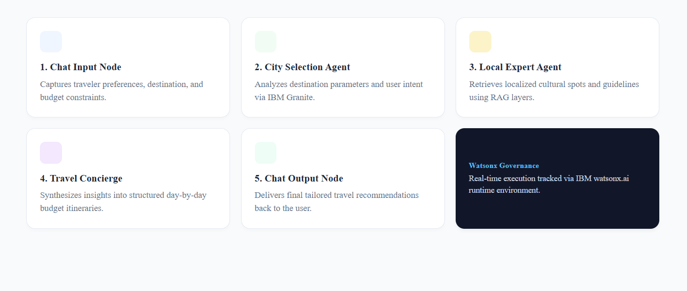
Langflow Workflow

Slide 8
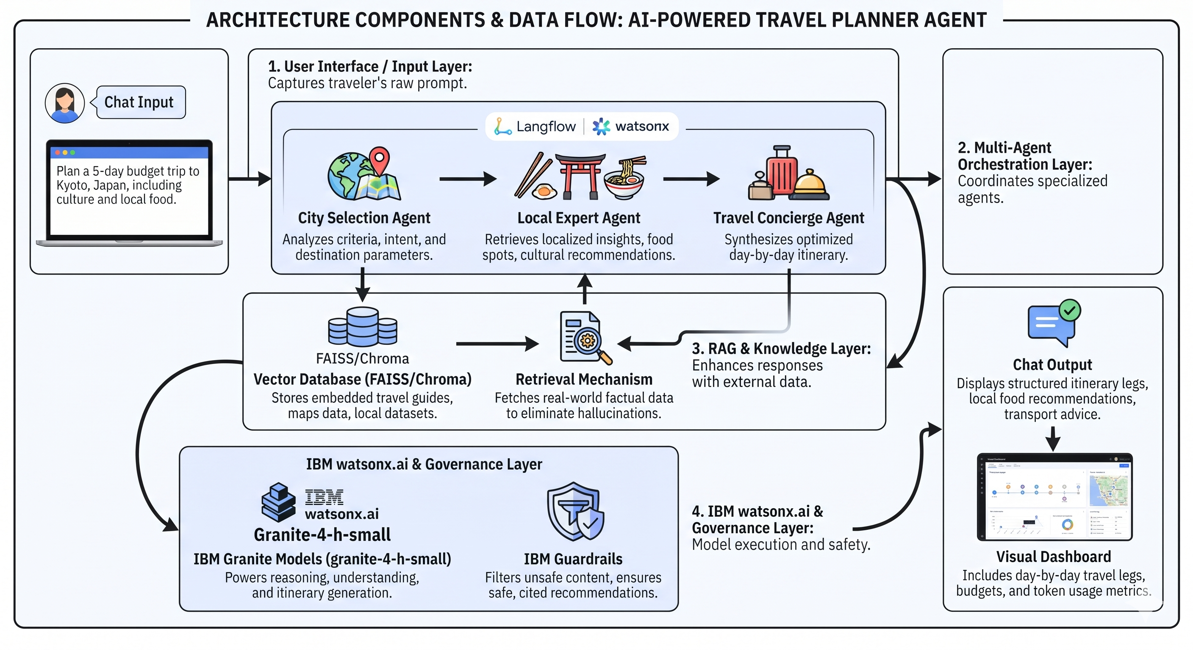
Architecture blueprint

Slide 9

Role of Agentic AI in the solution
Role of Agentic AI in Nutrition Agent
Autonomous Coordination: Agentic AI enables the Travel Planner Agent to function as an intelligent, autonomous system rather than a simple chatbot, coordinating multiple specialized agents. Context Awareness: Understands user details like budget, trip duration, and interests to generate tailored schedules.
Context Awareness: Understands user details like budget, trip duration, and interests to generate tailored schedules.
Real-Time Adaptation: Continuously updates suggestions based on modifications or feedback.
Collaborative Decision-Making: Agents communicate with each other (e.g., City Selection passing parameters to Local Expert), creating a proactive, goal-driven digital travel assistant.

Slide 10
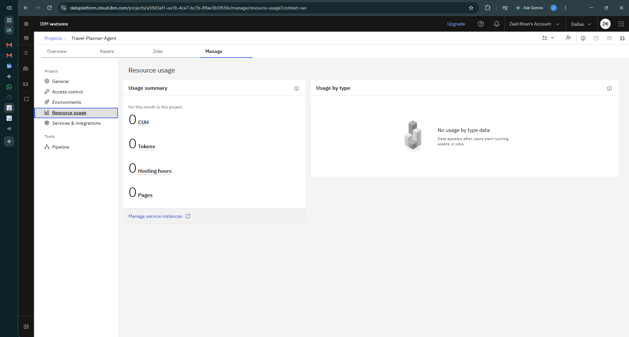
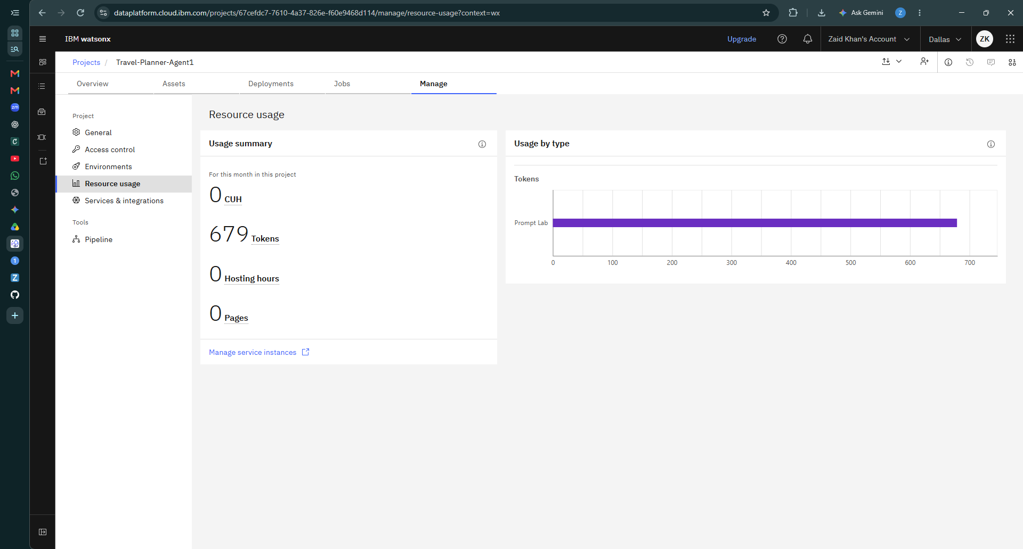
Token Usage
679 token are used
Before Prompt
After the Prompt
·
·

Slide 11
Novelty and Uniqueness
Multi-Agent Intelligence: Instead of a single chatbot, multiple specialized agents collaborate for accurate, context-aware travel guidance.
RAG-Based Accuracy: Integrates real-time data retrieval with AI generation to reduce errors and ensure trustworthy suggestions.
Hyper-Personalization: Tailors trips based on specific constraints like budget, group type, and destination preferences.
Scalable & Enterprise-Ready: Built on IBM watsonx.ai with IBM Granite models, ensuring enterprise-grade reliability and governance.

Slide 12
Git Hub Link
Please create public github repository (Enable Add README button while creating repository) with format –
Please test and Paste the working Github URL –https://github.com/zaid-sketch/Travel-Planner-Agent
Make sure you have Uploaded following three files into your github repository
1) app.json file , 2) yourproblemstatement.pdf file 3) your projectpresntation.pptx file 4)any other files
·
·
·

Slide 13
Future Scope
Integration with Live Booking APIs: Connecting with live flight, hotel, and transport booking engines to enable direct reservation capabilities within the agent interface.
AI-Powered Voice Assistant & Real-Time Alerts: Enhancing the system with voice-enabled interaction and real-time weather/delay alert notifications during active trips.

Slide 14
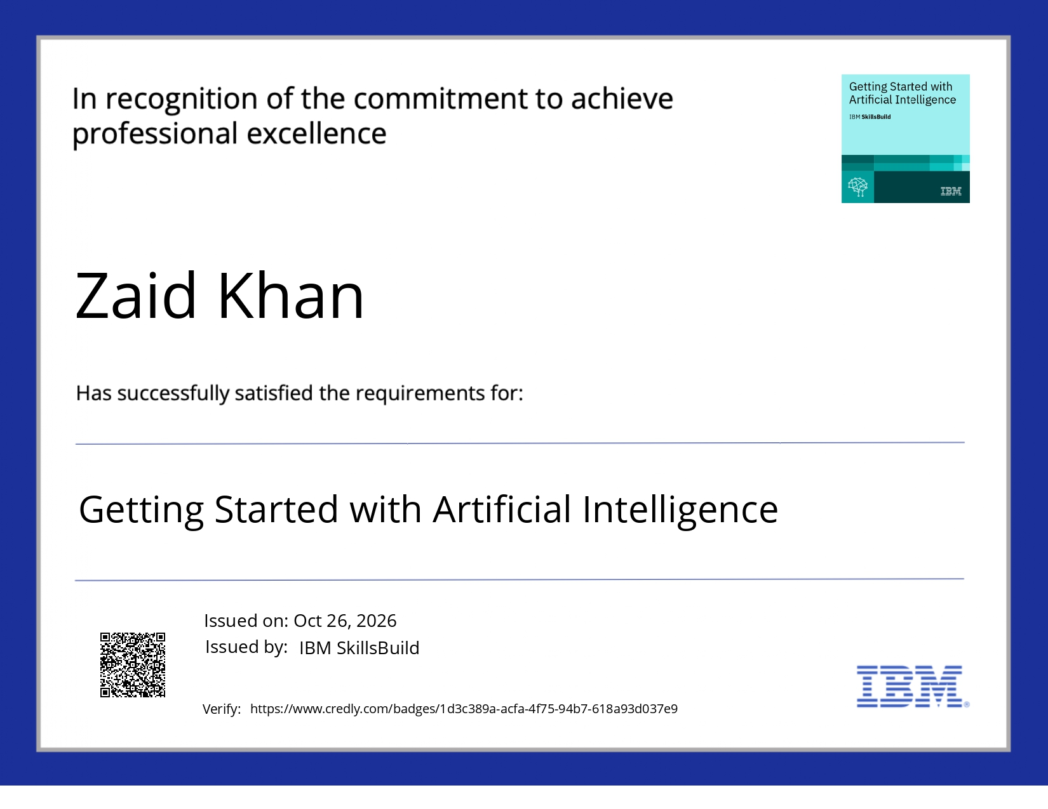
Certificates Earned:
Please add your credly certificate

Slide 15
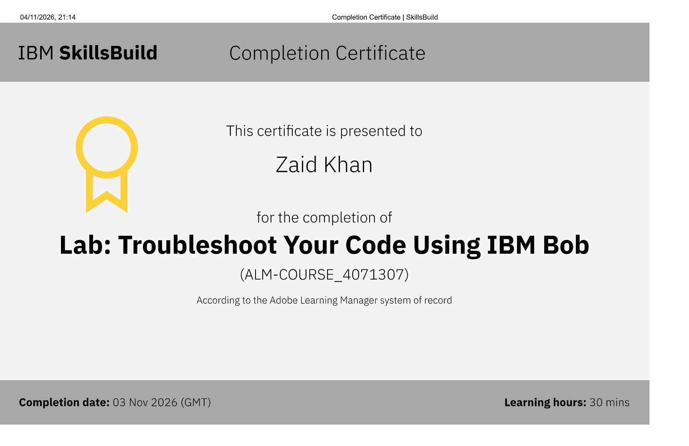
Certificates Earned:​
Add your IBM BOB Certificate

Slide 16


