Slide 1
Cloud Storage
Advantages of Using Cloud Storage Services

Slide 2
What is Cloud Storage?
Cloud computing model in which data is stored on remote servers accessed from the Internet, or “cloud”
Maintained, operated and managed by a cloud storage service provider on a storage servers that are built on virtualization techniques
Providing access to the data from anywhere and also provides data syncing and sharing capabilities across multiple devices

Slide 3
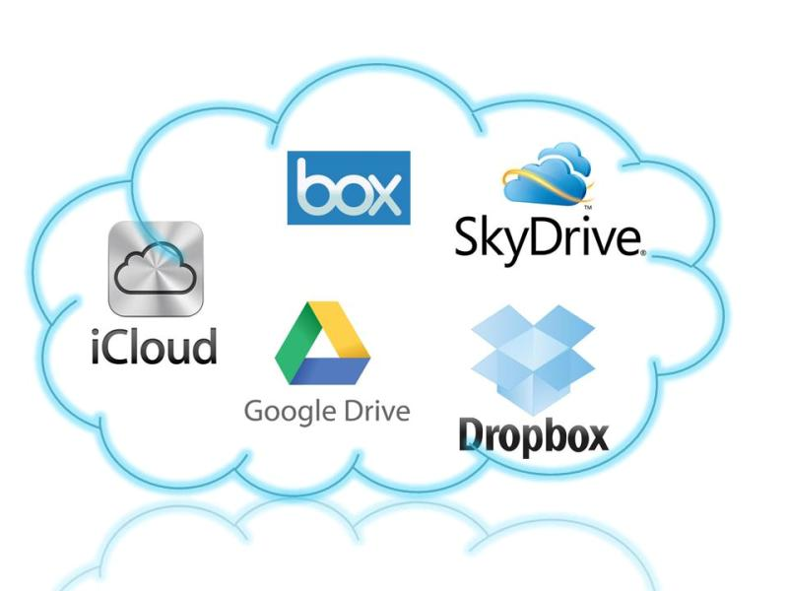
Example of Cloud Storage Providers?
Google Drive
iCloud
OneDrive (old version called SkyDrive)
Dropbox
SugarSync
iDrive

Slide 4
Advantages of Cloud Storage
Accessibility
Can access from various type of devices anywhere using internet connection
Syncing
Syncing ensures files are automatically updated across all of the devices
Sharing
Share any documents and photos with link, without have to email the physical files

Slide 5
Advantages of Cloud Storage (continued…)
Invisibility
Cloud storage is invisible, no physical presence, doesn’t take up valuable space
Cost
Backing up data isn’t always cheap, like external hard drives or backup tapes
Automation
Routine of backing up data done automatically

Slide 6
Advantages of Cloud Storage (continued…)
Protection
Cloud storage already contains layer of data protection
Recovery
Data-loss can be restored at any time
Collaboration
Allow multiple people to edit and collaborate on single document, with versioning feature

Slide 7
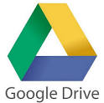
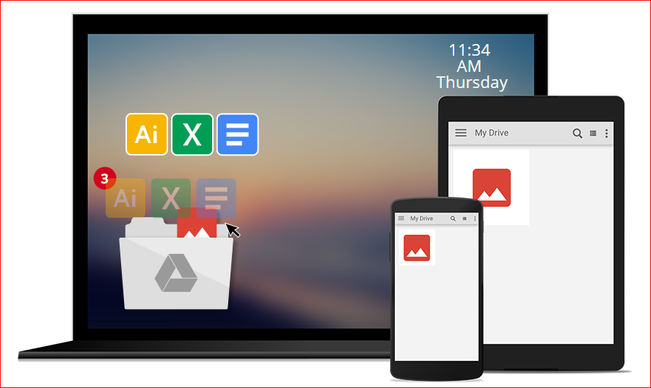
Example : Google Drive
Internet browser url access: https://www.google.com/drive/
Android phone / tablet application:
Google Drive
Google Photo
Google Docs
Google Sheets
Google Slides

