Slide 1
Topic
Sports Info
Student Name :
Zaid Iftikhar ( 1067872 )
Zohaib Kabir ( 1051954 )
Center Name : Aptech Computer Education
Branch : Metro Star Gate.

Slide 2
Problem Statement
Introduction
Infocom is a multi national company that builds informative sites. i.e. CellInfo.com site gives all the information about cell phones, LibertyElectronics.com gives information about various electronics products and so on. Now the company has decided to develop a site sportsinfo.com where the user will get information related to sports. The developers in the company are currently working on many other projects because of which development of the sportsinfo.com is getting delayed. Hence the company wants you to develop the site for them.

Slide 3
Customer Expectation:
sportsinfo.com needs to be constructed considering following requirements:
Home page with suitable logo.
A menu which will include all the functions implemented in the site.
The site should provide the information about following sports:
  Football Judo
  Tennis Motorcycle Racing
  Volleyball Golf
  Chess Billiards
  Badminton Swimming
  Athletics

Slide 4
Apart from the above mentioned sports, you may add other sports of your choice.
The information about a particular sport should include:
  How many players play the game?
  Strategy of the game.
  Is it a team game?
  Rules of the game.
  Some important facts about the game (when was the game invented, any special tournament like World cup / Wimbledon is played etc etc).
  Statistics/ records.
  Also include the images of the players, clicking on which should display the detailed information about that player.
  Which all countries play this game?

Slide 5
The user should be able to search a particular sport.
Maintain the guestbook as an additional feature just to keep information about the users that visited the site. Guestbook information includes name, email, date of visit, address, comment about the site, whether visitor will recommend the site to others or not etc. Also ask the visitor to rate the site (rating levels 1-Excellent, 2-Good, 3-Average, 4-Poor).
Provide a ‘About Us’ page which will introduce the company.
There should be a “Contact Us” page which will have the Address of the Company and the mail address which when clicked will invoke the local mail client from where they can send an email.
The site should have appropriate look and feel suitable to company’s reputation and status.

Slide 6
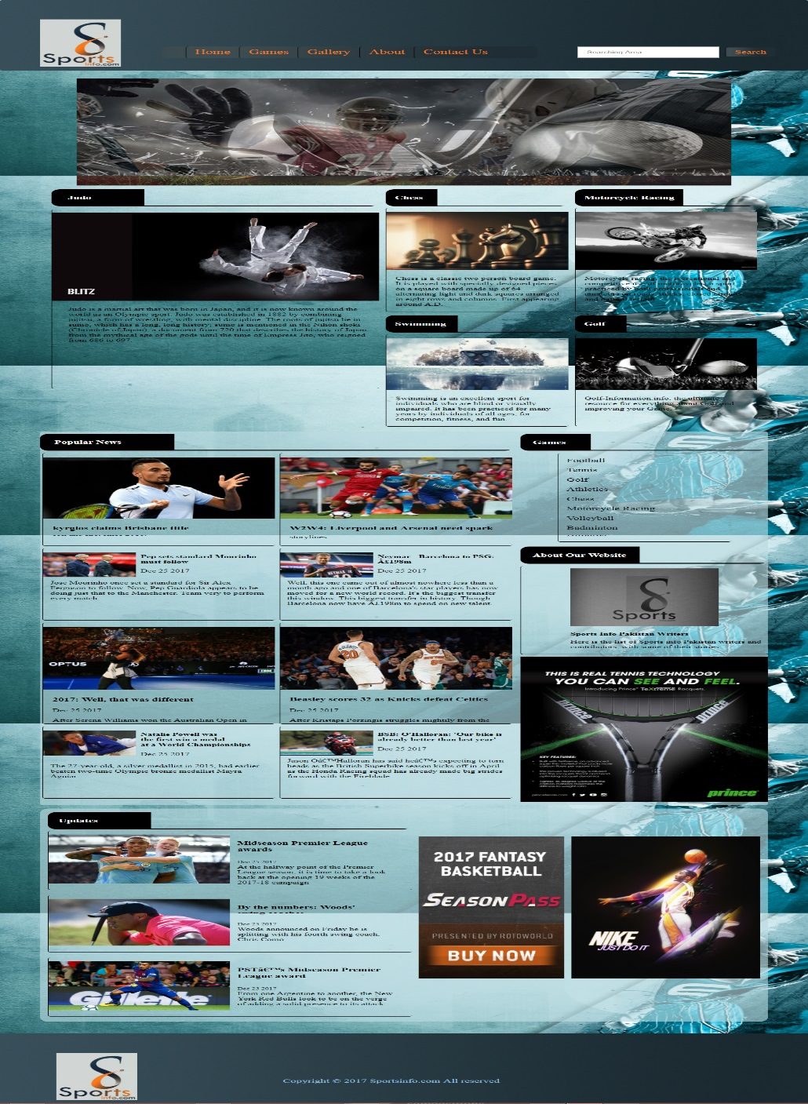
HOME PAGE Layout

Slide 7

ABOUT PAGE Layout

Slide 8
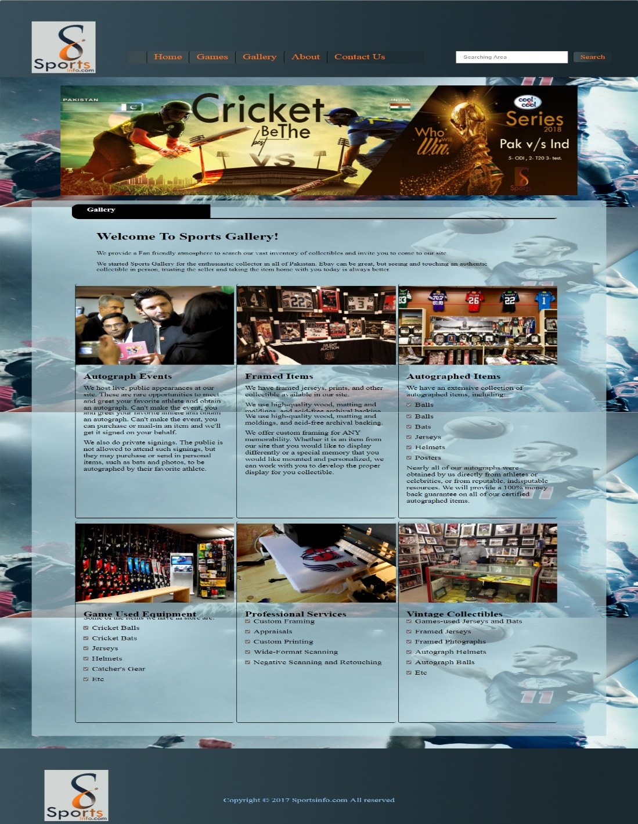
GALLERY PAGE Layout

Slide 9
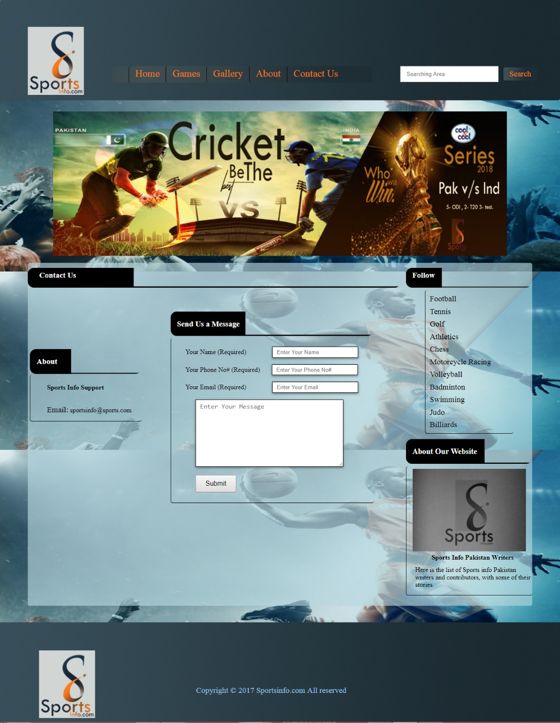
CONTACT PAGE Layout

