Slide 1
Artificial Intelligence (CS-323) Labs
Instructor Name: Ms. Hameeza Ahmed

Slide 2
Lab 1 Implementation of basic logic operations

Slide 3
Artificial Neural Networks
A neural network is a massively parallel, distributed processor made up of simple processing units (artificial neurons).
It resembles the brain in two respects:
Knowledge is acquired by the network from its environment through a learning process.
Synaptic connection strengths among neurons are used to store the acquired knowledge.
A NN is a machine learning approach inspired by the way in which the brain performs a particular learning task:
Knowledge about the learning task is given in the form of examples.
Inter neuron connection strengths (weights) are used to store the acquired information (the training examples).
During the learning process the weights are modified in order to model the particular learning task correctly on the training examples.

Slide 4
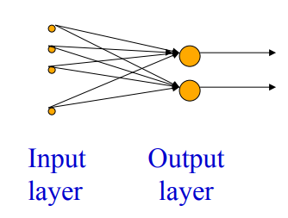
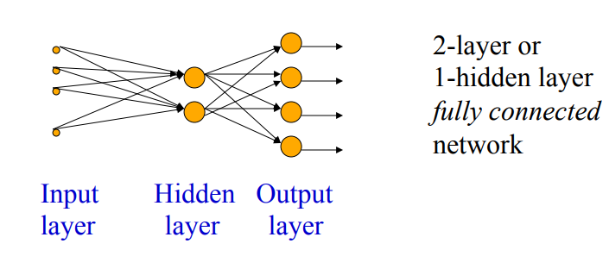
Different Network Topologies
Single layer feed-forward networks
Input layer projecting into the output layer
Multi-layer feed-forward networks
One or more hidden layers.
Input projects only from previous layers onto a layer.
typically, only from one layer to the next

Slide 5
Properties of NN
Learning from examples
labeled or unlabeled
Adaptivity
changing the connection strengths to learn things
Non-linearity
the non-linear activation functions are essential
Fault tolerance
if one of the neurons or connections is damaged, the whole network still works quite well
Thus, they might be better alternatives than classical solutions for problems characterised by:
high dimensionality, noisy, imprecise or imperfect data; and
a lack of a clearly stated mathematical solution or algorithm

Slide 6
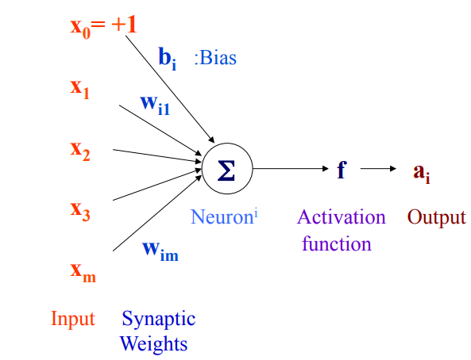
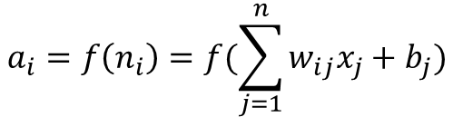
Artificial Neuron Model
$$a_{i}=f\left(n_{i}\right)=f(\sum_{j=1}^{n}{w_{ij}x_{j}+b_{j})}$$
An artificial neuron:
computes the weighted sum of its input (called its net input)
adds its bias
passes this value through an activation function
We say that the neuron “fires” (i.e. becomes active) if its output is above zero.
This extra free variable (bias) makes the neuron more powerful.

Slide 7
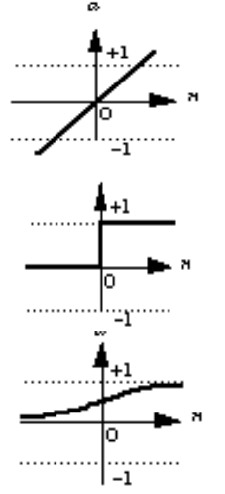
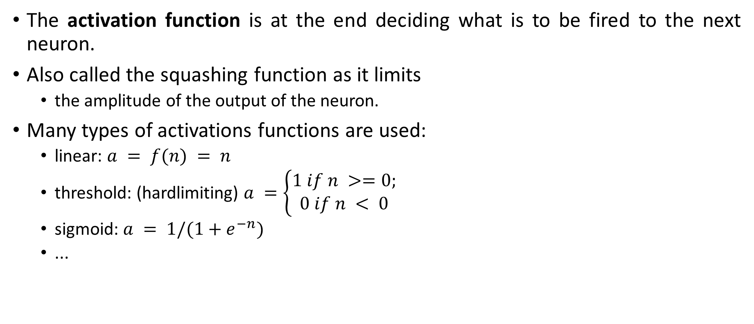
Activation Functions
The activation function is at the end deciding what is to be fired to the next neuron.
Also called the squashing function as it limits
the amplitude of the output of the neuron.
Many types of activations functions are used:
linear: $a = f(n) = n$
threshold: (hardlimiting) $a =\left\{\begin{matrix}1 if n >=0; \\ 0 if n < 0\end{matrix}\right.$
sigmoid: $a = 1/(1+e^{−n})$
...

Slide 8
Artificial Neural Networks
Early ANN Models:
Perceptron, ADALINE, Hopfield Network
Current Models:
Deep Learning Architectures
Multilayer feedforward networks (Multilayer perceptrons)
Radial Basis Function networks
Self Organizing Networks – ...
ANNs have been widely used in various domains for:
Pattern recognition
Function approximation
Associative memory
...

Slide 9
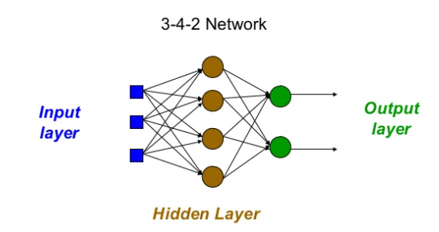
How to Decide on a Network Topology?
# of input nodes?
Number of features
# of output nodes?
Suitable to encode the output representation
transfer function?
Suitable to the problem
# of hidden nodes?
Not exactly known

Slide 10
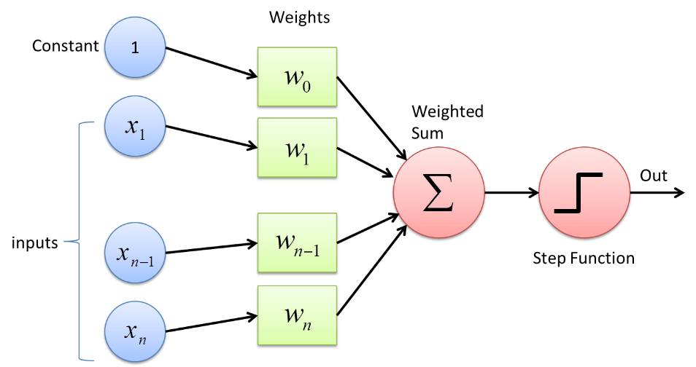
What is a Perceptron?
A perceptron is a single-layer neural network.
They consist of four main parts including input values, weights and bias, net sum, and an activation function.
How does a Perceptron work?
The process begins by taking all the input values and multiplying them by their weights.
Then, all of these multiplied values are added together to create the weighted sum.
The weighted sum is then applied to the activation function, producing the perceptron's output.
The activation function plays the integral role of ensuring the output is mapped between required values such as (0,1) or (-1,1). It is important to note that the weight of an input is indicative of the strength of a node.
Similarly, an input's bias value gives the ability to shift the activation function curve up or down.

Slide 11
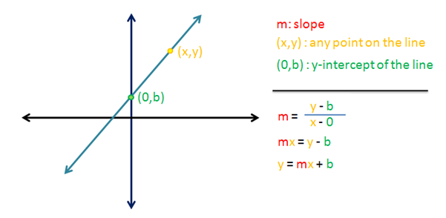
Linear Regression Equation
A single neuron in the neural network works as a straight line which has the following equation:
fundamental equation around which the whole concept of neural networks is based on.
y: Dependent variable (Output of the neural network)
m: Slope of the line
x: Independent variable (Input features)
b: y-intercept
In terms of neural networks, we specify the slope as Weights, intercept as Bias and the output(y) as z. So the equation becomes:
Here we have only one feature which we are giving to the model.
To input multiple features, we’ll have to scale up the equation.
The above equation can be scaled to ’n’ number of features which can be written as:
Here we have ’n’ input features fed to our model.
Corresponding to each input feature, we have a weight which specifies how important the feature is to our model to predict the output.
The bias term helps in shifting our line on the axis to better fit the training data or else the line will always go through the origin (0, 0).

Slide 12
Multilayer Perceptron
Each layer may have different number of nodes and different activation functions
But commonly:
Same activation function within one layer
sigmoid/tanh activation function is used in the hidden units, and
sigmoid/tanh or linear activation functions are used in the output units depending on the problem (classification-sigmoid/tanh or function approximation linear)

Slide 13
Implementation of Logic Functions
In this practical we will learn how basic logic functions can be implemented and trained, using MS Excel.
2 Input Logic AND-Gate
2 Input Logic OR-Gate
2 Input Logic NOR-Gate
2 Input Logic NAND-Gate
For the implementation of NOR and NAND gates, a positive bias is added to the weighted sum of inputs.

Slide 14

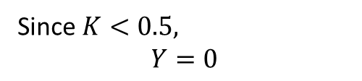
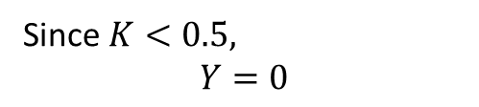
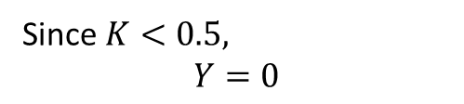

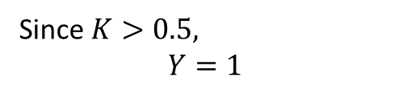
Examples
X1 | X2 | Z
0 | 0 | 0
0 | 1 | 0
1 | 0 | 0
1 | 1 | 1
2 Input Logic AND-Gate
CASE 1: X1=0, X2=0
CASE 3: X1=1, X2=0
0.3
0.3
0
1
$$K=\left(1∗0.3\right)+\left(0∗0.3\right)+0=0.3$$
0
$$K=\left(0∗0.3\right)+\left(0∗0.3\right)+0=0$$
0
0.3
0.3
Since $K<0.5,$
$$Y=0$$
Since $K<0.5,$
$$Y=0$$
CASE 2: X1=0, X2=1
CASE 4: X1=1, X2=1
$K=\left(1∗0.3\right)+\left(1∗0.3\right)+0=0$.6
$K=\left(0∗0.3\right)+\left(1∗0.3\right)+0=0$.3
0.3
0.3
1
Since $K>0.5,$
$$Y=1$$
0
Since $K<0.5,$
$$Y=0$$
1
1
0.3
0.3

Slide 15
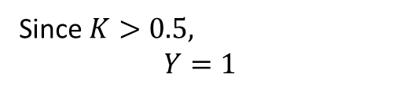
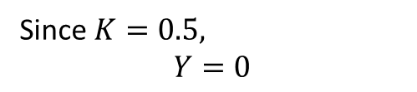
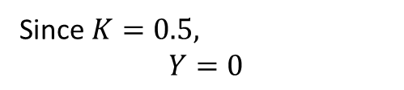

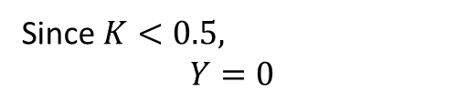
Examples
X1 | X2 | Z
0 | 0 | 1
0 | 1 | 0
1 | 0 | 0
1 | 1 | 0
2 Input Logic NOR-Gate
CASE 1: X1=0, X2=0
CASE 3: X1=1, X2=0
-0.5
-0.5
$$K=\left(1∗−0.5\right)+\left(0∗−0.5\right)+1=0.5$$
0
1
0
0
-0.5
-0.5
$$K=\left(0∗−0.5\right)+\left(0∗−0.5\right)+1=1$$
Since $K=0.5,$
$$Y=0$$
Since $K>0.5,$
$$Y=1$$
CASE 2: X1=0, X2=1
CASE 4: X1=1, X2=1
$$K=\left(1∗−0.5\right)+\left(1∗−0.5\right)+1=0$$
$K=\left(0∗−0.5\right)+\left(1∗−0.5\right)+1=0$.5
-0.5
-0.5
1
Since $K<0.5,$
$$Y=0$$
0
Since $K=0.5,$
$$Y=0$$
1
1
-0.5
-0.5

Slide 16
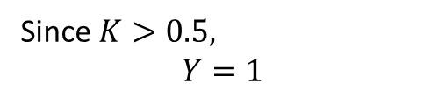
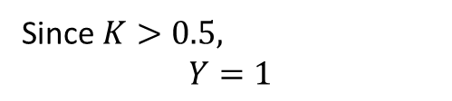

Examples
X1 | X2 | Z
0 | 0 | 0
0 | 1 | 1
1 | 0 | 1
1 | 1 | 1
2 Input Logic OR-Gate
CASE 1: X1=0, X2=0
CASE 3: X1=1, X2=0
0.6
0.6
$$K=\left(1∗0.6\right)+\left(0∗0.6\right)+0=0.6$$
0
1
0
0
0.6
0.6
$$K=\left(0∗0.6\right)+\left(0∗0.6\right)+0=0$$
Since $K>0.5,$
$$Y=1$$
Since $K<0.5,$
$$Y=0$$
CASE 2: X1=0, X2=1
CASE 4: X1=1, X2=1
$$K=\left(1∗0.6\right)+\left(1∗0.6\right)+0=1.2$$
$K=\left(0∗0.6\right)+\left(1∗0.6\right)+0=0$.6
0.6
0.6
1
Since $K>0.5,$
$$Y=1$$
0
Since $K>0.5,$
$$Y=1$$
1
1
0.6
0.6

Slide 17

Examples
X1 | X2 | Z
0 | 0 | 1
0 | 1 | 1
1 | 0 | 1
1 | 1 | 0
2 Input Logic NAND-Gate
CASE 1: X1=0, X2=0
CASE 3: X1=1, X2=0
-0.3
-0.3
$$K=\left(1∗−0.3\right)+\left(0∗−0.3\right)+1=0.7$$
0
1
0
0
-0.3
-0.3
$$K=\left(0∗−0.3\right)+\left(0∗−0.3\right)+1=1$$
Since $K>0.5,$
$$Y=1$$
Since $K>0.5,$
$$Y=1$$
CASE 2: X1=0, X2=1
CASE 4: X1=1, X2=1
$$K=\left(1∗−0.3\right)+\left(1∗−0.3\right)+1=0.4$$
$K=\left(0∗−0.3\right)+\left(1∗−0.3\right)+1=0$.7
0.3
-0.3
1
Since $K<0.5,$
$$Y=0$$
0
Since $K>0.5,$
$$Y=1$$
1
1
0.3
-0.3

Slide 18
Implementation of Logic Functions
First of all you have to include following columns in your Excel sheet:
Xi : (column for inputs)
Z : (column for true output)
Y : (column for computed output)
D : (column for keeping track of the difference between true output & computed one)
Wi : (column for initial weights, assigned arbitrarily in the first step)
Wf : (column for final weights, which is computed from initial weight and becomes the initial weight of the first step)

Slide 19
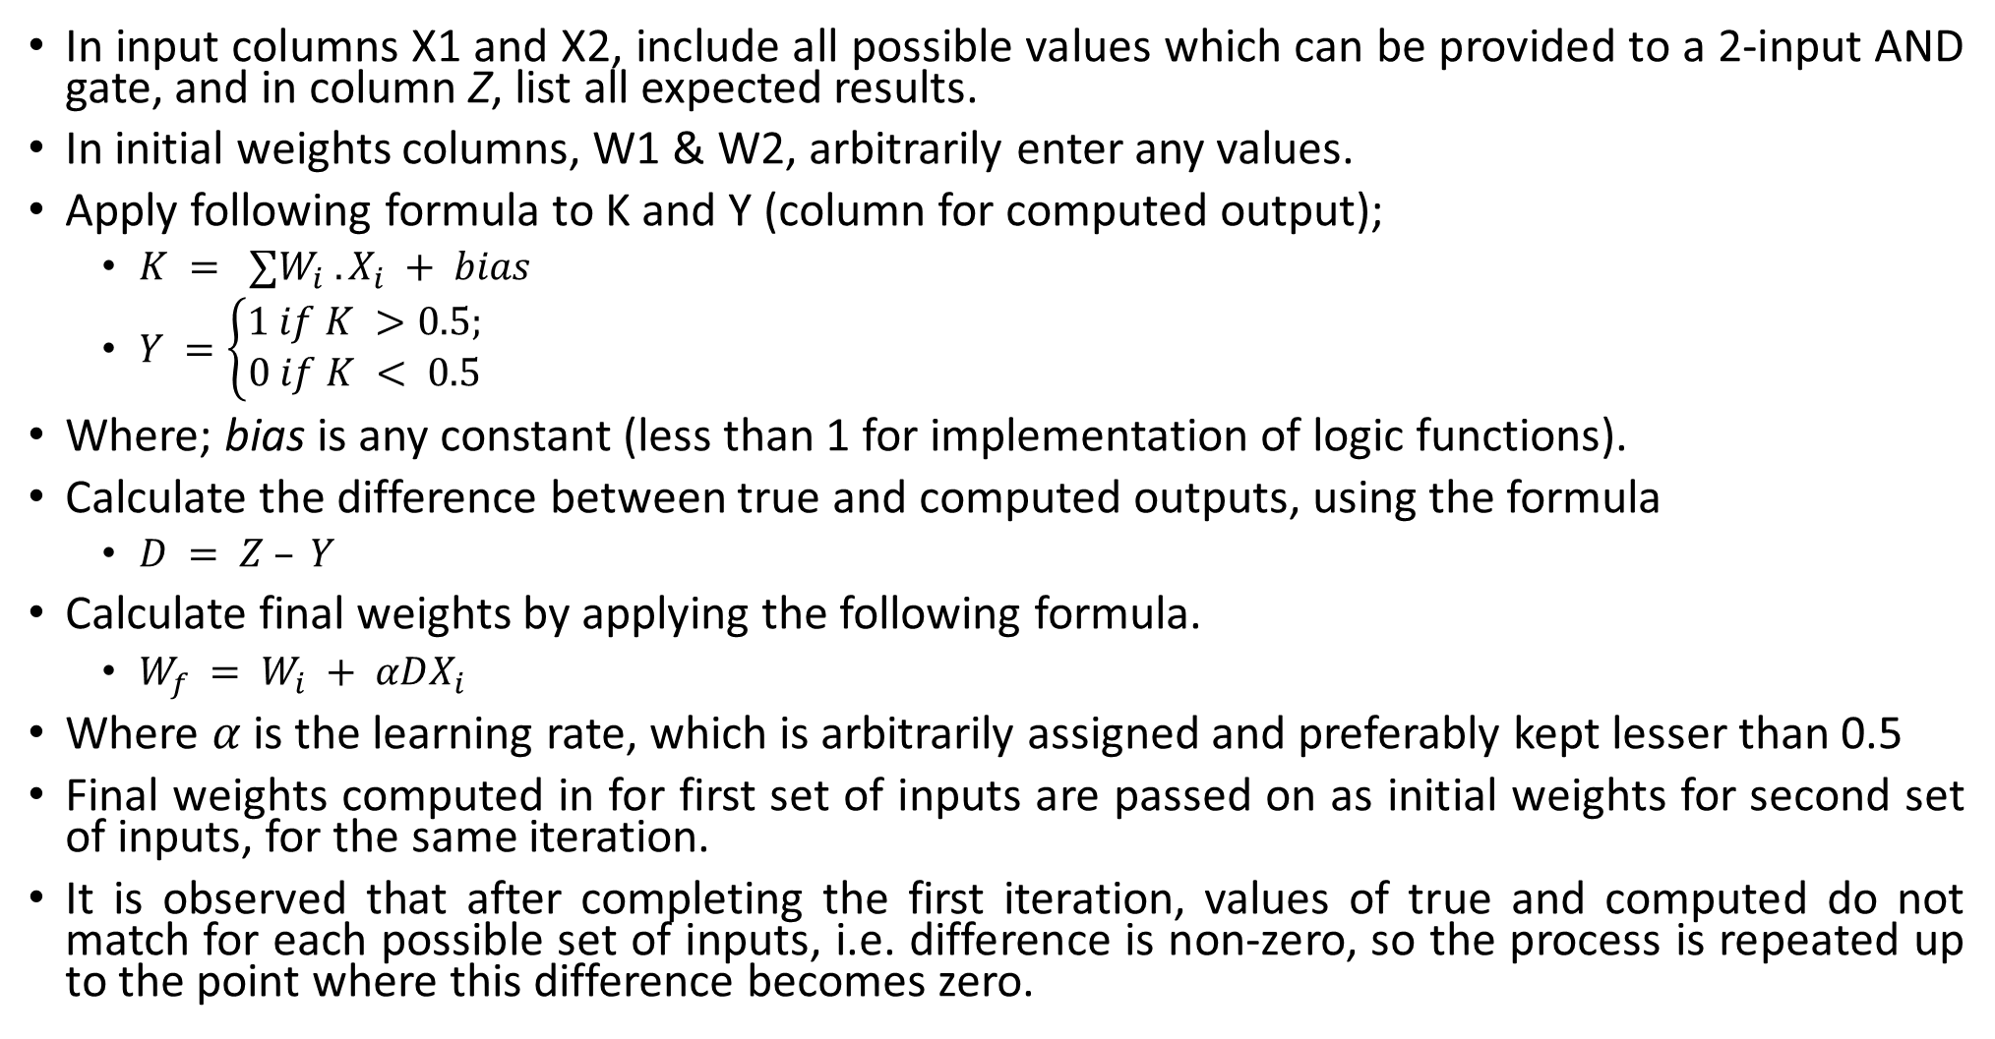
Procedure
In input columns X1 and X2, include all possible values which can be provided to a 2-input AND gate, and in column Z, list all expected results.
In initial weights columns, W1 & W2, arbitrarily enter any values.
Apply following formula to K and Y (column for computed output);
$K = ∑W_{i} . X_{i} + bias$
$Y =\left\{\begin{matrix}1 if K >0.5; \\ 0 if K < 0.5\end{matrix}\right.$
Where; bias is any constant (less than 1 for implementation of logic functions).
Calculate the difference between true and computed outputs, using the formula
$D = Z – Y$
Calculate final weights by applying the following formula.
$W_{f} = W_{i} + αDX_{i}$
Where $α$ is the learning rate, which is arbitrarily assigned and preferably kept lesser than 0.5
Final weights computed in for first set of inputs are passed on as initial weights for second set of inputs, for the same iteration.
It is observed that after completing the first iteration, values of true and computed do not match for each possible set of inputs, i.e. difference is non-zero, so the process is repeated up to the point where this difference becomes zero.

Slide 20
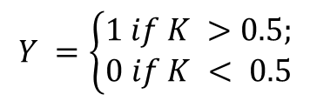



Implementation of Logic Functions
In this practical we will learn how basic logic functions can be implemented and trained, using MS Excel.
2 Input Logic AND-Gate
2 Input Logic OR-Gate
2 Input Logic NOR-Gate
2 Input Logic NAND-Gate
For the implementation of NOR and NAND gates, a positive bias is added to the weighted sum of inputs.
W1i=0.1, w2i=0.1, alpha=0.1, bias=0, Threshold=0.5
W1i=0.1, w2i=0.1, alpha=0.1, bias=0, Threshold=0.5
W1i=0.1, w2i=0.1, alpha=0.1, bias=1, Threshold=0.5
W1i=0.1, w2i=0.1, alpha=0.1, bias=1, Threshold=0.5
$$Y =\left\{\begin{matrix}1 if K >0.5; \\ 0 if K < 0.5\end{matrix}\right.$$
$$K = ∑W_{i} . X_{i} + bias$$
$$D = Z – Y$$
$$W_{f} = W_{i} + αDX_{i}$$

Slide 21
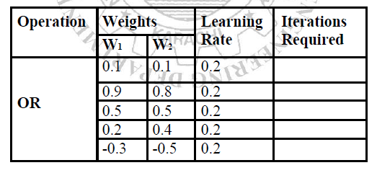
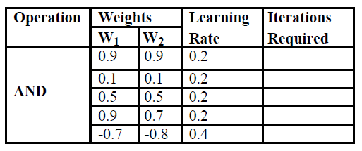
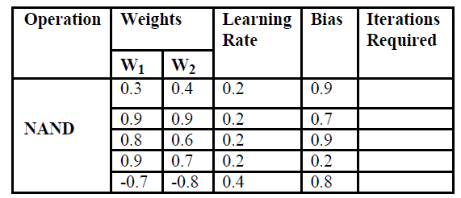
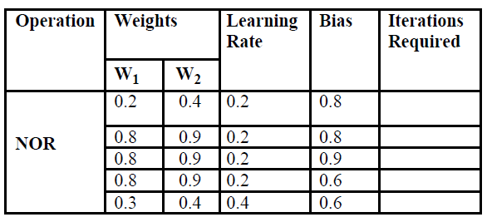
Tasks
Complete the following tables.

Slide 22
Tasks
For NAND and NOR implementation, what is the effect of setting bias to value <0.5?
Add a positive bias <0.3 to AND and OR gate‗s output and check how many iterations are required to get correct output.
What are your observations, regarding the following?
a. Lower value of learning rate is faster. (Yes/No)
b. For OR gate implementation, smaller values of weights require less iterations for obtaining correct result. (Yes/No)
c. For NAND gate implementation, larger values of weights require less iterations for obtaining correct result. (Yes/No)

Slide 23
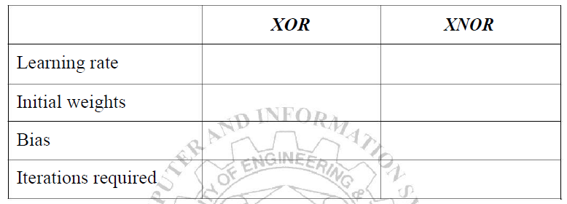
Tasks
Implement XOR and XNOR functions and give all the formula you used in the implementation. Draw the MLPs used for the implementation of above functions. Also mention the following:
Implement 3-input AND, OR, NAND and NOR gates.

