Slide 1
Java Tutorials
Let's Rock
First of all download latest version of java from
https://java.com/en/download/
& Java IDE like Eclipse from
https://eclipse.org/

Slide 2
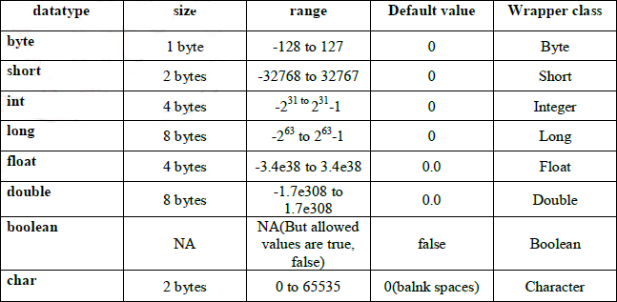
Lesson 1- java data types(primitive)

Slide 3
Lesson 1 continued
In addition to the eight primitive data types listed above, the Java programming language also provides special support for character strings via the java.lang.String class. Enclosing your character string within double quotes will automatically create a new String object; for example, String s = "this is a string";. String objects are immutable, which means that once created, their values cannot be changed. The String class is not technically a primitive data type, but considering the special support given to it by the language, you'll probably tend to think of it as such.

Slide 4
Class in Java
A class is nothing but a blueprint or a template for creating different objects which defines its properties and behaviors. Java class objects exhibit the properties and behaviors defined by its class. A class can contain fields and methods to describe the behavior of an object.
Below is an example of a class:-

Slide 5
Class in Java
class letsLearnAddition{
public static void main(String[] args){
public – refer notes for better understanding
static – refer notes for better understanding
void – refer notes for better understanding
main – refer notes for better understanding
}
}
Notes:
// public : is an Access Modifier, which defines who can access this Method. Public means that this Method will be accessible by any Class(If other Classes are able to access this Class.)
// static : is a keyword which identifies the class related thing. This means the given Method or variable is not instance related but Class related. It can be accessed without creating the instance of a Class.
//void : is used to define the Return Type of the Method. It defines what the method can return. Void means the Method will not return any value and can directly print the output.
//main: is the name of the Method. This Method name is searched by JVM as a starting point for an application with a particular signature only.
//String args[] : is the parameter to the main Method.
// the main method in red is the heart of a java class which runs the functions or methods associated with the class which is letsLearnAddition in our case. Note that this class does not have any field, property or functions(methods) yet, specific to the class as we are yet to define these. In next slide we will do just that.

Slide 6
method or function in Java
A method or a function in Java is nothing but a set of statements that execute a program logic. For example when we write -System.out.println(“abc”); we get abc printed in the terminal but for carrying out that execution Java performs a number of statements behind the scenes. But apart from Java’s inbuilt functions/methods we can also create our own custom methods/functions.
Refer the example in notes-
Notes:
class letsLearnAddition{
public static void main(String[] args){
// the main method above is Java’s inbuilt method
System.out.println(learnAddition(3,4));
// learnAddition above is custom made and called inside main for execution
}
// the below method is created outside but called or invoked inside main
public static int learnAddition(int a, int b){
return a+b;
}
}
P.S – the learnAddition(int a, int b) is a method with 2 parameters namely a and b and their datatypes are int. We will also see a method without parameters in following slides.

Slide 7
Modifiers in Java
Modifiers are keywords that when added change the meaning of definition of variables, class or method.
In Java, modifiers are categorized as-
Access modifiers
Non-Access modifiers

Slide 8
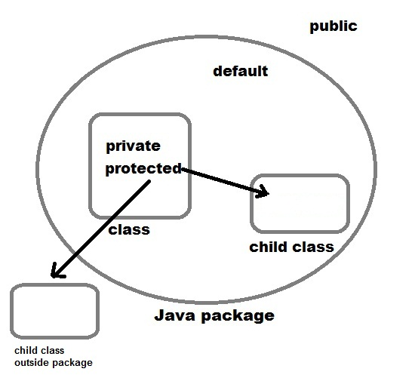
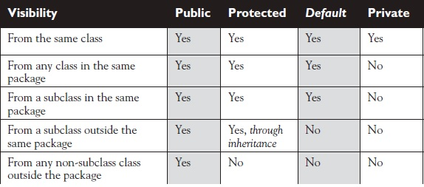
Access modifiers
1) Access control modifier
Java language has four access modifier to control access levels for classes, variable methods and constructor.
Default : Default has scope only inside the same package
Public : Public scope is visible everywhere
Protected : Protected has scope within the package and all sub classes
Private : Private has scope only within the classes
Notes:
Default – Default modifier is when a class, method or field is not associated with an access control modifier or left without any addition of modifiers preceding the rest of the statement. And such a variable or method is available to any other class within the same package. The fields in an interface are implicitly public, static or final and the methods in an interface are by default public. Eg-
String version = "1.5.1"; OR boolean processOrder() { return true; } OR class myDeafultClass{ …..}
Public – A class, method, constructor, interface, etc. declared public can be accessed from any other class. Therefore, fields, methods, blocks declared inside a public class can be accessed from any class belonging to the Java Universe.
However, if the public class we are trying to access is in a different package, then the public class still needs to be imported. Because of class inheritance, all public methods and variables of a class are inherited by its subclasses. Eg-
Example of public access modifier
//saved by Sam.java
package pack;
public class aClass{
public void msg(){System.out.println("Hello");}
}
//save by Pam.java
package mypack;
import pack.*;
class B{
public static void main(String args[]){
aClass obj = new aClass();
obj.msg();
}
}
Output:
Hello
Protected - Variables, methods, and constructors, which are declared protected in a superclass can be accessed only by the subclasses in other package or any class within the package of the protected members' class.
The protected access modifier cannot be applied to class and interfaces. Methods, fields can be declared protected, however methods and fields in an interface cannot be declared protected. Protected access gives the subclass a chance to use the helper method or variable, while preventing a nonrelated class from trying to use it. Eg-
In this example, we will create two packages p1 and p2. Class A in p1 is made public, to access it in p2. The method display in class A is protected and class B is inherited from class A and this protected method is then accessed by creating an object of class B.
//Java program to illustrate
//protected modifier
package p1;
//Class A
public class A
{
protected void display()
{
System.out.println(“Comsap Institute");
}
}
//Java program to illustrate
//protected modifier
package p2;
import p1.*; //importing all classes in package p1
//Class B is subclass of A
class B extends A
{
public static void main(String args[])
{
B obj = new B();
obj.display();
}
}
Output:
Comsap Institute
Private - Methods, variables, and constructors that are declared private can only be accessed within the declared class itself.
Private access modifier is the most restrictive access level. Class and interfaces cannot be private.
Variables that are declared private can be accessed outside the class, if public getter methods are present in the class.
Using the private modifier is the main way that an object encapsulates itself and hides data from the outside world. Eg-
public class Logger {
private String format;
public String getFormat() {
return this.format;
}
public void setFormat(String format)
{
this.format = format;
System.out.println(“This shows that private variables can be accessed using public methods”);
}
}
Output:
This shows that private variables can be accessed using public methods
=======================================
Here, the format variable of the Logger class is private, so there's no way for other classes to retrieve or set its value directly.
So, to make this variable available to the outside world, we defined two public methods: getFormat(), which returns the value of format, and setFormat(String), which sets its value.

Slide 9
Non-Access Modifiers
Non-access modifiers do not change the accessibility of variables and methods, but they do provide them special properties. Non-access modifiers are of 5 types,
Final
Static
Transient
Synchronized
Volatile
Notes:
Final - Final modifier is used to declare a field as final i.e. it prevents its content from being modified. Final field must be initialized when it is declared. Eg –
class Cloth {
final int MAX_PRICE = 999; //final variable
final int MIN_PRICE = 699;
final void display() //final method {
System.out.println("Maxprice is" + MAX_PRICE );
System.out.println("Minprice is" + MIN_PRICE);
}
}
A class can also be declared as final. A class declared as final cannot be inherited. String class in java.lang package is an example of final class. Method declared as final can be inherited but you cannot override(redefine) it.
======================================================================================
Static Modifier
Static Modifiers are used to create class variable and class methods which can be accessed without instance of a class. Lets study how it works with variables and member functions.
Static with Variables
Static variables are defined as a class member that can be accessed without any object of that class. Static variable has only one single storage. All the object of the class having static variable will have the same instance of static variable. Static variables are initialized only once.
Static variable are used to represent common property of a class. It saves memory. Suppose there are 100 employee in a company. All employee have its unique name and employee id but company name will be same all 100 employee. Here company name is the common property. So if you create a class to store employee detail, company_name field will be mark as static.
Example
class Employee {
int id;
String name;
static String company = “Comsap Computers";
}
Example of static variable
class ST_Employee {
int id;
String name;
static String company =“Comsap";
public void show() {
System.out.println(id+" "+name+" "+company);
}
public static void main( String[] args ) {
ST_Employee se1 = new ST_Employee();
se1.id = 104;
se1.name = “Sam";
se1.show();
ST_Employee se2 = new ST_Employee();
se2.eid = 108;
se2.name = “Pam";
se2.show();
}
}
Output :
104 Sam Comsap
108 Pam Comsap
Static variable vs Instance Variable
______________________________________________________________________________________________
Static variable Instance Variable
Represent common property Represent unique property
Accessed using class name Accessed using object
get memory only once get new memory each time a new object is created
Example
public class Test {
static int x = 100;
int y = 100;
public void increment() {
x++; y++; // ++ are increment operators which increase the initial value by 1 for each instance in this example
}
public static void main( String[] args ) {
Test t1 = new Test(); // 1st instance of class
Test t2 = new Test(); // 2nd instance of class
t1.increment();
t2.increment();
System.out.println(t2.y);
System.out.println(Test.x); //accessed without any instance of class.
}
}
Output :
101
102
See the difference in value of two variable. Static variable y shows the changes made to it by increment() method on the different object. While instance variable x show only the change made to it by increment() method on that particular instance.
Static Method
A method can also be declared as static. Static methods do not need instance of its class for being accessed. main() method is the most common example of static method. main() method is declared as static because it is called before any object of the class is created.
Example :
class Test {
public static void square(int x) {
System.out.println(x*x);
}
public static void main (String[] arg) {
square(8) //static method square () is called without any instance of class.
}
}
Output: 64
Static block
Static block is used to initialize static data member. Static block executes before main() method.
Example
class ST_Employee {
int id;
String name;
static String company;
static {
company =“Comsap"; //static block invoked before main() method
}
public void show() {
System.out.println(id+" "+name+" "+company);
}
public static void main( String[] args ) {
ST_Employee se1 = new ST_Employee();
se1.id = 104;
se1.name = “Sam";
se1.show();
}
}
Output :
104 Sam Comsap
Q. Why a non-static variable cannot be referenced from a static context ?
When you try to access a non-static variable from a static context like main method, java compiler throws a message like "a non-static variable cannot be referenced from a static context". This is because non-static variables are related with instance of class(object) and they get created when instance of a class is created by using new operator. So if you try to access a non-static variable without any instance compiler will complain because those variables are not yet created and they don't have any existence until an instance is created and associated with it.
Example of accessing non-static variable from a static context
class Test {
int x;
public static void main(String[] args) {
x=10;
}
}
Output :
compiler error: non-static variable count cannot be referenced from a static context
Same example using instance of class
class Test {
int x;
public static void main(String[] args) {
Test tt=new Test();
tt.x=10; //works fine with instance of class
}
}
======================================================================================
Transient - The transient keyword may be used as a property modifier in Java and is directly related with serialization. In short the properties declared as transient are not serialized by the default serialization mechanism. This may be useful when we have properties that represent data that we don't want to persist or transmit over the network (when an object is sent over the network it's also serialized into a stream of bytes). We may think of dynamic data that was calculated after some instance initialization and is subject to change often, so it doesn't make sense to persist, or sensitive information like authentication tokens that only make sense in the current execution context. These conditions are only examples as the need of transient usage is very specific for different scenarios.
A simple class
Let's define a simple class containing a transient property:
TestClass.java
package com.byteslounge.serialization;
import java.io.Serializable;
public class TestClass implements Serializable {
private static final long serialVersionUID = 8191670218412460916L;
private String propertyOne;
private transient String propertyTwo; // will not be serialized
public TestClass(String propertyOne, String propertyTwo) {
this.propertyOne = propertyOne;
this.propertyTwo = propertyTwo;
}
public String getPropertyOne() {
return propertyOne;
}
public String getPropertyTwo() {
return propertyTwo;
}
}
Note that we are implementing the Serializable interface. This is required to make TestClass serializable. Property propertyTwo is declared as transient so it will not be serialized.
Testing
Let's create a simple test class:
Main.java
package com.byteslounge.serialization;
import java.io.FileInputStream;
import java.io.FileOutputStream;
import java.io.ObjectInputStream;
import java.io.ObjectOutputStream;
public class Main {
public static void main(String[] args) throws Exception {
TestClass testWrite = new TestClass("valueOne", "valueTwo");
FileOutputStream fos = new FileOutputStream("testfile");
ObjectOutputStream oos = new ObjectOutputStream(fos);
oos.writeObject(testWrite);
oos.flush();
oos.close();
TestClass testRead;
FileInputStream fis = new FileInputStream("testfile");
ObjectInputStream ois = new ObjectInputStream(fis);
testRead = (TestClass)ois.readObject();
ois.close();
System.out.println("--Serialized object--");
System.out.println("propertyOne: " + testWrite.getPropertyOne());
System.out.println("propertyTwo: " + testWrite.getPropertyTwo());
System.out.println("");
System.out.println("--Read object--");
System.out.println("propertyOne: " + testRead.getPropertyOne());
System.out.println("propertyTwo: " + testRead.getPropertyTwo());
}
}
When we run the test the following output is generated:
--Serialized object-- propertyOne: valueOne propertyTwo: valueTwo --Read object-- propertyOne: valueOne propertyTwo: null
Property propertyTwo was not serialized so when we read our instance back propertyTwo value is null.
============================================================================
Synchronized modifier
When a method is synchronized it can be accessed by only one thread at a time. We will discuss it in detail in Thread.
Synchronization in Java
Synchronization in java is the capability to control the access of multiple threads to any shared resource.
Java Synchronization is better option where we want to allow only one thread to access the shared resource.
Why use Synchronization
The synchronization is mainly used to -
To prevent thread interference.
To prevent consistency problem.
Types of Synchronization
There are two types of synchronization
Process Synchronization
Thread Synchronization
Here, we will discuss only thread synchronization.
Thread Synchronization
There are two types of thread synchronization mutual exclusive and inter-thread communication.
Mutual Exclusive
Synchronized method.
Synchronized block.
static synchronization.
Cooperation (Inter-thread communication in java)
Mutual Exclusive
Mutual Exclusive helps keep threads from interfering with one another while sharing data. This can be done by three ways in java:
by synchronized method
by synchronized block
by static synchronization
Concept of Lock in Java
Synchronization is built around an internal entity known as the lock or monitor. Every object has an lock associated with it. By convention, a thread that needs consistent access to an object's fields has to acquire the object's lock before accessing them, and then release the lock when it's done with them.
From Java 5 the package java.util.concurrent.locks contains several lock implementations.
Understanding the problem without Synchronization
In this example, there is no synchronization, so output is inconsistent. Let's see the example:
Class Table{
void printTable(int n){//method not synchronized
for(int i=1;i<=5;i++){
System.out.println(n*i);
try{
Thread.sleep(400);
}catch(Exception e){System.out.println(e);}
}
}
}
class MyThread1 extends Thread{
Table t;
MyThread1(Table t){
this.t=t;
}
public void run(){
t.printTable(5);
}
}
class MyThread2 extends Thread{
Table t;
MyThread2(Table t){
this.t=t;
}
public void run(){
t.printTable(100);
}
}
class TestSynchronization1{
public static void main(String args[]){
Table obj = new Table();//only one object
MyThread1 t1=new MyThread1(obj);
MyThread2 t2=new MyThread2(obj);
t1.start();
t2.start();
}
}
Output:
5
100
10
200
15
300
20
400
25
500
Example of synchronized method by using annonymous class
In this program, we have created the two threads by anonymous class, so less coding is required.
//Program of synchronized method by using anonymous class
class Table{
synchronized void printTable(int n){//synchronized method
for(int i=1;i<=5;i++){
System.out.println(n*i);
try{
Thread.sleep(400);
}catch(Exception e){System.out.println(e);}
}
}
}
Output:
5
10
15
20
25
100
200
300
400
500
P.S – Thus you can see the difference in output between synchronized printTable method and the one without the use of synchronization
======================================================================================
Volatile modifier
Volatile modifier tells the compiler that the volatile variable can be changed unexpectedly by other parts of your program. Volatile variables are used in case of multithreading program
Basic Example
The following show a basic example where volatile is required
public class VolatileTest {
private static final Logger LOGGER = MyLoggerFactory.getSimplestLogger();
private static volatile int MY_INT = 0;
public static void main(String[] args) {
new ChangeListener().start();
new ChangeMaker().start();
}
static class ChangeListener extends Thread {
@Override
public void run() {
int local_value = MY_INT;
while ( local_value < 5){
if( local_value!= MY_INT){
LOGGER.log(Level.INFO,"Got Change for MY_INT : {0}", MY_INT);
local_value= MY_INT;
}
}
}
}
static class ChangeMaker extends Thread{
@Override
public void run() {
int local_value = MY_INT;
while (MY_INT <5){
LOGGER.log(Level.INFO, "Incrementing MY_INT to {0}", local_value+1);
MY_INT = ++local_value;
try {
Thread.sleep(500);
} catch (InterruptedException e) {
e.printStackTrace();
}
}
}
}
}
public class TestSynchronization3{
public static void main(String args[]){
final Table obj = new Table();//only one object
Thread t1=new Thread(){
public void run(){
obj.printTable(5);
}
};
Thread t2=new Thread(){
public void run(){
obj.printTable(100);
}
};
t1.start();
t2.start();
}
}
Output:
5
10
15
20
25
100
200
300
400
500
With the volatile keyword the output is :
Incrementing MY_INT to 1 Got Change for MY_INT : 1 Incrementing MY_INT to 2 Got Change for MY_INT : 2 Incrementing MY_INT to 3 Got Change for MY_INT : 3 Incrementing MY_INT to 4 Got Change for MY_INT : 4 Incrementing MY_INT to 5 Got Change for MY_INT : 5 Without the volatile keyword the output is :
Incrementing MY_INT to 1 Incrementing MY_INT to 2 Incrementing MY_INT to 3 Incrementing MY_INT to 4 Incrementing MY_INT to 5
.....And the change listener loop infinitely...
Explanation
So what happens? Each thread has its own stack, and so its own copy of variables it can access. When the thread is created, it copies the value of all accessible variables in its own memory. The volatile keyword is used to say to the jvm "Warning, this variable may be modified in an other Thread". Without this keyword the JVM is free to make some optimizations, like never refreshing those local copies in some threads. The volatile force the thread to update the original variable for each variable. The volatile keyword could be used on every kind of variable, either primitive or objects! Maybe the subject of another article, more detailed...
Never used volatile and never met this problem...
Like all threads issues, it happens under specials circumstances. Really special for this one... My example has big chances to show mainly because the ChangeListener thread is busy, thanks to the loop, and the JVM consider that this thread has no time for updating the local variables. Executing some synchronized methods or adding an other variable which is volatile (or even executing some simple lines of code) could modify the JVM behavior and "correct" this problem...
======================================================================================

Slide 10
Simple void method example
public class letsLearnAddition{
public static void add(){
int a = 5;
int b = 7;
System.out.println(a+b);
}
public static void main(String[] args){
add();
}
}
Notes:
Now lets understand what the above code means. First we are creating a method add(), inside which we are initializing 2 variables a and b and giving them values 5 and 7 respectively. In the next line we are just adding those variables values and printing them out with System.out.print(a+b). Note that a and b are variables of the class letsLearnAddition inside the method add(). Also see that we are calling add() method inside the main method to actually run it and get the output. And we are not returning any value but directly printing value using System.out.println(a+b); The add() method is without any parameters.

Slide 11
method based on data type(eg. int or String) w/o using void keyword
public class letsLearnAddition{
public static int add(){
int a = 5;
int b = 7;
return a+b;
}
public static void main(String[] args){
System.out.println(add());
}
}
Notes:
In previous slide we were calculating the value as well as printing it with System.out.println(a+b); However in the above add() method we have replaced void with datatype int. Hence our add() method is only capable of returning the calculated value and the actual printing of output is carried out inside main() method.
To clear the confusion just bear in mind that whenever you see void keyword in a method by default it means that it is capable of printing a value on its own but if you see any datatype keyword in a method like String, int, long, short, double etc. just know that it is there to only return a String or a value and actual printing will be done else where or in main() method.

Slide 12
Method with parameters
class letsLearnAddition{
public static void add(int num1, int num2){
System.out.println(num1 + num2);
}
public static void main(String[] args){
add(5, 7);
}
}
Please refer Slide 26(method overloading)
Notes:
In the above example the add() method has been populated with 2 integer values num1 and num2 and then we add and print them with System.out.println(num1 + num2);. But do note that it is only inside the main method's call to add method where we are replacing num1 and num2 with 5 and 7 respectively. Thus integers in our add method are getting initialized when we call it inside main method as add(5, 7).
IMPORATNT -- If instead of void we use int as method type for add(num1, num2) method we can also return num1+num2 and then simply print the output by calling writing System.out.println(add(5,7)); inside main method

Slide 13
Same implementation for String, short, float, double, long etc.
You can change the data type in the above methods and even change the method/function name as you like. For example you can add 2 Strings as shown below-
public class letsLearnAddition{
public static void addStrings(){
String a = “Hi, I am your name,”;
String b = “ and I am learning Java”;
System.out.println(a+b);
}
public static void main(String[] args){
addStrings();
}
}
Notes:
Likewise you can use parameters in addStrings() method as was shown in previous slide where we were dealing with numbers.
Continued….

Slide 14
public class letsAddStrings{
public static String addStrings(String a, String b){
return a+b;
}
public static void main(String[] args){
System.out.println(addStrings(“Hi, I am your name,”, “ and I am learning Java”);
}
}
Notes:
Notice in the above method we have replaced void with String keyword so as to return addition of 2 Strings a and b and then we have to write the actual Strings inside main method's addStrings() method in inverted commas separating the 2 strings with a comma.
Important – You can only use '+' operator when the datatype is String i.e we can add 2 string but cannot sustract('-'), multiply('*') or divide('/') 2 Strings as it will give java.lang.String error. In next slide we will see an example of char datatype

Slide 15
Char datatype
public class charDatatypeExample{
public static void charExample(){
char a = 'x';
System.out.println(a);
}
public static void main(String[] args){
add();
}
}
Notes:
Notice that at the time of initializing char a we have put the value x in single inverted commas. Also a char datatype variable will accept only a single character during initialization thus you cannot have 'xyz' instead of 'x'. However you cannot add two char variables like we did for String and int as adding 2 char variables will produce the ASCII code (which is an integer value) of the 2 added char variables.

Slide 16
Byte datatype
byte is also a numerical datatype which has a minimum value of -128 and maximum value of 127. It is mostly used to prevent unwanted memory usage when we already know that the numbers in our program will not exceed the range between -128 and 127 and can be used as an alternative to int which has a range between –2,147,483,648 to 2,147,483,647.
Example-
byte mybyte = 123;

Slide 17
More about arithmetic datatypes
float and double are both arithmetic datatypes just like int; the only difference being int is a whole number without any decimals while float and double keywords are specifically designed to meet the calculation requirements where input numbers or results run in decimal points.
Now we know that float and double are for numbers with decimals but there is still a difference between the two and that is -
float – accepts 6 to 9 decimal digits, about 7 on average
double – accepts 15 to 17 decimal digits, about 16 on average
Lets see 2 examples, one of each in next slide..

Slide 18
Float example
public class minusFloat {
public static void addNum(float num1, float num2){
System.out.println(num1 - num2);
}
public static void main(String[] args) {
addNum(5.987698768765876f, 0.1876587690876986587698767f);
}
}
Output-
5.80004 // notice there are 5 digits after the decimal though num2 has 25 digits //after decimal and we have to add an f at the end of each number to make it a float. Thus float has a range .1 to .00001 when it comes to digits after the
decimal point

Slide 19
Double example
public class minusDouble {
public static void addNum(double num1, double num2){
System.out.println(num1- num2);
}
public static void main(String[] args) {
addNum(5.987698768765876, 0.1876587690876986587698767);
}
}
Output-
5.8000399996781775 // notice there are only16 digits after the decimal // though num2 has 25 digits after decimal

Slide 20
Long and Short datatype difference
long and short are also arithmetic datatypes which means they deal with numbers. They may sound like opposites of each other which is true to the extent that long is of 8 byte which means it can store values ranging from -9,223,372,036,854,775,808 to 9,223,372,036,854,755,807 while short is of 2 byte which means it can store values ranging from -32768 to 32767. Thus long has higher capacity for number storage than short. Just remember that if you want the value of numerical variable to be between -32768 and 32767 use short otherwise use long and also choice should be done for better memory management in a program or application.

Slide 21
Boolean datatype
Boolean is used to check whether a statement is true or false. Below is an example of statement -
(((((short d = 72;
So the above example actually says that we are declaring a short datatype with a value of 72. Hence it is called a statement. ))))
Now a boolean statement looks like -
boolean exampleBoolean = true;
By default a boolean is false but you can set it to true at the time of declaration. Thus a boolean can either be true or false.
Also remember that boolean is complementary with if/else statements. Below is an example of if/else with boolean -
=========================================================

Slide 22
boolean example
public class booleanExample{
public static void main(String[] args){
boolean user = true;
if ( user == true) {
System.out.println("it's true");
}
else {
System.out.println("it's false");
}
}
}

Slide 23
Cont….
So the first IF Statement checks if the user variable has a value of true. The else part checks if it is false. You don't need to say "else if ( user = = false)". After all, if something is not true then it's false. So you can just use else: there's only two choices with boolean values.
Continued...

Slide 24
boolean example with not(!) operator
The only other conditional operator on our lists is the NOT operator. You can use this with boolean values. Have a look at the following code:
public class booleanExample{
public static void main(String[] args){
boolean user = true;
if ( !user) {
System.out.println("it's false");
}
else {
System.out.println("it's true");
}
}
}

Slide 25
boolean example with not(!) operator
It's almost the same as the other boolean code, except for this line:
if ( !user ) {
This time, we have our NOT operator before the user variable. The NOT operator is a single exclamation mark ( ! ) and it goes before the variable you're tying to test. It's testing for negation, which means that it's testing for the opposite of what the value actually is. Because the user variable is set to true then !user will test for false values. If user was set to false then !user would test for true values. Think of it like this: if something is NOT true then what is it? Or if it's NOT false then what?

Slide 26
Method overloading
Method overloading refers to more than one kind of execution for a single method, the difference in execution maybe of-
Difference in number of parameters/arguments specified in method
Difference in datatype of parameters/arguments specified in method
Refer the example in notes-
Notes:
Difference in number of parameters/arguments example
//the below class is actually a subclass of Class methodOverload and yes every class can have a sub class like the one below for method //overloading or some other purpose
class subClass{
static int letsAddIntegers(int a, int b){
return a+b;
}
static int letsAdd (int a, int b, int c){
return a+b+c;
}
}
class methodOverload{
public static void main(String[] args){
System.out.println(subClass.letsAdd (3,7)); //the method has to be called along with the sub class preceding the //methodname
System.out.println(subClass.letsAdd (3,7,5)); //the method has to be called along with the sub class preceding the //methodname
}
}
Output
10
15
=========================================================================
Difference in datatype of parameters/arguments
class subClass{
static int letsAdd(int a, int b){
return a+b;
}
static double letsAdd(double a, double b){
return a+b;
}
}
class methodOverload{
System.out.println(subClass.letsAdd(2,5));
System.out.println(subClass.letsAdd(5.6,7.3));
}

Slide 27
Constructor and constructor overloading
A constructor is a barebone structure or template for creating an object and has the same name as the class. Eg-
public class letsMakeConstructor{
public letsMakeConstructor(){
// refer notes of this slide for simple and
// parmeterized constructors
}
Public static void main(String[] args){
// the below line is called invoking/invocation of Object creation in Java
letsMakeConstructor construct = new letsMakeConstructor();
}
}
Notes:
Simple(default) Constructor example
class simpleConstructor(){
simpleConstructor(){
System.out.println(“This is a simple constructor”);
}
public static void main(String[] args){
// the below line in called invocation of Object(simple is an Object created with simpleConstructor constructor)
simpleConstructor simple = new simpleConstructor();
}
}
Output-
This is a simple constructor
===================================================================
Parameterized Constructor
public class paramConst{
public String n;
public int a;
paramConst(String name, int age){
n = name;
a = age;
}
public void show(){
System.out.println(n + “ is “ + a);
}
public static void main(String[] args){
paramConst pc = new paramConst (“pappu”, 23);
pc.show();
}
}
Output
pappu is 23
P.S – The above example of constructor has 2 parameters. Thus a constructor can be with a single constructor or multiple constructors or without any parameters.
============================================================================
Constructor Overloading
Writing multiple constructors, with different parameters, in the same class is known as constructor overloading. Depending upon the parameter list, the appropriate constructor is called when an object is created.
public class worker
{
public worker() // I , default constructor
{
System.out.println("Hello 1");
}
public worker(String name) // II, parameterized constructor with single parameter
{
System.out.println(“Worker name is " + name);
}
public worker(String name, int salary) // III, parameterized constructor with two parameters
{
System.out.println(“Worker name is " + name + " and salary is " + salary);
}
public static void main(String args[])
{
worker wrk1 = new worker(); // calls I
worker wrk2 = new worker("Mr.Khan"); // calls II
worker wrk3= new worker("Mr.Shaikh", 6000); // calls III
}
Output
Hello 1
Worker name is Mr. Khan
Worker name is Mr. Shaikh and salary is 6000

Slide 28
What are Tokens in java?
The smallest part or element of a java program is called a token. Thus in the below declaration-
int a = 72;
int (datatype/keyword) and a (variable/identifier) are both tokens as they let the java compiler know their own characteristics.
Thus depending on their characteristics tokens in java can be categorized as – Identifiers, Keywords, Literals, Operators and Separators. Now lets look at each of these tokens in detail.

Slide 29
Continued….
1. Identifiers
Identifiers are the names given by us to a class, variable or a method/functions. While naming identifiers one must avoid to name identifiers like keywords.
e.g- Identifiers should never be named as boolean, static, int, String, true, false etc.

Slide 30
Cont...
2. Keywords
Keywords are those words which have already been reserved to be used solely by compilers. Thus it is advisable not to use keywords as identifiers.
examples are: boolean, char, if, protected, new, this, try, catch, null, threadsafe etc.

Slide 31
Cont...
3. Literals
Literals are statements where variables are declared as well as initialized. Their values remain constant throughout the program and hence are also called Constants. Literals are of 4 types-
I. String Literals (refer Slide 8)
II. Character Literals (refer Slide 16)
III. Boolean Literals (refer Slide 22)
IV. Numeric Literals (refer Slide 11-14)

Slide 32
Cont...
4. Operators
Operators are symbols used for one or multiple operations in a java program to produce the arithmetic, relational or logical results. Operators are classified into -
I. Arithmetic Operators
II. Relational Operators
III. Bitwise Operators
IV. Logical Operators
V. Assignment Operators
VI. Miscellaneous Operators
Lets look at each of the categories of these operators-

Slide 33
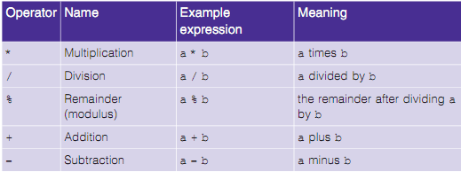
I. Arithmetic Operators

Slide 34
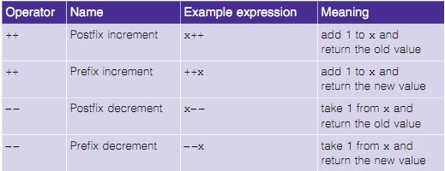
Cont...

Slide 35
Arithmetic Operators example
class arithmeticOperatorsClass{
public static void main(String[] args){
Int a = 10; int b = 20; int c = 30; int d = 40;
System.out.println(a+b);
System.out.println(b-a);
System.out.println(a*b);
System.out.println(b/a);
System.out.println(a%b);
System.out.println(c%a);
System.out.println(a++);
System.out.println(a--);
//Check the difference between the d++ and ++d in next slide's output of each
System.out.println(d++);
System.out.println(++d);
}
}

Slide 36
Cont...
30 //10+20
10 //20-10
200 //10*20
2 // 20/10
10 // 10%20
0 // 30%10
10 // 10++
10 // 10--
40 // 40++
41 // ++40

Slide 37
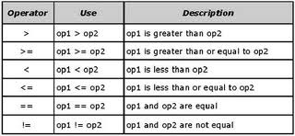
II. Relational Operator

Slide 38
Relational Operator example
class RelaOperatorComparison{
public static void main(String[] args){
int value1 = 1;
int value2 = 2;
if(value1 == value2)
System.out.println(“value1 == value2");
if(value1 != value2)
System.out.println(“value1 != value2");
if(value1 > value2)
System.out.println(“value1 > value2");
if(value1 < value2)
System.out.println(“value1 < value2");
if(value1 <= value2)
System.out.println(“value1 <= value2");
}
} Contd…..

Slide 39
Cont….
Output:
value1 != value2
value1 < value2
value1 <= value2

Slide 40
Cont…
public class ConditionalOperatorsDemo1
{
public static void main(String args[])
{
int a=10;
int b= 20;
int value1 = (a<b) ? a : b;
int value2 = (a>b) ? a : b;
System.out.println("value1 : "+value1);
System.out.println("value2 : "+value2);
}
}

Slide 41
III. Bitwise Operators
Bitwise Operatrors perform an operation on a bit-by-bit basis on integer datatypes like long, short, char and byte. A bit is the smallest unit of information that is stored in computer’s memory. Thus a computer stores every information in binary format of 0s and 1s. Thus as far as numbers are concerned every –
0 is ‘0’
1is ‘1’
2 is ‘10’
3 is ‘11’
4 is ‘100’ ans so on.. (refer notes for bitwise example)
Notes:
Let us assume that a=60; and b=13
In binary system the same values become-
a = 0011 1100
b = 0000 1101 and when we use diffrerent bitwise (& (bitwise and), | (bitwise or), ^ (bitwise XOR), ~ (bitwisecompliment),
<< (left shift), >> (right shift), >>> (zero fill right shift))
-----------------------------
a&b = 0000 1100 (where 0&1=0, 0&0=0, 1&1=1, 1&0=0 and integer value of 0000 1100 is 12 )
a|b = 0011 1101 (where 0|1=1, 0|0=0, 1|1=1, 1|0=1 and integer value of 0011 1101 is 61)
a^b = 0011 0001 (where 0^1=1, 0^0=0, 1^1=0, 1^0=1 and integer value of 0011 0001 is 49)
---------------------------------
~a = 1100 0011 (where 0=1, 1=0 and the result of interchanging 0s and 1s gives 1100 0011 which is -61)
a<<2 = 1111 0000 (where every single digit from a=0011 1100 is shifted left by 2 bits and the result is 1111 0000(integer 240))
a>>2 = 1111 (where every single digit from a=0011 1100 is shifted right by 2 bits and the result is1111 (integer 15))
a>>>2 = 0000 1111 (where every single digit from a=0011 1100 is shifted right by 2 bits and filled with 0s the result is 0000 1111 (integer 15))
======================================================================================
public class Test {
public static void main(String args[]) {
int a = 60; /* 60 = 0011 1100 */
int b = 13; /* 13 = 0000 1101 */
int c = 0; c = a & b; /* 12 = 0000 1100 */
System.out.println("a & b = " + c );
c = a | b; /* 61 = 0011 1101 */
System.out.println("a | b = " + c );
c = a ^ b; /* 49 = 0011 0001 */
System.out.println("a ^ b = " + c );
c = ~a; /*-61 = 1100 0011 */
System.out.println("~a = " + c );
c = a << 2; /* 240 = 1111 0000 */
System.out.println("a << 2 = " + c );
c = a >> 2; /* 15 = 1111 */
System.out.println("a >> 2 = " + c );
c = a >>> 2; /* 15 = 0000 1111 */
System.out.println("a >>> 2 = " + c );
}
}
Output
a & b = 12
a | b = 61
a ^ b = 49
~a = -61
a << 2 = 240
a >> 15
a >>> 15

Slide 42
IV. Logical Operators
Let us assume –
boolean a = true;
boolean b = false;
If we have –
(a&&b) the result becomes false where && is called ‘logical and’.
(a || b) the result becomes true where || is called ‘logical or’.
!(a&&b) the result becomes true where ! Is called ‘logical NOT’. (refer notes for example)
Notes:
public class Test {
public static void main(String args[]) {
boolean a = true;
boolean b = false;
System.out.println("a && b = " + (a&&b));
System.out.println("a || b = " + (a||b) );
System.out.println("!(a && b) = " + !(a && b));
}
}
Output
a && b = false
a || b = true
!(a && b) = true

Slide 43
V. Assignment Operator
‘=‘ simple assignment operator / assigns right side value to left side operand
(eg- if int c = a+b then c is being assigned value of a+b)
‘+=‘ add AND assignment operator / adds right side value to left side operand and assigns the result value to left side operandside operand
(eg- if int c += b then c is first added to b and the resulting value is then assigned to c )
Cont….

Slide 44
Cont…
‘-=‘ subtract AND assignment operator / subtracts right side value from left side operand and assigns the result value to left operand
(eg- if int c -= b then c is first substracted from b and the resulting value is then assigned to c )
‘*=‘ multiply AND assignment operator / multiplies right side value with left side operand and assigns the result value to left operand
(eg- if int c *= b then c is first multiplied with b and the resulting value is then assigned to c )
Cont….

Slide 45
Cont…
‘/=‘divide AND assignment operator / divides left side operand by right side value and assigns the result value to left operand
(eg- if int c /= b then c is first divided by b and the resulting value is then assigned to c )
‘%=‘ modulus AND assignment operator / gets the remainder after dividing left side operand by right side value and assigns the result value to left operand
(eg- if int c %= b then c is first divided by b and the resulting remainder value is then assigned to c ) Cont…
Check notes below
Notes:
public class Test {
public static void main(String args[]) {
int a = 10;
int b = 20;
int c = 0;
c = a + b;
System.out.println("c = a + b = " + c );
c += a ;
System.out.println("c += a = " + c );
c -= a ; System.out.println("c -= a = " + c );
c *= a ; System.out.println("c *= a = " + c );
a = 10; c = 15; c /= a ;
System.out.println("c /= a = " + c );
a = 10; c = 15; c %= a ;
System.out.println("c %= a = " + c );
c <<= 2 ;
System.out.println("c <<= 2 = " + c );
c >>= 2 ;
System.out.println("c >>= 2 = " + c );
c >>= 2 ;
System.out.println("c >>= 2 = " + c );
c &= a ;
System.out.println("c &= a = " + c );
c ^= a ;
System.out.println("c ^= a = " + c );
c |= a ;
System.out.println("c |= a = " + c ); }
}
Output
c = a + b = 30
c += a = 40
c -= a = 30
c *= a = 300
c /= a = 1
c %= a = 5
c <<= 2 = 20
c >>= 2 = 5
c >>= 2 = 1
c &= a = 0
c ^= a = 10
c |= a = 10

Slide 46
Cont…(pls refer notes of slide 40)
‘<<=‘ left shift AND assignment operator / left side operand’s bit value is shifted to the left by the same value as the value of right side operand and the resulting value is assigned to left side operand
(eg- C <<= 2 is same as C = C << 2)
‘>>=‘ right shift AND assignment operator / left side operand’s bit value is shifted to the right by the same value as the value of right side operand and the resulting value is assigned to left side operand
(eg- C <<= 2 is same as C = C << 2) Cont…
Check notes below
Notes:
public class Test {
public static void main(String args[]) {
int a = 10;
int b = 20;
int c = 0;
c = a + b;
System.out.println("c = a + b = " + c );
c += a ;
System.out.println("c += a = " + c );
c -= a ; System.out.println("c -= a = " + c );
c *= a ; System.out.println("c *= a = " + c );
a = 10; c = 15; c /= a ;
System.out.println("c /= a = " + c );
a = 10; c = 15; c %= a ;
System.out.println("c %= a = " + c );
c <<= 2 ;
System.out.println("c <<= 2 = " + c );
c >>= 2 ;
System.out.println("c >>= 2 = " + c );
c >>= 2 ;
System.out.println("c >>= 2 = " + c );
c &= a ;
System.out.println("c &= a = " + c );
c ^= a ;
System.out.println("c ^= a = " + c );
c |= a ;
System.out.println("c |= a = " + c ); }
}
Output
c = a + b = 30
c += a = 40
c -= a = 30
c *= a = 300
c /= a = 1
c %= a = 5
c <<= 2 = 20
c >>= 2 = 5
c >>= 2 = 1
c &= a = 0
c ^= a = 10
c |= a = 10

Slide 47
Cont…(pls refer notes of slide 40)
‘&=‘ bitwise AND assignment operator / the binary value of left hand operand is merged with the binary value (as per bitwise AND) of right hand operand and the resulting binary value is then assigned to left hand operand
‘^=‘ bitwise exclusive OR and assignment operator / the binary value of left hand operand is merged with the binary value (as per bitwise XOR) of right hand operand and the resulting binary value is then assigned to left hand operand Cont…
Check notes below
Notes:
public class Test {
public static void main(String args[]) {
int a = 10;
int b = 20;
int c = 0;
c = a + b;
System.out.println("c = a + b = " + c );
c += a ;
System.out.println("c += a = " + c );
c -= a ; System.out.println("c -= a = " + c );
c *= a ; System.out.println("c *= a = " + c );
a = 10; c = 15; c /= a ;
System.out.println("c /= a = " + c );
a = 10; c = 15; c %= a ;
System.out.println("c %= a = " + c );
c <<= 2 ;
System.out.println("c <<= 2 = " + c );
c >>= 2 ;
System.out.println("c >>= 2 = " + c );
c >>= 2 ;
System.out.println("c >>= 2 = " + c );
c &= a ;
System.out.println("c &= a = " + c );
c ^= a ;
System.out.println("c ^= a = " + c );
c |= a ;
System.out.println("c |= a = " + c ); }
}
Output
c = a + b = 30
c += a = 40
c -= a = 30
c *= a = 300
c /= a = 1
c %= a = 5
c <<= 2 = 20
c >>= 2 = 5
c >>= 2 = 1
c &= a = 0
c ^= a = 10
c |= a = 10

Slide 48
Cont…(pls refer notes of slide 40)
‘!=‘ bitwise inclusive OR and assignment operator / the binary value of left hand operand is merged with the binary value (as per bitwise OR) of right hand operand and the resulting binary value is then assigned to left hand operand
Check notes below
Notes:
public class Test {
public static void main(String args[]) {
int a = 10;
int b = 20;
int c = 0;
c = a + b;
System.out.println("c = a + b = " + c );
c += a ;
System.out.println("c += a = " + c );
c -= a ; System.out.println("c -= a = " + c );
c *= a ; System.out.println("c *= a = " + c );
a = 10; c = 15; c /= a ;
System.out.println("c /= a = " + c );
a = 10; c = 15; c %= a ;
System.out.println("c %= a = " + c );
c <<= 2 ;
System.out.println("c <<= 2 = " + c );
c >>= 2 ;
System.out.println("c >>= 2 = " + c );
c >>= 2 ;
System.out.println("c >>= 2 = " + c );
c &= a ;
System.out.println("c &= a = " + c );
c ^= a ;
System.out.println("c ^= a = " + c );
c |= a ;
System.out.println("c |= a = " + c ); }
}
Output
c = a + b = 30
c += a = 40
c -= a = 30
c *= a = 300
c /= a = 1
c %= a = 5
c <<= 2 = 20
c >>= 2 = 5
c >>= 2 = 1
c &= a = 0
c ^= a = 10
c |= a = 10

Slide 49
VI . Miscelleanous(ternary) Operators
Example
int a=10;
int b= 20;
int value1 = (a<b) ? a : b;
int value2 = (a>b) ? a : b;
What will be the values of “value1” and “value2”?
“value1” will be 10. Take a look at the expression “(a<b) ? a : b;”. This states that if “a” is less than “b”, the resultant value will be “a” and if “a” is not less than “b”, the resultant value will be “b”.
Cont…..
Check notes below
Notes:
public class Test {
public static void main(String args[]) {
int a, b;
a = 10;
b = (a == 1) ? 20: 30;
System.out.println( "Value of b is : " + b );
b = (a == 10) ? 20: 30;
System.out.println( "Value of b is : " + b );
}
}
Output
Value of b is : 30
Value of b is : 20

Slide 50
Cont...
5. Separators
Symbols used to define the structure or to indicate how the code is arranged are called separators.
The separators used in Java are as follows -
Parentheses ( )
Used to define precedence in expressions, to enclose parameters in method definitions, and enclosing cast types.
Braces { }
Used to define a block of code and to hold the values of arrays.
Brackets [ ]
Used to declare array types.

Slide 51
Cont...
Semicolon ;
Used to separate statements.
Comma ,
Used to separate identifiers in a variable declaration and in the for statement.
Period .
Used to separate package names from classes and subclasses and to separate a variable or a method from a reference variable.

Slide 52
Arrays - Syntax for declaration: String[] myStringArray; int[] myIntArray;
An array can be defined as a single variable of a datatype (String or int) which can contain different values under the same variable name. For simple understanding think of an array as your family last name. Just like every one in you family has the same last name but a different middle name which identifies their personality. Just like the family last name can accommodate as many members in it, the same way an array can accommodate one or more values of a variable of same datatype. Here are examples of array -

Slide 53
Cont...
int [] familyMembers = new int[3];
// in the above statement we declared and allowed int array the
// capacity to accept 3 family members. Note that we use new int[]
// to do that
Now lets use the int array in a program -
============================================

Slide 54
Cont...
class letsLearnArray{
public static void main(String[] args){
int[] familyMembersAge = new int[3]; // there are 3 members and we will assign // them their age/value
familyMembersAge[0] = 50; // 1st family members age is 50
familyMembersAge[1] = 40; // 2nd family members age is 40
familyMembersAge[2] = 30; // 3rd family members age is 30
System.out.println(“Age of 1st member is ” + familyMembersAge[0]);
System.out.println(”Age of 2nd member is ” familyMembersAge[1]);
System.out.println(”Age of 3rd member is ” familyMembersAge[2]);
}
}
Notes:
P. S. - Because arrays numbering system starts from 0 so if there is 1 member in family we write 0 instead of 1 and keep adding 1 to 0 or every single increment

Slide 55
Cont...
The example shown above is similar even in case of String. Lets now see it -
class letsLearnArray{
public static void main(String[] args){
String[] familyMemberName = new String[3];
familyMemberName[0] = “Mom”;
familyMemberName[1] = “Dad”;
familyMemberName[2] = “Son”;
System.out.println(“Name of 1st member is “ + familyMemberName[0]);
System.out.println(“Name of 2nd member is “ + familyMemberName[1]);
System.out.println(“Name of 3rd member is “ + familyMemberName[2]);
}
}
Notes:
P. S. - The above examples of String[] and int[] actually give this arrays a capacity to accept upto 3 values if you were to add one more member (4th member), say Daughter, you will get an error/exception because you already limited the array capacity to 3.

Slide 56
Cont...
But there is another way of initializing array without limiting the capacity to accept values -
String[] familyMemberName = {“Mom”, “Dad”, “Son”};
In the above array literal or statement we simply use {} in place of new String[3]. Also we can avoid familyMemberName[0] = “Mom”; for every family member which is a bit tedious. Thus initializing an array with braces is a better and economical way of using arrays. Look at the example below -

Slide 57
Cont...
class letsLearnArray{
public static void main(String[] args){
String[] familyMemberName = {“Mom”, “Dad”, “Son”, “Daughter”};
System.out.println(“1st member ” + familyMemberName[0]);
System.out.println(“2nd member ” + familyMemberName[1]);
System.out.println(“3rd member ” + familyMemberName[2]);
System.out.println(“4th member ” + familyMemberName[3]);
}
}
Notes:
As you can see the above example looks much cleaner than the previous 2 examples of array. Also we can add the 4th member without worrying about the capacity of the array as we do not predefine the capacity but dynamically add the member within braces. Same can done with int and char datatypes.

Slide 58
Loops
Loops are used to execute a calculation (int datatype)or repeat a String or char several times in an iteration format. For example if you want to print numbers 1 to 10 instead of typing System.out.println(1);
…………
System.out.println(10); You can simply use for loop. Example
class forLoop{
public static void main(String[] args){
for(int i=1;i<=10;i++){
System.out.println(i);
}
}
}
So that solves the problem of writing similar code over and over again.
In next slide we will see how many types of loops are there in Java.

Slide 59
Types of loops
These are-
1. for loop (see the example in prev. slide)
2. while loop
3. do...while loop
Since we have already seen an example of for loop lets skip to while loop.
While loop lets us repeatedly execute iteration of a statement with a certain condition in place and till the time that condition is true or fulfilled it will keep executing the code i.e it sets the limit beyond which the execution of code stops. Below is an example-

Slide 60
while loop e.g-
class whileLoop{
public static void main(String[] args){
int x = 5;
while(x<10){
x++;
System.out.println(x);
}
}
}
Notes:
OK, so what we have done is we initialized x as 5 and then we say that we want the code to keep adding the next number after 5 while it is still below 10. That will give-
Output
5
6
7
8
9
P. S – It is different than for loop in the sense that we always have to initialize the int variable first and that has to be outside and before starting the while loop. In for loop we do initialization(int i = 1)and its control (i<10 or i<=10) and increment (i++) in one line but in while loop that order is changed as shown above.

Slide 61
do while loop
class DoWhileLoopExample {
public static void main(String args[])
{ int i=10;
do{ System.out.println(i); i--; }
while(i>1); }
}
The output of this program is: 10 9 8 7 6 5 4 3 2
Notes:
In the above example we initialized i with a value 10 and inside do we are telling the program to print i’s value with decrement on every next line until i’s value remains above 1. Thus we get 10,9,8……2. In short do printing of i value while it is above 1.

Slide 62
break and continue statement in loop
break statement is used to put a stop in full execution of a loop.
continue statement is used to skip a value and continue with the remaining execution of loop after the skip
Refer examples in notes of this slide
Notes:
Break example
class breakExample{
static void stopAtThird(){
int[] arr= {1,2,3,4,5};
for(int i:arr){
if(i==3){
break;
}
System.out.println(i);
}
}
public static void main(String[] args){
stopAtThird();
}
}
Output
1
2
Thus it stops the full execution at 3 i.e all numbers before 3 will be the ouput
============================================================================
Continue example
class breakExample{
static void skipThird(){
int[] arr= {1,2,3,4,5};
for(int i:arr){
if(i==3){
continue;
}
System.out.println(i);
}
}
public static void main(String[] args){
skipThird();
}
}
Output
1
2
4
5
Thus it skips printing 3 and then continues with execution or printing the rest of the values

Slide 63
Exceptions in Java
An exception is an occurrence of a mistake that prevents successful execution of program. Thus to avoid such an event Java provides a technique called “Exception Handling”.
Java has classified exceptions into 2 type-
Checked Exceptions(Compile-time Exceptions)
Unchecked Exceptions(Runtime Exceptions)
Examples of such event are listed in notes of this slide.
Notes:
Every object created in Java may face an exception either at runtime or compile time. Lets see what is compile time(also compile time exception) and runtime(also runtime exception) difference-
Compile time (also compile time exceptions)
Every code we write in any programming language goes through 2 phases. The first phase is compile time where the written code is read by the compiler of the programming language to check if it is as per the standards of the languages compiler. If there are any inconsistencies or mistakes in the written code then such a code fails to compile during compile time. The exception which results from failure of compilation of code is called compile time exception.
P.S – Compile time exception is also called Cheked Exception
Lets understand this with this example: In this example we are reading the file myfile.txt and displaying its content on the screen. In this program there are three places where an checked exception is thrown as mentioned in the comments below. FileInputStream which is used for specifying the file path and name, throws FileNotFoundException. The read() method which reads the file content throws IOException and the close() method which closes the file input stream also throws IOException.
import java.io.*;
class Main {
public static void main(String[] args) {
FileReader file = new FileReader("C:\test\a.txt");
BufferedReader fileInput = new BufferedReader(file);
// Print first 3 lines of file "C:\test\a.txt"
for (int counter = 0; counter < 3; counter++)
System.out.println(fileInput.readLine());
fileInput.close();
}
}
======================================================================
Output:
Exception in thread "main" java.lang.Error: Unresolved compilation problems: Unhandled exception type FileNotFoundException Unhandled exception type IOException Unhandled exception type IOException
Why this compilation error?
As I mentioned in the beginning that checked exceptions gets checked during compile time. Since we didn’t handled/declared the exceptions, our program gave the compilation error. How to resolve the error?
There are two ways to avoid this error. We will see both the ways one by one.
Method 1: Declare the exception using throws keyword. As we know that all three occurrences of checked exceptions are inside main() method so one way to avoid the compilation error is: Declare the exception in the method using throws keyword. You may be thinking that our code is throwing FileNotFoundException and IOException both then why we are declaring the IOException alone. Th reason is that IOException is a parent class of FileNotFoundException so it by default covers that. If you want you can declare that too like this public static void main(String args[]) throws IOException, FileNotFoundException.
import java.io.*;
class Main {
public static void main(String[] args) throws IOException {
FileReader file = new FileReader("C:\test\a.txt");
BufferedReader fileInput = new BufferedReader(file);
// Print first 3 lines of file "C:\test\a.txt"
for (int counter = 0; counter < 3; counter++)
System.out.println(fileInput.readLine());
fileInput.close();
}
}
Output: File content is displayed on the screen.
First three lines of file “C:\test\a.txt”
Method 2: Handle them using try-catch blocks.
The above approach is not good at all. It is not a best exception handling practice. You should give meaningful message for each exception type so that it would be easy for someone to understand the error. The code should be like this:
import java.io.*;
class Example {
public static void main(String args[]) {
FileInputStream fis = null;
try{ fis = new FileInputStream("B:/myfile.txt");
}catch(FileNotFoundException fnfe){
System.out.println("The specified file is not " + "present at the given path");
} int k;
try{
while(( k = fis.read() ) != -1) {
System.out.print((char)k);
}
fis.close();
}catch(IOException ioe){
System.out.println("I/O error occurred: "+ioe);
}
}
}
Output:
This code will run fine and will display the file content.
Here are the few other Checked Exceptions –
SQLException
DataAccessException
ClassNotFoundException
InvocationTargetException
IOException
FileNotFoundException
ParseException
ClassNotFoundException
CloneNotSupportedException
InstantiationException
InterruptedException
NoSuchMethodException
NoSuchFieldException
Run time (also compile time exceptions)
The second phase is runtime where the written code is already successfully compiled by the compiler. But the compiled code is not always successfully executed and there are exceptions to execution of code. The exception which results from failure of execution of code is called runtime exception.
P.S – Runtime exception is also called Cheked Exception
Lets understand this with an example:
class Example {
public static void main(String args[]) {
int num1=10;
int num2=0; //Since I'm dividing an integer with 0 it should throw ArithmeticException
int res=num1/num2;
System.out.println(res);
}
}
If you compile this code, it would compile successfully however when you will run it, it would throw ArithmeticException. That clearly shows that unchecked exceptions are not checked at compile-time, they are being checked at runtime.
Lets see another example.
class Example {
public static void main(String args[]) {
int arr[] ={1,2,3,4,5}; //My array has only 5 elements but I'm trying to display the value of 8th element. It should throw //ArrayIndexOutOfBoundsException
System.out.println(arr[7]);
}
}
This code would also compile successfully since ArrayIndexOutOfBoundsException is also an unchecked exception. Note: It doesn’t mean that compiler is not checking these exceptions so we shouldn’t handle them. In fact we should handle them more carefully. For e.g. In the above example there should be a exception message to user that they are trying to display a value which doesn’t exist in array so that user would be able to correct the issue.
class Example {
public static void main(String args[]) {
try{
int arr[] ={1,2,3,4,5};
System.out.println(arr[7]);
}catch(ArrayIndexOutOfBoundsException e){
System.out.println("The specified index does not exist " + "in array. Please correct the error.");
}
}
}
Unchecked
ArrayIndexOutOfBoundsException
ClassCastException
IllegalArgumentException
IllegalStateException
NullPointerException
NumberFormatException
AssertionError
ExceptionInInitializerError
StackOverflowError
NoClassDefFoundError

Slide 64
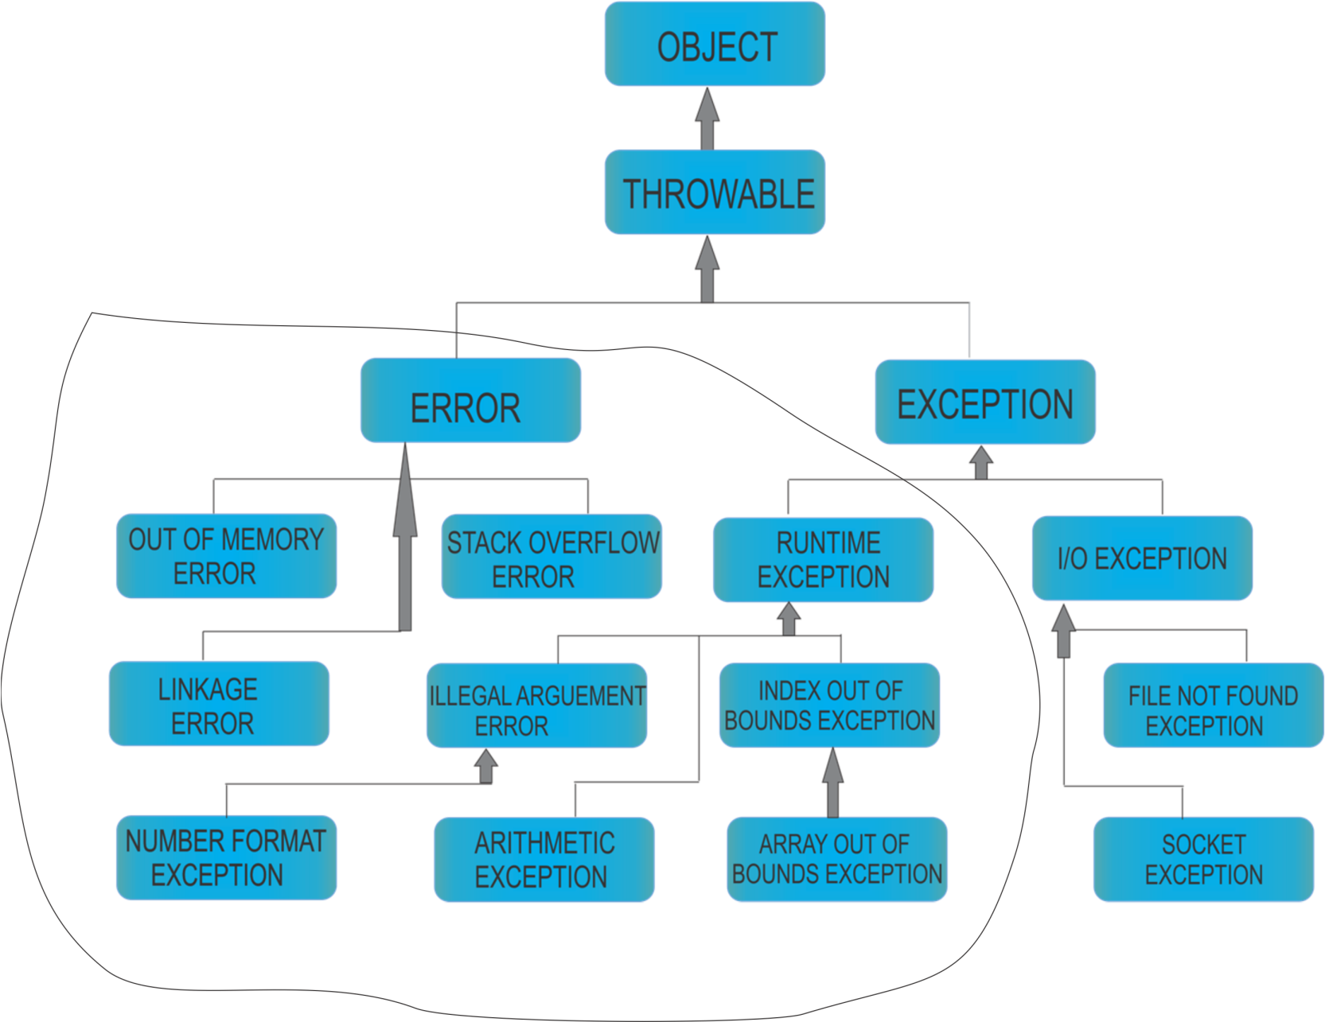
Difference between error, unchecked and checked exception
Notes:
In Java exceptions under Error and RuntimeException classes are unchecked exceptions, everything else under throwable is checked.

Slide 65
Inheritance in java
Inheritance in Java means the acquiring of properties(i.e methods, variables, fields) of an super/parent class by a child/subclass. In inheritance the child/subclass not only acquires the methods, variables, fields of super/parent class but can even add some new properties and behaviors of its own to such an acquired method, variable, field.
The new/subclass uses extends keyword to inherit properties from parent class or super class.E.g –
______________________________________________________
class childClass extends parentClass{
}
There are 5 types of Inheritance as shown in the notes of next slide-
Notes:
--------------------------------------------------------------------Refer the notes and next slide--------------------------------------------------------------

Slide 66
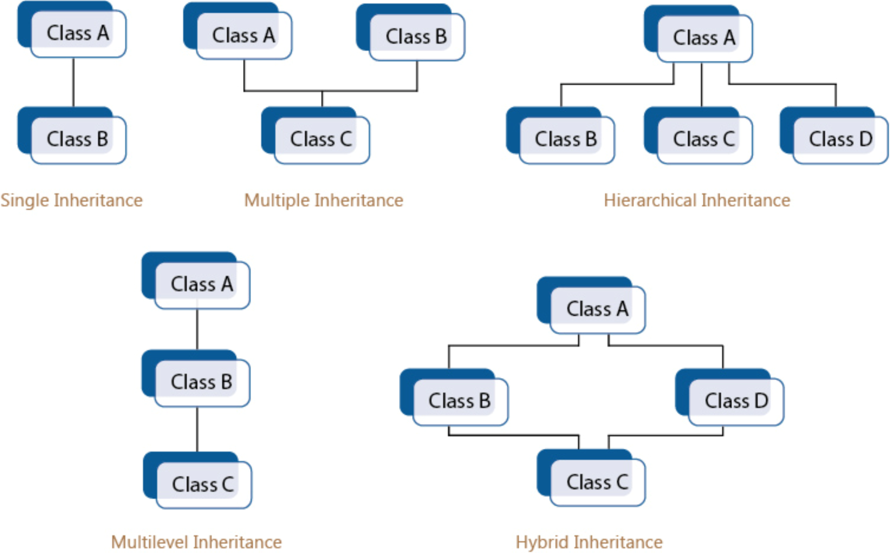
Types of inheritance
Notes:
1. Single Inheritance example
Single Inheritance is synonymous with Inheritance itself. Thus its definition is the definition of Inheritance.
--------------------------------------------------------------------------------------------------------------------------------------------------------------
class parentClass{
public void parMethod(){
String parStr = “I am parent String”;
System.out.println(parStr);
}
}
class childClass extends parentClass{
public void childMethod(){
String childStr = “I am a child String”;
System.out.println(childStr);
}
public static void main(String[] args){
childClass childObj = new childClass();
childObj.parMethod(); // calling parent class method
childObj.childMethod(); // calling child class method
}
}
Output-
I am a parent String
I am a child String
2. Multiple Inheritance
Multiple Inheritance refers to a single child class inheriting properties(methods, variables, fields) from more than one parent class(i.e 2 or more parent classes)
class parentClass1{
public void parMethod1(){
String parStr = “I am parent String”;
System.out.println(parStr);
}
}
class parentClass2{
public void parMethod2(){
String parStr = “I am parent String”;
System.out.println(parStr);
}
}
class childClass extends parentClass1, parentClass2{
public void childMethod(){
String childStr = “I am a child String”;
System.out.println(childStr);
}
public static void main(String[] args){
childClass childObj = new childClass();
childObj.parMethod(); // calling parent class method but not sure which parent class since parent1 and // parent2 both have parMethod().
childObj.childMethod(); // calling child class method
}
}
Output-
Compile time error
P.S – In the comments see that child class is invoking parMethod() but there is confusion as to which parent class’ method is being called. Hence use of multiple inheritance is discouraged in Java as it may lead to unwanted complexity while working on large applications or projects.
3. Hierarchical Inheritance
In hierarchical inheritance a single parent/base class is inherited by 2 or 3 or more child classes. E.g-
class parentClass{
public void parMethod(){
String parStr = “I am parent String”;
System.out.println(parStr);
}
}
class childClass1 extends parentClass{
public void childMethod1(){
String childStr1 = “I am a child1 String”;
System.out.println(childStr1);
}
class childClass2 extends parentClass{
public void childMethod2(){
String childStr2 = “I am a child2 String”;
System.out.println(childStr2);
}
public static void main(String[] args){
childClass1 childObj1 = new childClass1();
childClass2 childObj2 = new childClass2();
childObj1.parMethod(); // calling parent class method for childObj1
childObj1.childMethod1(); // calling child class1 method
childObj2.parMethod(); // calling parent class method for childObj2
childObj2.childMethod2(); // calling child class2 method
}
}
Output-
I am parent String
I am a child1 String
I am parent String
I am a child2 String
P.S - In the above example you can see that childObj1 of childClass1 as well as childObj2 of childClass2 both have access to single parent class
4. MultiLevel Inheritance
class parentClass{
public void parMethod(){
String parStr = “I am parent String”;
System.out.println(parStr);
}
}
class childClass1 extends parentClass{
public void childMethod1(){
String childStr1 = “I am a child1 String”;
System.out.println(childStr1);
}
class childClass2 extends childClass1{
public void childMethod2(){
String childStr2 = “I am a child2 String”;
System.out.println(childStr2);
}
public static void main(String[] args){
childClass2 childObj2 = new childClass2();
childObj2.parMethod();
childObj2.childMethod1();
childObj2.childMethod2();
}
}
Output-
I am parent String
I am a child1 String
I am a child2 String
P.S- In the above example child class1 first inherits parent class and then child class 2 inherits child class1 and thus also inherits parent class. Hence it is able to print the Strings of both child class1 and parent class.
5. Hybrid Inheritance
Hybrid inheritance is a combination of single and multiple inheritance. Thus given the compiling error that occurs in multiple inheritance even in hybrid we shall face the same error. Hence hybrid inheritance is performed by using interface instead of class in Java. E.g-
Using Class
public class A {
public void methodA() {
System.out.println("Class A methodA");
}
}
public class B extends A {
public void methodA() {
System.out.println("Child class B is overriding inherited method A");
}
public void methodB() {
System.out.println("Class B methodB");
}
}
public class C extends A {
public void methodA() {
System.out.println("Child class C is overriding the methodA");
}
public void methodC() {
System.out.println("Class C methodC");
}
} public class D extends B, C {
public void methodD() {
System.out.println("Class D methodD");
}
public static void main(String args[]) {
D obj1= new D();
obj1.methodD();
obj1.methodA();
}
}
Output:
Error!!
Using interface
interface A {
public void methodA();
}
interface B extends A {
public void methodB();
}
interface C extends A {
public void methodC();
}
class D implements B, C {
public void methodA() {
System.out.println("MethodA");
}
public void methodB() {
System.out.println("MethodB");
}
public void methodC() {
System.out.println("MethodC");
}
public static void main(String args[]) {
D obj1= new D();
obj1.methodA();
obj1.methodB();
obj1.methodC();
}
}
Output-
MethodA
MethodB
MethodC

Slide 67
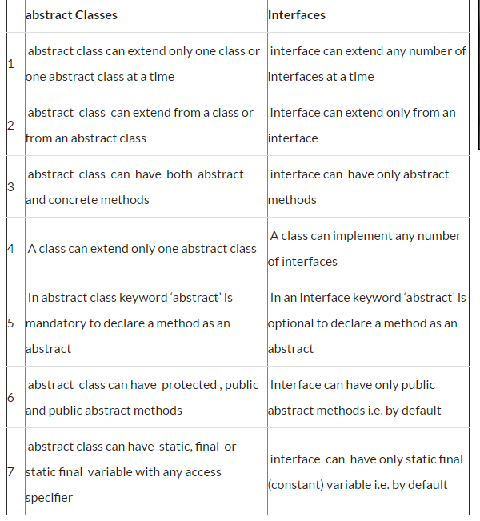
Abstract class vs interface difference
Notes:
Difference No.1:
Abstract class can extend only one class or one abstract class at a time
class Example1{
public void display1(){
System.out.println("display1 method");
}
}
abstract class Example2{
public void display2(){
System.out.println("display2 method");
}
}
abstract class Example3 extends Example1{
abstract void display3();
}
class Example4 extends Example2{
public void display3(){
System.out.println("display3 method");
}
}
class Demo{
public static void main(String args[]){
Example4 obj=new Example4();
obj.display3();
}
}
Output:
display3 method
Interface can extend any number of interfaces at a time
//first interface
interface Example1{
public void display1();
}
//second interface
interface Example2 {
public void display2();
}
//This interface is extending both the above interfaces
interface Example3 extends Example1,Example2{
}
class Example4 implements Example3{
public void display1(){
System.out.println("display2 method");
}
public void display2(){
System.out.println("display3 method");
}
}
class Demo{
public static void main(String args[]){
Example4 obj=new Example4();
obj.display1();
}
}
Output:
display2 method
Difference No.2:
Abstract class can be inherited by a class or an abstract class
class Example1{
public void display1(){
System.out.println("display1 method");
}
}
abstract class Example2{
public void display2(){
System.out.println("display2 method");
}
}
abstract class Example3 extends Example2{
abstract void display3();
}
class Example4 extends Example3{
public void display2(){
System.out.println("Example4-display2 method");
}
public void display3(){
System.out.println("display3 method");
}
}
class Demo{
public static void main(String args[]){
Example4 obj=new Example4();
obj.display2();
}
}
Output:
Example4-display2 method
Interfaces can be extended only by interfaces. Classes has to implement them instead of extend
interface Example1{
public void display1();
}
interface Example2 extends Example1{
}
class Example3 implements Example2{
public void display1(){
System.out.println("display1 method");
}
}
class Demo{
public static void main(String args[]){
Example3 obj=new Example3(); obj.display1();
}
}
Output:
display1 method
Difference No.4
A class can extend only one abstract class at a time
abstract class Example1{
public void display1(){ System.out.println("display1 method");
}
}
abstract class Example2{
abstract void display2();
}
class Example3 extends Example1{
public void display3(){
System.out.println("display3 method");
}
}
class Demo{
public static void main(String args[]){
Example3 obj=new Example3();
obj.display3();
}
}
A class can implement any number of interfaces at a time
interface Example1{
public void display1();
}
interface Example2{
public void display2();
}
class Example3 implements Example1,Example2{
public void display1(){
System.out.println("display1 method");
}
public void display2(){
System.out.println("display2 method");
}
public void display3(){
System.out.println("display3 method");
}
}
class Demo{
public static void main(String args[]){
Example3 obj=new Example3();
obj.display1(); obj.display3();
}
}
Difference No.5
In abstract class, the keyword ‘abstract’ is mandatory to declare a method as an abstract
abstract class Example1{
public abstract void display1();
}
class Example2 extends Example1{
public void display1(){
System.out.println("display1 method");
}
public void display2(){
System.out.println("display2 method");
}
}
class Demo{
public static void main(String args[]){
Example2 obj=new Example2();
obj.display1();
}
}
In interfaces, the keyword ‘abstract’ is optional to declare a method as an abstract because all the methods are abstract by default
interface Example1{
public void display1();
}
class Example2 implements Example1{
public void display1(){
System.out.println("display1 method");
}
public void display2(){
System.out.println("display2 method");
}
}
class Demo{
public static void main(String args[]){
Example2 obj=new Example2();
obj.display1();
}
}
Difference No.6
Difference No.6
Abstract class can have protected , public and public abstract methods
abstract class Example1{
protected abstract void display1();
public abstract void display2();
public abstract void display3();
}
class Example2 extends Example1{
public void display1(){
System.out.println("display1 method");
}
public void display2(){
System.out.println("display2 method");
}
public void display3(){
System.out.println("display3 method");
}
}
class Demo{
public static void main(String args[]){
Example2 obj=new Example2();
obj.display1();
}
}
Interface can have only public abstract methods i.e. by default
interface Example1{
void display1();
}
class Example2 implements Example1{
public void display1(){
System.out.println("display1 method");
}
public void display2(){
System.out.println("display2 method");
}
}
class Demo{
public static void main(String args[]){
Example2 obj=new Example2();
obj.display1();
}
}
Difference No.7
Abstract class can have static, final or static final variables with any access specifier
abstract class Example1{
private int numOne=10;
protected final int numTwo=20;
public static final int numThree=500;
public void display1(){
System.out.println("Num1="+numOne);
}
}
class Example2 extends Example1{
public void display2(){
System.out.println("Num2="+numTwo);
System.out.println("Num2="+numThree);
}
}
class Demo{
public static void main(String args[]){
Example2 obj=new Example2();
obj.display1();
obj.display2();
}
}
Interface can have only static final (constant) variable i.e. by default
interface Example1{
int numOne=10;
}
class Example2 implements Example1{
public void display1(){
System.out.println("Num1="+numOne);
}
}
class Demo{
public static void main(String args[]){
Example2 obj=new Example2();
obj.display1();
}
}

