Slide 1
Introduction to Analysis of Algorithms

Slide 2
What is a computer program?
... a series of instructions that performs a specific task when executing a computer

Slide 3
Introduction
Programs = algorithms + data structures
What is Algorithm?
a clearly specified set of simple instructions to be followed to perform a task
Takes a set of values, as input and
produces a value, or set of values, as output
What is data structures?
Methods of representing and organizing data

Slide 4
How do we present an algorithm
Algorithms may be specified in several ways
as a pseudo-code (English-like informal statement)
as a flowchart
as a computer program (suitable for simple problems

Slide 5
A sample problem
Suppose we have a simple problem of calculating the sales amount

Slide 6
Using pseudo-code to represent an algorithm
a pseudo-code is a semi-formal English-like sequence of statements
Advantages of using pseudo-code
Simple to use
Allows us to “think out” the problem
Easy to convert the pseudo code into actual coding

Slide 7
Example of a Pseudo-code
To calculate Sales Amount:
1. First get user to enter quantity
2. Get the price of the product
3. Calculate amount = price X quantity
4. Display the amount

Slide 8
Using Flow-Charts to represent an algorithm
Graphical representation of an algorithm
Uses shapes and arrows to describe flow or sequence of process to solve a problem

Slide 9
Some Flow-charting Symbols
Decisions
Process
Connectors
Input / Output
Direction of Flow
Terminators

Slide 10
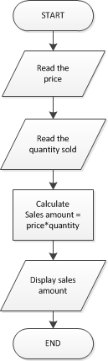
Example of Flowchart

Slide 11
Tools for Drawing Flow Chart Diagrams
Code2flow
Microsoft Visio
Chart Mage
Flowchart.js
Elm bot lines
Diagrams through ASCII Art
ASCIIO

Slide 12
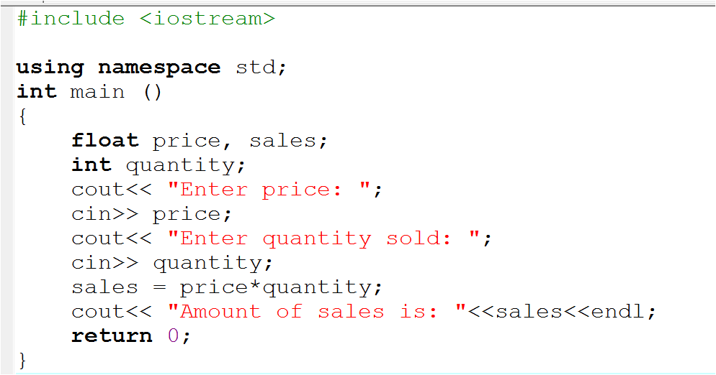
Example of a Computer Program (Source code)

Slide 13
What is algorithm analysis
Algorithm analysis is an important part of a broader computational complexity theory
provides theoretical estimates for the resources needed by any algorithm which solves a given computational problem
As a guide to find efficient algorithms.

Slide 14
Why do we need to analyze algorithms?
One problem can have multiple solutions
Writing a merely working program is not good enough
The program may be inefficient!
If the program is run on a large data set, then the running time can become an issue

Slide 15
Example: Selection of Algorithm
Given a list of N numbers, determine the kth largest, where k ≤ N.
Algorithm 1:
(1) Read N numbers into an array
(2) Sort the array in decreasing order by some simple algorithm
(3) Return the element in position k

Slide 16
Example: Selection of Algorithm
Algorithm 2:
(1) Read the first k elements into an array and sort them in decreasing order
(2) Each remaining element is read one by one
If smaller than the kth element, then it is ignored
Otherwise, it is placed in its correct spot in the array, bumping one element out of the array.
(3) The element in the kth position is returned as the answer.

Slide 17
Example: Selection of Algorithm
Which algorithm is better when
N =100 and k = 100?
N =100 and k = 1?
What happens when N = 1,000,000 and k = 500,000?
Conclusion: there exist better algorithms

Slide 18
Correct Algorithms vs Incorrect Algorithms
We will only analyze correct algorithms
Correct algorithm
If, for every input instance, it halts with the correct output
Incorrect algorithms
Might not halt at all on some input instances
Might halt with other than the desired answer

Slide 19
Benefits of Algorithm Analysis
Analyzing an algorithm
Predicting the resources that the algorithm requires
Resources include
Memory
Communication bandwidth
Computational time (usually most important)

Slide 20
Factors affecting the running time
computer
Faster computer speed performs better
compiler
Execution of different compilers uses different space and time requirements
algorithm used
Efficient algorithms vs. inefficient algorithm
input size to the algorithm
typically, the input size (number of items in the input) is the main consideration
E.g. sorting problem ⇒ the number of items to be sorted
E.g. multiply two matrices together ⇒ the total number of elements in the two matrices

Slide 21
Algorithm Analysis is performed based on…
Machine model
Instructions are executed one after another, with no concurrent operations ⇒ Not parallel computers

Slide 22
Computational complexity analysis Time complexity
Running time
Input size (N)
Notes:
Limitation of stopwatch
Machine dependent
Programming language dependent

Slide 23
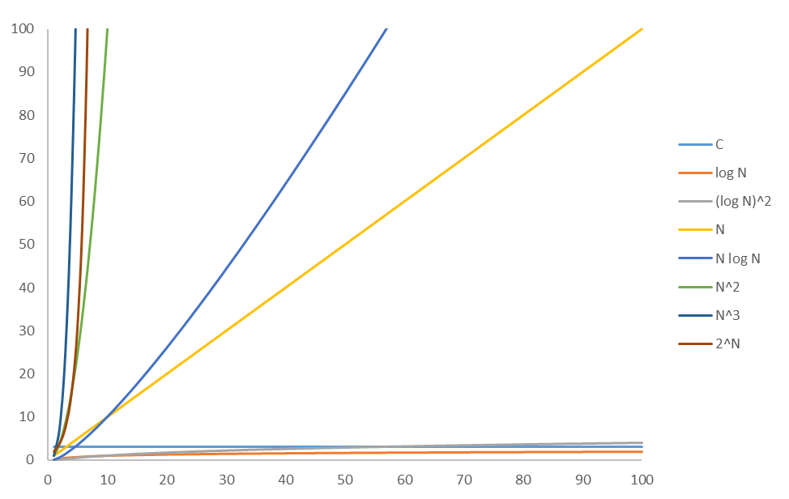
Typical Growth Rates

Slide 24
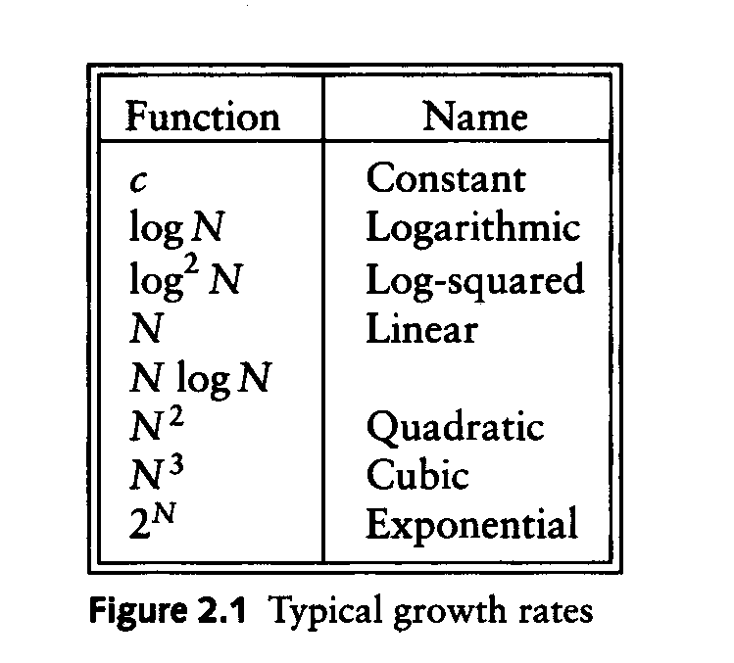
Typical Growth Rates
slowest
fastest

Slide 25
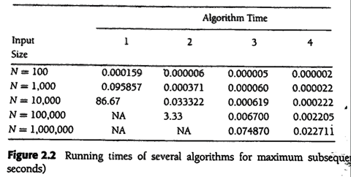
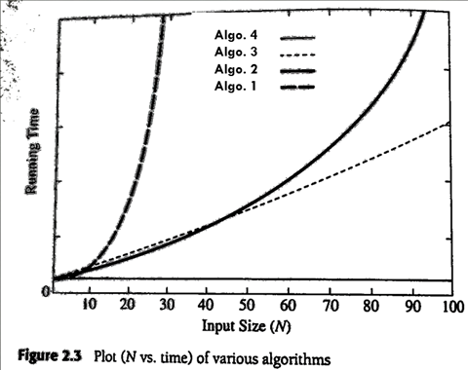
Running time Example: Maximum Subsequence Sum Problem

Slide 26
Worst- / average- / best-case
Worst-case running time of an algorithm
The longest running time for any input of size n
An upper bound on the running time for any input
⇒ guarantee that the algorithm will never take longer
Example: Sort a set of numbers in increasing order; and the data is in decreasing order
The worst case can occur fairly often
E.g. in searching a database for a particular piece of information
Best-case running time
sort a set of numbers in increasing order; and the data is already in increasing order
Average-case running time
May be difficult to define what “average” means

Slide 27
Asymptotic notations
Big-O notation, O
represents the worst-case performance of algorithm
Big-Omega notation, Ω
represents the best-case performance of algorithm
Big-Theta notation, Ө
represents the average-case performance of algorithm

Slide 28
Asymptotic notation: Big-Oh
f(N) = O(g(N))
There are positive constants c and n₀ such that
f(N) ≤ c g(N) when N ≥ n₀
The growth rate of f(N) is less than or equal to the growth rate of g(N)
g(N) is an upper bound on f(N)

Slide 29
Big-Omega
f(N) = Ω(g(N))
There are positive constants c and n₀ such that
f(N) ≥ c g(N) when N ≥ n₀
The growth rate of f(N) is greater than or equal to the growth rate of g(N).

Slide 30
Big-Theta
f(N) = Θ(rate of f(N) equals the growth rate of g(N)
Example: Let f(N)=N² , g(N)=2N²
We write f(N) = O(g(N)) and f(N) = Ω(g(N)),
thus f(N) = Θ(g(N)).

Slide 31
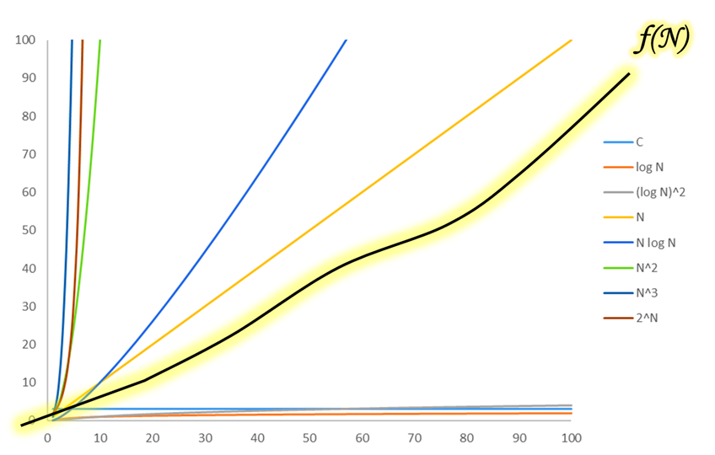
Determine g(N) in f(N) = O(g(N))
Asymptotically tight (closest) upper bound function

Slide 32
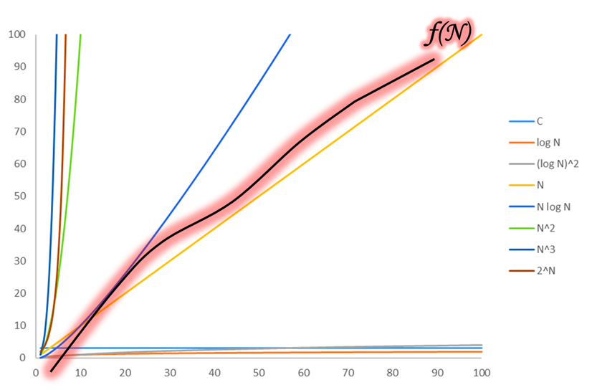
Determine g(N) in f(N) = O(g(N))
Asymptotically tight (closest) upper bound function

Slide 33
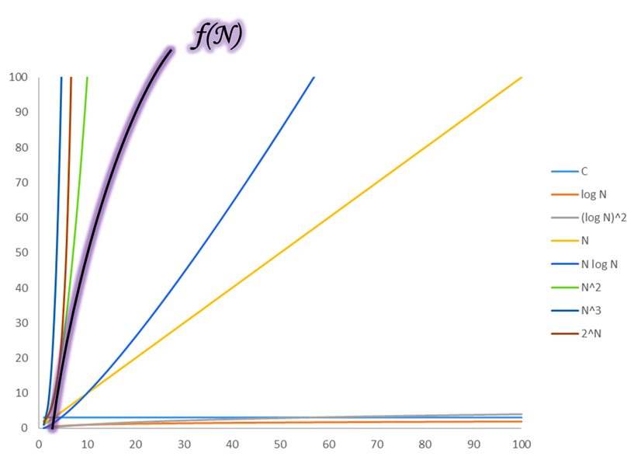
Determine g(N) in f(N) = O(g(N))
Asymptotically tight (closest) upper bound function

Slide 34
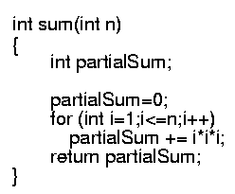

Example of Calculating Big-Oh
Calculate
Lines 1 and 4 count for one unit each
Line 2: (1 for initialization, N+1 for all the tests, N for all the increments) total 2N + 2
Line 3: executed N times, each time four units
total cost: 6N + 4 ⇒ O(N)
1
2N+2
4N
1
1
2
3
4

Slide 35
General Rules of Big-Oh Calculation
Ignore the lower order terms and the coefficients of the highest-order term
No need to specify the base of logarithm
Changing the base from one constant to another changes the value of the logarithm by only a constant factor
If T₁(N) = O(f(N)) and T₂(N) = O(g(N)), then
T₁(N) + T₂(N) = max(O(f(N)), O(g(N))),
T₁(N) * T₂(N) = O(f(N) * g(N))

Slide 36

General Rules of Big-Oh Calculation
For loops
at most the running time of the statements inside the for-loop (including tests) times the number of iterations.
Nested for loops
the running time of the statement multiplied by the product of the sizes of all the for-loops.
O(N²)

Slide 37
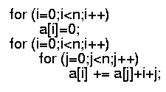
General Rules of Big-Oh Calculation
For consecutive statements, e.g:
Just add: O(N) + O(N²) = O(N²)
If/Else
never more than the running time of the test plus the larger of the running times of S1 and S2.

Slide 38
Running-time of algorithms
Bounds are for the algorithms, rather than programs
programs are just implementations of an algorithm, and almost always the details of the program do not affect the bounds
Bounds are for algorithms, rather than problems
A problem can be solved with several algorithms, some are more efficient than others

Slide 39
Advantages of algorithm analysis
To eliminate bad algorithms early
Pinpoints the bottlenecks, which are worth re-coding carefully

Slide 40
End of Slides

