Slide 1
Graphs

Slide 2
Graphs
Extremely useful tool in modeling problems
Consist of:
Vertices
Edges
Vertices can be considered “sites” or locations.
Edges represent
connections.
D
E
C
A
F
B
Vertex
Edge

Slide 3
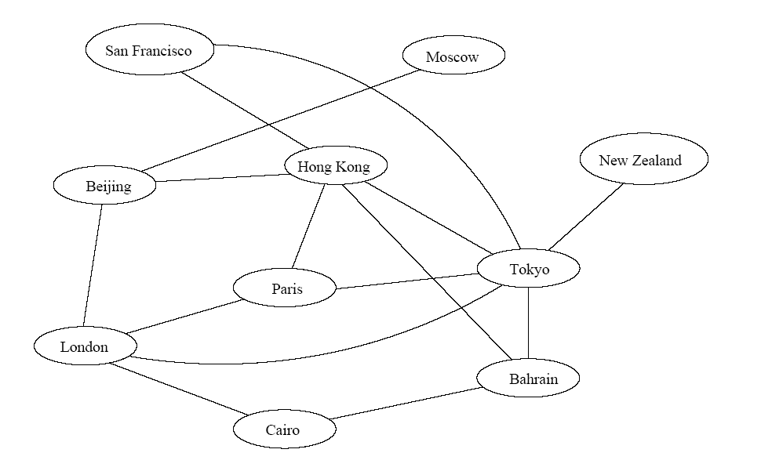
Applications
Air flight system
Each vertex represents a city
Each edge represents a direct flight between two cities
A query on direct flights becomes a query on whether an edge exists
A query on how to get to a location is “does a path exist from A to B”
We can even associate costs to edges (weighted graphs), then ask “what is the cheapest path from A to B”

Slide 4
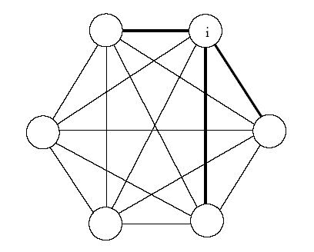
Another application
Wireless communication
Can be represented by a weighted complete graph (every two vertices are connected by an edge).
Each edge represents the Euclidean distance dij between two stations.
Each station uses a certain power i to transmit messages. Given this power i, only a few nodes can be reached (bold edges). A station reachable by i then use its own power to relay the message to other stations not reachable by i.
A typical wireless communication problem is: how to broadcast between all stations such that they are all connected and the power consumption is minimized.

Slide 5
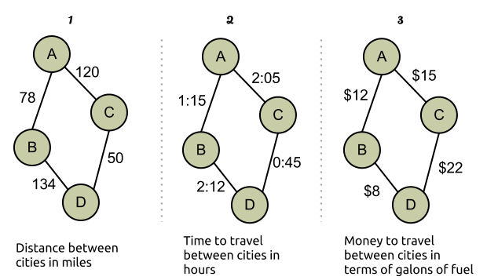
Weighted graphs in practice
https://dzone.com/articles/algorithm-week-dijkstra

Slide 6
Types of Graphs
directed vs. undirected
weighted vs. unweighted

Slide 7
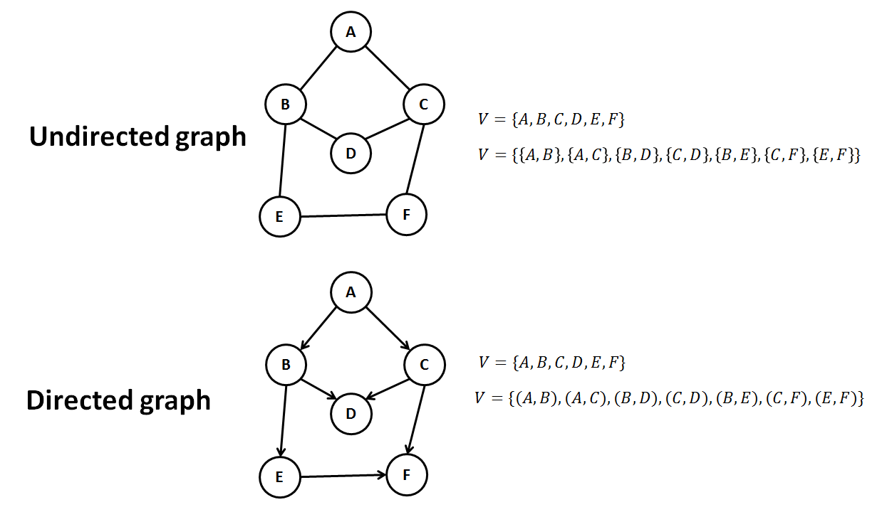
Directed vs. Undirected graphs

Slide 8
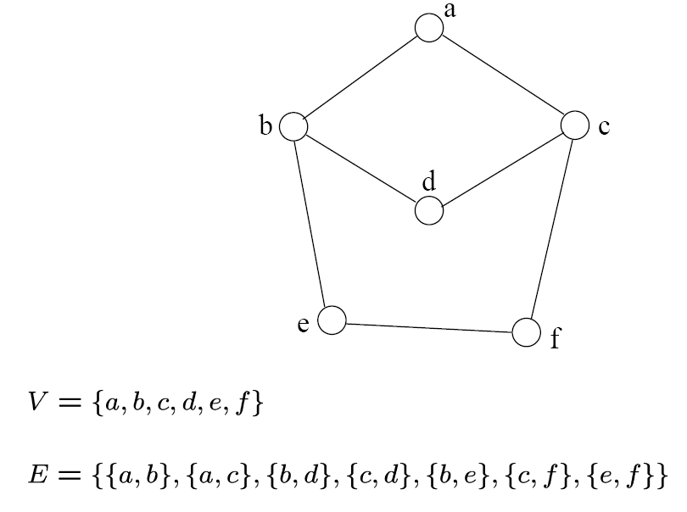
Definition
Undirected graph
An undirected graph is specified by an ordered pair (V,E), where V is the set of vertices and E is the set of edges
{a,b}
{a,c}
{b,d}
{c,d}
{b,e}
{c,f}
{e,f}

Slide 9
Terminology
If v₁ and v₂ are connected, they are said to be adjacent vertices
v₁ and v₂ are endpoints of the edge {v₁, v₂}
If an edge e is connected to v, then v is said to be incident on e. Also, the edge e is said to be incident on v.
{v₁, v₂} = {v₂, v₁}*
*Later, we will talk about “directed graphs”, where edges have direction. This means that {v₁,v₂} ≠ {v₂,v₁} . Directed graphs are drawn with arrows (called arcs) between edges.
A
B
This means {A,B} only, not {B,A}

Slide 10
Graph Representation
Two popular computer representations of a graph. Both represent the vertex set and the edge set, but in different ways.
Adjacency Matrix
Use a 2D matrix to represent the graph
Adjacency List
Use a 1D array of linked lists

Slide 11
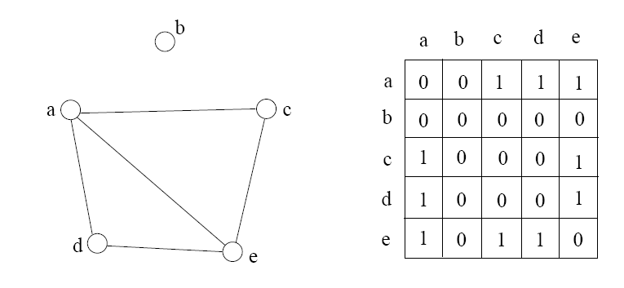
Adjacency Matrix
2D array A[n][n], where n is the number of vertices in the graph
Each row and column is indexed by the vertex id.
- e,g a=0, b=1, c=2, d=3, e=4
An array entry A [i] [j] is equal to 1 if there is an edge connecting vertices i and j. Otherwise, A [i] [j] is 0.
The storage requirement is Θ(n²). Not efficient if the graph has few edges.
We can detect in O(1) time whether two vertices are connected.

Slide 12
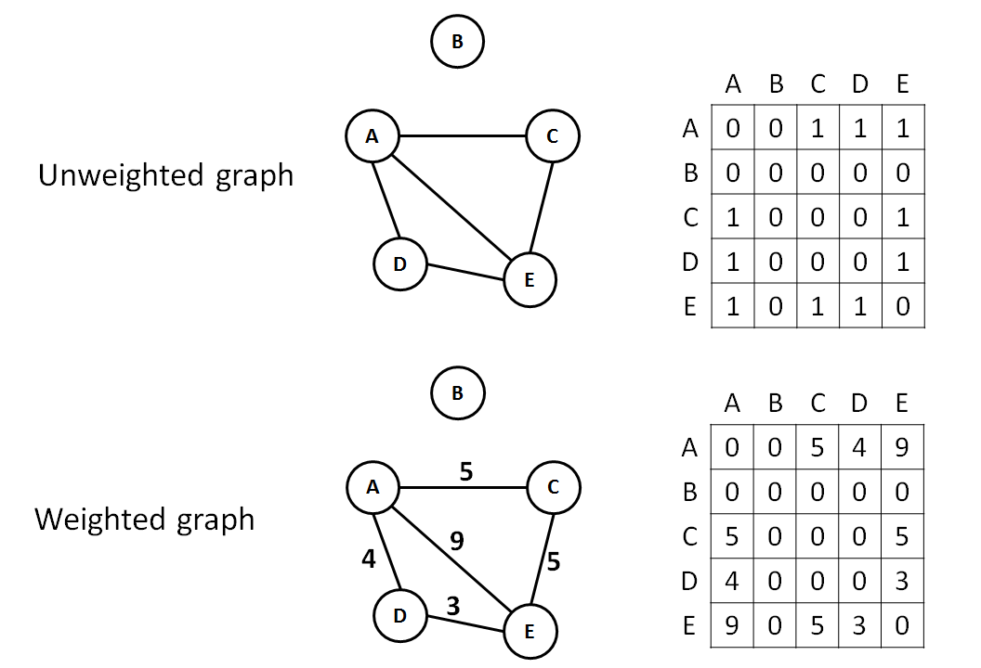
Adjacency matrix:
Weighted vs. Unweighted graphs

Slide 13
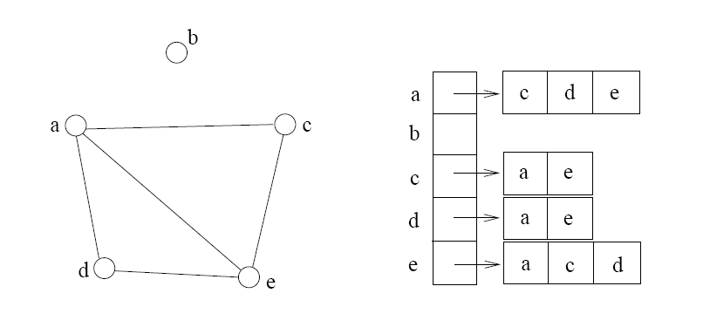
Adjacency list
The adjacency list is an array A[n-1] of lists, where n is the number of vertices in the graph.
Each array entry is indexed by the vertex id (as with adjacency matrix)
The list A[i] stores the ids of the vertices adjacent to i.

Slide 14
Example – Adjacency Matrix
0
 | 0 | 1 | 2 | 3 | 4 | 5 | 6 | 7 | 8 | 9
0 | 0 | 0 | 0 | 0 | 0 | 0 | 0 | 0 | 1 | 0
1 | 0 | 0 | 1 | 1 | 0 | 0 | 0 | 1 | 0 | 1
2 | 0 | 1 | 0 | 0 | 1 | 0 | 0 | 0 | 1 | 0
3 | 0 | 1 | 0 | 0 | 1 | 1 | 0 | 0 | 0 | 0
4 | 0 | 0 | 1 | 1 | 0 | 0 | 0 | 0 | 0 | 0
5 | 0 | 0 | 0 | 1 | 0 | 0 | 1 | 0 | 0 | 0
6 | 0 | 0 | 0 | 0 | 0 | 1 | 0 | 1 | 0 | 0
7 | 0 | 1 | 0 | 0 | 0 | 0 | 1 | 0 | 0 | 0
8 | 1 | 0 | 1 | 0 | 0 | 0 | 0 | 0 | 0 | 1
9 | 0 | 1 | 0 | 0 | 0 | 0 | 0 | 0 | 1 | 0
8
2
9
1
3
7
6
4
5

Slide 15
Example – Adjacency List
0
1
2
3
4
5
6
7
8
9
8
0
2 | 3 | 7 | 9
8
1 | 4 | 8
2
9
1 | 4 | 5
1
2 | 3
7
3 | 6
3
6
5 | 7
4
5
1 | 6
0 | 2 | 9
1 | 8

Slide 16
Storage of adjacency list
The array takes up Θ(n) space
Define degree of v, deg(v), to be the number of edges incident to v. Then, the total space to store the graph is proportional to:
An edge e={u,v} of the graph contributes a count of 1 to deg(u) and contributes a count 1 to deg(v)
Therefore, Σ_{vertex v}deg(v) = 2m, where m is the total number of edges

Slide 17
Storage of adjacency list
In all, the adjacency list takes up Θ(n+m) space.
If m = O(n²), both adjacent matrix and adjacent lists use Θ(n²) space.
If m = O(n), adjacent list outperform adjacent matrix
However, one cannot tell in O(1) time whether two vertices are connected.

Slide 18
Adjacency Lists vs. Matrix
Adjacency Lists
More compact than adjacency matrices if graph has few edges
Requires more time to find if an edge exists
Adjacency Matrix
Always require n² space
This can waste a lot of space if the number of edges are sparse
Can quickly find if an edge exists

Slide 19
Path between vertices
A path is a sequence of vertices (v₀, v₁, v₂,… v_{k}) such that:
For 0 ≤ i < k, {v_{i}, v_{i+1}} is an edge
For 0 ≤ i < k-1, v_{i} ≠ v_{i+2}
That is, the edge {v_{i}, v_{i+1}} ≠ {v_{i+1}, v_{i+2}}
Note: a path is allowed to go through the same vertex or the same edge any number of times!
The length of a path is the number of edges on the path

Slide 20
Types of paths
A path is simple if and only if it does not contain a vertex more than once.
A path is a cycle if and only if v₀= v_{k}
The beginning and end are the same vertex!
A path contains a cycle if some vertex appears twice or more

Slide 21
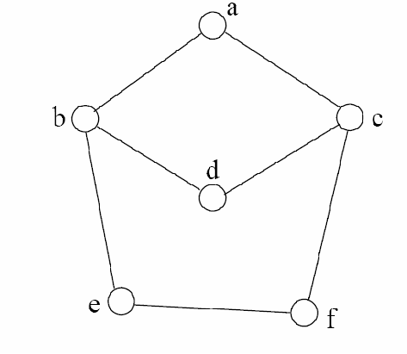
Examples
Are these paths?
Any cycles?
What is the path’s length?
{a,c,f,e}
{a,b,d,c,f,e}
{a, c, d, b, d, c, f, e}
{a,c,d,b,a}
{a,c,f,e,b,d,c,a}

Slide 22
Graph Traversal
Application example
Given a graph representation and a vertex s in the graph
Find all paths from s to other vertices
Two common graph traversal algorithms
Breadth-First Search (BFS)
Find the shortest paths in an unweighted graph
Depth-First Search (DFS)
Topological sort
Find strongly connected components
Let’s first look at BFS . . .

Slide 23
BFS and Shortest Path Problem
Given any source vertex s, BFS visits the other vertices at increasing distances away from s. In doing so, BFS discovers paths from s to other vertices
What do we mean by “distance”? The number of edges on a path from s.
Example
0
Consider s=vertex 1
8
2
Nodes at distance 1?
2, 3, 7, 9
1
2
s
9
1
1
Nodes at distance 2?
8, 6, 5, 4
7
1
3
6
2
4
1
5
Nodes at distance 3?
0
2
2

Slide 24
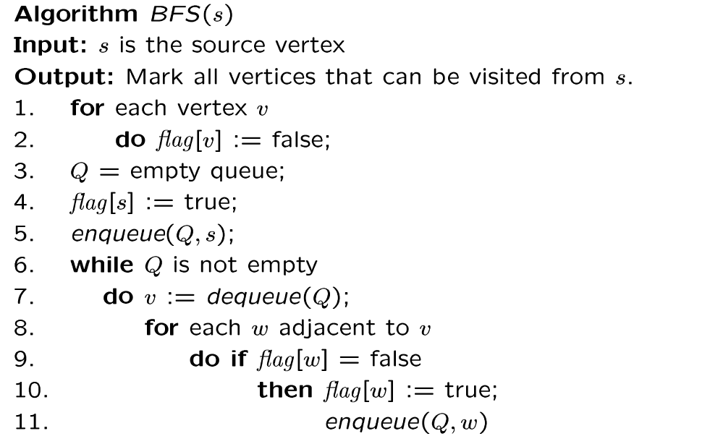
BSF algorithm
Why use queue? Need FIFO

Slide 25
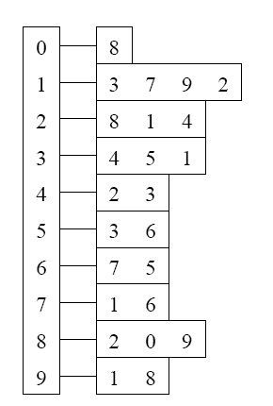
Example
Adjacency List
Visited Table (T/F)
0
1
2
3
4
5
6
7
8
9
F
F
F
F
F
F
F
F
F
F
0
8
source
2
9
1
3
7
6
4
5
Initialize visited
table (all False)
Q =
{ }
Initialize Q to be empty

Slide 26
Example
Adjacency List
Visited Table (T/F)
0
1
2
3
4
5
6
7
8
9
F
F
T
F
F
F
F
F
F
F
0
8
source
2
9
1
3
7
6
4
5
Flag that 2 has
been visited.
Q =
{ 2 }
Place source 2 on the queue.

Slide 27
Example
Adjacency List
Visited Table (T/F)
0
1
2
3
4
5
6
7
8
9
F
T
T
F
T
F
F
F
T
F
0
8
Neighbors
source
2
9
1
3
7
6
4
5
Mark neighbors
as visited.
Q =
{2} → { 8, 1, 4 }
Dequeue 2.
Place all unvisited neighbors of 2 on the queue

Slide 28
Example
Adjacency List
Visited Table (T/F)
0
1
2
3
4
5
6
7
8
9
T
T
T
F
T
F
F
F
T
T
0
8
source
2
9
1
3
7
Neighbors
6
4
5
Mark new visited
Neighbors.
Q =
{ 8, 1, 4 } → { 1, 4, 0, 9 }
Dequeue 8.
-- Place all unvisited neighbors of 8 on the queue.
-- Notice that 2 is not placed on the queue again, it has been visited!

Slide 29
Example
Adjacency List
Visited Table (T/F)
0
1
2
3
4
5
6
7
8
9
T
T
T
T
T
F
F
T
T
T
0
Neighbors
8
source
2
9
1
3
7
6
4
5
Mark new visited
Neighbors.
Q =
{ 1, 4, 0, 9 } → { 4, 0, 9, 3, 7 }
Dequeue 1.
-- Place all unvisited neighbors of 1 on the queue.
-- Only nodes 3 and 7 haven’t been visited yet.

Slide 30
Example
Adjacency List
Visited Table (T/F)
0
1
2
3
4
5
6
7
8
9
T
T
T
T
T
F
F
T
T
T
0
8
source
2
9
Neighbors
1
3
7
6
4
5
Q =
{ 4, 0, 9, 3, 7 } → { 0, 9, 3, 7 }
Dequeue 4.
-- 4 has no unvisited neighbors!

Slide 31
Example
Adjacency List
Visited Table (T/F)
Neighbors
0
1
2
3
4
5
6
7
8
9
T
T
T
T
T
F
F
T
T
T
0
8
source
2
9
1
3
7
6
4
5
Q =
{ 0, 9, 3, 7 } → { 9, 3, 7 }
Dequeue 0.
-- 0 has no unvisited neighbors!

Slide 32
Example
Adjacency List
Visited Table (T/F)
0
0
1
2
3
4
5
6
7
8
9
T
T
T
T
T
F
F
T
T
T
8
source
2
9
1
3
7
6
4
5
Neighbors
Q =
{ 9, 3, 7 } → { 3, 7 }
Dequeue 9.
-- 9 has no unvisited neighbors!

Slide 33
Example
Adjacency List
Visited Table (T/F)
0
1
2
3
4
5
6
7
8
9
T
T
T
T
T
T
F
T
T
T
0
8
Neighbors
source
2
9
1
3
7
6
4
5
Mark new visited
Vertex 5.
Q =
{ 3, 7 } → { 7, 5 }
Dequeue 3.
-- place neighbor 5 on the queue.

Slide 34
Example
Adjacency List
Visited Table (T/F)
0
1
2
3
4
5
6
7
8
9
T
T
T
T
T
T
T
T
T
T
0
8
source
2
9
1
7
Neighbors
3
6
4
5
Mark new visited
Vertex 6.
Q =
{ 7, 5 } → { 5, 6 }
Dequeue 7.
-- place neighbor 6 on the queue.

Slide 35
Example
Adjacency List
Visited Table (T/F)
0
1
2
3
4
5
6
7
8
9
T
T
T
T
T
T
T
T
T
T
0
8
source
2
9
Neighbors
1
3
7
6
4
5
Q =
{ 5, 6} → { 6 }
Dequeue 5.
-- no unvisited neighbors of 5.

Slide 36
Example
Adjacency List
Visited Table (T/F)
0
1
2
3
4
5
6
7
8
9
T
T
T
T
T
T
T
T
T
T
0
8
source
2
9
1
Neighbors
3
7
6
4
5
Q =
{ 6 } → { }
Dequeue 6.
-- no unvisited neighbors of 6.

Slide 37
Example
Adjacency List
Visited Table (T/F)
0
1
2
3
4
5
6
7
8
9
T
T
T
T
T
T
T
T
T
T
0
8
source
2
9
1
3
7
6
4
5
What did we discover?
Look at “visited” tables.
There exists a path from source
vertex 2 to all vertices in the graph.
Q =
{ }
STOP!!! Q is empty!!!

Slide 38
Shortest Path Recording
BFS we saw only tells us whether a path exists from source s, to other vertices v.
It doesn’t tell us the path!
We need to modify the algorithm to record the path.
How can we do that?
Note: we do not know which vertices lie on this path until we reach v!
Efficient solution:
Use an additional array pred[0..n-1]
Pred[w] = v means that vertex w was visited from v

Slide 39
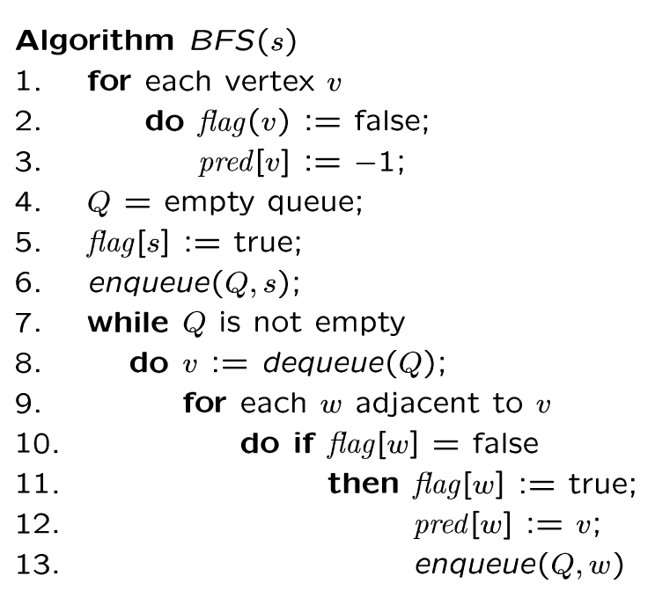
BFS + Path Finding
initialize all pred[v] to -1
Record where you came from

Slide 40
Example
Adjacency List
Visited Table (T/F)
0
1
2
3
4
5
6
7
8
9
F
F
F
F
F
F
F
F
F
F
-
-
-
-
-
-
-
-
-
-
0
8
source
2
9
1
3
7
6
4
5
Pred
Initialize visited
table (all False)
Initialize Pred to -1
Q =
{ }
Initialize Q to be empty

Slide 41
Example
Adjacency List
Visited Table (T/F)
0
1
2
3
4
5
6
7
8
9
F
F
T
F
F
F
F
F
F
F
-
-
-
-
-
-
-
-
-
-
0
8
source
2
9
1
3
7
6
4
5
Pred
Flag that 2 has
been visited.
Q =
{ 2 }
Place source 2 on the queue.

Slide 42
Example
Adjacency List
Visited Table (T/F)
0
1
2
3
4
5
6
7
8
9
F
T
T
F
T
F
F
F
T
F
-
2
-
-
2
-
-
-
2
-
0
8
Neighbors
source
2
9
1
3
7
6
4
5
Pred
Mark neighbors
as visited.
Record in Pred
that we came from 2.
Q =
{2} → { 8, 1, 4 }
Dequeue 2.
Place all unvisited neighbors of 2 on the queue

Slide 43
Example
Adjacency List
Visited Table (T/F)
0
1
2
3
4
5
6
7
8
9
T
T
T
F
T
F
F
F
T
T
8
2
-
-
2
-
-
-
2
8
0
8
source
2
9
1
3
7
Neighbors
6
4
5
Pred
Mark new visited
Neighbors.
Record in Pred
that we came from 8.
Q =
{ 8, 1, 4 } → { 1, 4, 0, 9 }
Dequeue 8.
-- Place all unvisited neighbors of 8 on the queue.
-- Notice that 2 is not placed on the queue again, it has been visited!

Slide 44
Example
Adjacency List
Visited Table (T/F)
0
1
2
3
4
5
6
7
8
9
T
T
T
T
T
F
F
T
T
T
8
2
-
1
2
-
-
1
2
8
0
Neighbors
8
source
2
9
1
3
7
6
4
5
Pred
Mark new visited
Neighbors.
Record in Pred
that we came from 1.
Q =
{ 1, 4, 0, 9 } → { 4, 0, 9, 3, 7 }
Dequeue 1.
-- Place all unvisited neighbors of 1 on the queue.
-- Only nodes 3 and 7 haven’t been visited yet.

Slide 45
Example
Adjacency List
Visited Table (T/F)
0
1
2
3
4
5
6
7
8
9
T
T
T
T
T
F
F
T
T
T
8
2
-
1
2
-
-
1
2
8
0
8
2
Neighbors
source
9
1
3
7
6
4
5
Pred
Q =
{ 4, 0, 9, 3, 7 } → { 0, 9, 3, 7 }
Dequeue 4.
-- 4 has no unvisited neighbors!

Slide 46
Example
Adjacency List
Visited Table (T/F)
Neighbors
0
1
2
3
4
5
6
7
8
9
T
T
T
T
T
F
F
T
T
T
8
2
-
1
2
-
-
1
2
8
0
8
source
2
9
1
3
7
6
4
5
Pred
Q =
{ 0, 9, 3, 7 } → { 9, 3, 7 }
Dequeue 0.
-- 0 has no unvisited neighbors!

Slide 47
Example
Adjacency List
Visited Table (T/F)
0
1
2
3
4
5
6
7
8
9
T
T
T
T
T
F
F
T
T
T
8
2
-
1
2
-
-
1
2
8
0
8
source
2
9
1
3
7
6
4
5
Neighbors
Pred
Q =
{ 9, 3, 7 } → { 3, 7 }
Dequeue 9.
-- 9 has no unvisited neighbors!

Slide 48
Example
Adjacency List
Visited Table (T/F)
0
1
2
3
4
5
6
7
8
9
T
T
T
T
T
T
F
T
T
T
8
2
-
1
2
3
-
1
2
8
0
8
Neighbors
source
2
9
1
3
7
6
4
5
Pred
Mark new visited
Vertex 5.
Record in Pred
that we came from 3.
Q =
{ 3, 7 } → { 7, 5 }
Dequeue 3.
-- place neighbor 5 on the queue.

Slide 49
Example
Adjacency List
Visited Table (T/F)
0
1
2
3
4
5
6
7
8
9
T
T
T
T
T
T
T
T
T
T
8
2
-
1
2
3
7
1
2
8
0
8
source
2
9
1
7
Neighbors
3
6
4
5
Pred
Mark new visited
Vertex 6.
Record in Pred
that we came from 7.
Q =
{ 7, 5 } → { 5, 6 }
Dequeue 7.
-- place neighbor 6 on the queue.

Slide 50
Example
Adjacency List
Visited Table (T/F)
0
1
2
3
4
5
6
7
8
9
T
T
T
T
T
T
T
T
T
T
8
2
-
1
2
3
7
1
2
8
0
8
source
2
9
Neighbors
1
3
7
6
4
5
Pred
Q =
{ 5, 6} → { 6 }
Dequeue 5.
-- no unvisited neighbors of 5.

Slide 51
Example
Adjacency List
Visited Table (T/F)
0
1
2
3
4
5
6
7
8
9
T
T
T
T
T
T
T
T
T
T
8
2
-
1
2
3
7
1
2
8
0
8
source
2
9
1
Neighbors
3
7
6
4
5
Pred
Q =
{ 6 } → { }
Dequeue 6.
-- no unvisited neighbors of 6.

Slide 52
Example
Adjacency List
Visited Table (T/F)
0
1
2
3
4
5
6
7
8
9
T
T
T
T
T
T
T
T
T
T
8
2
-
1
2
3
7
1
2
8
0
8
source
2
9
1
3
7
6
4
5
Pred
Pred now can be traced backward
to report the path!
Q =
{ }
STOP!!! Q is empty!!!

Slide 53
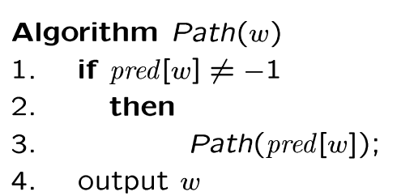
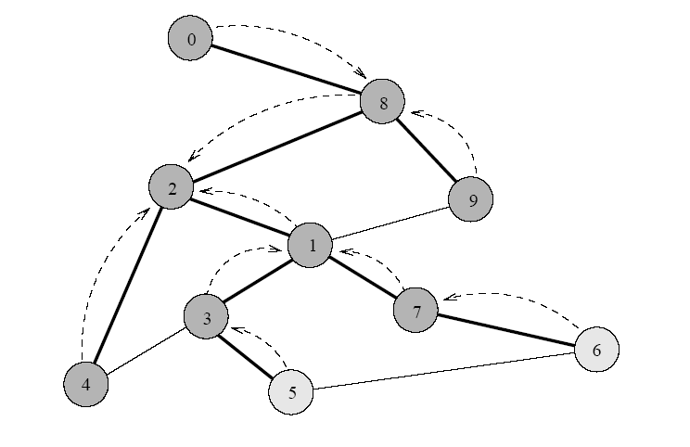
Path reporting
nodes
visited from
0
1
2
3
4
5
6
7
8
9
8
2
-
1
2
3
7
1
2
8
Try some examples, report path from s to v:
Path(0) ->
Path(6) ->
Path(1) ->
The path returned is the shortest from s to v (minimum number of edges).

Slide 54
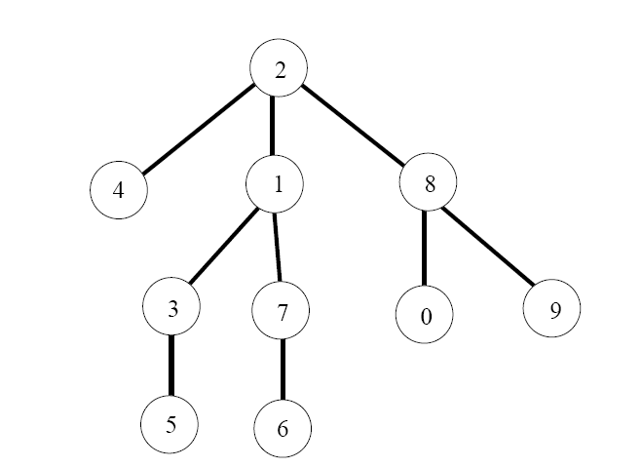
BFS tree
The paths found by BFS is often drawn as a rooted tree (called BFS tree), with the starting vertex as the root of the tree.
BFS tree for vertex s=2.
Question: What would a “level” order traversal tell you?

Slide 55
How do we record the shortest distances?
d(v) = ∞;
d(s) = 0;
d(w)=d(v)+1;

Slide 56
Application of BFS
One application concerns how to find
connected components in a graph
If a graph has more than one connected components, BFS builds a BFS-forest (not just BFS-tree)!
Each tree in the forest is a connected component.

Slide 57
End of slides

