Slide 1
GRAPHS: Depth-first search

Slide 2
Depth-First Search (DFS)
DFS is another popular graph search strategy
Idea is similar to pre-order traversal (visit children first)
DFS can provide certain information about the graph that BFS cannot
It can tell whether we have encountered a cycle or not

Slide 3
DFS Algorithm
DFS will continue to visit neighbors in a recursive pattern
Whenever we visit v from u, we recursively visit all unvisited neighbors of v. Then we backtrack (return) to u.
Note: it is possible that w2 was unvisited when we recursively visit w1, but became visited by the time we return from the recursive call.
u
v
w3
w1
w2

Slide 4
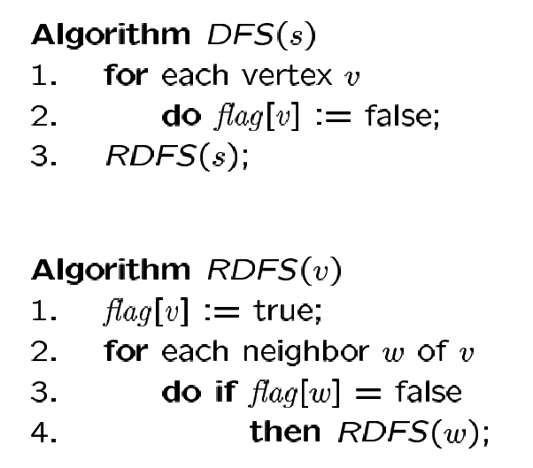
DFS Algorithm
Flag all vertices as not visited
Flag yourself as visited
For unvisited neighbors, call RDFS(w) recursively
We can also record the paths using pred[ ].

Slide 5
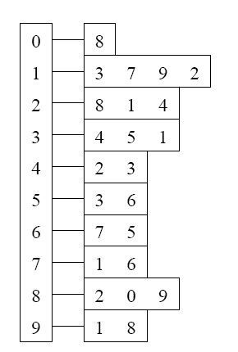
Example
Adjacency List
Visited Table (T/F)
0
0
1
2
3
4
5
6
7
8
9
F
F
F
F
F
F
F
F
F
F
-
-
-
-
-
-
-
-
-
-
8
source
2
9
1
3
7
6
4
5
Pred
Initialize visited
table (all False)
Initialize Pred to -1

Slide 6
Example
Adjacency List
Visited Table (T/F)
0
0
1
2
3
4
5
6
7
8
9
F
F
T
F
F
F
F
F
F
F
-
-
-
-
-
-
-
-
-
-
8
2
9
source
1
3
7
6
4
5
Pred
Mark 2 as visited
RDFS( 2 )
Now visit RDFS(8)

Slide 7
Example
Adjacency List
Visited Table (T/F)
0
8
0
1
2
3
4
5
6
7
8
9
F
F
T
F
F
F
F
F
T
F
-
-
-
-
-
-
-
-
2
-
source
2
9
1
3
7
6
4
5
Pred
Mark 8 as visited
mark Pred[8]
Recursive calls
RDFS( 2 )
RDFS(8)
2 is already visited, so visit RDFS(0)

Slide 8
Example
Adjacency List
Visited Table (T/F)
0
8
0
1
2
3
4
5
6
7
8
9
T
F
T
F
F
F
F
F
T
F
8
-
-
-
-
-
-
-
2
-
source
2
9
1
3
7
6
4
5
Pred
Mark 0 as visited
Mark Pred[0]
Recursive calls
RDFS( 2 )
RDFS(8)
RDFS(0) -> no unvisited neighbors, return
to call RDFS(8)

Slide 9
Example
Back to 8
Adjacency List
Visited Table (T/F)
0
8
0
1
2
3
4
5
6
7
8
9
T
F
T
F
F
F
F
F
T
F
8
-
-
-
-
-
-
-
2
-
source
2
9
1
3
7
6
4
5
Pred
Recursive calls
RDFS( 2 )
RDFS(8)
Now visit 9 -> RDFS(9)

Slide 10
Example
Adjacency List
Visited Table (T/F)
0
8
0
1
2
3
4
5
6
7
8
9
T
F
T
F
F
F
F
F
T
T
8
-
-
-
-
-
-
-
2
8
source
2
9
1
3
7
6
4
5
Pred
Mark 9 as visited
Mark Pred[9]
Recursive calls
RDFS( 2 )
RDFS(8)
RDFS(9)
-> visit 1, RDFS(1)

Slide 11
Example
Adjacency List
Visited Table (T/F)
0
8
0
1
2
3
4
5
6
7
8
9
T
T
T
F
F
F
F
F
T
T
8
9
-
-
-
-
-
-
2
8
source
2
9
1
3
7
6
4
5
Pred
Mark 1 as visited
Mark Pred[1]
Recursive calls
RDFS( 2 )
RDFS(8)
RDFS(9)
RDFS(1)
visit RDFS(3)

Slide 12
Example
Adjacency List
Visited Table (T/F)
0
8
0
1
2
3
4
5
6
7
8
9
T
T
T
T
F
F
F
F
T
T
8
9
-
1
-
-
-
-
2
8
source
2
9
1
3
7
6
4
5
Pred
Mark 3 as visited
Mark Pred[3]
Recursive calls
RDFS( 2 )
RDFS(8)
RDFS(9)
RDFS(1)
RDFS(3)
visit RDFS(4)

Slide 13
Example
Adjacency List
Visited Table (T/F)
0
8
0
1
2
3
4
5
6
7
8
9
T
T
T
T
T
F
F
F
T
T
8
9
-
1
3
-
-
-
2
8
source
2
9
1
3
7
6
4
5
Pred
RDFS( 2 )
RDFS(8)
RDFS(9)
RDFS(1)
RDFS(3)
RDFS(4) → STOP all of 4’s neighbors have been visited
return back to call RDFS(3)
Mark 4 as visited
Mark Pred[4]
Recursive calls

Slide 14

Example
Adjacency List
Visited Table (T/F)
0
8
0
1
2
3
4
5
6
7
8
9
T
T
T
T
T
F
F
F
T
T
8
9
-
1
3
-
-
-
2
8
source
2
9
1
3
7
6
4
5
Back to 3
Pred
RDFS( 2 )
RDFS(8)
RDFS(9)
RDFS(1)
RDFS(3)
visit 5 -> RDFS(5)
Recursive calls

Slide 15
Example
Adjacency List
Visited Table (T/F)
0
8
0
1
2
3
4
5
6
7
8
9
T
T
T
T
T
T
F
F
T
T
8
9
-
1
3
3
-
-
2
8
source
2
9
1
3
7
6
4
5
Pred
RDFS( 2 )
RDFS(8)
RDFS(9)
RDFS(1)
RDFS(3)
RDFS(5)
3 is already visited, so visit 6 -> RDFS(6)
Recursive calls
Mark 5 as visited
Mark Pred[5]

Slide 16
Example
Adjacency List
Visited Table (T/F)
0
8
0
1
2
3
4
5
6
7
8
9
T
T
T
T
T
T
T
F
T
T
8
9
-
1
3
3
5
-
2
8
source
2
9
1
3
7
6
4
5
RDFS( 2 )
RDFS(8)
RDFS(9)
RDFS(1)
RDFS(3)
RDFS(5)
RDFS(6)
visit 7 -> RDFS(7)
Pred
Recursive calls
Mark 6 as visited
Mark Pred[6]

Slide 17
Example
Adjacency List
Visited Table (T/F)
0
8
0
1
2
3
4
5
6
7
8
9
T
T
T
T
T
T
T
T
T
T
8
9
-
1
3
3
5
6
2
8
source
2
9
1
3
7
6
4
5
Pred
RDFS( 2 )
RDFS(8)
RDFS(9)
RDFS(1)
RDFS(3)
RDFS(5)
RDFS(6)
RDFS(7) -> Stop no more unvisited neighbors
Recursive calls
Mark 7 as visited
Mark Pred[7]

Slide 18
Example
Adjacency List
Visited Table (T/F)
0
0
1
2
3
4
5
6
7
8
9
T
T
T
T
T
T
T
T
T
T
8
9
-
1
3
3
5
6
2
8
8
source
2
9
1
3
7
6
4
5
RDFS( 2 )
RDFS(8)
RDFS(9)
RDFS(1)
RDFS(3)
RDFS(5)
RDFS(6) -> Stop
Pred
Recursive calls

Slide 19
Example
Adjacency List
Visited Table (T/F)
0
0
1
2
3
4
5
6
7
8
9
T
T
T
T
T
T
T
T
T
T
8
9
-
1
3
3
5
6
2
8
8
source
2
9
1
3
7
6
4
5
RDFS( 2 )
RDFS(8)
RDFS(9)
RDFS(1)
RDFS(3)
RDFS(5) -> Stop
Pred
Recursive calls

Slide 20
Example
Adjacency List
Visited Table (T/F)
0
0
1
2
3
4
5
6
7
8
9
T
T
T
T
T
T
T
T
T
T
8
9
-
1
3
3
5
6
2
8
8
source
2
9
1
3
7
6
4
5
RDFS( 2 )
RDFS(8)
RDFS(9)
RDFS(1)
RDFS(3) -> Stop
Pred
Recursive calls

Slide 21
Example
Adjacency List
Visited Table (T/F)
0
0
1
2
3
4
5
6
7
8
9
T
T
T
T
T
T
T
T
T
T
8
9
-
1
3
3
5
6
2
8
8
source
2
9
1
3
7
6
4
5
RDFS( 2 )
RDFS(8)
RDFS(9)
RDFS(1) -> Stop
Pred
Recursive calls

Slide 22
Example
Adjacency List
Visited Table (T/F)
0
0
1
2
3
4
5
6
7
8
9
T
T
T
T
T
T
T
T
T
T
8
9
-
1
3
3
5
6
2
8
8
source
2
9
1
3
7
6
4
5
RDFS( 2 )
RDFS(8)
RDFS(9) -> Stop
Pred
Recursive calls

Slide 23
Example
Adjacency List
Visited Table (T/F)
0
0
1
2
3
4
5
6
7
8
9
T
T
T
T
T
T
T
T
T
T
8
9
-
1
3
3
5
6
2
8
8
source
2
9
1
3
7
6
4
5
RDFS( 2 )
RDFS(8) -> Stop
Pred
Recursive calls

Slide 24
Example
Adjacency List
Visited Table (T/F)
0
0
1
2
3
4
5
6
7
8
9
T
T
T
T
T
T
T
T
T
T
8
9
-
1
3
3
5
6
2
8
8
source
2
9
1
3
7
6
4
5
RDFS( 2 ) -> Stop
Pred
Recursive calls

Slide 25
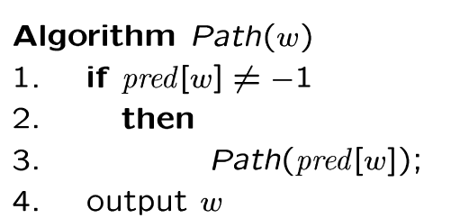
Example
0
Adjacency List
Visited Table (T/F)
8
0
1
2
3
4
5
6
7
8
9
T
T
T
T
T
T
T
T
T
T
8
9
-
1
3
3
5
6
2
8
source
2
9
1
3
7
6
4
5
Check our paths, does DFS find valid paths? Yes.
Pred
Try some examples.
Path(0) ->
Path(6) ->
Path(7) ->

Slide 26
Time Complexity of DFS (Using adjacency list)
We never visited a vertex more than once
We had to examine all edges of the vertices
We know Σ_{vertex v} degree(v) = 2m where m is the number of edges
So, the running time of DFS is proportional to the number of edges and number of vertices (same as BFS)
O(n + m)
You will also see this written as:
O(|v|+|e|) |v| = number of vertices (n) |e| = number of edges (m)

Slide 27
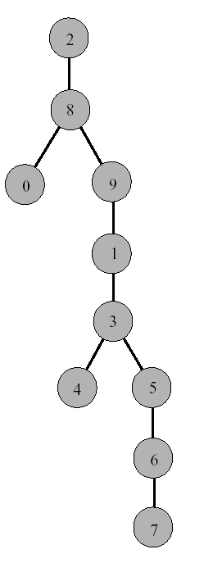
DFS Tree
Resulting DFS-tree.
Notice it is much “deeper”
than the BFS tree.
Captures the structure of the recursive calls
when we visit a neighbor w of v, we add w as child of v
whenever DFS returns from a vertex v, we climb up in the tree from v to its parent

Slide 28
END OF SLIDES

