Slide 1
HASHING

Slide 2
HASH TABLES
Created to support the following operations
Find
Insert
Delete. (deletions may be unnecessary in some applications)

Slide 3
HASH TABLES
Unlike binary search tree, AVL tree and B+-tree, the following functions cannot be done:
Minimum and maximum
Successor and predecessor
Report data within a given range
List out the data in order

Slide 4
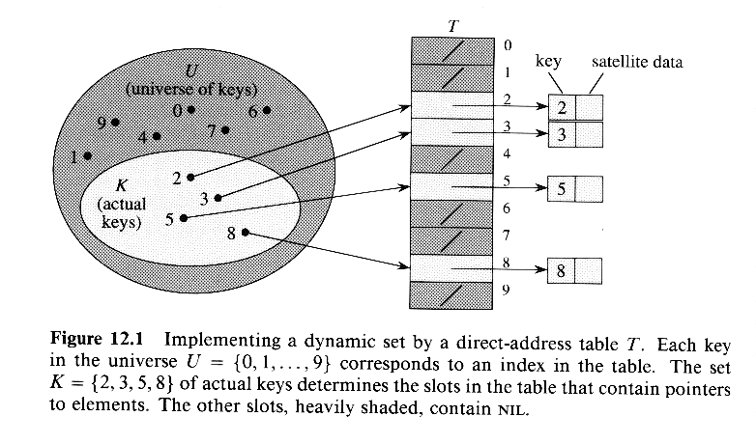
UNREALISTIC SOLUTION
Each position (slot) corresponds to a key in the universe of keys
Table T[k] corresponds to an element with key k
If the set contains no element with key k, then T[k]=NULL

Slide 5
UNREALISTIC SOLUTION
Advantage: insert, delete and find all take O(1) (worst-case) time
Problem:
The scheme wastes too much space if the universe is too large compared with the actual number of elements to be stored.
E.g. student IDs are 8-digit integers, so the universe size is 10⁸, but we only have about 7000 students

Slide 6
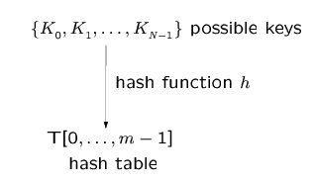
HASHING
Usually, size of m << size of N.
The hash function h(K_{i}) = an integer in [0, …, m-1] called the hash value of the key K_{i}

Slide 7
EXAMPLE APPLICATIONS
Compilers use hash tables (symbol table) to keep track of declared variables.
On-line spell checkers. After prehashing the entire dictionary, one can check each word in constant time and print out the misspelled word in order of their appearance in the document.
Useful in applications when the input keys come in sorted order. This is a bad case for binary search tree. AVL tree and B+-tree are harder to implement and they are not necessarily more efficient.

Slide 8
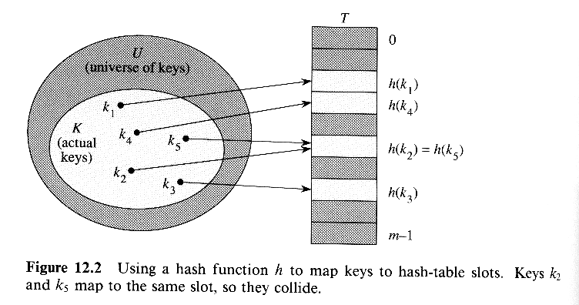
HASHING
With hashing, an element of key k is stored in T[h(k)]
h: hash function
maps the universe U of keys into the slots of a hash table T[0,1,...,m-1]
an element of key k hashes to slot h(k)
h(k) is the hash value of key k

Slide 9
HASHING
Problem: collision
two keys may hash to the same slot
can we ensure that any two distinct keys get different cells?
No, if |U|>m, where m is the size of the hash table

Slide 10
HASHING
Design a good hash function
that is fast to compute and
can minimize the number of collisions
Design a method to resolve the collisions when they occur

Slide 11
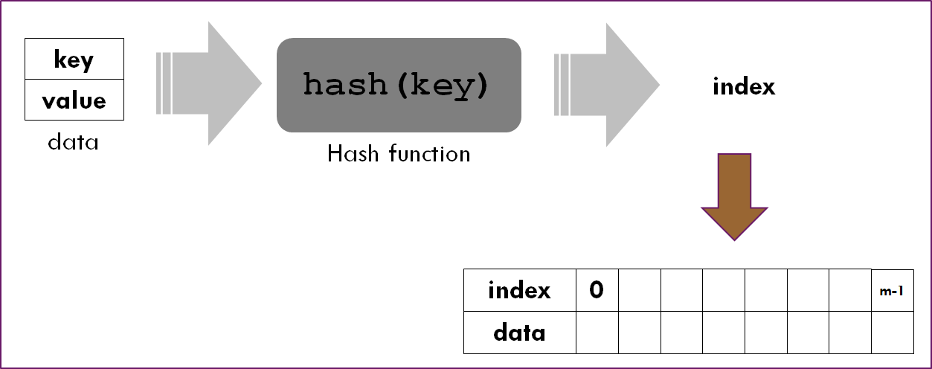
Hashing

Slide 12
Examples of Hash Functions
Modulo operation
Mid-Square
Folding

Slide 13
1. Modulo operation
The division method
h(k) = k mod m
e.g. m=12, k=100, h(k)=4
Requires only a single division operation (quite fast)
Certain values of m should be avoided
e.g. if m=2^{p}, then h(k) is just the p lowest-order bits of k; the hash function does not depend on all the bits
Similarly, if the keys are decimal numbers, should not set m to be a power of 10
It’s a good practice to set the table size m to be a prime number
Good values for m: primes not too close to exact powers of 2
e.g. the hash table is to hold 2000 numbers, and we don’t mind an average of 3 numbers being hashed to the same entry
choose m=701

Slide 14
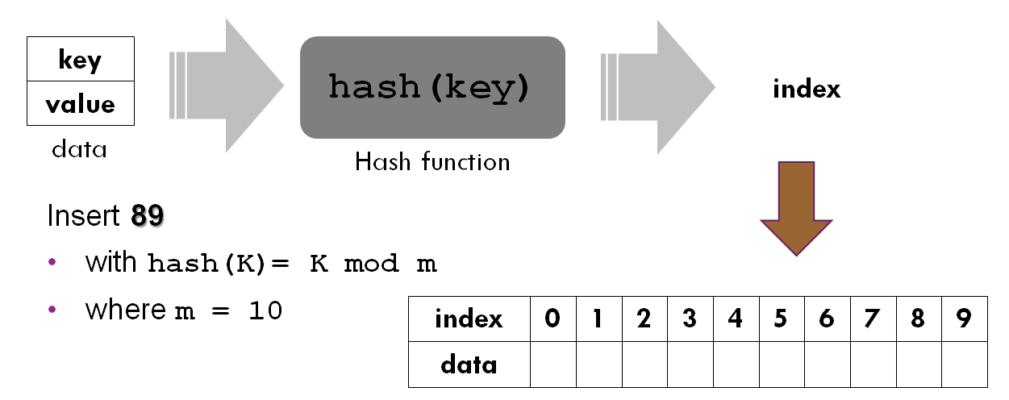
Example: Hashing using Modulo

Slide 15
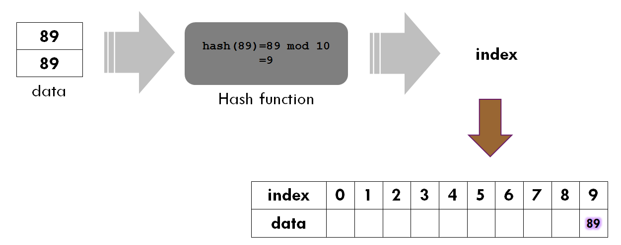
Example: Modulo function

Slide 16
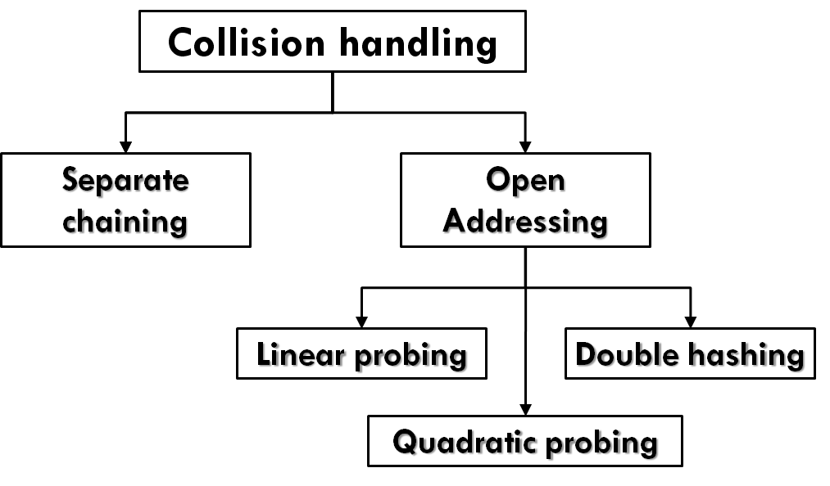
COLLISION HANDLING

Slide 17
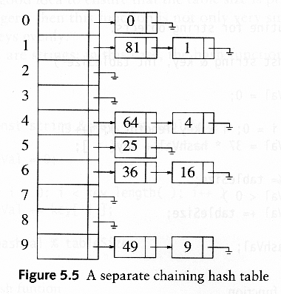
COLLISION HANDLING: (1) SEPARATE CHAINING
Instead of a hash table, we use a table of linked list
keep a linked list of keys that hash to the same value
h(K) = K mod 10

Slide 18
SEPARATE CHAINING
To insert a key K
Compute h(K) to determine which list to traverse
If T[h(K)] contains a null pointer, initialize this entry to point to a linked list that contains K alone.
If T[h(K)] is a non-empty list, we add K at the beginning of this list.

Slide 19
SEPARATE CHAINING
To Retrieve a key K
Compute h(K) to determine which list to traverse
If T[h(K)] contains a null pointer, then key is not found
If T[h(K)] is a non-empty list, search the T[h(k)] list.

Slide 20
SEPARATE CHAINING
To delete a key K
compute h(K), then search for K within the list at T[h(K)]. Delete K if it is found.

Slide 21
How to determine hashtable size, m
Assume that we will be storing n keys. Then we should make m the next larger prime number. If the hash function works well, the number of keys in each linked list will be a small constant.
Therefore, we expect that each search, insertion, and deletion can be done in constant time.
Disadvantage: Memory allocation in linked list manipulation will slow down the program.
Advantage: deletion is easy.

Slide 22
COLLISION HANDLING: (2) OPEN ADDRESSING
Open addressing:
relocate the key K to be inserted if it collides with an existing key. That is, we store K at an entry different from T[h(K)].
Two issues arise
what is the relocation scheme?
how to search for K later?

Slide 23
3 METHODS FOR OPEN ADDRESSING
Three common methods for resolving a collision in open addressing
Linear probing
Quadratic probing
Double hashing

Slide 24
OPEN ADDRESSING
To insert a key K, compute h₀(K).
If T[h₀(K)] is empty, insert it there.
If collision occurs, probe alternative cell h₁(K), h₂(K), .... until an empty cell is found.
h_{i}(K) = hash[hash(K) + f(i)]
f: collision resolution strategy

Slide 25
LINEAR PROBING
f(i) =i
cells are probed sequentially (with wraparound)
h_{i}(K) = hash[ hash(K) + i ], i = 1, 2, 3, …. m
If we cannot find an empty entry to put K, it means that the table is full and we should report an error.

Slide 26
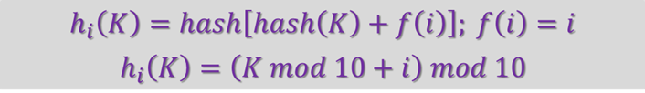
Linear probing
Insert keys 89, 18, 49, 58, 69, 6
with hash(K)=K mod 10

Slide 27
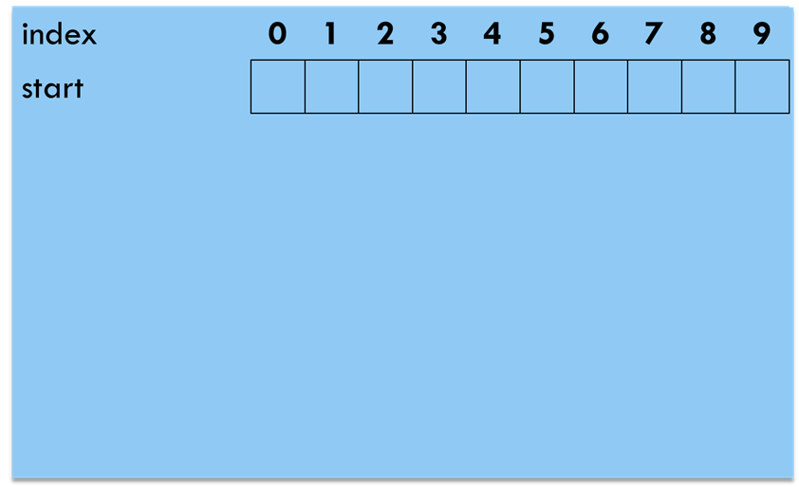
Linear probing
Insert keys 89, 18, 49, 58, 69, 6 with hash(K)=K mod 10

Slide 28
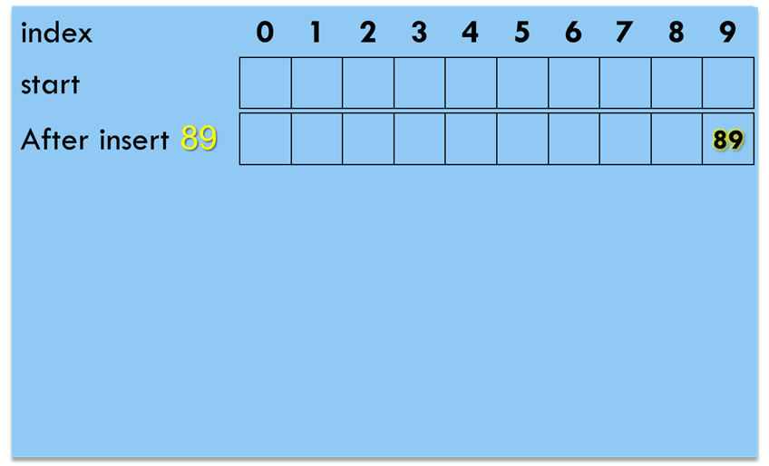
Linear probing
Insert key 89
To insert 89, probe
T[9]

Slide 29
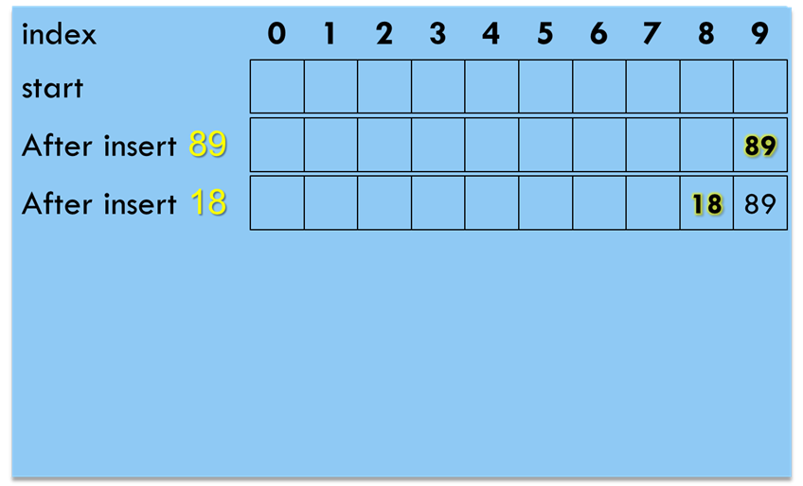
Linear probing
Insert keys 89, 18
To insert 18, probe
T[8]

Slide 30
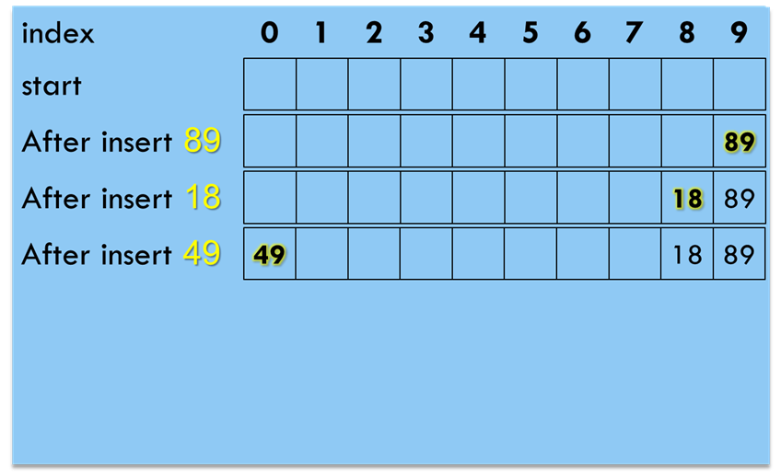
Linear probing
Insert keys 89, 18, 49
To insert 49, probe
T[9]
T[(9+1) mod 10]

Slide 31
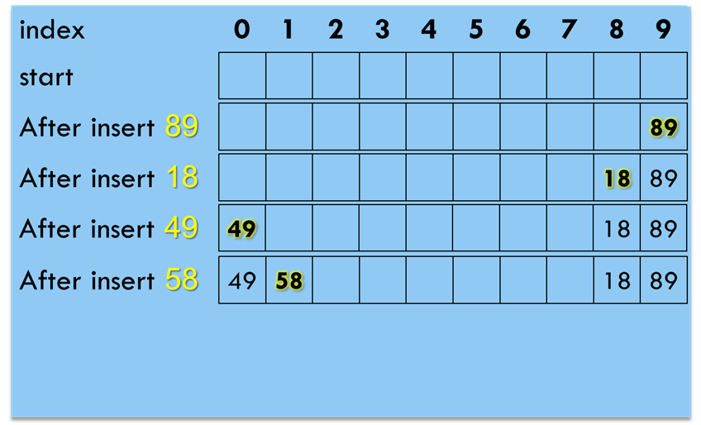
Linear probing
Insert keys 89, 18, 49, 58
To insert 58, probe
T[8]
T[(8+1) mod 10]
T[(8+2) mod 10]

Slide 32
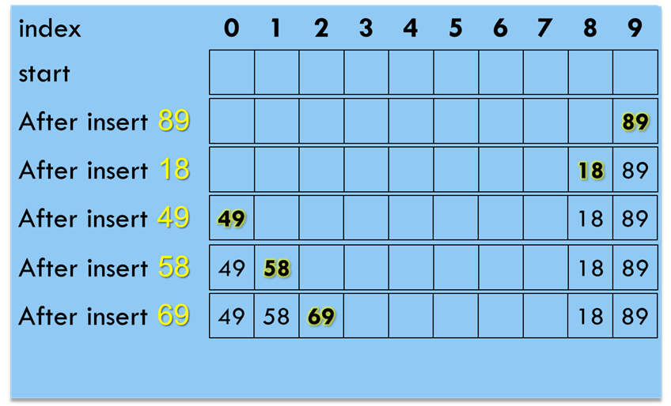
Linear probing
Insert keys 89, 18, 49, 58, 69
To insert 69, probe
T[9]
T[(9+1) mod 10]
T[(9+2) mod 10]
T[(9+3) mod 10]

Slide 33
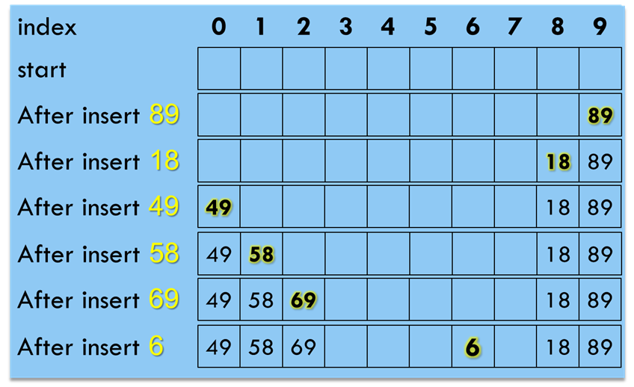
Linear probing
Insert keys 89, 18, 49, 58, 69, 6
To insert 6, probe
T[6]

Slide 34
PRIMARY CLUSTERING
We call a block of contiguously occupied table entries a cluster
On the average, when we insert a new key K, we may hit the middle of a cluster. Therefore, the time to insert K would be proportional to half the size of a cluster. That is, the larger the cluster, the slower the performance.

Slide 35
PRIMARY CLUSTERING...
Linear probing has the following disadvantages:
Once h(K) falls into a cluster, this cluster will definitely grow in size by one. Thus, this may worsen the performance of insertion in the future.
If two cluster are only separated by one entry, then inserting one key into a cluster can merge the two clusters together. Thus, the cluster size can increase drastically by a single insertion. This means that the performance of insertion can deteriorate drastically after a single insertion.
Large clusters are easy targets for collisions.

Slide 36
QUADRATIC PROBING
If the table size is prime, then a new key can always be inserted if the table is at least half empty (see proof in text book)

Slide 37
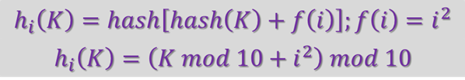
Quadratic probing
Insert keys 89, 18, 49, 58, 69, 6
with hash(K)=K mod 10

Slide 38
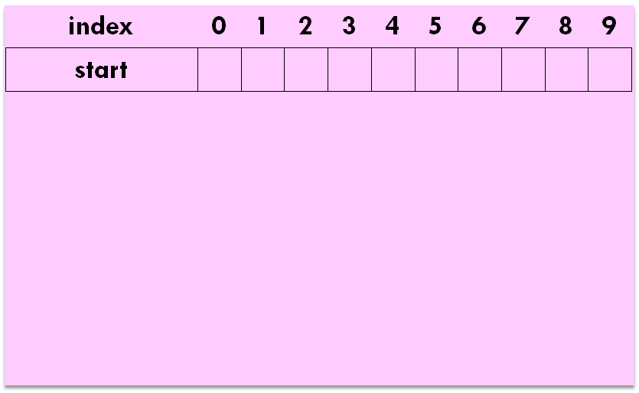
Quadratic probing
Insert keys 89, 18, 49, 58, 69, 6 with hash(K)=K mod 10

Slide 39
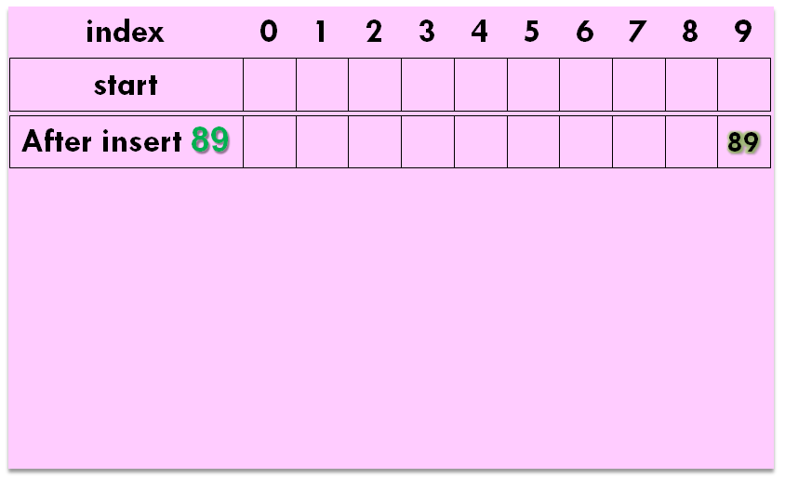
Quadratic probing
Insert key 89
To insert 89, probe
T[9]

Slide 40
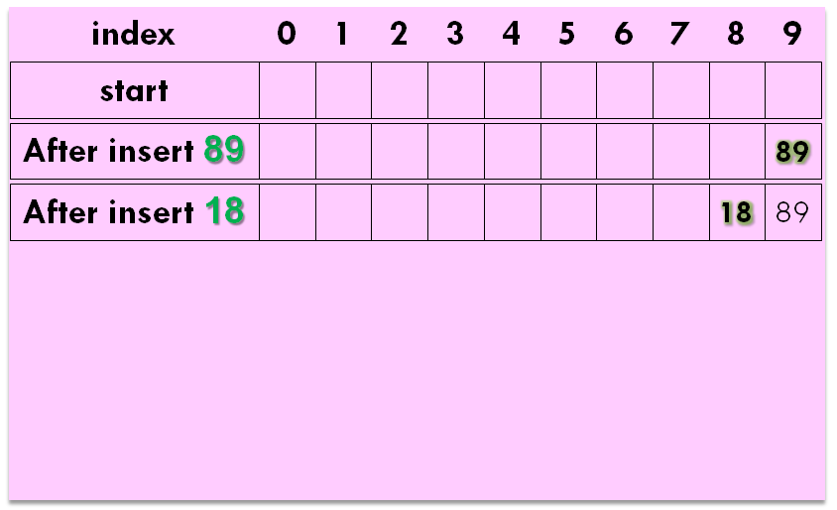
Quadratic probing
Insert keys 89, 18
To insert 18, probe
T[8]

Slide 41
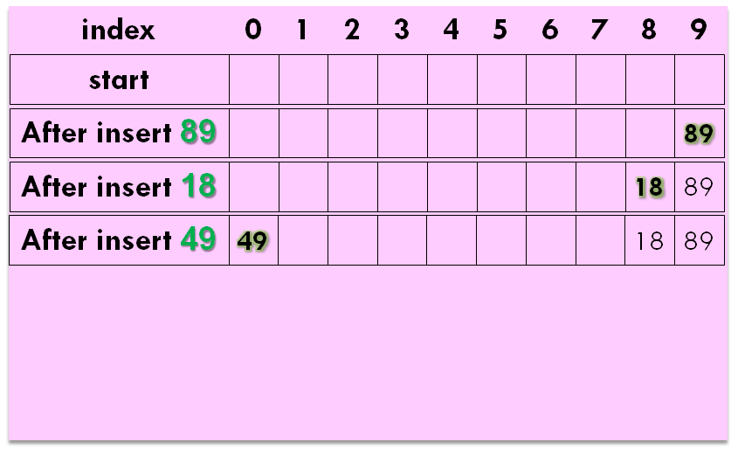
Quadratic probing
Insert keys 89, 18, 49
To insert 49, probe
T[9]
T[(9+1) mod 10]

Slide 42
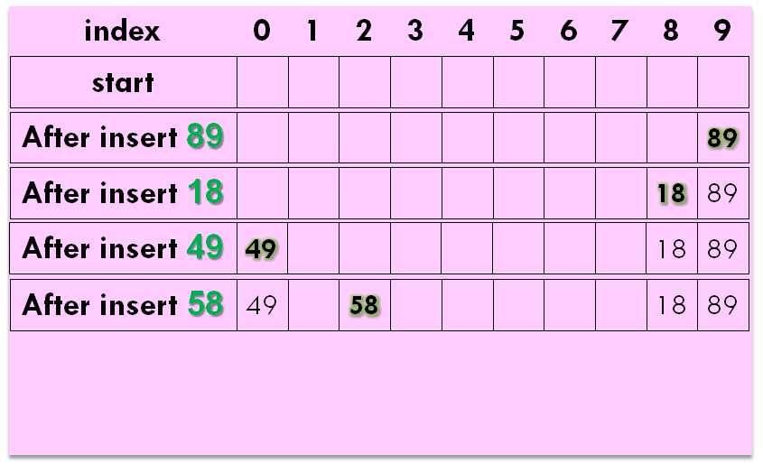
Quadratic probing
Insert keys 89, 18, 49, 58
To insert 58, probe
T[8],
T[(8+1) mod 10]
T[(8+4) mod 10]

Slide 43
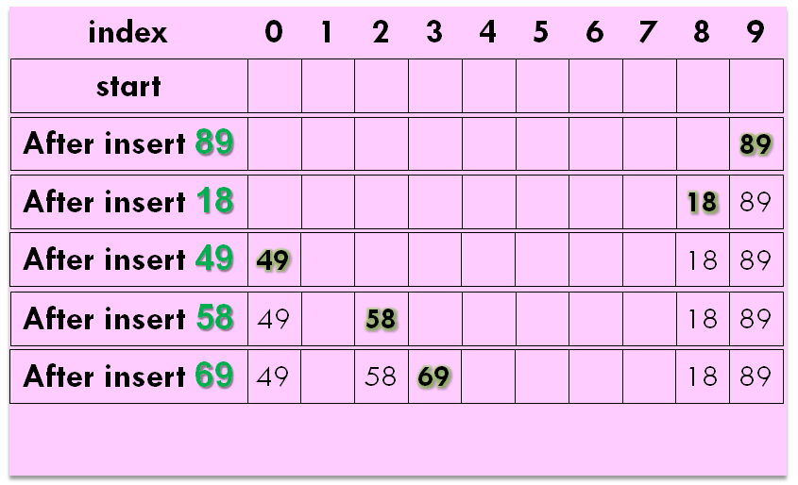
Quadratic probing
Insert keys 89, 18, 49, 58, 69
To insert 69, probe
T[9]
T[(9+1) mod 10]
T[(9+4) mod 10]

Slide 44
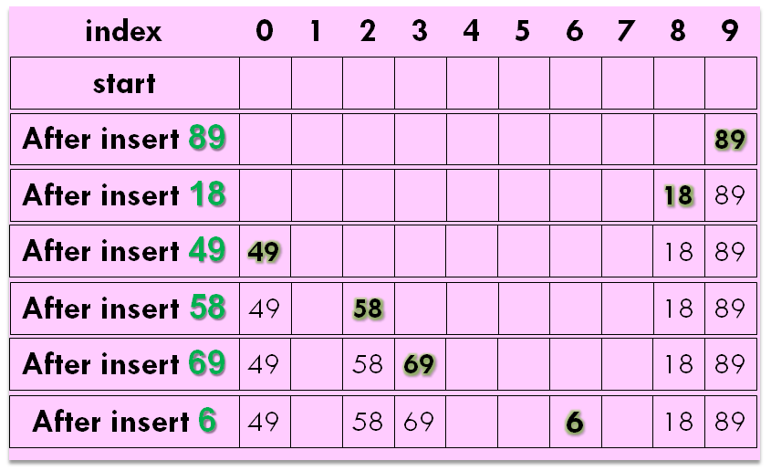
Quadratic probing
Insert keys 89, 18, 49, 58, 69, 6
To insert 6, probe
T[6]

Slide 45
SECONDARY CLUSTERING
Keys that hash to the same home position will probe the same alternative cells
Simulation results suggest that it generally causes less than an extra half probe per search
To avoid secondary clustering, the probe sequence need to be a function of the original key value, not the home position

Slide 46
DOUBLE HASHING
To alleviate the problem of clustering, the sequence of probes for a key should be independent of its primary position => use two hash functions: hash() and hash2()
f(i) = i * hash2(K)
E.g. hash2(K) = R - (K mod R), with R is a prime smaller than m

Slide 47
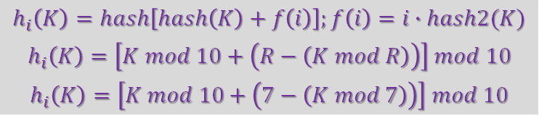
Double hashing
Insert keys 89, 18, 49, 58, 69, 6 with
hash(K)=K mod 10
hash2(K)=R-(K mod R)
m=10, R=7

Slide 48
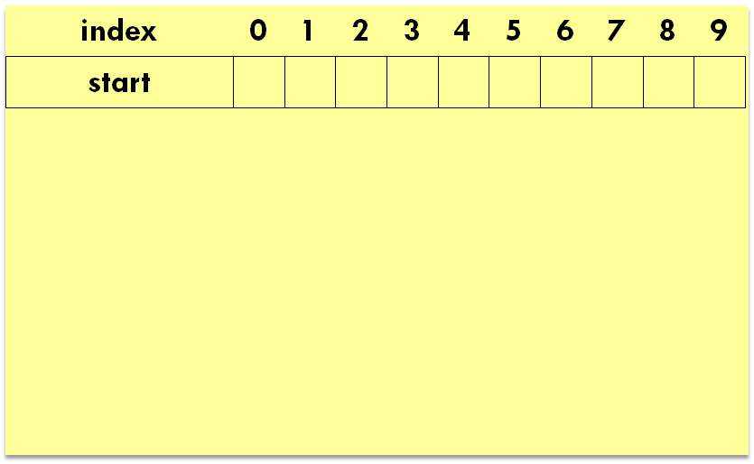
Double hashing
Insert keys 89, 18, 49, 58, 69, 6

Slide 49
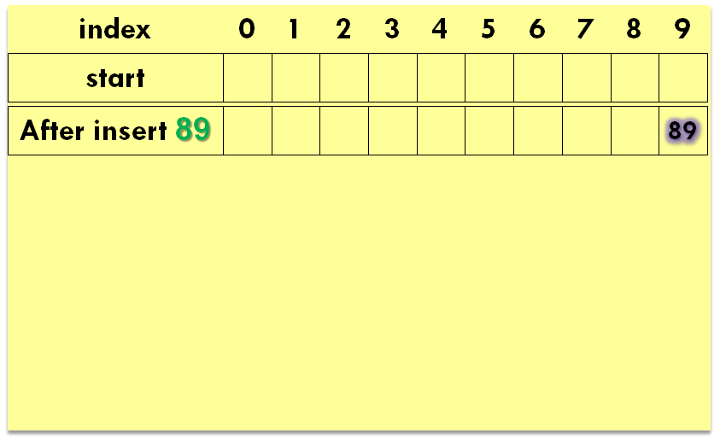
Double hashing
Insert key 89
To insert 89, probe
T[9]

Slide 50
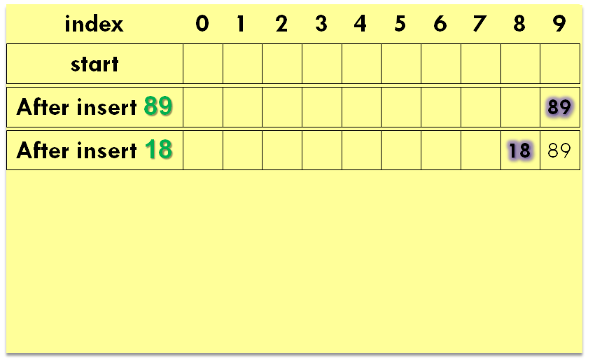
Double hashing
Insert keys 89, 18
To insert 18, probe
T[8]

Slide 51
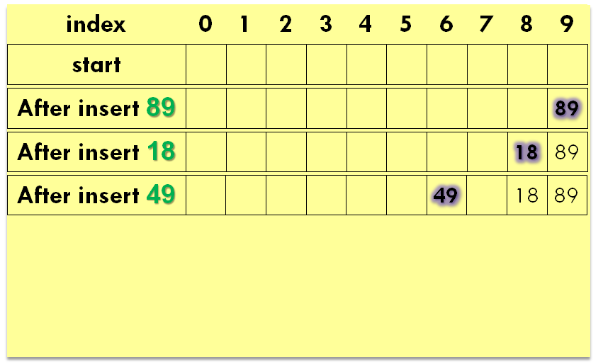
Double hashing
Insert keys 89, 18, 49
To insert 49, probe
T[9]
T[6]

Slide 52
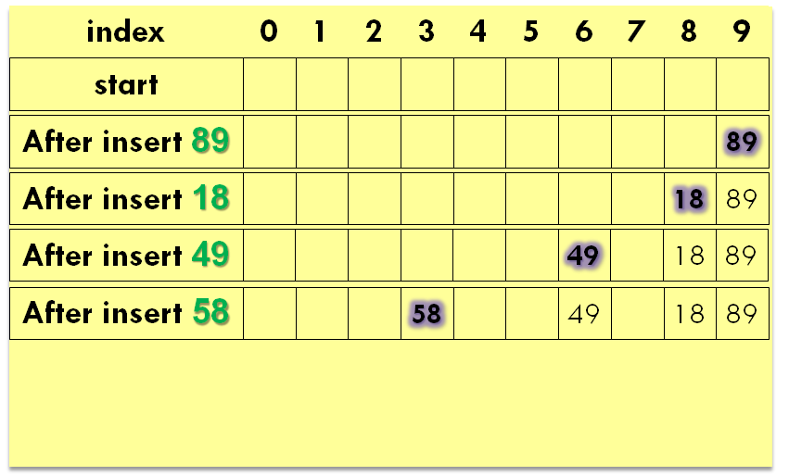
Double hashing
Insert keys 89, 18, 49, 58
To insert 58, probe
T[8]
T[3]

Slide 53
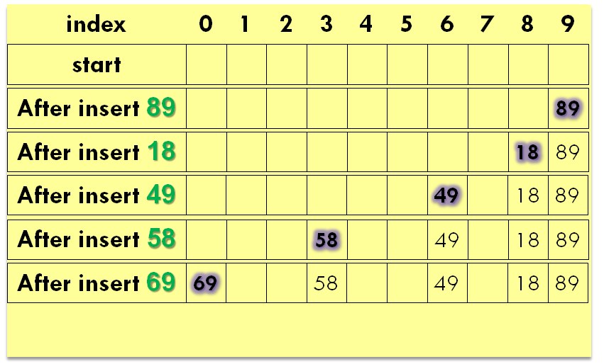
Double hashing
Insert keys 89, 18, 49, 58, 69
To insert 69, probe
T[9]
T[0]

Slide 54
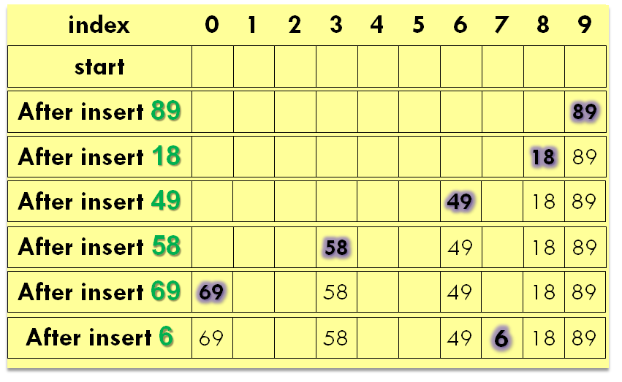
Double hashing
Insert keys 89, 18, 49, 58, 69, 6
To insert 6, probe
T[6]
T[7]

Slide 55
CHOICE OF HASH2()
Hash2() must never evaluate to zero
For any key K, hash2(K) must be relatively prime to the table size m. Otherwise, we will only be able to examine a fraction of the table entries.
E.g., if hash(K) = 0 and hash2(K) = m/2, then we can only examine the entries T[0], T[m/2], and nothing else!

Slide 56
CHOICE OF HASH2()
One solution is to make m prime, and choose R to be a prime smaller than m, and set hash2(K) = R – (K mod R)
Quadratic probing, however, does not require the use of a second hash function likely to be simpler and faster in practice

Slide 57
DELETION IN OPEN ADDRESSING
Actual deletion cannot be performed in open addressing hash tables
otherwise this will isolate records further down the probe sequence
Solution: Add an extra bit to each table entry, and mark a deleted slot by storing a special value DELETED (tombstone)

Slide 58
END OF SLIDES

