Slide 1

Queue

Slide 2
Queue Overview
Queue ADT
Basic operations of queue
Enqueuing
Dequeuing
Implementation of queue
Array
Linked list

Slide 3
Queue ADT
Like a stack, a queue is also a list.
Insertion is done only at one end, while deletion is performed at the other end.
Accessing the elements of queues follows a First In, First Out (FIFO) order.
Like customers standing in a check-out line in a store, the first customer in is the first customer served.

Slide 4
The Queue ADT
Another form of restricted list
Insertion is done at one end, whereas deletion is performed at the other end
Basic operations:
enqueue: insert an element at the rear of the list
dequeue: delete the element at the front of the list
First-in First-out (FIFO) list
Remove (Dequeue)
Insert (Enqueue)
front
rear

Slide 5
Queue Implementation using Array
There are several different algorithms to implement Enqueue and Dequeue
Naïve way
When enqueuing, the front index is always fixed and the rear index moves forward in the array.
rear
rear
rear
3
3
6
3
6
9
front
front
front
Enqueue(3)
Enqueue(6)
Enqueue(9)

Slide 6
Queue Implementation using Array
Naïve way
When enqueuing, the front index is always fixed and the rear index moves forward in the array.
When dequeuing, the element at the front the queue is removed. Move all the elements after it by one position. (Inefficient!!!)
rear
rear
rear = -1
6
9
9
front
front
front
Dequeue()
Dequeue()
Dequeue()

Slide 7
Queue Implementation using Array
Better way
When an item is enqueued, make the rear index move forward.
When an item is dequeued, the front index moves by one element towards the back of the queue (thus removing the front item, so no copying to neighboring elements is needed).
(front)
XXXXOOOOO (rear)
OXXXXOOOO (after 1 dequeue, and 1 enqueue)
OOXXXXXOO (after another dequeue, and 2 enqueues)
OOOOXXXXX (after 2 more dequeues, and 2 enqueues)
The problem here is that the rear index cannot move beyond the last element in the array.

Slide 8
Queue Implementation using Circular Array
Using a circular array
When an element moves past the end of a circular array, it wraps around to the beginning, e.g.
OOOOO7963 → 4OOOO7963 (after Enqueue(4))
After Enqueue(4), the rear index moves from 3 to 4.

Slide 9
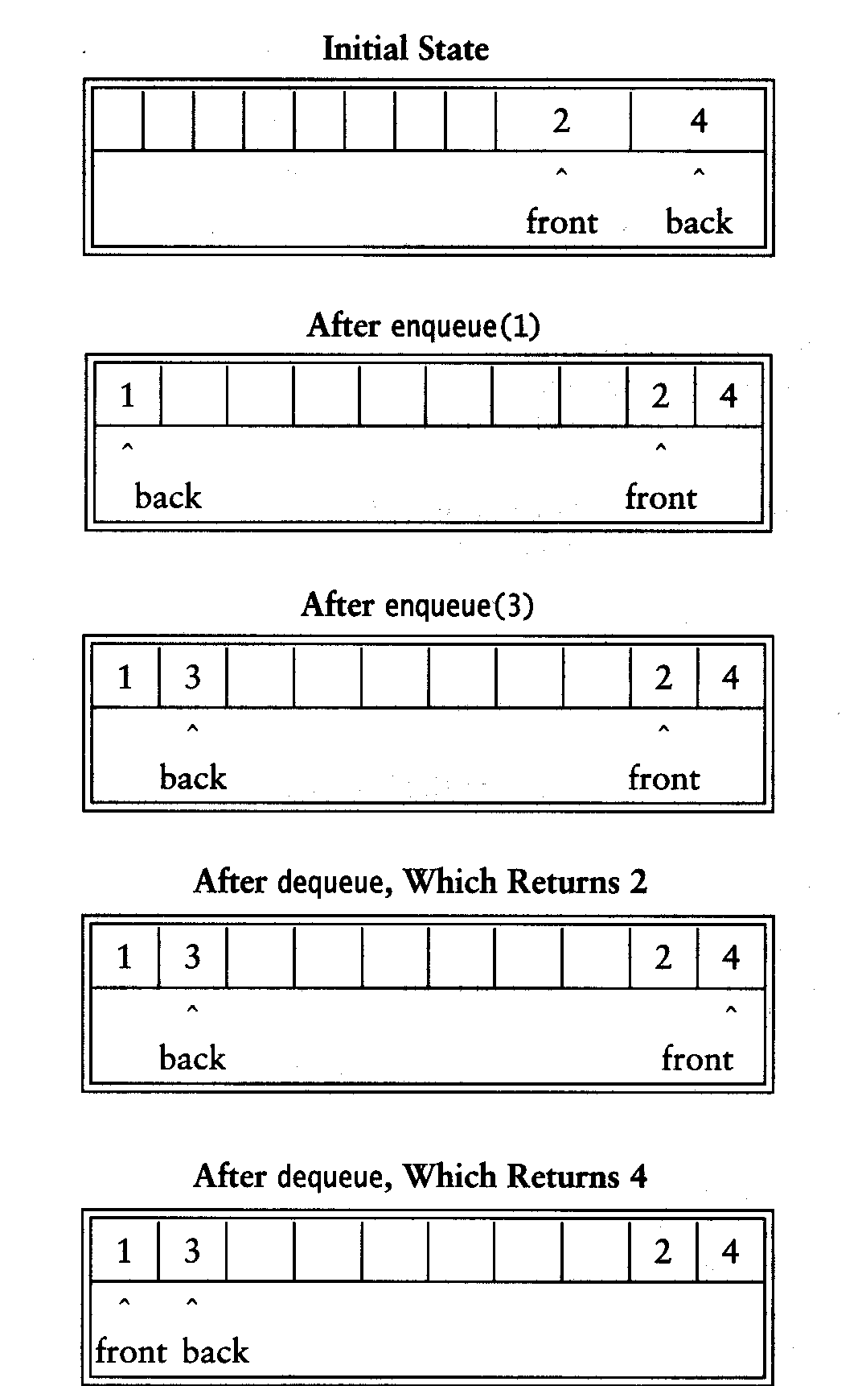
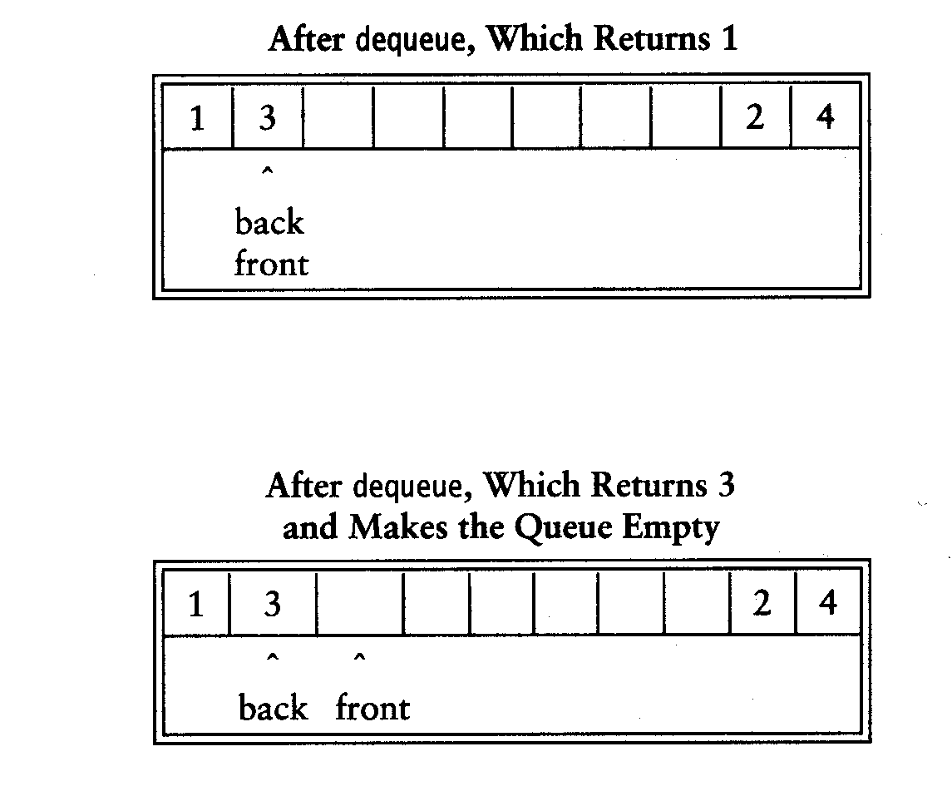

Slide 10
Issues with Queue Implementation using Circular Array
Empty queue
back = front - 1
Full queue?
back = front - 1 the same!
Reason: n values to represent n+1 states

Slide 11
How to determine if the circular Queue is Empty or Full?
Solutions
Use a boolean variable to say explicitly whether the queue is empty or not
Make the array of size n+1 and only allow n elements to be stored
Use a counter of the number of elements in the queue

Slide 12
Queue Implementation using Linked List
class Queue {
public:
Queue(int size = 10); // constructor
~Queue() { delete [] values; } // destructor
bool IsEmpty(void);
bool IsFull(void);
bool Enqueue(double x);
bool Dequeue(double & x);
void DisplayQueue(void);
private:
int front; // front index
int rear; // rear index
int counter; // number of elements
int maxSize; // size of array queue
double* values; // element array
};

Slide 13
Queue Class
Attributes of Queue
front/rear: front/rear index
counter: number of elements in the queue
maxSize: capacity of the queue
values: point to an array which stores elements of the queue

Slide 14
Queue Class
Operations of Queue
IsEmpty: return true if queue is empty, return false otherwise
IsFull: return true if queue is full, return false otherwise
Enqueue: add an element to the rear of queue
Dequeue: delete the element at the front of queue
DisplayQueue: print all the data

Slide 15
Creating Queue Class
Queue(int size = 10)
Allocate a queue array of size. By default, size = 10.
front is set to 0, pointing to the first element of the array
rear is set to -1. The queue is empty initially.
Queue::Queue(int size /* = 10 */) {
values = new double[size];
maxSize = size;
front = 0;
rear = -1;
counter = 0;
}

Slide 16
IsEmpty & IsFull
Since we keep track of the number of elements that are actually in the queue: counter, it is easy to check if the queue is empty or full.
bool Queue::IsEmpty() {
if (counter) return false;
else return true;
}
bool Queue::IsFull()
if (counter < maxSize) return false;
else return true;
}

Slide 17
Enqueue
bool Queue::Enqueue(double x) {
if (IsFull()) {
cout << "Error: the queue is full." << endl;
return false;
}
else {
// calculate the new rear position (circular)
rear = (rear + 1) % maxSize;
// insert new item
values[rear] = x;
// update counter
counter++;
return true;
}
}

Slide 18
Dequeue
bool Queue::Dequeue(double & x) {
if (IsEmpty()) {
cout << "Error: the queue is empty." << endl;
return false;
}
else {
// retrieve the front item
x = values[front];
// move front
front = (front + 1) % maxSize;
// update counter
counter--;
return true;
}
}

Slide 19

Printing the elements
void Queue::DisplayQueue() {
cout << "front -->";
for (int i = 0; i < counter; i++) {
if (i == 0) cout << "\t";
else cout << "\t\t";
cout << values[(front + i) % maxSize];
if (i != counter - 1)
cout << endl;
else
cout << "\t<-- rear" << endl;
}
}

Slide 20
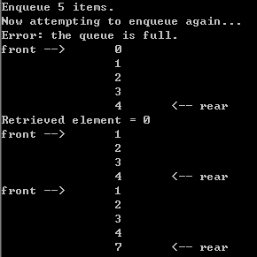
Sample run using a Queue
int main(void) {
Queue queue(5);
cout << "Enqueue 5 items." << endl;
for (int x = 0; x < 5; x++)
queue.Enqueue(x);
cout << "Now attempting to enqueue again..." << endl;
queue.Enqueue(5);
queue.DisplayQueue();
double value;
queue.Dequeue(value);
cout << "Retrieved element = " << value << endl;
queue.DisplayQueue();
queue.Enqueue(7);
queue.DisplayQueue();
return 0;
}

Slide 21
Queue Implementation using Linked List
class Queue {
public:
Queue() { // constructor
front = rear = NULL;
counter = 0;
}
~Queue() { // destructor
double value;
while (!IsEmpty()) Dequeue(value);
}
bool IsEmpty() {
if (counter) return false;
else return true;
}
void Enqueue(double x);
bool Dequeue(double & x);
void DisplayQueue(void);
private:
Node* front; // pointer to front node
Node* rear; // pointer to last node
int counter; // number of elements
};

Slide 22
Enqueue
void Queue::Enqueue(double x) {
Node* newNode = new Node;
newNode->data = x;
newNode->next = NULL;
if (IsEmpty()) {
front = newNode;
rear = newNode;
}
else {
rear->next = newNode;
rear = newNode;
}
counter++;
}
rear
8
5
rear
8
5
newNode

Slide 23
Dequeue
bool Queue::Dequeue(double & x) {
if (IsEmpty()) {g
cout << "Error: the queue is empty." << endl;
return false;
}
else {
x = front->data;
Node* nextNode = front->next;
delete front;
front = nextNode;
counter--;
}
}
front
3
8
5
front
8
5

Slide 24
Printing the elements
void Queue::DisplayQueue() {
cout << "front -->";
Node* currNode = front;
for (int i = 0; i < counter; i++) {
if (i == 0) cout << "\t";
else cout << "\t\t";
cout << currNode->data;
if (i != counter - 1)
cout << endl;
else
cout << "\t<-- rear" << endl;
currNode = currNode->next;
}
}

Slide 25
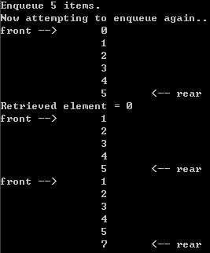
Result
Queue implemented using linked list will never be full
based on array
based on linked list

Slide 26
END OF SLIDES

