Slide 1
RECURSION

Slide 2
Introduction to Recursion
In some problems, it may be natural to define the problem in terms of the problem itself.
Recursion is useful for problems that can be represented by a simpler version of the same problem.

Slide 3
Example 1: Factorial function
Example: the factorial function
6! = 6 * 5 * 4 * 3 * 2 * 1
We could write: 6! = 6 * 5!
In general, we can express the factorial function as follows: n! = n * (n-1)!
Is this correct? Well… almost.
The factorial function is only defined for positive integers. So we should be a bit more precise:
n! = 1 (if n is equal to 1)
n! = n * (n-1)! (if n is larger than 1)

Slide 4
factorial function (iterative)
Typical C++ iterative solution:
int fac(int numb){
int product=1;
while(numb>1){
product *= numb;
numb--;
}
return product;
}

Slide 5
factorial function (recursive)
The C++ equivalent of this definition:
int fac(int numb){
if(numb<=1)
return 1;
else
return numb * fac(numb-1);
}
recursion means that a function calls itself

Slide 6
Rules for Recursion
Recursion is one way to decompose a task into smaller subtasks.
At least one of the subtasks is a smaller example of the same task.
We must always make sure that the recursion bottoms out:
A recursive function must contain at least one non-recursive branch.
The recursive calls must eventually lead to a non-recursive branch.

Slide 7
Recursion General Form
How to write recursively?
int recur_fn(parameters){
if(stopping condition)
return stopping value;
// other stopping conditions if needed
return function of recur_fn(revised parameters)
}

Slide 8
factorial function (recursive)
Assume the number typed is 3, that is, numb=3.
fac(3) :
3 <= 1 ? No.
fac(3) = 3 * fac(2)
fac(2) :
2 <= 1 ? No.
fac(2) = 2 * fac(1)
fac(1) :
1 <= 1 ? Yes.
return 1
int fac(int numb){
if(numb<=1)
return 1;
else
return numb * fac(numb-1);
}
fac(2) = 2 * 1 = 2
return fac(2)
fac(3) = 3 * 2 = 6
return fac(3)
fac(3) has the value 6

Slide 9
factorial function
For certain problems (such as the factorial function), a recursive solution often leads to short and elegant code. Compare the recursive solution with the iterative solution:
Iterative solution
int fac(int numb){
int product=1;
while(numb>1){
product *= numb;
numb--;
}
return product;
}
Recursive solution
int fac(int numb){
if(numb<=1)
return 1;
else
return numb*fac(numb-1);
}

Slide 10
Is Recursion a better solution?
To trace recursion, recall that function calls operate as a stack – the new function is put on top of the caller
We have to pay a price for recursion:
calling a function consumes more time and memory than adjusting a loop counter.
high performance applications (graphic action games, simulations of nuclear explosions) hardly ever use recursion.
In less demanding applications recursion is an attractive alternative for iteration

Slide 11
Cautions with Recursion
Similarly, if we use recursion we must be careful not to create an infinite chain of function calls:
int fac(int numb){
return numb * fac(numb-1);
}
Or:
int fac(int numb){
if (numb<=1)
return 1;
else
return numb * fac(numb+1);
}
Oops!
No termination condition
Oops!

Slide 12
Cautions with Iteration
If we use iteration, we must be careful not to create an infinite loop by accident:
for(int incr=1; incr!=10;incr+=2)
...
int result = 1;
while(result >0){
...
result++;
}
Oops!
Oops!

Slide 13
Example 2: Fibonacci numbers
Fibonacci numbers:
0, 1, 1, 2, 3, 5, 8, 13, 21, 34, ...
where each number is the sum of the preceding two
Do you know any interesting fact about Fibonacci??

Slide 14
Fibonacci function (iterative)
int fib(int n)
{
int f[n+1];
f[0] = 0; f[1] = 1;
for (int i=2; i<= n; i++)
f[i] = f[i-1] + f[i-2];
return f[n];
}

Slide 15
Fibonacci function (recursive)
Recursive definition:
F(0) = 0;
F(1) = 1;
F(number) = F(number-1)+ F(number-2);

Slide 16
Fibonacci function (recursive)
int fib(int number)
{
if (number == 0) return 0;
if (number == 1) return 1;
return (fib(number-1) + fib(number-2));
}
int main(){ // driver function
int inp_number;
cout << "Please enter an integer: ";
cin >> inp_number;
cout << "The Fibonacci number for "<< inp_number
<< " is "<< fib(inp_number)<<endl;
return 0;
}

Slide 17
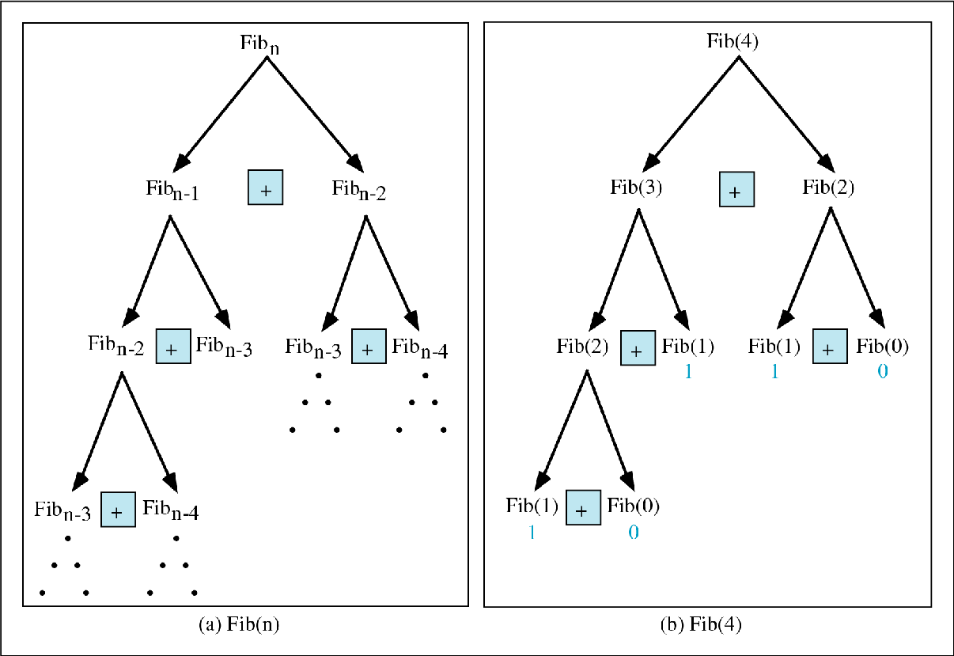
Copyright © 2000 by Brooks/Cole Publishing Company A division of International Thomson Publishing Inc.

Slide 18
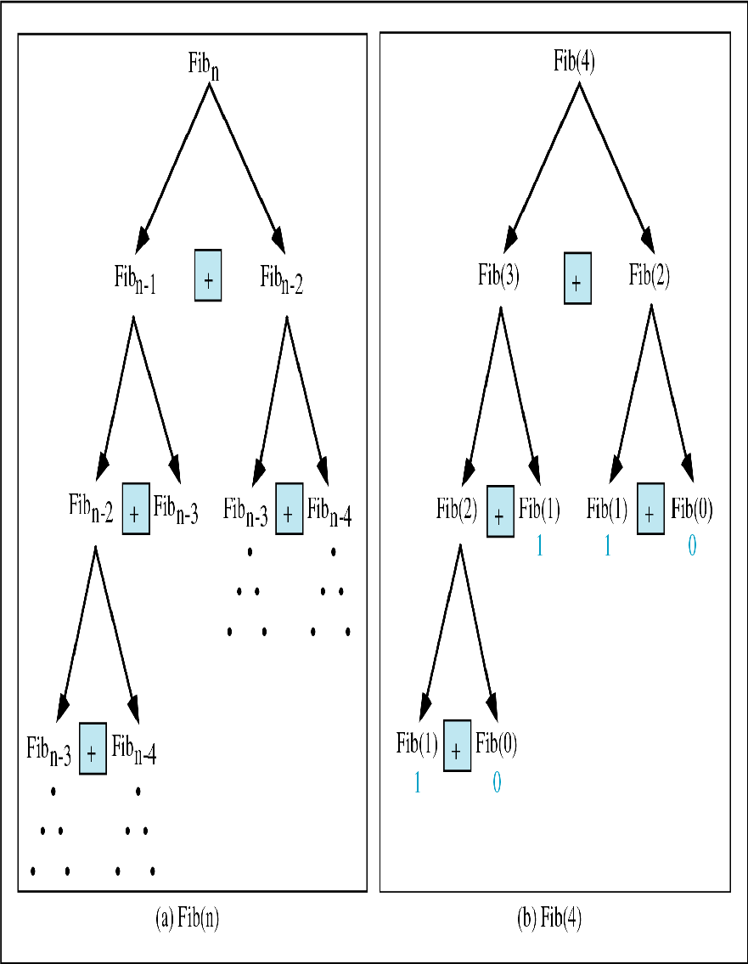
Tracing a Fibonacci function
int fib(int num)
{
if (num == 0) return 0;
if (num == 1) return 1;
return
(fib(num-1)+fib(num-2));
}
Assume the input number is 4, that is, num=4:
fib(4):
4 == 0 ? No; 4 == 1? No.
fib(4) = fib(3) + fib(2)
fib(3):
3 == 0 ? No; 3 == 1? No.
fib(3) = fib(2) + fib(1)
fib(2):
2 == 0? No; 2==1? No.
fib(2) = fib(1)+fib(0)
fib(1):
1== 0 ? No; 1 == 1? Yes.
fib(1) = 1;
return fib(1);

Slide 19
Tracing a Fibonacci function
fib(0):
0 == 0 ? Yes.
fib(0) = 0;
return fib(0);
fib(2) = 1 + 0 = 1;
return fib(2);
fib(3) = 1 + fib(1)
fib(1):
1 == 0 ? No; 1 == 1? Yes
fib(1) = 1;
return fib(1);
fib(3) = 1 + 1 = 2;
return fib(3)

Slide 20
Tracing a Fibonacci function
fib(2):
2 == 0 ? No; 2 == 1? No.
fib(2) = fib(1) + fib(0)
fib(1):
1== 0 ? No; 1 == 1? Yes.
fib(1) = 1;
return fib(1);
fib(0):
0 == 0 ? Yes.
fib(0) = 0;
return fib(0);
fib(2) = 1 + 0 = 1;
return fib(2);
fib(4) = fib(3) + fib(2)
= 2 + 1 = 3;
return fib(4);

Slide 21
Link to Example 3: Binary Search
Search for an element in an array
Sequential search
Binary search
Binary search
Compare the search element with the middle element of the array
If not equal, then apply binary search to half of the array (if not empty) where the search element would be.

Slide 22
Binary Search with Recursion
// Searches an ordered array of integers using recursion
int bsearchr(const int data[], // input: array
int first, // input: lower bound
int last, // input: upper bound
int value // input: value to find
)// output: index if found, otherwise return –1
{ int middle = (first + last) / 2;
if (data[middle] == value)
return middle;
else if (first >= last)
return -1;
else if (value < data[middle])
return bsearchr(data, first, middle-1, value);
else
return bsearchr(data, middle+1, last, value);
}

Slide 23
Binary Search
int main() {
const int array_size = 8;
int list[array_size]={1, 2, 3, 5, 7, 10, 14, 17};
int search_value;
cout << "Enter search value: ";
cin >> search_value;
cout << bsearchr(list,0,array_size-1,search_value)
<< endl;
return 0;
}

Slide 24
Binary Search using iteration
// Searches an ordered array of integers
int bsearch(const int data[], // input: array
int size, // input: array size
int value // input: value to find
){ // output: if found,return
// index; otherwise, return -1
int first, last, upper;
first = 0;
last = size - 1;
while (true) {
middle = (first + last) / 2;
if (data[middle] == value)
return middle;
else if (first >= last)
return -1;
else if (value < data[middle])
last = middle - 1;
else
first = middle + 1;
}
}

Slide 25

Example 4: Exponential function
How to write the function exp(int numb, int power) recursively?

Slide 26
Example 4: Exponential function
The non-recursive version of the function
exp(int numb, int power)
int exp(int numb, int power)
{
int answer = 1, count;
for (count=1; count<=power; ++count)
answer *= numb;
return answer;
}

Slide 27
Example 5: number of zero
Write a recursive function that counts the number of zero digits in an integer
zeros(10200) returns 3.
int zeros(int numb){
if(numb==0) // 1 digit (zero/non-zero):
return 1; // bottom out.
else if(numb < 10 && numb > -10)
return 0;
else // > 1 digits: recursion
return zeros(numb/10) + zeros(numb%10);
}
zeros(10200)
zeros(1020) + zeros(0)
zeros(102) + zeros(0) + zeros(0)
zeros(10) + zeros(2) + zeros(0) + zeros(0)
zeros(1) + zeros(0) + zeros(2) + zeros(0) + zeros(0)

Slide 28
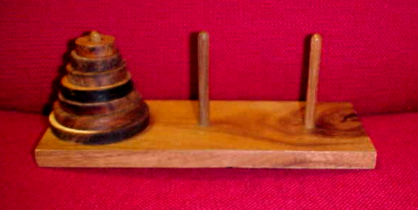
Example 6: Towers of Hanoi
Only one disc could be moved at a time
A larger disc must never be stacked above a smaller one
One and only one extra needle could be used for intermediate storage of discs
see applet

Slide 29
Towers of Hanoi
Write the code to implement the solution of the Towers of Hanoi using the recursion method

Slide 30
Towers of Hanoi
int main() {
int num_disc; //number of discs
cout << "Please enter a positive number (0 to quit)";
cin >> num_disc;
while (num_disc > 0){
hanoi(1, 3, num_disc);
cout << "Please enter a positive number ";
cin >> num_disc;
}
return 0;
}

Slide 31
End of Slides

