Slide 1
SORTING
Insertion sort Merge sort
Quick Sort

Slide 2
DEFINITION OF sorting
To arrange a list of data according to the selected sorting key in ascending or descending order

Slide 3
SOME Types of sorting ALGORITHMS
Insertion sort
Merge sort
Quick Sort
Heap sort

Slide 4
Insertion sort

Slide 5
Insertion sort
One of the simplest sorting algorithm
Contains N-1 passes for a list of size N
A list is split into two:
The left side is sorted (position 0 to p)
The right side is not yet sorted (p+1 to size-1)
The element from the right side is inserted into the left side one by one in its correct position
Decrement size of right side
Increment size of left side

Slide 6
Insertion sort ALGORITHM
1) Starting with p = 1, p represents the number of elements sorted so far.
2) Insert the (p+1)th element in its place in the list so that now p+1 elements are sorted.
3) increment p and go to step (2)

Slide 7
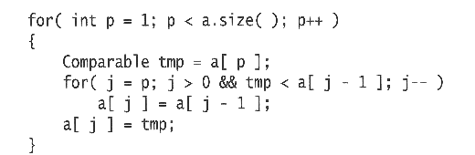
Insertion Sort algorithm
Outer loop: repeats N - 1 times
For pass p = 1 through N - 1, ensures that the elements in positions 0 through p are in sorted order
elements in positions 0 through p - 1 are already sorted
move the element in position p to the left until its correct place is found among the first p + 1 elements

Slide 8
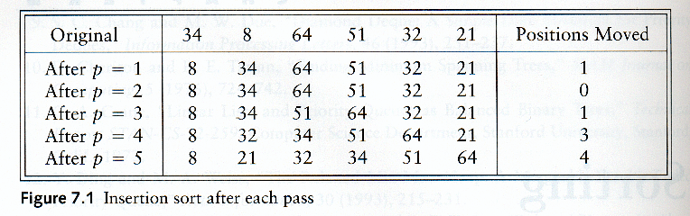
Insertion Sort – an example

Slide 9
Extended Example
To sort the following numbers in increasing order:
34 8 64 51 32 21
P = 1; Look at first element only, no change.
P = 2; tmp = 8;
34 > tmp, so second element is set to 34.
We have reached the front of the list. Thus, 1st position = tmp
After second pass: 8 34 64 51 32 21
(first 2 elements are sorted)

Slide 10
P = 3; tmp = 64;
34 < 64, so stop at 3rd position and set 3rd position = 64
After third pass: 8 34 64 51 32 21
(first 3 elements are sorted)
P = 4; tmp = 51;
51 < 64, so we have 8 34 64 64 32 21,
34 < 51, so stop at 2nd position, set 3rd position = tmp,
After fourth pass: 8 34 51 64 32 21
(first 4 elements are sorted)
P = 5; tmp = 32,
32 < 64, so 8 34 51 64 64 21,
32 < 51, so 8 34 51 51 64 21,
next 32 < 34, so 8 34 34, 51 64 21,
next 32 > 8, so stop at 1st position and set 2nd position = 32,
After fifth pass: 8 32 34 51 64 21
P = 6; tmp = 21, . . .
After sixth pass: 8 21 32 34 51 64

Slide 11
Analysis: worst-case running time
Inner loop is executed p times, for each p=1..N
⇒ Overall: 1 + 2 + 3 + . . . + N = O(N²)
Space requirement is O(N)

Slide 12
Analysis: best case
The input is already sorted in increasing order
When inserting A[p] into the sorted A[0..p-1], only need to compare A[p] with A[p-1] and there is no data movement
For each iteration of the outer for-loop, the inner for-loop terminates after checking the loop condition once => O(N) time
If input is nearly sorted, insertion sort runs fast

Slide 13
merge sort

Slide 14
Merge sort
Based on divide-and-conquer strategy
Divide the list into two smaller lists of about equal sizes
Sort each smaller list recursively
Merge the two sorted lists to get one sorted list
How do we divide the list? How much time needed?
How do we merge the two sorted lists? How much time needed?

Slide 15
Dividing
If the input list is a linked list, dividing takes Θ(N) time
We scan the linked list, stop at the ⎣N/2⎦ th entry and cut the link
If the input list is an array A[0..N-1]: dividing takes O(1) time
we can represent a sublist by two integers left and right: to divide A[left..Right], we compute center=(left+right)/2 and obtain A[left..Center] and A[center+1..Right]

Slide 16
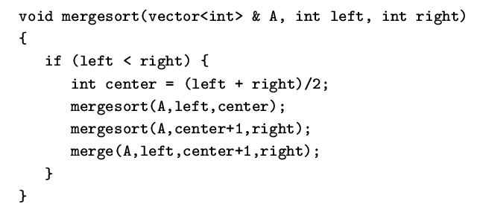
Merge sort
Divide-and-conquer strategy
recursively mergesort the first half and the second half
merge the two sorted halves together

Slide 17
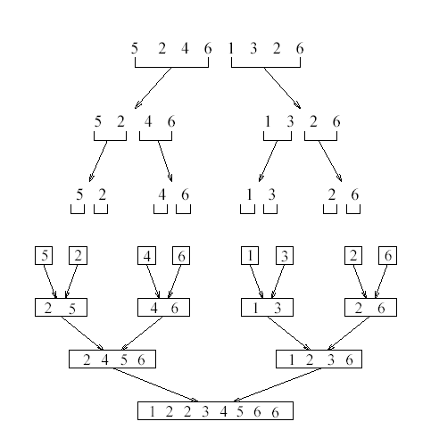
see applet
http://www.cosc.canterbury.ac.nz/people/mukundan/dsal/MSort.html

Slide 18
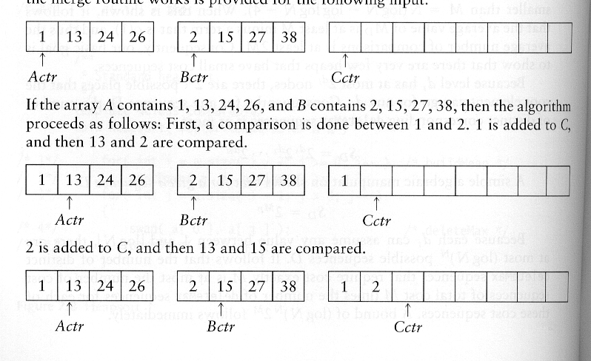
How to merge?
Input: two sorted array A and B
Output: an output sorted array C
Three counters: Actr, Bctr, and Cctr
initially set to the beginning of their respective arrays
(1) The smaller of A[Actr] and B[Bctr] is copied to the next entry in C, and the appropriate counters are advanced
(2) When either input list is exhausted, the remainder of the other list is copied to C

Slide 19
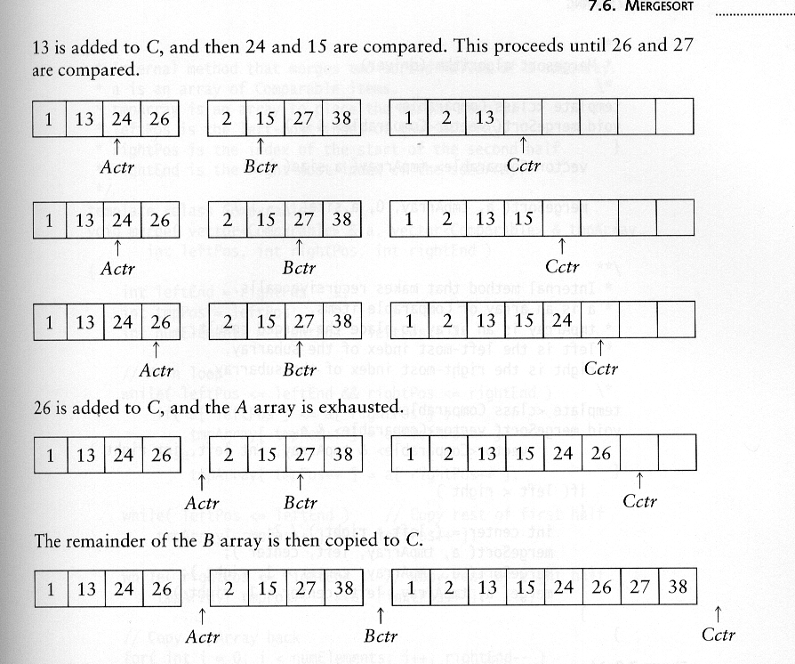
Example: Merge

Slide 20
Example: Merge...
Running time analysis:
Clearly, merge takes O(m1 + m2) where m1 and m2 are
the sizes of the two sublists.
Space requirement:
merging two sorted lists requires linear extra memory
additional work to copy to the temporary array and back

Slide 21
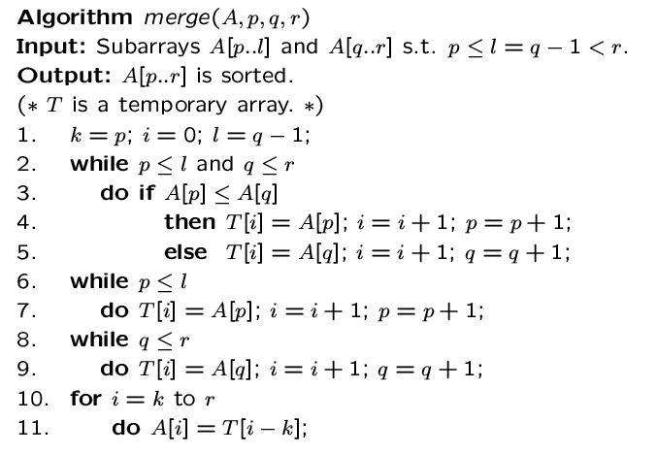

Slide 22
quick sort

Slide 23
Quicksort
Fastest known sorting algorithm in practice
Average case: O(N log N)
Worst case: O(N²)
But, the worst case seldom happens.
Another divide-and-conquer recursive algorithm like mergesort

Slide 24
Quicksort
S
v
Divide step:
Pick any element (pivot) v in S
Partition S – {v} into two disjoint groups
S1 = {x ∈ S – {v} | x ≤ v}
S2 = {x ∈ S – {v} | x ≥ v}
Conquer step: recursively sort S1 and S2
Combine step: combine the sorted S1, followed by v, followed by the sorted S2
v
S1
S2

Slide 25
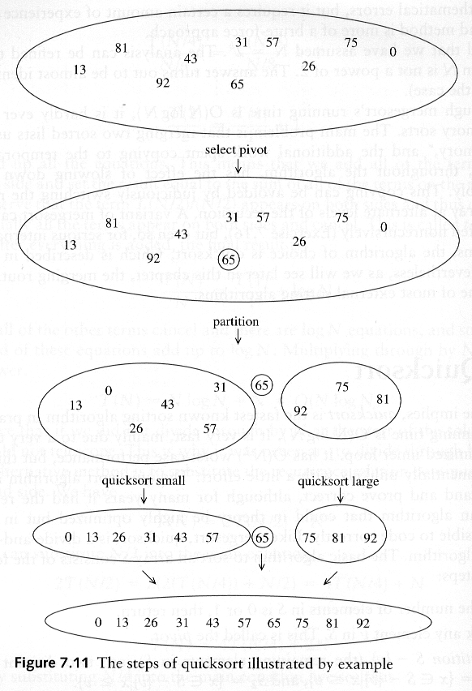
Example: Quicksort

Slide 26
Example: Quicksort...

Slide 27
Pseudocode
Input: an array A[p, r]
Quicksort (A, p, r) {
if (p < r) {
q = Partition (A, p, r) //q is the position of the pivot element
Quicksort (A, p, q-1)
Quicksort (A, q+1, r)
}
}

Slide 28
Partitioning
Partitioning
Key step of quicksort algorithm
Goal: given the picked pivot, partition the remaining elements into two smaller sets
Many ways to implement
Even the slightest deviations may cause surprisingly bad results.
We will learn an easy and efficient partitioning strategy here.
How to pick a pivot will be discussed later

Slide 29
Partitioning Strategy
Want to partition an array A[left .. right]
First, get the pivot element out of the way by swapping it with the last element. (Swap pivot and A[right])
Let i start at the first element and j start at the next-to-last element (i = left, j = right – 1)
swap
5
6
4
6
3
12
19
5
6
4
19
3
12
6
pivot
i
j

Slide 30
Partitioning Strategy
Want to have
A[p] <= pivot, for p < i
A[p] >= pivot, for p > j
When i < j
Move i right, skipping over elements smaller than the pivot
Move j left, skipping over elements greater than the pivot
When both i and j have stopped
A[i] >= pivot
A[j] <= pivot
5
6
4
19
3
12
6
5
6
4
19
3
12
6
i
j
i
j

Slide 31
Partitioning Strategy
When i and j have stopped and i is to the left of j
Swap A[i] and A[j]
The large element is pushed to the right and the small element is pushed to the left
After swapping
A[i] <= pivot
A[j] >= pivot
Repeat the process until i and j cross
swap
5
6
4
19
3
12
6
5
3
4
19
6
12
6
i
j
i
j

Slide 32
Partitioning Strategy
When i and j have crossed
Swap A[i] and pivot
Result:
A[p] <= pivot, for p < i
A[p] >= pivot, for p > i
5
3
4
19
6
12
6
i
j
5
3
4
19
6
12
6
j
i
5
3
4
6
6
12
19
j
i

Slide 33
Small arrays
For very small arrays, quicksort does not perform as well as insertion sort
how small depends on many factors, such as the time spent making a recursive call, the compiler, etc
Do not use quicksort recursively for small arrays
Instead, use a sorting algorithm that is efficient for small arrays, such as insertion sort

Slide 34
Picking the Pivot
Use the first element as pivot
if the input is random, ok
if the input is presorted (or in reverse order)
all the elements go into S2 (or S1)
this happens consistently throughout the recursive calls
Results in O(n²) behavior (Analyze this case later)
Choose the pivot randomly
generally safe
random number generation can be expensive

Slide 35
Picking the Pivot
Use the median of the array
Partitioning always cuts the array into roughly half
An optimal quicksort (O(N log N))
However, hard to find the exact median
e.g., sort an array to pick the value in the middle

Slide 36
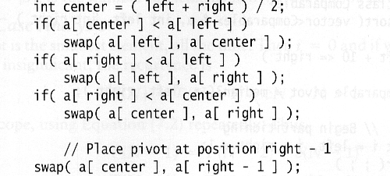
Pivot: median of three
We will use median of three
Compare just three elements: the leftmost, rightmost and center
Swap these elements if necessary so that
A[left] = Smallest
A[right] = Largest
A[center] = Median of three
Pick A[center] as the pivot
Swap A[center] and A[right – 1] so that pivot is at second last position (why?)
median3

Slide 37
Pivot: median of three
2
5
6
4
13
3
12
19
6
A[left] = 2, A[center] = 13, A[right] = 6
2
5
6
4
6
3
12
19
13
Swap A[center] and A[right]
2
5
6
4
6
3
12
19
13
Choose A[center] as pivot
pivot
2
5
6
4
19
3
12
6
13
Swap pivot and A[right – 1]
pivot
Note we only need to partition A[left + 1, …, right – 2]. Why?

Slide 38
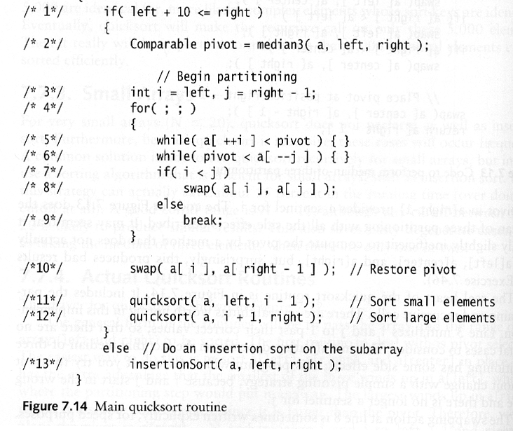
Main Quicksort Routine
Choose pivot
Partitioning
Recursion
For small arrays

Slide 39
Partitioning Part
Works only if pivot is picked as median-of-three.
A[left] <= pivot and A[right] >= pivot
Thus, only need to partition A[left + 1, …,right – 2]
j will not run past the end because
a[left] <= pivot
i will not run past the end because
a[right-1] = pivot

Slide 40
Comparison between Quick sort and Merge sort
Both quicksort and mergesort take O(N log N) in the average case.
Quicksort is faster than mergesort. Why?
The inner loop consists of an increment/decrement (by 1, which is fast), a test and a jump.
There is no extra juggling as in mergesort.
inner loop

Slide 41
Analysis
Assumptions:
A random pivot (no median-of-three partitioning
No cutoff for small arrays
Running time
pivot selection: constant time O(1)
partitioning: linear time O(N)
running time of the two recursive calls
T(N)=T(i)+T(N-i-1)+cN where c is a constant
i: number of elements in S1

Slide 42
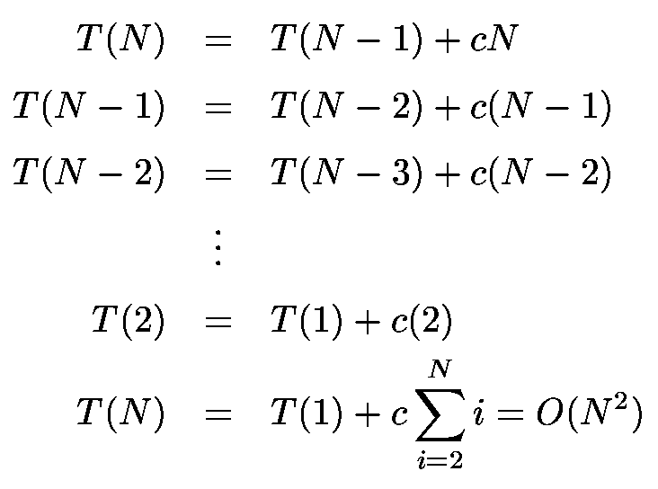
Worst-Case Analysis
What will be the worst case?
The pivot is the smallest element, all the time
Partition is always unbalanced

Slide 43
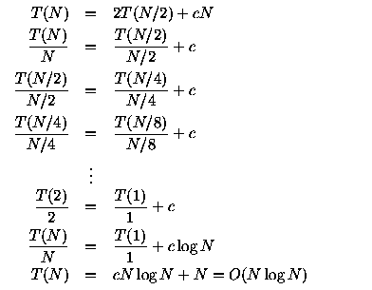
Best-case Analysis
What will be the best case?
Partition is perfectly balanced.
Pivot is always in the middle (median of the array)

Slide 44
Average-Case Analysis
Assume
Each of the sizes for S1 is equally likely
This assumption is valid for our pivoting (median-of-three) and partitioning strategy
On average, the running time is O(N log N)

Slide 45
End of slides

