Slide 1
Connected Components, Directed graphs, Topological sort

Slide 2
Application 1: Connectivity
G =
P
Q
N
L
R
O
M
D
s
E
C
A
How do we tell if two vertices
are connected?
F
B
K
G
A connected to F?
A connected to L?
H

Slide 3
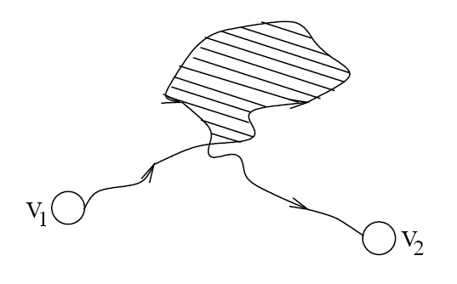
Connectivity
A graph is connected if and only if there exists a path between every pair of distinct vertices.
A graph is connected if and only if there exists a simple path between every pair of distinct vertices (since every non-simple path contains a cycle, which can be bypassed)

Slide 4
Connectivity
How to check for connectivity?
Run BFS or DFS (using an arbitrary vertex as the source)
If all vertices have been visited, the graph is connected.
Running time? O(n + m)

Slide 5
Connected Components

Slide 6
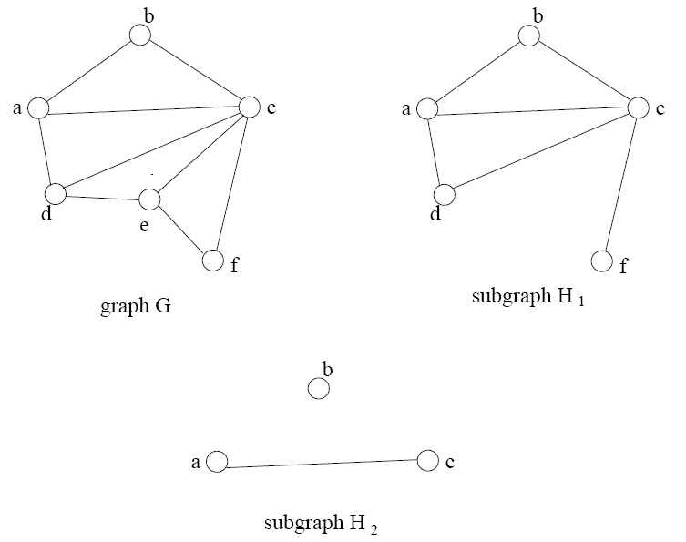

Subgraphs

Slide 7
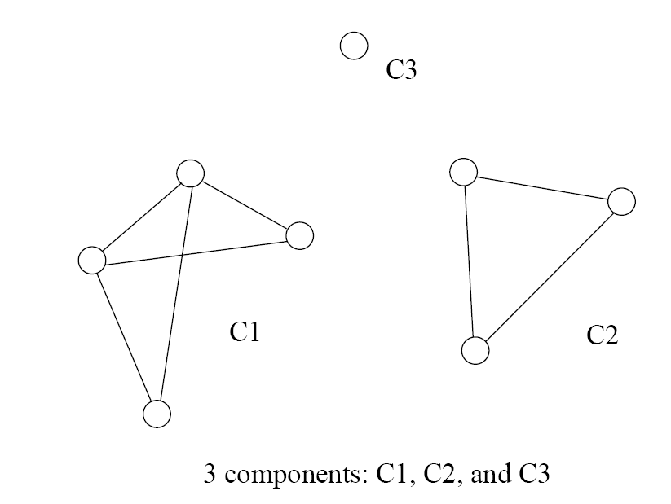
Connected Components
Formally stated:
A connected component is a maximal connected subgraph of a graph.
The set of connected components is unique for a given graph.

Slide 8
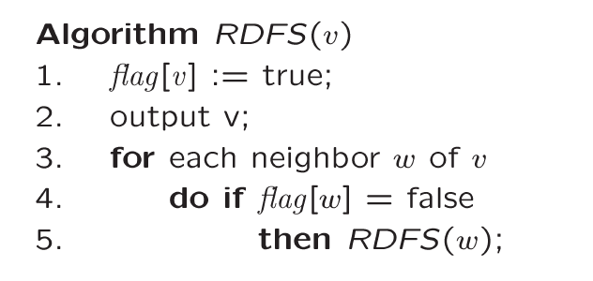
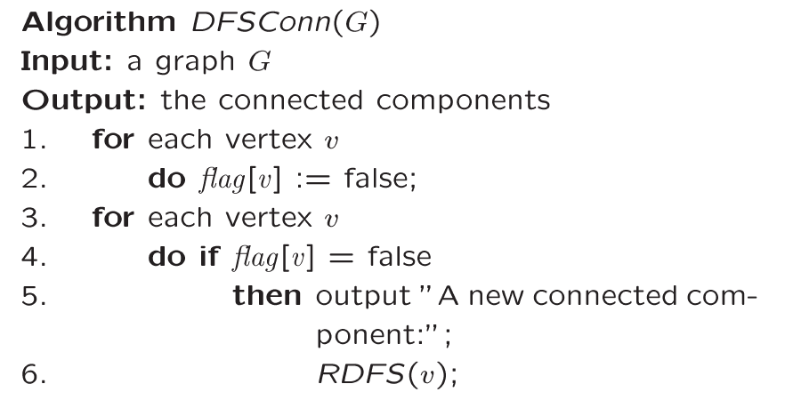
Finding Connected Components
For each vertex
If not visited
Call DFS
This will find
all vertices
connected
to “v” => one
connected component
Basic DFS algorithm.

Slide 9
Time Complexity
Running time for each i connected component
Question:
Can two connected components have the same edge?
Can two connected components have the same vertex?
So:

Slide 10
Trees
Tree arises in many computer science applications
A graph G is a tree if and only if it is connected and acyclic
(Acyclic means it does not contain any simple cycles)
The following statements are equivalent
G is a tree
G is acyclic and has exactly n-1 edges
G is connected and has exactly n-1 edges

Slide 11
Tree as a (directed) Graph
Is it a graph?
Does it contain cycles?
(in other words, is it acyclic)
How many vertices?
How many edges?
15
6
18
3
8
30
16

Slide 12
Directed Graph
A graph is directed if direction is assigned to each edge. We call the directed edges arcs.
An edge is denoted as an ordered pair (u, v)
Recall: for an undirected graph
An edge is denoted {u,v}, which actually corresponds to two arcs (u,v) and (v,u)

Slide 13
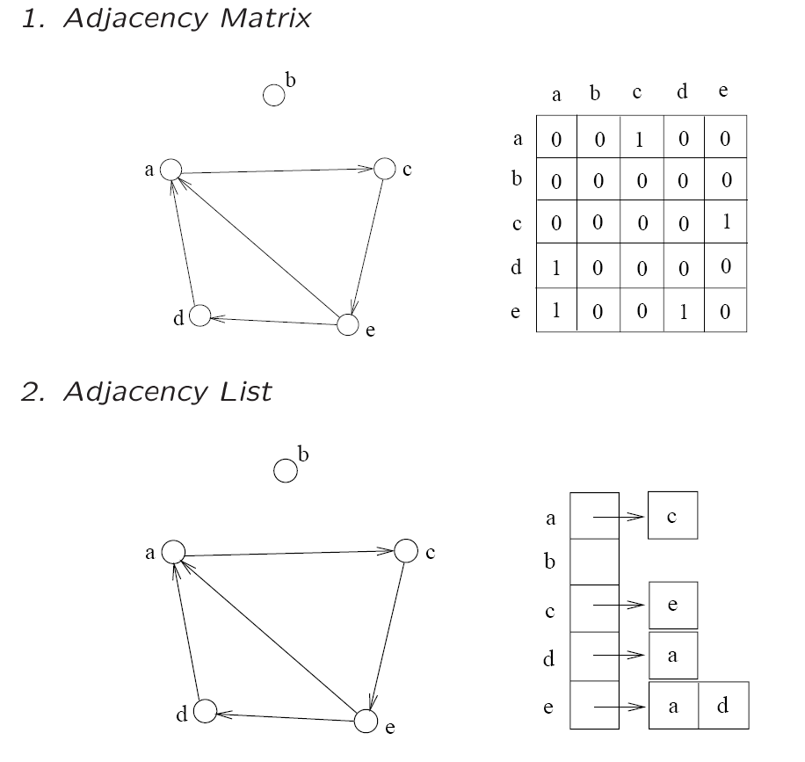
Representations
The adjacency matrix and adjacency list can be used

Slide 14
Directed Acyclic Graph
A directed path is a sequence of vertices (v₀, v₁, . . . , v_{k})
Such that (v_{i}, v_{i+1}) is an arc
A directed cycle is a directed path such that the first and last vertices are the same.
A directed graph is acyclic if it does not contain any directed cycles

Slide 15
Indegree and Outdegree
Since the edges are directed
We can’t simply talk about Deg(v)
Instead, we need to consider the arcs coming “in” and going “out”
Thus, we define terms
Indegree(v)
Outdegree(v)

Slide 16
Outdegree
All of the arcs going “out” from v
Simple to compute
Scan through list Adj[v] and count the arcs
What is the total outdegree? (m=#edges)

Slide 17
Indegree
All of the arcs coming “in” to v
Not as simple to compute as outdegree
First, initialize indegree[v]=0 for each vertex v
Scan through adj[v] list for each v
For each vertex w seen, indegree[w]++;
Running time: O(n+m)
What is the total indegree?

Slide 18
Indegree + Outdegree
Each arc (u,v) contributes count 1 to the outdegree of u and count 1 to the indegree of v.

Slide 19
Example
6
3
Indeg(2)?
Indeg(8)?
Outdeg(0)?
Num of Edges?
Total OutDeg?
Total Indeg?
8
0
7
2
9
1
5
4

Slide 20
Directed Graphs Usage
Directed graphs are often used to represent order-dependent tasks
That is we cannot start a task before another task finishes
We can model this task dependent constraint using arcs
An arc (i,j) means task j cannot start until task i is finished
Clearly, for the system not to hang, the graph must be acyclic.
i
j
Task j cannot start until task i is finished

Slide 21
University Example
Any directed cycles?
₁₀₄
CS departments course structure
₁₅₁
₁₇₁
₁₈₀
₃₄₂
₂₂₁
₂₀₁
₂₁₁
₂₅₁
₂₇₁
_{M111}
_{M132}
₂₅₂
₂₃₁
₃₀₃
₃₄₃
₂₇₂
₃₆₁
₃₈₁
₃₂₇
₃₄₁
₃₃₆
₃₃₄
₃₆₂
₃₃₂
How many indeg(171)?
How many outdeg(171)?

Slide 22
End of slides

