Slide 1
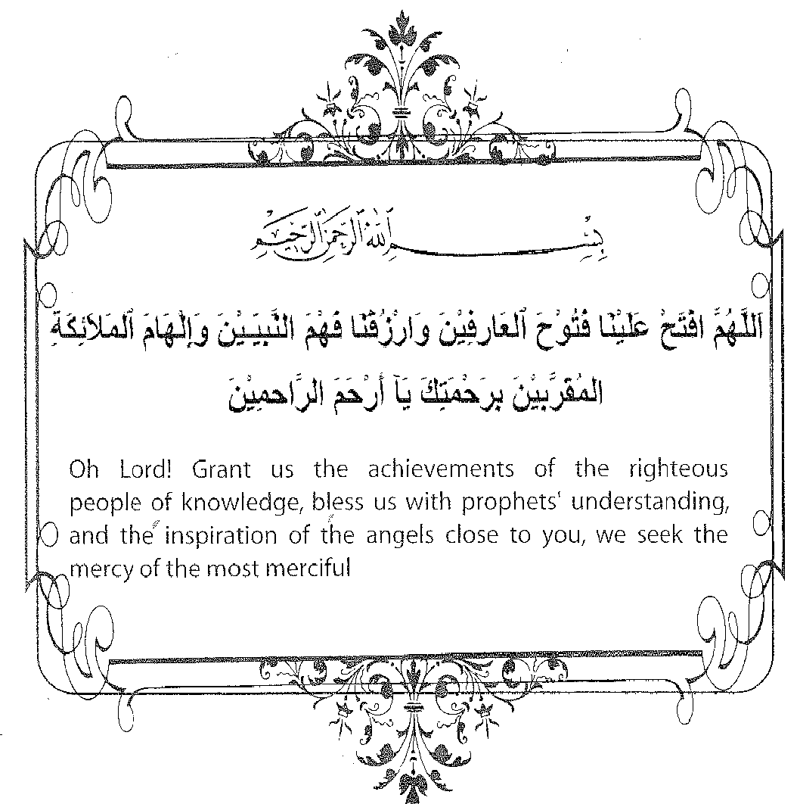
Du`a for Study

Slide 2
C++ Programming: From Problem Analysis to Program Design (D.S. Malik, 2018) A First Book of C++, (G. Bronson, 2012) C++ for Everyone (C.S. Horstman, 2012)
CHAPTER 1:
Introduction to Computers & Programming Languages
ELEMENTS OF PROGRAMMING
CSC 1100

Slide 3

CSC 1100 – Week1
DCS, KICT
In this topic, you will learn about:
Componentes of Computer
Introduction to Programming
Types of Programming Languages
Structured versus Object-oriented Programming
Algorithms & Problem Solving
C++ Programming
Common Mistakes in C++

Slide 4
Hardware Components
CSC 1100 – Week1
DCS, KICT
Computer hardware
Central Processing Unit
Main memory/Random Access Memory (RAM)
Input/Output Devices
Secondary storage
Computer software

Slide 5
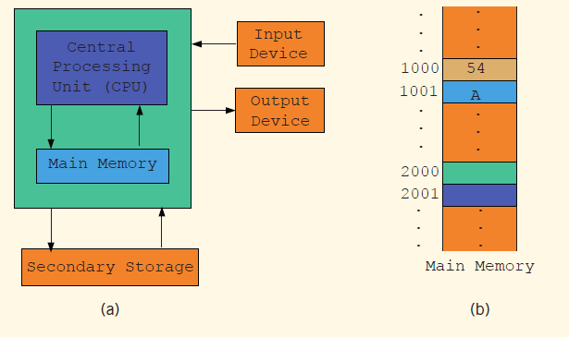
CSC 1100 – Week1
DCS, KICT
Central Processing Unit & Main Memory

Slide 6
Software
CSC 1100 – Week1
DCS, KICT
Software is a program that performs specific task
System programs control the computer
Operating system monitors the overall activity of the computer and provides services such as:
Memory management
Input/output activities
Storage management
A program that performs specific task
Word processors
Spreadsheets
Games

Slide 7
Introduction to Programming
CSC 1100 – Week1
DCS, KICT
Computer program (software)
Data and instructions used to operate a computer
Programming
Writing computer program in a language that the computer can respond to and that other programmers can understand
Programming language
Set of instructions, data, and rules used to construct a program

Slide 8
Types of Programming Languages
CSC 1100 – Week1
DCS, KICT
High-level languages (e.g., C, C++, C#, Visual Basic, Java, Python, R)
Low-level languages (e.g., Assembly language)

Slide 9
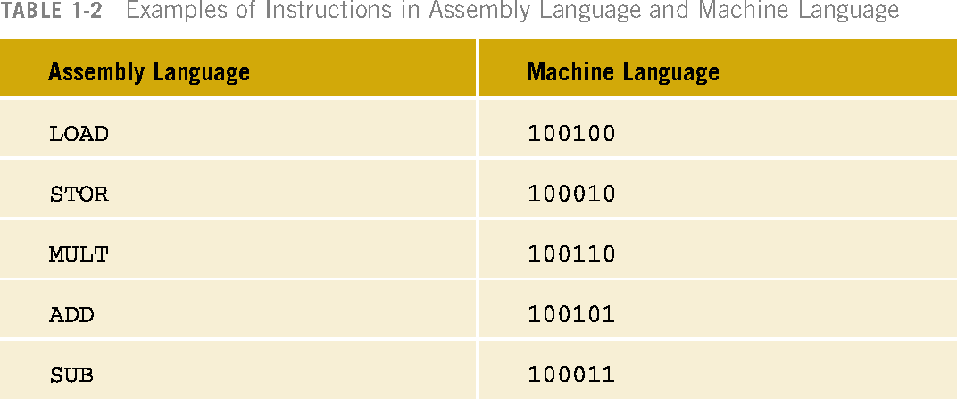
Assembly vs Machine Language
CSC 1100 – Week1
DCS, KICT
Assembly language is one of the earliest programming language used in early computers
To calculate wages = rates * hours in assembly language:
1) Load 2) Multiply 3) Store
010001
010010
010011
C++ Programming: From Problem Analysis to Program Design

Slide 10
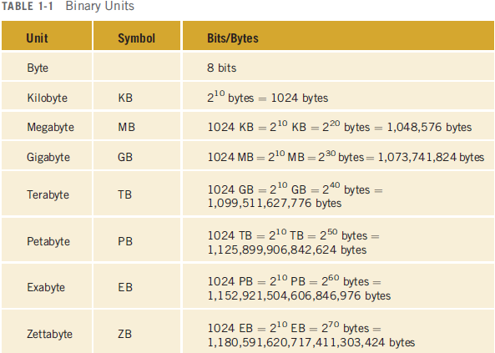
CSC 1100 – Week1
DCS, KICT
Machine Language
C++ Programming: From Problem Analysis to Program Design

Slide 11
Programming Methodologies
CSC 1100 – Week1
DCS, KICT
Structured
Object oriented
C++ is an object-oriented language
Has procedures and objects
Supports code reuse

Slide 12
Structured Programming
CSC 1100 – Week1
DCS, KICT
Structured design
Dividing a problem into smaller sub-problems
Structured programming:
Implementing a structured design
The structured design approach is also called:
Top-down (or bottom-up) design
Stepwise refinement
Modular programming

Slide 13
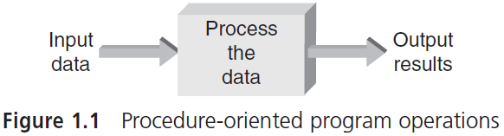
Structured/procedural Programming
CSC 1100 – Week1
DCS, KICT
a + b = ?
a = 2 , b =3
5

Slide 14
Object Oriented Programming
CSC 1100 – Week1
DCS, KICT
Object-oriented design (OOD)
Identify components called objects
Determine how objects interact with each other
Specify relevant data and possible operations to be performed on that data
Each object consists of data and operations on that data

Slide 15
History of C & C++Programming
CSC 1100 – Week1
DCS, KICT
C++ began as extension to C
C is a procedural language developed in the 1970s at AT&T Bell Laboratories
In early 1980s, Bjarne Stroustrup (“Bee-yarn-eh Strow-strup”, also at AT&T) used his background in simulation languages to develop C++
Object-orientation and other procedural improvements were combined with existing C language features to form C++

Slide 16
Algorithms and Procedures
CSC 1100 – Week1
DCS, KICT
Before writing a program, a programmer must clearly understand:
What data is to be used
The expected result
The procedure needed to produce this result
The procedure is referred to as an algorithm
Step-by-step sequence of instructions describing how to perform a computation
A First Book of C++ 4th Edition

Slide 17
Algorithms and Procedures (cont’d.)
CSC 1100 – Week1
DCS, KICT
Computers think in an algorithmic way (step by step, use rules)
Human thinks the heuristic way (based on experience, no rules!)
Assume that a program must calculate the sum of all whole numbers from 1 through 100 (1+2+3+4+5+…+100)
A computer :
Cannot respond to heuristic command: “Add the numbers from 1 - 100”
Is an algorithm-responding machine and not a heuristic-responding machine
Several methods or algorithms can be used to find the required sum

Slide 18
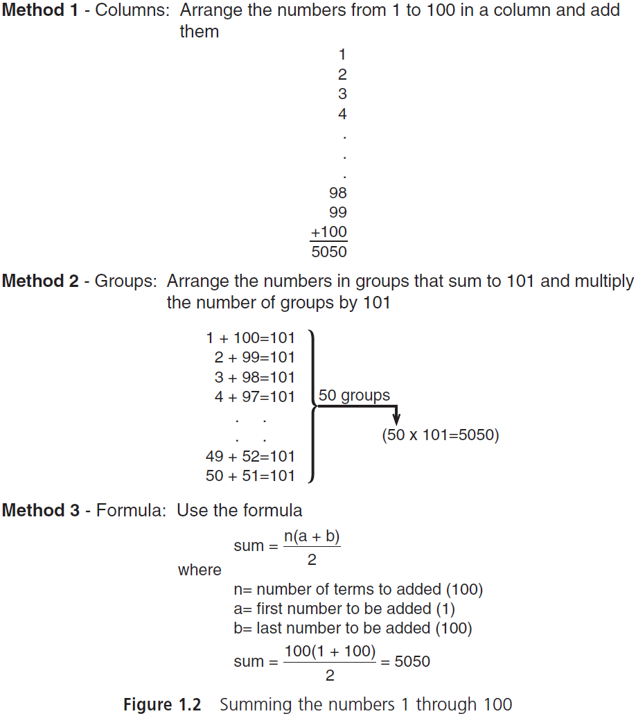
Different methods to sum up numbers
CSC 1100 – Week1
DCS, KICT

Slide 19
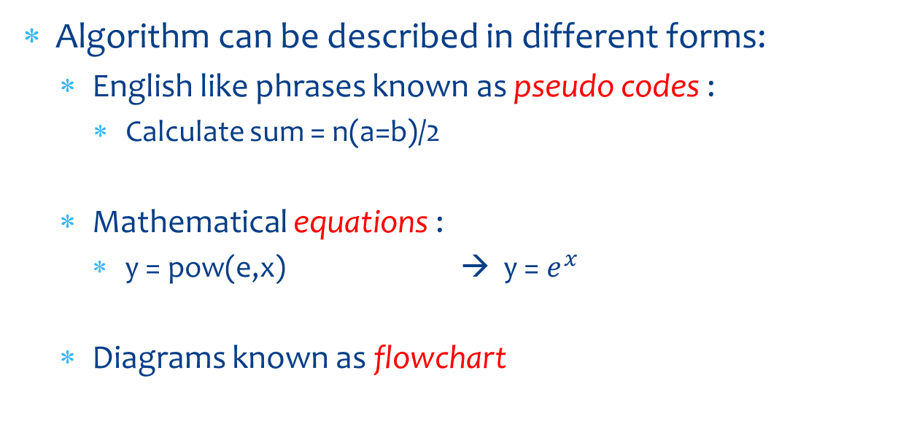
Algorithms and Procedures (cont’d.)
CSC 1100 – Week1
DCS, KICT
n(a+b)/2
A First Book of C++ 4th Edition

Slide 20
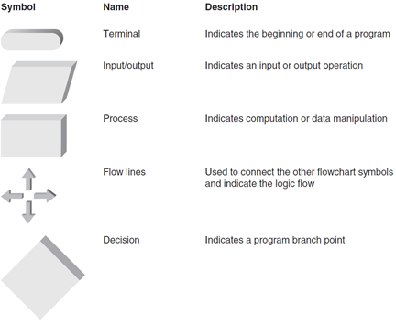
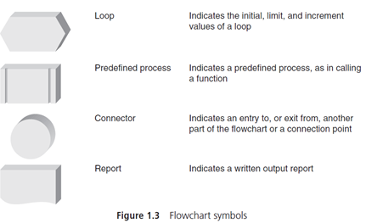
Flow Chart Symbols
CSC 1100 – Week1
DCS, KICT

Slide 21
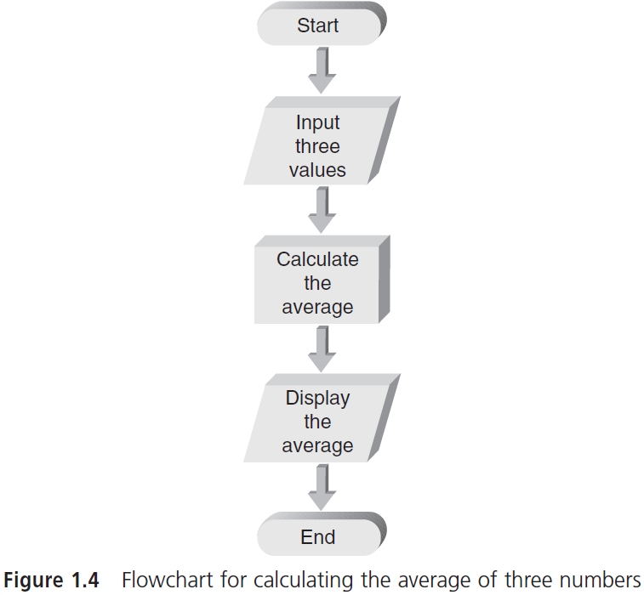
Program Flow Chart Calculate average of 3 numbers
CSC 1100 – Week1
DCS, KICT

Slide 22
Program Translation
CSC 1100 – Week1
DCS, KICT
C++ source program
Set of instructions written in C++ language
Machine language
Internal computer language
Consists of a series of 1s and 0s (binaries)
Source program cannot be executed until it is translated into machine language
Interpreted language translates one statement at a time
Compiled language translates all statements together

Slide 23
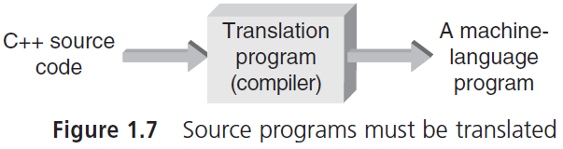
Program Translation (cont'd.)
CSC 1100 – Week1
DCS, KICT
int x = 8
100100 010010

Slide 24
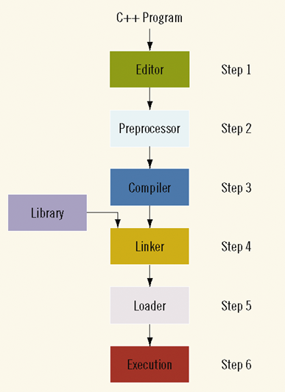
Processing a Program
CSC 1100 – Week1
DCS, KICT

Slide 25
C++ Identifiers & Its Rules
CSC 1100 – Week1
DCS, KICT
Identifiers (or variables)
Names that convey an idea of the purpose of function or class
Identifier composition rules
First character must be a letter or underscore (A1, _1)
Only letter, digit, or underscore may follow (AA, A2, A_)
Blank spaces aren’t allowed (A B)
Identify component words with initial capitalization (numPos)
Cannot be C++ keyword (e.g., auto, break, int, switch …)
Should be a mnemonic (short, easy to remember, meaningful)

Slide 26
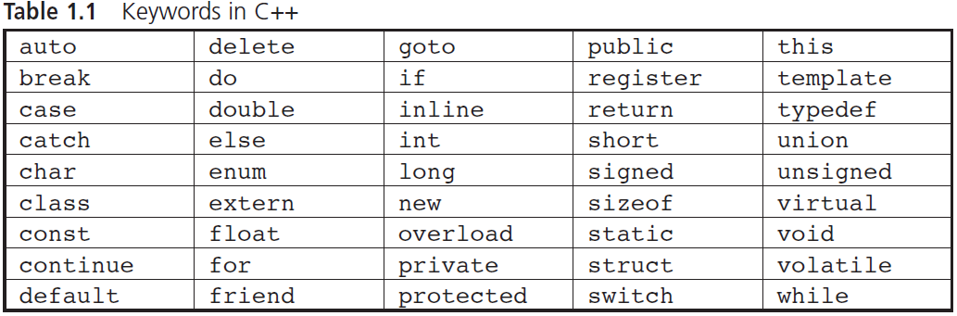
Standard commands & keywords in C++
CSC 1100 – Week1
DCS, KICT

Slide 27
Valid Identifiers (variables)
CSC 1100 – Week1
DCS, KICT
Examples of valid identifiers:
grosspay $cost (valid in C++)
addNums degToRad
multByTwo salesTax
netPay total_
_name my$
**Note: When we combine two or more words to form an identifier (or variables), it is the best to capitalize each of the new word.

Slide 28
Invalid Identifiers
CSC 1100 – Week1
DCS, KICT
Examples of invalid identifiers:
4ab3 (begins with a number)
e*6 (contains a special character)
while (is a keyword)
#amount (begins with special character)

Slide 29
The main() Function
CSC 1100 – Week1
DCS, KICT
Each C++ program must have one and only one key function named main()
Called a driver function because it drives the other modules

Slide 30
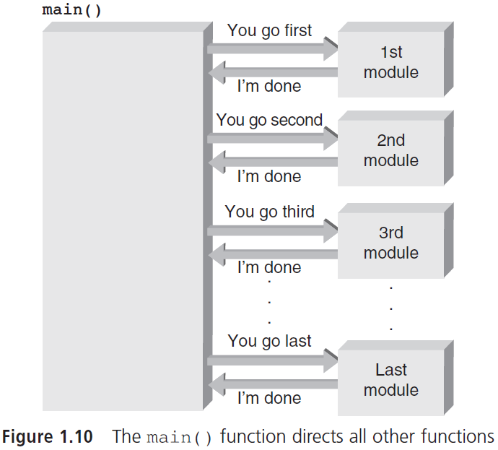
The main() Function (cont'd.)
CSC 1100 – Week1
DCS, KICT

Slide 31
The main() Function (cont'd.)
CSC 1100 – Week1
DCS, KICT
First line of function is called header line
What type of data, if any, is returned from function
The name of function
What type of data, if any, is sent into function
Data transmitted into function at runtime are referred to as of function
arguments (input to function)
Example:
header line void sum(int aa, int b)
{
}
data 1
data 2

Slide 32
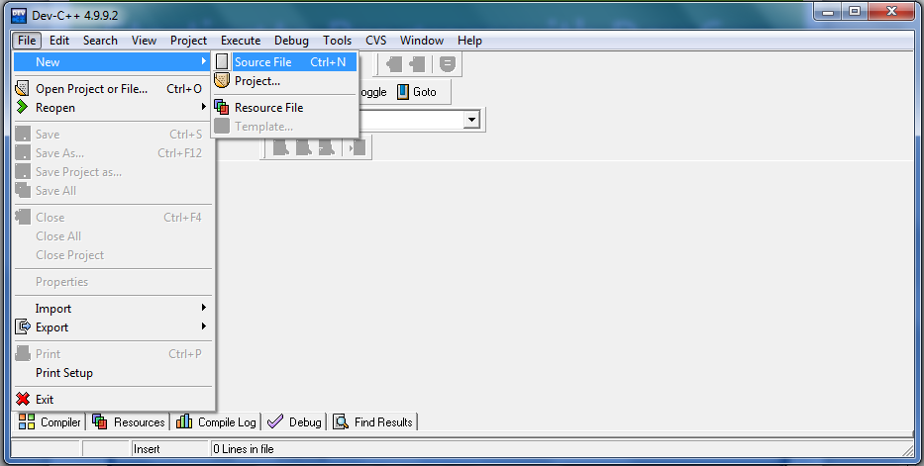
Starting to Program with Dev C++
CSC 1100 – Week1
DCS, KICT

Slide 33
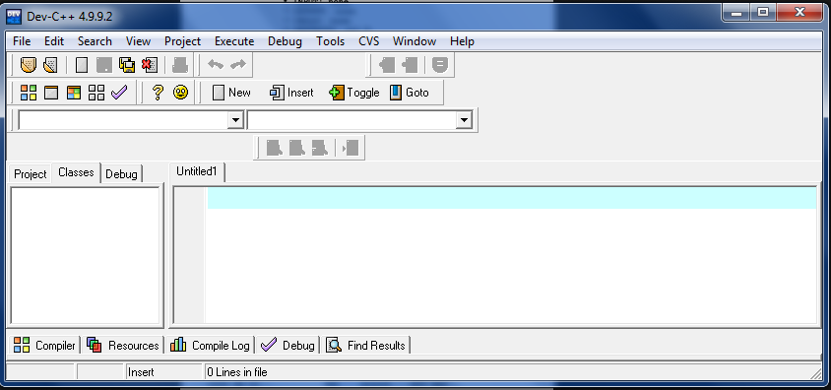
Starting to Program with Dev C++
CSC 1100 – Week1
DCS, KICT

Slide 34
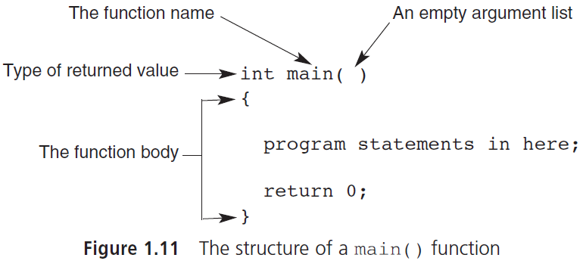
The main() Function (cont'd.)
CSC 1100 – Week1
DCS, KICT
beginning of program
end of program

Slide 35
The cout Object
CSC 1100 – Week1
DCS, KICT
The cout object sends data to the standard output display device
The display device is usually a video screen
Name derived from console output and pronounced “see out”
similar to “printf” in C programming
Data is passed to cout by the insertion symbol
cout << "Hello there, World!";

Slide 36
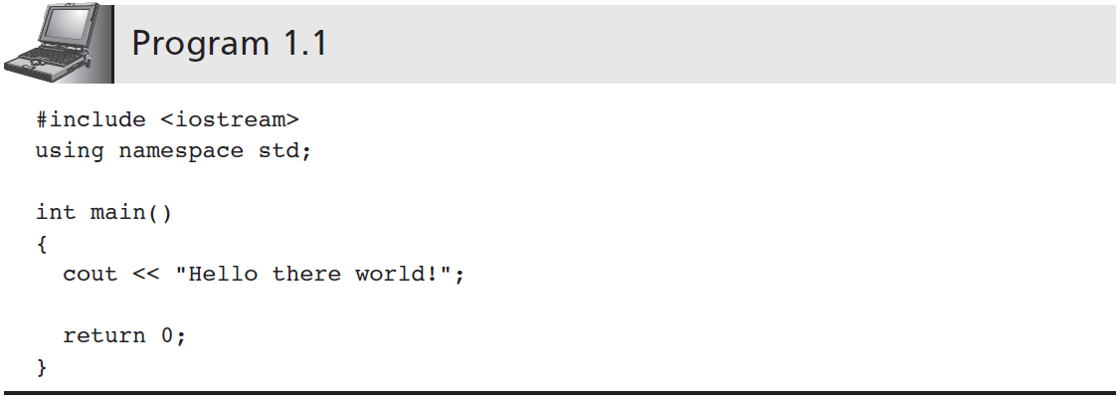
The cout Object (cont’d.)
CSC 1100 – Week1
DCS, KICT
//Pre-processor command <header file>
//File for pre-written classes/classes (a container that
// provides contexts/scope for variables)
cout << "Welcome to the C++ world! ";
system("pause"); //to freeze the screen

Slide 37
The cout Object (cont’d.)
CSC 1100 – Week1
DCS, KICT
//Pre-processor command <header file>
name for namespace
cout << "Welcome to the C++ world! ";
std::cout << "Welcome to the C++ world! ";
system("pause");

Slide 38
The cout Object (cont’d.)
CSC 1100 – Week1
DCS, KICT
Preprocessor command
Performs an action before the compiler translates source code to machine code
Example: #include <iostream>
Causes the iostream file to be inserted wherever the #include command appears
iostream is part of the C++ standard library
Included in iostream are two important classes:
istream: Declarations and methods for data input
ostream: Declarations and methods for data output

Slide 39
The cout Object (cont’d.)
CSC 1100 – Week1
DCS, KICT
Namespace
File accessed by compiler when looking for prewritten classes or functions
Sample namespace statement:
using namespace std;
iostream contained in a namespace called std
Compiler uses iostream’s cout object from std whenever cout is referenced

Slide 40
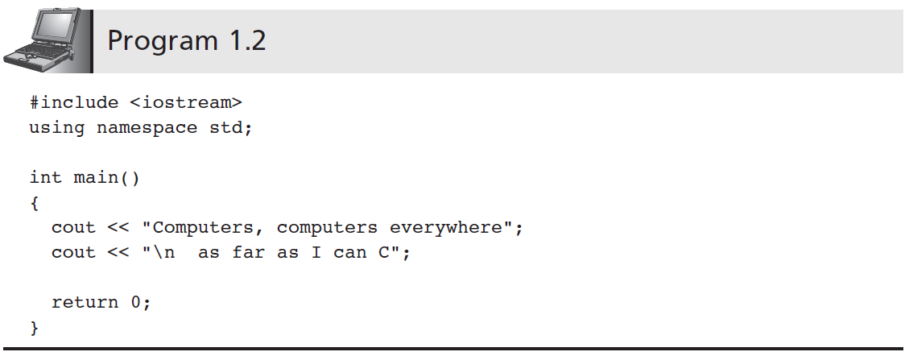
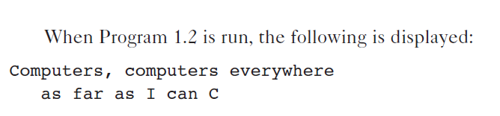
The cout Object (cont’d.)
CSC 1100 – Week1
DCS, KICT

Slide 41
The cout Object (cont’d.)
CSC 1100 – Week1
DCS, KICT
Newline escape sequence (“\n”)
Instructs the display device to move to a new line
Caused when the characters backslash \ and n are used together
Backslash provides an “escape” from the normal interpretation of the character that follows
Newline escape sequences can be placed anywhere within a message to cout

Slide 42
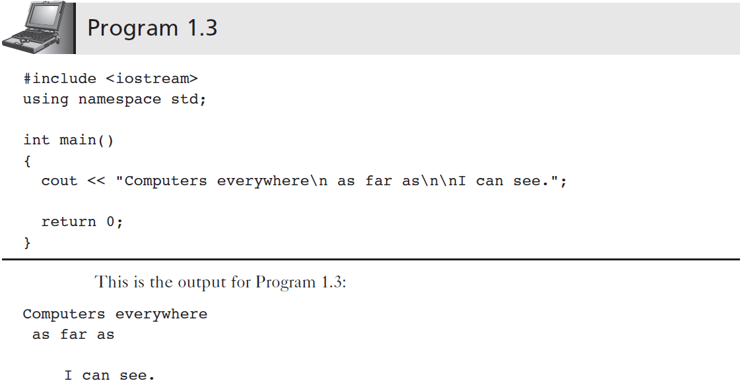
The cout Object (cont’d.)
CSC 1100 – Week1
DCS, KICT

Slide 43
Programming Style
CSC 1100 – Week1
DCS, KICT
Every C++ program must contain one and only one main() function
Statements included within braces { }
C++ allows flexibility in format for the word main, the parentheses ( ), and braces { }
More than one statement can be put on line
One statement can be written across lines
Use formatting for clarity and ease of program reading

Slide 44
Programming Style (cont’d.)
CSC 1100 – Week1
DCS, KICT
Function name starts in column 1
Name and parentheses on their own line
Opening brace of function body on next line
Aligned with first letter of function name
Closing brace is last line of function
Aligned with opening brace
Standard form highlights the function as a unit

Slide 45
Programming Style (cont’d.)
CSC 1100 – Week1
DCS, KICT
Within function, indent statements 2-3 spaces
Creates uniform look for similar statement groups
Good programming practice
Final program form should be consistent
Proper format improves program readability and understandability

Slide 46
Comments
CSC 1100 – Week1
DCS, KICT
Explanatory remarks written within program (//)
Clarify purpose of the program
Describe objective of a group of statements
Explain function of a single line of code
Computer ignores all comments
Comments exist only for convenience of reader
A well-constructed program should be readable and understandable
Comments help explain unclear components

Slide 47
Comments (cont’d.)
CSC 1100 – Week1
DCS, KICT
Line comment
Begins with two slashes(//) and continues to the end of the line
Can be written on line by itself or at the end of line that contains program code
// this is a line comment
Block comment
Multiple-line comment begins with the symbols /* and ends with the symbols */
/* This is a block comment that
spans
three lines */

Slide 48
Common Programming Errors
CSC 1100 – Week1
DCS, KICT
Omitting parentheses after main( )
Omitting or incorrectly typing the opening brace {
Opening brace signifies start of function body
Omitting or incorrectly typing the closing brace }
Closing brace signifies end of function
Omitting the semicolon at the end of each statement ;
Adding a semicolon after the preprocessor command
#include <iostream> ; X (wrong, not needed)

Slide 49
Common Programming Errors (cont'd.)
CSC 1100 – Week1
DCS, KICT
Misspelling the name of an object or function
Example: Typing “cot” instead of “cout”
Forgetting to close a string sent to cout with a double-quote symbol
cout << "Salaam everyone
Forgetting the \n to indicate a new line
missing closing quote "

Slide 50
What have we learned?
CSC 1100 – Week1
DCS, KICT
A C++ program consists of one or more modules
One module must be the function main()
main() is starting point of C++ program
The simplest C++ program has the form:
#include <iostream>
using namespaces std;
int main()
{
program statements;
return 0;
}

Slide 51
What have we learned?(cont'd.)
CSC 1100 – Week1
DCS, KICT
C++ statements are terminated by a semicolon ;
Standard library contains many functions and classes
Standard Library provided with C++ compiler
Includes <iostream> for input and output
cout object displays text or numeric results
Stream of characters is sent to cout by:
Enclosing characters in double quotes " "
Using the insertion (“put to”) operator, <<

Slide 52
In-class Activity (Due 19/9 before class)
CSC 1100 – Week1
DCS, KICT
Find a partner & get into a group of 2
Describe the algorithm for the following programming problem in written English (break up the problem into smaller parts).
Draw a step-by-step flow chart to represent the problem.
Sara and Ameena are setting up new cake business. They accept three types of orders : birthday cake, wedding cakes and cup cakes. They are pretty excited about getting the orders in.
Suppose that the cost of each birthday cake is RM35 per kg, wedding cake is RM55 per kg and cupcake is RM 4.50 per piece. How much money can they earn if customers ordered 3 birthday cakes with 2 kg, 4.5 kg and 3 kg each, 2 wedding cakes with 5 kg and 3.5 kg each and 250 cupcakes?

Slide 53
Example Algorithm
CSC 1100 – Week1
DCS, KICT
Find the volume of a cone:
volume of cone = ∏ x r² x h
Algorithm :
Get the radius of the cone
Get the height of the cone
Calculate the volume using the equation:
volume of cone = ∏ x r² x h

