Slide 1
C++ Programming: From Problem Analysis to Program Design (D.S. Malik, 2018) A First Book of C++, (G. Bronson, 2012) C++ for Everyone (C.S. Horstman, 2012)
CHAPTER 2
Basic Elements of C++: Data Types, Declarations & Assignments
ELEMENTS OF PROGRAMMING
CSC 1100

Slide 2

CSC 1100 – Week1
DCS, KICT
In this topic, you will learn about:
Motivations for C++
Different data types in C++
Arithmetic Operators
Arithmetic Expressions
Variable Declarations
Common Programming Errors

Slide 3
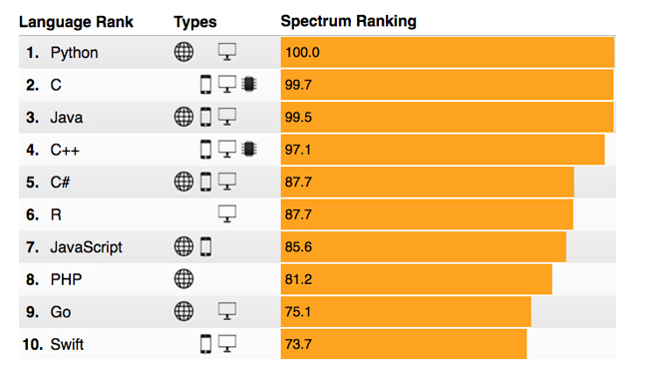
Top 2017 Programming Languages (IEEE Spectrum)
CSC 1100 – Week1
DCS, KICT

Slide 4
Data Types
CSC 1100 – Week2
DCS, KICT
The objective of all programs is to process data
Data is classified into specific types
Numerical
Alphabetical
Audio
Video
C++ allows only certain operations to be performed on certain types of data
Prevents inappropriate programming operations

Slide 5
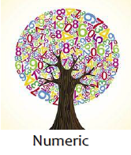





CSC 1100 – Week2
DCS, KICT
Types of Data

Slide 6


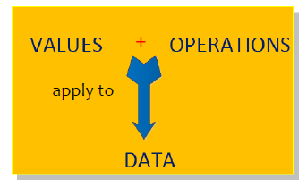
What is a Data Type?
CSC 1100 – Week2
DCS, KICT
A set of values and operations that can be applied to a particular data

Slide 7
Data Types Example
CSC 1100 – Week2
DCS, KICT
Integer
The values:
set of all Integer numbers (whole number, no decimal points)
The operations:
common mathematical and comparison operators

Slide 8
Data Types Example
CSC 1100 – Week2
DCS, KICT
Literals
Values that explicitly identifies itself (what you see is what you get)
The numbers 2, 3.6, and –8.2 are literals
Values are literally displayed
The text “Hello World!” is a literal
Text itself is displayed
Literals also known as literal values and constants

Slide 9
Categories of Data Types in C++
CSC 1100 – Week2
DCS, KICT
Class data type
Programmer-created data type
Set of acceptable values and operations defined by a programmer using C++ code
Built-in data type
Provided as an integral part of C++
Also known as a primitive type
Requires no external code
Consists of basic numerical types
Majority of operations are symbols (e.g. +, -, *, …)

Slide 10
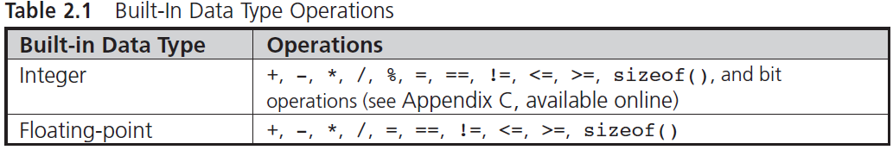
Numerical Data Types
CSC 1100 – Week2
DCS, KICT

Slide 11
Integer Data Types
CSC 1100 – Week2
DCS, KICT
C++ provides nine built-in integer data types :
bool, char, short int, int, long int unsigned char, unsigned short int, unsigned int, unsigned long int
Three most important
int
char
bool
Reason for remaining types is historical
Originally provided for special situations
Difference among types based on storage requirements

Slide 12

Integer Data Types (cont’d.)
CSC 1100 – Week2
DCS, KICT
int data type
Set of values supported are whole numbers
Whole numbers mathematically known as integers
Explicit signs allowed
Examples of valid int :
0 5 -10 +25 1000 253 -26351 +36
Explicit signs : positive (+) and negative (-)

Slide 13
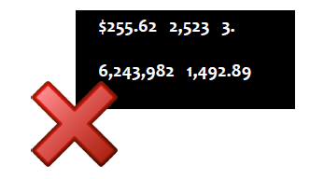
Integer Data Types (cont’d.)
CSC 1100 – Week2
DCS, KICT
Commas, decimal points, and special signs not allowed
Examples of invalid int :

Slide 14
Integer Data Types (cont’d.)
CSC 1100 – Week2
DCS, KICT
Different compilers have different internal limits on the largest and smallest values that can be stored in each data type
Most common allocation for int is 4 bytes
(range: -2,147,483,648 to 2,147,483,647)
smallest possible integer stored
largest possible integer stored

Slide 15
Integer Data Types (cont’d.)
CSC 1100 – Week2
DCS, KICT
char data type
Used to store single characters
Letters of the alphabet (upper- and lowercase)
Digits 0 through 9
Special symbols such as + $ . , - !
Single character value: letter, digit, or special character enclosed in single quotes
Examples 'A' '$' 'b' '7' 'y' '!' 'M' 'q'
A First Book of C++ 4th Edition

Slide 16
Integer Data Types (cont’d.)
CSC 1100 – Week2
DCS, KICT
Character values stored in ASCII or Unicode codes
ASCII: American Standard Code for Information Interchange
Provides English language-based character set plus codes for printer and display control
Each character code contained in 1 byte (1 byte = 8 bits)
256 distinct codes

Slide 17
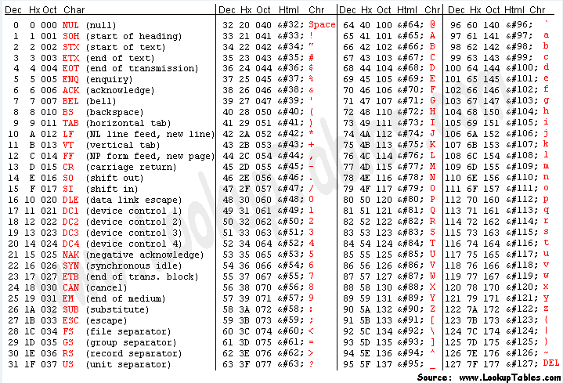
ASCII Code
CSC 1100 – Week2
DCS, KICT

Slide 18
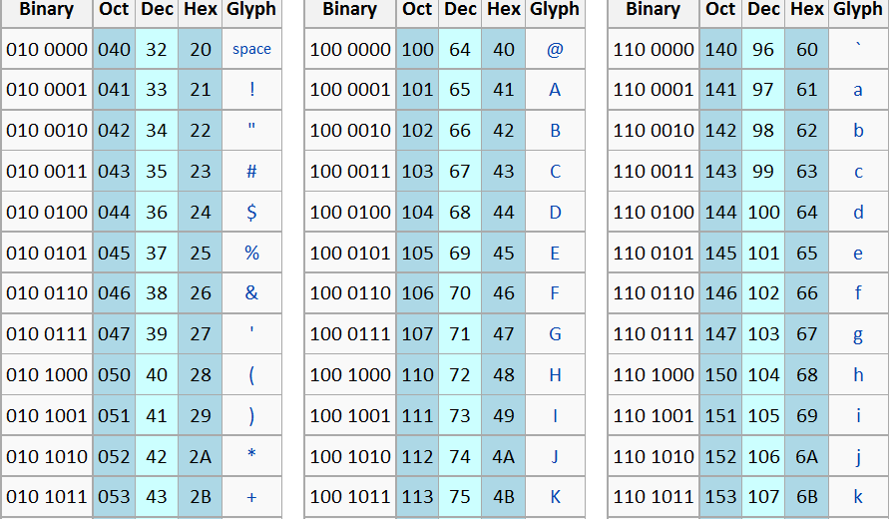
ASCII Code
CSC 1100 – Week2
DCS, KICT

Slide 19
Integer Data Types (cont’d.)
CSC 1100 – Week2
DCS, KICT
Unicode: provides other language character sets
Each character contained in 2 bytes
Can represent 65,536 characters
First 256 Unicode codes have same numerical value as the 256 ASCII codes

Slide 20
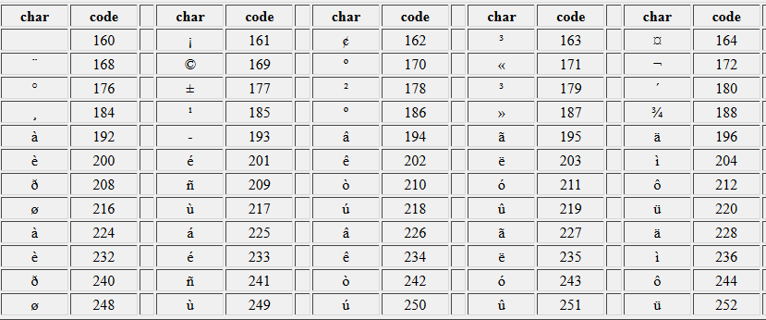
Unicode
CSC 1100 – Week2
DCS, KICT

Slide 21
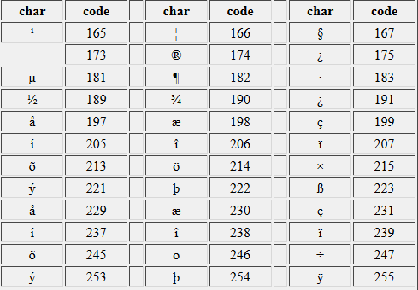
Unicode
CSC 1100 – Week2
DCS, KICT

Slide 22
Integer Data Types (cont’d.)
CSC 1100 – Week2
DCS, KICT
The escape character
Backslash ( \ )
Special meaning in C++
Placed in front of a group of characters, it tells the compiler to escape from normal interpretation of these characters
Escape sequence: combination of a backslash and specific characters
Example: newline escape sequence, \n

Slide 23
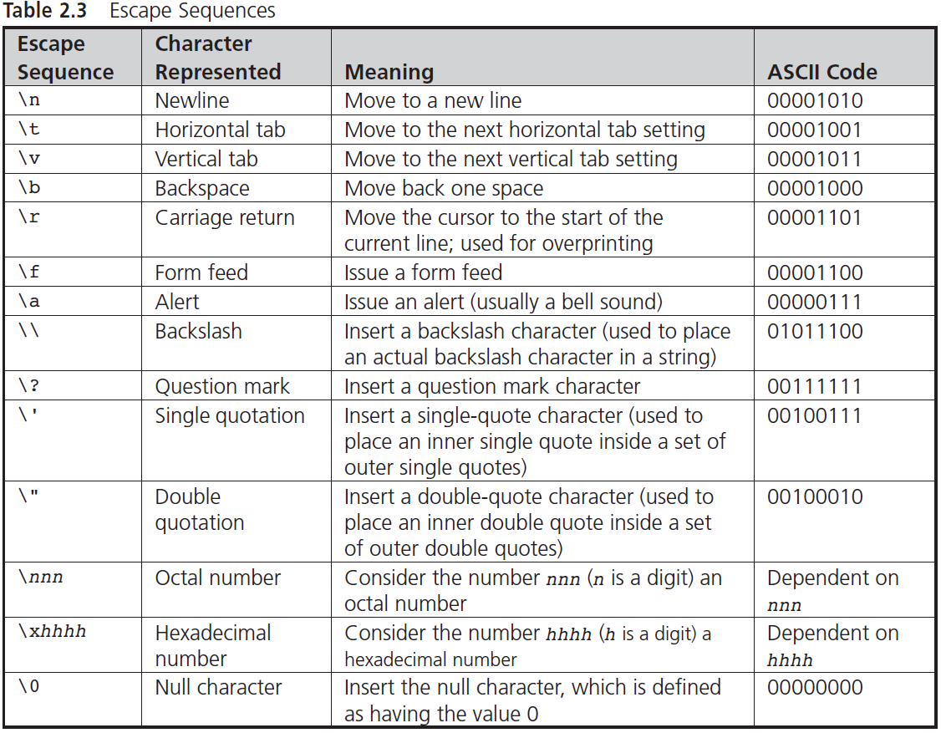
CSC 1100 – Week2
DCS, KICT

Slide 24
Integer Data Types (cont’d.)
CSC 1100 – Week2
DCS, KICT
bool data type
Represents boolean (logical) data
Restricted to true or false values
Often used when a program must examine a specific condition
If condition is true, the program takes one action; if false, it takes another action
Boolean data type uses an integer storage code

Slide 25

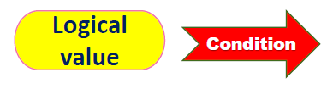
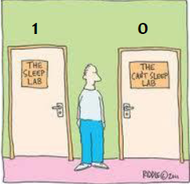
Bool Data Type
CSC 1100 – Week2
DCS, KICT

Slide 26
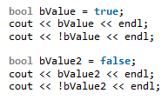



Example Boolean
CSC 1100 – Week2
DCS, KICT

Slide 27
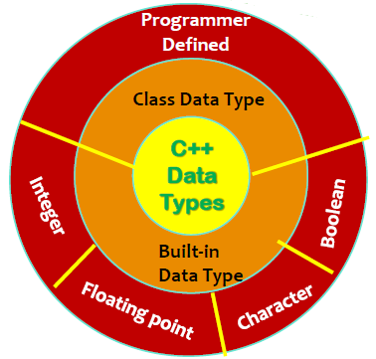
Overview of C++ Data Types
CSC 1100 – Week2
DCS, KICT

Slide 28
Determining Storage Size
CSC 1100 – Week2
DCS, KICT
C++ makes it possible to see how values are stored
sizeof()
Provides the number of bytes required to store a value for any data type
Built-in operator that does not use an arithmetic symbol

Slide 29
Determining Storage Size (cont’d.)
CSC 1100 – Week2
DCS, KICT
Signed data type: stores negative, positive, and zero values
Unsigned data type: stores positive and zero values
Provides a range of positive values double that of unsigned counterparts
Some applications only use unsigned data types
Example: date applications in form yearmonthday

Slide 30
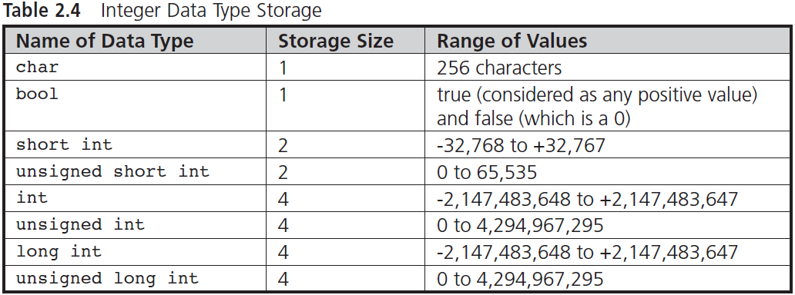
Determining Storage Size (cont'd.)
CSC 1100 – Week2
DCS, KICT

Slide 31
Determining Storage Size (cont'd.)
CSC 1100 – Week2
DCS, KICT
Type | Storage | Absolute Range
Float | 4 bytes | 1.40129846432481707 x 10⁻⁴⁵ to 3.40282346638528860 x 10⁻⁴⁵
double and long double | 8 bytes | 4.94065645841246544 x 10⁻⁴⁵ to 1.79769313486231570 x 10⁻⁴⁵

Slide 32
Floating-Point Types
CSC 1100 – Week2
DCS, KICT
The number zero or any positive or negative number that contains a decimal point
Also called real number
Examples: +10.625 5. -6.2 3521.92 0.0
5. and 0.0 are floating-point, but same values without a decimal (5, 0) would be integers
C++ supports three floating-point types
float, double, long double
Different storage requirements for each

Slide 33
Floating-Point Types (cont'd.)
CSC 1100 – Week2
DCS, KICT
Most compilers use twice the amount of storage for doubles as for floats
Allows a double to have approximately twice the precision of a float
A float value is sometimes referred to as a single-precision number
A double value is sometimes referred to as a double-precision number
Examples :
45.1252 (single precision)
45.12526732 (double precision)

Slide 34
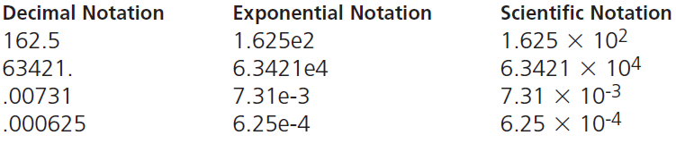
Exponential Notation
CSC 1100 – Week2
DCS, KICT
Floating-point numbers can be written in exponential notation
Similar to scientific notation
Used to express very large and very small values in compact form

Slide 35
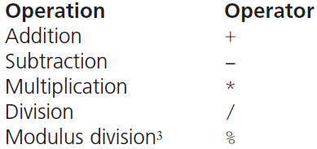
Arithmetic Operations
CSC 1100 – Week2
DCS, KICT
Binary operators: require two operands
Can be a literal or an identifier
Binary arithmetic expression:
literalValue operator literalValue
A First Book of C++ 4th Edition

Slide 36
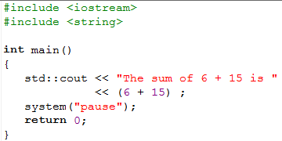
Arithmetic Operators
CSC 1100 – Week2
DCS, KICT
cout allows for display of result of a numerical expression
Display is on standard output device
Example:
cout << "The sum of 6 and 15 is "
<< (6 + 15);
Statement sends string and value to cout
String: “The total of 6 and 15 is ”
Value: value of the expression 6 + 15
Display produced: The total of 6 and 15 is 21

Slide 37
Arithmetic Operators (cont'd.)
CSC 1100 – Week2
DCS, KICT
Manipulator
Item used to change how an output stream of characters is displayed
endl (end+lowercase ‘L’) manipulator causes a newline character ('\n') to be inserted in the display first
Then forces all current insertions to be displayed immediately

Slide 38
Arithmetic Expressions
CSC 1100 – Week2
DCS, KICT
Mixed-mode expression
Arithmetic expression containing integer and non-integer operands
Rule for evaluating arithmetic expressions
Both operands are integers: result is integer
Example : 1 + 2 = 3
One operand is floating-point: result is floating-point
Example : 1.0 + 2 = 3.0
Overloaded operator: a symbol that represents more than one operation
Execution depends on types of operands
Example : “a” + “b” = “ab” (Concatenation for string)
2 + 3 = 5 (Addition for integer)

Slide 39
Integer Division & Modulus
CSC 1100 – Week2
DCS, KICT
Division of two integers yields an integer
Integers cannot contain a fractional part (i.e., decimal points) ; results may seem strange
Example: integer 15 divided by integer 2 produces the integer result 7 (i.e., 15/2 = 7 and not 7.5)
Modulus operator (%): captures the remainder
Also known as the remainder operator
Example: 9 % 4 is 1 (remainder of 9/4 is 1)
Useful operator for determining odd or even numbers

Slide 40
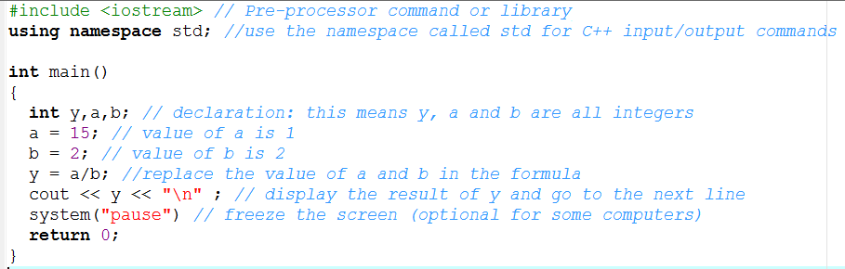

Integer Division
CSC 1100 – Week2
DCS, KICT
Program:
Output:

Slide 41
Negation
CSC 1100 – Week2
DCS, KICT
A unary operation that negates (reverses the sign of) the operand
Uses same sign as binary subtraction (-)
Example : -9

Slide 42
Operator Precedence and Associativity
CSC 1100 – Week2
DCS, KICT
Rules for expressions with multiple operators
Two binary operators cannot be placed side by side
Example : x = a + - b
Parentheses may be used to form groupings
Example : x = (a+b) * (c-d )
Expressions within parentheses are evaluated first
Example: x = a/b + (c * d) → (c * d) get evaluated first

Slide 43
Operator Precedence and Associativity (cont'd.)
CSC 1100 – Week2
DCS, KICT
Rules for expressions with multiple operators
Sets of parentheses may be enclosed by other parentheses
Example : x = ( (a+b) * 3 + ( (c/d) – e) )
Parentheses cannot be used to indicate multiplication
Example : x = a (b) x = a * (b)
x = a * b
*Accepted in Maths but not in programming

Slide 44
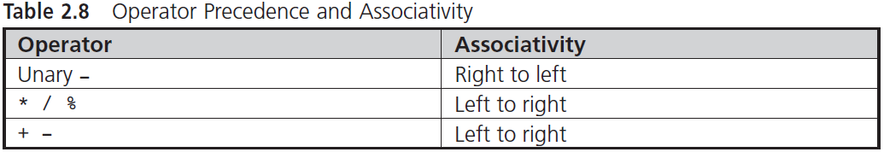
Operator Precedence and Associativity (cont'd.)
CSC 1100 – Week2
DCS, KICT

Slide 45
Variables and Declarations
CSC 1100 – Week2
DCS, KICT
Symbolic names used in place of memory addresses
Symbolic names are called variables (or identifiers)
These variables refer to memory locations
The value stored in the variable can be changed
Simplifies programming effort
Assignment statement: assigns/gives a value to a variable
Format: variable name = value assigned/given;
Example: num1 = 45;

Slide 46
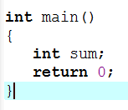
Declaration Statements
CSC 1100 – Week2
DCS, KICT
Names a variable and specifies its data type
General form:
dataType variableName;
Example:
int sum;
declares sum as variable which stores an integer value
Declaration statements can be placed anywhere in function
Typically grouped together and placed immediately after the function’s opening brace
Variable must be declared before it can be used

Slide 47
Example 1: Finding average grade
CSC 1100 – Week2
DCS, KICT
//PROGRAM 2.3
#include <iostream>
using namespace std;
int main()
{
double grade1; // declare variable grade1 as a double
double grade2; // declare variable grade2 as a double
double total; // declare variable total as a double
double average; // declare variable average as a double
grade1 = 85.5; //assign a value of 85.5 to grade1
grade2 = 97.0; //assign a value of 97.0 to grade2
total = grade1 + grade2; //add grade1 & grade2, store in total
average = total/2.0; //divide total with 2.0, store in average
cout << "The average grade is " << average << endl;
system("Pause");
return 0;
}
Variable
declaration
Variable assignment/ initialization
Process/
computation

Slide 48
Multiple Declarations
CSC 1100 – Week2
DCS, KICT
Variables with the same data type can be grouped together and declared in one statement
Format: dataType variableList;
Example:
double grade1, grade2, total, average;
Initialization: using a declaration statement to store a value in a variable
Good programming practice is to declare each initialized variable on a line by itself
Example:
double grade2 = 93.5;
/*initialize grade2 with a default value */

Slide 49
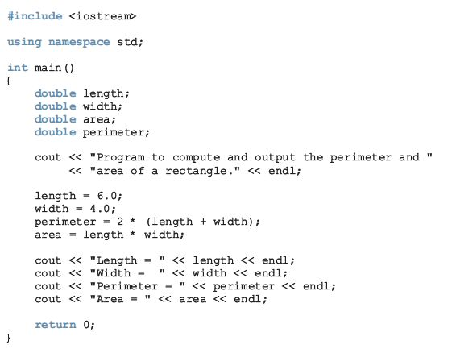




Example 2: Finding area & parameter of a rectangle
CSC 1100 – Week2
DCS, KICT
C++ Programming: From Problem Analysis to Program Design

Slide 50
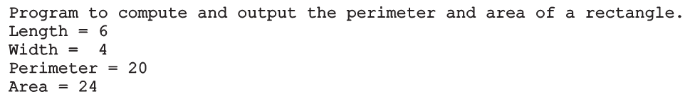
CSC 1100 – Week2
DCS, KICT
Sample run:
C++ Programming: From Problem Analysis to Program Design

Slide 51
Programming Exercise 1
CSC 1100 – Week2
DCS, KICT
Create a program to sum up a series of integer no from (1-68).
Use the formula for sum that you learnt last week. Use you flow chart as a guide to your algorithm.
Work in pairs.

Slide 52
Programming Exercise 2
CSC 1100 – Week2
DCS, KICT
Create a program to solve your algorithm problem for flow chart exercise last week.
Work with the same partner.
Finish your programs in class and submit your solutions through italeem.

Slide 53
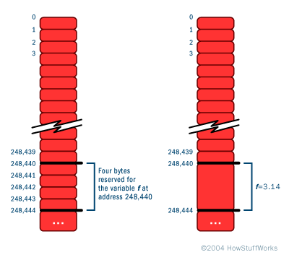
Memory Allocation
CSC 1100 – Week2
DCS, KICT
Each data type has its own storage requirements
Computer must know variable’s data type to allocate storage
Declaration statements are used for the purpose of allocating storage

Slide 54
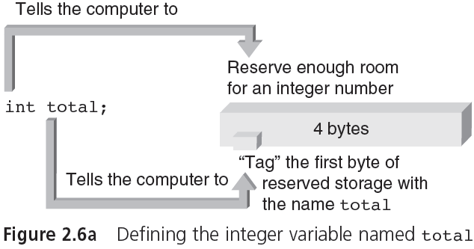
Memory Allocation (cont'd.)
CSC 1100 – Week2
DCS, KICT
MEMORY ADDRESS
12345
total
12346
4 bytes allocated for total
12347
12348
12349

Slide 55

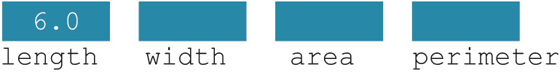
CSC 1100 – Week2
DCS, KICT
Variable: a memory location whose contents can be changed
Figure 2-2 Memory allocation
Figure 2-3 Memory spaces after the statement length = 6.0; executes
C++ Programming: From Problem Analysis to Program Design

Slide 56
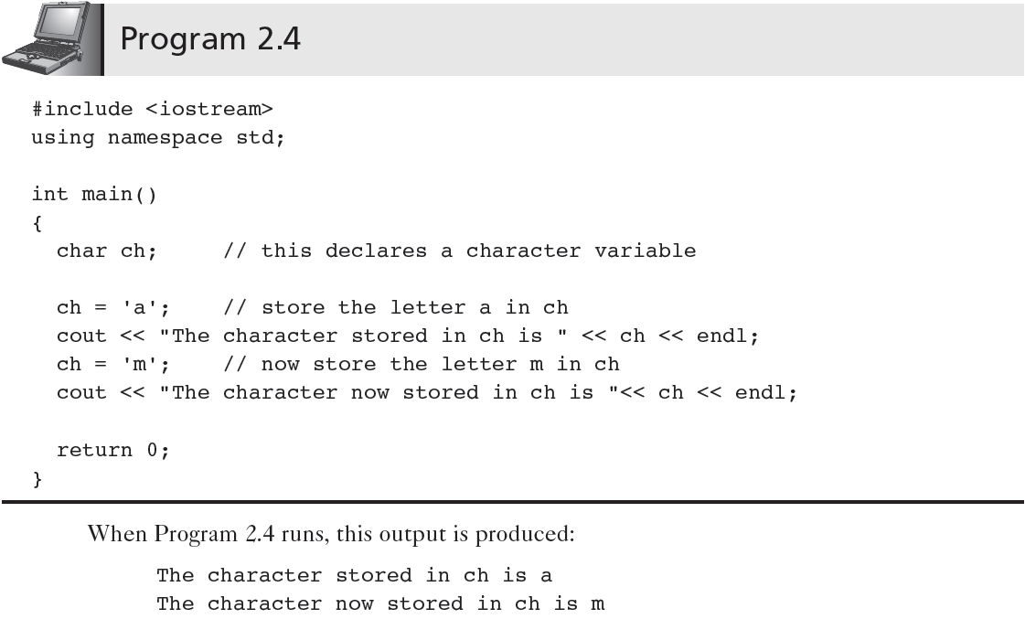
Example: Declaration of char
CSC 1100 – Week2
DCS, KICT

Slide 57
Integer values representing char
CSC 1100 – Week2
DCS, KICT
Modify Program 2.4 to do the following:
Declare 2 variables named ch1 and ch2 of type char
Assign (store) ch1 with character ‘a’ and ch2 with character ‘m’
Declare another new variable named newChar of type int
Add ch1 and ch2 together and assign the result to newChar.
Display newChar. What is your answer?
Next, change the datatype for newChar to char.
Repeat Step 4 & 5. What is your answer now
Try sizeof(ch1) to find the amount of bytes needed for char

Slide 58


Common Programming Errors
CSC 1100 – Week2
DCS, KICT
Forgetting to declare all variables used in a program
Attempting to store one data type in a variable declared for a different type

Slide 59

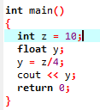

Common Programming Errors
CSC 1100 – Week2
DCS, KICT
Using a variable in an expression before the variable is assigned a value
Dividing integer values incorrectly

Slide 60
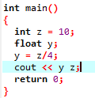

Common Programming Errors (cont'd.)
CSC 1100 – Week2
DCS, KICT
Mixing data types in the same expression without clearly understanding the effect produced
It is best not to mix data types in an expression unless a specific result is desired
Forgetting to separate individual data streams passed to cout with an insertion << (“put to”) symbol

Slide 61
Summary
CSC 1100 – Week2
DCS, KICT
Four basic types of data recognized by C++
Integer, floating-point, character, boolean
(int, float, char, bool)
cout object can be used to display all data types
Every variable in a C++ program must be declared as the type of variable it can store

Slide 62
Summary (cont'd.)
CSC 1100 – Week2
DCS, KICT
A simple C++ program containing declaration statements has the format:
#include <iostream>
using namespace std;
int main()
{
declaration statements;
other statements;
return 0;
}

Slide 63
Summary (cont'd.)
CSC 1100 – Week2
DCS, KICT
Declaration statements: inform the compiler of function’s valid variable names
Definition statements: declaration statements that also cause computer to set aside memory locations for a variable
sizeof() operator: determines the amount of storage reserved for a variable

Slide 64
Chapter Supplement: Bits, Bytes, and Binary Number Representations
CSC 1100 – Week2
DCS, KICT
This section explains how numbers are stored in a computer’s memory and different means of representing them

Slide 65
Bits and Bytes
CSC 1100 – Week2
DCS, KICT
Bit (Binary Digit)
A switch that can be open or closed
Byte
Group of 8 bits
Character code (example: ASCII and Unicode)
Collection of patterns used to represent letters, single digits, and other characters
Number codes (binaries representing decimal values)
Patterns used to store numbers
Words and addresses (larger units of bytes)

Slide 66
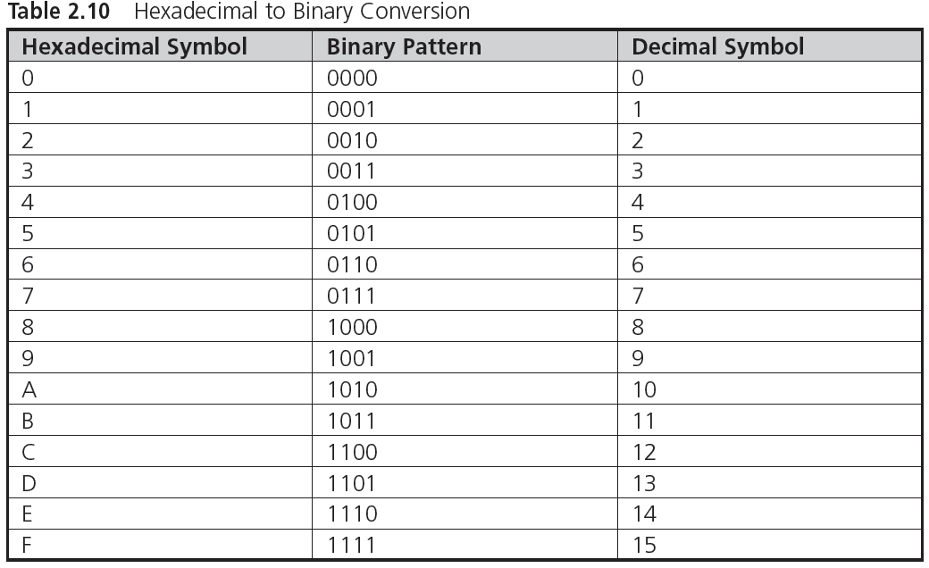
Binary, Hexadecimal, and Octal Numbers
CSC 1100 – Week2
DCS, KICT
0 + 0 + 0 + 2⁰
0 + 0 + 2¹ + 0
0 + 0 + 2¹ + 2⁰
0 + 2² + 0 + 0
0 + 2² + 0 + 2⁰
2³ + 2² + 0 + 0
2³ + 2² + 2¹ + 0
2³ + 2² + 2¹ + 2⁰
http://www.wikihow.com/Convert-from-Decimal-to-Binary

Slide 67
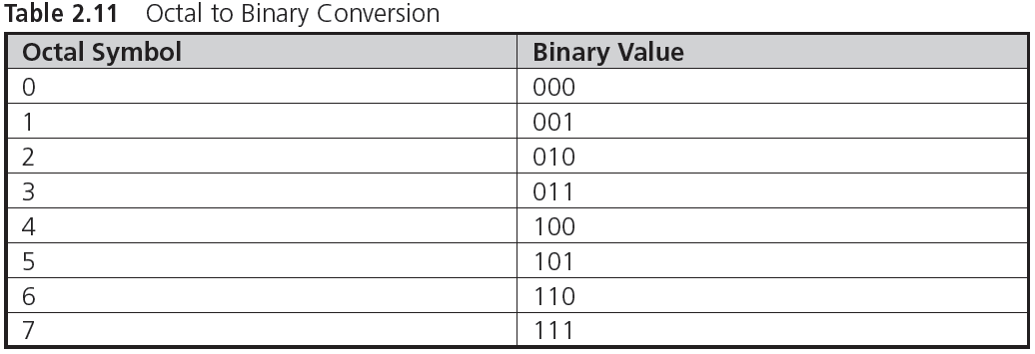
Binary, Hexadecimal, and Octal Numbers (cont’d.)
CSC 1100 – Week2
DCS, KICT
Octal → Decimal → Binary
14 → (1 x 8¹) + (4 x 8⁰) = 12 → 2³ + 2² + 0 + 0 = 1100
http://math.tutorvista.com/number-system/convert-octal-to-binary.html

