Slide 1
C++ Programming: From Problem Analysis to Program Design (D.S. Malik, 2018) A First Book of C++, (G. Bronson, 2012) C++ for Everyone (C.S. Horstman, 2012)
CHAPTER 2 (Pt 2)
Basic Elements of C++: Data Types, Declarations & Assignments
ELEMENTS OF PROGRAMMING
CSC 1100

Slide 2

CSC 1100 – Week1
DCS, KICT
In this topic, you will learn about:
Introduction to user input
Common Programming Errors
Summary
Bits & Bytes

Slide 3
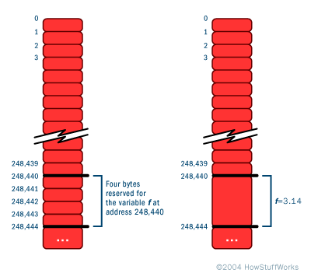
Memory Allocation
CSC 1100 – Week2
DCS, KICT
Each data type has its own storage requirements
Computer must know variable’s data type to allocate storage
Declaration statements are used for the purpose of allocating storage
3

Slide 4
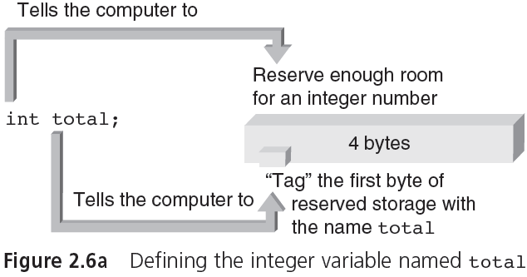
Memory Allocation (cont'd.)
CSC 1100 – Week2
DCS, KICT
MEMORY ADDRESS
12345
total
12346
4 bytes allocated for total
12347
12348
12349
4

Slide 5

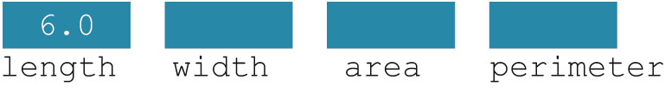
CSC 1100 – Week2
DCS, KICT
Variable: a memory location whose contents can be changed
Figure 2-2 Memory allocation
Figure 2-3 Memory spaces after the statement length = 6.0; executes
C++ Programming: From Problem Analysis to Program Design

Slide 6
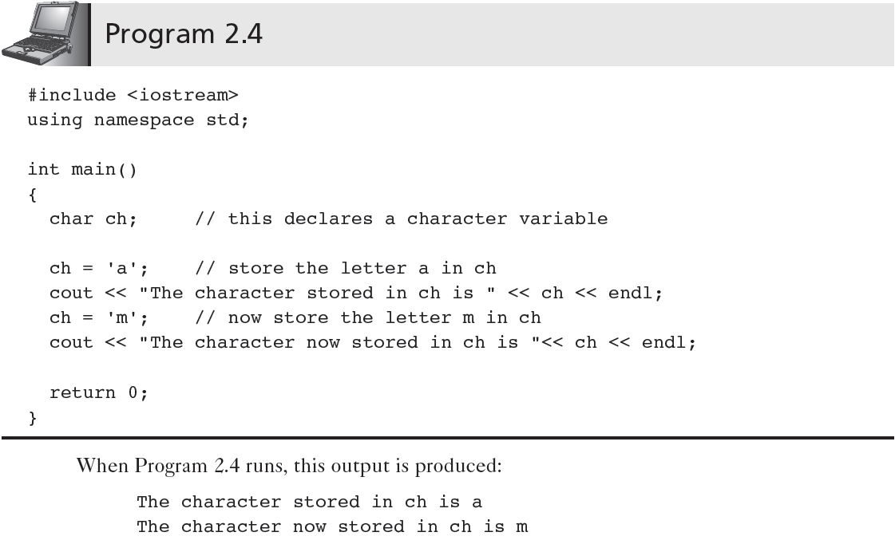
Example: Declaration of char
CSC 1100 – Week2
DCS, KICT
6

Slide 7
Integer values representing char
CSC 1100 – Week2
DCS, KICT
Modify Program 2.4 to do the following:
Declare 2 variables named ch1 and ch2 of type char
Assign (store) ch1 with character ‘a’ and ch2 with character ‘m’
Declare another new variable named newChar of type int
Add ch1 and ch2 together and assign the result to newChar.
Display newChar. What is your answer?
Next, change the datatype for newChar to char.
Repeat Step 4 & 5. What is your answer now
Try sizeof(ch1) to find the amount of bytes needed for char
7

Slide 8


Input read statements
CSC 1100 – Week2
DCS, KICT
8
cin is used with >> to gather input
This is called an input (read) statement
The stream extraction operator is >>
For example, if miles is a double variable
cin >> miles;
Causes computer to get a value of type double and places it in the variable miles

Slide 9
CSC 1100 – Week2
DCS, KICT
9
Input read statements(cont'd.)
Using more than one variable in cin allows more than one value to be read at a time
Example: if feet and inches are variables of type int, this statement:
cin >> feet >> inches;
Inputs two integers from the keyboard
Places them in variables feet and inches respectively
Programming with C++: From Problem Analysis to Program Design

Slide 10

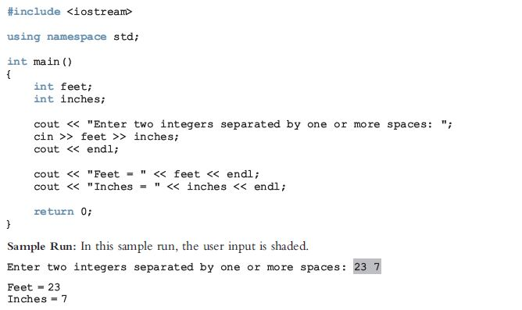
CSC 1100 – Week2
DCS, KICT
10
Programming with C++: From Problem Analysis to Program Design

Slide 11


Common Programming Errors
CSC 1100 – Week2
DCS, KICT
Forgetting to declare all variables used in a program
Attempting to store one data type in a variable declared for a different type
11

Slide 12

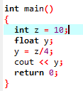

Common Programming Errors
CSC 1100 – Week2
DCS, KICT
Using a variable in an expression before the variable is assigned a value
Dividing integer values incorrectly
12

Slide 13
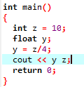

Common Programming Errors (cont'd.)
CSC 1100 – Week2
DCS, KICT
Mixing data types in the same expression without clearly understanding the effect produced
It is best not to mix data types in an expression unless a specific result is desired
Forgetting to separate individual data streams passed to cout with an insertion << (“put to”) symbol
13

Slide 14
Summary
CSC 1100 – Week2
DCS, KICT
Four basic types of data recognized by C++
Integer, floating-point, character, boolean
(int, float, char, bool)
cout object can be used to display all data types. Stands for “console output”
Every variable in a C++ program must be declared as the type of variable it can store
14

Slide 15
Summary (cont'd.)
CSC 1100 – Week2
DCS, KICT
A simple C++ program containing declaration statements has the format:
#include <iostream>
using namespace std;
int main()
{
declaration statements;
assignment statements;
processing statements;
return 0;
}
15

Slide 16
Summary (cont'd.)
CSC 1100 – Week2
DCS, KICT
Declaration statements: inform the compiler of function’s valid variable names
Definition statements: declaration statements that also cause computer to set aside memory locations for a variable
Processing statements: contains formula pr expressions that describes/represent a computation task
sizeof() operator: determines the amount of storage reserved for a variable
16

Slide 17
Chapter Supplement: Bits, Bytes, and Binary Number Representations
CSC 1100 – Week2
DCS, KICT
This section explains how numbers are stored in a computer’s memory and different means of representing them
17

Slide 18
Bits and Bytes
CSC 1100 – Week2
DCS, KICT
Bit (Binary Digit)
A switch that can be open or closed
Byte
Group of 8 bits
Character code (example: ASCII and Unicode)
Collection of patterns used to represent letters, single digits, and other characters
Number codes (binaries representing decimal values)
Patterns used to store numbers
Words and addresses (larger units of bytes)
18

Slide 19
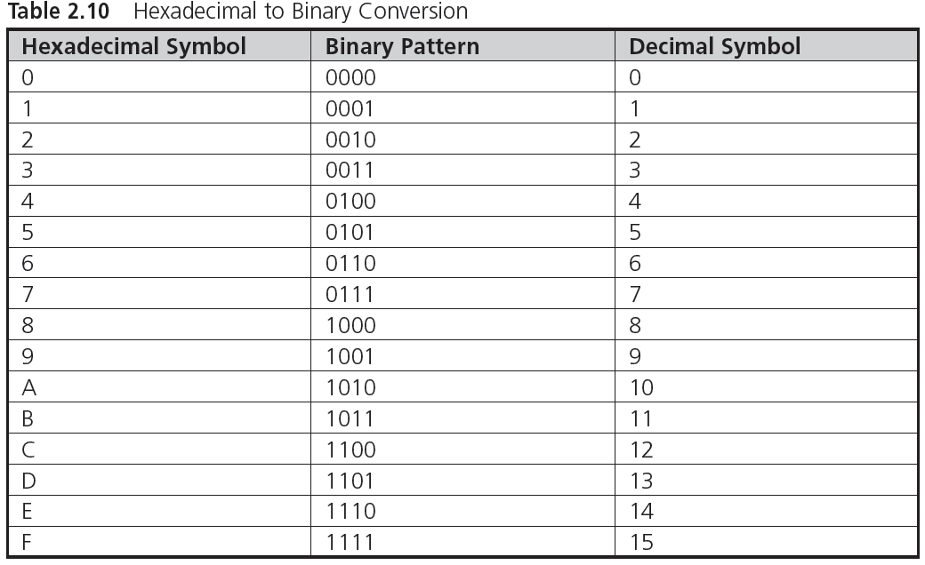
Binary, Hexadecimal, and Octal Numbers
CSC 1100 – Week2
DCS, KICT
0 + 0 + 0 + 2⁰
0 + 0 + 2¹ + 0
0 + 0 + 2¹ + 2⁰
0 + 2² + 0 + 0
0 + 2² + 0 + 2⁰
2³ + 2² + 0 + 0
2³ + 2² + 2¹ + 0
2³ + 2² + 2¹ + 2⁰
http://www.wikihow.com/Convert-from-Decimal-to-Binary
19

Slide 20
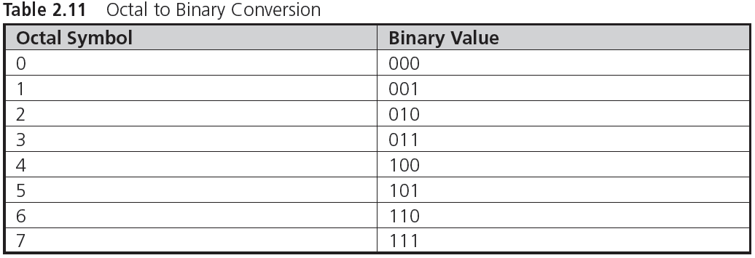
Binary, Hexadecimal, and Octal Numbers (cont’d.)
CSC 1100 – Week2
DCS, KICT
Octal → Decimal → Binary
14 → (1 x 8¹) + (4 x 8⁰) = 12 → 2³ + 2² + 0 + 0 = 1100
http://math.tutorvista.com/number-system/convert-octal-to-binary.html
http://www.binaryhexconverter.com/hex-to-decimal-converter
20

Slide 21
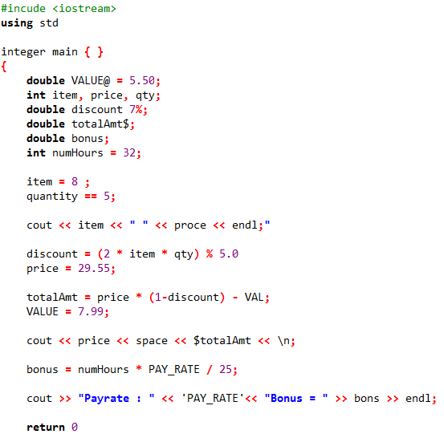
Class Exercise 1: Detecting Syntax Error
CSC 1100 – Week2
DCS, KICT
21

