Slide 1
C++ Programming: From Problem Analysis to Program Design (D.S. Malik, 2018) A First Book of C++, (G. Bronson, 2012) C++ for Everyone (C.S. Horstman, 2012)
CHAPTER 3 (Pt 1)
Assignments, Interactive Input & Output Display
ELEMENTS OF PROGRAMMING
CSC 1100

Slide 2

CSC 1100 – Week3
DCS, KICT
In this topic, you will learn about:
Assignment Operators
Interactive Keyboard Input
Input Stream Functions
Manipulators for Formatted Output

Slide 3

Assignment Operators
CSC 1100 – Week3
DCS, KICT
Basic assignment operator
Format: variable = expression;
Computes value of expression on right of = sign, assigns it to variable on left side of = sign
If not initialized in a declaration statement, a variable should be assigned a value before used in any computation
Variables can only store one value at a time
Subsequent assignment statements will overwrite previously assigned values

Slide 4
Assignment Operators (cont'd.)
CSC 1100 – Week3
DCS, KICT
Operand to right of = sign can be:
A constant
A variable
A valid C++ expression
Operand to left of = sign must be a variable
If operand on right side is an expression:
All variables in expression must have a value to get a valid result from the assignment

Slide 5
Assignment Operators (cont'd.)
CSC 1100 – Week3
DCS, KICT
Expression: combination of constants and variables that can be evaluated
Examples:
sum = 3 + 7;
diff = 15 –6;
product = .05 * 14.6;
tally = count + 1;
newtotal = 18.3 + total;
average = sum / items;
slope = (y2 – y1) / (x2 – x1);
constant (literal)
variable
A First Book of C++ 4th Edition

Slide 6
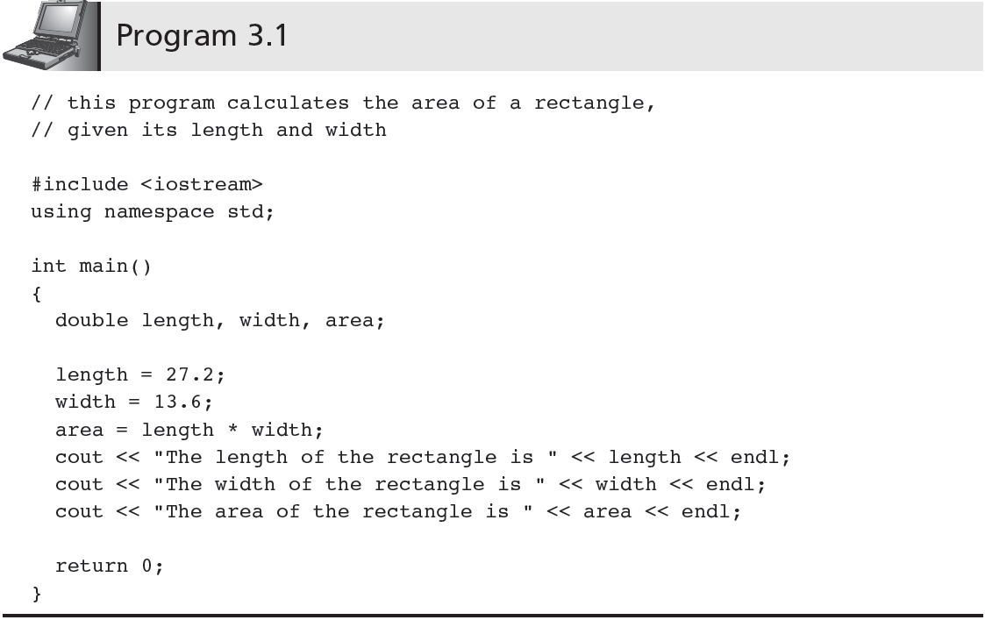
Assignment Operators (cont'd.)
CSC 1100 – Week3
DCS, KICT
constant
expression (2 or more variables)

Slide 7
Coercion
CSC 1100 – Week3
DCS, KICT
Value on right side of a C++ expression is converted to data type of variable on the left side
Example:
If temp is an integer variable (int temp), the assignment
temp = 25.89;
causes integer value 25 to be stored in integer variable temp
A First Book of C++ 4th Edition

Slide 8
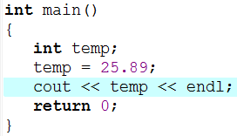


Coercion (cont’d)
CSC 1100 – Week3
DCS, KICT
Program
Compilation
Warning
Output : Decimal values ignored

Slide 9
Assignment Variations
CSC 1100 – Week3
DCS, KICT
sum = sum + 10; is a valid C++ expression
The value of sum + 10 is stored in variable sum
Not a valid algebra equation (in formal Mathematics)

Slide 10
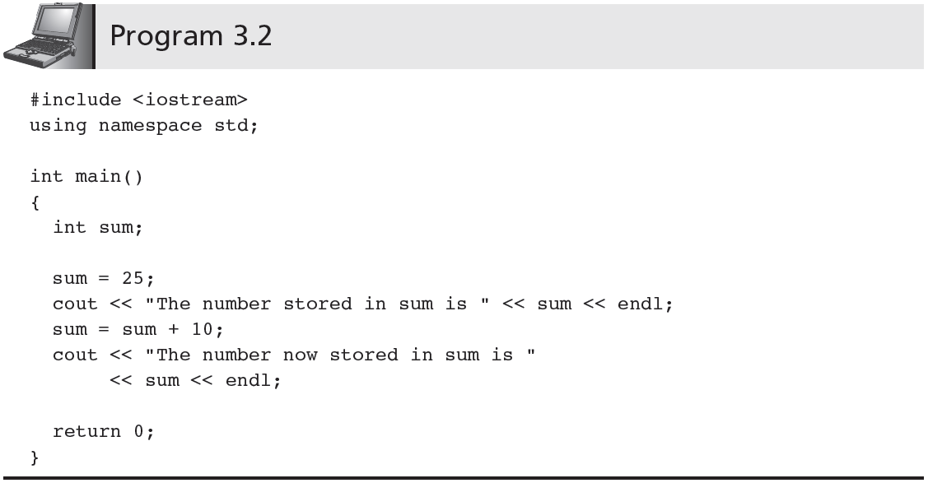
Assignment Variations (cont'd.)
CSC 1100 – Week3
DCS, KICT
// Initialization value for use in accumulation
// Accumulation
A First Book of C++ 4th Edition

Slide 11
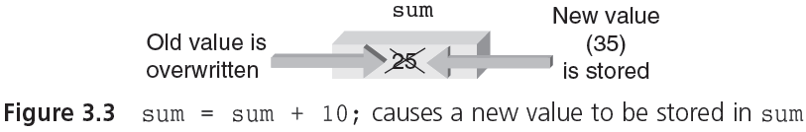
Assignment Variations (cont'd.)
CSC 1100 – Week3
DCS, KICT
A First Book of C++ 4th Edition

Slide 12
Assignment Variations (cont'd.)
CSC 1100 – Week3
DCS, KICT
Assignment expressions such as:
sum = sum + 25;
can be written by using the following shortcut operators:
+= -= *= /= %=
Example:
sum = sum + 10;
can be written as:
sum += 10; (this means sum = sum + 10)

Slide 13
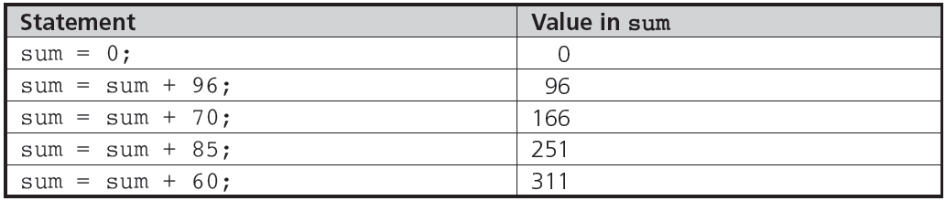
Accumulation
CSC 1100 – Week3
DCS, KICT
The following statements add the numbers 96, 70, 85, and 60 in calculator fashion:
A First Book of C++ 4th Edition

Slide 14
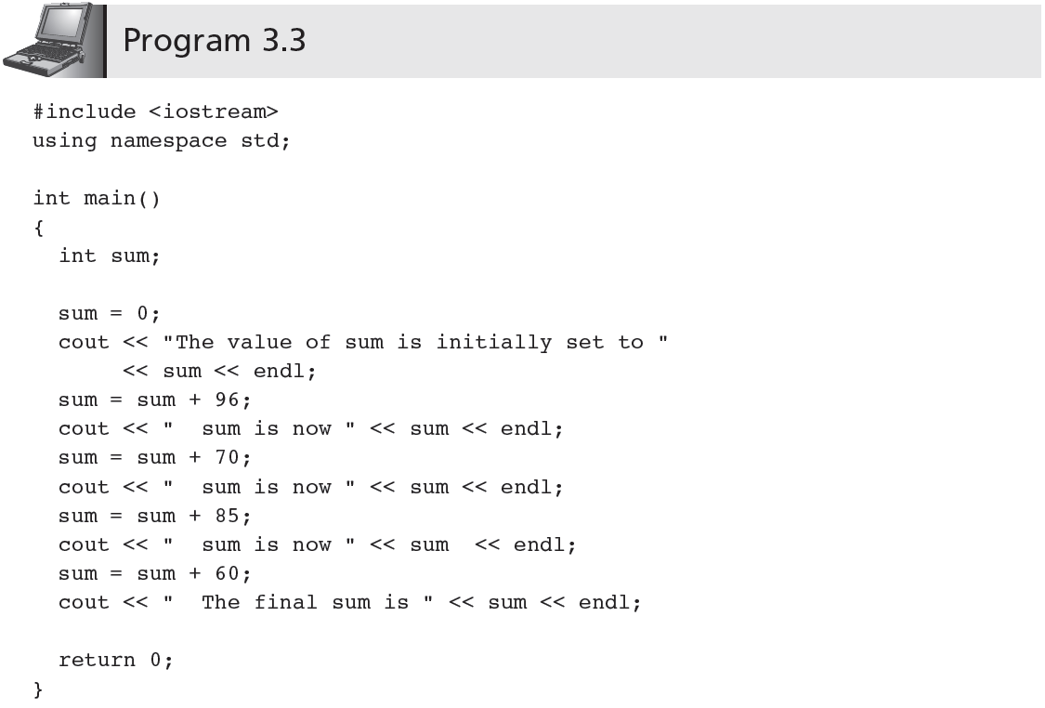
Accumulating (cont'd.)
CSC 1100 – Week3
DCS, KICT

Slide 15
Counting
CSC 1100 – Week3
DCS, KICT
Has the form:
variable = variable + fixedNumber;
Each time statement is executed, value of variable is increased by a fixed amount
Increment operators (++), (--)
Unary operator for special case when variable is increased or decreased by 1
Using the increment operator, the expression:
variable = variable + 1;
can be replaced by
either: ++variable; or variable++;

Slide 16
CSC 1100 – Week3
DCS, KICT
Examples of counting statements:
i= i + 1;
n = n + 1;
count = count + 1;
j = j + 2;
m = m + 2;
kk = kk + 3;

Slide 17
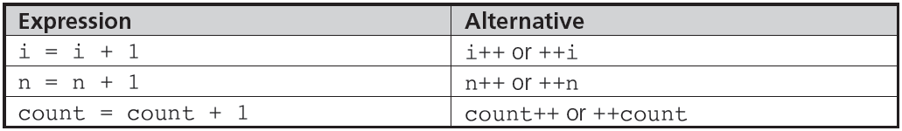
CSC 1100 – Week3
DCS, KICT
Examples of the increment operator:
A First Book of C++ 4th Edition

Slide 18
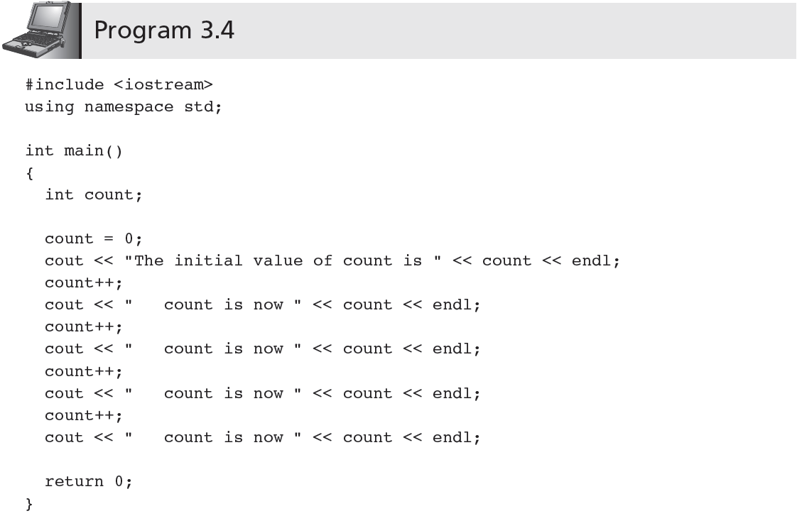
Counting (cont'd.)
CSC 1100 – Week3
DCS, KICT

Slide 19
Counting (cont'd.)
CSC 1100 – Week3
DCS, KICT
Prefix increment operator: the ++ or -- operator appears before a variable
The expression k = ++n performs two actions:
n = n + 1; // increment n first
k = n; // assign n’s value to k
Postfix increment operator: the ++ or -- operator appears after a variable
The expression k = n++ works differently:
k = n; // assign n’s value to k
n = n + 1; // and then increment n
A First Book of C++ 4th Edition

Slide 20
cin and the Extraction Operator >> (cont’d.)
CSC 1100 – Week3
DCS, KICT
No difference between a single cin with multiple variables and multiple cin statements with one variable
When scanning, >> skips all whitespace
Blanks and certain nonprintable characters
>> distinguishes between character 2 and number 2 by the right-side operand of >>
If type char or int (or double), the 2 is treated as a character or as a number 2

Slide 21
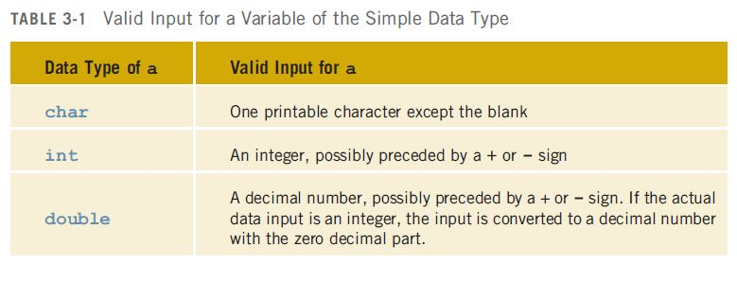
cin and the Extraction Operator >> (cont’d.)
CSC 1100 – Week3
DCS, KICT
Entering a char value into an int or double variable causes serious errors, called input failure

Slide 22
cin and the Extraction Operator >> (cont’d.)
CSC 1100 – Week3
DCS, KICT
When reading data into a char variable
>> skips leading whitespace, finds and stores only the next
character
Reading stops after a single character
To read data into an int or double variable
>> skips leading whitespace, reads + or - sign (if any), reads the digits (including decimal)
Reading stops on whitespace non-digit character

Slide 23
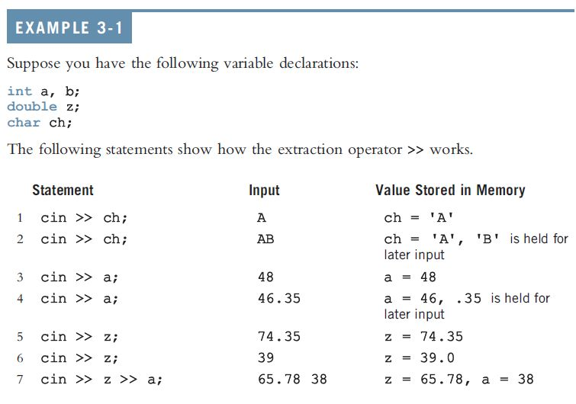

cin and the Extraction Operator >> (cont’d.)
CSC 1100 – Week3
DCS, KICT

Slide 24
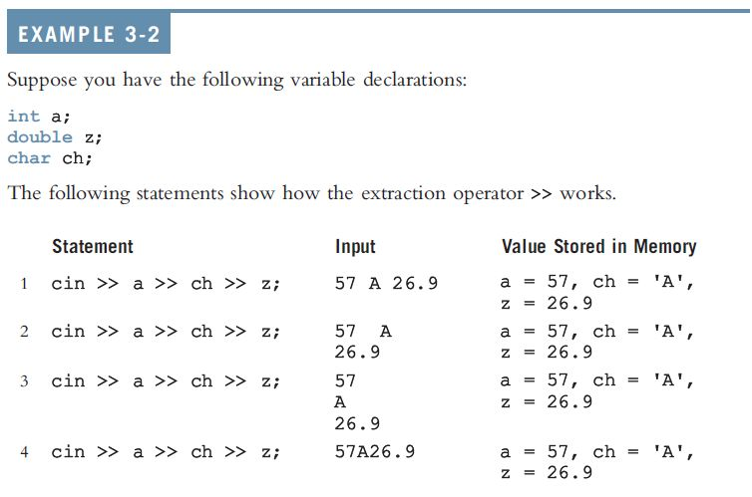
cin and the Extraction Operator >> (cont’d.)
CSC 1100 – Week3
DCS, KICT

Slide 25
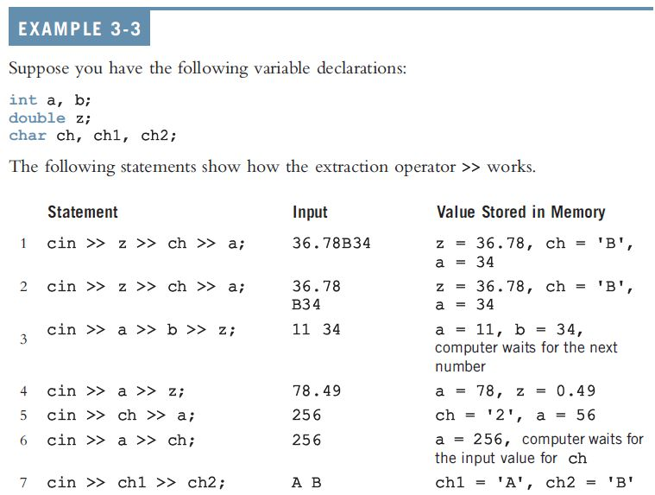
cin and the Extraction Operator >> (cont’d.)
CSC 1100 – Week3
DCS, KICT
cin and the Extraction Operator >> (cont’d.)

Slide 26
Input Failure
CSC 1100 – Week3
DCS, KICT
input Failure
Things can go wrong during execution
If input data does not match corresponding variables, program may run into problems
Trying to read a letter into an int or double variable will result in an input failure
If an error occurs when reading data
Input stream enters the fail state

Slide 27
Formatted Output
CSC 1100 – Week3
DCS, KICT
A program must present results attractively
Field width manipulators: control format of numbers displayed by cout
Manipulators included in the output stream

Slide 28
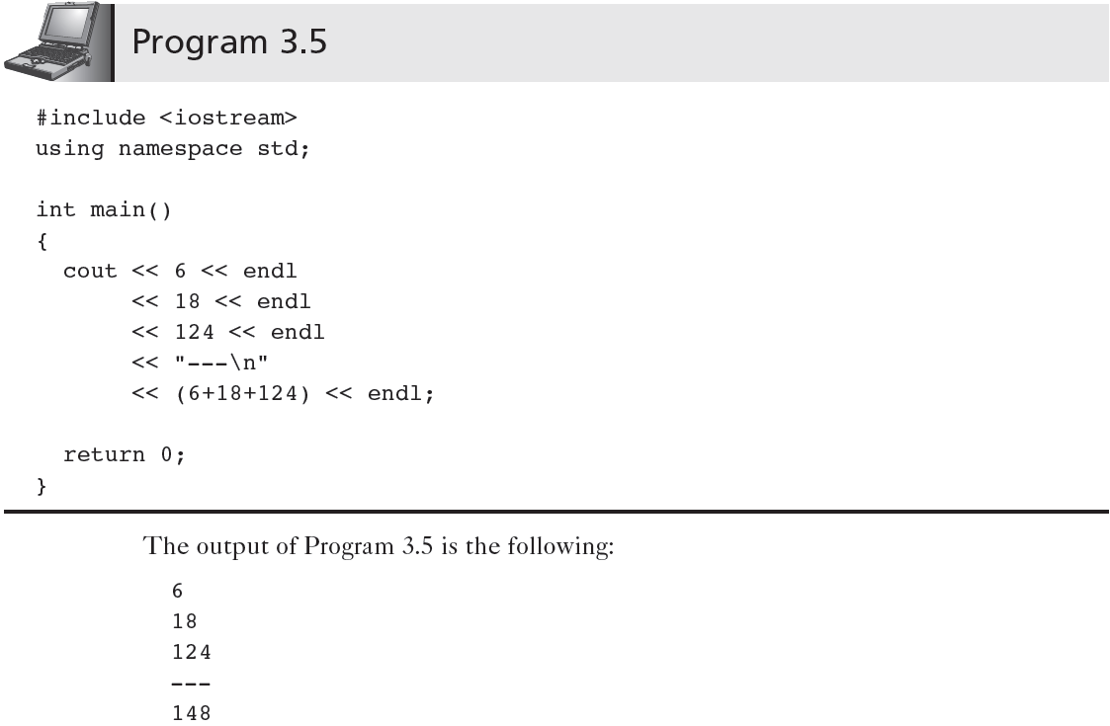
Formatted Output (cont'd.)
CSC 1100 – Week3
DCS, KICT
manipulators

Slide 29
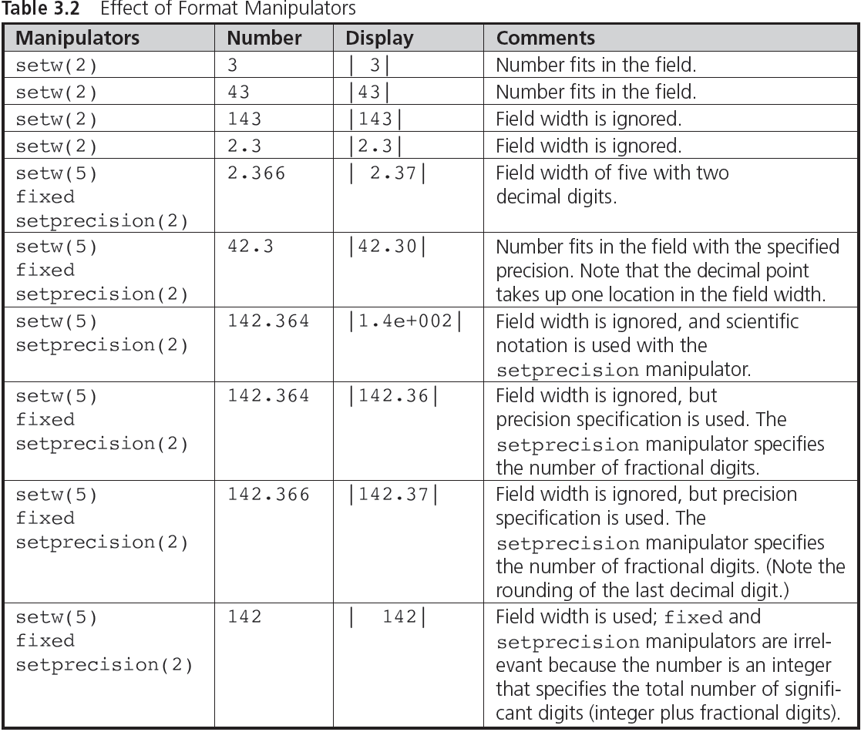
CSC 1100 – Week3
DCS, KICT

Slide 30
Formatted Output Examples
CSC 1100 – Week3
DCS, KICT
Manipulator | Number | Display | Description
setw(3) | 5 | _ _ 5 | first two spaces on left empty
setw(3) | 5.2 | 5 . 2 | decimal point ‘.’ considered 1 space
setw(3) | 143 | 1 4 3 | exactly 3 spaces allocated
setw(2) | 123 | 1 2 3 | field width ignored (number size > width)
fixed | 5.1 | 5 . 1 0 0 0 0 0 | display six decimal points by default
showpoint | 52.123456 | 5 2 . 1 2 3 5 | display six digits in total (including fraction but excluding ‘.’)
setw(2) fixed | 23.4 | 2 3 . 4 0 0 0 0 0 | fixed() has higher priority than setw(). Six decimal points are displayed
setw(7) fixed setprecision(3) | 53.456 | _ 5 3 . 4 5 6 | setprecision() has higher priority over fixed(). Three decimal points displayed. setw(7) allocates 7 spaces

Slide 31
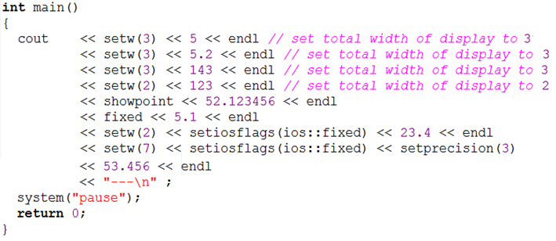
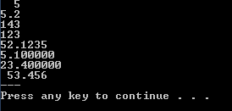
Formatted Output (cont'd.)
CSC 1100 – Week3
DCS, KICT

Slide 32
Formatted Output (cont'd.)
CSC 1100 – Week3
DCS, KICT
#include <iostream>
#include <iomanip>
int main()
{
float sum = 4 + 12.52 + 145;
// set total width of display to 6
std::cout << std::setw(6) << 4 << std::endl
<< std::setw(6) << std::fixed << std::setprecision(2)
<< 12.52 << std::endl
<< std::setw(6) << std::setiosflags(std::ios::fixed)
<< 145 << std::endl << "------\n"
<< sum << std::endl;
return 0;
}
library for manipulators
Six spaces allocated inclusive of decimal point '.'

Slide 33

The setiosflags() Manipulator
CSC 1100 – Week3
DCS, KICT
Field justification manipulator
Example:
std::cout << "|" << std::setw(10)
<<std::setiosflags(std::ios::left)
<< 142 << "|";
| 1 4 2 _ _ _ _ _ _ _ |
Ten spaces allocated

Slide 34
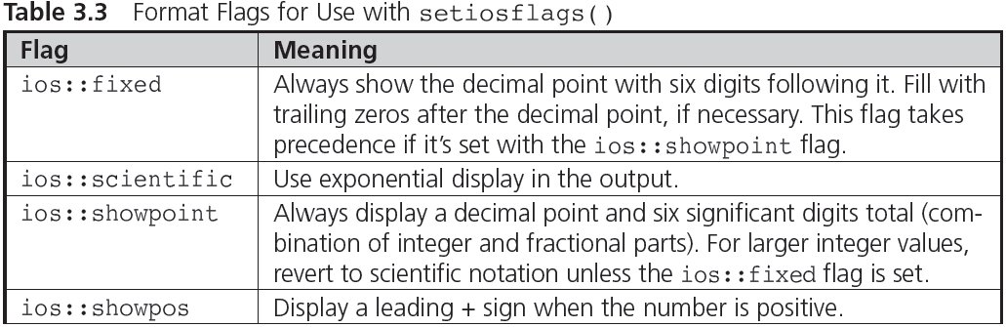
The setiosflags( ) Manipulator
CSC 1100 – Week3
DCS, KICT

Slide 35
Hexadecimal and Octal I/O
CSC 1100 – Week3
DCS, KICT
oct and hex manipulators are used for conversions to octal and hexadecimal
Display of integer values in one of three possible numbering systems (decimal, octal, and hexadecimal) doesn’t affect how the number is stored in a computer
All numbers are stored by using the computer’s internal codes

Slide 36
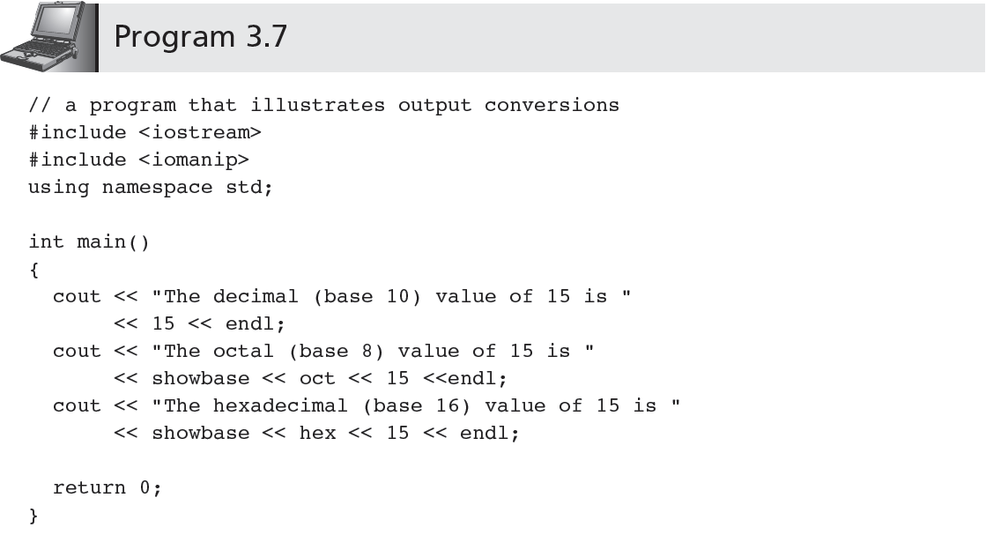
Hexadecimal and Octal I/O (cont'd.)
CSC 1100 – Week3
DCS, KICT
library for manipulators

Slide 37
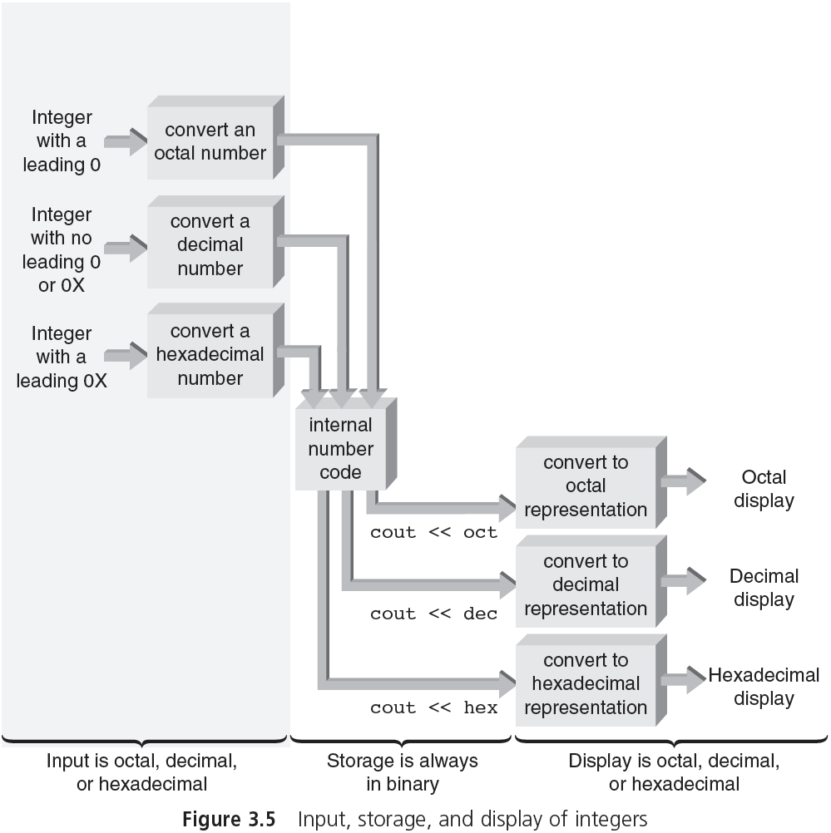
CSC 1100 – Week3
DCS, KICT

Slide 38
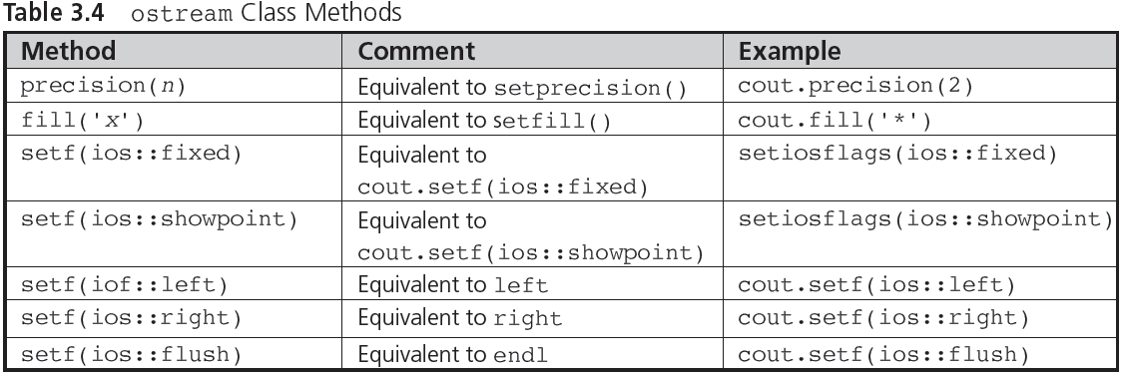
Hexadecimal and Octal I/O (cont'd.)
CSC 1100 – Week3
DCS, KICT
A First Book of C++ 4th Edition

Slide 39
In-class Activity
CSC 1100 – Week3
DCS, KICT
Create a C++ program that requires user input to find the volume of a sphere given the formula:
volume of sphere = 4∏
Algorithm :
Get the radius(r) of the sphere
Get the value of pi (∏)= 3.142
Calculate the volume using the equation:
volume of sphere = 4× ∏ ×
Use the C++ manipulators to do the following:
Left-justify the output results
Display the results with 4 precision values only

