Slide 1
C++ Programming: From Problem Analysis to Program Design (D.S. Malik, 2018) A First Book of C++, (G. Bronson, 2012) C++ for Everyone (C.S. Horstman, 2012)
CHAPTER 4 (Pt 1)
Control Structures 1: Selection
ELEMENTS OF PROGRAMMING
CSC 1100

Slide 2

CSC 1100 – Week4
DCS, KICT
In this topic, you will learn about:
Relational Operators
Logical Expressions
Control Structure
One-way selection
Two-way Selection
Multiple Selections

Slide 3
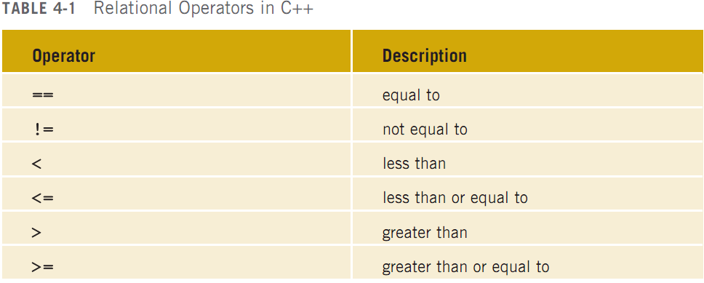
Relational Operators (cont’d.)
CSC 1100 – Week4
DCS, KICT

Slide 4
Relational Operators and Simple Data Types
CSC 1100 – Week4
DCS, KICT
Conditional statements: only executed if certain conditions are met
Condition: represented by a logical (Boolean) expression that evaluates to a logical (Boolean) value of true or false
Relational operators:
Allow comparisons
Require two operands (binary)
Evaluate to true or false

Slide 5
Relational Operators and Simple Data Types (cont’d.)
CSC 1100 – Week4
DCS, KICT
Relational operators can be used with all three simple data types:
8 < 15 evaluates to true
6 != 6 evaluates to false
2.5 > 5.8 evaluates to false
5.9 <= 7.5 evaluates to true

Slide 6
Comparing Characters
CSC 1100 – Week4
DCS, KICT
Expression of char values with relational operators
Result depends on machine’s collating sequence
ASCII character set
Logical (Boolean) expressions
Used to compare operands
Expressions such as 4 < 6 and 'R' > 'T’
Returns an integer value of 1 if the logical expression evaluates to true
Returns an integer value of 0 (false) otherwise

Slide 7
The int Data Type and Logical (Boolean) Expressions
CSC 1100 – Week4
DCS, KICT
Earlier versions of C++ did not provide built-in data types that had Boolean values
Logical expressions evaluate to either 1 or 0
Logical expression value was stored in a variable of the data type int
Can use the int data type to manipulate logical (Boolean) expressions

Slide 8
bool Data Type and Logical (Boolean) Expressions
CSC 1100 – Week4
DCS, KICT
The data type bool has logical (Boolean) values true and false
bool, true, and false are reserved words
The identifier true has the value 1
The identifier false has the value 0

Slide 9
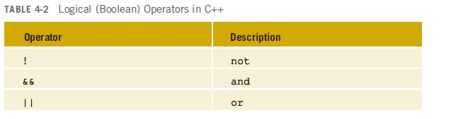
Logical (Boolean) Operators and Logical Expressions
CSC 1100 – Week4
DCS, KICT
Logical (Boolean) operators: enable you to combine logical expressions

Slide 10
Logical Operators
CSC 1100 – Week4
DCS, KICT
More complex conditions can be created using logical operators AND, OR, and NOT
Represented by the symbols: &&, ||, !
AND operator, &&:
Used with two simple expressions
Example: (age > 40) && (term < 10)
Compound condition is true (has value of 1) only
if age > 40 and term < 10
Both expressions must be true
10
A First Book of C++ 4th Edition

Slide 11
Logical Operators (cont'd.)
CSC 1100 – Wk4
OR operator, ||:
Used with two simple expressions
Example: (age > 40) || (term < 10)
Compound condition is true if either age > 40 or if term < 10 or if both conditions are true
Both expressions true OR one of them is true
NOT operator, !:
Changes an expression to its opposite state
If expression is true, then !expression is false
11
A First Book of C++ 4th Edition

Slide 12
Logical (Boolean) Expressions (cont'd.)
CSC 1100 – Week4
DCS, KICT
Relational expressions (conditions):
Are evaluated to yield/produce a numerical result
Condition that is true evaluates to 1
Condition that is false evaluates to 0
Example:
The relationship 2.0 > 3.3 is always false; therefore, the expression has a value of 0
boolean value
12
A First Book of C++ 4th Edition

Slide 13
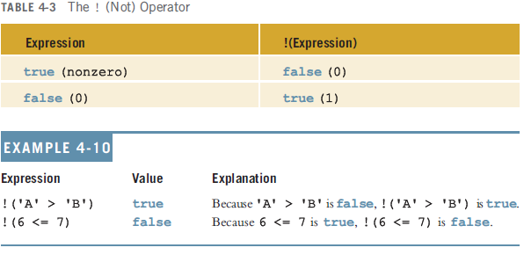
Logical (Boolean) Operators and Logical Expressions (cont’d.)
CSC 1100 – Week4
DCS, KICT

Slide 14
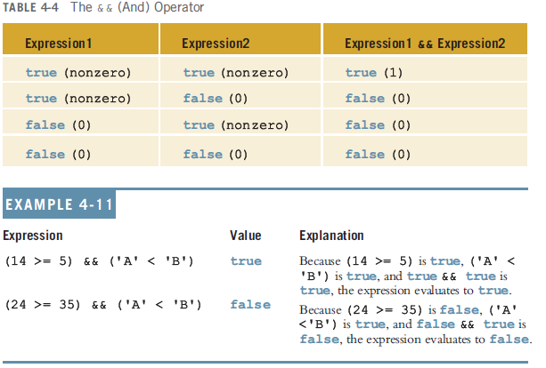
Logical (Boolean) Operators and Logical Expressions (cont’d.)
CSC 1100 – Week4
DCS, KICT

Slide 15
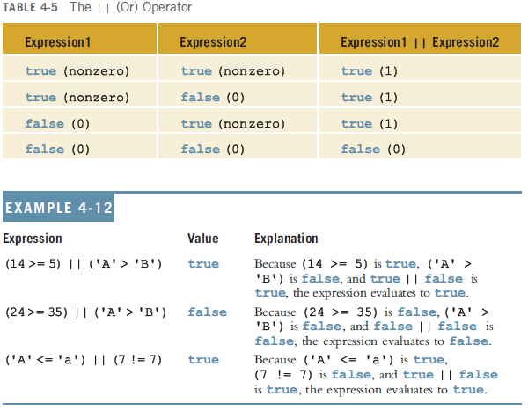
Logical (Boolean) Operators and Logical Expressions (cont’d.)
CSC 1100 – Week4
DCS, KICT

Slide 16
Evaluation of Logical Expression
CSC 1100 – Week4
DCS, KICT
16
Which of the following conditions are true (value =1), provided that a = 3 and b = 4?
a + 1 <= b
a + 1 >= b
a + 1 != b
1
1
0
16
A First Book of C++ 4th Edition

Slide 17
Evaluation of Boolean Operators
CSC 1100 – Wk4
Suppose that the value of b is false and x is 0. What is the value of each of the following expression?
b && x != 0
!b || x != 0
!b && x == 0
b || x != 0
0
1
1
0
17
A First Book of C++ 4th Edition

Slide 18
Order of Precedence
CSC 1100 – Week4
DCS, KICT
Relational and logical operators are evaluated from left to right
The associativity is left to right
Parentheses can override precedence

Slide 19
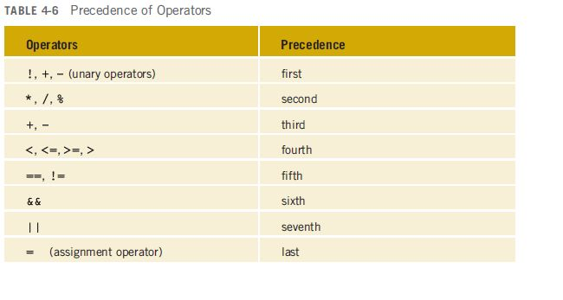
Order of Precedence (cont’d.)
CSC 1100 – Week4
DCS, KICT

Slide 20
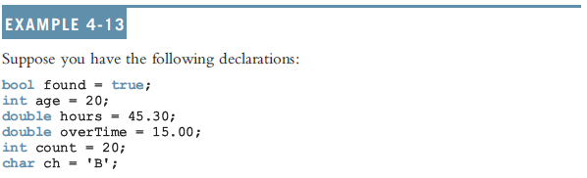
Order of Precedence (cont’d.)
CSC 1100 – Week4
DCS, KICT

Slide 21
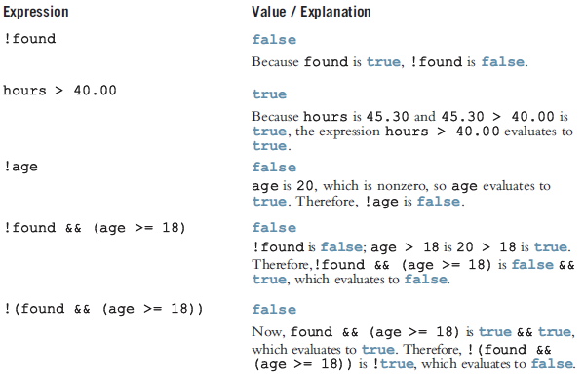
Order of Precedence (cont’d.)
CSC 1100 – Week4
DCS, KICT

Slide 22
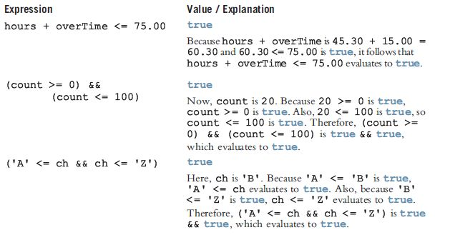
Order of Precedence (cont’d.)
CSC 1100 – Week4
DCS, KICT

Slide 23
Relational Operators and the string Type
CSC 1100 – Week4
DCS, KICT
Relational operators can be applied to strings
Strings are compared character by character, starting with the first character
Comparison continues until either a mismatch is found or all characters are found equal
If two strings of different lengths are compared and the comparison is equal to the last character of the shorter string
The shorter string is less than the larger string

Slide 24
Relational Operators and the string Type (cont’d.)
CSC 1100 – Week4
DCS, KICT
Suppose we have the following declarations:
string str1 = "Hello";
string str2 = "Hi";
string str3 = "Air";
string str4 = "Bill";
string str4 = "Big";

Slide 25
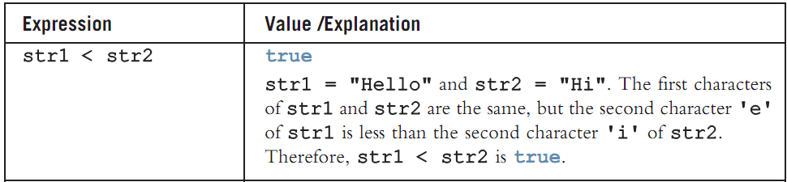
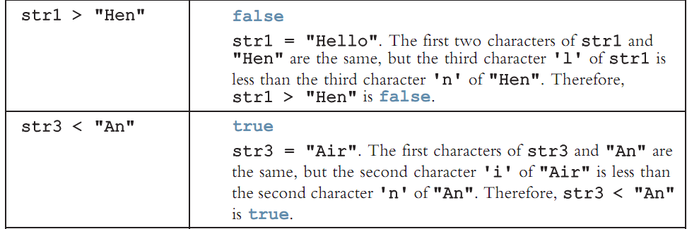
Relational Operators and the string Type (cont’d.)
CSC 1100 – Week4
DCS, KICT

Slide 26
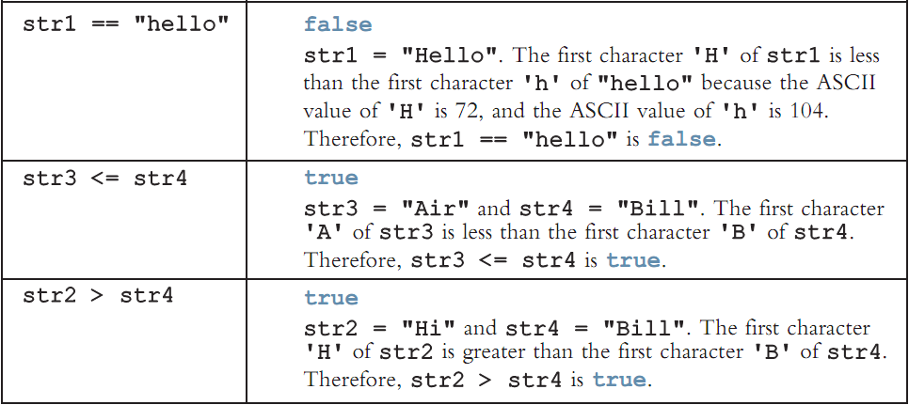
Relational Operators and the string Type (cont’d.)
CSC 1100 – Week4
DCS, KICT

Slide 27
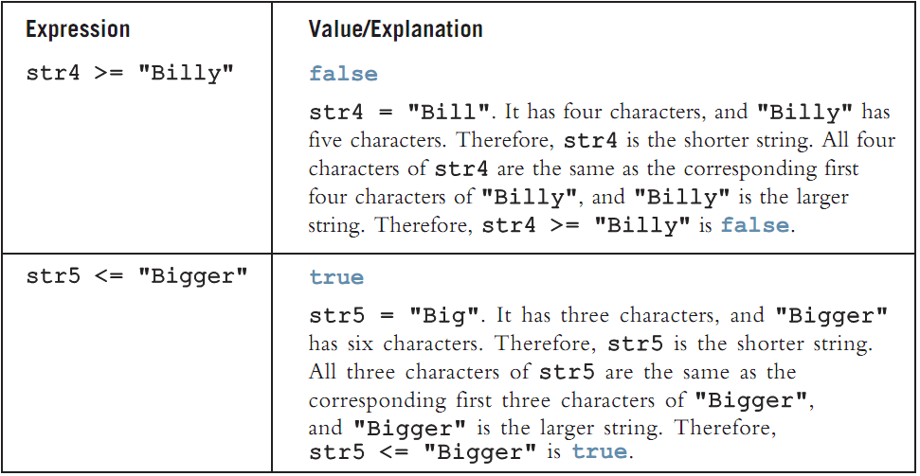
Relational Operators and the string Type (cont’d.)
CSC 1100 – Week4
DCS, KICT

Slide 28
Control Structures
CSC 1100 – Week4
DCS, KICT
A computer can proceed:
In sequence
Selectively (branch): making a choice
Repetitively (iteratively): looping
By calling a function
Two most common control structures:
Selection
Repetition

Slide 29
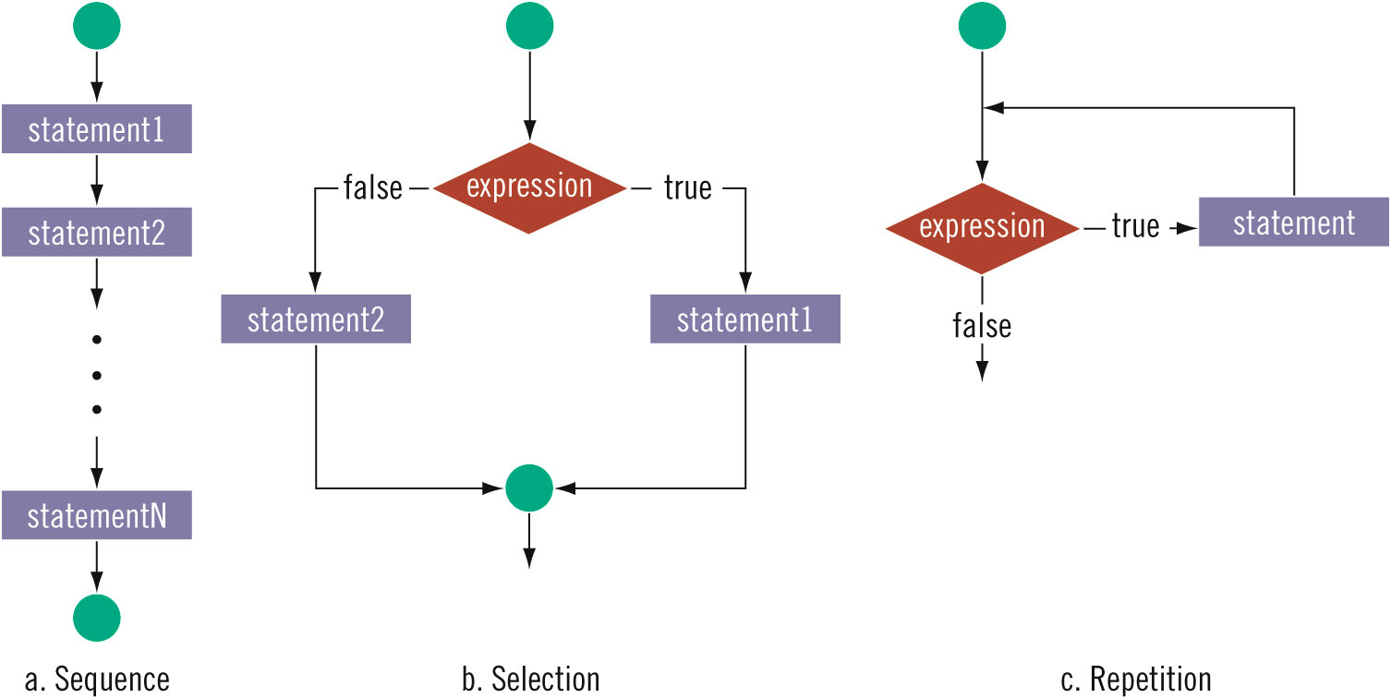
Control Structures (cont’d.)
CSC 1100 – Week4
DCS, KICT

Slide 30
Selection: if and if...else
CSC 1100 – Week4
DCS, KICT
Execution of selection or repetition requires execution of a logical expression:
Evaluates to true or false
“8 is greater than 3”

Slide 31
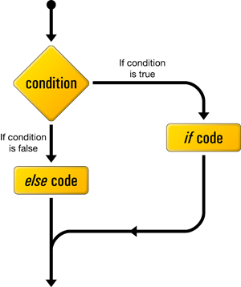


CSC 1100 – Week4
DCS, KICT
The if-else Condition (boolean)
?
Class
cancelled?
YES!!!
NO…
31

Slide 32

One-Way Selection
CSC 1100 – Week4
DCS, KICT
One-way selection syntax:
Statement is executed if the value of the expression is true
Statement is bypassed if the value is false; program goes to the next statement
Expression is called a decision maker

Slide 33
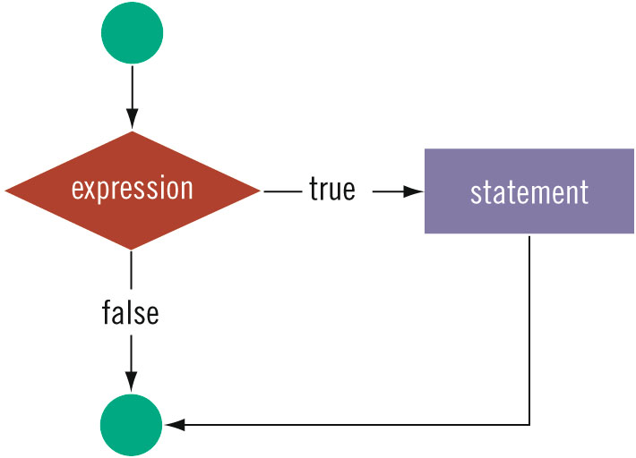
One-Way Selection (cont’d.)
CSC 1100 – Week4
DCS, KICT

Slide 34
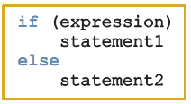
Two-Way Selection
CSC 1100 – Week4
DCS, KICT
Two-way selection syntax:
If expression is true, statement1 is executed; otherwise, statement2 is executed
statement1 and statement2 are any C++ statements

Slide 35
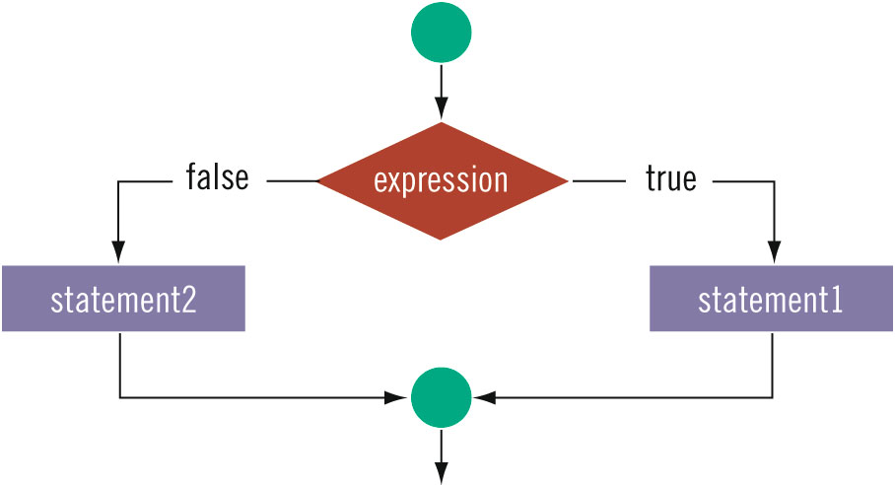
Two-Way Selection (cont’d.)
CSC 1100 – Week4
DCS, KICT

Slide 36
Multiple Selections
CSC 1100 – Week4
DCS, KICT
More than two control statements.
An else is associated with the most recent if that has not been paired with an else

Slide 37
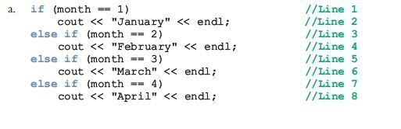

Multiple Selections (if-else Chain)
CSC 1100 – Week4
DCS, KICT

Slide 38
Example : Language Options
CSC 1100 – Week4
DCS, KICT
Write a C++ program that displays different language options based on different user inputs.
If the user enters ‘0', display “English”
If the user enters ‘1', display “Arabic”
If the user enters other than ‘0' or ‘1', display “Malay”

Slide 39
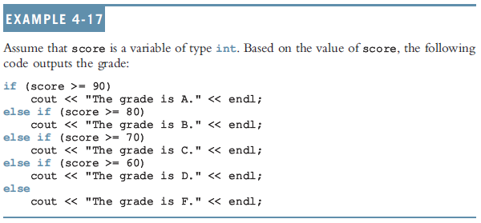
Multiple Selections (cont'd)
CSC 1100 – Week4
DCS, KICT

