Slide 1
C++ Programming: From Problem Analysis to Program Design (D.S. Malik, 2018) A First Book of C++, (G. Bronson, 2012) C++ for Everyone (C.S. Horstman, 2012)
CHAPTER 4 (Pt 2)
Control Structures 1: Selection
ELEMENTS OF PROGRAMMING
CSC 1100

Slide 2

CSC 1100 – Week4
DCS, KICT
In this topic, you will learn about:
Multiple one-way selection
if without else
Compound Statements
Nested selection
cascaded if
Switch Statements
Common Mistakes in Selection
Building Test Cases for Program Validation

Slide 3
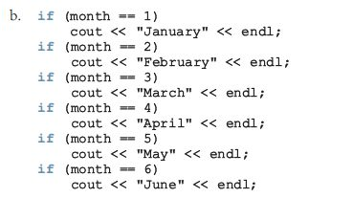
Comparing if…else Statements with if Statements (cont’d.)
CSC 1100 – Week4
DCS, KICT
Every true value
will be executed

Slide 4
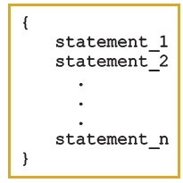
Compound (Block of) Statements
CSC 1100 – Week4
DCS, KICT
Compound statement (block of statements):
A compound statement functions like a single statement

Slide 5
Compound (Block of) Statements (cont’d.)
CSC 1100 – Week4
DCS, KICT
if (age > 18)
{
cout << "Eligible to vote." << endl;
cout << "No longer a minor." << endl;
}
else
{
cout << "Not eligible to vote." << endl;
cout << "Still a minor." << endl;
}

Slide 6
Block Scope
CSC 1100 – Week4
DCS, KICT
Block of code: all statements contained within a compound statement
Any variable declared within a block has meaning only between its declaration and the closing braces of the block
Example with two blocks of code
A First Book of C++ 4th Edition

Slide 7
Block Scope (cont'd.)
CSC 1100 – Week4
DCS, KICT
{ // start of outer block
int a = 25;
int b = 17;
cout << “The value of a is ” << a << “ and b is ” << b
<< endl;
{ // start of inner block
double a = 46.25; //new data type & value for a
int c = 10;
cout << “ a is now ” << a //takes the new value
<< “ b is now ” << b
<< “ and c is ” << c << endl;
} // end of inner block
cout << “a is now ” << a << “ and b is ” << b << endl;
} // end of outer block
A First Book of C++ 4th Edition

Slide 8
Block Scope (cont'd.)
CSC 1100 – Week4
DCS, KICT
Output of block scope example:
The value of a is 25 and b is 17
a is now 46.25 b is now 17 and c is 10
a is now 25 and b is 17
A First Book of C++ 4th Edition

Slide 9
Comparing Floating-Point Numbers for Equality: A Precaution
CSC 1100 – Week4
DCS, KICT
Comparison of floating-point numbers for equality may not behave as you would expect
Example:
1.0 == 3.0/7.0 + 2.0/7.0 + 2.0/7.0 evaluates to false
Why? 3.0/7.0 + 2.0/7.0 + 2.0/7.0 = 0.99999999999999989
Solution: use a tolerance value
Example: if fabs(x – y) < 0.000001

Slide 10
Confusion Between the Equality (==) and Assignment (=) Operators
CSC 1100 – Week4
DCS, KICT
C++ allows you to use any expression that can be evaluated to either true or false as an expression in the if statement:
if (x = 5)
cout << "The value is five." << endl;
The appearance of = in place of == resembles a silent killer
It is not a syntax error
It is a logical error

Slide 11
Conditional Operator (?:)
CSC 1100 – Week4
DCS, KICT
Conditional operator (?:)
Ternary operator: takes 3 arguments
Syntax for the conditional operator:
expression1 ? expression2 : expression3
If expression1 is true, the result of the conditional expression is expression2
Otherwise, the result is expression3
Example: max = (a >= b) ? a : b;

Slide 12
Problems Associated with the if-else Statement
CSC 1100 – Week4
DCS, KICT
Most common problems:
Misunderstanding what an expression is
Using the assignment operator, =, in place of the relational operator, ==
Example:
Initialize int age = 18;
The expression if (age = 40) sets age to the new value 40
Does not compare age to 40 (but assigns the value 40 to age)
Has a value of 40 (true)
Produces invalid results if used in if-else statement
Correct expression should be if (age == 40)
A First Book of C++ 4th Edition

Slide 13

Nested if
CSC 1100 – Week4
DCS, KICT
Nesting : one control statement is located within another
‘If’ within an ‘if’
Cascaded effect
if
if
if

Slide 14
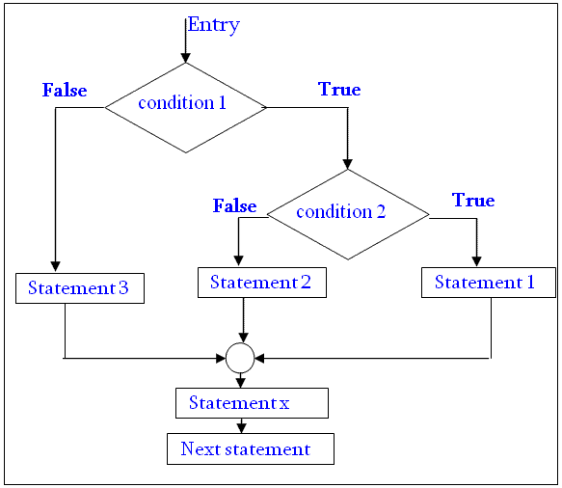
Nested if-else flowchart
CSC 1100 – Week4
DCS, KICT
If condition 1 is false then, skip to statement 3.
If condition 1 is true, then tests condition 2.
If condition 2 is true then, executes statement 1
If condition 2 is false then, executes statement 2.
Finally, control is transferred to the statement x.
C++ for Everyone

Slide 15
Nested if-else flowchart
CSC 1100 – Week4
DCS, KICT
Shipping charges:
In M’sia
True
False
In West M’sia
True
Set shipping cost = RM30
False
Set shipping cost = RM10
Set shipping cost = RM7
A First Book of C++ 4th Edition

Slide 16
Nested if Statements
CSC 1100 – Week4
DCS, KICT
if-else statement can contain simple or compound/nested if statements
Another if-else statement can be included
Example:
if (hours < 9)
{
if (distance > 500)
cout << “snap”;
}
else
cout << “pop”;
If within an if statement
A First Book of C++ 4th Edition

Slide 17
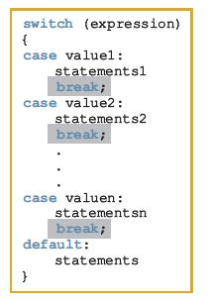
switch Structures
CSC 1100 – Week4
DCS, KICT
switch structure: alternate to if-else
switch (integral) expression is evaluated first
Value of the expression determines which corresponding action is taken
Expression is sometimes called the selector

Slide 18
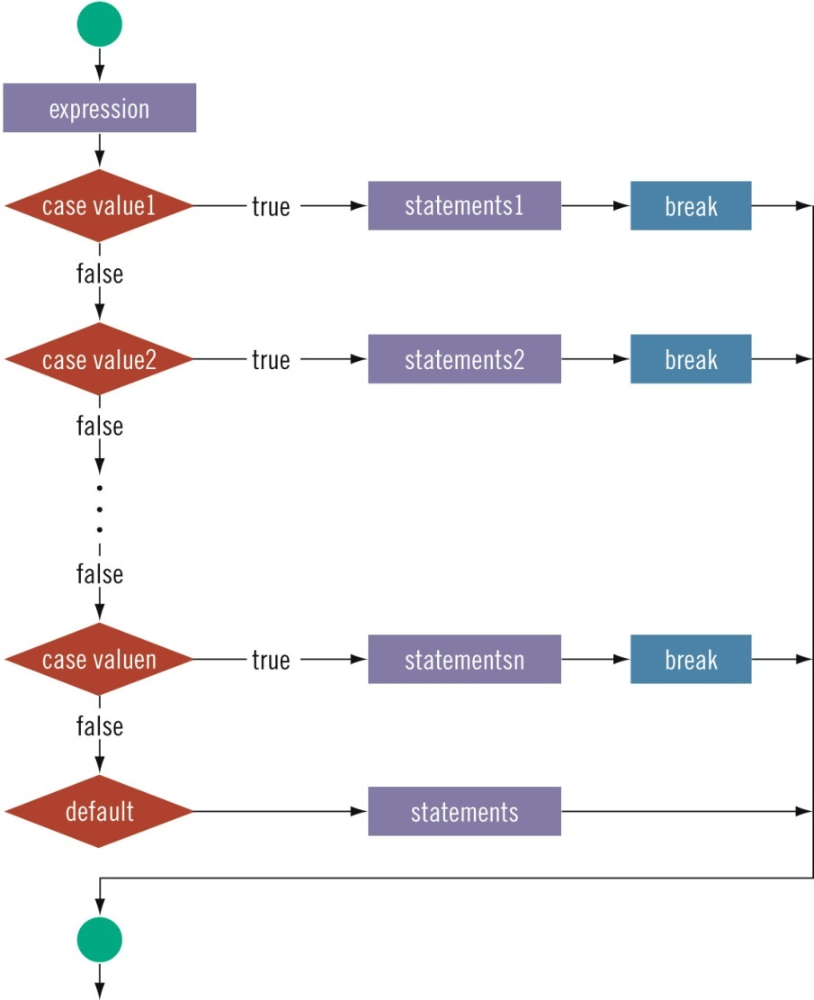

CSC 1100 – Week4
DCS, KICT
switch Structures (cont’d.)

Slide 19
The switch Statement
CSC 1100 – Week4
DCS, KICT
Four new keywords used:
switch, case, default, and break
Function of switch:
Expression following switch is evaluated
Must evaluate to an integer result
Results compared sequentially to alternative case values until a match found
When a case value is matched, all statements after it execute until a break is encountered
When break statement reached, switch terminates
A First Book of C++ 4th Edition

Slide 20
The switch Statement (cont’d)
CSC 1100 – Week4
DCS, KICT
One or more statements may follow a case label
Braces are not needed to turn multiple statements into a single compound statement
The break statement is optional
If no match found, default statement block is executed
The default key is optional (just like ‘else’)

Slide 21
The switch Statement (cont'd.)
CSC 1100 – Week4
DCS, KICT
Format:
switch (expression)
{ // start of compound statement
case value_1: // terminated with a colon
statement1;
statement2;
break;
case value_2: // terminated with a colon
statement3;
break;
default: // terminated with a colon
statement4;
} // end of switch and compound statement
A First Book of C++ 4th Edition

Slide 22
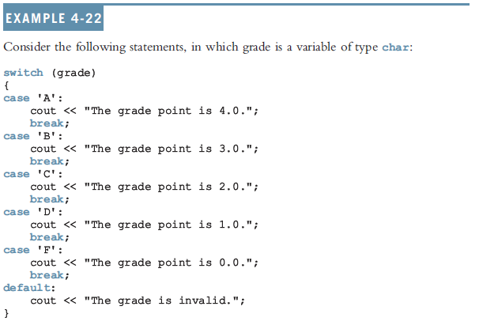
CSC 1100 – Week4
DCS, KICT
switch Example

Slide 23
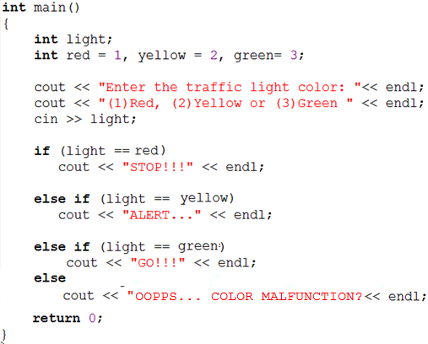
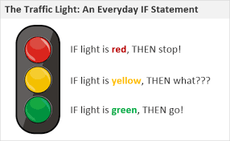
Selection (from if-else to switch)
CSC 1100 – Week4
DCS, KICT
Rewrite the following if-else into switch statements
A First Book of C++ 4th Edition

Slide 24
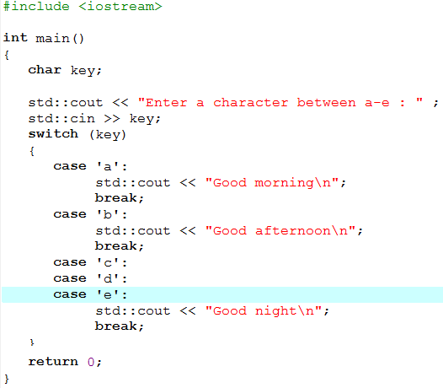
Stacking the switch Statement
CSC 1100 – Week4
DCS, KICT
Multiple case values can be used to refer to the same set of statements
A First Book of C++ 4th Edition

Slide 25
Common Programming Errors
CSC 1100 – Week4
DCS, KICT
Using the assignment operator, =, in place of the relational operator, ==
Assuming that the if-else statement is selecting an incorrect choice when the problem is really the values being tested
Using nested if statements without including braces to clearly indicate the desired structure
A First Book of C++ 4th Edition

Slide 26
Input Failure and the if Statement
CSC 1100 – Week4
DCS, KICT
If input stream enters a fail state
All subsequent input statements associated with that stream are ignored
Program continues to execute
May produce erroneous results
Can use if statements to check status of input stream
If stream enters the fail state, include instructions that stop program execution

Slide 27
Summary
CSC 1100 – Week4
DCS, KICT
Using assignment in place of the equality operator creates a semantic error
Use assert to terminate a program if certain conditions are not met
Control structures alter normal control flow
Most common control structures are selection and repetition
Relational operators: ==, <, <=, >, >=, !=
Logical expressions evaluate to 1 (true) or 0 (false)
Logical operators: ! (not), && (and), || (or)

Slide 28
Summary (cont'd.)
CSC 1100 – Week4
DCS, KICT
if-else statements select between two alternative statements based on the value of an expression
if-else statements can contain other if-else statements
If braces are not used, each else statement is associated with the closest unpaired if
if-else chain: a multi-way selection statement
Each else statement (except for the final else) is another if-else statement
The expression in an if or if...else structure is usually a logical expression
No stand-alone else statement in C++
Every else has a related if
A First Book of C++ 4th Edition

Slide 29
Summary (cont’d.)
CSC 1100 – Week4
DCS, KICT
Any sequence of statements enclosed between braces, { and }, is called a compound statement or block of statements
Variables have meaning only within the block where they are declared
Includes any inner blocks (use additional { } for inner blocks)

Slide 30
Summary (cont'd.)
CSC 1100 – Week4
DCS, KICT
switch statement: multiway selection statement
The value of an integer expression is compared to a sequence of integer or character constants or constant expressions
Program execution transferred to first matching case
Execution continues until optional break statement is encountered
A First Book of C++ 4th Edition

Slide 31
A Closer Look at Testing
CSC 1100 – Week4
DCS, KICT
A comprehensive set of test runs would reveal all possible program errors
Ensuring that a program works correctly for any combination of input and computed data
This goal is usually impossible
Except for extremely simple programs
At a minimum, test data should include:
Suitable values for input data
Illegal input values that the program should reject
Limiting values that are checked in the program
A First Book of C++ 4th Edition

Slide 32
CSC 1100 – Week4
DCS, KICT
For countries with 4 seasons, the seasons occur on certain months and days of the year. Write a program that accepts month (number) and day from the user and displays current season.
Month | Season | Condition | Day | Season
1 | Winter | Month divisible by 3 | days >= 21 | Spring
2
3
4 | Spring | Month divisible by 3 | days >= 21 | Summer
5
6
7 | Summer | Month divisible by 3 | days >= 21 | Fall
8
9
10 | Fall | Month divisible by 3 | days >= 21 | Winter
11
12
A First Book of C++ 4th Edition

Slide 33
Building Test Cases (Determine Season)
CSC 1100 – Week4
DCS, KICT
Test Case | Month | Day | Expected Output | Comment
1 | 1 | 19 | Winter | Not divisible by 3, take default season
2 | 3 | 21 | Spring | Divisible by 3, check days >= 21
3 | 8 | 10 | Summer | Not divisible by 3, take default season
4 | 9 | 25 | Fall | Divisible by 3, check days >= 21
A First Book of C++ 4th Edition

Slide 34
Using Pseudocode to Develop, Test, and Debug a Program
CSC 1100 – Week4
DCS, KICT
Pseudocode, or just pseudo
Informal mixture of C++ and ordinary language
Helps you quickly develop the correct structure of the program and avoid making common errors
Use a wide range of values in a walk-through to evaluate the program

Slide 35
Avoiding Bugs by Avoiding Partially Understood Concepts and Techniques
CSC 1100 – Week4
DCS, KICT
Must use concepts and techniques correctly
Otherwise solution will be either incorrect or deficient
If you do not understand a concept or technique completely
Don’t use it
Save yourself an enormous amount of debugging time

