Slide 1
C++ Programming: From Problem Analysis to Program Design (D.S. Malik, 2018) A First Book of C++, (G. Bronson, 2012) C++ for Everyone (C.S. Horstman, 2012)
CHAPTER 5 (Pt 1)
Control Structures II: Repetition
ELEMENTS OF PROGRAMMING
CSC 1100

Slide 2
Reminder: Lab Test 1
CSC 1100 – Week5
DCS, KICT
DETAILS:
Date: 2 November 2017 (Thursday)
Time: 11.35 a.m. - 12.50 p.m
Venue: Teaching Lab 7
Topics: Chapter 1 - 6
Format :
Written
Programming (compiler allowed)
A First Book of C++ 4th Edition

Slide 3
Objectives
CSC 1100 – Week5
DCS, KICT
In this chapter, you will learn about:
Repetition & its use
The while Statement
Interactive while loop
break & continue Statements
Sentinels

Slide 4
Why Repetition?
CSC 1100 – Week5
DCS, KICT
Allows efficient use of variables; limit the number of variables needed
Avoid having to type a statement over & over again (impractical)
expression
true
statement
false

Slide 5
Things to consider in repetition:
CSC 1100 – Week5
DCS, KICT
What do we want to repeat?
What do we want to change in each repetition?
How many times to repeat?

Slide 6
Examples of repetition
CSC 1100 – Week5
DCS, KICT
Summing up numbers entered by the user one after another (finding total)
Printing special patterns/shapes
Repeating a particular computation
Allowing users to enter inputs multiple times

Slide 7
The while Statement
CSC 1100 – Week5
DCS, KICT
A general repetition statement
Format:
while (expression)
statement;
Function:
expression is evaluated the same as an if-else statement
Statement following expression executed repeatedly as long as expression has non-zero value (i.e., true)
A First Book of C++ 4th Edition

Slide 8
The while Statement (cont'd.)
CSC 1100 – Week5
DCS, KICT
Steps in execution of while statement:
Test the expression
If the expression has a non-zero (true) value
Execute the statement following the parentheses
Go back to step 1
else
a. Exit the while statement
A First Book of C++ 4th Edition

Slide 9
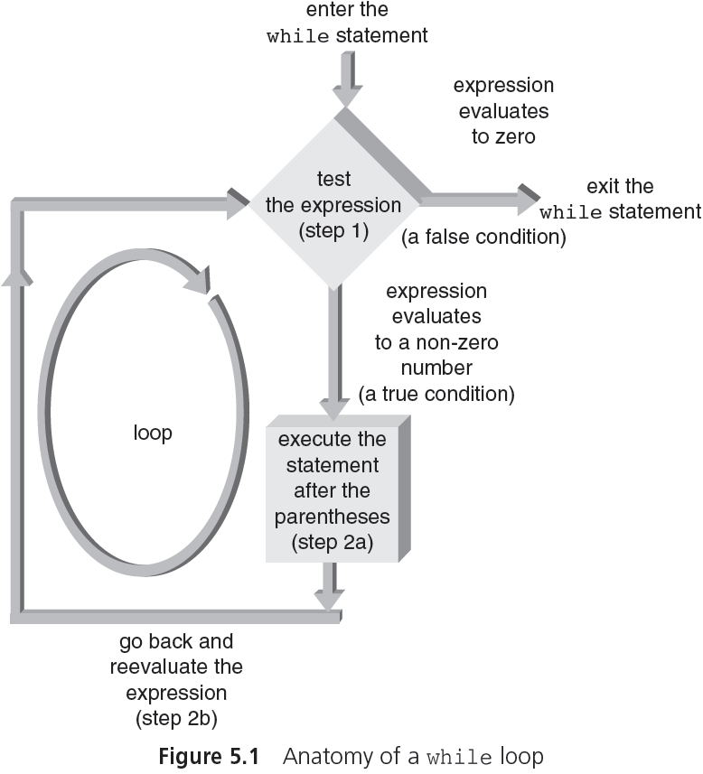
CSC 1100 – Week5
DCS, KICT
A First Book of C++ 4th Edition

Slide 10
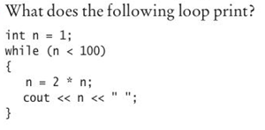
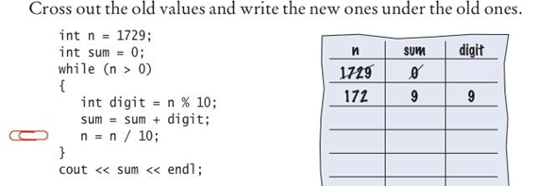
Example 1: Program Tracing
CSC 1100 – Week5
DCS, KICT
n | n = 2*n
1 | 2
2 | 4
3 | 6
C++ for Everyone 2nd Edition

Slide 11
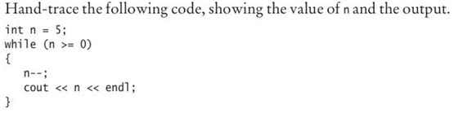
Example 2 (Program Tracing)
CSC 1100 – Week5
DCS, KICT
n | n - -
5
4
4
3
3
2
2
1
1
0
0
-1
C++ for Everyone 2nd Edition

Slide 12
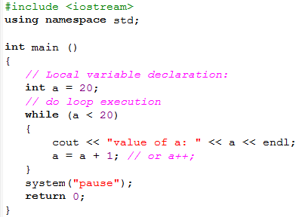
Example 3: false condition
CSC 1100 – Week5
DCS, KICT
No output
A First Book of C++ 4th Edition

Slide 13
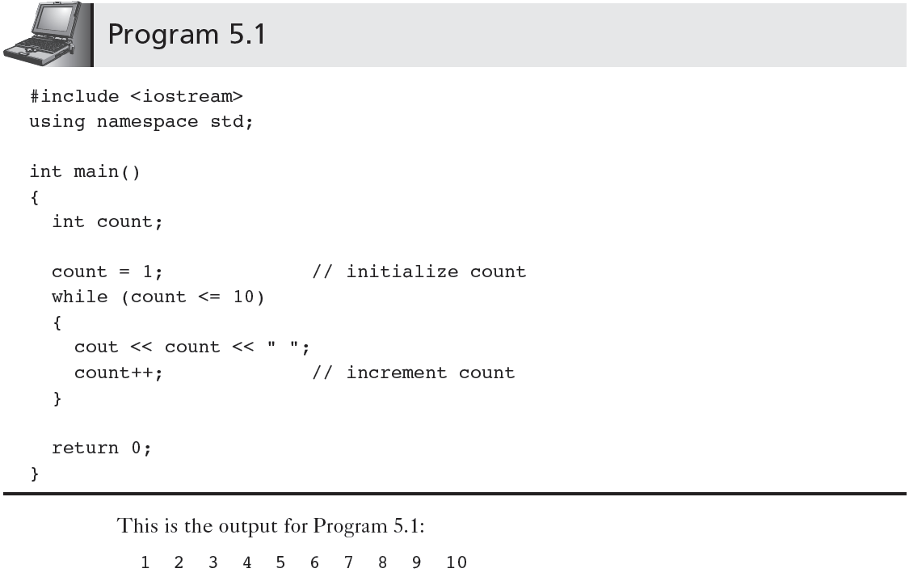
The while Statement (cont'd.)
CSC 1100 – Week5
DCS, KICT
// repeat “while” statement 10 times
/* count only gets added here */
//post increment, count will be increased by 1 in the next statement
A First Book of C++ 4th Edition

Slide 14
What does the following codes print?
CSC 1100 – Week5
DCS, KICT
int main()
{
int i = 0, j = 10, n = 0;
while (i < j)
{
i++;
j--;
n++;
cout << i << " " << j << " " << n << "\n";
}
}
C++ for Everyone 2nd Edition

Slide 15
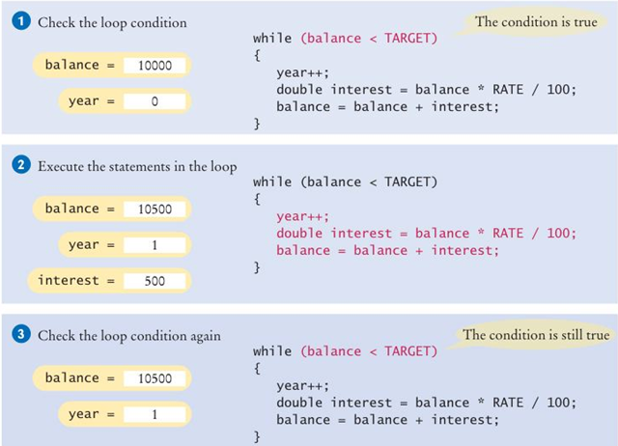
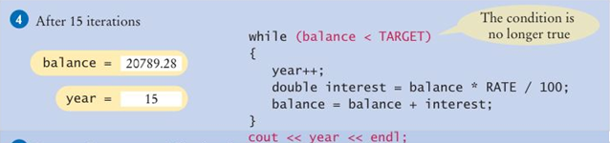
CSC 1100 – Week5
DCS, KICT
Assume TARGET is 20,000
Example:
While statement
C++ for Everyone 2nd Edition

Slide 16
Types of Loop
CSC 1100 – Week5
DCS, KICT
Infinite loop
a loop that never ends
Fixed-count loop
Uses tested expression as a counter that checks for a fixed number of repetitions
Variation loop
Uses a counter that is incremented by a value other than 1
Interactive loop
Combining interactive data entry with repetition
A First Book of C++ 4th Edition

Slide 17
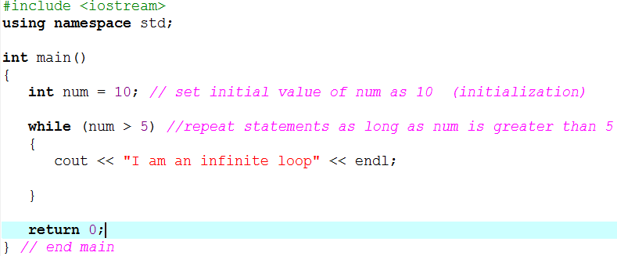
Infinite Loop
CSC 1100 – Week5
DCS, KICT
What is wrong with this program???
The variable num does not change
The condition is true (1) forever
A First Book of C++ 4th Edition

Slide 18
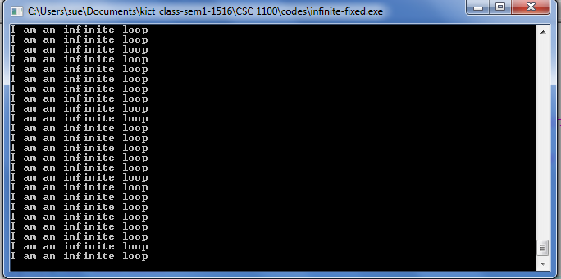
CSC 1100 – Week5
DCS, KICT
Output
A First Book of C++ 4th Edition

Slide 19
Fixing Infinite Loop
CSC 1100 – Week5
DCS, KICT
Add termination condition
Missing ‘terminating’ condition
A First Book of C++ 4th Edition

Slide 20
Variation Loop
CSC 1100 – Week5
DCS, KICT
Example:
Celsius-to-Fahrenheit temperature conversion
Display Fahrenheit and Celsius temperatures, from 5-50 degrees C, in 5 degree increments
#include <iostream>
int main(){
int celsius; double fahren;
celsius = 5; // starting celsius value (initialization)
while (celsius <= 50) //repeat statements 50 times
{
fahren = (9.0/5.0) * celsius + 32.0;
std::cout << std::setw(4) << celsius
<< std::setw(13) << fahren << endl;
celsius = celsius + 5; //increment celsius by 5 each time
}
return 0;
} // end main
A First Book of C++ 4th Edition

Slide 21
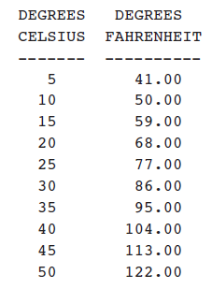
Sample Output
CSC 1100 – Week5
DCS, KICT
Increment by 5
A First Book of C++ 4th Edition

Slide 22
Interactive while Loops
CSC 1100 – Week5
DCS, KICT
Combining interactive data entry with the repetition of a while statement
Produces very powerful and adaptable programs
Example (Program 5.5): while statement accepts and displays four user-entered numbers
Numbers accepted and displayed one at a time
A First Book of C++ 4th Edition

Slide 23
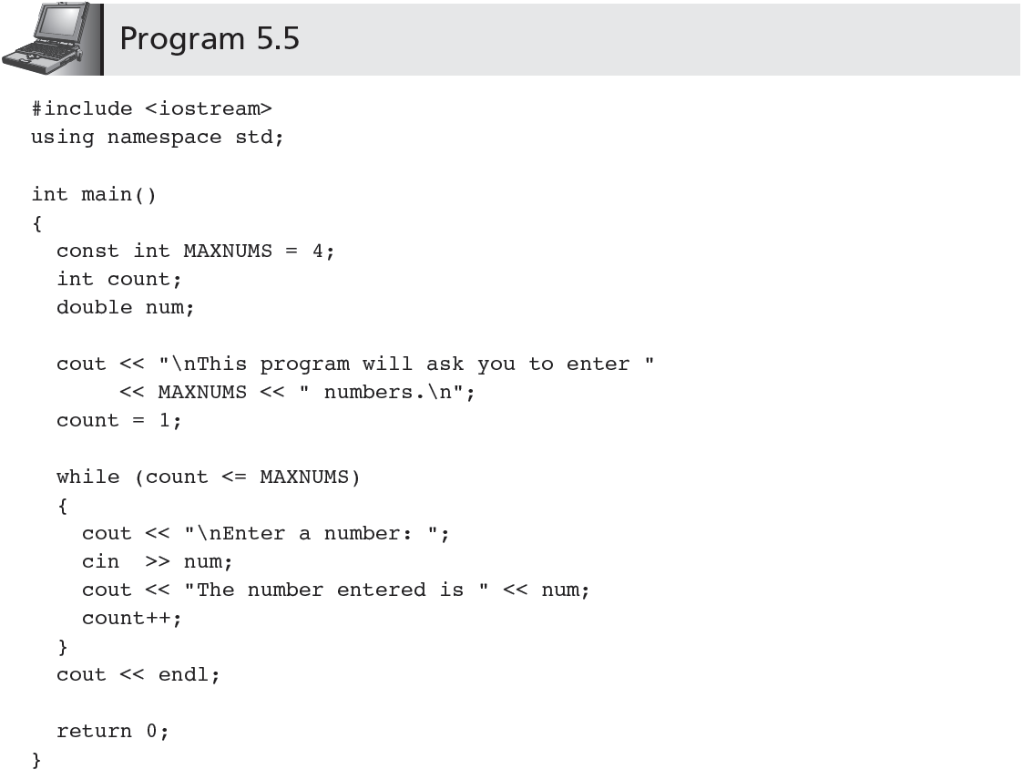
Interactive while Loop
CSC 1100 – Week5
DCS, KICT
//define MAXNUMS as a fixed constant value
//starting value for count (initialization)
//repeat the process MAXNUMS of times = 4
//increment count by 1 in the next cout statement
A First Book of C++ 4th Edition

Slide 24
Interactive while Loops (cont'd.)
CSC 1100 – Week5
DCS, KICT
Sample run of Program 5.5:
This program will ask you to enter 4 numbers.
Enter a number: 26.2
The number entered is 26.2
Enter a number: 5
The number entered is 5
Enter a number: 103.456
The number entered is 103.456
Enter a number: 1267.89
The number entered is 1267.89
1
2
3
4
A First Book of C++ 4th Edition

Slide 25
Interactive while Loops (cont'd.)
CSC 1100 – Week5
DCS, KICT
Example (Program 5.6): adding a single number to a total
A number is entered by the user
Accumulating statement adds the number to total
total = total + num;
A while statement repeats the process
A First Book of C++ 4th Edition

Slide 26
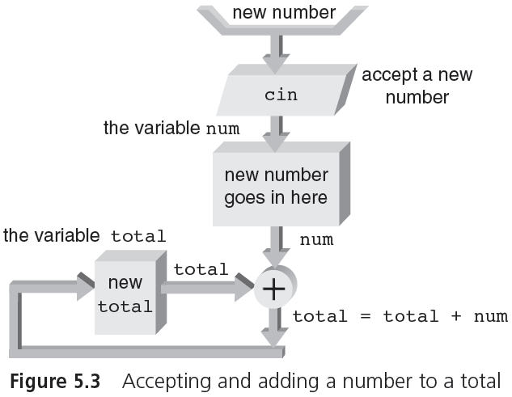
Interactive while Loops (cont'd.)
CSC 1100 – Week5
DCS, KICT
A First Book of C++ 4th Edition

Slide 27
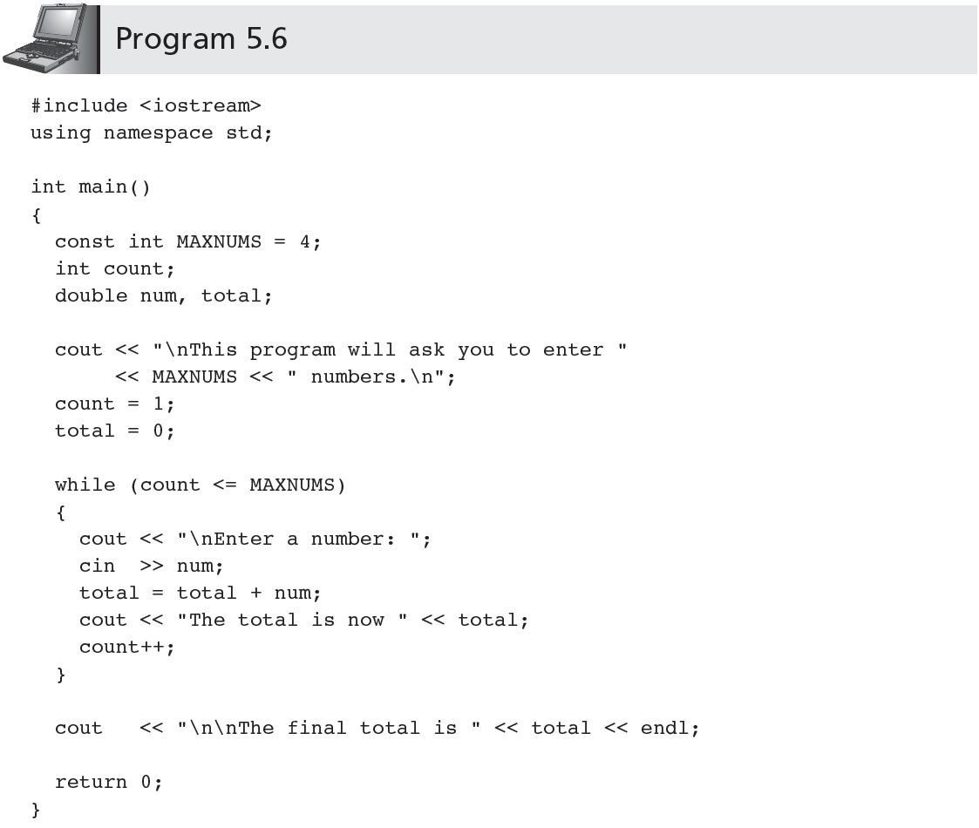
Accumulative while Loop
CSC 1100 – Week5
DCS, KICT
//always initialize accumulating variable to a starting value
//repeat 4 times
//accumulation: use of same variable to accumulate (total)
//increment counter by 1
A First Book of C++ 4th Edition

Slide 28
Interactive while Loops (cont'd.)
CSC 1100 – Week5
DCS, KICT
Sample run of Program 5.6:
This program will ask you to enter 4 numbers.
Enter a number: 26.2
The total is now 26.2
Enter a number: 5
The total is now 31.2
Enter a number: 103.456
The total is now 134.656
Enter a number: 1267.89
The total is now 1402.546
The final total is 1402.546
total = 0 + 26.2
total = 26.2 + 5
total = 31.2 + 103.456
total = 134.656 + 1267.89
A First Book of C++ 4th Edition

Slide 29
Sentinels
CSC 1100 – Week5
DCS, KICT
Sentinels
Data values used to signal the start or end of data series (exit criteria)
Values must be selected so as not to conflict with legitimate data values
A First Book of C++ 4th Edition

Slide 30
Example 1: Sentinel
CSC 1100 – Week5
DCS, KICT
#include <iostream>
using namespace std;
int main(){
const int sentinel = 999; // set fixed sentinel value for exit
int num;
cout << “Enter an integer value or 999 to exit: ”;
cin >> num;
while (num != sentinel) //repeat statements until 999 is entered
{
cout << num << endl;
cout << “Enter an integer value or 999 to exit: ”;
cin >> num;
}
return 0;
} // end main
A First Book of C++ 4th Edition

Slide 31
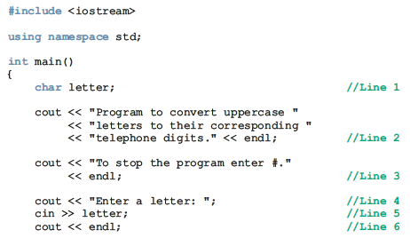
CSC 1100 – Week5
DCS, KICT
Example 2: Sentinel
The program converts uppercase letters to their corresponding telephone digit
C++ Programming: From Problem Analysis to Program Design

Slide 32
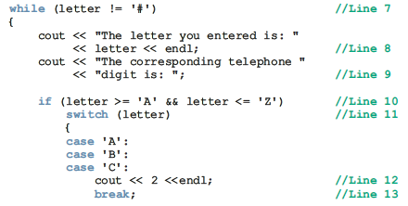
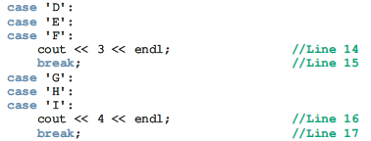
CSC 1100 – Week5
DCS, KICT
Cont’d
C++ Programming: From Problem Analysis to Program Design

Slide 33
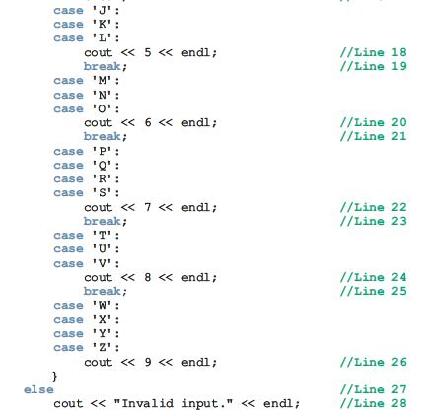
CSC 1100 – Week5
DCS, KICT
Cont’d
C++ Programming: From Problem Analysis to Program Design

Slide 34
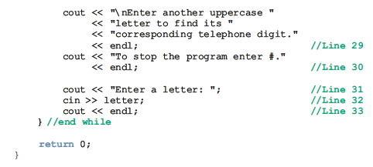
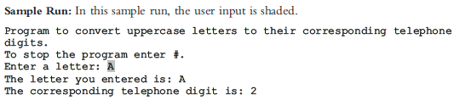

CSC 1100 – Week5
DCS, KICT
Cont’d
C++ Programming: From Problem Analysis to Program Design

Slide 35
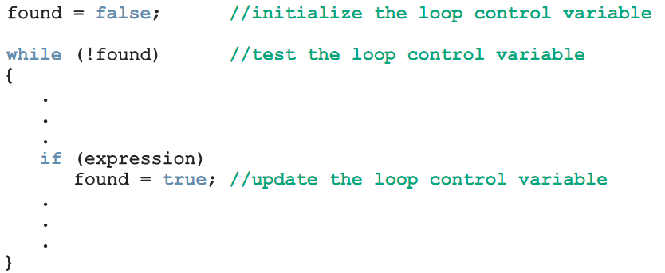
Flag-controlled while loop
CSC 1100 – Week5
DCS, KICT
uses a bool variable to control the loop
C++ Programming: From Problem Analysis to Program Design

Slide 36
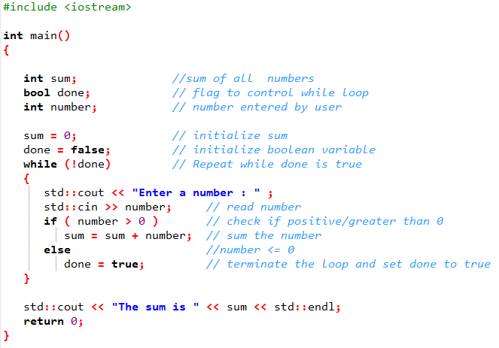
Example : Flag-controlled
CSC 1100 – Week5
DCS, KICT
Uses a bool variable to control the loop

Slide 37
End Of File -Controlled while Loops (cont’d.)
CSC 1100 – Week5
DCS, KICT
Used when it is difficult to select a sentinel value
The logical value returned by cin can determine if there is no more input
C++ Programming: From Problem Analysis to Program Design

Slide 38
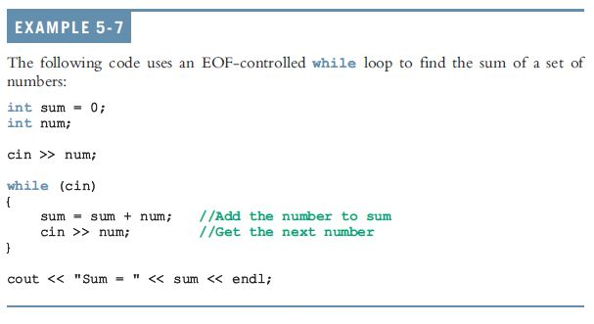
EOF-Controlled while Loops (cont’d.)
CSC 1100 – Week5
DCS, KICT
C++ Programming: From Problem Analysis to Program Design

Slide 39
break Statements
CSC 1100 – Week5
DCS, KICT
break: forces immediate exit from structures
alter the flow of control
Use in switch statements:
The desired case has been detected and processed
Use in while, for, and do-while statements:
An unusual condition is detected
Commonly used together with the if-else statement
Format:
break;
A First Book of C++ 4th Edition

Slide 40
continue Statements
CSC 1100 – Week5
DCS, KICT
continue: causes the next iteration of the loop to begin immediately
Execution transferred to the top of the loop
Applies only to while, do-while, and for statements
Commonly used together with the if-else statement
Format:
continue;
A First Book of C++ 4th Edition

Slide 41
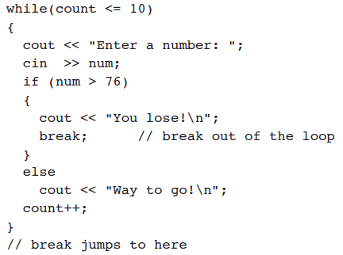
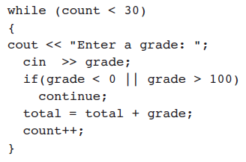
Example break and continue Statements
CSC 1100 – Week5
DCS, KICT
continue example
break example
C++ for Everyone

Slide 42
The Null Statement
CSC 1100 – Week5
DCS, KICT
Used where a statement is syntactically required but no action is called for (i.e., need a statement with no action)
A do-nothing statement
Typically used with while or for statements
Format:
;
A First Book of C++ 4th Edition

Slide 43
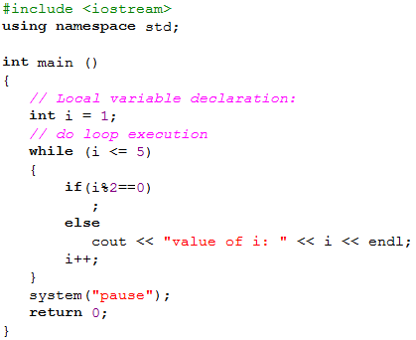

Example Null Statement
CSC 1100 – Week5
DCS, KICT
A First Book of C++ 4th Edition

Slide 44

Exercise 5a: while (Pg. 200)
CSC 1100 – Week5
DCS, KICT
Formula for mpg (mile per gallon) = Difference between current & prev mileage
current gallons
Mileage | Gallons | MPG
22,495 | Full | -
22,841 | 12.2 | 346/12.2
23,185 | 11.3 | ?
23,400 | 10.5 | ?
23,772 | 11.0 | ?
24,055 | 12.2 | ?
24,434 | 14.7 | ?
24,804 | 14.3 | ?
A First Book of C++ 4th Edition

