Slide 1
C++ Programming: From Problem Analysis to Program Design (D.S. Malik, 2018) A First Book of C++, (G. Bronson, 2012) C++ for Everyone (C.S. Horstman, 2012)
CHAPTER 5 (Pt 2)
Control Structures II: Repetition
ELEMENTS OF PROGRAMMING
CSC 1100

Slide 2
Objectives
CSC 1100 – Week5
DCS, KICT
In this chapter, you will learn about:
The do-while Statement
The for statement
Nested repetition
Common programming errors
2

Slide 3
The do-while Statement
CSC 1100 – Week5
DCS, KICT
for and while evaluate an expression at the beginning of the statement
do-while statement evaluates an expression at the end of the statement
Allows some statements to be executed before an expression is evaluated
Format:
do
statement ;
while (expression) ; // don’t forget ;
A First Book of C++ 4th Edition

Slide 4
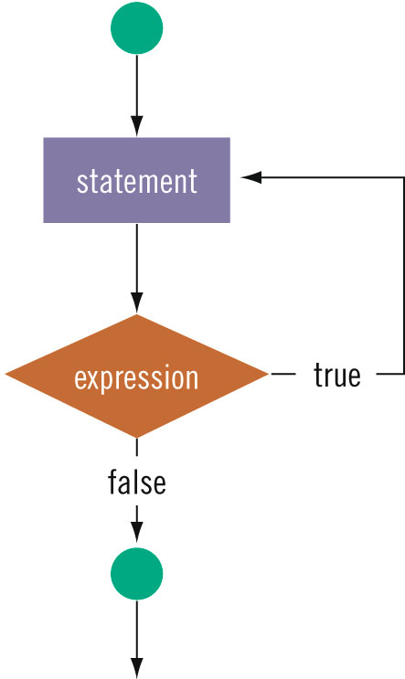
CSC 1100 – Week5
DCS, KICT
Statement is executed once
before condition is checked

Slide 5
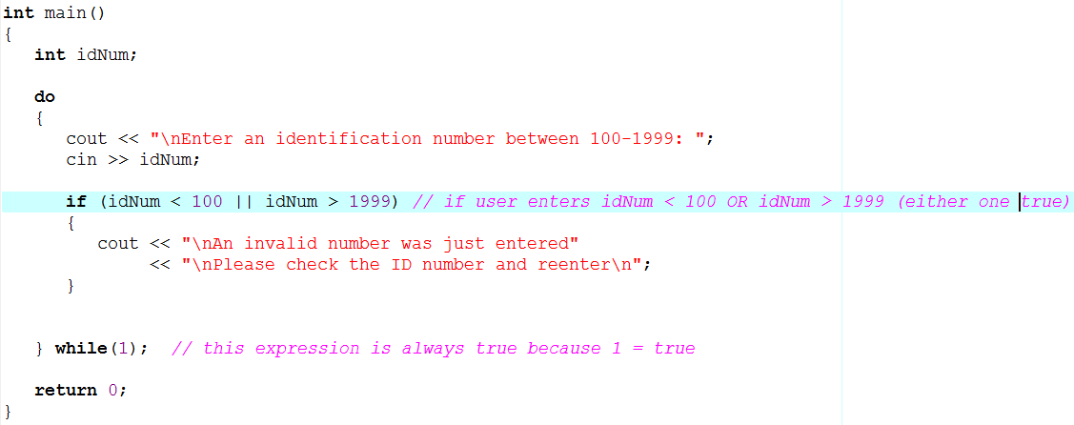
The do-while Statement
CSC 1100 – Week5
DCS, KICT
Statement within loop executed at least once EVEN IF CONDITION IS FALSE (evaluation done at end)
A First Book of C++ 4th Edition

Slide 6
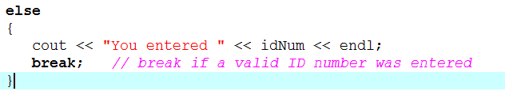
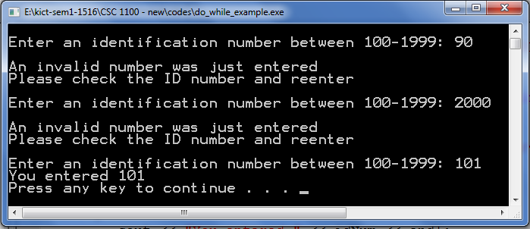
Validity Checks
CSC 1100 – Week5
DCS, KICT
Provided by do-while statement through filtering of user-entered input
Repeat loop until valid number is entered
Add a termination or EXIT statement to stop loop
A First Book of C++ 4th Edition

Slide 7
The for Statement
CSC 1100 – Week5
DCS, KICT
Same function as the while statement but in different form
for (initializing list; expression; altering list)
statement;
Function: statement executed as long as expression has non-zero (true) value
Components:
Initializing list: initial value of expression
Expression/condition: a valid C++ expression
Altering list: statements executed at end of each for loop to alter value of expression
A First Book of C++ 4th Edition

Slide 8
The for Statement (cont'd.)
CSC 1100 – Week5
DCS, KICT
Components of for statement correspond to operations performed in while statement
Initialization
Expression evaluation
Altering of expression values
Components of for statement are optional, but semicolons must always be present
A First Book of C++ 4th Edition

Slide 9
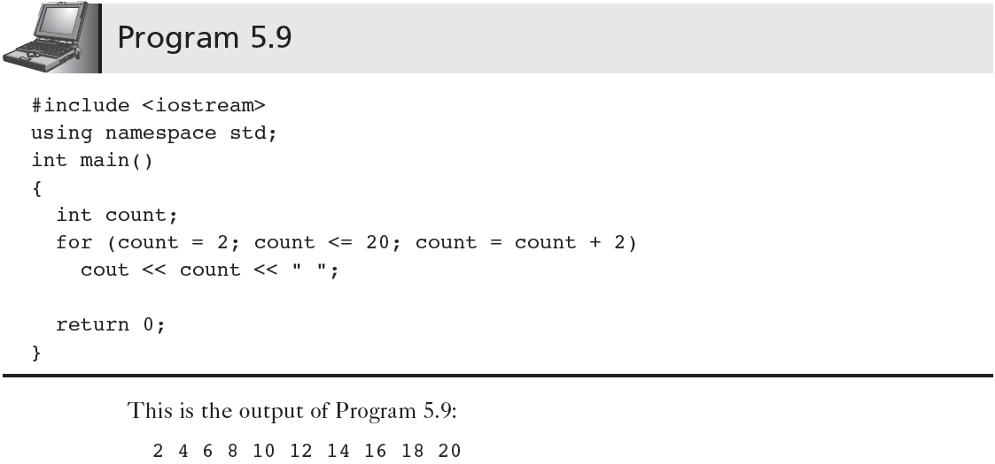
The for Statement (cont'd.)
CSC 1100 – Week5
DCS, KICT
A First Book of C++ 4th Edition

Slide 10
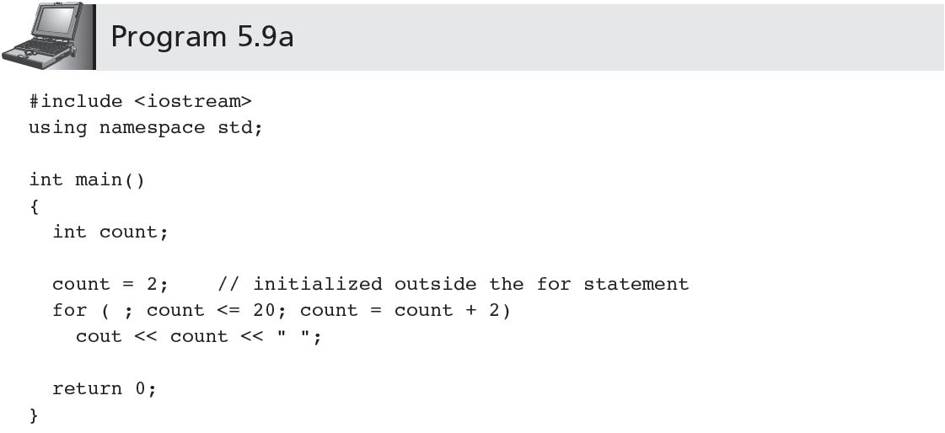
Initialization outside for Statement
CSC 1100 – Week5
DCS, KICT
Program 5.9 modified: initializer outside for loop
A First Book of C++ 4th Edition

Slide 11

‘while’ vs ‘for’ loop
CSC 1100 – Week5
DCS, KICT
A First Book of C++ 4th Edition

Slide 12
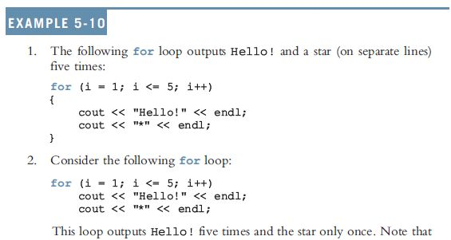
for Loop Example 1
CSC 1100 – Week5
DCS, KICT
C++ Programming: From Problem Analysis to Program Design, 8th Edition

Slide 13
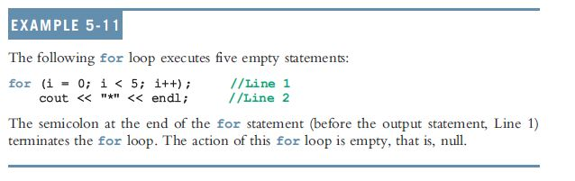
for Loop Example 2
CSC 1100 – Week5
DCS, KICT
The following is a semantic error:
The following is a legal (but infinite) for loop:
for (;;)
cout << "Hello" << endl;
C++ Programming: From Problem Analysis to Program Design, 8th Edition

Slide 14
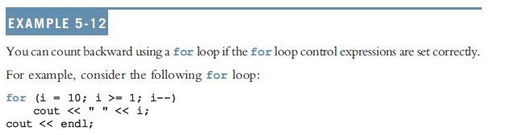
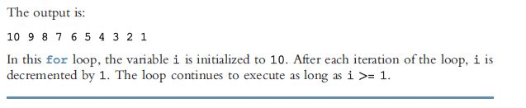
CSC 1100 – Week5
DCS, KICT
for Loop Example 3
C++ Programming: From Problem Analysis to Program Design, 8th Edition

Slide 15
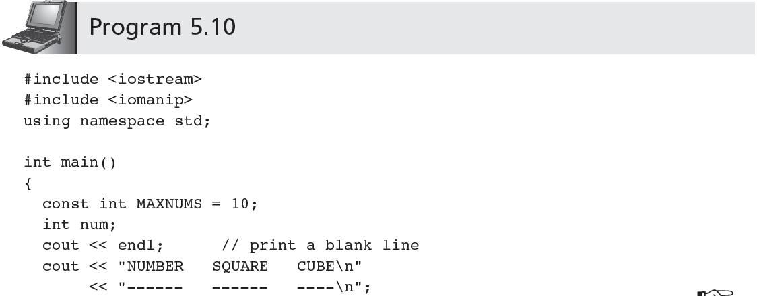
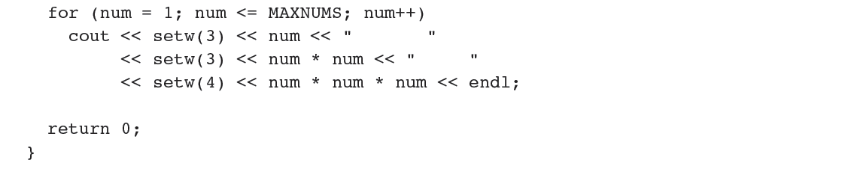
The for Statement (cont'd.)
CSC 1100 – Week5
DCS, KICT
What is the output of this program?
//can use “pow” for this
A First Book of C++ 4th Edition

Slide 16
The for Statement (cont'd.)
CSC 1100 – Week5
DCS, KICT
When Program 5.10 is run, the display produced is:
NUMBER SQUARE CUBE
_ _ _ _ _ _ _ _ _ _ _ _ _ _ _ _
1 1 1
2 4 8
3 9 27
4 16 64
5 25 125
6 36 216
7 49 343
8 64 512
9 81 729
10 100 1000
A First Book of C++ 4th Edition

Slide 17

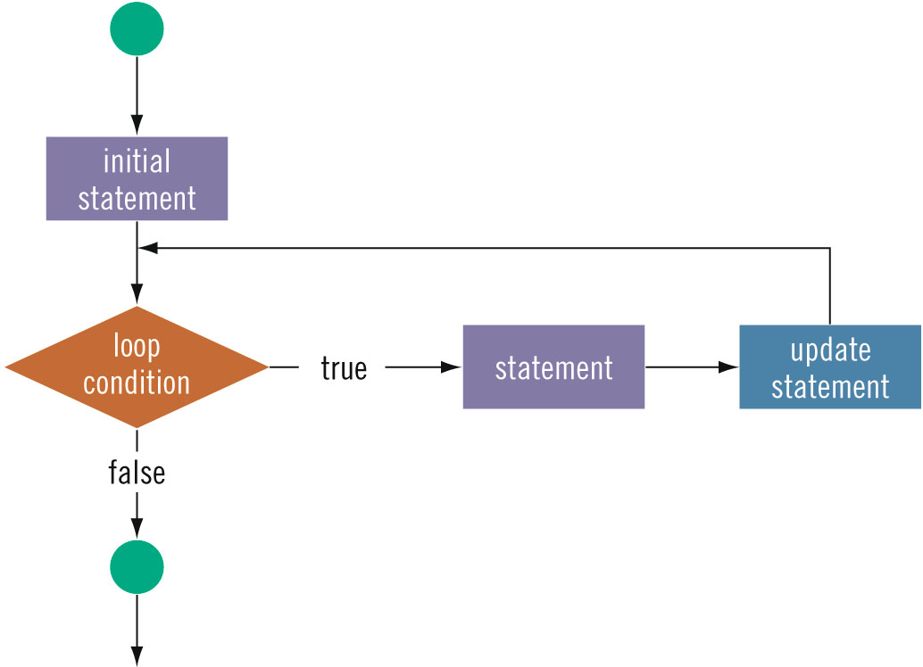
Flowchart Symbol
CSC 1100 – Week5
DCS, KICT

Slide 18
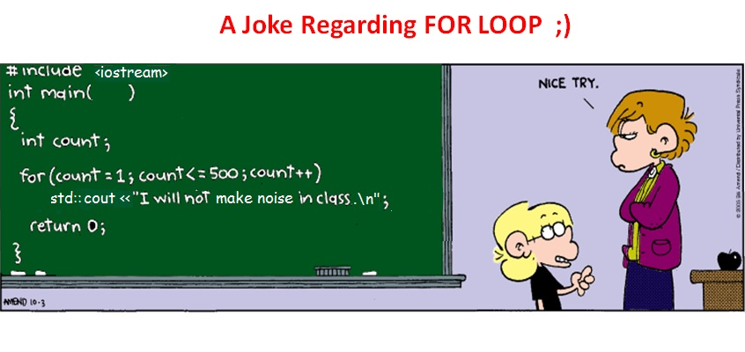
The for Statement (cont'd.)
CSC 1100 – Week5
DCS, KICT

Slide 19

for Loops Examples
CSC 1100 – Week5
DCS, KICT
Determine the value of total after each of the for loop repetition
i | total
- | 50
2 | 48
4 | 44
6 | 38
8 | 30
10 | 20
total = 50 – 2
total = 48 – 4
total = 44 – 6
total = 38 – 8
total = 30 – 10
C++ for Everyone 2nd Edition

Slide 20
Interactive for Loops
CSC 1100 – Week5
DCS, KICT
Same effect as using cin object within a while loop
Provides interactive user input
A First Book of C++ 4th Edition

Slide 21
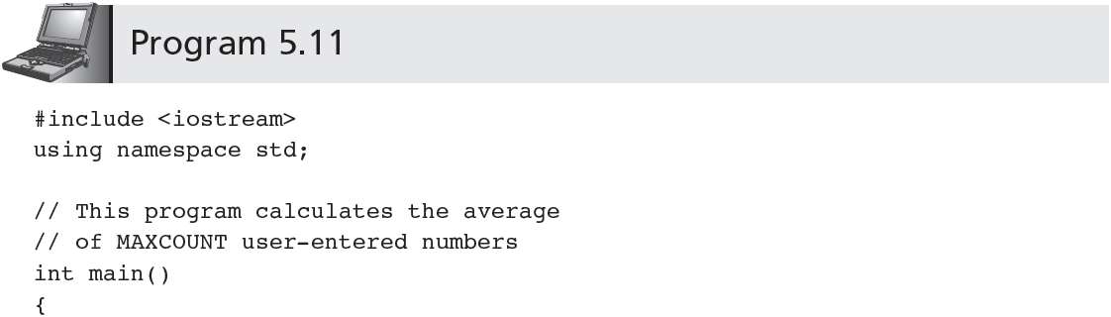
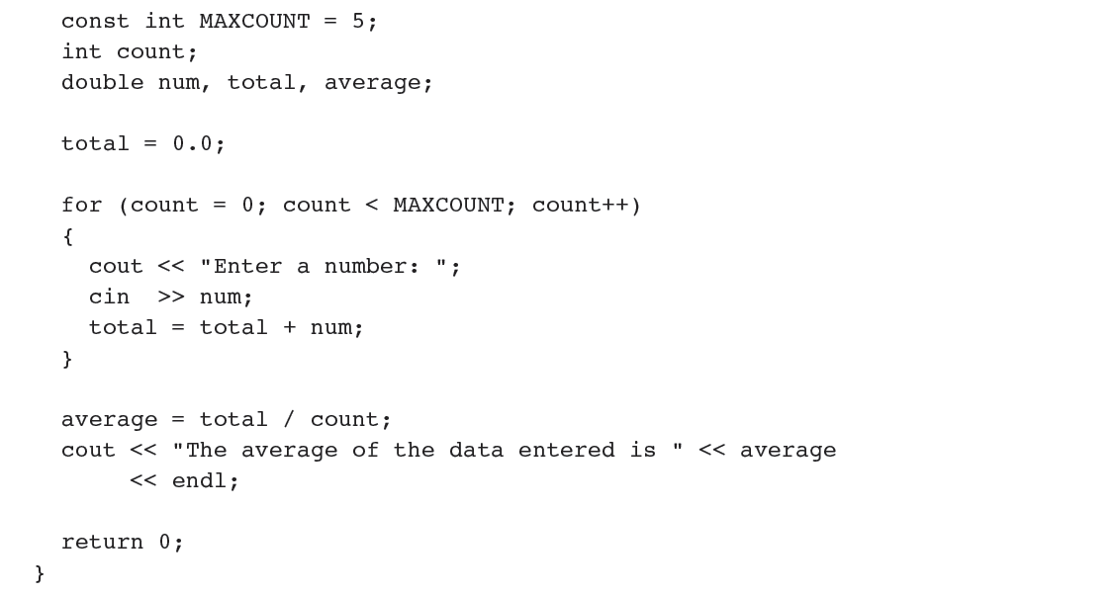
CSC 1100 – Week5
Accumulation
Use braces { } with multiple statements
//accumulate total inside a for loop
//calculate average outside a for loop
A First Book of C++ 4th Edition

Slide 22
Interactive for Loops (cont'd.)
CSC 1100 – Week5
DCS, KICT
Program 5.11: for statement creates a loop
Loop executed five times
Actions performed in each loop
User prompted to enter a number
Number added to the total
A First Book of C++ 4th Edition

Slide 23
Interactive for Loops (cont'd.)
CSC 1100 – Week5
DCS, KICT
Initialization variations:
Alternative 1: initialize total outside the loop and count inside the loop as in Program 5.11
Alternative 2: initialize both total and count inside loop
for (total = 0.0, count = 0; count < MAXCOUNT; count++)
Alternative 3: initialize and declare both total and count inside loop
for (double total = 0.0, int count = 0;
count < MAXCOUNT; count++)
A First Book of C++ 4th Edition

Slide 24
Nested Loops
CSC 1100 – Week5
DCS, KICT
A loop contained within another loop
Example:
int main()
{
for(int i = 1; i <= 5; i++) //start of outer loop
{
cout << "\ni is now " << i << endl;
for(int j = 1; j <= 4; j++) //start of inner loop
{
cout << " j = " << j;
} // end of inner loop
} // end of outer loop
}
What is the output of this program?
A First Book of C++ 4th Edition

Slide 25
Nested Loops (cont'd.)
CSC 1100 – Week5
DCS, KICT
Outer (first) loop:
Controlled by value of i
Inner (second) loop:
Controlled by value of j
Rules:
For each single trip through outer loop, inner loop runs through its entire sequence
Different variable to control each loop
Inner loop statements contained within outer loop
A First Book of C++ 4th Edition

Slide 26
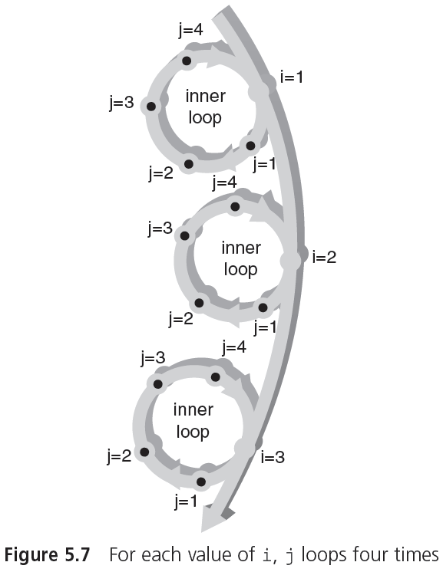
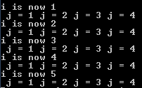
Nested Loops (cont'd.)
CSC 1100 – Week5
DCS, KICT
j controls inner loop
i controls outer loop
A First Book of C++ 4th Edition

Slide 27
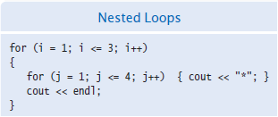
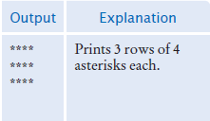
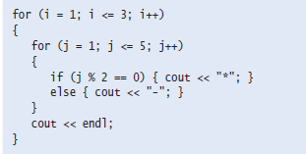
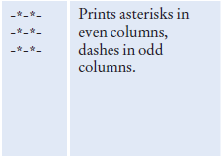


Nested ‘for’ Examples
CSC 1100 – Week5
DCS, KICT
C++ for Everyone 2nd Edition

Slide 28
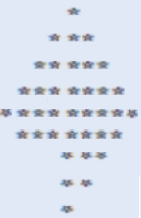
Nested for Loop Exercise 1
CSC 1100 – Week5
DCS, KICT
Based on the above code snippet, write a program that produces the following shape:
C++ for Everyone 2nd Edition

Slide 29
Common Programming Errors
CSC 1100 – Week5
DCS, KICT
“Off by one” errors: loop executes one time too many or one time too few
Initial and final conditions to control loop must be carefully constructed
Inadvertent use of assignment operator, =, in place of the equality operator, ==
This error is not detected by the compiler
A First Book of C++ 4th Edition

Slide 30


Common Programming Errors (cont'd.)
CSC 1100 – Week5
DCS, KICT
Using the equality operator when testing double-precision operands
Do not test expression (fnum == 0.01)
Replace by a test requiring absolute value of
fabs(num1 – num2) < epsilon for very small epsilon
Placing a semicolon at end of the for statement parentheses:
for (count = 0; count < 10; count ++);
total = total + num;
Creates a loop that executes 10 times and does nothing but increment count
A First Book of C++ 4th Edition

Slide 31
Common Programming Errors (cont'd.)
CSC 1100 – Week5
DCS, KICT
Using commas instead of semicolons to separate items in a for statement:
for (count =1 , count < 10 , count ++)
Commas should be used only to separate items within the separating and initializing lists
Eg: for(count=1,total=0; count < 10; count++)
Changing the value of the control variable used in the tested condition both inside the for loop and in its altering list (redundant)
Eg: for( int i=0; i < 10; i++ )
cout << i++ ;
Omitting the final semicolon from the do-while statement
//i is incremented twice
A First Book of C++ 4th Edition

Slide 32
Summary
CSC 1100 – Week5
DCS, KICT
while, for, and do-while statements create loops
These statements evaluate an expression
On the basis of the expression value, either terminate the loop or continue with it
Each pass through the loop is called a repetition or iteration
while checks expression before any other statement in the loop
Variables in the tested expression must have values assigned before while is encountered
A First Book of C++ 4th Edition

Slide 33
Summary (cont'd.)
CSC 1100 – Week5
DCS, KICT
The for statement: fixed-count loops
Included in parentheses at top of loop:
Initializing expressions
Tested expression
Expressions that affect the tested expression
Other loop statements can also be included as part of the altering list
A First Book of C++ 4th Edition

Slide 34
Summary (cont'd.)
CSC 1100 – Week5
DCS, KICT
The do-while statement checks its expression at the end of the loop
Body of the loop must execute at least once
do-while loop must contain statement(s) that either:
Alter the tested expression’s value or
Force a break from the loop
A First Book of C++ 4th Edition

